Slide 1
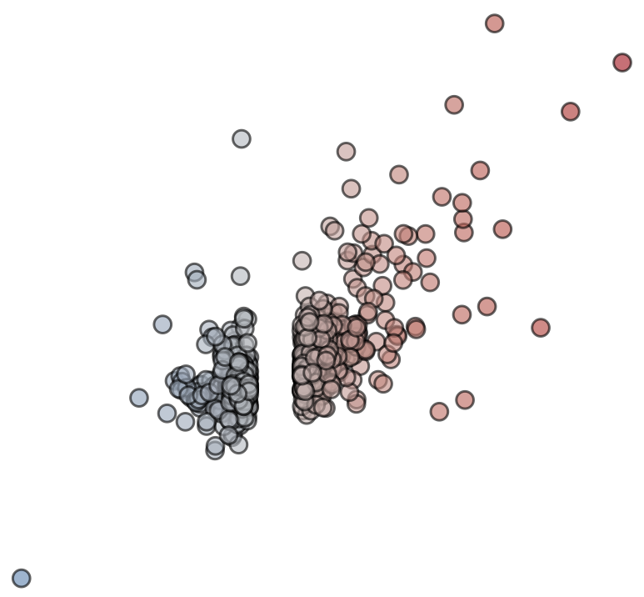
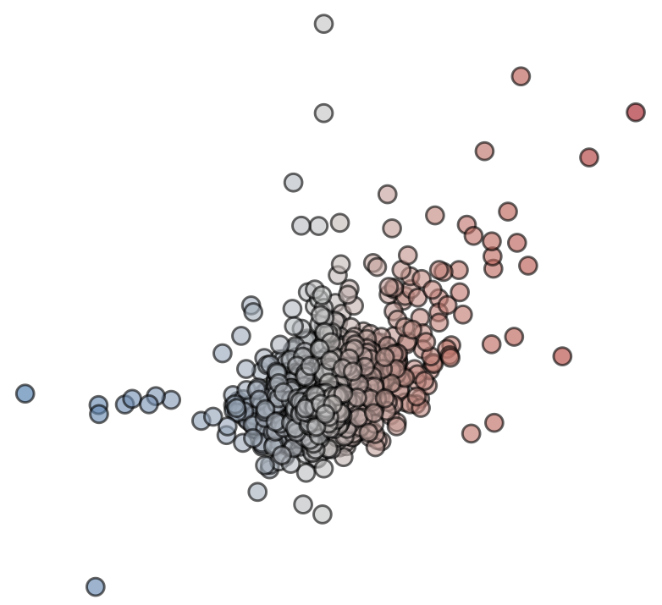
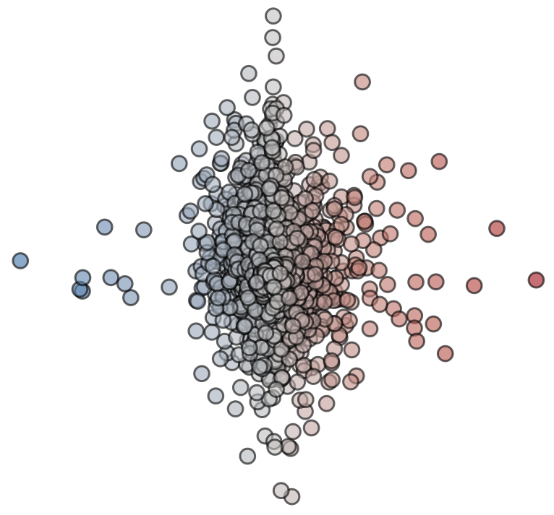
A
Expression changes upon CTNNB1 GOF
CTNNB1 & IKZF1/3 bound promoters
B
Expression changes upon CTNNB1 GOF
Ccr2
6
Ccr2
4
Cd28
Prdm1
Prdm1
Pggt1b
Zap70
Nkd1
4
Cd28
Nkd1
Cd5
Pggt1b
Zap70
Cd5
Axin2
Axin2
2
Nuak1
Nuak1
Ikzf1/3 KO
mRNA L2FC upon CTNNB1 GOF
Ikzf1/3 KO
mRNA L2FC upon CTNNB1 GOF
2
Nt5e
Ifitm1
Tbx19
Tbx19
Cebpb
0
Rnd3
0
Myc
Akap2
Ccl9
Akap2
Myc
-2
-2
Esr1
Esr1
-2
0
2
4
-4
-2
0
2
4
mRNA L2FC upon CTNNB1 GOF
NTC
mRNA L2FC upon CTNNB1 GOF
NTC
C
10
Tead1
Tbx19
5
Myc
Cd28
Ccr2
Cebpb
Cd5
Nkd1
CTNNB1 GOF
mRNA L2FC upon Ikzf1/3 KO
0
Ifitm1
Prdm1
Esr1
Nt5e
Axin2
Nuak1
-5
Zap70
-4
-2
0
2
4
mRNA L2FC upon CTNNB1 GOF
NTC

