Slide 1
Equipment
Requirement
Library
Process
Element
Library
Equipment
Independent
Recipe
Material
Definition
Library
Is made
up of
Is made
up of
Has a type of
Is made
up of
1..N
1..N
Is made
up of
1..N
Equipment
Requirement
Element
Process
Element
Specification
General
Recipe
Site
Recipe
Material
Definition
1
1
1
0..N
Corresponds
to↑
1
1
Corresponds
to ↑
←May be derived from
1
0..N
0..N
0..N
0..N
0..N
0..N
Process
Procedure
Other
Information
Process
Parameter
Process
Input
Process
Output
Corresponds
to ↑
Corresponds
to ↑
0..N
0..N
0..N
Is made
up of
0..N
0..N
1..N
Has→
Equipment
Requirement
Process
Element
0..N
0..N
← Has
0..N
1..N
0..N
1..N
↓Uses % of
the input
↓ Produces % of
the output
1
1
Process
Element Link
Percent
Input
Percent
Output
Has a
type of
Process
Stage
1..N
Process
Operation
1..N
Process
Action
Is made
up of
Is made
up of

Slide 2
Resource
Constraint
Library
Process
Element
Library
GRecipe
Material
Definition
Library
Is made
up of
Is made
up of
Has a type of
Is made
up of
1..N
1..N
Is made
up of
1..N
Resource
Constraint
Specification
Process
Element
Specification
General
Recipe
Site
Recipe
Material
Definition
1
1
1
0..N
Corresponds
to↑
1
1
Corresponds
to ↑
←May be derived from
1
0..N
0..N
0..N
0..N
0..N
0..N
0..N
Process
Procedure
Other
Information
Process
Element
Parameter
Process
Input
Process
Output
Process
Intermediate
Corresponds
to ↑
Corresponds
to ↑
0..N
0..N
0..N
0..N
Is made
up of
0..N
0..N
1..N
Has→
Resource
Constraint
Process
Element
0..N
0..N
← Has
0..N
1..N
0..N
1..N
↓Uses % of
the input
↓ Produces % of
the output
1
1
Directed
Link
Percent
Input
Percent
Output
Has a
type of
Process
Stage
1..N
Process
Operation
1..N
Process
Action
Is made
up of
Is made
up of

Slide 3
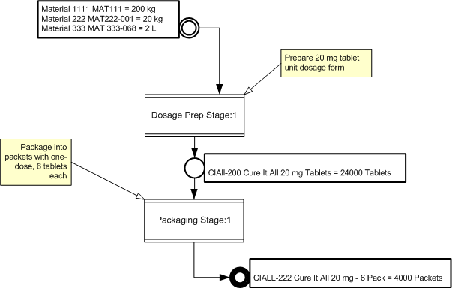

Slide 4
Materials
Directed Link
Annotation
Process Element

Slide 5
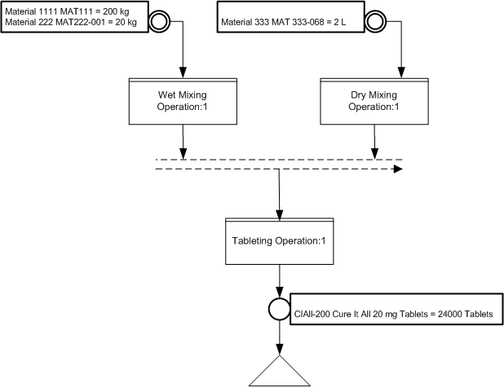

Slide 6
Child Process Element
End Optional
Parallel Indicator
Directed Links
Next Operation Indicator

Slide 7
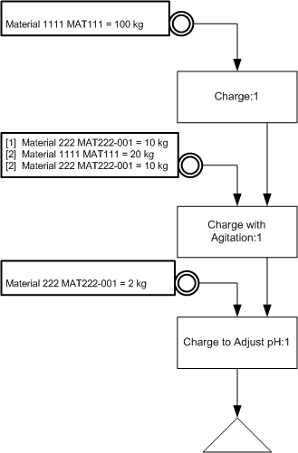

Slide 8
Directed Links

Slide 9
Materials
Directed Links

Slide 10
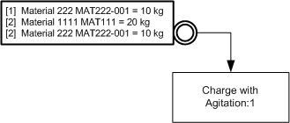
Material Order

Slide 11
New Import/Include Structure for B2MML & General Recipes
B2MML Common
Extensions
(Extended NameSpace)
B2MML Core
Components
(no NameSpace)
BatchML
GRextensions
(Extended NameSpace)
Import
Include
Import
B2MML
Extensions
(Extended NameSpace)
B2MML
Common
(B2MML NameSpace)
Import
Include
B2MML
Equipment…
B2MML
Personnel…
B2MML
Material …
(B2MML NameSpace)
BatchML
GRecipe
(B2MML NameSpace)

Slide 12
First in first series under a parallel (first action in first path)
Action in middle of series under a parallel (not first or last in path)
Last in last series of actions under a parallel (last action in last path)
First in a series of actions under a parallel (first action in path)
Last of series of actions under a parallel (last action in path)
Action not under a parallel
Single action at start of a parallel (only action in path)
Single action under a parallel (only action in path)
Single action at end of parallel (only action in path)

