Slide 1


WBF XML Figures
Batch to Manufacturing
Markup Language
B2MML - V0401

Slide 2
B2MML Core
Components
(no NameSpace)
B2MML Common
Extensions
(Extended NameSpace)
Import in Extended NameSpace
B2MML
Common
(B2MML NameSpace)
Import in B2MML NameSpace
BatchML
General Recipe
Extensions
(Extended NameSpace)
BatchML
Information
Extensions
(Extended NameSpace)
BatchML Batch
Production Record
Extensions
(Extended NameSpace)
B2MML
Extensions
(Extended NameSpace)
B2MML
AllExtensions
(Extended NameSpace)
Import in Extended NameSpace
BatchML
General Recipe
(B2MML NameSpace)
BatchML
Information
(B2MML NameSpace)
B2MML Production
Schedule
(B2MML NameSpace)
B2MML Production
Performance
(B2MML NameSpace)
B2MML – Other
ISA95 models
(B2MML NameSpace)
Import
BatchML Batch
Production Record
(B2MML NameSpace)
Include

Slide 3





Name of an element or element type
Indicates fixed order of elements
Indicates elements
Indicates 1 instance only
Indicates 1 to many instances
Indicates 0 or 1 instance only
Indicates 0 to many instances
Indicates selection of alternatives
Indicates contained elements
Indicates no contained elements

Slide 4
Information About
Personnel Classes
Information
About Persons
Personnel
Class
0..n
Person
0..n
Defined by
Has
properties
of
Has
values for
0..n
0..n
Personnel
Class Property
Maps to
Person
Property
Is tested
by a
1..n
0..n
Qualification
Test
Result
0..n
Qualification
Test
Specification
0..n
Records the
execution of
Information About
Qualification Tests
Defines a
procedure for
obtaining a

Slide 5
Information About
Material Classes
Information About
Material Definitions
Information About
Material Lots & Sublots
Material
Class
Defines
a grouping
Material
Definition
0..n
Material Lot
Made up of
Material
Sublot
0..n
0..n
1..1
Defined by
0..n
Has
properties
of
Has
properties
of
Has
values
for
0..n
Has
values for
May be made up
of sublots
0..n
0..n
0..n
Material
Class
Property
Material
Definition
Property
Maps to
Material Lot
Property
0..n
May
map to
Is associated
with a
Is tested
by a
1..n
Is tested
by a
1..n
0..n
Records the
execution of
QA Test
Result
0..n
QA Test
Specification
0..n
Defines a
procedure for
obtaining a
0..n
Information
About QA Tests

Slide 6
Information About
Equipment Classes
Information
About Equipment
May be made up of
0..n
Equipment
Class
0..n
Equipment
0..n
Defined by
Has
properties
of
Has
values for
0..n
0..n
Equipment
Class Property
Maps to
Equipment
Property
Is tested
by a
1..n
0..n
Equipment
Capability Test
Result
Information About
Capability Tests
0..n
Equipment
Capability Test
Specification
0..n
Records the
execution of
Defines a
procedure for
obtaining a

Slide 7
ENTERPRISE
May contain 1 or more
SITE
May contain 1 or more
AREA
May contain 1 or more
May contain 1 or more
May contain 1 or more
PROCESS CELL
PRODUCTION
UNIT
PRODUCTION
LINE
Must contain 1 or more
May contain 1 or more
UNIT
WORK CELL
Equipment used
in batch
operations.
Equipment used
in continuous
operations.
Equipment used
in repetitive or
discrete operations.

Slide 8
Maintenance
Request
Is against
0..n
1..1
0..n
May result in
Equipment
0..1
0..n
1..1
Maintenance
Work Order
Is made
against
1..1
0..n
May be generated for
Maintenance
Response

Slide 9
0..n
0..n
has an execution dependency on
May be
made up of
Process
Segment
0..n
Is defined as a collection of
Process
Segment
Dependency
0..n
0..n
0..n
0..n
Personnel Segment
Specification
Equipment Segment
Specification
Material Segment
Specification
Process
Segment
Parameter
Has properties
of
Has properties
of
Has properties
of
0..n
0..n
0..n
Personnel Segment
Specification
Property
Equipment Segment
Specification
Property
Material Segment
Specification
Property

Slide 10



Identify Class by ID
Identify subclass By Class ID & Property Value
Personnel Capability
- Class = Operator
Quantity = 8
Personnel Capability
- Class = Operator
Quantity = 8
Operator
Personnel Capability Property
- Ranking = Master
Quantity = 3
Operator
Operator Property
- Ranking = Master
Personnel Capability Property
- Ranking = Standard
Quantity = 4
Operator Property
- Ranking = Standard
Personnel Capability Property
- Ranking = Junior
Quantity = 1
Operator Property
- Ranking = Junior
Supervisor
Mechanic

Slide 11
Has a reference to >
Has a reference to <
Has a reference to >
Bill of
Resources
(External)
Product
Definition
Product
Production Rule
(External)
Bill of
Material
(External)
Has
associated >
Has
associated
Has
associated >
Has
associated >
May be
made
up of
0..n
1..n
Corresponds
to
0..n
0..n
Product
Segment
Process
Segment
Manufacturing
Bill
has an execution dependency on
0..n
0..n
0..n
1..n
0..n
1..1
Product
Segment
Dependency
Is a collection of
0..n
0..n
0..n
0..n
1..n
Product
Parameter
Personnel
Specification
Equipment
Specification
Material
Specification
0..n
0..n
0..n
Personnel
Specification
Property
Equipment
Specification
Property
Material
Specification
Property

Slide 12
Transaction
Profile
Is made up of
1..n
Supported Action

Slide 13
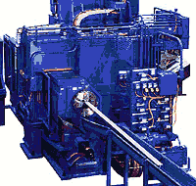

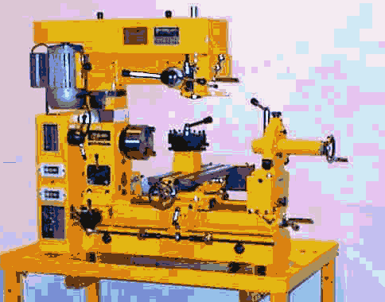
Identify Class by ID
Identify subclass By Class ID & Property Value
Identify Instance by ID
Equipment Specification
- Class = Mill
Quantity = 8
Equipment Specification
- Class = Mill
Quantity = 8
Equipment Specification
- ID = Miller#1
Milling Machine
Equipment Specification Property
- Spec = Fine
Quantity = 3
Milling Machine
Miller#1
Equipment Property
- Spec = Fine
Equipment Specification Property
- Spec = Medium
Quantity = 4
Equipment Property
- Spec = Medium
Equipment Specification Property
- Spec = Course
Quantity = 1
Equipment Property
- Spec = Course

Slide 14
Production
Capability
Is defined as a collection of
0..n
0..n
0..n
0..n
Corresponds to
Process
Segment
Personnel
Capability
Equipment
Capability
Material
Capability
Process
Segment
Capability
0..n
Has properties
of
Has properties
of
Has properties
of
0..n
0..n
0..n
Is defined as a collection of
Personnel
Capability
Property
Equipment
Capability
Property
Material
Capability
Property
0..n
0..n
0..n
Personnel Segment
Capability
Equipment
Segment
Capability
Material Segment
Capability
Has properties
of
Has properties
of
Has properties
of
0..n
0..n
0..n
Personnel Segment
Capability
Property
Equipment Segment
Capability
Property
Material Segment
Capability
Property

Slide 15
Identify Class by ID
Identify subclass By Class ID & Property Value
Identify Instance by ID
Equipment Capability
- Class = Mill
Quantity = 8
Equipment Capability
- Class = Mill
Quantity = 8
Equipment Capability
- ID = Miller#1
Milling Machine
Equipment Capability Property
- Spec = Fine
Quantity = 3
Milling Machine
Miller#1
Equipment Property
- Spec = Fine
Equipment Capability Property
- Spec = Medium
Quantity = 4
Equipment Property
- Spec = Medium
Equipment Capability Property
- Spec = Course
Quantity = 1
Equipment Property
- Spec = Course

Slide 16
Production
Schedule
Is made up of
Corresponds
to a
1..n
Production
Request
Product
Production
Rule
Is made up of
1..n
0..n
Process
Segment
Corresponds
to a
Segment
Requirement
0..n
Requested
Segment
Response
May contain
0..n
0..n
0..n
0..n
0..n
0..n
0..n
Production
Parameter
Personnel
Requirement
Equipment
Requirement
Material
Requirement
Material Produced
Requirement
Material Consumed
Requirement
Consumable
Expected
1..n
1..n
1..n
1..n
1..n
1..n
Personnel
Requirement
Property
Equipment
Requirement
Property
Material
Requirement
Property
Material Produced
Requirement
Property
Material Consumed
Requirement
Property
Consumable
Expected
Property

Slide 17
Identify Class by ID
Identify subclass By Class ID & Property Value
Identify Instance by ID
Equipment Requirement
- Class = Mill
Quantity = 8
Equipment Requirement
- Class = Mill
Quantity = 8
Equipment Requirement
- ID = Miller#1
Milling Machine
Equipment Requirement Property
- Spec = Fine
Quantity = 3
Milling Machine
Miller#1
Equipment Property
- Spec = Fine
Equipment Requirement Property
- Spec = Medium
Quantity = 4
Equipment Property
- Spec = Medium
Equipment Requirement Property
- Spec = Course
Quantity = 1
Equipment Property
- Spec = Course

Slide 18
Production
Performance
Is made up of
1..n
Production
Response
Is made up of
1..n
0..n
Segment
Response
Corresponds
to a
Process
Segment
May contain
0..n
0..n
0..n
0..n
0..n
0..n
0..n
Production
Data
Personnel
Actual
Equipment
Actual
Material
Actual
Material Produced
Actual
Material Consumed
Actual
Consumable
Actual
1..n
1..n
1..n
1..n
1..n
1..n
Personnel
Actual
Property
Equipment
Actual
Property
Material
Actual
Property
Material Produced
Actual
Property
Material Consumed
Actual
Property
Consumable
Actual
Property

Slide 19
Identify Class by ID
Identify subclass By Class ID & Property Value
Identify Instance by ID
Equipment Actual
- Class = Mill
Quantity = 8
Equipment Actual
- Class = Mill
Quantity = 8
Equipment Actual
- ID = Miller#1
Milling Machine
Equipment Actual Property
- Spec = Fine
Quantity = 3
Milling Machine
Miller#1
Equipment Property
- Spec = Fine
Equipment Actual Property
- Spec = Medium
Quantity = 4
Equipment Property
- Spec = Medium
Equipment Actual Property
- Spec = Course
Quantity = 1
Equipment Property
- Spec = Course

Slide 20
Transaction
Profile
Is made up of
1..n
Supported Action

Slide 21
GET Equipment
Information Provider
Application Identification Area
Information
User
Data Area
VERB = GET
GET
Local
processing
SHOW Equipment
Noun = Equipment
ID= “A*”
Application Identification Area
Data Area
VERB = SHOW
Noun = Equipment
ID= “ABC”
Description = “Simple equipment”
Equipment Property
ID = “Throughput”
Value = “200”
Value Unit of Measure = “PPM”
Description = “Throughput as parts
per minute”
…
Noun = Equipment
ID= “A11862”
Description = “Complex equipment”
Equipment Property
ID = “Throughput”
Value = “2000”
Value Unit of Measure = “PPM”
Description = “Throughput as parts
per minute”
…
SHOW

Slide 22
Information
Requestor
Information
Provider
GetEquipmentClass
ShowEquipmentClass
Information
Sender
Information
Receiver
ProcessProductionSchedule
AcknowledgeProductionSchedule
Information
Sender
Information
Receiver
ChangeProductDefinition
RespondProductDefinition
Information
Sender
Information
Receiver
CancelMaterialLot
ConfirmBOD

Slide 23
Information
Publisher
Information
Subscriber
SyncPerson (Add)
ConfirmBOD
Information
Publisher
Information
Subscriber
SyncProcessSegment (Change)
ConfirmBOD
Information
Publisher
Information
Subscriber
SyncMaintainceInformation (Delete)
ConfirmBOD

Slide 24
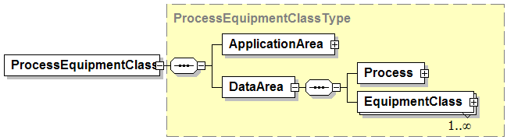
Combined Verb and Object Element Name
Verb Specific Area
<Verb><Object>
<Verb>
<Object>
Object Specific Area

Slide 25
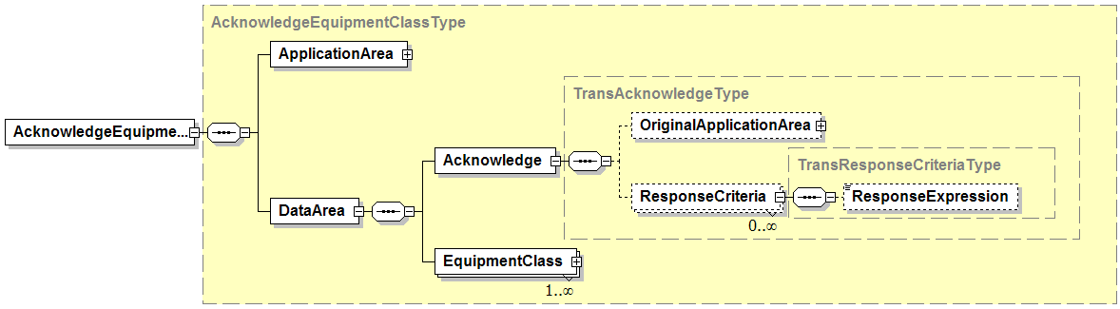
Contains optional “acknowledgeCode” attribute
Contains required “actionCode” attribute

Slide 26

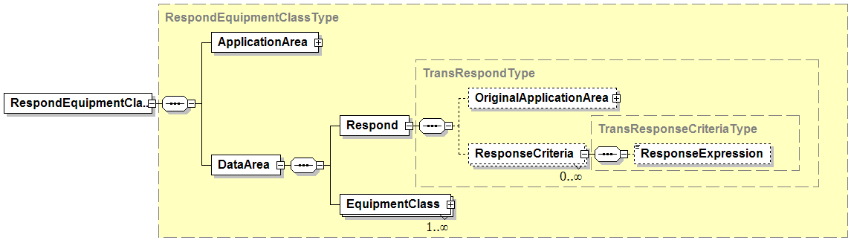
Contains optional “responseCode” attribute
Contains required “actionCode” attribute

Slide 27
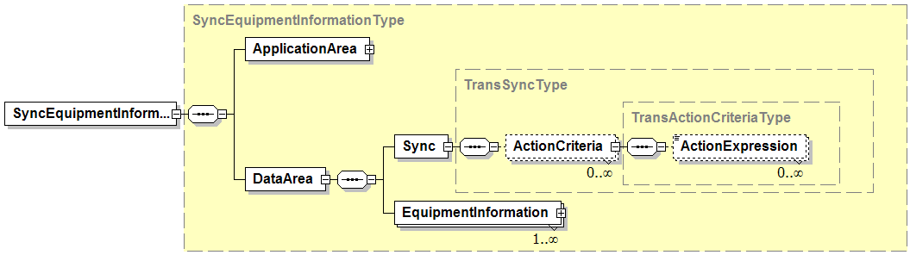

Contains required “actionCode” attribute of Add, Change, or Delete
Contains required “actionCode” attribute of Accepted or Rejected

Slide 28
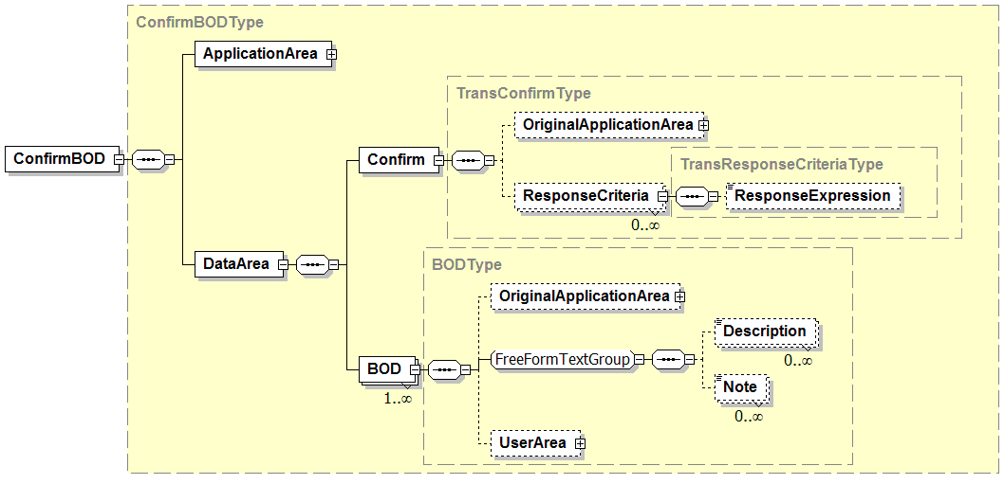
Contains required “actionCode” attribute of Accepted or Rejected
Contains additional information provided by the sender to assist in the handling of any error condition.

Slide 29
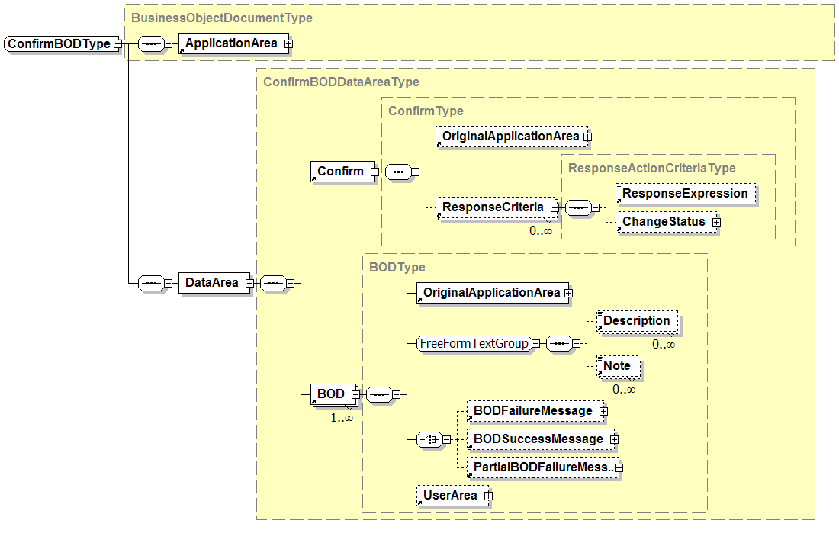
Not defined in B2MML
Not defined in B2MML

Slide 30
Production Planning & Scheduling Scenario
Level 4
PLM
Level 4
Asset Mgt
Level 4
Production Planning & Capacity Analysis
Level 4
Inventory Mgt
SHOW Equipment
SHOW Product Definition
PROCESS Production Capability
PROCESS Production Schedule
PROCESS Production Performance
GET Product Definition
GET Equipment
PROCESS MaterialSubLot
Level 3
Product Definition Management
Level 3
Production Resource Mgt
Level 3
Detailed Scheduling
Level 3
Production Tracking
Communication within Levels 3 or 4 are not shown since they are not in the scope of ISA-95 Parts 1 and 2

Slide 31
Business Process Scenario #1a
PUSH MODEL – Production Schedule / Production Performance
ERP
Level 4
Production Scheduling
MOM
Level 3
PROCESS – Production Schedule
PROCESS – Production Performance
Some work
complete
PROCESS* – Production Performance
All work finished
Scenario assumptions:
1. ERP send production schedule to MOM for processing
2. MOM (Manufacturing Operations Management) sends production performance to ERP for processing
* Message contains a FINAL flag to indicate that the message is the final production performance for the associated production schedule.

Slide 32
Business Process Scenario #3a
PULL MODEL – Production Schedule / Production Performance
ERP
Level 4
GET – Production Schedule
MOM
Level 3
SHOW – Production Schedule
Some work
complete
GET – Production Performance~
SHOW – Production Performance
All work finished
GET – Production Performance~
SHOW* – Production Performance
Scenario assumptions:
1. MOM requests production schedule from ERP
2. ERP requests production performance from MOM
~ The GET production performance message contains an identification of a production schedule (Production Performance / Production Schedule ID)
* The final SHOW production performance message contains a flag to indicate that the message is the final production performance for the associated production schedule.

Slide 33
Business Process Scenario #1a
PUBLISH MODEL – Production Schedule / Production Performance
ERP
Level 4
Production Scheduling
MOM
Level 3
SYNC ADD – Production Schedule
SYNC ADD – Production Performance
Some work
complete
SYNC CHANGE* – Production Performance
All work finished
Scenario assumptions:
1. MOM subscribes to production schedules.
2. ERP subscribes to production performances.
3. ERP publishes production schedule.
4. MOM publishes initial production performance with a SYNC ADD message.
5. MOM publishes subsequent production performances for the schedule with SYNC CHANGE messages.
* Message contains a FINAL flag to indicate that the message is the final production performance for the associated production schedule.

Slide 34
Business Process Scenario #1b
PUSH MODEL – Production Schedule Changes
ERP
Level 4
Production Scheduling
PROCESS – Production Schedule
MOM
Level 3
PROCESS – Production Performance
Some work
complete
Schedule
changes
CHANGE – Production Schedule
PROCESS – Production Performance
Some more
work complete
PROCESS* – Production Performance
All work finished
Scenario assumptions:
1. ERP sends production schedule to MOM for processing
2. MOM sends production performance to ERP for processing
3. ERP makes change to schedule and sends to MOM for processing
* Message contains a FINAL flag to indicate that the message is the final production performance for the associated production schedule.

Slide 35
Business Process Scenario #1b
PUBLISH MODEL – Production Schedule Changes
ERP
Level 4
Production Scheduling
SYNC ADD – Production Schedule
MOM
Level 3
SYNC ADD – Production Performance
Some work
complete
Schedule
changes
SYNC CHANGE – Production Schedule
SYNC CHANGE – Production Performance
Some more
work complete
SYNC CHANGE* – Production Performance
All work finished
Scenario assumptions:
1. MOM subscribes to production schedules.
2. ERP subscribes to production performances.
3. ERP publishes production schedule.
4. MOM publishes initial production performance with a SYNC ADD message.
5. ERP changes the schedule based on initial work done and republished with a SYNC CHANGE
6. MOM publishes subsequent production performances for the schedule with SYNC CHANGE messages.
* Message contains a FINAL flag to indicate that the message is the final production performance for the associated production schedule.

Slide 36
Business Process Scenario #1b
PUBLISH MODEL – Production Schedule Changes
ERP
Level 4
Production Scheduling
SYNC ADD – Production Schedule
MOM
Level 3
SYNC ADD – Production Performance
Some work
complete
Schedule
changes
SYNC CHANGE – Production Schedule
SYNC CHANGE – Production Performance
Some more
work complete
SYNC CHANGE* – Production Performance
All work finished
Scenario assumptions:
1. MOM subscribes to production schedules.
2. ERP subscribes to production performances.
3. ERP publishes production schedule.
4. MOM publishes initial production performance with a SYNC ADD message.
5. ERP changes schedule and republishes with SYNC CHANGE
6. MOM publishes subsequent production performances for the schedule with SYNC CHANGE messages.
* Message contains a FINAL flag to indicate that the message is the final production performance for the associated production schedule.

Slide 37
Business Process Scenario #1c
PUSH MODEL – Production Schedule Canceled
ERP
Level 4
Production Scheduling
PROCESS – Production Schedule
MOM
Level 3
Schedule
invalidated
CANCEL – Production Schedule
Scenario assumptions:
1. ERP sends production schedule to MOM for processing
2. ERP cancels schedule before actual production starts, and sends CANCEL of schedule to MOM

Slide 38
Business Process Scenario #1c
PULL and PUSH MODEL – Production Schedule Canceled
ERP
Level 4
Production Scheduling
GET – Production Schedule
MOM
Level 3
SHOW – Production Schedule
Schedule
invalidated
CANCEL – Production Schedule
Scenario assumptions:
1. MOM requests production schedule from ERP.
2. ERP cancels schedule before actual production starts, and sends CANCEL of schedule to MOM.

Slide 39
Business Process Scenario #1d
PUSH MODEL – Daily Production Performance
ERP
Level 4
MOM
Level 3
Production Tracking
PROCESS – Production Performance (May 24, 2005)
PROCESS – Production Performance (May 25, 2005)
Scenario assumptions:
1. MES sends daily production performance to ERP
2. Scope of production performance (which production lines, etc…) and timing of the publication (daily, weekly, time published) is not defined in a transaction message but is determined to in an out-of-band agreement.

Slide 40
Business Process Scenario #2d
PUBLISH/SUBSCRIBE MODEL – Daily Production Performance
ERP
Level 4
MOM
Level 3
SYNC ADD – Production Performance (May 24, 2005)
SYNC ADD – Production Performance (May 25, 2005)
Scenario assumptions:
1. ERP subscribes to daily production performance from MOM
2. MOM publishes daily production performance
3. Scope of production performance (which production lines, etc…) and timing of the publication (daily, weekly, time published) is not defined in a transaction message but is determined to in an out-of-band agreement.

Slide 41
Business Process Scenario #3d
PULL MODEL – Daily Production Performance
ERP
Level 4
MOM
Level 3
GET – Production Performance (May 24, 2005)
SHOW – Production Performance (May 24, 2005)
GET – Production Performance (May 25, 2005)
SHOW – Production Performance (May 25, 2005)
Scenario assumptions:
1. ERP requests production performance from MOM on a daily schedule

Slide 42
Business Process Scenario #1h
PUSH/PULL MODEL – Production Schedule based on Production Capability
ERP
Level 4
Production Scheduling
GET – Production Capability
MOM
Level 3
Execution
SHOW – Production Capability
PROCESS – Production Schedule
PROCESS – Production Performance
Some work
complete
PROCESS – Production Performance
Some more
work complete
PROCESS – Production Performance
All work finished
Scenario assumptions:
1. ERP requests production capability for the planning period
2. MOM sends production capability to ERP
3. ERP sends production schedule to MOM for processing
4. MOM sends production performance to ERP reflecting partial order completion
5. MOM sends production performance to ERP reflecting partial order completion
6. MOM sends production performance to ERP reflecting completion of order

Slide 43
Business Process Scenario #1h
PUBLISH and PUSH MODEL – Production Schedule based on Production Capability
ERP
Level 4
Production Scheduling
MOM
Level 3
Execution
SYNC ADD – Production Capability
SYNC ADD – Production Schedule
PROCESS – Production Performance
Some work
complete
PROCESS – Production Performance
Some more
work complete
PROCESS* – Production Performance
All work finished
Scenario assumptions:
1. ERP subscribes to production capability.
2. MOM subscribes to production schedules.
3. MOM publishes production capability on a regular schedule, e.g. every 2 days,
4. ERP generates a production schedule and publishes it.
5. MOM sends production performance to ERP reflecting partial order completion.
6. MOM sends production performance to ERP reflecting partial order completion.
7. MOM sends production performance to ERP reflecting completion of order.
* Message contains a FINAL flag to indicate that the message is the final production performance for the associated production schedule.

Slide 44
Business Process Scenario #1e
PUSH MODEL – Production Schedule / Capability Changes
ERP
Level 4
MOM
Level 3
Production Resource Management
PROCESS – Production Schedule
PROCESS – Production Capability
Schedule
changes
CHANGE – Production Schedule
Scenario assumptions:
1. ERP send production schedule to MOM for processing
2. MOM sends updated production capability to ERP for processing
3. Scope of production capability (which production lines, etc…) and timing of the publication (daily, weekly, time published) is not defined in a transaction message but is determined to in an out-of-band agreement.
4. ERP changes schedule based on new capability and sends CHANGE to MOM

Slide 45
Business Process Scenario #1f
PUSH MODEL – Material Lot added, material lot quantity changed
ERP
Level 4
MOM
Level 3
New material lot
is available
PROCESS – Material Lot (quantity = 400)
CHANGE – Material Lot (quantity = 300)
Material lot
quantity changed
CHANGE – Material Lot (quantity = 200)
Material lot
quantity changed
CHANGE – Material Lot (quantity = 0)
Material lot
quantity changed
Material lot no
longer available
CANCEL – Material Lot
Scenario assumptions:
1. Consumable material arrives at the facility and is entered into the ERP
2. ERP send material lot information to MOM for processing
3. MOM sends quantity changes in material lot to ERP as material is consumed
4. ERP sends CANCEL when material lot is no longer available

Slide 46
Business Process Scenario #1g
Mixed MODEL – Material Lot added, material lot quantity changed
ERP
Level 4
MOM
Level 3
New material lot
is available
SYNC ADD – Material Lot (quantity = 400)
CHANGE – Material Lot (quantity = 300)
Material lot
quantity changed
CHANGE – Material Lot (quantity = 200)
Material lot
quantity changed
CHANGE – Material Lot (quantity = 0)
Material lot
quantity changed
Material lot no
longer available
SYNC DELETE – Material Lot
Scenario assumptions:
1. ERP publishes material lot information, MOM subscribes
2. MOM sends quantity changes in material lot to ERP
3. ERP send SYNC DELETE when material lot is no longer available

Slide 47
New Business Process Scenario #1j
PUSH/PULL MODEL – Production Schedule Changes using Production Capability as input
ERP
Level 4
Production Scheduling
MOM
Level 3
PROCESS – Production Schedule
PROCESS – Production Performance
Some work
complete
GET – Production Capability
SHOW – Production Capability
Schedule
changes
CHANGE – Production Schedule
PROCESS – Production Performance
Some more
work complete
PROCESS – Production Performance
All work finished
Scenario assumptions:
1. ERP sends production schedule to MOM for processing
2. MOM sends production performance to ERP for processing
3. ERP requests production capability from MOM
4. MOM sends production capability to ERP
5. ERP makes change to schedule and sends to MOM for processing
6. MOM sends production performance to ERP reflecting partial order completion
7. MOM sends production performance to ERP reflecting completion of order

Slide 48
Business Process Scenario #2a
PUBLISH/SUBSCRIBE MODEL – Production Schedule / Production Performance
ERP
Level 4
SYNC ADD – Production Schedule
MES
Level 3
SYNC ADD – Production Performance
Some work
complete
SYNC CHANGE – Production Performance
More work
complete
SYNC CHANGE* – Production Performance
All work finished
Scenario assumptions:
1. ERP publishes production schedules, MES subscribes to changes
2. MES publishes production responses, ERP subscribes to changes
3. MES publishes SYNC ADD on first response and SYNC CHANGE on subsequent responses
* Message contains a FINAL flag to indicate that the message is the final production performance for the associated production schedule.

Slide 49
Business Process Scenario #2b
PUBLISH/SUBSCRIBE MODEL – Production Schedule Changes
ERP
Level 4
SYNC ADD – Production Schedule
MES
Level 3
SYNC ADD – Production Performance
Some work
complete
Schedule
changes
SYNC CHANGE – Production Schedule
SYNC CHANGE – Production Performance
Some more
work complete
SYNC CHANGE* – Production Performance
All work finished
Scenario assumptions:
1. ERP publishes production schedules, MES subscribes to changes
2. MES publishes production responses, ERP subscribes to changes
3. ERP changes production schedule and sends changed production schedule using SYNC CHANGE to MES
* Message contains a FINAL flag to indicate that the message is the final production performance for the associated production schedule.

Slide 50
Business Process Scenario #2c
PUBLISH/SUBSCRIBE MODEL – Production Schedule Canceled
ERP
Level 4
SYNC ADD – Production Schedule
MES
Level 3
Schedule
canceled
SYNC DELETE – Production Schedule
Scenario assumptions:
1. ERP publishes production schedules, MES subscribes to changes
2. ERP cancels the schedule before production starts and sends SYNC DELETE to MES

Slide 51
Business Process Scenario #3b
GET/SHOW MODEL – Production Schedule Changes
ERP
Level 4
GET – Production Schedule
MES
Level 3
SHOW – Production Schedule
Some work
complete
Schedule
changes
GET – Production Schedule
SHOW – Production Schedule
All work finished
GET – Production Performance
SHOW* – Production Performance
Scenario assumptions:
1. MES requests production schedule from ERP
2. ERP requests production performance from MES
3. ERP changes production schedule and returns changed schedule on next request
* Message would contain a flag to indicate that the message is the final production performance for the associated production schedule.

Slide 52
Business Process Scenario #1g
PUSH and PULL MODEL – Material Lot added, material lot quantity changed
ERP
Level 4
MOM
Level 3
New material lot
is available
GET – Material Lot (ReceiptStatus = “New”)
SHOW – Material Lot (quantity = 400)
CHANGE – Material Lot (quantity = 300)
Material lot
quantity changed
CHANGE – Material Lot (quantity = 200)
Material lot
quantity changed
CHANGE – Material Lot (quantity = 0)
Material lot
quantity changed
Scenario assumptions:
1. MOM requests material lot information from ERP
2. ERP sends information on new material lots (lots with no changes)
3. MOM pushes quantity changes in material lot to ERP

