Slide 1




MESA XML Figures
Batch to Manufacturing
Markup Language
B2MML – V0700

Slide 2
B2MML Core
Components
(no NameSpace)
Import
B2MML Common
Extensions
(Extended NameSpace)
Include
Import in Extended NameSpace
B2MML
Common
(B2MML NameSpace)
Import in B2MML NameSpace
BatchML
General Recipe
Extensions
(Extended NameSpace)
BatchML
Information
Extensions
(Extended NameSpace)
BatchML Batch
Production Record
Extensions
(Extended NameSpace)
B2MML
Extensions
(Extended NameSpace)
B2MML
AllExtensions
(Extended NameSpace)
Import in Extended NameSpace
B2MML Production
Performance Types
(B2MML NameSpace)
B2MML Operations
Performance Types
(B2MML NameSpace)
BatchML
General Recipe
(B2MML NameSpace)
BatchML
Information
(B2MML NameSpace)
B2MML Production
Schedule
(B2MML NameSpace)
B2MML Production
Performance
(B2MML NameSpace)
B2MML Operations
Schedule
(B2MML NameSpace)
B2MML Operations
Performance
(B2MML NameSpace)
B2MML – Other
ISA95 models
(B2MML NameSpace)
BatchML Batch
Production Record
(B2MML NameSpace)

Slide 3





Name of an element or element type
Indicates fixed order of elements
Indicates elements
Indicates 1 instance only
Indicates 1 to many instances
Indicates 0 or 1 instance only
Indicates 0 to many instances
Indicates selection of alternatives
Indicates contained elements
Indicates no contained elements

Slide 4
ENTERPRISE
SITE
AREA
PROCESS
CELL
PRODUCTION
UNIT
PRODUCTION
LINE
STORAGE
ZONE
WORK
CENTERS
Contains
Contains
Contains
Contains
UNIT
UNIT
WORK
CELL
STORAGE
UNIT
WORK
UNITS
UNIT
UNIT
WORK
CELL
STORAGE
UNIT
Equipment used
in batch
production
Equipment used
in continuous
production
Equipment used
in repetitive or
discrete production
Equipment used
for storage or
movement
Notes:
Dennis this is the new picture

Slide 5
Role based equipment hierarchy
Physical asset equipment hierarchy
ENTERPRISE
Company A
May correspond to
ENTERPRISE
Company A
Contains
SITE
SITE
SITE
SITE
SITE
May correspond to
SITE
SITE
Boston
SITE
Boston
Contains
AREA
May correspond to
AREA
AREA
SITE ASSET
Test Machine 12
AREA
North Building
May correspond to
WORK CENTER
Line 52
May correspond to
WORK UNIT
Test Machine 12
Notes:
Dennis this is the new picture

Slide 6
PERSONNEL
Information About
Personnel Classes
Information
About Persons
Information About
Tests
Personnel
Class
0..n
0..n
Person
< Defined by
0..n
0..n
Has
properties
of >
Is tested
by a >
Is tested
by a >
Has
values for >
0..n
0..n
Qualification
Test
Specification
0..n
0..n
< Records the
execution of
Qualification
Test
Result
Is tested
by a >
Defines a
procedure for
obtaining a >
0..n
0..n
Personnel
Class Property
0..n
0..n
Person
Property
< Maps to
0..n
0..n
< may contain nested
< may contain nested

Slide 7
EQUIPMENT
Information About
Equipment Classes
Information
About Equipment
Information About
Tests
< May be made up of
< May be made up of
0..n
Equipment
Class
0..n
Equipment
0..n
< Defined by
Has
properties
of >
0..n
0..n
Has
values for >
Is tested
by an >
Is tested
by an >
0..n
0..n
Equipment
Capability Test
Specification
0..n
0..n
< Records the
execution of
Equipment
Capability Test
Result
Is tested
by an >
Defines a
procedure for
obtaining an >
0..n
0..n
Equipment
Class Property
0..n
0..n
Equipment
Property
Maps to
0..n
0..n
< may contain nested
< may contain nested

Slide 8
PHYSICAL ASSET
Information About
Physical Assets
Information About
Physical Asset Classes
Information About
Tests
> May be made up of
0..n
Equipment
> Implemented by
0..1
Physical
Asset
> is an instance of
1..1
Physical
Asset Class
0..1
< records use
and removal of
asset to
implement
equipment
0..n
0..n
0..n
Has
values for >
Is tested
by an >
Is tested
by an >
Has
properties
of >
Equipment
Asset Mapping
0..n
0..n
Physical Asset
Capability Test
Specification
Physical Asset
Capability Test
Result
< records the
testing of
0..n
0..n
Defines a
procedure for
obtaining an <
Is tested
by an <
0..n
0..n
Physical
Asset
Property
0..n
Maps to
0..n
Physical
Asset Class
Property
0..n
0..n
< may contain nested
< may contain nested

Slide 9
MATERIAL
Information About
Material Classes
Information About
Material Definitions
Information About
Material Lots
Information About
Material Sublots
Information
About Tests
Is assembled from
Is assembled from
Is assembled from
Is assembled from
0..n
0..n
0..n
0..n
0..n
0..n
Material
Class
Defines
a grouping
Material
Definition
0..n
Material Lot
Made up of
Material
Sublot
0..n
0..n
1..1
Defined by
0..n
Has
properties
of
Has
properties
of
Is tested
by a >
Has
values for
0..n
Is tested
by a >
Has
values for
Is tested
by a >
0..n
0..n
May be made up
of sublots
0..n
Material Test
Specification
0..n
Records the
execution of
Is tested
by a >
0..n
0..n
Material Test
Result
Is tested
by a >
Defines a
procedure
for
obtaining a
0..n
0..n
0..n
0..n
Material
Class
Property
Material
Definition
Property
0..n
0..n
Material Lot
Property
0..n
May
map to
Maps to
0..n
0..n
0..n
< may contain nested
< may contain nested
< may contain nested

Slide 10
Information About
Process Segments
0..n
has an execution dependency on
Process
Segment
0..n
0..n
Process
Segment
Dependency
is a collection of
May be made up of
0..n
0..n
0..n
0..n
0..n
Process
Segment
Parameter
Personnel
Segment
Specification
Equipment
Segment
Specification
Physical Asset
Segment
Specification
Material
Segment
Specification
0..n
0..n
Has properties
of
Has properties
of
Has properties
of
Has properties
of
Is assembled
from
May be made up of
0..n
0..n
0..n
0..n
Personnel Segment
Specification
Property
Equipment Segment
Specification
Property
Physical Asset
Segment
Specification
Property
Material Segment
Specification
Property

Slide 11
Information About
Operations Capability
Operations
Capability
1
Is a
collection of
0..n
0..n
0..n
0..n
0..n
Process
Segment
Capability
Personnel
Capability
Equipment
Capability
Physical Asset
Capability
Material
Capability
0..n
Has properties
of
Has properties
of
Has properties
of
Has properties
of
Is assembled
from
1
1
1
1
0..n
0..n
0..n
0..n
Personnel
Capability
Property
Equipment
Capability
Property
Physical Asset
Capability
Property
Material
Capability
Property

Slide 12
Operations Definition
Information About
Operations Definition
Has a reference to <
Has a reference to >
Bill of
Resources
(External)
Operations
Definition
Work Definition
(External)
Bill of
Material
(External)
Has
associated >
Has
associated
1..1
may have a reference to >
Has associated >
Operations
Material Bill
May be
made
up of
0..n
1..n
May have a reference to >
0..n
Operations
Segment
Corresponds
to
Process
Segment
0..n
0..n
has an execution dependency on
0..n
0..n
1..n
0..n
Operations
Material Bill
Item
Operations
Segment
Dependency
Is a collection of
1..1
0..n
0..n
Is assembled
from
0..n
0..n
0..n
0..n
0..n
1..n
Parameter
Specification
Personnel
Specification
Equipment
Specification
Physical Asset
Specification
Material
Specification
0..n
0..n
Is assembled
from
May be made up of
0..n
0..n
0..n
0..n
Personnel
Specification
Property
Equipment
Specification
Property
Physical Asset
Specification
Property
Material
Specification
Property

Slide 13
Information About
Operations Schedule
Operations
Schedule
Is made up of
May correspond
to an <
1..n
Work Definition
Operations
Request
Is made up of
May correspond
to an <
1..n
0..n
Process Segment
Segment
Requirement
Requested
Segment
Response
Corresponds
to an <
May contain
0..n
May contain
0..n
0..n
0..n
0..n
0..n
Segment
Parameter
Personnel
Requirement
Equipment
Requirement
Physical Asset
Requirement
Material
Requirement
0..n
0..n
Is assem bled
from
May be made up of
1..n
1..n
1..n
1..n
Personnel
Requirement
Property
Equipment
Requirement
Property
Physical Asset
Requirement
Property
Material
Requirement
Property
Corresponds to
element in the
Corresponds to
element in the
Corresponds to
element in the
Corresponds to
element in the

Slide 14
Information About
Operations Performance
Operations
Performance
Is made up of
1..n
May correspond
to a >
Operations
Response
Operations
Request
0..n
0..1
Is made up of
1..n
Process Segment
Corresponds
to a <
Segment
Response
May contain
May contain
0..n
0..n
0..n
0..n
0..n
0..n
Segment
Data
Personnel
Actual
Equipment
Actual
Physical Asset
Actual
Material
Actual
0..n
0..n
Is assembled
from
May be made up of
1..n
1..n
1..n
1..n
Personnel
Actual
Property
Equipment
Actual
Property
Physical Asset
Actual
Property
Material
Actual
Property

Slide 15
Transaction
Profile
Is made up of
1..n
Supported Action

Slide 16
Product Definition
Information About
Product Definition
Has a reference to >
Has a reference to <
Has a reference to >
Bill of
Resources
(External)
Product
Definition
Product
Production Rule
(External)
Bill of
Material
(External)
Has
associated >
Has
associated
Has
associated >
Has
associated >
May be
made
up of
0..n
1..n
May have a reference to >
0..n
0..n
Product
Segment
Corresponds
to
Process
Segment
Manufacturing Bill
(Item)
has an execution dependency on
0..n
0..n
0..n
1..n
0..n
0..n
1..1
0..n
Is assembled
from
Product
Segment
Dependency
Is a collection of
0..n
0..n
0..n
0..n
0..n
1..n
Parameter
Specification
Personnel
Specification
Equipment
Specification
Physical Asset
Specification
Material
Specification
0..n
0..n
Is assembled
from
May be made up of
0..n
0..n
0..n
0..n
Personnel
Specification
Property
Equipment
Specification
Property
Physical Asset
Specification
Property
Material
Specification
Property

Slide 17
Production Schedule
Information About
Production Schedule
Production
Schedule
Is made up of
May correspond
to a <
1..n
Product
Production
Rule
Production
Request
Is made up of
May correspond
to a <
1..n
0..n
Product
Segment or
Process Segment
Segment
Requirement
Requested
Segment
Response
Corresponds
to a <
May contain
0..n
May contain
0..n
0..n
0..n
0..n
0..n
Production
Parameter
Personnel
Requirement
Equipment
Requirement
Physical Asset
Requirement
Material
Requirement
0..n
0..n
Is assembled
from
May be made up of
1..n
1..n
1..n
1..n
Personnel
Requirement
Property
Equipment
Requirement
Property
Physical Asset
Requirement
Property
Material
Requirement
Property

Slide 18
Production Performance
Information About
Production Performance
Production
Performance
Is made up of
1..n
Production
Response
Is made up of
1..n
Product
Segment or
Process Segment
Corresponds
to a <
Segment
Response
May contain
May contain
0..n
0..n
0..n
0..n
0..n
0..n
Production
Data
Personnel
Actual
Equipment
Actual
Physical Asset
Actual
Material
Actual
0..n
0..n
Is assembled
from
May be made up of
1..n
1..n
1..n
1..n
Personnel
Actual
Property
Equipment
Actual
Property
Physical Asset
Actual
Property
Material
Actual
Property

Slide 19
Production Capability
Information About
ProductionCapability
Production
Capability
1
Is a
collection of
0..n
0..n
0..n
0..n
0..n
Process
Segment
Capability
Personnel
Capability
Equipment
Capability
Physical Asset
Capability
Material
Capability
0..n
Has properties
of
Has properties
of
Has properties
of
Has properties
of
Is assembled
from
1
1
1
1
0..n
0..n
0..n
0..n
Personnel
Capability
Property
Equipment
Capability
Property
Physical Asset
Capability
Property
Material
Capability
Property

Slide 20
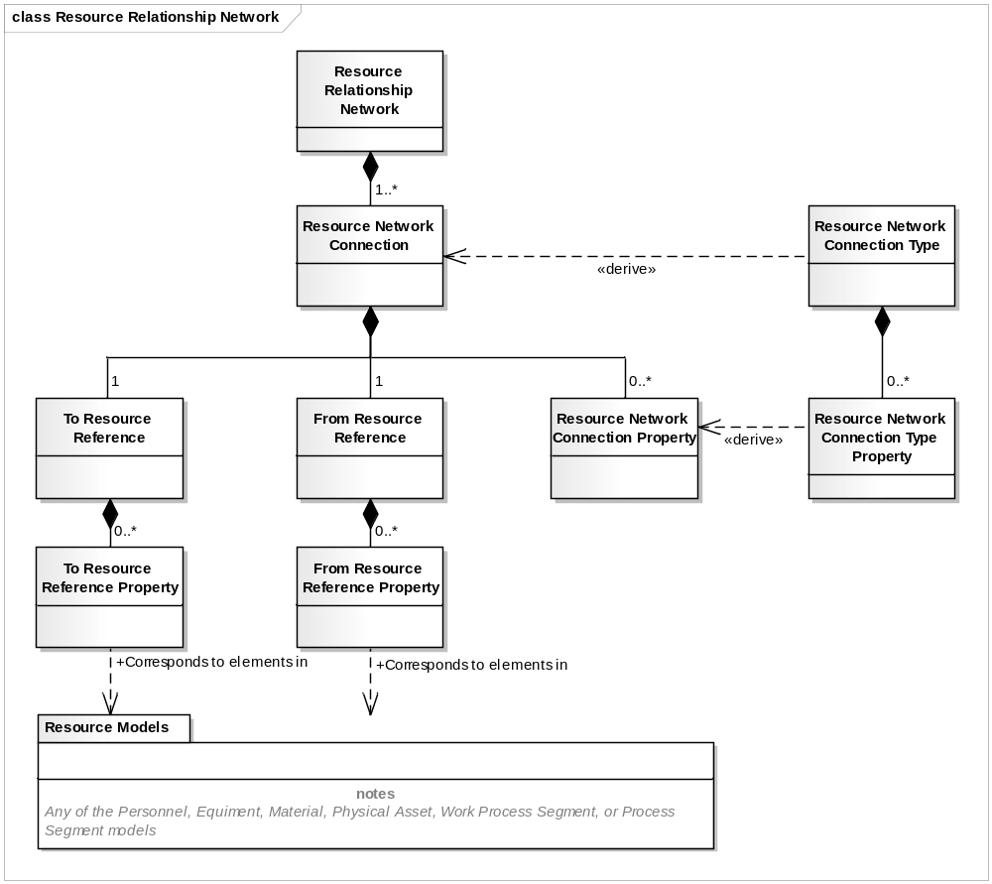
Information About a
Resource Relationship Network
Information About
Resource Connection Types

Slide 21
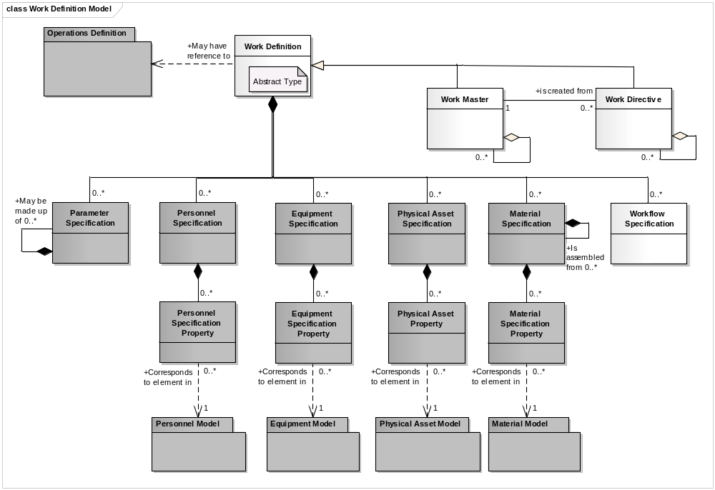
Information About
Work Masters
Information About
Work Directives

Slide 22
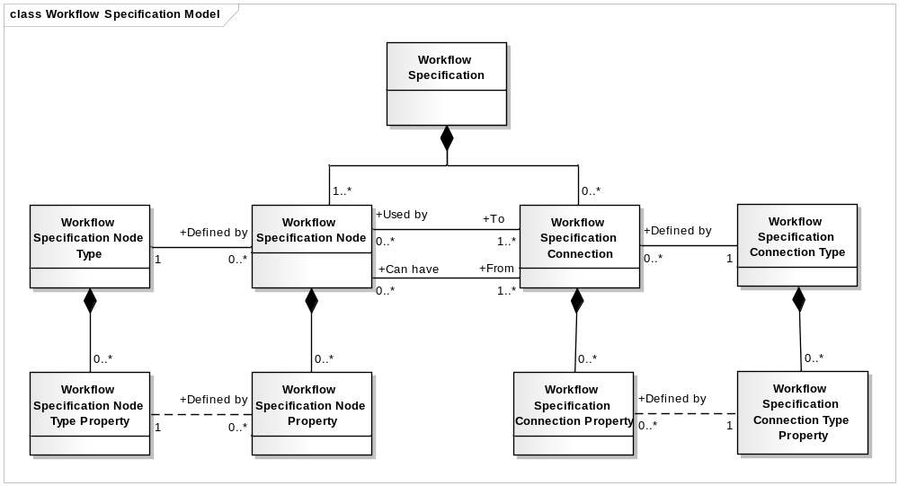
Information About
Workflow Specification
Information About
Workflow Specification
Type
0..1
0..n
0..n
0..n
0..n
< may contain nested
< may contain nested
< may contain nested
< may contain nested

Slide 23
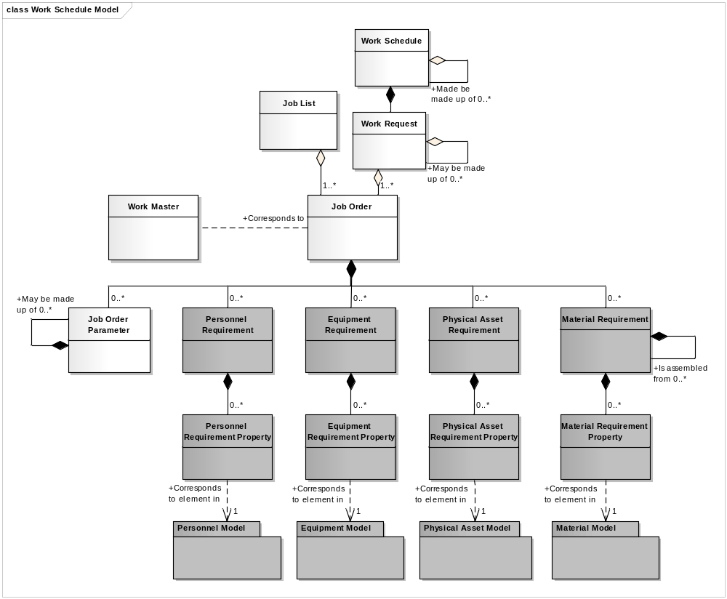
Information About
Job Lists
Information About
Work Schedules

Slide 24
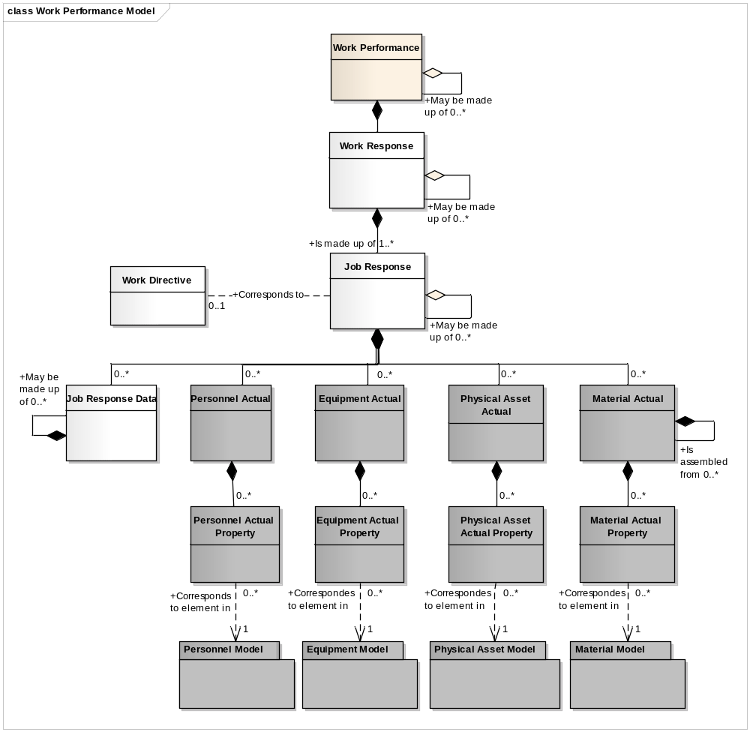
Information About
Work Performance
Information About
Job Responses

Slide 25
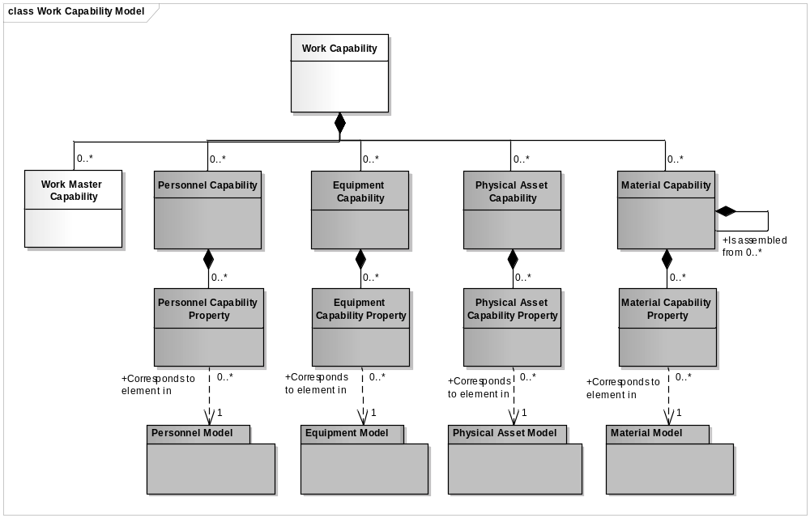
Information About
Work Capability

Slide 26
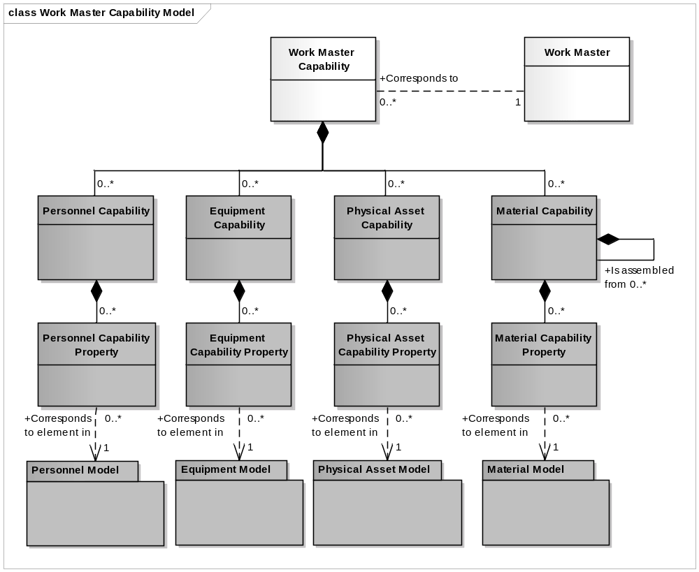
Work Master Capability

Slide 27
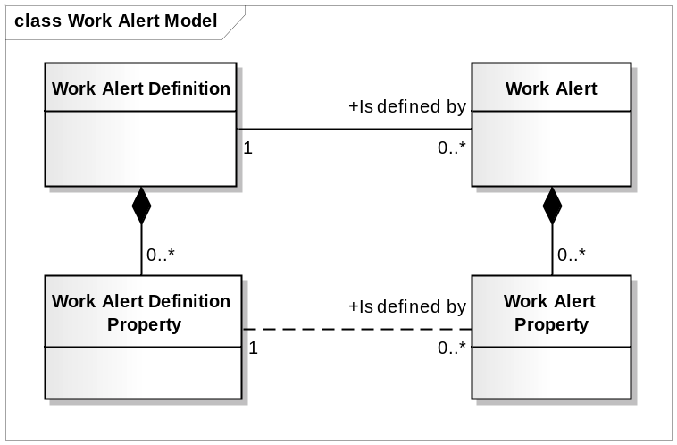
Information About
Work Alert Types and Work Alerts
Information About
Work Alert Types
Information About
Work Alerts

Slide 28
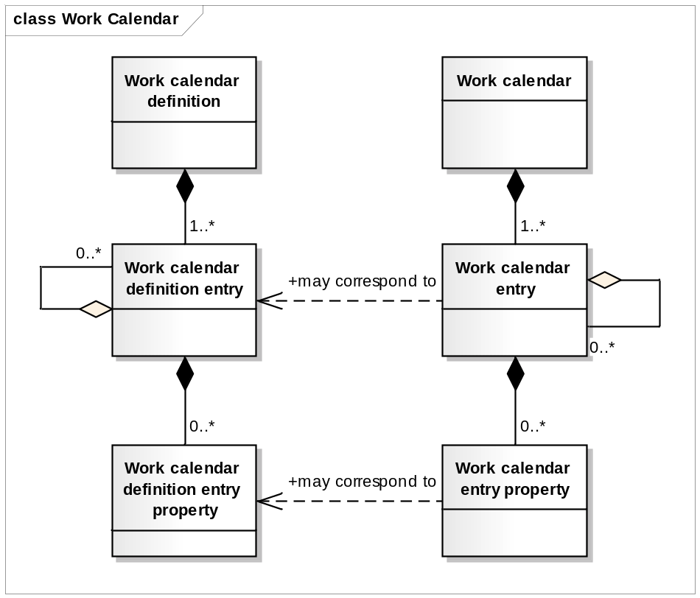
Information About
Work Calendar Definitions and Work Calendar Entries
Information About
Work Calendar Definitions
Information About
Work Calendar Entries

Slide 29
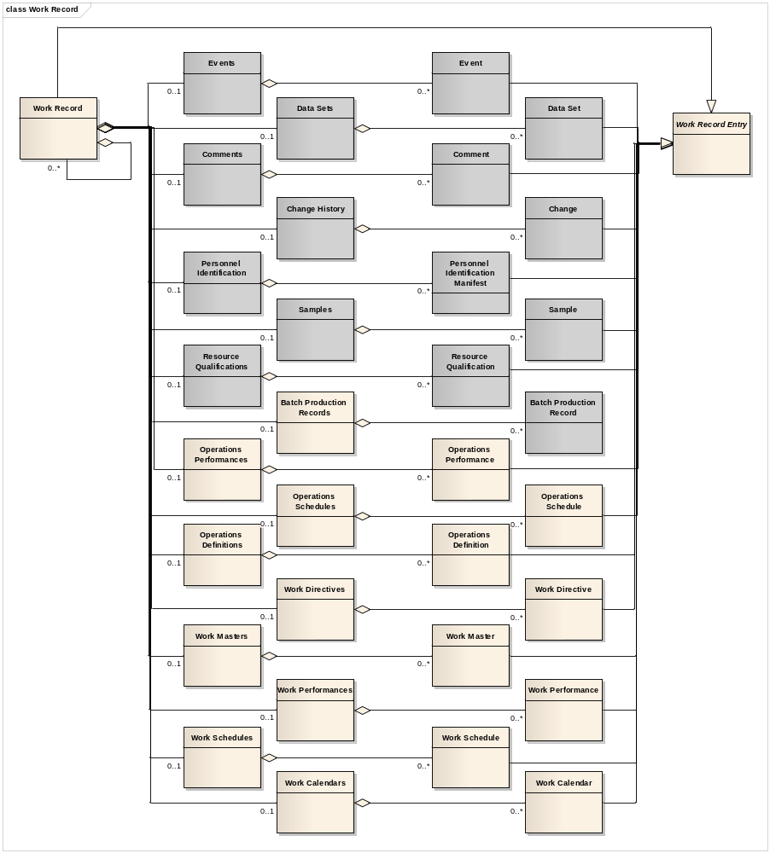

Slide 30
ENTERPRISE
May contain 1 or more
SITE
May contain 1 or more
AREA
May contain 1 or more
May contain 1 or more
May contain 1 or more
PROCESS CELL
PRODUCTION
UNIT
PRODUCTION
LINE
Must contain 1 or more
May contain 1 or more
UNIT
WORK CELL
Equipment used
in batch
operations.
Equipment used
in continuous
operations.
Equipment used
in repetitive or
discrete operations.

Slide 31



Identify Class by ID
Identify subclass By Class ID & Property Value
Personnel Capability
- Class = Operator
Quantity = 8
Personnel Capability
- Class = Operator
Quantity = 8
Operator
Personnel Capability Property
- Ranking = Master
Quantity = 3
Operator
Operator Property
- Ranking = Master
Personnel Capability Property
- Ranking = Standard
Quantity = 4
Operator Property
- Ranking = Standard
Personnel Capability Property
- Ranking = Junior
Quantity = 1
Operator Property
- Ranking = Junior
Supervisor
Mechanic

Slide 32
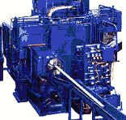

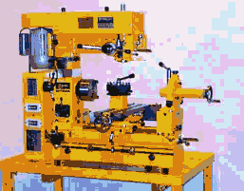


Identify Class by ID
Identify subclass By Class ID & Property Value
Identify Instance by ID
Equipment Specification
- Class = Mill
Quantity = 8
Equipment Specification
- Class = Mill
Quantity = 8
Equipment Specification
- ID = Miller#1
Milling Machine
Equipment Specification Property
- Spec = Fine
Quantity = 3
Milling Machine
Miller#1
Equipment Property
- Spec = Fine
Equipment Specification Property
- Spec = Medium
Quantity = 4
Equipment Property
- Spec = Medium
Equipment Specification Property
- Spec = Course
Quantity = 1
Equipment Property
- Spec = Course

Slide 33
Identify Class by ID
Identify subclass By Class ID & Property Value
Identify Instance by ID
Equipment Capability
- Class = Mill
Quantity = 8
Equipment Capability
- Class = Mill
Quantity = 8
Equipment Capability
- ID = Miller#1
Milling Machine
Equipment Capability Property
- Spec = Fine
Quantity = 3
Milling Machine
Miller#1
Equipment Property
- Spec = Fine
Equipment Capability Property
- Spec = Medium
Quantity = 4
Equipment Property
- Spec = Medium
Equipment Capability Property
- Spec = Course
Quantity = 1
Equipment Property
- Spec = Course

Slide 34
Identify Class by ID
Identify subclass By Class ID & Property Value
Identify Instance by ID
Equipment Requirement
- Class = Mill
Quantity = 8
Equipment Requirement
- Class = Mill
Quantity = 8
Equipment Requirement
- ID = Miller#1
Milling Machine
Equipment Requirement Property
- Spec = Fine
Quantity = 3
Milling Machine
Miller#1
Equipment Property
- Spec = Fine
Equipment Requirement Property
- Spec = Medium
Quantity = 4
Equipment Property
- Spec = Medium
Equipment Requirement Property
- Spec = Course
Quantity = 1
Equipment Property
- Spec = Course

Slide 35
Identify Class by ID
Identify subclass By Class ID & Property Value
Identify Instance by ID
Equipment Actual
- Class = Mill
Quantity = 8
Equipment Actual
- Class = Mill
Quantity = 8
Equipment Actual
- ID = Miller#1
Milling Machine
Equipment Actual Property
- Spec = Fine
Quantity = 3
Milling Machine
Miller#1
Equipment Property
- Spec = Fine
Equipment Actual Property
- Spec = Medium
Quantity = 4
Equipment Property
- Spec = Medium
Equipment Actual Property
- Spec = Course
Quantity = 1
Equipment Property
- Spec = Course

Slide 36
GET Equipment
Information Provider
Application Identification Area
Information
User
Data Area
VERB = GET
GET
Local
processing
SHOW Equipment
Noun = Equipment
ID= “A*”
Application Identification Area
Data Area
VERB = SHOW
Noun = Equipment
ID= “ABC”
Description = “Simple equipment”
Equipment Property
ID = “Throughput”
Value = “200”
Value Unit of Measure = “PPM”
Description = “Throughput as parts
per minute”
…
Noun = Equipment
ID= “A11862”
Description = “Complex equipment”
Equipment Property
ID = “Throughput”
Value = “2000”
Value Unit of Measure = “PPM”
Description = “Throughput as parts
per minute”
…
SHOW

Slide 37
Information
Requestor
Information
Provider
GetEquipmentClass
ShowEquipmentClass
Information
Sender
Information
Receiver
ProcessProductionSchedule
AcknowledgeProductionSchedule
Information
Sender
Information
Receiver
ChangeProductDefinition
RespondProductDefinition
Information
Sender
Information
Receiver
CancelMaterialLot
ConfirmBOD

Slide 38
Information
Publisher
Information
Subscriber
SyncPerson (Add)
ConfirmBOD
Information
Publisher
Information
Subscriber
SyncProcessSegment (Change)
ConfirmBOD
Information
Publisher
Information
Subscriber
SyncMaintainceInformation (Delete)
ConfirmBOD

Slide 39
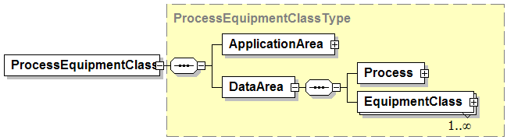
Combined Verb and Object Element Name
Verb Specific Area
<Verb><Object>
<Verb>
<Object>
Object Specific Area

Slide 40
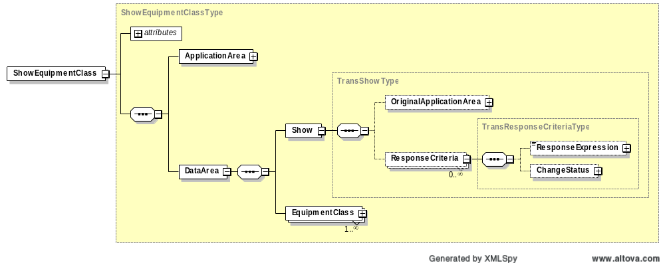
Contains required “actionCode” attribute of Accepted or Rejected
Contains optional addition reasons for return status

Slide 41
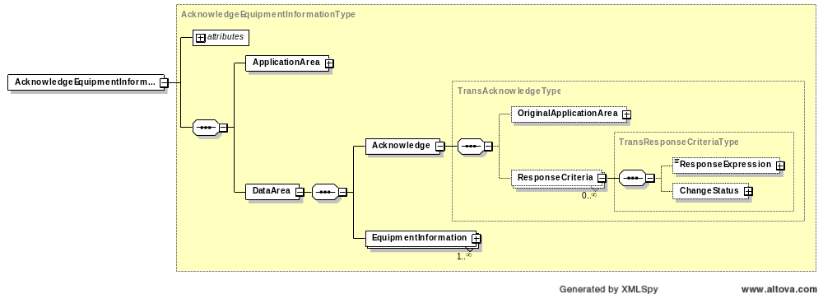
Contains optional “acknowledgeCode” attribute
Contains required “actionCode” attribute

Slide 42

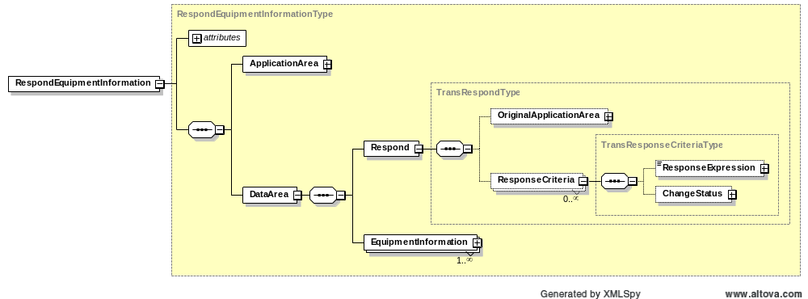
Contains optional “responseCode” attribute
Contains required “actionCode” attribute

Slide 43
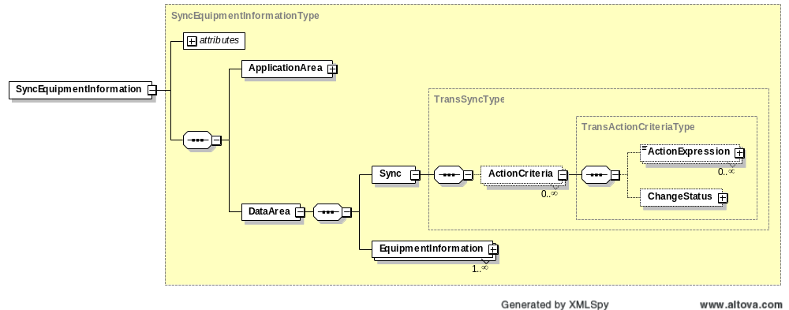
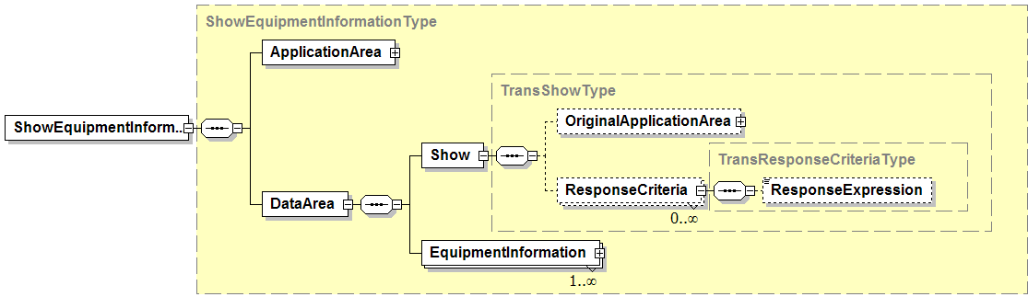
Contains required “actionCode” attribute of Add, Change, or Delete
Contains required “actionCode” attribute of Accepted or Rejected

Slide 44
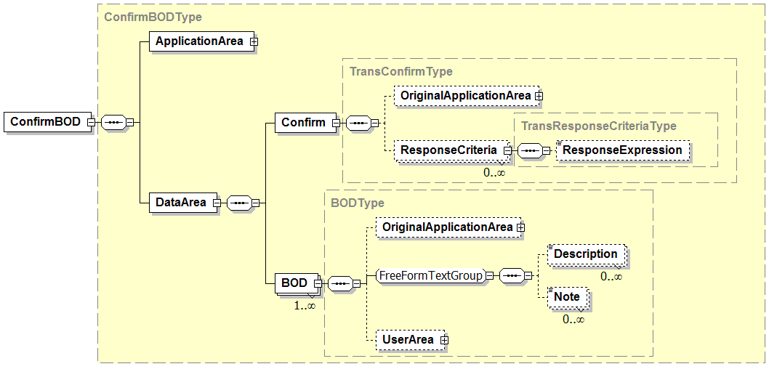
Contains required “actionCode” attribute of Accepted or Rejected
Contains additional information provided by the sender to assist in the handling of any error condition.

Slide 45
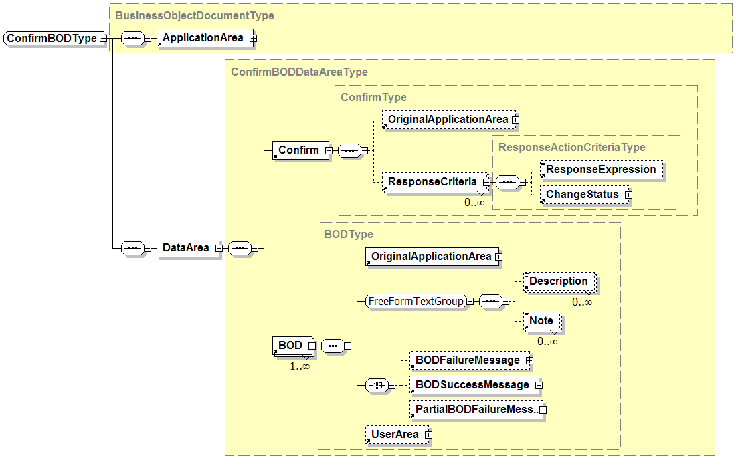
Not defined in B2MML

Slide 46
Production Planning & Scheduling Scenario
Level 4
PLM
Level 4
Asset Mgt
Level 4
Production Planning & Capacity Analysis
Level 4
Inventory Mgt
SHOW Equipment
SHOW Product Definition
PROCESS Production Capability
PROCESS Production Schedule
PROCESS Production Performance
GET Product Definition
GET Equipment
PROCESS MaterialSubLot
Level 3
Product Definition Management
Level 3
Production Resource Mgt
Level 3
Detailed Scheduling
Level 3
Production Tracking
Communication within Levels 3 or 4 are not shown since they are not in the scope of ISA-95 Parts 1 and 2

Slide 47
Business Process Scenario #1a
PUSH MODEL – Production Schedule / Production Performance
ERP
Level 4
Production Scheduling
MOM
Level 3
PROCESS – Production Schedule
PROCESS – Production Performance
Some work
complete
PROCESS* – Production Performance
All work finished
Scenario assumptions:
1. ERP send production schedule to MOM for processing
2. MOM (Manufacturing Operations Management) sends production performance to ERP for processing
* Message contains a FINAL flag to indicate that the message is the final production performance for the associated production schedule.

Slide 48
Business Process Scenario #3a
PULL MODEL – Production Schedule / Production Performance
ERP
Level 4
GET – Production Schedule
MOM
Level 3
SHOW – Production Schedule
Some work
complete
GET – Production Performance~
SHOW – Production Performance
All work finished
GET – Production Performance~
SHOW* – Production Performance
Scenario assumptions:
1. MOM requests production schedule from ERP
2. ERP requests production performance from MOM
~ The GET production performance message contains an identification of a production schedule (Production Performance / Production Schedule ID)
* The final SHOW production performance message contains a flag to indicate that the message is the final production performance for the associated production schedule.

Slide 49
Business Process Scenario #1a
PUBLISH MODEL – Production Schedule / Production Performance
ERP
Level 4
Production Scheduling
MOM
Level 3
SYNC ADD – Production Schedule
SYNC ADD – Production Performance
Some work
complete
SYNC CHANGE* – Production Performance
All work finished
Scenario assumptions:
1. MOM subscribes to production schedules.
2. ERP subscribes to production performances.
3. ERP publishes production schedule.
4. MOM publishes initial production performance with a SYNC ADD message.
5. MOM publishes subsequent production performances for the schedule with SYNC CHANGE messages.
* Message contains a FINAL flag to indicate that the message is the final production performance for the associated production schedule.

Slide 50
Business Process Scenario #1b
PUSH MODEL – Production Schedule Changes
ERP
Level 4
Production Scheduling
PROCESS – Production Schedule
MOM
Level 3
PROCESS – Production Performance
Some work
complete
Schedule
changes
CHANGE – Production Schedule
PROCESS – Production Performance
Some more
work complete
PROCESS* – Production Performance
All work finished
Scenario assumptions:
1. ERP sends production schedule to MOM for processing
2. MOM sends production performance to ERP for processing
3. ERP makes change to schedule and sends to MOM for processing
* Message contains a FINAL flag to indicate that the message is the final production performance for the associated production schedule.

Slide 51
Business Process Scenario #1b
PUBLISH MODEL – Production Schedule Changes
ERP
Level 4
Production Scheduling
SYNC ADD – Production Schedule
MOM
Level 3
SYNC ADD – Production Performance
Some work
complete
Schedule
changes
SYNC CHANGE – Production Schedule
SYNC CHANGE – Production Performance
Some more
work complete
SYNC CHANGE* – Production Performance
All work finished
Scenario assumptions:
1. MOM subscribes to production schedules.
2. ERP subscribes to production performances.
3. ERP publishes production schedule.
4. MOM publishes initial production performance with a SYNC ADD message.
5. ERP changes the schedule based on initial work done and republished with a SYNC CHANGE
6. MOM publishes subsequent production performances for the schedule with SYNC CHANGE messages.
* Message contains a FINAL flag to indicate that the message is the final production performance for the associated production schedule.

Slide 52
Business Process Scenario #1b
PUBLISH MODEL – Production Schedule Changes
ERP
Level 4
Production Scheduling
SYNC ADD – Production Schedule
MOM
Level 3
SYNC ADD – Production Performance
Some work
complete
Schedule
changes
SYNC CHANGE – Production Schedule
SYNC CHANGE – Production Performance
Some more
work complete
SYNC CHANGE* – Production Performance
All work finished
Scenario assumptions:
1. MOM subscribes to production schedules.
2. ERP subscribes to production performances.
3. ERP publishes production schedule.
4. MOM publishes initial production performance with a SYNC ADD message.
5. ERP changes schedule and republishes with SYNC CHANGE
6. MOM publishes subsequent production performances for the schedule with SYNC CHANGE messages.
* Message contains a FINAL flag to indicate that the message is the final production performance for the associated production schedule.

Slide 53
Business Process Scenario #1c
PUSH MODEL – Production Schedule Canceled
ERP
Level 4
Production Scheduling
PROCESS – Production Schedule
MOM
Level 3
Schedule
invalidated
CANCEL – Production Schedule
Scenario assumptions:
1. ERP sends production schedule to MOM for processing
2. ERP cancels schedule before actual production starts, and sends CANCEL of schedule to MOM

Slide 54
Business Process Scenario #1c
PULL and PUSH MODEL – Production Schedule Canceled
ERP
Level 4
Production Scheduling
GET – Production Schedule
MOM
Level 3
SHOW – Production Schedule
Schedule
invalidated
CANCEL – Production Schedule
Scenario assumptions:
1. MOM requests production schedule from ERP.
2. ERP cancels schedule before actual production starts, and sends CANCEL of schedule to MOM.

Slide 55
Business Process Scenario #1d
PUSH MODEL – Daily Production Performance
ERP
Level 4
MOM
Level 3
Production Tracking
PROCESS – Production Performance (May 24, 2005)
PROCESS – Production Performance (May 25, 2005)
Scenario assumptions:
1. MES sends daily production performance to ERP
2. Scope of production performance (which production lines, etc…) and timing of the publication (daily, weekly, time published) is not defined in a transaction message but is determined to in an out-of-band agreement.

Slide 56
Business Process Scenario #2d
PUBLISH/SUBSCRIBE MODEL – Daily Production Performance
ERP
Level 4
MOM
Level 3
SYNC ADD – Production Performance (May 24, 2005)
SYNC ADD – Production Performance (May 25, 2005)
Scenario assumptions:
1. ERP subscribes to daily production performance from MOM
2. MOM publishes daily production performance
3. Scope of production performance (which production lines, etc…) and timing of the publication (daily, weekly, time published) is not defined in a transaction message but is determined to in an out-of-band agreement.

Slide 57
Business Process Scenario #3d
PULL MODEL – Daily Production Performance
ERP
Level 4
MOM
Level 3
GET – Production Performance (May 24, 2005)
SHOW – Production Performance (May 24, 2005)
GET – Production Performance (May 25, 2005)
SHOW – Production Performance (May 25, 2005)
Scenario assumptions:
1. ERP requests production performance from MOM on a daily schedule

Slide 58
Business Process Scenario #1h
PUSH/PULL MODEL – Production Schedule based on Production Capability
ERP
Level 4
Production Scheduling
GET – Production Capability
MOM
Level 3
Execution
SHOW – Production Capability
PROCESS – Production Schedule
PROCESS – Production Performance
Some work
complete
PROCESS – Production Performance
Some more
work complete
PROCESS – Production Performance
All work finished
Scenario assumptions:
1. ERP requests production capability for the planning period
2. MOM sends production capability to ERP
3. ERP sends production schedule to MOM for processing
4. MOM sends production performance to ERP reflecting partial order completion
5. MOM sends production performance to ERP reflecting partial order completion
6. MOM sends production performance to ERP reflecting completion of order

Slide 59
Business Process Scenario #1h
PUBLISH and PUSH MODEL – Production Schedule based on Production Capability
ERP
Level 4
Production Scheduling
MOM
Level 3
Execution
SYNC ADD – Production Capability
SYNC ADD – Production Schedule
PROCESS – Production Performance
Some work
complete
PROCESS – Production Performance
Some more
work complete
PROCESS* – Production Performance
All work finished
Scenario assumptions:
1. ERP subscribes to production capability.
2. MOM subscribes to production schedules.
3. MOM publishes production capability on a regular schedule, e.g. every 2 days,
4. ERP generates a production schedule and publishes it.
5. MOM sends production performance to ERP reflecting partial order completion.
6. MOM sends production performance to ERP reflecting partial order completion.
7. MOM sends production performance to ERP reflecting completion of order.
* Message contains a FINAL flag to indicate that the message is the final production performance for the associated production schedule.

Slide 60
Business Process Scenario #1e
PUSH MODEL – Production Schedule / Capability Changes
ERP
Level 4
MOM
Level 3
Production Resource Management
PROCESS – Production Schedule
PROCESS – Production Capability
Schedule
changes
CHANGE – Production Schedule
Scenario assumptions:
1. ERP send production schedule to MOM for processing
2. MOM sends updated production capability to ERP for processing
3. Scope of production capability (which production lines, etc…) and timing of the publication (daily, weekly, time published) is not defined in a transaction message but is determined to in an out-of-band agreement.
4. ERP changes schedule based on new capability and sends CHANGE to MOM

Slide 61
Business Process Scenario #1f
PUSH MODEL – Material Lot added, material lot quantity changed
ERP
Level 4
MOM
Level 3
New material lot
is available
PROCESS – Material Lot (quantity = 400)
CHANGE – Material Lot (quantity = 300)
Material lot
quantity changed
CHANGE – Material Lot (quantity = 200)
Material lot
quantity changed
CHANGE – Material Lot (quantity = 0)
Material lot
quantity changed
Material lot no
longer available
CANCEL – Material Lot
Scenario assumptions:
1. Consumable material arrives at the facility and is entered into the ERP
2. ERP send material lot information to MOM for processing
3. MOM sends quantity changes in material lot to ERP as material is consumed
4. ERP sends CANCEL when material lot is no longer available

Slide 62
Business Process Scenario #1g
Mixed MODEL – Material Lot added, material lot quantity changed
ERP
Level 4
MOM
Level 3
New material lot
is available
SYNC ADD – Material Lot (quantity = 400)
CHANGE – Material Lot (quantity = 300)
Material lot
quantity changed
CHANGE – Material Lot (quantity = 200)
Material lot
quantity changed
CHANGE – Material Lot (quantity = 0)
Material lot
quantity changed
Material lot no
longer available
SYNC DELETE – Material Lot
Scenario assumptions:
1. ERP publishes material lot information, MOM subscribes
2. MOM sends quantity changes in material lot to ERP
3. ERP send SYNC DELETE when material lot is no longer available

Slide 63
New Business Process Scenario #1j
PUSH/PULL MODEL – Production Schedule Changes using Production Capability as input
ERP
Level 4
Production Scheduling
MOM
Level 3
PROCESS – Production Schedule
PROCESS – Production Performance
Some work
complete
GET – Production Capability
SHOW – Production Capability
Schedule
changes
CHANGE – Production Schedule
PROCESS – Production Performance
Some more
work complete
PROCESS – Production Performance
All work finished
Scenario assumptions:
1. ERP sends production schedule to MOM for processing
2. MOM sends production performance to ERP for processing
3. ERP requests production capability from MOM
4. MOM sends production capability to ERP
5. ERP makes change to schedule and sends to MOM for processing
6. MOM sends production performance to ERP reflecting partial order completion
7. MOM sends production performance to ERP reflecting completion of order

Slide 64
Business Process Scenario #2a
PUBLISH/SUBSCRIBE MODEL – Production Schedule / Production Performance
ERP
Level 4
SYNC ADD – Production Schedule
MES
Level 3
SYNC ADD – Production Performance
Some work
complete
SYNC CHANGE – Production Performance
More work
complete
SYNC CHANGE* – Production Performance
All work finished
Scenario assumptions:
1. ERP publishes production schedules, MES subscribes to changes
2. MES publishes production responses, ERP subscribes to changes
3. MES publishes SYNC ADD on first response and SYNC CHANGE on subsequent responses
* Message contains a FINAL flag to indicate that the message is the final production performance for the associated production schedule.

Slide 65
Business Process Scenario #2b
PUBLISH/SUBSCRIBE MODEL – Production Schedule Changes
ERP
Level 4
SYNC ADD – Production Schedule
MES
Level 3
SYNC ADD – Production Performance
Some work
complete
Schedule
changes
SYNC CHANGE – Production Schedule
SYNC CHANGE – Production Performance
Some more
work complete
SYNC CHANGE* – Production Performance
All work finished
Scenario assumptions:
1. ERP publishes production schedules, MES subscribes to changes
2. MES publishes production responses, ERP subscribes to changes
3. ERP changes production schedule and sends changed production schedule using SYNC CHANGE to MES
* Message contains a FINAL flag to indicate that the message is the final production performance for the associated production schedule.

Slide 66
Business Process Scenario #2c
PUBLISH/SUBSCRIBE MODEL – Production Schedule Canceled
ERP
Level 4
SYNC ADD – Production Schedule
MES
Level 3
Schedule
canceled
SYNC DELETE – Production Schedule
Scenario assumptions:
1. ERP publishes production schedules, MES subscribes to changes
2. ERP cancels the schedule before production starts and sends SYNC DELETE to MES

Slide 67
Business Process Scenario #3b
GET/SHOW MODEL – Production Schedule Changes
ERP
Level 4
GET – Production Schedule
MES
Level 3
SHOW – Production Schedule
Some work
complete
Schedule
changes
GET – Production Schedule
SHOW – Production Schedule
All work finished
GET – Production Performance
SHOW* – Production Performance
Scenario assumptions:
1. MES requests production schedule from ERP
2. ERP requests production performance from MES
3. ERP changes production schedule and returns changed schedule on next request
* Message would contain a flag to indicate that the message is the final production performance for the associated production schedule.

Slide 68
Business Process Scenario #1g
PUSH and PULL MODEL – Material Lot added, material lot quantity changed
ERP
Level 4
MOM
Level 3
New material lot
is available
GET – Material Lot (ReceiptStatus = “New”)
SHOW – Material Lot (quantity = 400)
CHANGE – Material Lot (quantity = 300)
Material lot
quantity changed
CHANGE – Material Lot (quantity = 200)
Material lot
quantity changed
CHANGE – Material Lot (quantity = 0)
Material lot
quantity changed
Scenario assumptions:
1. MOM requests material lot information from ERP
2. ERP sends information on new material lots (lots with no changes)
3. MOM pushes quantity changes in material lot to ERP

