Slide 1

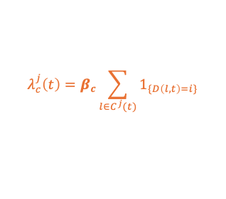




RECORDED TEMPORAL NETWORK
SYNTHETIC TEMPORAL NETWORK
LOCATION RECONSTRUCTION
Office
Patient room
Patient room
Corridor
Patient room
Patient room
Nursing station
t₁
t₂
t₃
t₁
t₂
t₃
…
T
T
Literature
EPIDEMIC MODEL
Individual locations
Contacts
Parameters
Data
$$ν μ$$
$$B$$
$$V$$
$$β_{c} β_{e}$$
Grid search
Forces of infection
Close-proximity
$$λ_{c}^{j}\left(t\right)=β_{c}\sum_{l∈C^{j}(t)}{1_{\{D\left(l,t\right)=i\}}}$$
Long-distance
$$λ_{e}^{j}\left(t\right)=β_{e}\sum_{k∈R^{j}}{1_{\left\{r^{j}\left(t \right)=k\right\}}B\frac{E^{k} (t)}{V^{k}}}$$
SIMULATIONS
Exploration or transmission schemes
Infections
INTERVENTION SCENARIOS
Individual
Time
Mask wearing
Hand hygiene
Intervention evaluation
Collective
Ventilation
Air filtration
Decontamination

