Slide 1

Exploring Sociocultural Patterns in Baby Naming Using K-Means Clustering
Stephan Laleye

Slide 2
Project Purpose
Analyze baby naming trends in New York City between the years 2011 to 2021.
Uncovering influences on the naming conventions employed by the various recorded ethnic groups within this dataset.
Implementation of the ( K-means ) machine learning approach to produce reliable and descriptive clusters describing which names belong to which ethnic groups, and which names are so popular that they span multiple ethnic groups at once.

Slide 3
Key Questions
How do ethnic groups influence baby names?
What baby names are common across multiple ethnicities?
Can a K-means clustering algorithm reveal meaningful patterns in naming trends?

Slide 4
Methodology
A K-means clustering algorithm is used to group names based on ethnic influence.
Clustering is done based on similarities in name frequency and ethnicity.
Data preprocessing is conducted through ‘One-Hot’ encoding and the ( standardization ) scaling of numeric features.
The K-means model is trained using a ( K = 5 ) threshold.
The evaluation of a given cluster is based on ethnic diversity and name prevalence.

Slide 5
The Dataset
Popular Baby Names (NYC 2011-2021)
69,215 records containing the following attributes
First Name
Ethnicity
Name Ranking ( Popularity )
Gender
Count
Record Year
Provided by the New York City Department of Health
Original File ( .xlsx ) converted into a Parquet

Slide 6
The Code
Preprocessing:
StringIndexer method used to encode the different ethnicities
VectorAssembler method used for combining relevant attributes
StandardScaler used for normalizing the data
K-Means:
Number of clusters (k = 5)
Split into an 80% / 20% dataset, 80% training and 20% testing
Clustering applied to predict ethnic influence on naming conventions across clusters

Slide 7
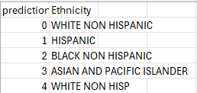
Output One:
For each cluster, the primary ethnicity was defined based on name associations.

Slide 8
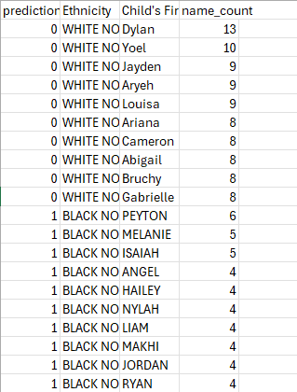
Output Two:
Top 10 names found within each cluster/ethnicity.
Breakdown by gender for more insight into possibility of naming trends / patterns.

Slide 9
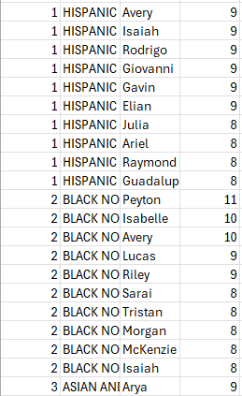
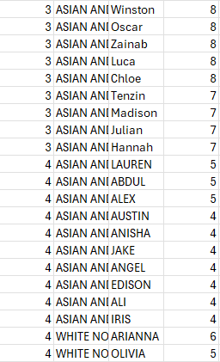
Output Two: ( Continued )

Slide 10
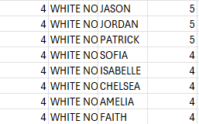
Output Two: ( Continued )

Slide 11
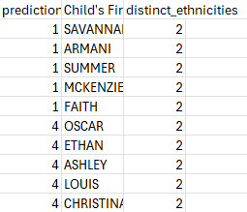
Output Three:
Names found across two or more clusters, showing ethnic crossover between clusters.

Slide 12
Post Analysis Inferneces
Names like Savanna, Oscar, and Ethan span multiple ethnic groups.
Clustering reveals cultural adoption of names across diverse groups.
Certain clusters were heavily dominated by specific ethnicities, showing more rigid naming conventions.
Example: Cluster 1 primarily influenced by Hispanic and Asian names.

Slide 13
Conclusive Thoughts
The K-means clustering implementation somewhat successfully highlighted cultural patterns in naming conventions.
This algorithm type revealed some overlap of the names encountered across multiple ethnicities, indicating cultural exchange in naming trends.
Encoding may simplify ethnic relationships.
Use of alternative clustering methods like Gaussian Mixture Models (GMM).
Additional features that described each record better ( socioeconomic status, birth year )

Slide 14
Thank You!!!

