Slide 1

CS 777 Term Project
Zhiyuan Zhang

Slide 2
Introduction
Project overview and significance
Why is this important?

Slide 3
Method
Data processing
Feature selection and scaling

Slide 4
Clustering
K-Means Clustering
Model Evaluation

Slide 5
Code
Data splitting
Model Training
Model Testing
Visulization

Slide 6
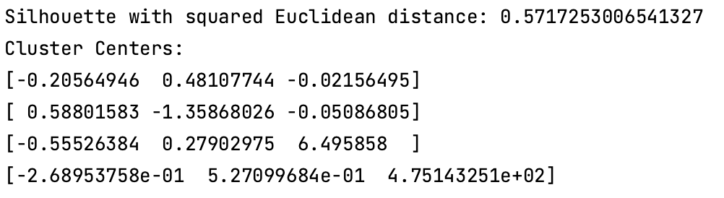
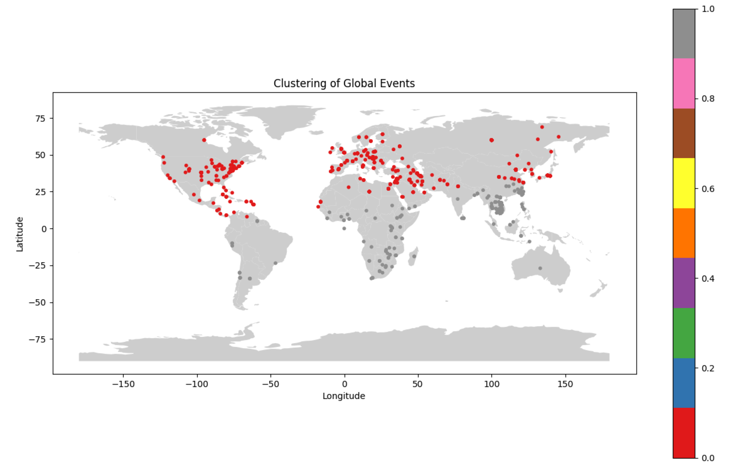
Results

Slide 7
Findings
Hotspot identification
Policy implications
Model evaluation

Slide 8

Conclusion

Slide 9

Thank you

