Slide 1
NBA Shot Analysis
CS777 Term Project
Brandon Bartol
2024

Slide 2
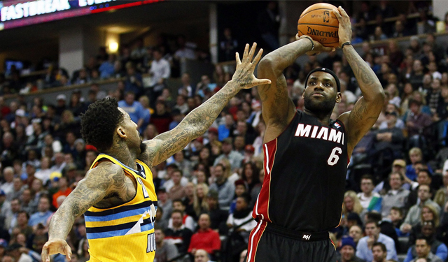
The NBA/Basketball
The NBA is a professional basketball league in the United States. The goal of this game is to take shots to score more points than the opposing teams. Shots can either have a value of 2 or 3 depending on where they were taken.
The best players in this league are named to “All-Star” teams each year.
Can we build shows how an All-Star’s shooting differs from a non-All-Star? Are they more efficient or do they shoot in different ways?

Slide 3
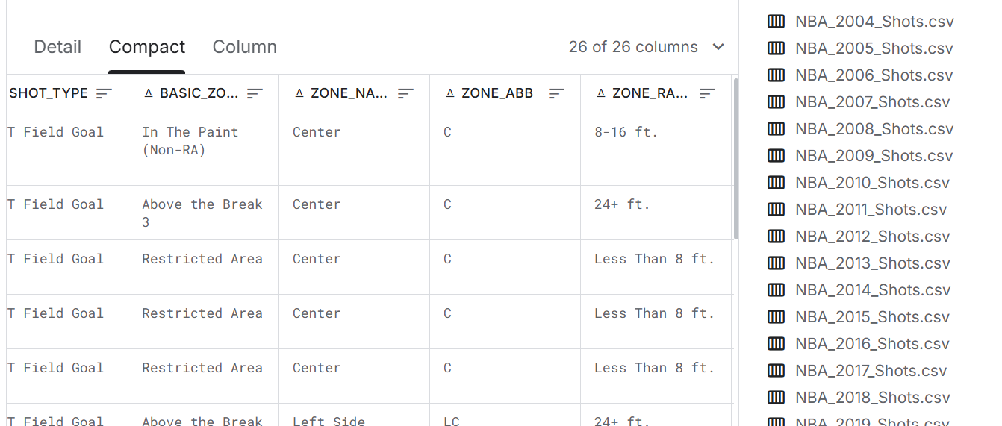
NBA Shot Summary
5 sources were merged together to create the starting data set.
Each of these datasets contained 26 columns representing every shot taken in the NBA that season.
The merged dataset on column name contained 1031742 rows x 26 columns
Data is both categorical and numeric. The data I focused on defined the type of shot and location, but there was also information about the player and teams involved.
An additional data source containing the names of all the All-Stars was joined with the Shot dataset to flag which shots were taken by All-Stars.

Slide 4
Project Outline
1. Preprocessing
Dataset is reviewed and cleansed to ensure data validity
2. Data Modeling
Data is split and Classification/Regression models are created
3. Performance Evaluation
Performance metrics are output and visualizations are made

Slide 5
Preprocessing
Non-statistics are removed such as the date and team columns provided additional background into the game where the shot took place.
3 columns of interest:
ACTION_TYPE– There are 48 different categorical descriptions that describe the shot type such as 'Jump Shot', 'Pullup Jump shot', and 'Driving Layup Shot'
ZONE_NAME – There are 6 different zones that a player can shoot from: ['Center', 'Left Side Center', 'Right Side Center', 'Left Side', 'Right Side', 'Back Court']
ZONE_RANGE – There are 5 different ranges a player can shoot from: ['Less Than 8 ft.', '24+ ft.', '8-16 ft.', '16-24 ft.', 'Back Court Shot’]
Preprocessing consists of indexer, encoder, and assembler (shown on next slide)

Slide 6
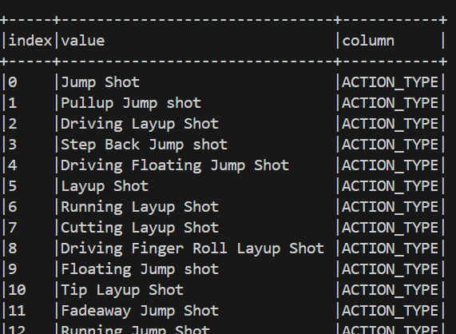
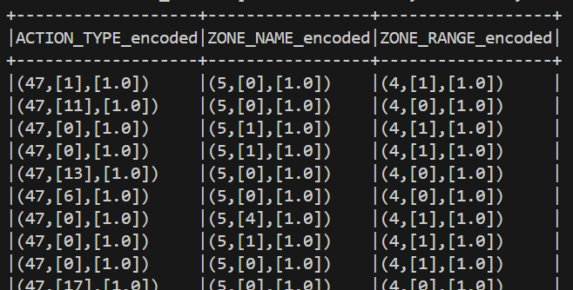
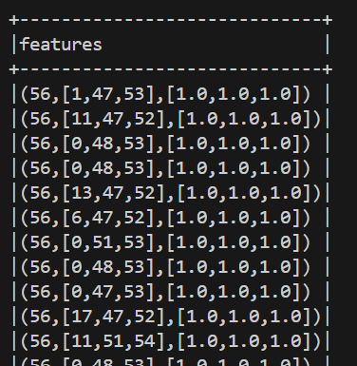
Preprocessing (Cont)
Indexer – Assigns number to each categorical feature
Encoder – Stores indexed feature in matrix location
Assembler – Combines features into single matrix

Slide 7
Data Split
Data was split 2 different ways.
Data always split into 80% training data 20% testing data.
For the logistic regression the full dataset was split and a “train_data” and “test_data” table were created.
For the linear regression the full dataset was first split into All-Stars and non-All-Stars, then this population was split into “as_train_data”, “as_test_data” , “non_as_train_data”, and “non_as_test_data”

Slide 8
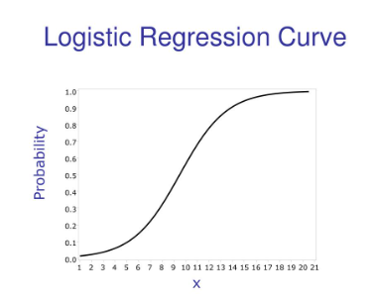
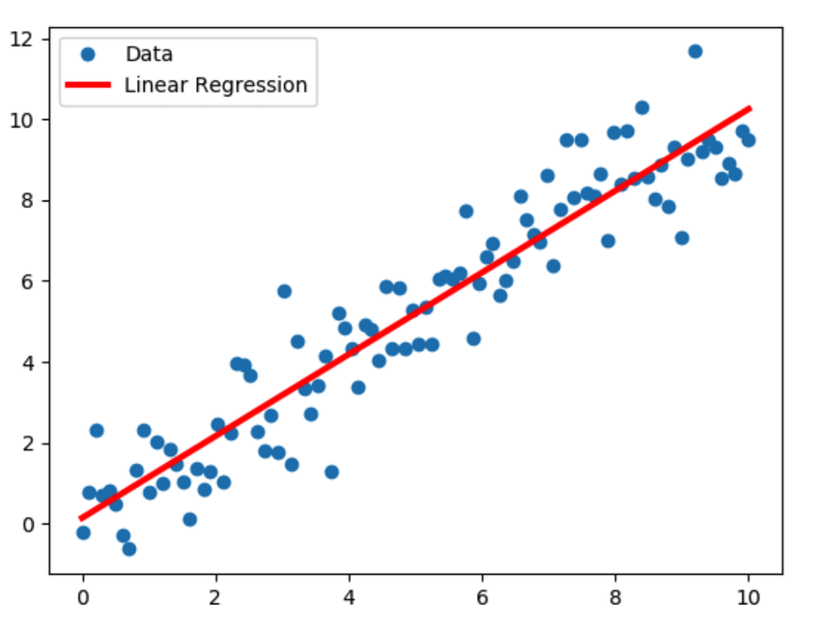
Model Overview
Logistic Regression and Linear Regression were chosen analyze dataset.
Logistic Regression is used for classification and uses a logistic function to estimate probability the tuple belongs in binary class.
Linear Regression is used for regression tasks. It seeks to find the best-fit line that predicts the dependent variable based on the independent variables

Slide 9
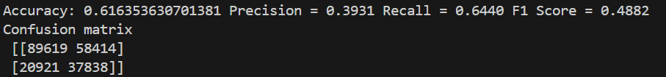
Logistic Regression
Logistic Regression is a supervised machine learining technique that predicts the probability that an instance belongs to a particular class. “LogisticRegression” model in the pyspark.ml package was used.
Parameters chosen were a maximum of 20 iterations and a regularization parameter of 0.1.
A parameter grid consisting of [0.1, 0.01, 0.001] was originally used to find the optimal regularization parameter.

Slide 10
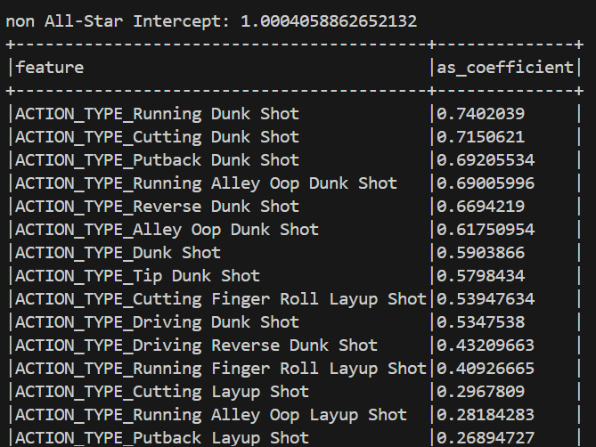
Linear Regression
Logistic Regression is a supervised machine learining technique that predicts a continuous outcome variable based the predictor variables. “LinearRegression” model in the pyspark.ml package was used.
Parameters chosen were a maximum of 20 iterations and a regularization parameter of 0.1.
A parameter grid consisting of [0.1, 0.01, 0.001] was originally used to find the optimal regularization parameter.

Slide 11
Results – Model Performance
Logistic Regression model stats:
Suffers from false positives and is bias towards assuming a shot was made as is evidence by the precision
Recall shows it was able to correctly predict 64.4% of the made shot attempts, but as the F-score shows it sacrifices precision from this increase in recall
Overall not able to accurately model if a shot was made

Slide 12
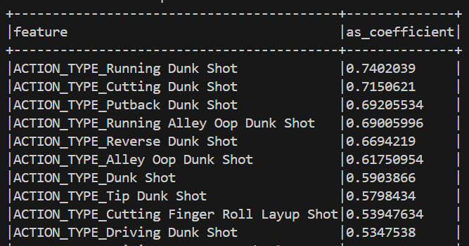
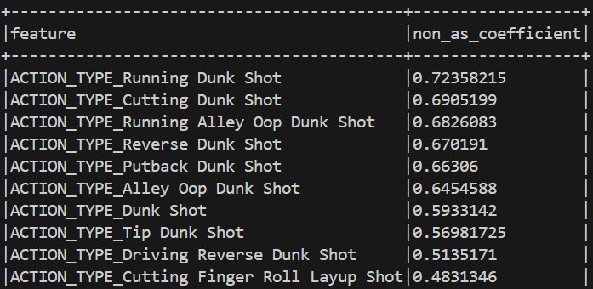
Results – Linear Regression
Unable to accurately predict the value of a single shot as is evidence by the performance metrics
All Star Root Mean Squared Error (RMSE) = 1.1378
All Star R2 = 0.0379
non-All Star Root Mean Squared Error (RMSE) = 1.1765
non-All Star R2 = 0.0379

Slide 13
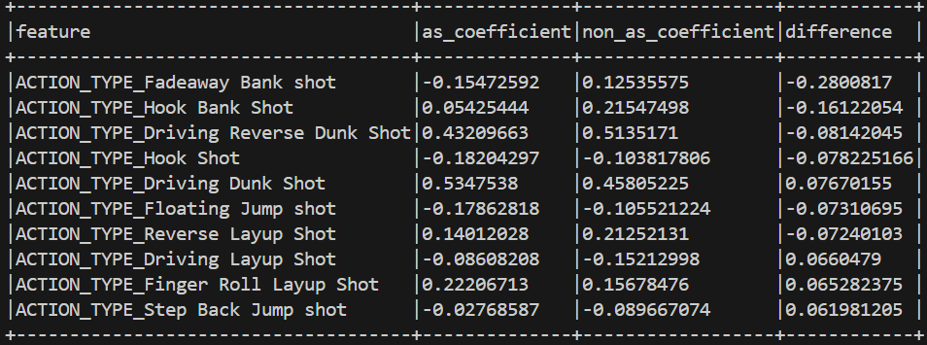
Results – Linear Regression
Mixed Success showing the difference between All-Stars and non-All-Stars
36/57 features resulted in higher expected points for All Stars

Slide 14
Results – Linear Regression
Expected point value from Linear Regression is poor at predicting individual shots but does a great job of modeling expected total points
Predicted point values for both populations summed to within 1% of the actual point value

Slide 15
Conclusion and Future Improvements
Individual shot performance could not be accurately modeled through these models
Overall expected point values for shots could be modeled through linear regression
There were was some evidence that All-Stars were more accurate with their shots but this could not be conclusively proven
Models such as decision trees or random forests could do a better job of predicting discrete shot values rather than a continuous output like the linear regression model
Addition features such as information on the shot defense or trajectory of the shot would be needed to model the outcome at a shot-by-shot level

Slide 16
Thank you!

Slide 17
References
Class Notes
library(pyspark.ml)
library(pandas)
library(pyspark.sql)
library(pyspark.mllib)
⛹🏾‍♂️ NBA Shots (kaggle.com)
Wikipedia (for All Star lists: 2024 NBA All-Star Game - Wikipedia, https://en.wikipedia.org/wiki/2023_NBA_All-Star_Game, https://en.wikipedia.org/wiki/2022_NBA_All-Star_Game, https://en.wikipedia.org/wiki/2021_NBA_All-Star_Game, https://en.wikipedia.org/wiki/2020_NBA_All-Star_Game)

