Slide 1
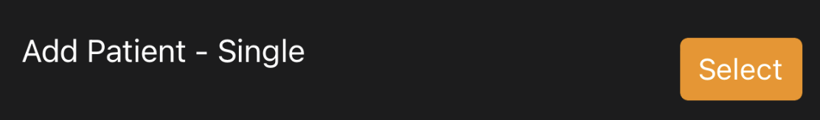
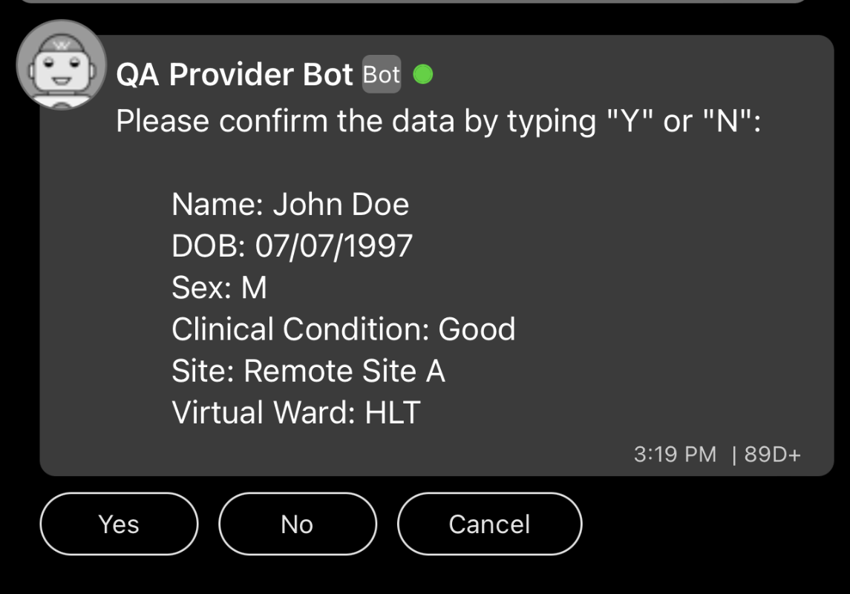
Quick Reference Guide – Add New Patient
Access the main menu by typing “/list”
Choose the patient’s site
  Select the site that the patient is at. The patient will be shown in a list of patients at that site but can be transferred to a different site at any time.
Access the main menu by typing “/list”
Type the patient’s first and last name
  Once prompted enter the patients first and last name in order without punctuation. (e.g. John Doe)
Type patient’s date of birth
  Enter the patients date of birth as MM/DD/YYYY, (e.g. 01/31/1995
Type the patient’s first and last name
  Once prompted enter the patients first and last name in order without punctuation. (e.g. John Doe)
Type patient’s date of birth
  Enter the patients date of birth as MM/DD/YYYY, (e.g. 01/31/1995
Choose a virtual ward for the patient
Select the patient’s sex as assigned at birth (confirm)
  Either select “M” for male or “F” for female. Or you can type the letter “m” or “f” for male or female.
Tips and Tricks
At any time you can type “/list” to return to the main menu
Any information entered here can be edited in from the patient record
Select the patient’s Clinical Condition
  Select the current clinical condition of the patient.
Select the patient’s Clinical Condition
  Select the current clinical condition of the patient.

Slide 2
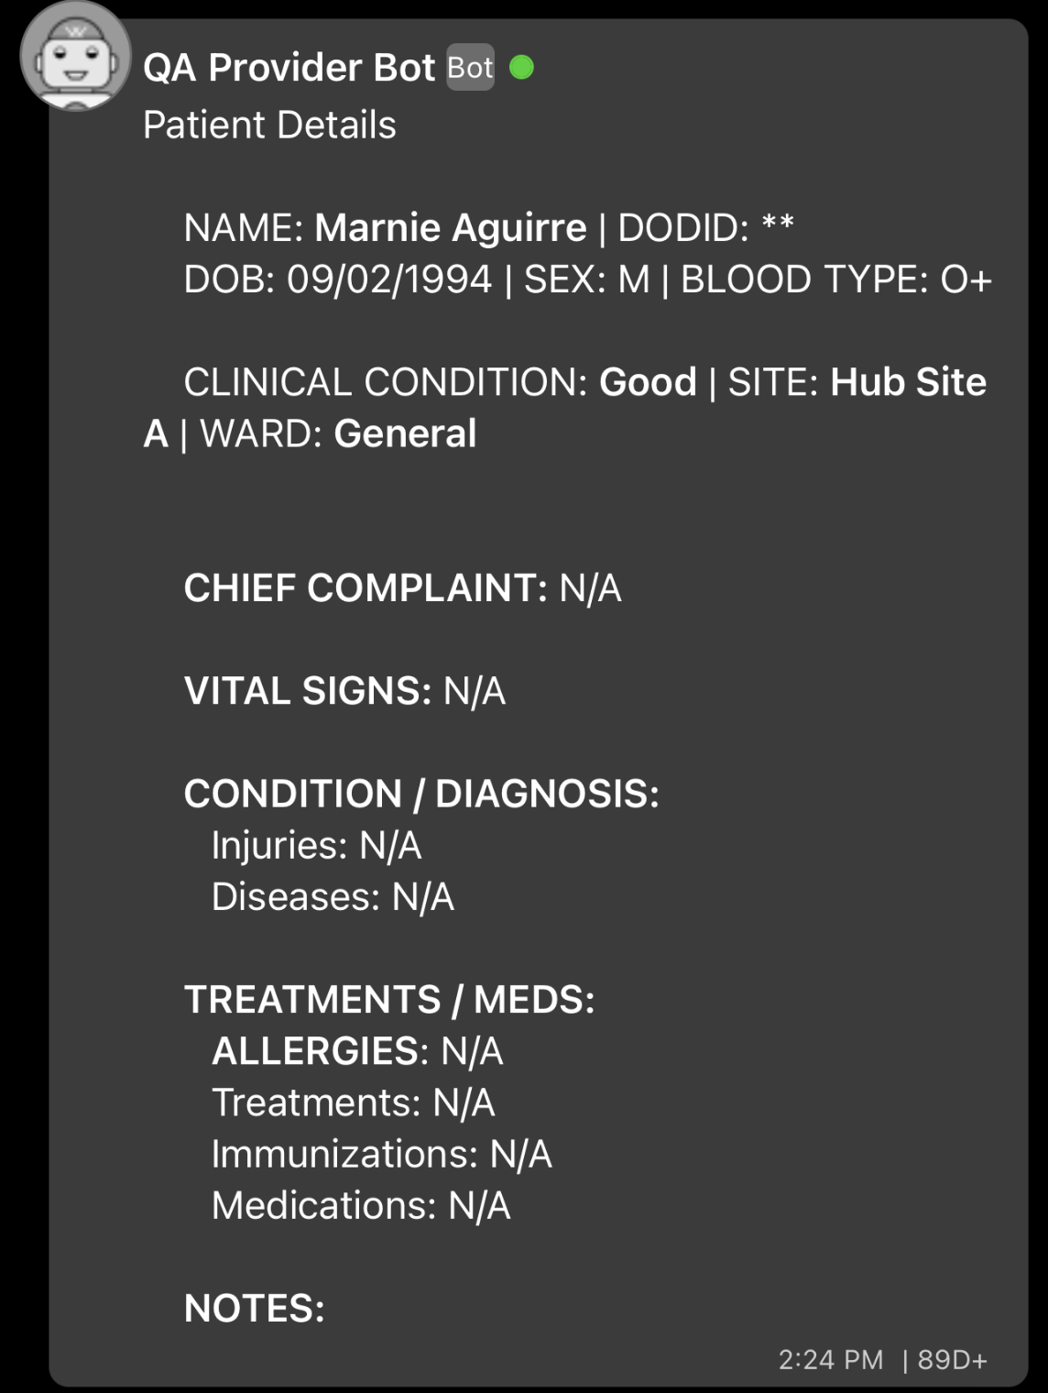

Quick Reference Guide – Update Patient Record
Transfer Patient.
  Change Patient’s Virtual Ward
  Change Patient’s Site
  Patient will display in the list of the new site’s patients
Edit Patient Info/History
  Patient Name
  Delete Patient
  Date of Birth
  Blood Type
  Clinical Condition
  Allergies
  DODID is not an editable field
Document Care/Condition
  Chief Complaint
  Vital Signs
  Condition/Diagnosis
  Treatments
  Immunizations
  Medications
  Freetext Note
  Updates will be date/time stamped.
Tips and Tricks
At any time you can type “/list” to return to the main menu
To return to patient record select “Go Back
If you want to cancel information entered select “Cancel” to return to patient record

Slide 3
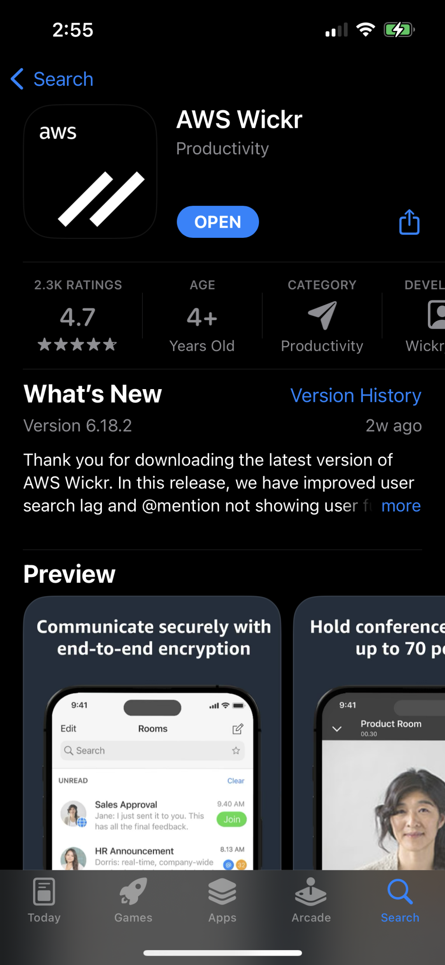
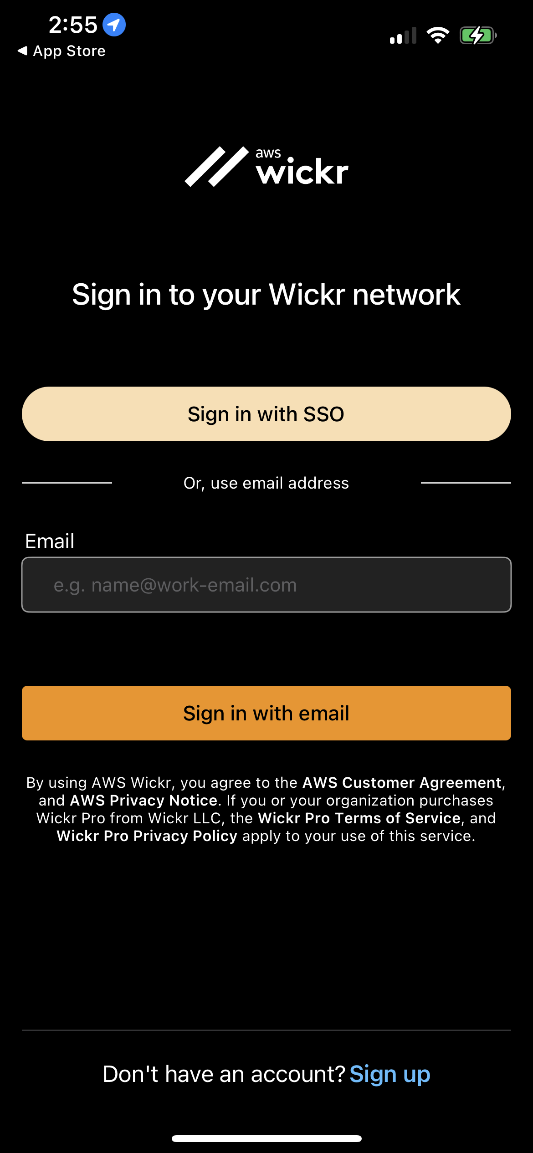
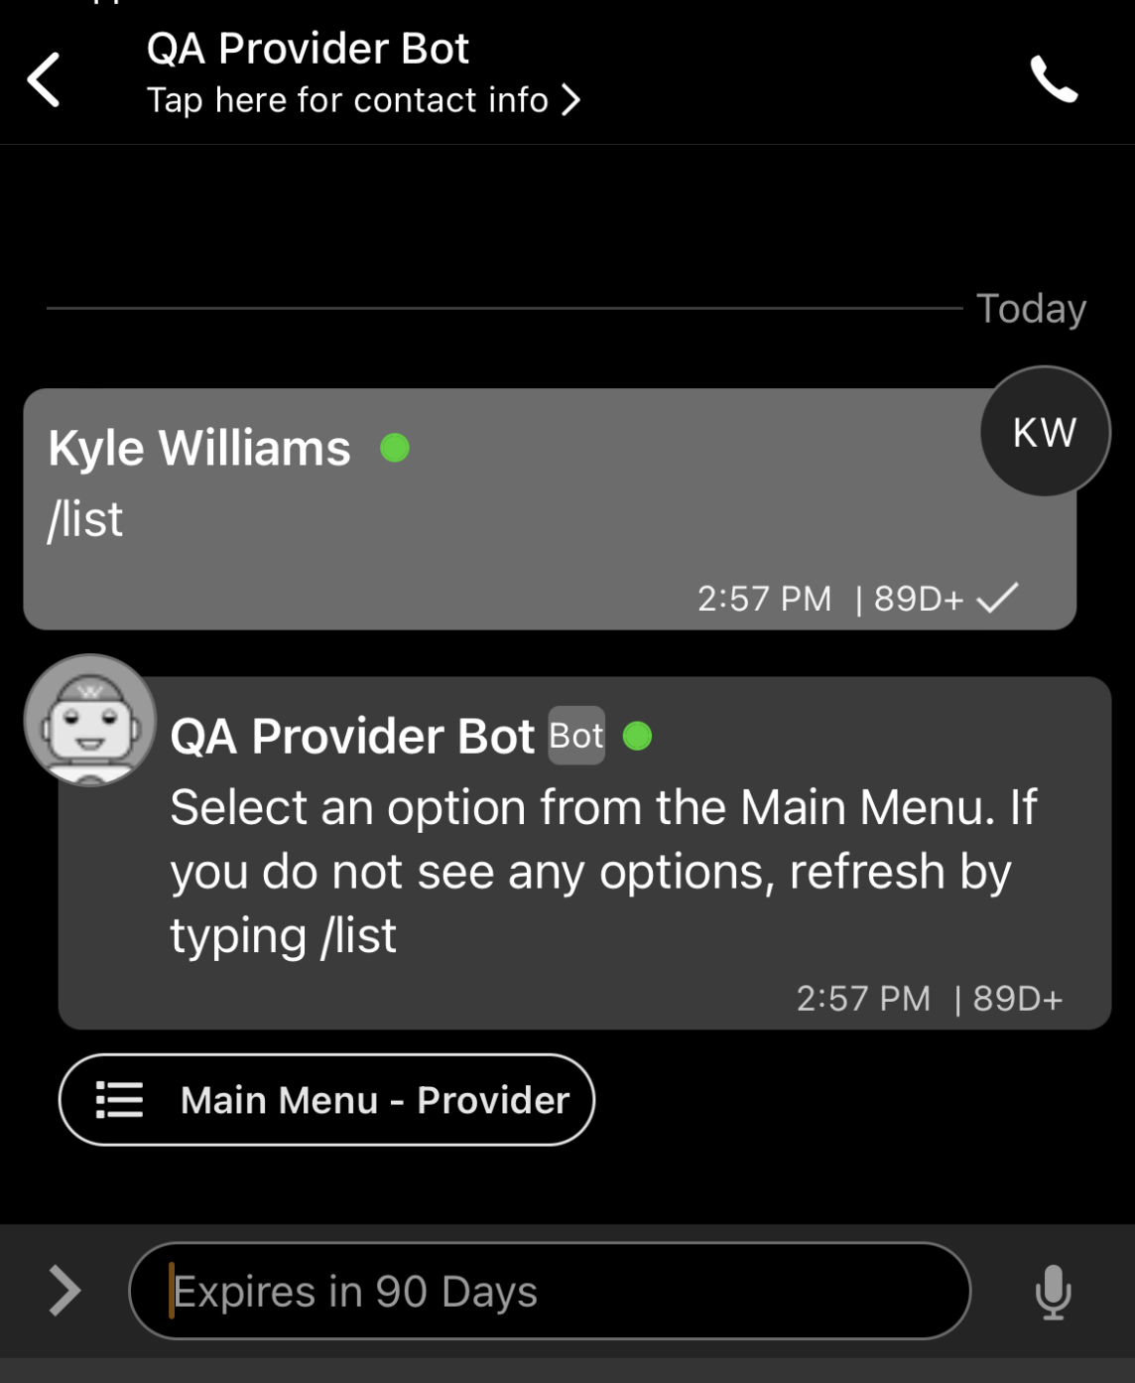
Quick Reference Guide – Getting Started
Search for AWS Wickr from the App Store or Google Play Store
To get started your unit will provide you with instructions on login credentials
To create a direct message with the QA Provider Bot select the create new message icon and begin to type “QA Provider Bot”. The field will auto complete
Type “/list” to access the main menu
1
Download AWS Wickr from the App Store or Google Play Store
2
3
Sign in with your provided login credentials.
Create a Direct Message with your site’s Provider Bot to access the Main Menu

Slide 4
Quick Reference Guide – Getting Started
1
2
Download AWS Wickr from the App Store or Google Play Store
Sign in with your provided login credentials.
3
Create a Direct Message with your site’s Provider Bot to access the Main Menu

Slide 5
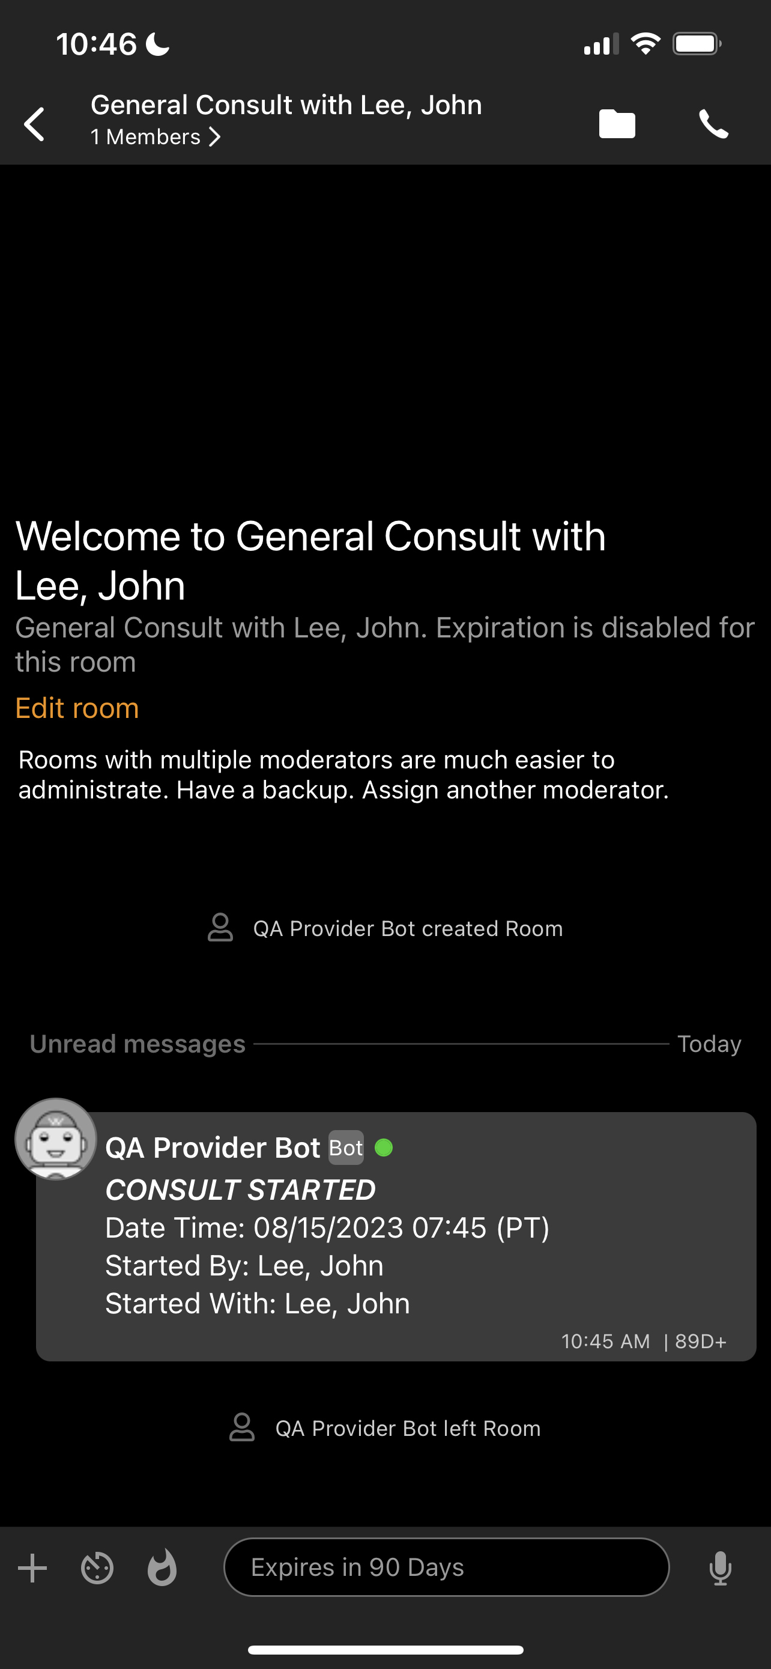
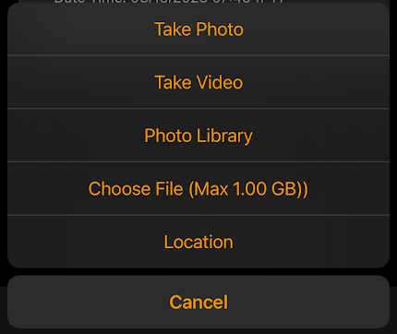
Quick Reference Guide – Mobile Telehealth Consultations
Consults can be started from the patient tab or from the main menu
First select a specialty, then an on duty provider to begin your consult
To start a video or audio call press the phone icon
Type a message or hold the microphone icon to record a voice memo
Press the “+” to take a photo, video, add a photo, add a file, or share location

Slide 6
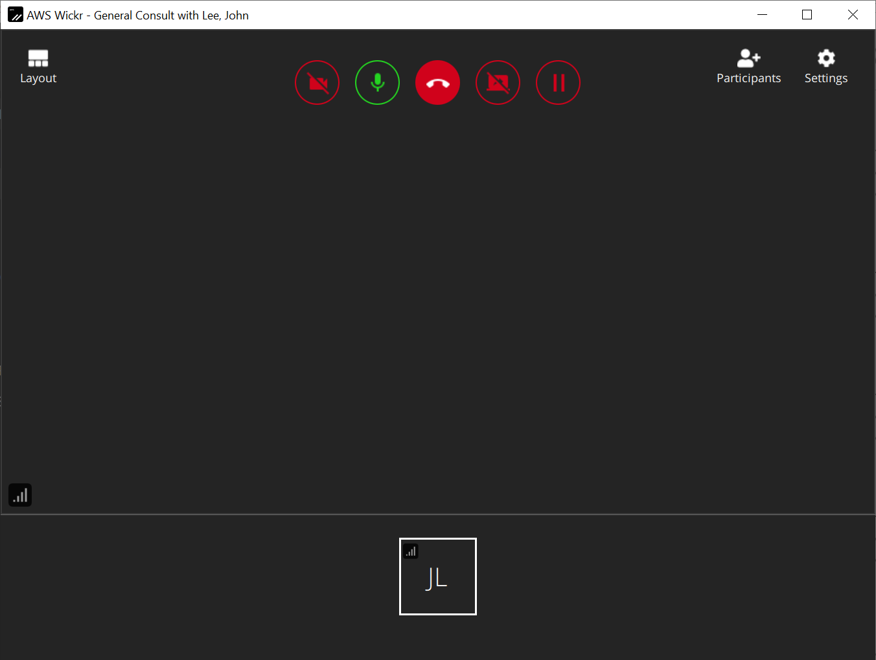
Quick Reference Guide – Desktop Telehealth Consultations
The consults will be listed under “Rooms” on the left side of AWS Wickr
Just like the mobile application, consults initiated from within the patient record will be patient specific, general consults from the main menu will not
To enable/disable camera and microphone, share screen, pause call, or end meeting use the buttons on the top row
Other Providers
You
Telehealth consultations can contain up to 100 participants in meeting mode and 500 attendees in view only presenter mode.
Participants can be added, removed, or muted from the participants button
Camera, speakers, and microphone, settings can be controlled from the settings button

