Slide 1
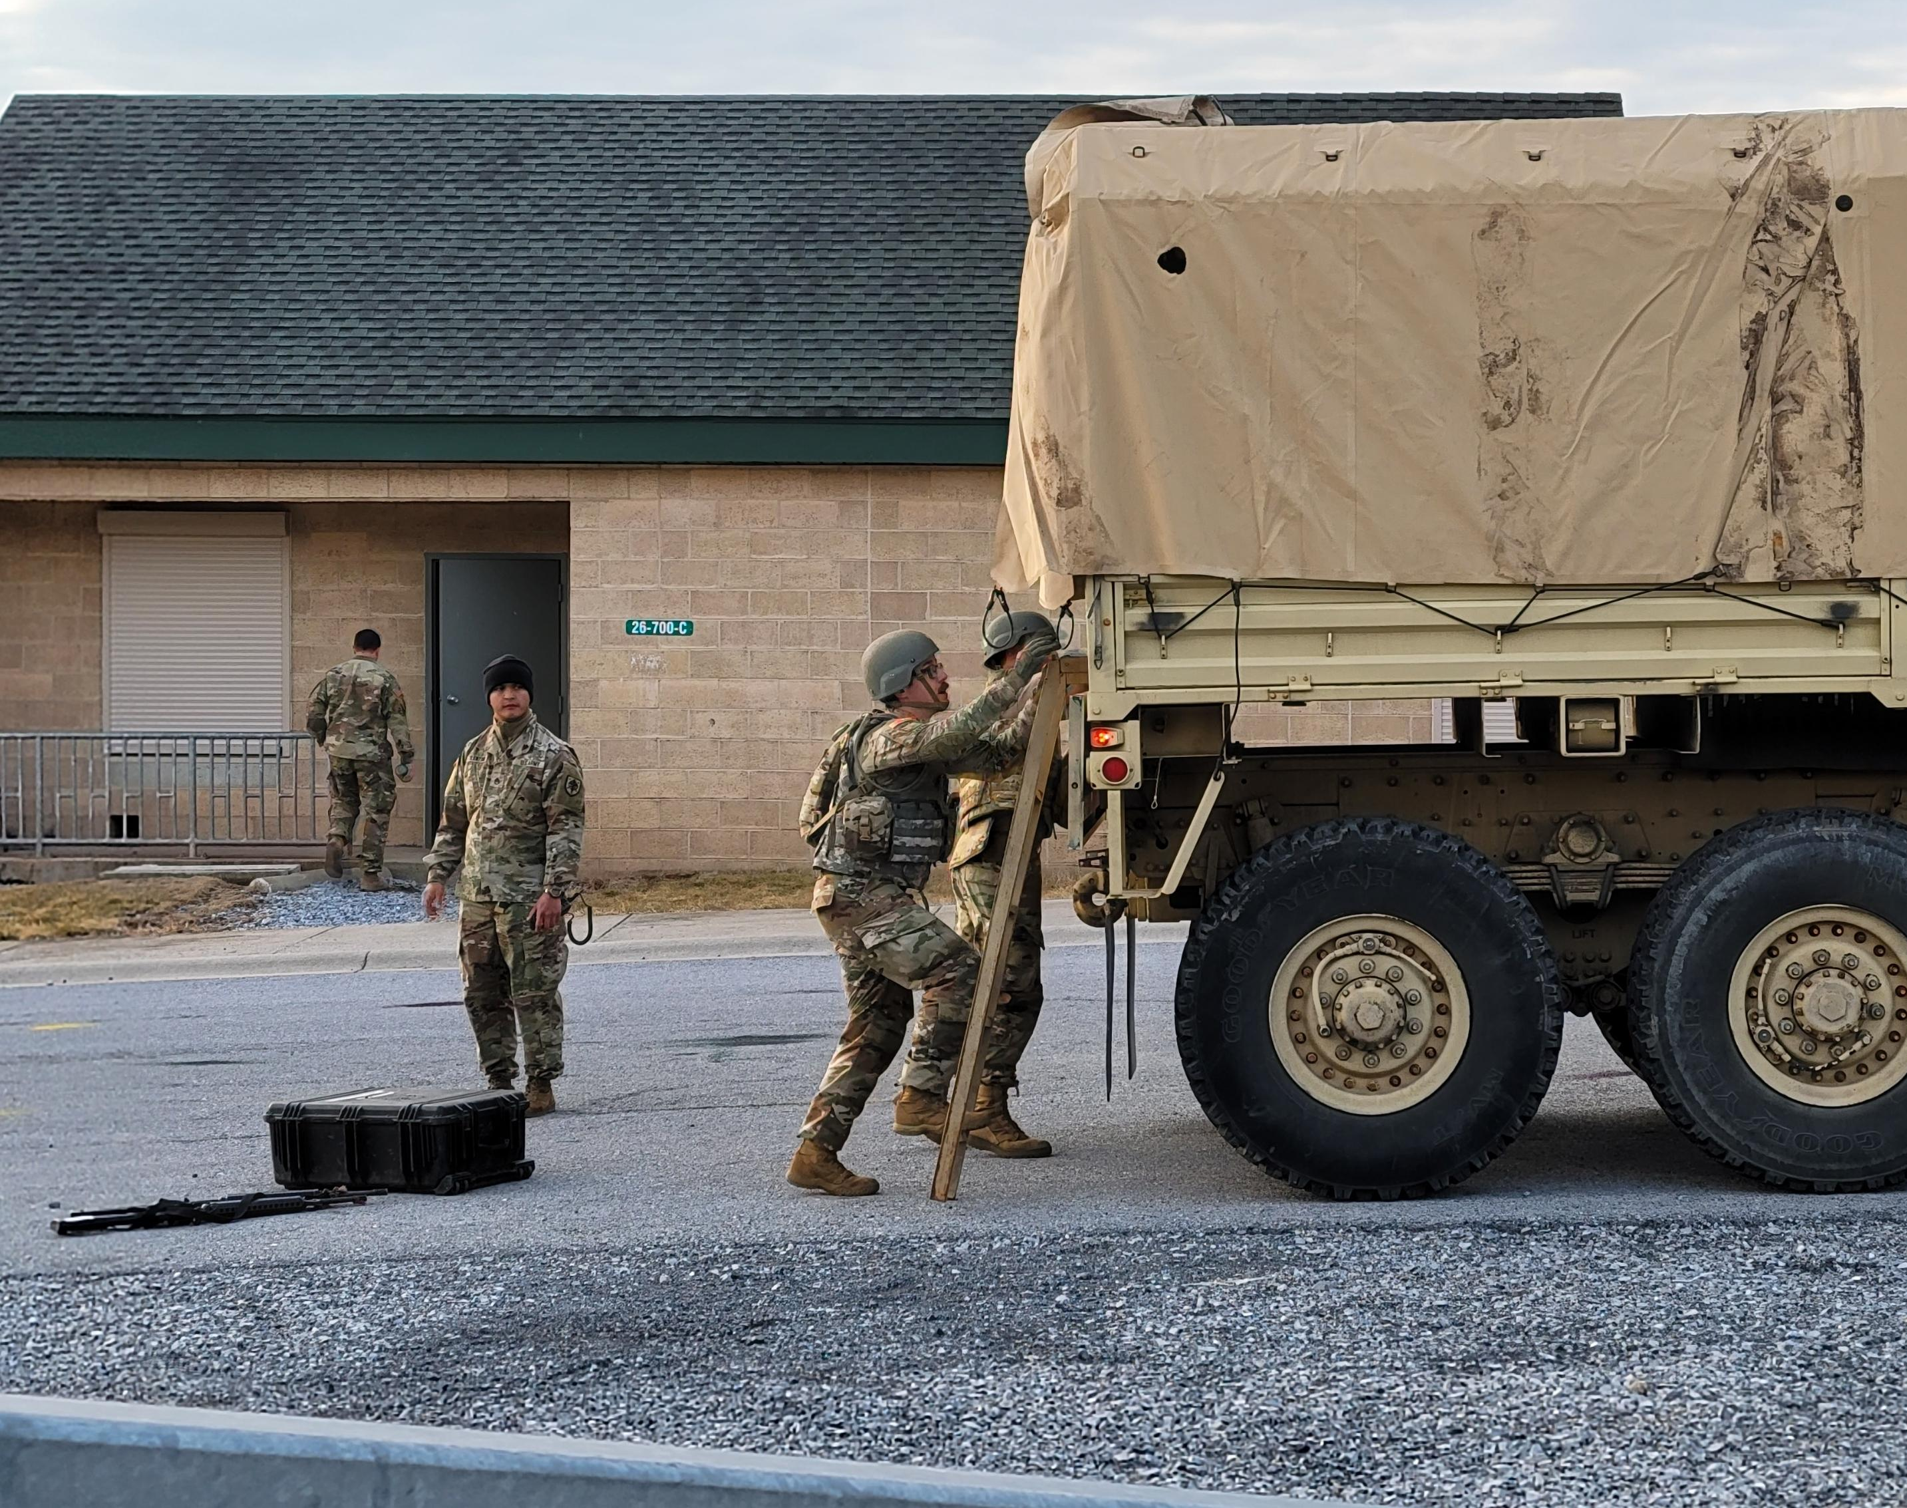

Slide 2
Welcome to the METCC-P Pilot
Please use the following links to help you get started:

Slide 3

Welcome to the METCC-P Pilot
Please use the following links to help you get started:

