Slide 1


METCC-P QuickStart Guide
Admin and Provider Bots
October 2023

Slide 2


Wickr RAM for Mobile Devices
Download app, sign in, and message the bot
Step One: Download/install Wickr Enterprise (RAM)
Download Wickr Enterprise from your app store (icons below)
Once downloaded, DO NOT Open the Wickr Enterprise App at this time
Step Two: Configure Wickr RAM via Deeplink
This step will auto configure your device to point to the Wickr RAM environment
To begin Configuration, Click this link: DEEPLINK
After browser window opens
select Always allow
click “Open Wickr Enterprise”
WARNING: DO NOT CLICK CONFIGURE YOUR ACCOUNT.
The DEEPLINK may take a moment to begin the configuration process of your account
Wickr RAM User Acceptance Agreement window
Click OK or Agree & Continue
Login window opens
Sign in with your primary government email
Default password is your EDIPI (DOD ID) with R@m at the end (e.g., 1234567890R@m)
You will be prompted to change your password at first login
If you receive "Invalid Username or Password", contact the Service Desk at 1-833-457-0457
Step Three: Saving Master Recovery Key
Click SAVE when prompted for Master Recovery Key and KEEP IT SAFE
If you cannot save the document onto your device, take a screenshot
This key MUST be retained:
If you do not have access to your device’s camera functions, or in a location where mobile devices are not authorized, you will need the MRK to register your additional device(s)
NOTE: If you have access to your device’s camera functions, you will be able to add other devices using the QR Code and camera to and sync content. In this case the MRK is not required
Click the check box agreeing you have saved the Recovery Key
Click NEXT once saved
Success! You can now begin securely messaging Wickr RAM users/contacts

Slide 3
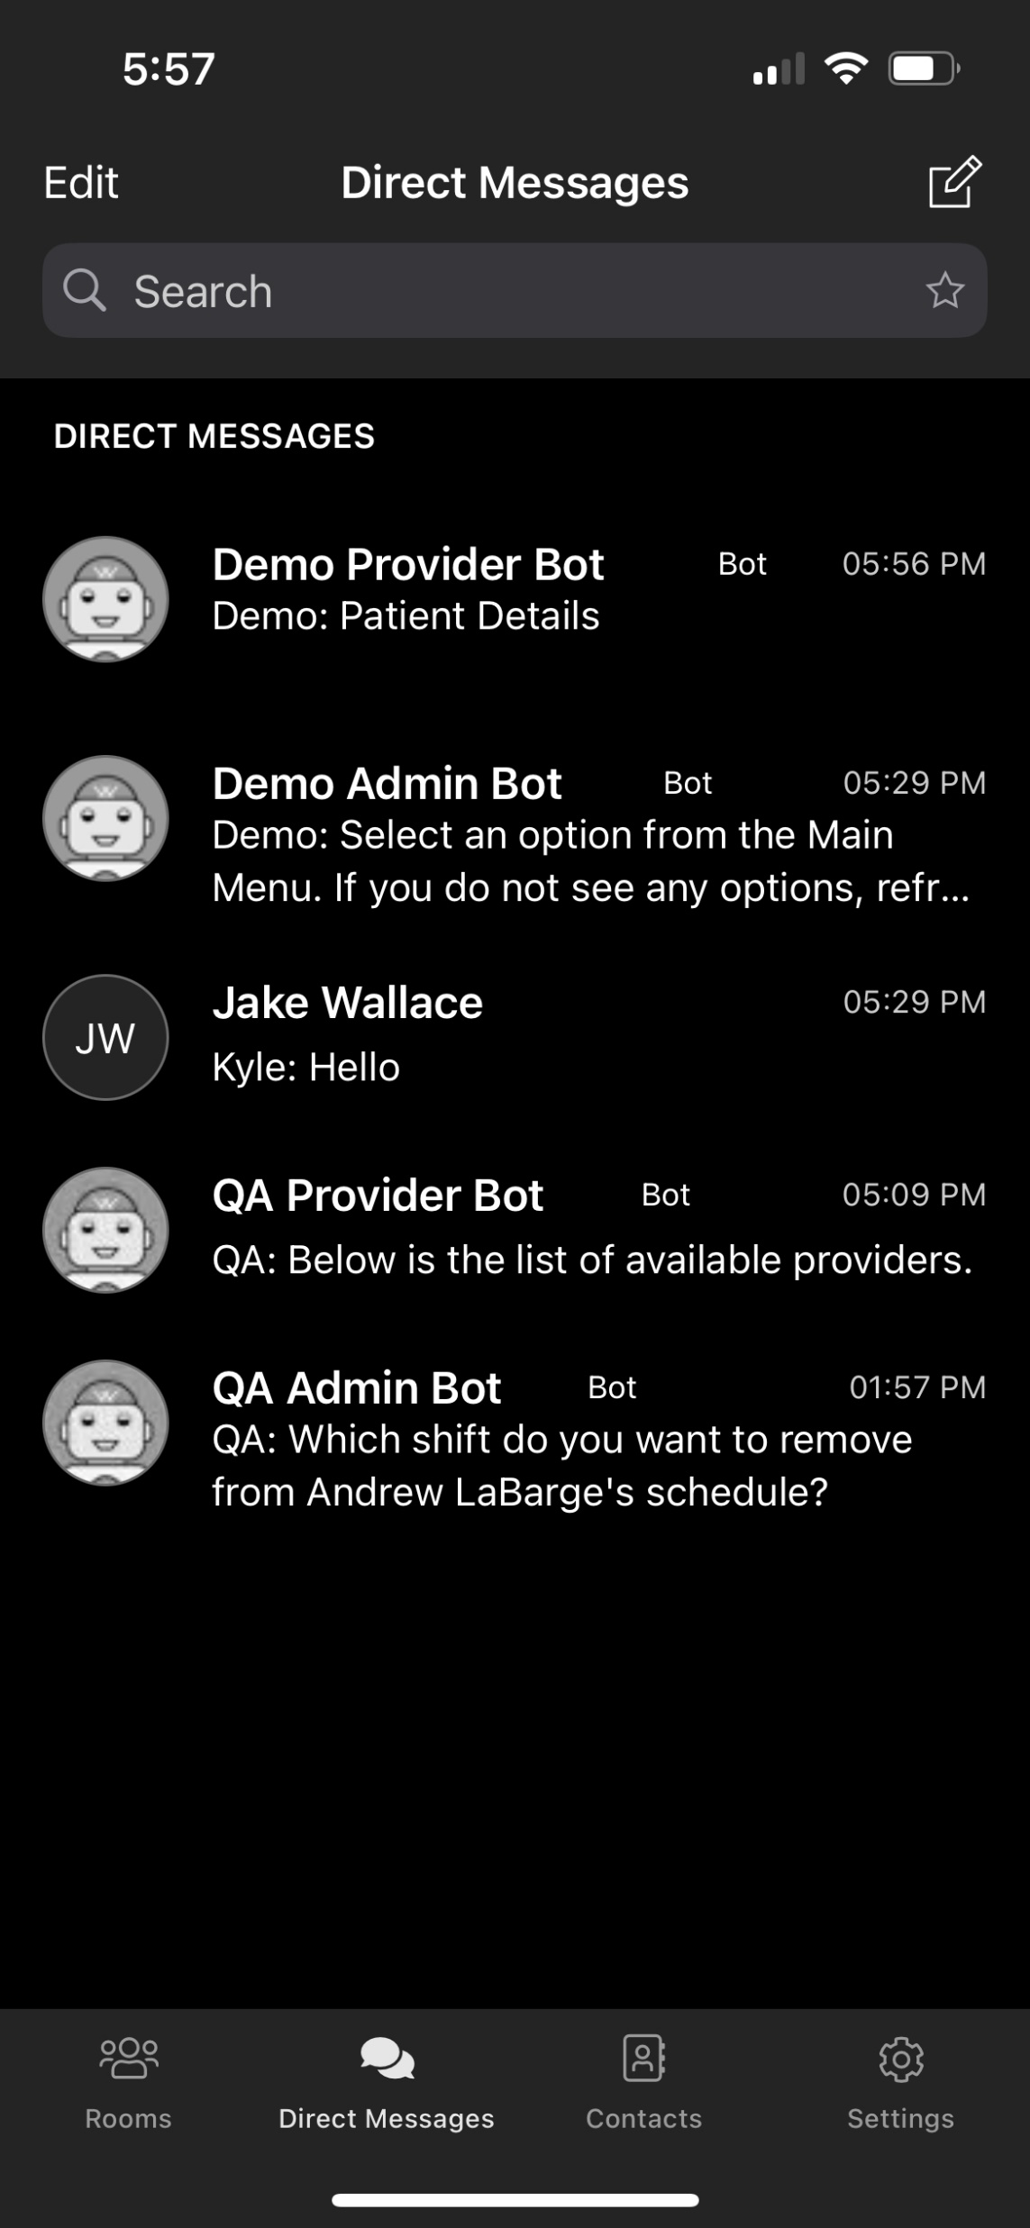
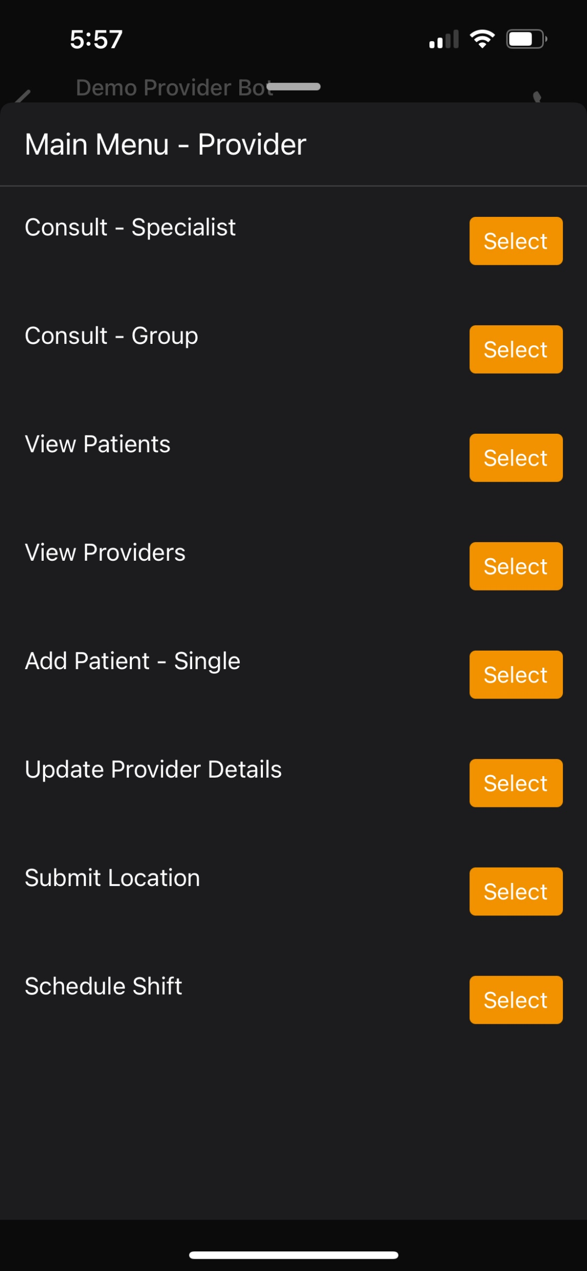
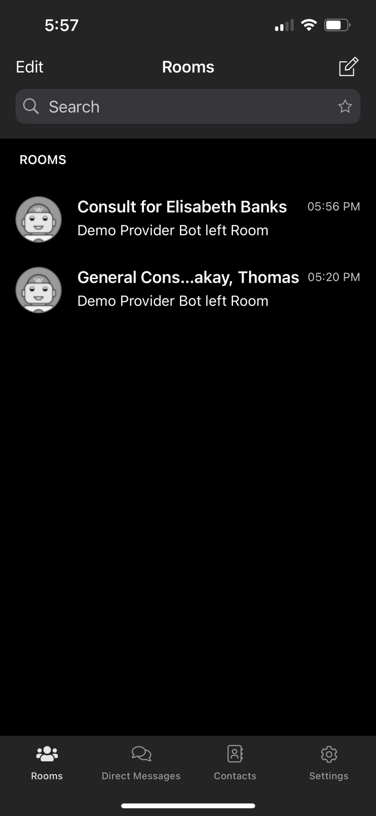
METCC-P Mobile Interface
Navigation Overview
Reminder to type /list to activate the bot and display the Main Menu
Provider Bot Main Menu
Utilize the following bot workflows:
Create Specialist Consult
Create Group Consult
Search Patient List
Document Patient Care
Initiate Patient Consult
Search Provider List
Add a new patient
Update your own details
Submit your location
Schedule current or future shift
Access Bots in Direct Messages
View direct messages that you previously sent to bots or other users (It is recommended that you PIN Bot communications for quick access)
Access Consults in Rooms
Consults initiated by yourself or others, will be shown in the Rooms tab

Slide 4
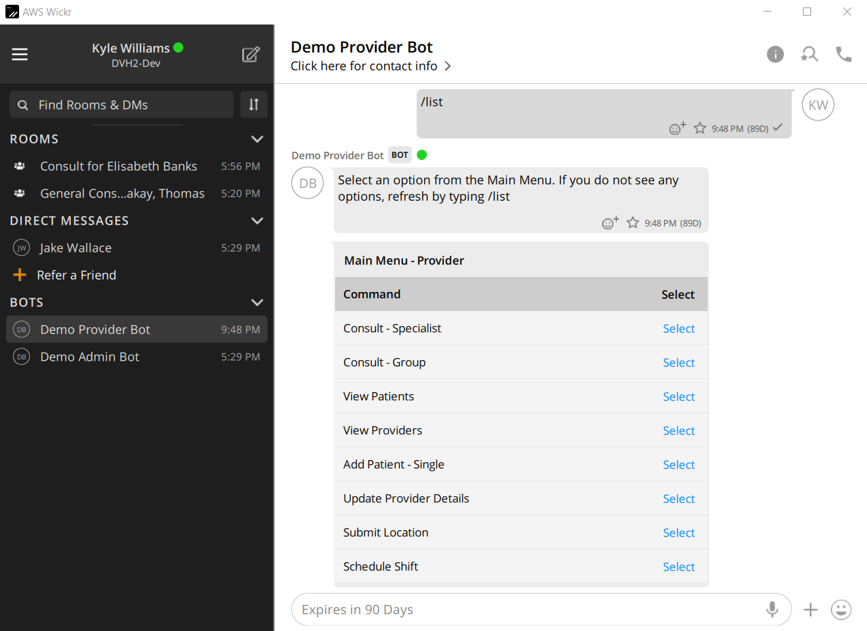
METCC-P Desktop Interface
Download and Navigation Overview
Access Consults in Rooms
Consults initiated by yourself or others, will be shown in the Rooms tab
Reminder to type /list to activate the bot and display the Main Menu
Desktop Instructions
Use this link to download Wickr Enterprise for Desktop. Login and initial bot activation steps are identical to mobile.
Demo Provider Bot Main Menu
Utilize the following bot workflows:
Create Specialist Consult
Create Group Consult
Search Patient List
Document Patient Care
Initiate Patient Consult
Search Provider List
Add a new patient
Update your own details
Submit your location
Schedule current or future shift
Access Direct Messages
View messages that you previously sent to other users
Access Bots
Desktop includes a dedicated Bots section in the left-hand navigation
(It is recommended that you PIN Bot communications for quick access)

