Slide 1

REVIEW-II
DocuMind AI: Grounded Multimodal Intelligence for Enterprise Documents
KUMAR METLA
Reg. No: 2300031747
Under the Guidance
of
Guide Name
Designation
Department of Computer Science & Engineering
KONERU LAKSHMAIAH EDUCATION FOUNDATION
Notes:
Introduce the team and guide. DocuMind AI turns scanned and digital enterprise documents into structured, searchable, verifiable knowledge, and answers questions only from evidence it can cite.

Slide 2
OUTLINE
Introduction
Problem Statement & Objectives
Functional & Non-Functional Requirements
Requirement Traceability / Acceptance Criteria
1
2
3
Alternative Solutions & Trade-off Analysis
Complete System Architecture
Architecture Diagram · Technology Stack · Design Rationale
Detailed Design & Data Flow
4
5
6
Implementation & Unit-Level Progress
Testing & Results
Conclusion & Future Scope
7
8
9
Notes:
Nine sections, following the Review-II template order.

Slide 3
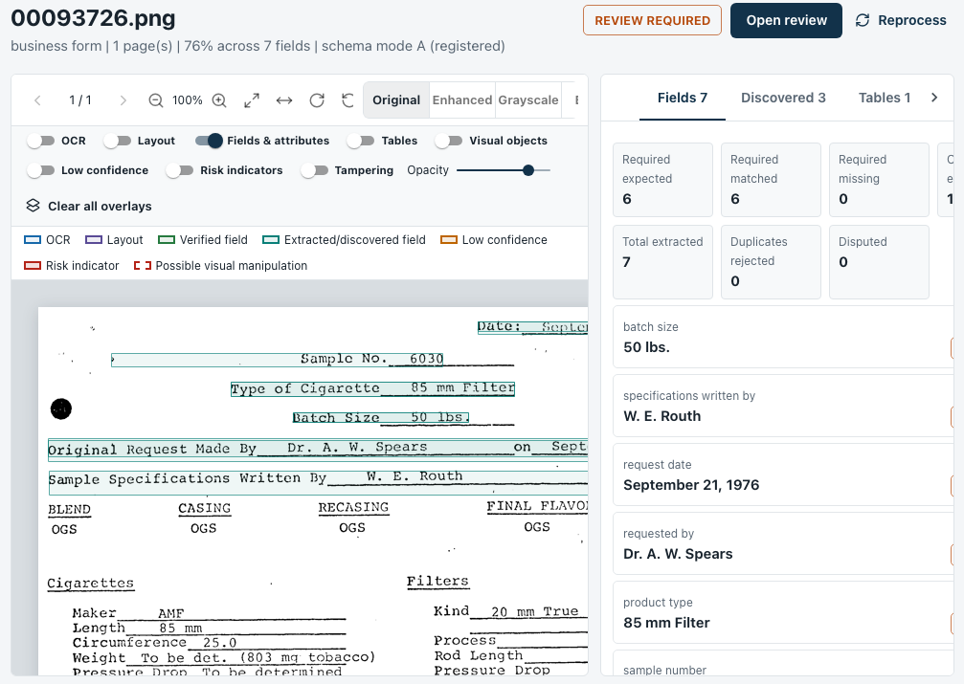
INTRODUCTION
Enterprises run on invoices, POs, contracts and forms — often scanned
DocuMind AI turns them into structured, searchable, verifiable data
Reads every page with OCR + layout analysis
Extracts fields with page, box and confidence
Links documents in a knowledge graph
Answers questions only with cited evidence — and says “not found” otherwise
Routes uncertain results to human reviewers
Live system: a 1976 scanned form — 6 / 6 required fields extracted, each linked to its source box
Notes:
Screenshot is from the running application, not a mock-up. Toggle overlays show OCR boxes, layout regions and verified/low-confidence fields.

Slide 4
PROBLEM STATEMENT & OBJECTIVES
The Problem
O1
Multimodal extraction with provenance
OCR, layout, tables & fields — each with page, box, confidence
Evidence is scattered across many related documents
OCR-only tools lose layout — which value belongs to which label?
Document chatbots answer confidently without evidence
No page, box or confidence → results cannot be audited
Hybrid semantic + graph retrieval
BGE-M3 vectors in Qdrant + cross-document links in Neo4j
O2
Grounded answers that can abstain
Every claim cited; “not found” instead of a guess
O3
O4
Secure, reviewable, measurable platform
RBAC, tenant isolation, human review, audit, evaluation
Notes:
Four objectives, as the template allows. Each is traced to evidence on the traceability and testing slides.

Slide 5
FUNCTIONAL & NON-FUNCTIONAL REQUIREMENTS
Functional Requirements
Non-Functional Requirements
FR1
Upload PDF, PNG, JPG, TIFF, TXT with tracked processing states
NFR1
Security — JWT, Argon2 hashing, 3-role RBAC
FR2
OCR, layout, tables & fields — with page, box, confidence
NFR2
Tenant isolation in PostgreSQL, Qdrant & Neo4j
FR3
Hybrid search and Q&A with citations
NFR3
Traceability — provenance on every field & answer
FR4
Cross-document knowledge graph
NFR4
Honesty — model status from live smoke tests
FR5
Risk indicators + review: accept / reject / escalate
NFR5
Performance — async ingestion; answer p95 ≈ 108 ms
FR6
Reports, analytics, audit history, live model status
NFR6
Deployable — Docker Compose + health checks
Notes:
Requirements are scoped to what is implemented and verified. Aspirational SRS items (multi-agent orchestration, SSO) are listed under future scope.

Slide 6
FUNCTIONAL & NON-FUNCTIONAL REQUIREMENTS
Requirement Traceability / Acceptance Criteria
Req. | Acceptance criterion | Measured evidence | Result
FR1 | Unseen document from a new tenant is processed | Status REVIEW_REQUIRED, text read | PASS
FR2 | ≥ 4 fields found with no schema supplied | 8 fields (invoice no., date, total…) | PASS
FR3 | Question on doc A cites A; on doc B cites B, not A | cites_A = False on B's question | PASS
FR3 | Off-corpus question → not_found, 0 citations | 3 / 3 abstained · 0 overclaims | PASS
FR4 | Vendor question answered via graph path | neo4j-evidence-path-v1 · 4 paths | PASS
FR5 | Low-confidence documents routed to review | 2 documents REVIEW_REQUIRED | PASS
NFR2 | Anonymous → 401, cross-tenant → 404 | 32 adversarial tests refused | PASS
NFR3 | Reprocess stable; deleted doc never cited | Graph 20 / 22 before & after | PASS
Notes:
Every row maps to a saved command transcript in docs/audit/artifacts/release (phase33-live-sequence.txt, evaluation-phase4.json) and to automated tests.

Slide 7
ALTERNATIVE SOLUTIONS & TRADE-OFF ANALYSIS
Key design decisions and the trade-offs accepted
Decision | Alternatives | Chosen | Trade-off accepted
OCR engine | Cloud OCR API · Donut (OCR-free) | Tesseract 5.5.3 (pinned) + PP-OCRv5 | Offline, reproducible; weaker on handwriting
Embeddings | TF-IDF · feature hashing | BGE-M3 (1024-d dense + sparse) | Paraphrase match 0.71 vs 0.09; larger model
Vector store | FAISS · Chroma · pgvector | Qdrant 1.18 | Payload filters enforce tenant scope; +1 service
Relationships | Vector-only RAG | Vector RAG + Neo4j GraphRAG | Answers “which docs relate?”; needs an ontology
Answer generator | Qwen 9B local · hosted LLM | Grounded template generator | No hallucination, no data egress; less fluent
Field extraction | Fine-tuned LayoutLMv3 | Schema rules + generic discovery | Works without labels; LayoutLMv3 awaits data
Notes:
Measured, not assumed: BGE-M3 scored 0.707 for a rent paraphrase vs 0.0925 under feature hashing (bge-m3-activation.txt). Qwen 9B is blocked by the 16 GB RAM host, and the UI says so rather than faking it.

Slide 8
COMPLETE SYSTEM ARCHITECTURE
Architecture Diagram
Presentation
React 18 analyst console
Upload · Documents · Review · Ask · Graph · Analytics · Reports · Model Lab · Audit
API
FastAPI gateway
JWT auth · RBAC · tenant scope · rate limiting · request-ID logs · health / readiness
Services
Document pipeline
ingest · OCR · layout · fields
Retrieval & GraphRAG
router · hybrid · graph paths
Grounding
fenced prompt · citation check
Governance
review · risk · reports · audit
Model registry
live smoke tests → status
Data
PostgreSQL 16
metadata · lineage · audit
Qdrant 1.18
evidence vectors
Neo4j 5.22
knowledge graph
Redis 7 + Celery
async job queue
File store
originals · page images
Notes:
Four layers. The model registry is shown separately because every status badge in the UI is computed from it. Seven containers run in Docker Compose: backend, worker, frontend, PostgreSQL, Redis, Qdrant, Neo4j.

Slide 9
COMPLETE SYSTEM ARCHITECTURE
Technology Stack
Frontend
Backend
Document AI
React 18 · TypeScript · Vite 7 · MUI 6 · TanStack Query · Cytoscape.js · Recharts · react-pdf
Python 3.13 · FastAPI · Pydantic · SQLAlchemy 2 (async) · Celery · PyJWT · Argon2
Tesseract 5.5.3 · PP-OCRv5 · PP-StructureV3 · OpenCV · PyMuPDF · Isolation Forest
Retrieval & Reasoning
Data Stores
DevOps & QA
BGE-M3 · BGE reranker v2-m3 · Qdrant · Neo4j Cypher · grounded generator
PostgreSQL 16 (migrations 001–004) · Qdrant 1.18 · Neo4j 5.22 · Redis 7
Docker Compose · Kubernetes · GitHub Actions · pytest · Vitest · Playwright · ruff · ESLint
Notes:
All components are open source and run locally — no document leaves the machine.

Slide 10
COMPLETE SYSTEM ARCHITECTURE
Design Rationale
Evidence before answer
Generator sees only retrieved evidence; every claim needs a citation
Abstain, don’t guess
Coverage verdict: full / partial / insufficient drives the answer status
1
2
Honest model status
ACTIVE only after install, load, inference & schema checks pass
Isolation at every store
Tenant filter in SQL, Qdrant payloads and Neo4j queries
3
4
Cheapest correct path first
Structured fields → hybrid vectors → graph paths
Documents are untrusted
Text fenced with a per-request nonce — cannot override instructions
5
6
Notes:
Each principle exists because the audit found a concrete failure without it — see the defects slide in Testing & Results.

Slide 11
DETAILED DESIGN & DATA FLOW
Ingestion pipeline — every stage keeps provenance
1
2
3
4
Upload & validate
type, size, SHA-256, tenant
Quality routing
digital → parser · scan → OCR
OCR consensus
Tesseract / PP-OCRv5 variants
Layout & tables
regions, reading order, cells
8
7
6
5
Graph projection
evidence-backed edges → Neo4j
Embed & index
BGE-M3 → Qdrant (tenant)
Page-aware chunks
fields, tables, OCR lines
Field extraction
schema + generic discovery
Persisted status: UPLOADED → QUEUED → PREPROCESSING → OCR_COMPLETED → EXTRACTION_COMPLETED → VALIDATION_COMPLETED → INDEXED → REVIEW_REQUIRED / APPROVED
Notes:
Upload success is not processing success: each state is persisted in PostgreSQL and shown in the UI. Low OCR confidence routes to REVIEW_REQUIRED instead of silently becoming a trusted value.

Slide 12
DETAILED DESIGN & DATA FLOW
Question answering — GraphRAG with grounding and abstention
Question
scope: all / selected docs
Query router
intent · requested fields · entities
Graph ontology (examples)
Invoice
ISSUED_BY
Vendor
Invoice
REFERENCES
Purchase Order
Structured fields
PostgreSQL
Hybrid vectors
Qdrant + BGE-M3
Graph paths
Neo4j Cypher
Document
REQUESTED_BY
Person
Document
HAS_ATTRIBUTE
Attribute
Evidence ranking + coverage verdict
full → supported · partial → partially_supported · none → not_found
Document
DUPLICATE_OF
Document
Grounded generator
nonce-fenced evidence
Citation validator
answer + citations + trace
Every edge stores evidence text, page, confidence, method and status (verified / proposed)
Notes:
A fresh retrieval plan per question. The cheapest correct handler answers first; the graph serves relationship questions such as 'which documents relate to this vendor'. Relationship names reaching Cypher are validated against a strict pattern — user text is never interpolated.

Slide 13
IMPLEMENTATION & UNIT-LEVEL PROGRESS
Unit | What is implemented | Status
Auth & tenancy | JWT sessions, Argon2 passwords, 3 roles, tenant-scoped data | Done
Ingestion & OCR | 5 formats, multi-page; Tesseract + PP-OCRv5 consensus, word boxes | Done
Layout & tables | Geometry tables, PP-StructureV3 regions, uncertainty flags | Done
Field extraction | Schema extractor v3 + generic discovery; type-checked labels | Done
Vector retrieval | BGE-M3 1024-d + reranker; Qdrant collection per model & dimension | Done
Knowledge graph | Neo4j evidence graph, entity resolution, idempotent rebuilds | Done
Grounded Q&A | Router, coverage verdict, fenced prompt, citation validation | Done
Review, risk, reports | Review queue, ELA forensics, Isolation Forest, PDF reports, audit | Done
Heavy models | LayoutLMv3 · Donut · YOLO (no labels) · Qwen 9B (16 GB RAM) | Blocked — disclosed
Notes:
Blocked models are shown as BLOCKED in the Model Laboratory with the exact reason and activation steps. The core pipeline runs fully without them.

Slide 14
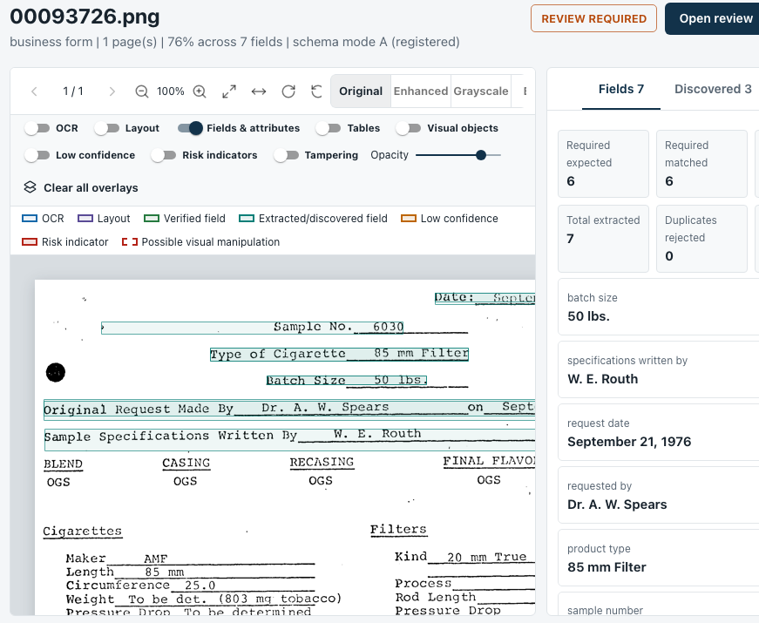
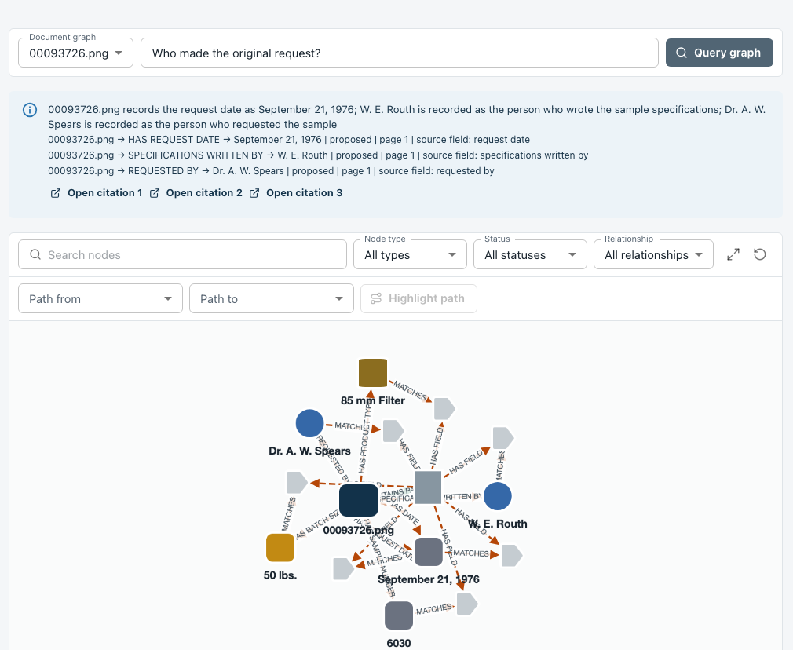
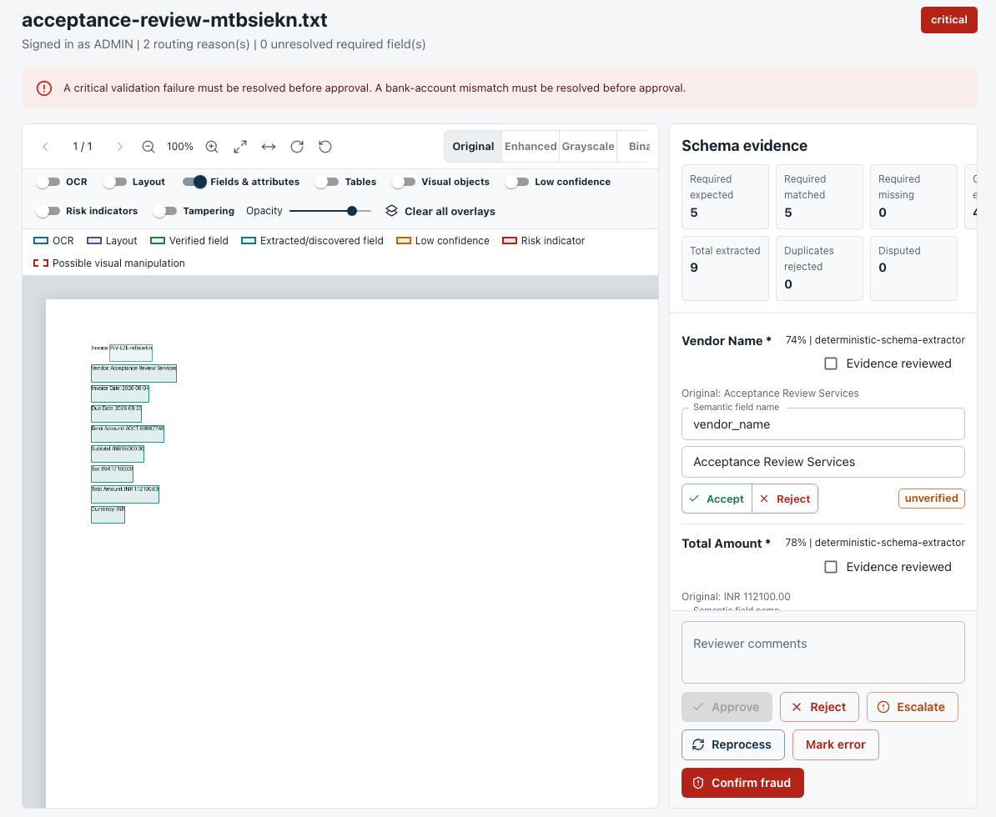
IMPLEMENTATION & UNIT-LEVEL PROGRESS
Working modules — screenshots from the running system
Document viewer
OCR / field overlays from backend boxes
Knowledge graph
“Who made the original request?” → 3 cited paths
Review workspace
Accept / reject / escalate — persisted & audited
Notes:
All three screens call the real API; overlay coordinates come from the backend.

Slide 15
TESTING& RESULTS
Automated tests and measured evaluation
549
55
Metric (unseen docs) | Result | n
Extraction accuracy | 100 % | 9 / 9
Answer accuracy | 100 % | 5 / 5
Citation correctness | 100 % | 5 / 5
Grounding fidelity | 100 % | 5 / 5
Abstention correctness | 100 % | 3 / 3
Overclaims | 0 | 8
Answer latency (median / p95) | 97 / 108 ms | 8
Ingest latency (median) | 1.6 s | 3 docs
backend tests passed
pytest · 2 skipped
frontend unit tests
Vitest
2 / 2
32
end-to-end journeys
Playwright
tenant-isolation attacks
all refused
Small controlled corpus (3 docs, 8 questions): 95 % CI for 5 / 5 is 56.6–100 %
Notes:
Numbers are from docs/audit/artifacts/release (backend-final3.txt, evaluation-phase4.json, playwright-2of2.txt). The evaluation reports denominators and Wilson intervals so a small sample is not presented as production accuracy.

Slide 16
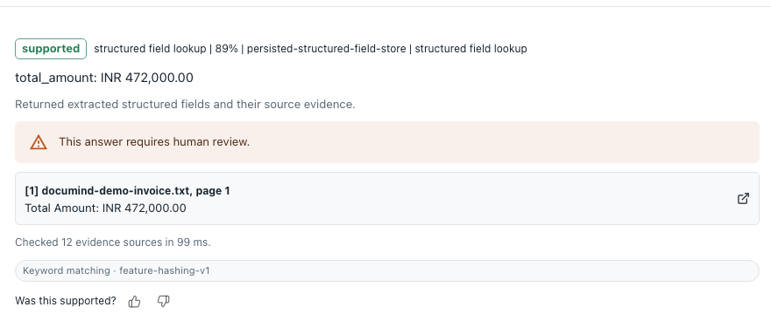
TESTING& RESULTS
Live 14-step acceptance run on unseen documents — 14 / 14 passed
✓
Upload → OCR → 8 fields found, no schema supplied
✓
45 chunks, each tagged with document, tenant, page
✓
Graph built: 20 nodes, 22 typed edges
✓
Question on A cites only A; on B cites B, never A
✓
Cross-document question uses both related docs
Grounded answer with citation
Status, retriever, confidence, cited page, evidence-source count and serving embedding model are all shown to the user.
✓
Unrelated documents stay unrelated
✓
Unsupported question → not_found, 0 citations
✓
Anonymous → 401 · other tenant → 404
Off-corpus: “what is the weather in Leeds” → not_found, 0 citations — no guess
✓
Reprocess idempotent · deleted doc never cited
Notes:
Transcript: docs/audit/artifacts/release/phase33-live-sequence.txt, run against the full Docker stack (7/7 services healthy).

Slide 17
TESTING& RESULTS
Adversarial audit — 37 defects found and closed; key examples
Defect found by testing | Root cause | Fix
Same “base-case” answer to unrelated questions | One shared word counted as evidence | Coverage verdict: full / partial / none
“Share price” question marked supported | Matched only on invoice_date | Corpus-grounded check → partial
Qdrant shown ACTIVE while down | Status read from config, not server | Live probe + recovery circuit
Blank pages flagged as duplicates | Perceptual hash meaningless when empty | Hash rejected; SHA-256 kept
Prompt-injection channel | Document text mixed into instructions | Nonce-fenced evidence; 14 tests
Graph reachable only for demo fields | Hard-coded relation allowlist | Relations derived from corpus
Notes:
From docs/audit/AUDIT_2026.md: D-22, D-23, D-01/D-03, D-29, D-30, D-21/D-35. Each fix is pinned by regression tests so the bug cannot silently return.

Slide 18
CONCLUSION& FUTURE SCOPE
Conclusion
Future Scope
End-to-end platform: upload → OCR → fields → vectors + graph → cited answer
Abstains when unsupported; model status computed, not claimed
Fine-tune LayoutLMv3 / Donut on a labelled corpus
GPU-hosted local LLM (Qwen) behind the same grounding checks
Larger DocVQA / DUDE-style benchmark for tighter confidence intervals
Handwriting & multilingual OCR evaluation
Graph-based fraud-network analytics; SSO (OIDC)
Objectives met
✓
O1 9 / 9 fields extracted correctly
✓
O2 BGE-M3, Qdrant & Neo4j verified live
✓
O3 5 / 5 answers cited · 3 / 3 abstained
✓
O4 32 / 32 isolation attacks refused
Notes:
Limitations stated plainly: heavy models need labels, checkpoints or GPU memory we did not have; evaluation corpus is small and controlled.

Slide 19
THANK YOU

