Slide 1


OpenMRS: htmlforms
Ellen Ball
eball@pih.org
September 14, 2010

Slide 2
Preface
The htmlform implementers training class was offered on September 14th and 15th, 2010 in Cape Town, South Africa to Millennium Villages project employees. This was part of a 3 day OpenMRS implementer training organized by Andrew Kanter.
The presentation is meant for students with some knowledge of OpenMRS basics and concepts. It could be done with or without the labs. The full training could take 1 full day, especially if the students do many of the lab exercises. A shorter training could encompass the basic html and htmlform sections only.
Ellen Ball
Partners In Health
Boston, Massachusetts USA

Slide 3
Table of contents
What and why htmlforms
html
htmlform
What’s not on a form?
Testing checklist
Advanced goodies
More html and htmlform tags
Flowsheets
InfoPath converter

Slide 4
Why htmlforms?
Non-proprietary – InfoPath only runs on Windows
Integrated within OpenMRS
Runs with any web browser
Runs on Ubuntu, Mac, Windows, etc.
Easy to troubleshoot
Layout benefits of a webpage
All html tags allowed

Slide 5
Comparison with InfoPath: FormEntry module
Advantages:
Forms are entered in-the-webapp. No requirement for proprietary software on the client.
Review a form after entering it and have it look "just like you entered it“
Form submission immediately creates data (i.e. no waiting for queues to be processed.)
Disadvantages:
WYSIWYG editor not production quality, yet
Behavior is not really programmable

Slide 6
Comparison with Xform: Xforms module
Advantages:
Richer layout/design
Disadvantages:
Not for mobile devices
No WYSIWIG designer, yet

Slide 7
Basic html tags
<p>Hello world!</p>
<b>bold</b>
<i>italics</i>
<center>Hello South Africa</center>
References
http://www.w3schools.com
http://www.w3schools.com/tags/default.asp
Examples: http://www.w3schools.com/html/default.asp

Slide 8
Basic html Lab 1
Learn html
This website is a great place to see examples and try adding new tags and text:
http://www.w3schools.com/html/html_examples.asp
Assignment
Add your name
Add your country
Change your name to bold font

Slide 9
htmlform tags reference guide
All htmlform tags are documented here:
http://wiki.openmrs.org/display/docs/HTML+Form+Entry+Module+HTML+Reference

Slide 10
Basic htmlform tags
All htmlforms require the following tags:
<htmlform>
<encounterDate />
<encounterLocation />
<obs conceptId=“x" />
<encounterProvider role="Provider" />
<submit />
http://wiki.openmrs.org/display/docs/HTML+Form+Entry+Module+HTML+Reference

Slide 11
Simple htmlform Example 1
<htmlform>
<p> Date of encounter: <encounterDate /> </p>
<p> Health center: <encounterLocation /> </p>
<p>Chest xray finding: <obs conceptId="12" /> </p>
<p>Clinician's name:<encounterProvider role="Provider" /></p>
<p><submit /></p>
</htmlform>

Slide 12
Htmlform Pre-Lab 2 exercise
Prior to creating htmlform and lab 2, setup a blank form, add locations and add providers
Install htmlform module
Add new form with “Administation -> Forms -> Manage forms”
Click “Add forms”
Confirm locations (“Administation -> Locations -> Manage locations”)
Confirm providers

Slide 13
Simple htmlform Lab 2
Create htmlform
“Administration -> HTML Form Entry -> Manage HTML forms”
Click “Add”
Add name and use previously created form
Add htmlform tags
<htmlform>
<p> Date of encounter: <encounterDate /> </p>
<p> Health center: <encounterLocation /> </p>
<p>Chest xray finding: <obs conceptId="12" /> </p>
<p>Clinician:<encounterProvider role="Provider" /></p>
<p><submit /></p>
</htmlform>
5. Add html tags from previous homework (Name, country, etc.)

Slide 14

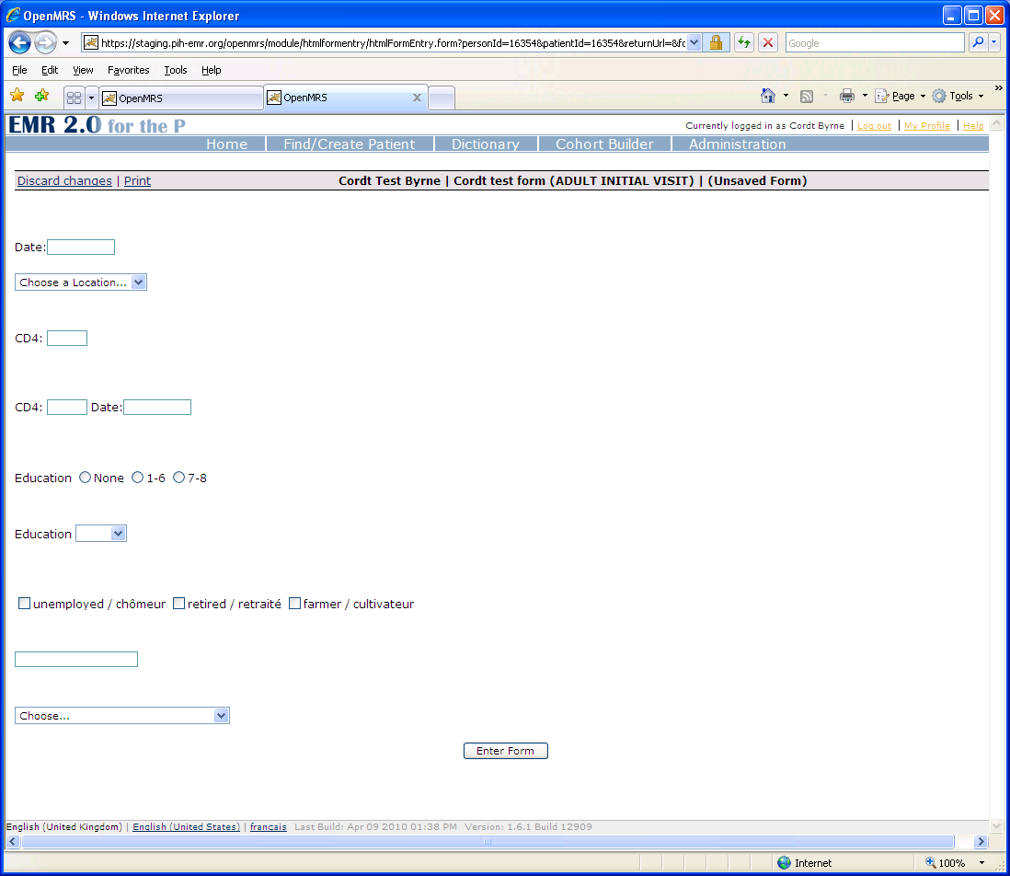
Observation (obs) tag numeric
Free text box
<obs conceptId="5497" labelText=“CD4:“ />
Free text box with observationdate
<obs conceptId="5497" labelText=“CD4:" dateLabel="Date:"/>

Slide 15
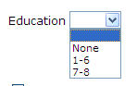
Observation (obs) tag select one
Radio buttons
<obs conceptId="123" labelText="Education" answers="0,6,8" answerLabels="None,1-6,7-8" style="radio"/>
Dropdown
<obs conceptId="123" labelText="Education" answers="0,6,8" answerLabels="None,1-6,7-8" style="dropdown"/>

Slide 16
Observation (obs) tag select one or more
Checkbox
Occupation?
<obs conceptId="1304" answerConceptId="1309" answerLabel="unemployed / chômeur" style="checkbox" />
<obs conceptId="1304" answerConceptId="2446" answerLabel="retired / retraité" style="checkbox" />
<obs conceptId="1304" answerConceptId="1306" answerLabel="farmer / cultivateur" style="checkbox" />

Slide 17
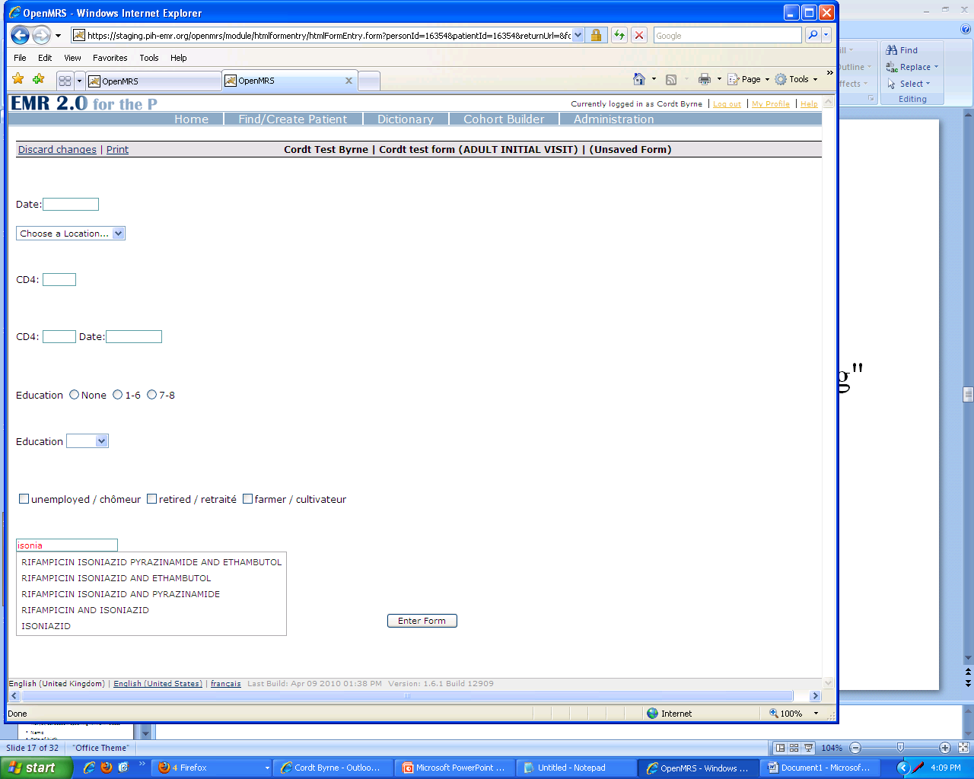
Observation (obs) tag using classes
A list of drugs can be shown using this tag:
<obs conceptId="1296" answerClasses="Drug"
style="autocomplete"/>

Slide 18
Alternatives to concept id
Concepts can be specified with concept id, concept map, or uuid.
<obs conceptId="3509" answerConceptId="2070“ style="checkbox" />
<obs conceptId="3509" answerConceptId="XYZ:HT“ style="checkbox" />
<obs conceptId="3509" answerConceptId="0cbe2ed3-cd5f-4f46-9459-26127c9265ab“ style="checkbox" />

Slide 19
What’s not entered on a form? Not yet, but added in upcoming htmlform release
Name
Date of birth
Drug order
Workflow and states
Home address
Relationships
NOTE: Ask students for others

Slide 20
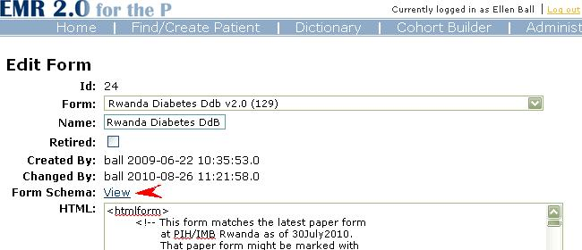
htmlform schema part 1
“View” from the “Manage htmlform forms” page

Slide 21
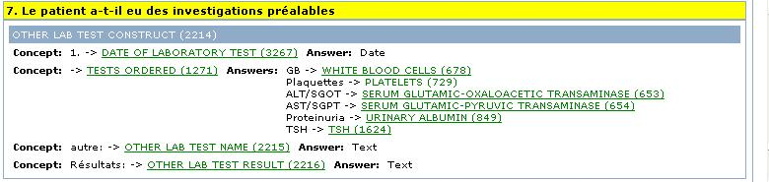
htmlform schema part 2
Useful for testing concepts

Slide 22
Guidelines for managing forms
All paper forms should have a version number and date (see PaperID) - not just in the filename or filesystem, but at the top (or bottom) of each page
Each paper form should have one "owner" or keeper. These files should be kept on the PIH wiki, Intranet, Google docs, or some other central location. They should be accessible to many.
The OpenMRS forms show the matching PaperID from the matching paper form, so it is simple to know the source of the form
Description and Version fields are available on the "Edit Metadata" page in OpenMRS. The version field should match that part of the PaperID. The PaperID should be in the description.
Think about the wrath of Ellen when you feel like using "NEW", "CURRENT", and "OLD" in the name
A copy of the latest OpenMRS forms should be stored on one OpenMRS server. Older forms should be retired.
Number the sections (paper and OpenMRS forms).
All paper forms should have page numbers (ie. 3/7 for 3rd page of 7 total).

Slide 23
Version tracking PaperID
Suggested format for the PaperID:
Intake-HIV-Adult-RW-Burera.V2.7.bho.4Feb09.fr.doc
where Intake is the kind of form HIV is a specific program ADULT is a further identifier for use RW is the country Burera is a more specific location V2.7 is the version bho is the initials of the author 28Sept10 is the date modified fr is the language

Slide 24
Checklist for implementing form
Build the htmlform from paper
Compare the paper form to the htmlform
Include PaperId on htmlform
Review form schema
Enter form with a test patient
View the entered form
Edit the entered form
Confirm program enrollment (if used)
Confirm the provider list
Confirm drugs (if used)
Test with different browsers

Slide 25
Advanced html
Header
<h1>Advanced</h1>
Style
<style>h1 {color: blue;}</style>
Images
<img src=“mvp-logo.jpg”>
Comments
<!– this is a comment -->
Tables
<table>lots of stuff</table>

Slide 26
html tag: table
Very useful…
<table>
<tr>
<td>Column 1</td>
<td>Column 2</td>
</tr>
</table>

Slide 27
html tag: table lab 4
Add one (or more) of these:
table
image
header
comment
style
Table example:
http://www.w3schools.com/html/tryit.asp?filename=tryhtml_tables

Slide 28
Advanced htmlform
<encounterProvider role=“Pediatrician” />
<enrollInProgram programId=“1” />
<excludeIf logicTest="GENDER = F"/>
<section headerLabel=“1: History”>
</section>

Slide 29
Advanced htmlform Lab 5
Create a new form (or change your previous form)
Add ALL the following items to your form:
Obs with textbox
Obs with dropdown
Obs with radio buttons
Obs using checkboxes (at least 4 choices)
Use <section> htmlform tag
Add table with at least 2 columns and 2 rows
(optional) Use <encounterProvider role=“Pediatrician” />, which will require you to create a new role “Pediatrician” on the server.
(optional) Add one image on your form

Slide 30
Advanced htmlform: obsgroup
<obsgroup groupingConceptId="1234">
<obs conceptId="1234" answerConceptId="123" answerLabel="Other"/>
<obs conceptId="987" labelText="specify:"/>
</obsgroup>

Slide 31
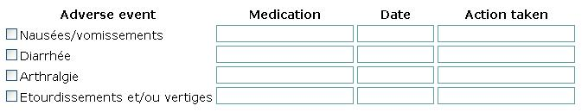
Advanced htmlform: Repeat template
<repeat>
<template>
<obsgroup groupingConceptId="1295">
<tr>
<td><obs conceptId="1297" answerConceptId="{concept}" answerLabel="{effect}" labelText=""/></td>
<td><obs conceptId="3063"/></td>
<td><obs conceptId="1300"/></td>
<td><obs conceptId="1643"/></td>
</tr>
</obsgroup>
</template>
<render concept="6355" effect="Nausées/vomissements"/>
<render concept="16" effect="Diarrhée"/>
<render concept="80" effect="Arthralgie"/>
<render concept="877" effect="Etourdissements et/ou vertiges"/>
</repeat>

Slide 32
Advanced htmlform Lab 6
Use repeat and obsgroups tags.
Create a table with lab tests where each row has the following columns:
Dropdown list of lab tests
Date of test
Textbox for additional comments
Create one row
Use repeat tag to add duplicate rows

Slide 33
Advanced htmlform: Language translation
<translations defaultLocale="en">
<code name="night_sweats">
<variant locale="en" value="night sweats"/>
<variant locale="fr" value="sueurs nocturnes"/>
</code>
</translations>
And then in the body of the form:
<obs conceptId="1234" labelCode="night_sweats"/>

Slide 34
Advanced htmlform Lookup
<lookup class="value" expression="patientIdentifiers.get(&quot;IMB ID&quot;)" />
<lookup class="value" expression="patient.personName.familyName" />
<lookup class="value" expression="patient.personName.givenName" />

Slide 35
additional “goodies”
Today
HTML Form Flowsheet Module
http://wiki.openmrs.org/display/docs/HtmlFormFlowsheet+Module
Infopath converter
beta version (September 2010)
converts InfoPath forms to HTMLform
JavaScript behavior for decision-support
http://wiki.openmrs.org/display/docs/HTML+Form+Entry+Module+Javascript
Future
htmlform wysiwyg designer
Draft designer

Slide 36
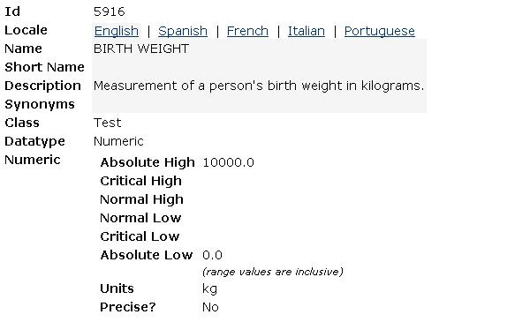
Data validation
JavaScript for decision support
Use concept dictionary ranges with datatype “numeric”

Slide 37
Resources
OpenMRS htmlform module reference
www.w3schools.com
eball@pih.org

