Slide 1
Warping
CSE 590 Computational Photography
Tamara Berg

Slide 2
Picture Time!

Slide 3
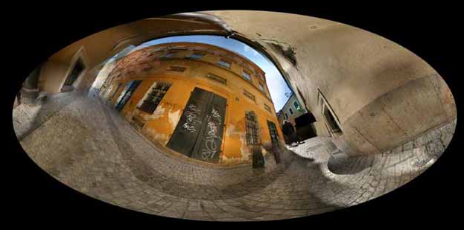
Image Warping
http://www.jeffrey-martin.com
Slides from: Alexei Efros & Steve Seitz

Slide 4

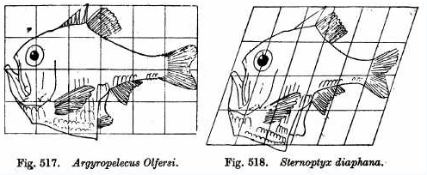
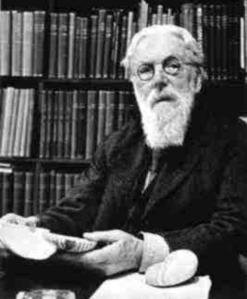
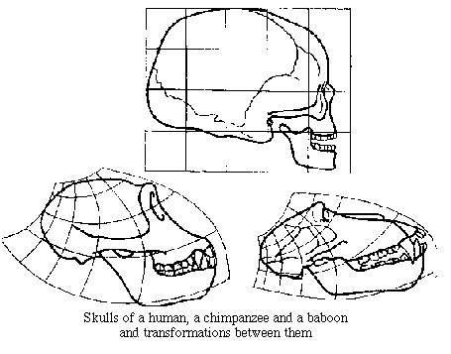
Image Warping in Biology
D'Arcy Thompson
http://www-groups.dcs.st-and.ac.uk/~history/Miscellaneous/darcy.html
http://en.wikipedia.org/wiki/D'Arcy_Thompson
Importance of shape and structure in evolution
Slide by Durand and Freeman
Notes:
He advocated structuralism as an alternative to survival of the fittest in governing the form of species.
Thompson pointed out example after example of correlations between biological forms and mechanical phenomena. He showed the similarity in the forms of jellyfish and the forms of drops of liquid falling into viscous fluid, and between the internal supporting structures in the hollow bones of birds and well-known engineering truss designs. His observations of phyllotaxis (numerical relationships between spiral structures in plants) and the Fibonacci sequence has become a textbook staple.
Perhaps the most famous part of the work is on "The Comparison of Related Forms," where Thompson explored the degree to which differences in the forms of related animals could be described by means of relatively simple mathematical transformations. The shape of chimp and human skulls are related by simple transformations.

Slide 5
Image Transformations
image filtering: change range of image
g(x) = T(f(x))
f
f
T
x
x
image warping: change domain of image
g(x) = f(T(x))
f
f
T
x
x
Notes:
A few classes ago we talked about image filtering? What’s an example of a filtering method? Filtering with a gaussian to smooth the image. This changes the range of the image ie for any image pixel we change it’s value by filtering. Image warping actually changes the domain of the image.

Slide 6
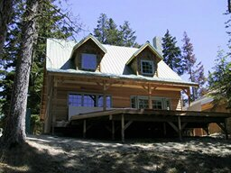
Image Transformations
image filtering: change range of image
g(x) = T(f(x))
f
g
T
image warping: change domain of image
g(x) = f(T(x))
f
g
T
Notes:
So by filtering each pixel remains, but their values might change. With warping we’re actually changing the set of pixels, x and y range over a different set of values.

Slide 7
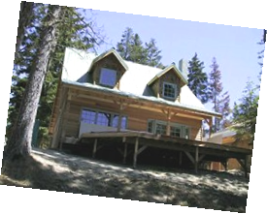
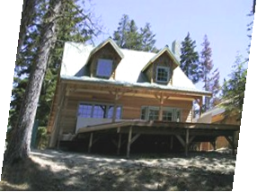
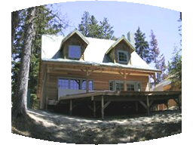
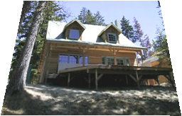
Parametric (global) warping
Examples of parametric warps:
translation
rotation
aspect
perspective
affine
cylindrical

Slide 8
Parametric (global) warping
T
p = (x,y)
p’ = (x’,y’)
Transformation T is a coordinate-changing machine:
p’ = T(p)
What does it mean that T is global?
Is the same for any point p
can be described by just a few numbers (parameters)
Let’s represent T as a matrix:
p’ = Mp

Slide 9
Scaling
Scaling a coordinate means multiplying each of its components by a scalar
Uniform scaling means this scalar is the same for all components:
× 2

Slide 10
Scaling
Non-uniform scaling: different scalars per component:
X × 2, Y × 0.5

Slide 11
Scaling
Scaling operation:
Or, in matrix form:
scaling matrix S
What’s inverse of S?
Notes:
How would you represent this in matrix form?
Inverse – what you multiply x’y’ by to get xy [1/a 0; 0 1/b]

Slide 12
2-D Rotation
(x’, y’)
(x, y)
x’ = x cos(θ) - y sin(θ)
y’ = x sin(θ) + y cos(θ)
θ
Notes:
For a 2d rotation x’ = xcostheta – ysintheta. y’ = xsintheta + ycostheta. But how do we get this?

Slide 13
2-D Rotation
(x’, y’)
(x, y)
θ
φ
Notes:
How do you represent x and y in polar coordinates?

Slide 14
2-D Rotation
x = r cos (φ)
y = r sin (φ)
x’ = r cos (φ + θ)
y’ = r sin (φ + θ)
(x’, y’)
(x, y)
θ
φ
Notes:
x = rcosphi and y = rsinphi in polar coordinates. Where r is what? Distance from x,y to origin
And x’ = rcos (theta+phi). Y’ = rsin(theta+phi).

Slide 15
2-D Rotation
x = r cos (φ)
y = r sin (φ)
x’ = r cos (φ + θ)
y’ = r sin (φ + θ)
Trig Identity…
x’ = r cos(φ) cos(θ) – r sin(φ) sin(θ)
y’ = r sin(φ) cos(θ) + r cos(φ) sin(θ)
(x’, y’)
(x, y)
θ
φ
Notes:
So then by a trig identity, x’ = rcos(phi)cos(theta) – rsin(phi)sin(theta).
Y’ = rsin(phi)cos(theta) + rcos(phi)sin(theta).
What do you see in the x’ and y’ equations? Rcos(phi) and rsin(phi).
So then we can substitute in x and y for those parts of the equation.

Slide 16
2-D Rotation
x = r cos (φ)
y = r sin (φ)
x’ = r cos (φ + θ)
y’ = r sin (φ + θ)
Trig Identity…
x’ = r cos(φ) cos(θ) – r sin(φ) sin(θ)
y’ = r sin(φ) cos(θ) + r cos(φ) sin(θ)
Substitute…
x’ = x cos(θ) - y sin(θ)
y’ = x sin(θ) + y cos(θ)
(x’, y’)
(x, y)
θ
φ
Notes:
And we get this.
So now what should the rotation matrix look like? Ie what matrix times [x y] gives us [x’ y’]?

Slide 17
2-D Rotation
This is easy to capture in matrix form:
What is the inverse transformation?
Rotation by –θ
For rotation matrices
R
(x’, y’)
(x, y)
θ
φ
Notes:
so any 2d rotation by angle theta is easy to capture in matrix form. R is the rotation matrix.
How would we go in the other direction, from x’,y’ to x,y? By multiplying by the inverse of R. which is basically just rotating x’,y’ back in the oposite direction by angle theta.
So to go from x’y’ to xy we multiply by a matrix R which is rotation by –theta. Which is just R transpose.

Slide 18
2x2 Matrices
What types of transformations can be represented with a 2x2 matrix?
2D Identity?
Notes:
So what kinds of transormations can we represent with a 2x2 matrix?
How about the identity?

Slide 19
2x2 Matrices
What types of transformations can be represented with a 2x2 matrix?
2D Identity?

Slide 20
2x2 Matrices
What types of transformations can be represented with a 2x2 matrix?
2D Identity?
2D Scale?
Notes:
What about scaling? We saw this one before.

Slide 21
2x2 Matrices
What types of transformations can be represented with a 2x2 matrix?
2D Identity?
2D Scale?

Slide 22
2x2 Matrices
What types of transformations can be represented with a 2x2 matrix?
2D Rotate around (0,0)?
2D Shear?
Notes:
Rotation we’ve seen is just this matrix.
What about shear? Do you all know what shear means? The effect of a shear transformation looks like ``pushing'' a geometric object in a direction that is parallel to a coordinate plane (3D) or a coordinate axis (2D). One example would be take a rectangle now push down on it so you get a parallelogram -> draw on board.

Slide 23
2x2 Matrices
What types of transformations can be represented with a 2x2 matrix?
2D Mirror about Y axis?
Notes:
What about mirroring about the Y axis so that x’ becomes –x, and y’ is still y.

Slide 24
2x2 Matrices
What types of transformations can be represented with a 2x2 matrix?
2D Mirror about Y axis?

Slide 25
2x2 Matrices
What types of transformations can be represented with a 2x2 matrix?
2D Mirror about Y axis?
2D Mirror over (0,0)?

Slide 26
2x2 Matrices
What types of transformations can be represented with a 2x2 matrix?
2D Mirror about Y axis?
2D Mirror over (0,0)?

Slide 27
2x2 Matrices
What types of transformations can be represented with a 2x2 matrix?
2D Translation?
Notes:
What about translation? What matrix could we use to represent this?

Slide 28
2x2 Matrices
What types of transformations can be represented with a 2x2 matrix?
2D Translation?
NO!
Notes:
Ha trick question. You can’t represent translation with a 2x2 matrix! Only linear 2d transformations can be represented with a 2x2 matrix (linear combinations of x and y)

Slide 29
All 2D Linear Transformations
Linear transformations are combinations of …
Scale,
Rotation,
Shear, and
Mirror
Properties of linear transformations:
Origin maps to origin
Lines map to lines
Parallel lines remain parallel
Ratios are preserved
Closed under composition

Slide 30
Homogeneous Coordinates
Q: How can we represent translation as a 3x3 matrix?
Notes:
So what’s the solution? Homogeneous coordinates. It turns out we can represent translation as a 3x3 matrix in HC.

Slide 31
Homogeneous Coordinates
Homogeneous coordinates
represent coordinates in 2 dimensions with a 3-vector
Notes:
homogeneous coords mean we represent each point x,y as a 3d vector x,y,1

Slide 32
Homogeneous Coordinates
2D Points → Homogeneous Coordinates
Append 1 to every 2D point: (x y) → (x y 1)
Homogeneous coordinates → 2D Points
Divide by third coordinate (x y w) → (x/w y/w)
Special properties
Scale invariant: (x y w) = k * (x y w)
(x, y, 0) represents a point at infinity
(0, 0, 0) is not allowed
y
Scale Invariance
2
(2,1,1)
or (4,2,2)
or (6,3,3)
1
1
2
x

Slide 33
Homogeneous Coordinates
Q: How can we represent translation as a 3x3 matrix?
Notes:
Now how can we represent translation?

Slide 34
Homogeneous Coordinates
Q: How can we represent translation as a 3x3 matrix?
A: Using the rightmost column:
Notes:
We can use the rightmost column to encode the translation.

Slide 35
Translation
Example of translation
Homogeneous Coordinates
t_{x} = 2 t_{y} = 1
Notes:
do multiplication on the board.

Slide 36
Translation
Example of translation
Homogeneous Coordinates
t_{x} = 2 t_{y} = 1

Slide 37
Basic 2D Transformations
Basic 2D transformations as 3x3 matrices
Translate
Scale
Rotate
Shear
Notes:
We can also write all of those other transformations as 3x3 matrices by just having the last column be [0 0 1]

Slide 38
Matrix Composition
Transformations can be combined by matrix multiplication
p’ = T(t_{x},t_{y}) R(Θ) S(s_{x},s_{y}) p
Notes:
Now we can combine transformation by multiplying a point in order by each transformation matrix.
So what transformations are we doing here?
We take our original point p, then multiply by a scale transfrom, then a rotation, then a translation. So basically we’ve scaled, rotated and translated every point p to get new points p’.

Slide 39
Affine Transformations
Affine transformations are combinations of …
Linear transformations, and
Translations
Properties of affine transformations:
Origin does not necessarily map to origin
Lines map to lines
Parallel lines remain parallel
Ratios are preserved
Closed under composition
Models change of basis
Notes:
There are names for different kinds of rotations. One you’ve maybe heard of before are affine transformations. These are a combination of those linear transforms (scale, rotation, shear) and translations..
Some properties of affine transformations are that lines map to lines, parallel lines remain parallel, ratios are preserved. But the origin doesn’t necessarily map to the origin.
Do you remember somewhere we saw that parallel lines didn’t remain parallel? In cameras. Here parallel lines map to converging lines. This is not an affine transformation. Rather it is a…

Slide 40
Projective Transformations
Projective transformations …
Affine transformations, and
Projective warps
Properties of projective transformations:
Origin does not necessarily map to origin
Lines map to lines
Parallel lines do not necessarily remain parallel
Ratios are not preserved
Closed under composition
Models change of basis
Notes:
Projective transformation. In these parallel lines do not necessarily remain parallel and Rations are not preserved.

Slide 41
Recovering Transformations
?
T(x,y)
y
y’
x
x’
f(x,y)
g(x’,y’)
What if we know f and g and want to recover the transform T?
willing to let user provide correspondences
How many do we need?
Notes:
So what if we have two images the second one is a transformed version of the first one.
How could we go about recovering the transform T? well if we knew some corresponding points in f and g, then maybe we could reconstruct what T would be.
So maybe we ask a user to provide correspondences. So user clicks on a point in f and a point in g and says these are the same point. Then the user clicks on another point in f and a point in g and says these are the same point.
How many correspondences do we need to recover T? depends on T.

Slide 42
Translation: # correspondences?
?
T(x,y)
y
y’
x
x’
How many correspondences needed for translation?
Notes:
What about for translation? Well if I click on one point in f and one in g, then I can figure out the translation right?

Slide 43
Translation: # correspondences?
?
T(x,y)
y
y’
x
x’
How many correspondences needed for translation?
How many Degrees of Freedom?
Notes:
Another way to look at this is, how many degrees of freedom does T have (ie how many unknowns parameters in the matrix)? There were two parameters tx and ty. So 2 degrees of freedom in T.
So then we need one point of correspondence because each correspondence provides 2 known values (x,y). So each correspondence provides info to solve 2 degrees of freedom.

Slide 44
Translation: # correspondences?
?
T(x,y)
y
y’
x
x’
How many correspondences needed for translation?
How many Degrees of Freedom?
What is the transformation matrix?
Notes:
Then to reconstruct the transformation matrix we just compute it as [1 0 px’-px; 0 1 py’-py; 0 0 1]

Slide 45
Euclidian: # correspondences?
?
T(x,y)
y
y’
x
x’
How many correspondences needed for translation+rotation?
How many DOF?
Notes:
What about translation + rotation.
This has 3 params, tx,ty,theta. So 3 DOF. So how many points of correspondence do we need? Well each point enables us to recover 2 degrees of freedom, so we would need 2 correspondences.

Slide 46
Affine: # correspondences?
?
T(x,y)
y
y’
x
x’
How many correspondences needed for affine?
How many DOF?
Notes:
What about affine?

Slide 47
Affine: # correspondences?
?
T(x,y)
y
y’
x
x’
How many correspondences needed for affine?
How many DOF?
Notes:
Remember affine transforms can be represented as a matrix that looks like this. So there are how many parameters here? a,b,c,d,e,f = 6 parameters. So we need how many points of correspondence? At least 3 to find the affine transform matrix.

Slide 48
Projective: # correspondences?
?
T(x,y)
y
y’
x
x’
How many correspondences needed for projective?
How many DOF?
Notes:
What about projective? 9 parameters, so need 5 points of correspondence to find the parameters of the transform matrix.

Slide 49

Example: warping triangles
B
B’
?
T(x,y)
C’
A
C
A’
Source
Destination
Given two triangles: ABC and A’B’C’ in 2D (12 numbers)
Need to find transform T to transfer all pixels from one to the other.
How can we compute the transformation matrix:
Notes:
So say we have two triangles that we know are in correspondence and we want to recover the affine transform T that maps between triangle ABC and A’B’C’.
How can we recover the transformation matrix for T?
well we know this (bottom eqn). This gives us two equations x’ = ax + by +c, y’ = dx+ey+f. From our triangles we have 3 points in correspondence so this gives us a system of 6 equation with 6 unknowns and we can use techniques to solve for the 6 unknowns. (x1’ = ax1+by1+c, y1’=dx1+ey1+f. x2’=ax2+by2, etc).

Slide 50
Example: warping triangles
B
B’
?
T(x,y)
C’
A
C
A’
Source
Destination
Given two triangles: ABC and A’B’C’ in 2D (12 numbers)
Need to find transform T to transfer all pixels from one to the other.
How can we compute the transformation matrix:
cp2transform in matlab!
input – correspondences.
output – transformation.
Notes:
Luckily for you matlab already has this functionality built in!
So you can use the cp2transform functionality to recover the best transform given some set of correspondences. So this function takes as input some corresponding points, and outputs the best fitting transform.

Slide 51
Image warping
T(x,y)
y
y’
x
x’
f(x,y)
g(x’,y’)
Given a coordinate transform (x’,y’) = T(x,y) and a source image f(x,y), how do we compute a transformed image g(x’,y’) = f(T(x,y))?
Notes:
What about if we have a transform T and we want to apply it to some image f. how do we compute the transformed image g?

Slide 52
Forward warping
T(x,y)
y
y’
x
x’
f(x,y)
g(x’,y’)
Send each pixel f(x,y) to its corresponding location
(x’,y’) = T(x,y) in the second image
Q: what if pixel lands “between” two pixels?
Notes:
Just multiply each x,y location by transformation matrix, T to get x’y’
But what if x’y’ lands “between” two valid pixel locations?

Slide 53
Forward warping
T(x,y)
y
y’
x
x’
f(x,y)
g(x’,y’)
Send each pixel f(x,y) to its corresponding location
(x’,y’) = T(x,y) in the second image
Q: what if pixel lands “between” two pixels?
A: distribute color among neighboring pixels (x’,y’)
Known as “splatting”
Notes:
Then we can distribute the color among neighboring valid pixels. This is known as “splatting”

Slide 54
Image warping
T(x,y)
y
y’
x
x’
f(x,y)
g(x’,y’)
Given a coordinate transform (x’,y’) = T(x,y) and a source image f(x,y), how do we compute a transformed image g(x’,y’) = f(T(x,y))?
imtransform in matlab!
input – transform and source image
output – transformed image.
Notes:
Ok so how do we do this in matlab? Luckily for you matlab has a built in function called imtransform, which takes as input the transform you want to apply and a source image. It then outputs a transformed image.
Later if we have time we’ll try to do this.

Slide 55
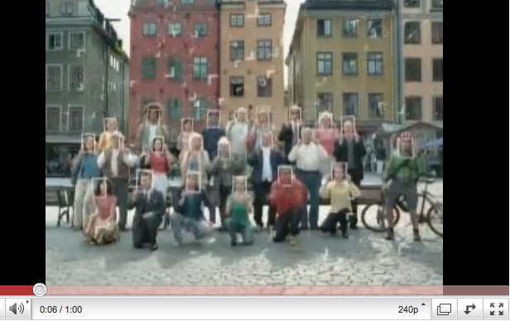
Warping in action
HP commercial
Notes:
Now you have all the tools to implement HW4.

Slide 56
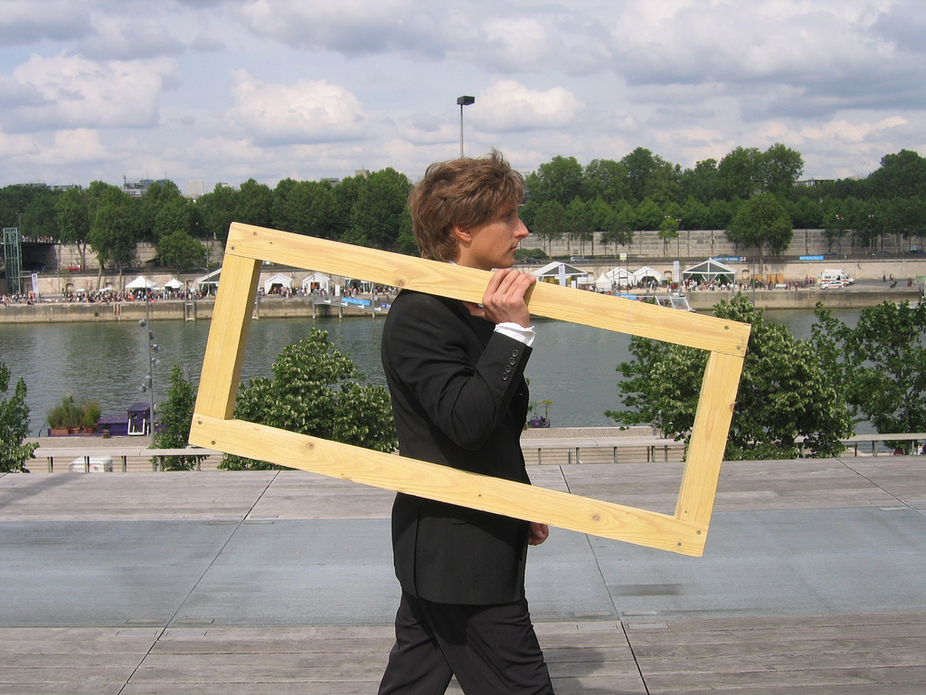
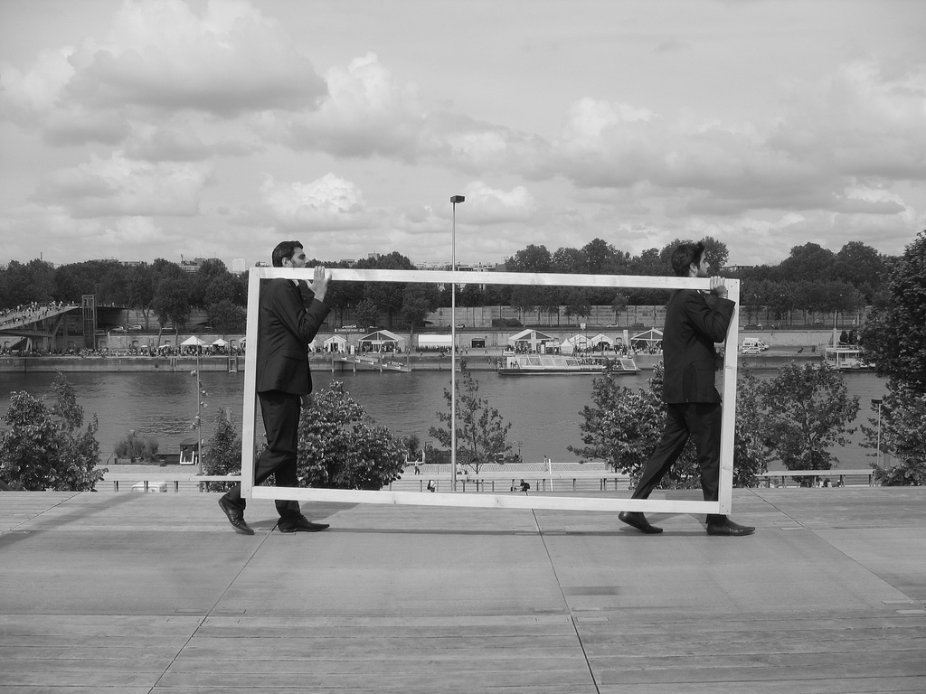
Warping in action
+
Target
Source

Slide 57
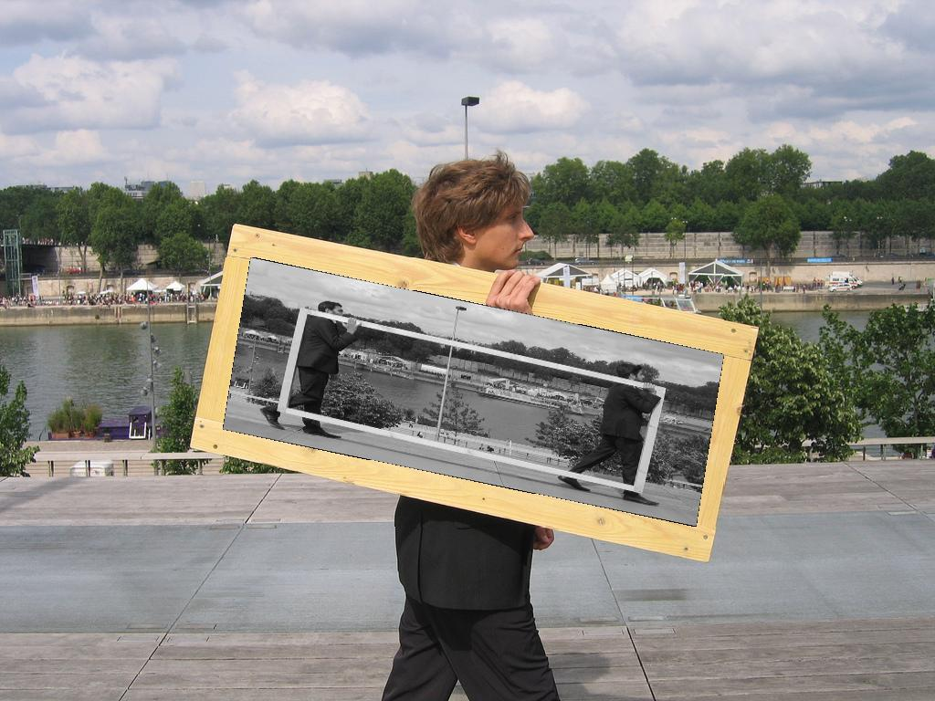
Warping in action
+
Target
Source
=
Result
Notes:
How would you do it?

Slide 58
Warping in action
+
Target
Source
User clicks on 4 points in target, 4 points in source.

Slide 59
Warping in action
+
Target
Source
User clicks on 4 points in target, 4 points in source.
Find best affine transformation between source subimg and target subimg.

Slide 60
Warping in action
+
Target
Source
User clicks on 4 points in target, 4 points in source.
Find best affine transformation between source subimg and target subimg.
Transform the source subimg accordingly.
Notes:
Show on board what this would mean in this case.

Slide 61
Warping in action
+
Target
Source
User clicks on 4 points in target, 4 points in source.
Find best affine transformation between source subimg and target subimg.
Transform the source subimg accordingly.
Insert the transformed source subimg into the target image.

Slide 62
Warping in action
+
Target
Source
User clicks on 4 points in target, 4 points in source.
Find best affine transformation between source subimg and target subimg.
Transform the source subimg accordingly.
Insert the transformed source subimg into the target image.

Slide 63
Warping in action
+
Target
Source
=
Result

Slide 64
Matlab Demo

