Slide 1
Lab 1 Tutorial
Metamodeling and OCL

Slide 2
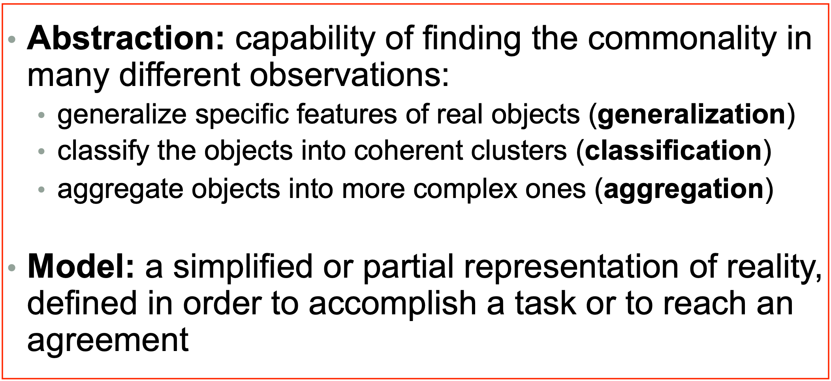
Learning objectives
After the lab, you should be able to apply the features of abstraction i.e., to model a system using a class diagram based on the given requirements
We will use EMF – Eclipse Modeling Framework to do the metamodeling

Slide 3
Requirements – Modeling a Factory
We need to model a factory which produces items (or tools) –
Each factory and its item have a name
Each tool can be a simple item or a complex item
A simple item has –
a material where a material can be wood, steel, copper or gold
a shape where a shape can be a cylinder (has height and radius) or a block (has length, width and height)
a color where a color is denoted by the three RGB value
A complex item is made up of two or more components where each component is connected to a simple or a complex item

Slide 4
Requirements – Modeling a Factory
We need to model a factory which produces items (or tools) –
Each factory and its item have a name
Each tool can be a simple item or a complex item
A simple item has –
a material where a material can be wood, steel, copper or gold
a shape where a shape can be a cylinder (has height and radius) or a block (has length, width and height)
a color where a color is denoted by the three RGB value
A complex item is made up of two or more components where each component is connected to a simple or a complex item
Notes:
Generally you start top down. You take the higher level concepts and then go deeper into each concepts by adding more details into each concept. For e.g., Factory and item. And then go deeper into adding more properties into items
Questions –
Why do we not have a reference relation instead of supertype relation between Item and ComplexItem or SimpleItem?
What happens if do not consider item as an abstract class?
Pros and cons of Enum Vs String?
Can I create an enum with shape Cylinder and Block and add that in the shape?
Can I create an enum for color?
Why is the relation between component and item a reference and not any other?
Can I add an attribute in the concrete class with the same name as the attribute of an abstract class?

Slide 5


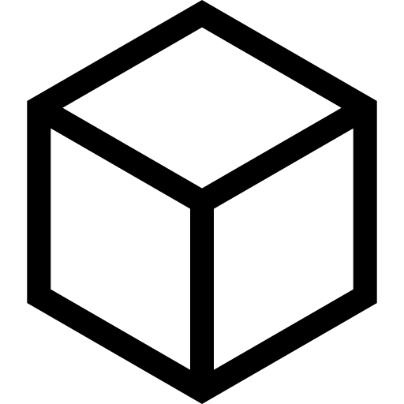
Example
HammerHandle (WOOD)
HammerHead (STEEL)
Brown
Grey
Cylinder Shape
Block Shape
Hammer
Notes:
On creating an instance we get only the concrete classes as children and not abstract. Why?

Slide 6
Requirements – Modeling the connections
Each complex item has components and item connections where each item connection connects two components
Each item has a marker which is a designated location at which another component can connect with it
Each marker has a name

Slide 7
Requirements – Modeling the connections
Each complex item has components and item connections where each item connection connects two components
Each item has a marker which is a designated point on the component at which another component can connect
Each marker has a name

Slide 8

Example
HammerHandle (WOOD)
HammerHead (STEEL)
Brown
Grey
Cylinder Shape
Block Shape
Head Connection Point
Handle Connection Point
Hammer

