Slide 1
Lab 1 Tutorial
Metamodeling and OCL

Slide 2
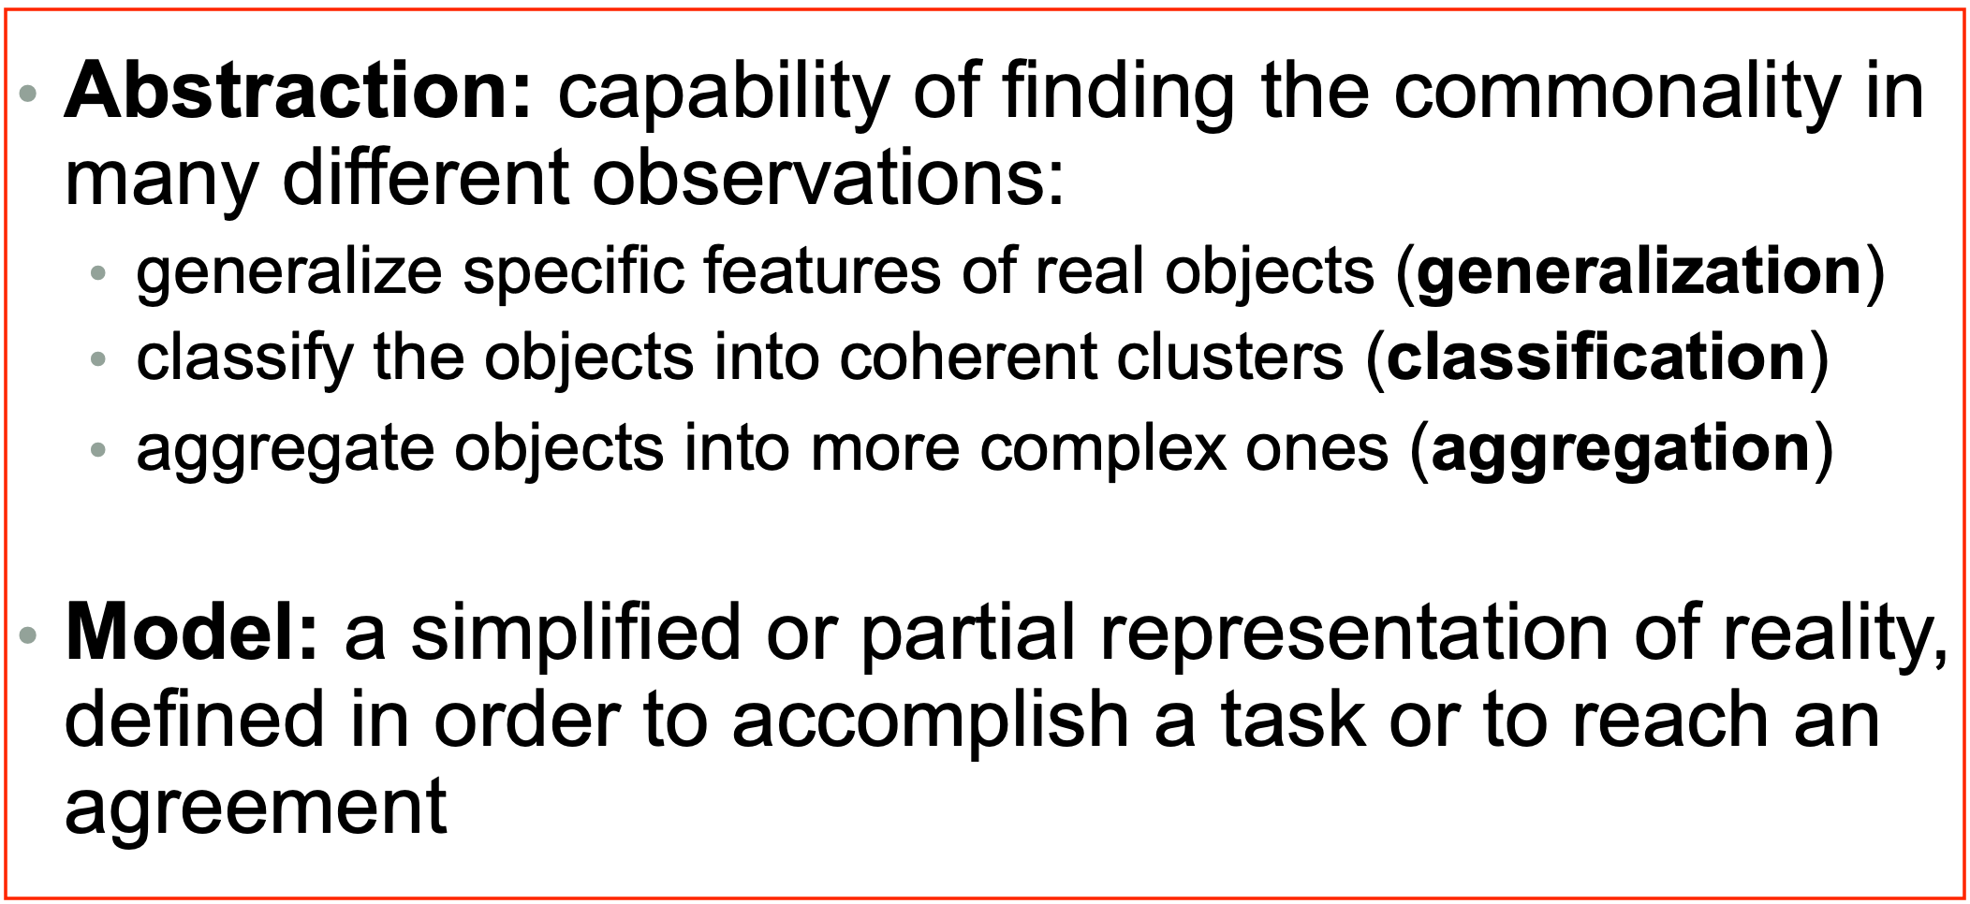
Learning objectives
After the lab, you should be able to apply the features of abstraction i.e., to model a system using a class diagram based on the given requirements
We will use EMF – Eclipse Modeling Framework to do the metamodeling

Slide 3
Requirements – Modeling a Factory
We need to model a factory which produces items (or tools) –
Each factory and its item have a name
Each tool can be a simple item or a complex item
A simple item has –
a material where a material can be wood, steel, copper or gold
a shape where a shape can be a cylinder (has height and radius) or a block (has length, width and height)
a color where a color is denoted by the three RGB value
A complex item is made up of two or more components where each component is connected to a simple or a complex item

Slide 4
Requirements – Modeling a Factory
We need to model a factory which produces items (or tools) –
Each factory and its item have a name
Each tool can be a simple item or a complex item
A simple item has –
a material where a material can be wood, steel, copper or gold
a shape where a shape can be a cylinder (has height and radius) or a block (has length, width and height)
a color where a color is denoted by the three RGB value
A complex item is made up of two or more components where each component is connected to a simple or a complex item

Slide 5


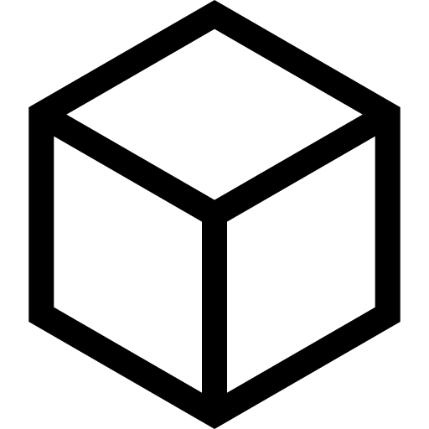
Example
HammerHandle (WOOD)
HammerHead (STEEL)
Brown
Grey
Cylinder Shape
Block Shape
Hammer

Slide 6
Questions to think about?
Why do we not have a reference relation instead of supertype relation between Item and ComplexItem or SimpleItem?
What happens if do not consider item as an abstract class?
Pros and cons of Enum Vs PrimitiveDatatype?
Can I create an enum with shape Cylinder and Block and add that in the shape? What are the benefits and drawbacks of that?
Can I create an enum for color? What are the benefits and drawbacks of that?
Why is the relation between component and item a reference and not any other? What will be the implications of other relation types?

Slide 7
Further Requirements – Modeling the connections
Each complex item has components and item connections where each item connection connects two components
Each item has a marker which is a designated location at which another component can connect with it
Each marker has a name

Slide 8
Further Requirements – Modeling the connections
Each complex item has components and item connections where each item connection connects two components
Each item has a marker which is a designated point on the component at which another component can connect
Each marker has a name

Slide 9

Example
HammerHandle (WOOD)
HammerHead (STEEL)
Brown
Grey
Cylinder Shape
Block Shape
Head Connection Point
Handle Connection Point
Hammer

