Slide 1
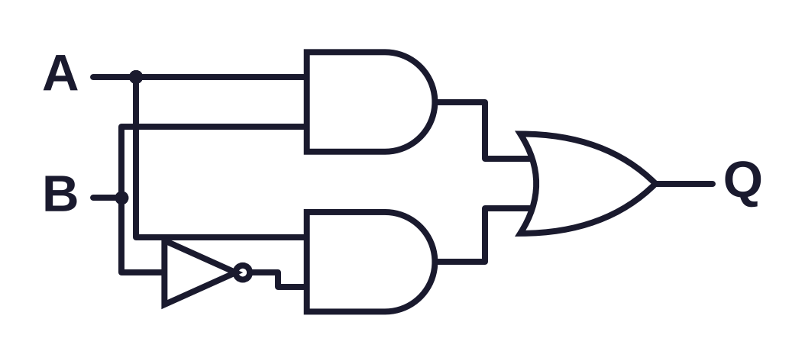
OCR A LEVEL COMPUTER SCIENCE • 1.4.3
Boolean
algebra
is the same as
Fewer gates, same answer: simplify logic with laws and Karnaugh maps, then build the circuits that add and remember
A
Q
Notes:
Tasks marked ESSENTIAL consolidate the core knowledge and should always be used. Tasks marked OPTIONAL can be skipped if time is short without losing any examined content. The deck is designed for two lessons: lesson 1 covers gates, truth tables and the laws (up to the Task 2 answers); lesson 2 covers Karnaugh maps, adders and the D-type flip-flop, then the exam section.

Slide 2
What you will be able to do
OUTCOMES
Read and write Boolean expressions in exam notation
Turn logic gate diagrams into expressions and truth tables, and back again
Simplify expressions with De Morgan's laws, distribution, association, commutation and double negation
Simplify expressions using Karnaugh maps
Explain how half adders, full adders and D-type flip-flops work

Slide 3
Where this fits: 1.4.3 Boolean algebra
CONTEXT
Boolean algebra is the maths of true and false. It is how every processor is designed. OCR splits it into five parts.
(a)
Define problems
(b)
Karnaugh maps
(c)
The laws
(d)
Gates and truth tables
(e)
Adders and flip-flops
Write an expression from a description
Simplify with a grid
De Morgan's and friends
Diagram, expression, table
Circuits that add and store
Order today: gates and truth tables (d), the laws (c), Karnaugh maps (b), then adders and flip-flops (e).
Paper 1 tests this almost every year. It is mostly method marks: learn the method.
Notes:
Spec point (a), defining problems with Boolean logic, is assumed. Today is (b) to (e). Remind students this is Paper 1 content: it appears almost every year, often as 5 to 10 marks of quick-win questions.

Slide 4
Reading exam notation
KEY IDEA
Operation | Exam symbol | Example | Also accepted
AND (conjunction) | ∧ | A ∧ B | A AND B, A.B
OR (disjunction) | ∨ | A ∨ B | A OR B, A + B
NOT (negation) | ¬ | ¬A | NOT A, ~A, a bar over A
XOR (exclusive OR) | ⊻ | A ⊻ B | A XOR B, A ⊕ B
Equivalence | ≡ | Q ≡ A ∧ B | ↔, Q = A ∧ B
∧ looks like an A without its bar: A for AND. Brackets are worked out first.
Notes:
OCR questions always use the first symbol column. Students may answer in any accepted form. Point out the memory hook: the AND symbol looks like a capital A without its bar.

Slide 5
Rusty gates: what am I?
ESSENTIAL
DISCUSS
On your whiteboard: name the gate that gives each output column Q1 to Q5.
A | B | Q1 | Q2 | Q3 | Q4 | Q5 | Stretch
0 | 0 | 0 | 0 | 1 | 0 | 1 | 1
0 | 1 | 0 | 1 | 1 | 1 | 0 | 0
1 | 0 | 0 | 1 | 1 | 1 | 0 | 0
1 | 1 | 1 | 1 | 0 | 0 | 0 | 1
Stuck?
Ask: when is the output 1? Only when both are 1? When at least one is 1? When they are different?
Hint: five of the six gates from GCSE are here. NOT needs only one input.
Notes:
Pairs, mini-whiteboards. Quick retrieval of the gates from GCSE. Then 3, 2, 1, show. Ask how they decided: AND is only 1 when both are 1, and so on. The stretch column is XNOR, which is not on the spec but appears in the K-map stretch later.

Slide 6
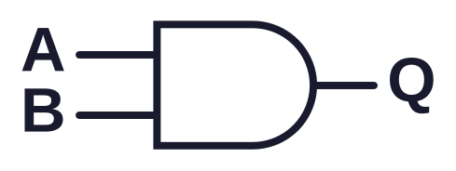
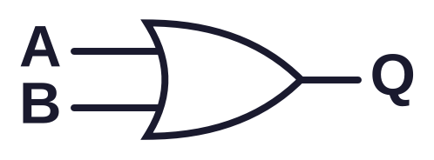
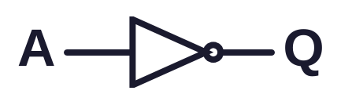
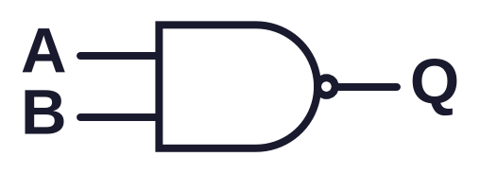
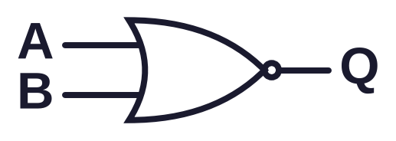
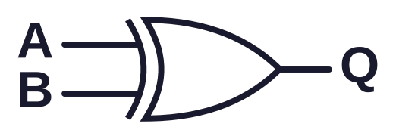
Starter answers: the six gates
ANSWERS
AND: Q1
OR: Q2
NOT
A ∧ B
A ∨ B
¬A
1 if both are 1
1 if at least one is 1
flips the input
NAND: Q3
NOR: Q5
XOR: Q4
¬(A ∧ B)
¬(A ∨ B)
A ⊻ B
opposite of AND
opposite of OR
1 if inputs differ
Stretch: 1, 0, 0, 1 is XNOR, the opposite of XOR (not on the spec).
Notes:
This slide doubles as the gate reference for the lesson. NAND and NOR are the inverse of AND and OR: the bubble means NOT.

Slide 7
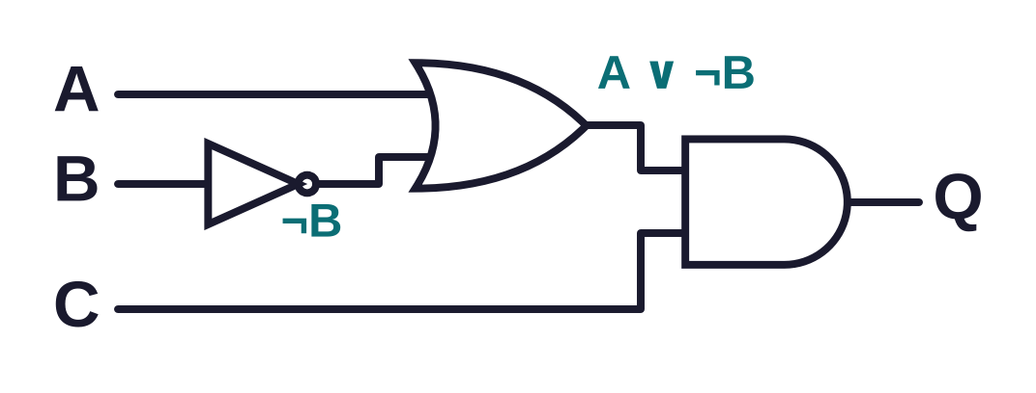
Expression to diagram to truth table
WORKED EXAMPLE
Q = (A ∨ ¬B) ∧ C
A | B | C | ¬B | A ∨ ¬B | Q
0 | 0 | 0 | 1 | 1 | 0
0 | 0 | 1 | 1 | 1 | 1
0 | 1 | 0 | 0 | 0 | 0
0 | 1 | 1 | 0 | 0 | 0
1 | 0 | 0 | 1 | 1 | 0
1 | 0 | 1 | 1 | 1 | 1
1 | 1 | 0 | 0 | 1 | 0
1 | 1 | 1 | 0 | 1 | 1
1 3 inputs, so 2³ = 8 rows
2 Count up in binary: 000 to 111
3 One column per gate, brackets first
Intermediate columns cost seconds and stop silly mistakes.
Notes:
Model this from June 2024 Q7(b). Build the diagram from the inside out: brackets first. Then build the truth table with one column for every gate output. Show how the intermediate columns make each step easy and checkable.

Slide 8
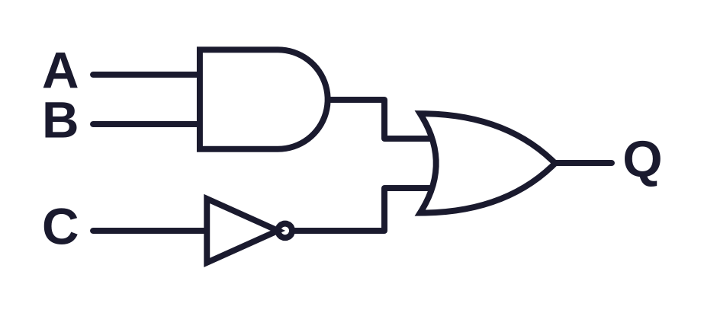
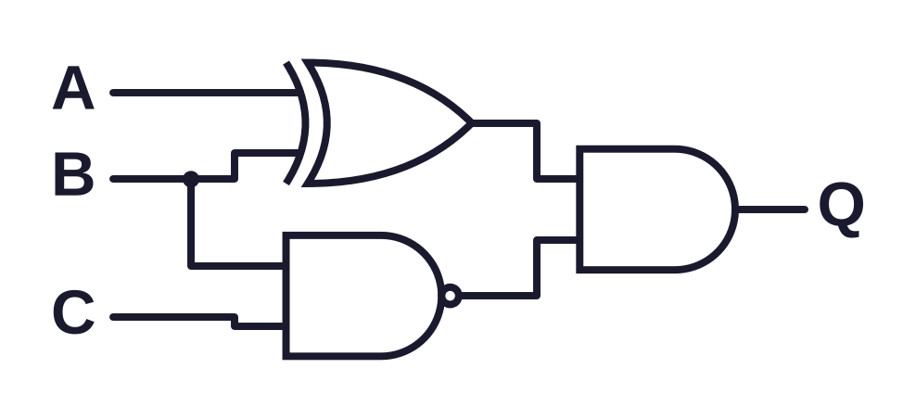
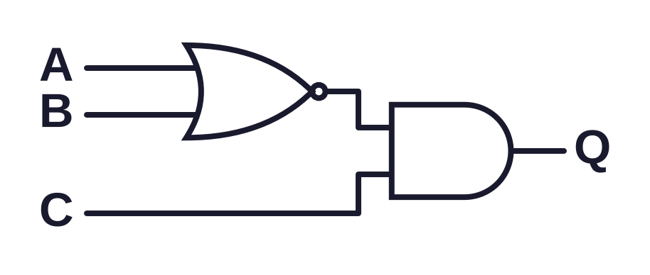
Diagram detective
ESSENTIAL
TASK 1
Core: write Q, then its truth table
Stretch
1
3
2
4 Draw Q = (A ∨ B) ∧ ¬(A ∧ B). Which single gate does it act like?
Check: a 3-input truth table has 8 rows. Did you count in binary?
Notes:
Pairs, mini-whiteboards. For each circuit write the expression, then the 8-row truth table with intermediate columns. Stretch: the second part is drawing a diagram from an expression, which is a common 3-mark question.

Slide 9
Diagram detective: core answers
ANSWERS
1 Q = (A ∧ B) ∨ ¬C
2 Q = ¬(A ∨ B) ∧ C
A | B | C | A ∧ B | ¬C | Q
0 | 0 | 0 | 0 | 1 | 1
0 | 0 | 1 | 0 | 0 | 0
0 | 1 | 0 | 0 | 1 | 1
0 | 1 | 1 | 0 | 0 | 0
1 | 0 | 0 | 0 | 1 | 1
1 | 0 | 1 | 0 | 0 | 0
1 | 1 | 0 | 1 | 1 | 1
1 | 1 | 1 | 1 | 0 | 1
A | B | C | ¬(A ∨ B) | Q
0 | 0 | 0 | 1 | 0
0 | 0 | 1 | 1 | 1
0 | 1 | 0 | 0 | 0
0 | 1 | 1 | 0 | 0
1 | 0 | 0 | 0 | 0
1 | 0 | 1 | 0 | 0
1 | 1 | 0 | 0 | 0
1 | 1 | 1 | 0 | 0
Circuit 2: the bubble on the OR gate makes it NOR, so write ¬( ) round A ∨ B.

Slide 10
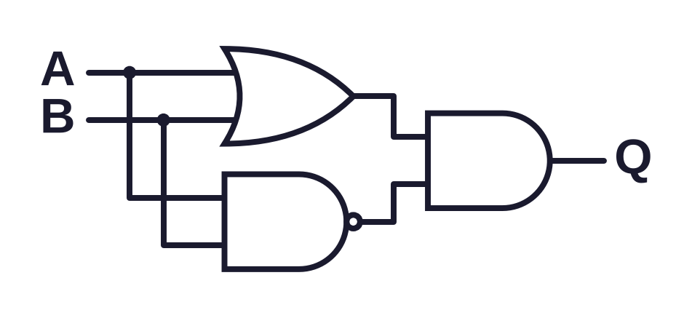
Diagram detective: stretch answers
ANSWERS
3 Q = (A ⊻ B) ∧ ¬(B ∧ C)
4 (A ∨ B) ∧ ¬(A ∧ B)
A | B | C | A ⊻ B | ¬(B ∧ C) | Q
0 | 0 | 0 | 0 | 1 | 0
0 | 0 | 1 | 0 | 1 | 0
0 | 1 | 0 | 1 | 1 | 1
0 | 1 | 1 | 1 | 0 | 0
1 | 0 | 0 | 1 | 1 | 1
1 | 0 | 1 | 1 | 1 | 1
1 | 1 | 0 | 0 | 1 | 0
1 | 1 | 1 | 0 | 0 | 0
It is 1 when at least one input is 1 but not both: it acts like an XOR gate.
Draw one gate per operator. The final gate is the operator outside all brackets.

Slide 11
Same answer, fewer gates?
ESSENTIAL
DISCUSS
A | B | Q
0 | 0
0 | 1
1 | 0
1 | 1
On your whiteboard: complete the truth table for this circuit. What do you notice about Q?
A chip maker builds this 10 million times. Which design would you choose?
Hint: write the expression first. It has an A in both halves.
Notes:
Pairs. Students complete the 4-row truth table on whiteboards and should discover Q is always equal to A. Then the hook: a chip maker builds this circuit 10 million times. Which design would you choose and why? Draw out cost, power, heat and speed.

Slide 12
Why simplify?
ANSWERS
A | B | Q
0 | 0 | 0
0 | 1 | 0
1 | 0 | 1
1 | 1 | 1
Fewer gates means
Cheaper: fewer components on every chip
Less power and heat: longer battery life, less cooling
Faster: each gate adds a tiny delay, so fewer gates in a row means a quicker result
Smaller: more fits on the same area of silicon
(A ∧ B) ∨ (A ∧ ¬B) ≡ A
Simplifying finds the smallest circuit that gives exactly the same truth table.
Notes:
Q is always the same as A. Four gates do the work of a wire. Link to the real world: processors contain billions of transistors, so every gate saved is multiplied many times.

Slide 13
The five laws on the specification
KEY IDEA
Law | AND form | OR form
Commutation | A ∧ B ≡ B ∧ A | A ∨ B ≡ B ∨ A
Association | (A ∧ B) ∧ C ≡ A ∧ (B ∧ C) | (A ∨ B) ∨ C ≡ A ∨ (B ∨ C)
Distribution | A ∧ (B ∨ C) ≡ (A ∧ B) ∨ (A ∧ C) | A ∨ (B ∧ C) ≡ (A ∨ B) ∧ (A ∨ C)
Double negation | ¬¬A ≡ A
De Morgan's | ¬(A ∧ B) ≡ ¬A ∨ ¬B | ¬(A ∨ B) ≡ ¬A ∧ ¬B
In the exam, name the law at each step. Naming it earns marks.
Notes:
These are the five rules named in 1.4.3(c). Most behave like ordinary algebra, which is the hook in the last column. The second form of distribution, OR over AND, has no ordinary algebra equivalent, so flag it.

Slide 14
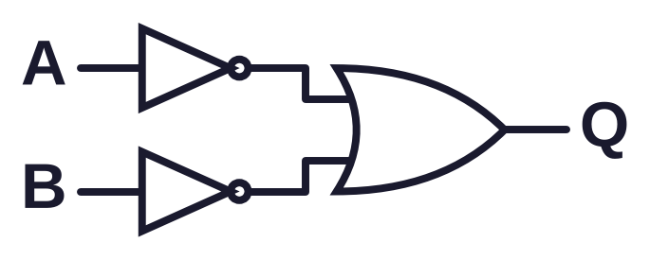
De Morgan's laws
KEY IDEA
Break the line, change the sign
¬(A ∧ B) ≡ ¬A ∨ ¬B
¬(A ∨ B) ≡ ¬A ∧ ¬B
≡
NAND is the same as OR with both inputs inverted
In everyday words
In code
"I will watch it unless it is scary or long" means watch if ¬(S ∨ L), which is the same as not scary and not long: ¬S ∧ ¬L.
not (age < 13 or age > 19)
is the same as
age >= 13 and age <= 19
Change ∧ to ∨ (or ∨ to ∧) and NOT each part. Never do only one of these.
Notes:
Use the film example aloud: 'not scary or long' means 'not scary and not long'. Then the gate version: a NAND gate is identical to an OR gate with both inputs inverted. Students will use this to spot single-gate equivalents in exam questions.

Slide 15
Your simplifying toolkit
KEY IDEA
Rule | AND | OR | Why
Identity | A ∧ 1 ≡ A | A ∨ 0 ≡ A | 1 and 0 change nothing here
Null | A ∧ 0 ≡ 0 | A ∨ 1 ≡ 1 | One input decides it
Idempotent | A ∧ A ≡ A | A ∨ A ≡ A | Saying it twice adds nothing
Complement | A ∧ ¬A ≡ 0 | A ∨ ¬A ≡ 1 | Can never or always be true
Beyond the spec: absorption. A ∨ (A ∧ B) ≡ A and A ∧ (A ∨ B) ≡ A. A handy shortcut, but you can always reach the same answer with distribution.
Complement is the move that makes terms vanish: look for X and ¬X together.
Notes:
These identities are not named in the specification but mark schemes use them in model answers, so students should use them and say what they are doing. Absorption is beyond the spec: a shortcut, but students can always get there with distribution instead.

Slide 16
Name that law
ESSENTIAL
CHECK-IN
On your whiteboard: name the law used in each line.
¬(P ∨ Q) ≡ ¬P ∧ ¬Q
X ∧ Y ≡ Y ∧ X
1
2
¬¬Z ≡ Z
A ∧ (B ∨ C) ≡ (A ∧ B) ∨ (A ∧ C)
3
4
(A ∨ B) ∨ C ≡ A ∨ (B ∨ C)
¬(¬A ∧ B) ≡ A ∨ ¬B (two laws)
5
6
3, 2, 1, show.
Notes:
Mini-whiteboards, write the law only. 3, 2, 1, show. Number 6 needs two laws: a good discussion point.

Slide 17
Name that law: answers
ANSWERS
 | Line | Law
1 | ¬(P ∨ Q) ≡ ¬P ∧ ¬Q | De Morgan's
2 | X ∧ Y ≡ Y ∧ X | Commutation
3 | ¬¬Z ≡ Z | Double negation
4 | A ∧ (B ∨ C) ≡ (A ∧ B) ∨ (A ∧ C) | Distribution
5 | (A ∨ B) ∨ C ≡ A ∨ (B ∨ C) | Association
6 | ¬(¬A ∧ B) ≡ A ∨ ¬B | De Morgan's, then double negation
Letters do not matter: P, Q, X or A, the pattern is what you spot.

Slide 18
Simplify, naming each law
WORKED EXAMPLE
Q ≡ ¬(¬A ∧ ¬B) [Oct 2021]
(A ∧ B) ∨ (A ∧ ¬B)
Step | Law
¬¬A ∨ ¬¬B | De Morgan's
A ∨ B | Double negation
Step | Law
A ∧ (B ∨ ¬B) | Distribution
A ∧ 1 | Complement
A | Identity
No negation left, as the question asked.
This proves the four-gate circuit is just A.
Layout: one step per line, the law beside it. Examiners mark each step.
Notes:
Left is Oct 2021 Q5(b)(i), worth 2 marks: one for naming De Morgan's and/or double negation, one for A ∨ B. Right is the hook circuit from earlier, proved with the laws. Stress the layout: one step per line, the law on the right.

Slide 19
A longer one: ¬(A ∧ ¬B) ∧ A
WORKED EXAMPLE
1
(¬A ∨ ¬¬B) ∧ A
De Morgan's on the bracket
2
(¬A ∨ B) ∧ A
Double negation
3
A ∧ (¬A ∨ B)
Commutation
4
(A ∧ ¬A) ∨ (A ∧ B)
Distribution
5
0 ∨ (A ∧ B)
Complement
6
A ∧ B
Identity
Spot the pattern, apply one law, rewrite the whole line. Repeat.
Notes:
Think aloud: what is the first thing I see? A NOT over a bracket, so De Morgan's. Then remove the double NOT. Then I see a single A next to a bracket, so distribute. Then hunt for X and ¬X together.

Slide 20
Pass the board
ESSENTIAL
TASK 2
Groups of 3 or 4, one board. Write one step and name its law, then pass the board on. Check the step you are given before you add yours.
Core
Stretch
1 ¬¬A ∧ (B ∨ ¬B)
2 ¬(¬A ∨ ¬B)
3 (A ∨ B) ∧ (A ∨ ¬B)
4 ¬(¬A ∧ B) ∧ ¬A
5 A ∨ (¬A ∧ B)
Which single gate is 4?
Hint for 3: use the OR form of distribution, working backwards.
Notes:
Groups of 3 or 4, one mini-whiteboard per group. Person 1 writes the first step and names the law, then passes the board. The next person checks the step before adding the next one. Rotate who starts for each expression. Fast groups do the stretch. If time is short, do expressions 1 and 2 only.

Slide 21
Pass the board: core answers
ANSWERS
1 ¬¬A ∧ (B ∨ ¬B)
2 ¬(¬A ∨ ¬B)
3 (A ∨ B) ∧ (A ∨ ¬B)
A ∧ (B ∨ ¬B)
¬¬A ∧ ¬¬B
A ∨ (B ∧ ¬B)
Double negation
De Morgan's
Distribution
A ∧ 1
A ∧ B
A ∨ 0
Complement
Double negation
Complement
A
A
Identity
Identity
Answer 3 shows the OR form of distribution: A ∨ (B ∧ C) ≡ (A ∨ B) ∧ (A ∨ C).

Slide 22
Pass the board: stretch answers
ANSWERS
4 ¬(¬A ∧ B) ∧ ¬A
5 A ∨ (¬A ∧ B)
Step | Law
(A ∨ ¬B) ∧ ¬A | De Morgan's, double neg.
(¬A ∧ A) ∨ (¬A ∧ ¬B) | Commutation, distribution
0 ∨ (¬A ∧ ¬B) | Complement
¬A ∧ ¬B | Identity
Step | Law
(A ∨ ¬A) ∧ (A ∨ B) | Distribution
1 ∧ (A ∨ B) | Complement
A ∨ B | Identity
¬A ∧ ¬B ≡ ¬(A ∨ B): a NOR gate.
Check any answer with a quick truth table: both sides must match on every row.

Slide 23
Karnaugh maps: a truth table as a grid
KEY IDEA
A | B | C | Q
0 | 0 | 0 | 0
0 | 0 | 1 | 1
0 | 1 | 0 | 0
0 | 1 | 1 | 1
1 | 0 | 0 | 1
1 | 0 | 1 | 1
1 | 1 | 0 | 0
1 | 1 | 1 | 0
AB
00
01
11
10
C
0
0
0
0
1
1
1
1
0
1
Gray code: 00, 01, 11, 10
Next-door cells differ by one bit only. The left and right edges are next door too.
Never write the columns 00, 01, 10, 11. The map will not work.
Notes:
Each cell is one row of the truth table. Columns go 00, 01, 11, 10: Gray code, so neighbouring cells differ by exactly one bit. That is what makes grouping work. Show how row ABC = 110 lands in column 11, row 0.

Slide 24
Grouping rules
KEY IDEA
Draw groups of 1s
Read each group
Size 1, 2, 4 or 8 only
Rectangles only: no diagonals or L shapes
Make groups as big as possible
Use as few groups as possible
Groups may overlap
Groups may wrap round the edges
Every 1 must be in a group
Keep the variables that stay the same in every cell
Drop any variable that changes
0 means NOT, so write ¬A
Join the groups with ∨
Bigger group, fewer variables, simpler term.
Notes:
Rules on the left, how to read a group on the right. A group of 2 removes 1 variable, a group of 4 removes 2, a group of 8 removes 3.

Slide 25
A 3-variable map
WORKED EXAMPLE
AB
Group | Stays the same | Term
Teal | A = 0, C = 1 | ¬A ∧ C
Brown | A = 1, B = 0 | A ∧ ¬B
00
01
11
10
C
0
0
0
0
1
1
1
1
0
1
Q = (¬A ∧ C) ∨ (A ∧ ¬B)
Q = (¬A ∧ ¬B ∧ C) ∨ (¬A ∧ B ∧ C) ∨ (A ∧ ¬B ∧ ¬C) ∨ (A ∧ ¬B ∧ C)
Four terms of three variables become two terms of two.
Read each group: what stays the same? That is the term.
Notes:
Use the map from the previous slide. Group 1, teal: column 00 and 01 in row C=1: A is 0 in both, B changes, C is 1, so ¬A ∧ C. Group 2, brown: the 1s at AB = 10 in both rows. A = 1, B = 0, C changes: A ∧ ¬B. Ask: could the 1s at AB = 00 and AB = 10 in row C = 1 also be grouped by wrapping round? Yes, but every 1 is already covered, so that group would add an unnecessary term.

Slide 26
Map it, group it, simplify it
ESSENTIAL
TASK 3
AB
Core
00
01
11
10
1 Q is 1 when ABC is 010, 011, 110 or 111
2 Q = (A ∧ ¬B ∧ ¬C) ∨ (A ∧ ¬B ∧ C) ∨ (A ∧ B ∧ C)
C
0
1
Draw this blank map for each one.
Stretch
3 Q is 1 when ABC is 000, 001, 011, 100 or 101
Stretch hint: the left and right edges of the map are neighbours.
Notes:
Individual, mini-whiteboards. Students draw a 2 by 4 grid with columns 00, 01, 11, 10. Check the column order before they start.

Slide 27
Map it: answers
ANSWERS
Core 1
Core 2
Stretch 3
AB
AB
AB
00
01
11
10
00
01
11
10
00
01
11
10
C
0
0
1
1
0
C
0
0
0
0
1
C
0
1
0
0
1
1
0
1
1
0
1
0
0
1
1
1
1
1
0
1
Q = B
Q = (A ∧ ¬B) ∨ (A ∧ C)
Q = ¬B ∨ (¬A ∧ C)
1: a group of 4 drops two variables.
2: the groups overlap. That is allowed.
3: the teal group wraps round the edges.
Check: does every 1 sit in at least one group?

Slide 28
A 4-variable map
WORKED EXAMPLE
Q = (¬C ∧ D) ∨ (¬C ∧ ¬D) ∨ (A ∧ C ∧ ¬B) [June 2025]
AB
Fill: a term without A or B fills a whole row
Teal (8): C = 0 throughout, so ¬C
Brown (4): A = 1, B = 0, so A ∧ ¬B
00
01
11
10
CD
00
1
1
1
1
01
1
1
1
1
11
0
0
0
1
10
0
0
0
1
Q = ¬C ∨ (A ∧ ¬B)
Mark scheme: 1 for the table, 1 for each group, 1 for the expression.
Notes:
From the June 2025 AS paper. Fill row by row. ¬C ∧ D fills the whole CD = 01 row because A and B are not in the term. ¬C ∧ ¬D fills the CD = 00 row. A ∧ C ∧ ¬B fills column 10, rows 11 and 10. Then group: an 8 and a 4. Mark scheme: 1 for the table, 1 for each group, 1 for the expression.

Slide 29
Edges, corners and missing letters
KEY IDEA
(¬A ∧ ¬B) ∨ (A ∧ ¬B) [Nov 2020]
The four corners are one group
AB
AB
00
01
11
10
00
01
11
10
CD
00
1
0
0
1
CD
00
1
0
0
1
01
1
0
0
1
01
0
0
0
0
11
1
0
0
1
11
0
0
0
0
10
1
0
0
1
10
1
0
0
1
No C or D, so fill whole columns. One wrap-around group: Q = ¬B
B = 0 and D = 0 in all four: Q = ¬B ∧ ¬D
The map is like a globe: the top meets the bottom and the left meets the right.
Notes:
Left: the November 2020 question used a 4-variable grid for an expression with only A and B. Students who only filled one cell per term lost marks. Right: corners are all neighbours of each other, which is the hardest group to spot.

Slide 30
Four-variable maps
ESSENTIAL
TASK 4
Core
Stretch
1 Map and simplify (A ∧ ¬B ∧ C) ∨ (A ∧ ¬B ∧ ¬C) ∨ (¬A ∧ ¬B)
3 Group and simplify. Which gate does it act like on B and D?
2 Group this map and write Q [June 2018]
AB
AB
00
01
11
10
00
01
11
10
CD
00
1
1
1
1
CD
00
1
0
0
1
01
0
0
1
1
01
0
1
1
0
11
0
0
0
1
11
0
1
1
0
10
0
0
0
1
10
1
0
0
1
Look for the biggest groups first, then mop up any 1s left over.
Notes:
Individual then compare with a partner. Question 2 is the June 2018 map. For the stretch, the answer is a well-known function of B and D only: students should notice A and C vanish.

Slide 31
Four-variable maps: answers
ANSWERS
Core 1
Core 2
Stretch 3
AB
AB
AB
00
01
11
10
00
01
11
10
00
01
11
10
CD
00
1
0
0
1
CD
00
1
1
1
1
CD
00
1
0
0
1
01
1
0
0
1
01
0
0
1
1
01
0
1
1
0
11
1
0
0
1
11
0
0
0
1
11
0
1
1
0
10
1
0
0
1
10
0
0
0
1
10
1
0
0
1
Q = ¬B
(¬C ∧ ¬D) ∨ (A ∧ ¬B) ∨ (A ∧ ¬C)
(¬B ∧ ¬D) ∨ (B ∧ D)
One group of 8 that wraps round.
Three groups of 4. They overlap.
1 when B and D match: XNOR.
Core 2 is the June 2018 answer: 5 marks for the groups and the three terms.

Slide 32
Check-in: Karnaugh maps
ESSENTIAL
CHECK-IN
1
The column order for AB is:
2
Which group is NOT allowed?
A 00, 01, 10, 11
B 00, 01, 11, 10
C 00, 10, 01, 11
D 11, 10, 01, 00
A a group of 2
B a group of 4 that wraps
C a group of 6
D two groups that overlap
3
A group covers AB = 01 and 11, with C = 1. Its term is:
4
Making groups bigger gives:
A B ∧ C
B A ∧ B ∧ C
C B
D A ∧ C
A more terms
B fewer variables per term
C more gates
D a different truth table
Write the letter only. 3, 2, 1, show.

Slide 33
Check-in answers
ANSWERS
B Gray code: only one bit changes between neighbours.
1
C Groups must be 1, 2, 4 or 8.
2
A A changes, so it drops out. B = 1 and C = 1 stay: B ∧ C.
3
B Bigger groups drop more variables, so the circuit is simpler.
4

Slide 34
Teach a circuit to add
ESSENTIAL
DISCUSS
On your whiteboard: add each pair of bits. Write the answer as two bits: carry, then sum.
A | B | A + B | Carry | Sum
0 | 0
0 | 1
1 | 0
1 | 1
Then
Look at the Carry column and the Sum column. Which gate from the starter gives each one?
Hint: in binary, 1 + 1 = 10.
Notes:
Pairs. Students add single bits on whiteboards. 1 + 1 = 10 in binary, so we need two outputs: a carry and a sum. Then ask them to match each output column to a gate from the starter. Sum is XOR, carry is AND.

Slide 35
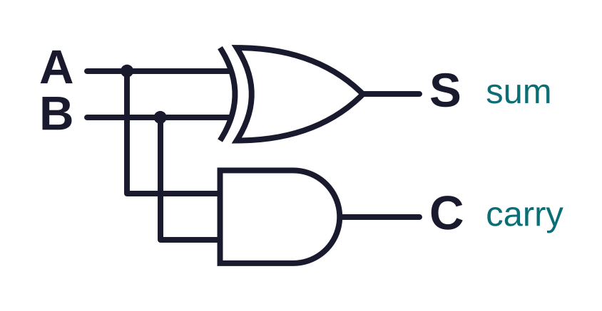
The half adder
KEY IDEA
A | B | C | S
0 | 0 | 0 | 0
0 | 1 | 0 | 1
1 | 0 | 0 | 1
1 | 1 | 1 | 0
S ≡ A ⊻ B
C ≡ A ∧ B
Half: it adds two bits but has no input for a carry from the column before.
Half adder: 2 inputs, 2 outputs. Sum is XOR, carry is AND.
Notes:
Answers to the discovery task: sum is XOR, carry is AND. This is the circuit in the October 2021 question. It is called half because it cannot accept a carry from a previous column.

Slide 36
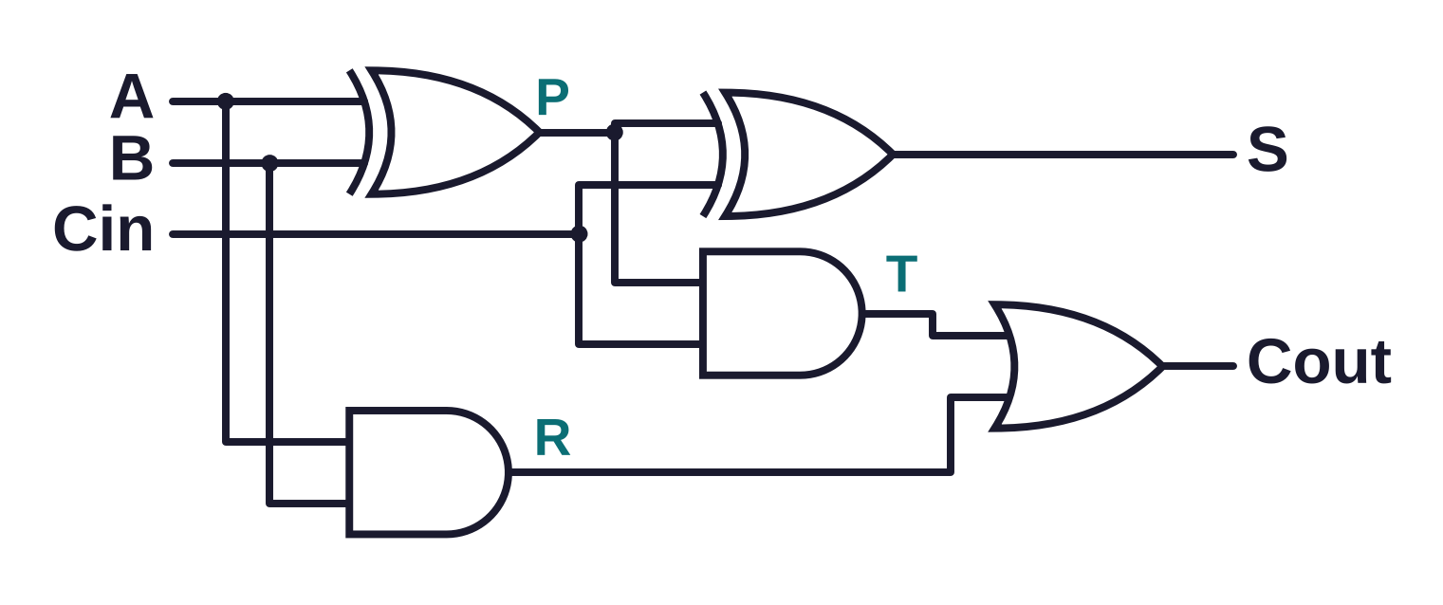
The full adder
KEY IDEA
How it works
Inputs: A, B and a carry in
Half adder 1 adds A and B
Half adder 2 adds the carry in
OR: carry out if either half adder carried
S ≡ A ⊻ B ⊻ Cin
Cout ≡ (A ∧ B) ∨ (Cin ∧ (A ⊻ B))
Full adder = two half adders + an OR gate.
Notes:
Two half adders and an OR gate. The first half adder adds A and B. The second adds that result to the carry in. A carry out happens if either half adder produced a carry, hence the OR. P, R and T label the inside wires for the next task.

Slide 37
Trace the full adder
ESSENTIAL
TASK 5
Stretch: chain four full adders
Four full adders, with the carry out of each joined to the carry in of the next, add two 4-bit numbers.
A | B | Cin | P | R | T | S | Cout
1 | 0 | 1
1 | 1 | 0
1 | 1 | 1
Add 1011 + 0110 column by column. Write the carry into each column. What does the final carry out tell you?
Core: complete each row.
Work left to right through the circuit: P and R first, then T.
Notes:
Pairs, mini-whiteboards. Use the labelled wires P, R and T on the full adder diagram. Leave the diagram from the previous slide on screen or ask students to sketch it. Stretch links to overflow in 1.4.1.

Slide 38
Trace the full adder: answers
ANSWERS
A | B | Cin | P | R | T | S | Cout
1 | 0 | 1 | 1 | 0 | 1 | 0 | 1
1 | 1 | 0 | 0 | 1 | 0 | 0 | 1
1 | 1 | 1 | 0 | 1 | 0 | 1 | 1
Bit | 3 | 2 | 1 | 0
Carry in | 1 | 1 | 0 | 0
A | 1 | 0 | 1 | 1
B | 0 | 1 | 1 | 0
Sum | 0 | 0 | 0 | 1
Carry out | 1 | 1 | 1 | 0
1 + 1 + 1 = 11 in binary: sum 1, carry 1.
1011 + 0110 = 1 0001. The final carry out of 1 means the answer needs 5 bits: overflow.
Joining full adders like this is called a ripple carry adder.

Slide 39
The D-type flip-flop
KEY IDEA
Inputs: D (data) and the clock
Outputs: Q, and ¬Q which is always its opposite
Rising edge: when the clock goes from 0 to 1, Q becomes D
Otherwise: Q holds its value, even if D changes
Used in: registers, memory and counters
Data
D
Q
Clock
¬Q
Purpose: stores 1 bit. It delays a signal until the clock says go.
Q only changes on the rising edge of the clock.
Notes:
Purpose: stores one bit, or delays a signal by one clock cycle. Two inputs, data and clock. Two outputs, Q and NOT Q. Q only changes on the rising edge of the clock, when it copies D. At all other times it holds its value, whatever D does. That is what memory means.

Slide 40
Reading a timing diagram
WORKED EXAMPLE
Clock
D
Q
1 Find each rising edge (dashed line)
2 Read D at that moment and copy it to Q
3 Keep Q flat until the next rising edge
Between rising edges, D can do anything: Q ignores it.
Notes:
Each dashed line is a rising edge. At each one, look straight down at D and copy it to Q. Between edges Q stays flat. Notice that Q changes a little after D does, at the next rising edge: the flip-flop delays the change until the clock says go.

Slide 41
Complete the timing diagram
ESSENTIAL
TASK 6
Clock
D
Q
Q starts at 0
On your whiteboard: sketch the clock and D, then draw Q underneath.
Stretch: why does a short pulse on D sometimes not appear on Q?
Only look at D when a dashed line crosses it.
Notes:
Mini-whiteboards: sketch the clock and D, then draw Q. Watch for students who follow D exactly: the short pulse in the middle of the second cycle should be ignored.

Slide 42
Timing diagram: answer
ANSWERS
Clock
D
Q
Stretch: the pulse on D starts and ends between two rising edges, so the flip-flop never reads it. This is how a clock keeps a processor in step.
Q is D, delayed until the next rising edge.

Slide 43
From gates to a processor
OPTIONAL
BEYOND THE SPEC
NAND does it all
Registers
Faster adding
Every gate can be built from NAND gates alone. Chips are often made this way because one gate type is cheap to make.
Eight D-type flip-flops sharing one clock store a byte. A 64-bit register is 64 flip-flops.
A ripple carry adder waits for each carry in turn. Real CPUs use carry lookahead to work out carries in parallel.
Not examined. Try it: Nand2Tetris builds a computer from NAND gates.
Notes:
Not examined. This shows students where the topic leads. Nand2Tetris is free and builds a whole computer from NAND gates.

Slide 44
What the mark schemes reward
EXAM TIP
Marks are given for
Watch out for
Naming the law at each step (Oct 2021)
1 mark per correct K-map group (June 2025)
Brackets where needed (Oct 2021)
1 mark per truth table column (Oct 2021)
Any accepted notation: AND, . and ∧ all score
Columns 00, 01, 10, 11: wrong order
Groups of 3 or 6, or diagonal groups
Missing the wrap-around group
Extra terms: "any additional symbols max 2 marks"
"When the clock changes": say rising edge
Show your working: method marks are there even if the final answer slips.
Notes:
Drawn from mark schemes: Oct 2021, Nov 2020, June 2018, June 2024 and June 2025. There are no examiner reports in the project folder, so these points come from mark scheme wording.

Slide 45
Structuring your answer
EXAM TIP
Simplify, naming laws
Karnaugh map
Describe a circuit
1
Write each step on a new line
1
Fill the map: 0s can be blank
1
Name the inputs
2
Put the law next to it
2
Ring the groups
2
Name the outputs
3
Stop when nothing else applies
3
Write one term per group
3
Say when and how outputs change
4
Check with a truth table
4
Join the terms with ∨
4
For adders: half, full, chain, carry
Count the marks: 4 marks means 4 separate points or steps.
Notes:
Three answer frames that cover most Boolean questions. Students could copy these onto the back of their revision booklet.

Slide 46
What a good answer looks like: adders
EXAM TIP
The circuit is a half adder. Describe how it can be adapted to add together two 4-bit binary numbers. [4] (Oct 2021)
Weak: 1 mark
Strong: 4 marks
"Use four of them joined together so it can add 4 bits."
"S gives the sum and C the carry (1). Two half adders joined with an OR gate make a full adder (1). Four full adders add two 4-bit numbers (1), with the carry out of each joined to the carry in of the next (1)."
Four half adders cannot pass on a carry. No full adder, no carry link.
Half adder, full adder, chain of four, carry link: four steps, four marks.
Notes:
October 2021 Q5(c)(iii). The mark scheme lists six points for 4 marks, so a strong answer covers the chain from half adder to four full adders and the carry link.

Slide 47
What a good answer looks like: flip-flops
EXAM TIP
Describe the inputs and outputs used by a D-type flip-flop, explaining how the inputs control the outputs. [4] (Nov 2020)
Weak: 1 mark
Strong: 4 marks
"It has an input and an output and it stores data when the clock changes."
"It has a data input D and a clock input (1). The outputs are Q and ¬Q (1). When the clock goes high, on the rising edge, Q changes to the value of D (1). ¬Q is always the opposite of Q (1)."
Inputs and outputs not named. "Clock changes" is too vague.
Name, name, then explain when: inputs, outputs, rising edge.
Notes:
November 2020 Q4(b)(ii). Two marks for naming inputs and outputs (AO1.1), two for explaining how they interact (AO1.2).

Slide 48
Boolean algebra in your NEA
NEA LINK
Where it earns marks
Simplify a game condition
3.2.2(b) Algorithms: clear, simplified conditions in your pseudocode
3.2.3 Test data: a truth table gives one test for every combination
3.4.4 Maintenance: simple conditions are easier to read and change
Before
while not (lives == 0 or quit)
De Morgan's
After
while lives != 0 and not quit
Test it: 4 rows, lives 0 or not, quit true or false.
Write the condition, simplify it, then test every row of its truth table.
Notes:
Boolean logic appears in every NEA as conditions in selection and loops. Simplifying them with De Morgan's makes code easier to read and test. A truth table of a condition gives a complete set of test data.

Slide 49
Exam practice
ESSENTIAL
TASK 7
Core
Stretch
(a) An alarm sounds (Q) if the door is opened (D) while the alarm is set (S), or the panic button is pressed (P). Write a Boolean expression for Q. [2]
(b) Simplify ¬(¬A ∨ B) ∨ (A ∧ B), naming the law at each step. [3]
(c) Use a Karnaugh map to simplify (A ∧ B ∧ ¬C) ∨ (A ∧ B ∧ C) ∨ (¬A ∧ B ∧ C). [3]
(d) Explain why a half adder cannot add the second column of two binary numbers. [2]
(e) Use a 4-variable map to simplify (¬A ∧ ¬B ∧ ¬D) ∨ (A ∧ ¬B ∧ ¬D) ∨ (B ∧ C ∧ D). [4]
Exam-style questions in the style of Paper 1. Answer in your book.
Notes:
Exam-style questions in the style of Paper 1. Individual, in books. Could be set as homework if time is short.

Slide 50
Exam answers: core
ANSWERS
(a) [2]
(b) [3]
Q ≡ (D ∧ S) ∨ P
D ∧ S (1), ∨ P with brackets in the right place (1)
Accept AND, OR and . or + notation
Step | Law
(¬¬A ∧ ¬B) ∨ (A ∧ B) | De Morgan's (1)
(A ∧ ¬B) ∨ (A ∧ B) | Double negation (1)
A ∧ (¬B ∨ B) | Distribution
A | Complement, identity (1)
No law named, no method mark, even if the answer is right.

Slide 51
Exam answers: stretch
ANSWERS
(c) [3]
(d) [2]
(e) [4]
AB
AB
It has no carry in input (1), so the carry from the first column would be lost (1).
00
01
11
10
00
01
11
10
CD
00
1
0
0
1
C
0
0
0
1
0
01
0
0
0
0
1
0
1
1
0
11
0
1
1
0
10
1
0
0
1
(A ∧ B) ∨ (B ∧ C)
Map (1), groups (1), expression (1)
(¬B ∧ ¬D) ∨ (B ∧ C ∧ D)
Map (1), corners (1), pair (1), expression (1)
(c) can also be written B ∧ (A ∨ C), using distribution.

Slide 52
Exit ticket
RECAP
Simplify ¬(A ∨ ¬B), naming each law.
1
Which group sizes are allowed on a Karnaugh map?
2
When does the Q output of a D-type flip-flop change?
3

Slide 53
Exit ticket answers
ANSWERS
¬A ∧ ¬¬B (De Morgan's), then ¬A ∧ B (double negation).
1
1, 2, 4 or 8: powers of 2, in rectangles, wrapping allowed.
2
On the rising edge of the clock, when Q takes the value of D.
3

Slide 54
Key terms to remember
RECAP
De Morgan's laws
¬(A ∧ B) ≡ ¬A ∨ ¬B and ¬(A ∨ B) ≡ ¬A ∧ ¬B
Distribution
A ∧ (B ∨ C) ≡ (A ∧ B) ∨ (A ∧ C)
Commutation
order does not matter: A ∧ B ≡ B ∧ A
Association
brackets can move: (A ∧ B) ∧ C ≡ A ∧ (B ∧ C)
Double negation
¬¬A ≡ A
Karnaugh map
a truth table drawn as a grid, used to simplify
Half adder
adds 2 bits: sum (XOR) and carry (AND)
Full adder
adds 2 bits and a carry in
D-type flip-flop
stores 1 bit: Q takes D on the rising edge

Slide 55
Wider study
RESEARCH
Choose one task to complete before next week. Write it up in your book.
Task | Focus | Level
1 | Build a half adder in a free online logic simulator, such as CircuitVerse | Accessible
2 | Make NOT, AND and OR gates using only NAND gates | Medium
3 | Gray code: why rotary dials and sensors use it | Medium
4 | Build and test a 4-bit ripple carry adder in a simulator | Medium to high
5 | Nand2Tetris: build a computer starting from NAND gates | Medium to high
6 | Quine-McCluskey: how software simplifies expressions with many variables | High

