Slide 1


Slide 2
OCR A LEVEL COMPUTER SCIENCE • 2.1.1
Reality
Thinking
abstractly
Stations
Bends
Trees
Lines
Distance
Rivers
Abstraction
Hide the detail that does not matter, so you can solve the problem that does
Model
Stations
Lines
Notes:
2.1.1 Thinking abstractly: (a) nature of abstraction, (b) need for abstraction, (c) differences between an abstraction and reality, (d) devise an abstract model. 60 minutes. Students stay seated throughout.
Before the lesson: one mini whiteboard and pen per student (or per pair), exercise books. Nothing to print or cut out.

Slide 3
What you will be able to do
OUTCOMES
Explain what abstraction is
Explain why abstraction is needed
Describe the differences between an abstraction and reality
Devise an abstract model for a situation
Use abstraction in exam answers and in your NEA
Notes:
Show briefly. Timings total 60 minutes. If time is short, cut Showdown rounds 6 to 8 (Stretch) first, then set Your turn as homework.

Slide 4
Computational thinking: the big picture
CONTEXT
Computational thinking is how a computer scientist attacks a problem. OCR splits it into five skills.
2.1.1
Thinking
abstractly
2.1.2
Thinking
ahead
2.1.3
Thinking
procedurally
2.1.4
Thinking
logically
2.1.5
Thinking
concurrently
Hide the detail that does not matter
Plan the inputs, outputs and what must be true first
Break a problem into smaller steps
Decide where choices are made
Spot what can happen at the same time
All five are tested in Paper 2 and used in every NEA. Today: abstraction.
Notes:
0 to 1 minute. Use this slide at the start of each 2.1 lesson so students see how the five skills fit together.
Paper 2 (Algorithms and programming, H446/02) is 140 marks, 2 hours 30 minutes. 2.1 is examined there, often in the context of a scenario. The NEA specification says the project should "apply the principles of computational thinking to a practical coding problem".

Slide 5
Draw it in 60 seconds
DISCUSS
A new Year 7 student is lost at the school gate. They need to find this classroom.
You have 60 seconds to draw them a map.
On your whiteboard: draw the map. Then hold it up and compare with the next table. What did you leave out? What did you keep?
Stuck? Use this sentence starter
"We left out ______ because ______. We kept ______ because ______."
Hint: nobody has time to draw every brick.
Notes:
1 to 4 minutes. Individually or in pairs. Count down from 60 out loud. Then tables hold up boards and compare with the table next to them.

Slide 6
Starter answers
ANSWERS
What you kept
Turns, doors and stairs
Landmarks such as the hall or library
The room number
Why: a Year 7 only needs to know where to turn.
What you left out
Colours of walls and posters
Windows, bins and plants
Exact distances and people
Why: extra detail is slower to draw and harder to follow.
You just used abstraction: you removed the detail the problem did not need.
Notes:
4 to 8 minutes. Take one example from each table. Ask: would a map for a fire evacuation keep the same things? (No: it needs fire exits and assembly points.)

Slide 7
What is abstraction?
KEY IDEA
Abstraction means removing or hiding unnecessary detail so you can focus on the parts that matter to the problem.
The result is a model: a simpler version of reality
What you keep depends on the problem you are solving
A computer can only work with a model, never with reality itself
Real world
Abstract model
Program
Abstraction = remove what is not needed so you can focus on what is.
Notes:
8 to 10 minutes. Read the definition together. Students copy the definition into their books.

Slide 8
Why do we need abstraction?
KEY IDEA
1
Less complex
2
Less to store and process
Easier to understand, design and explain
Uses less memory and runs faster
3
Quicker to build and test
4
Use it without knowing how
Less code to write and fewer things to go wrong
print("Hi") hides hundreds of machine code instructions
In an exam, link the benefit to the scenario in the question.
Notes:
Ask tables to rank the four benefits for a sat nav before revealing your view. There is no single right order; the point is to justify.

Slide 9
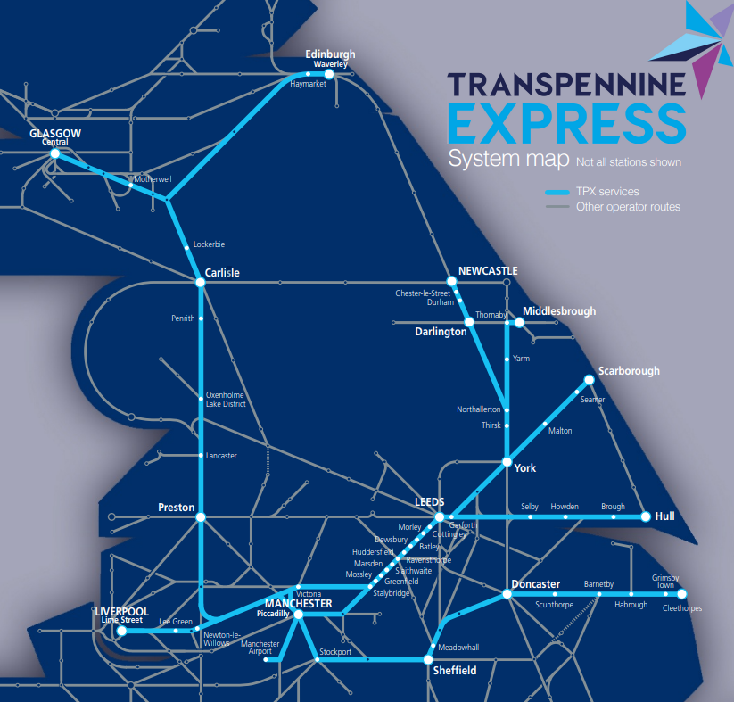
This is the original map of their rail system that Trans Pennine Express train company used in 2016.

Slide 10
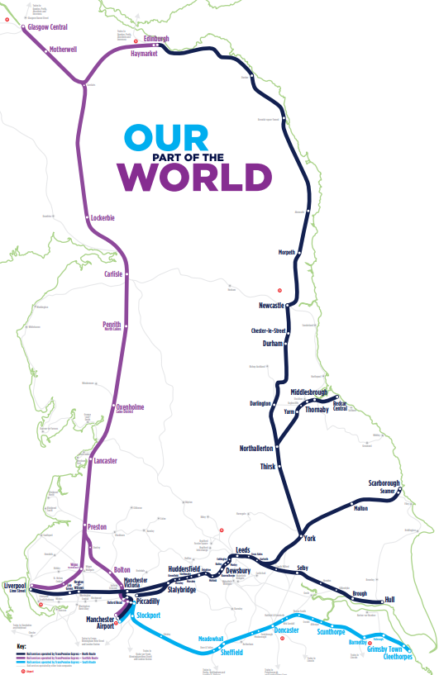
The company then changed to this map in 2019.

Slide 11
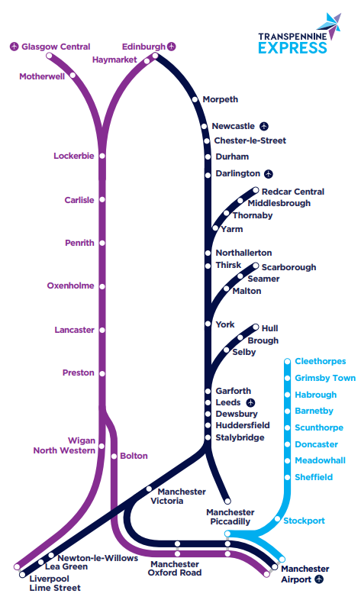
125 miles
22 miles
This is the map they now use.
Does scale matter?
7 miles

Slide 12

Which is the easiest to understand?
Why?

Slide 13
Kinds of abstraction
KEY IDEA
Core
Stretch
Representational: remove details so something is shown simply. The Tube map keeps stations and lines only
Generalisation: group things by what they have in common. Cars, buses and bikes all become a Vehicle with a speed and a position
Procedural: use a subroutine by knowing what it does, not how. You call sort() without reading its code
Data: use a stack with push and pop without knowing it is stored in an array
Layers: Python hides machine code, which hides the hardware
Generalisation is still abstraction: you hide the differences that do not matter.
Notes:
Year 12 need the Core pair. The Stretch column links forward to 2.2 (subroutines), 1.4.2 (abstract data types) and 1.3.3 (protocol layers) and suits Year 13 revision.

Slide 14
Same thing, different problem
TASK 1
The real thing: a train journey from Leeds to Manchester. Three programs model it:
A ticket price calculator B live departure board C train driver simulator
1 Departure time
6 Colour of the seats
2 Platform number
7 Minutes delayed
3 Distance travelled
8 Position of signals
4 Passenger's age
9 Station names
5 Slope of the track
10 Driver's name
On your whiteboard: write A, B, C (or X for none) next to each number.
Notes:
12 to 21 minutes. Pairs or tables. One whiteboard per table. Students write 1 to 10 down the side and add letters. 4 minutes to work, then show the answers. A detail can need more than one letter.

Slide 15
Same thing, different problem: answers
ANSWERS
Detail | A Price | B Board | C Simulator
1 Departure time | ✓ peak fares | ✓
2 Platform number |  | ✓
3 Distance travelled | ✓ |  | ✓
4 Passenger's age | ✓ railcards
5 Slope of the track |  |  | ✓
6 Colour of the seats
7 Minutes delayed |  | ✓
8 Position of signals |  |  | ✓
9 Station names | ✓ | ✓ | ✓
10 Driver's name
What you keep depends on the problem. Exam answers must use the scenario.
Notes:
21 to 23 minutes. 1 point per correct letter. Accept other answers if a table can justify them, for example delay for the price calculator (Delay Repay refunds). Rows 6 and 10 are needed by none of the three programs.

Slide 16
Abstraction vs reality
KEY IDEA
Model | What it leaves out | What can go wrong
Tube map | Real distances and bends | Tourists ride one stop that is a 4-minute walk
Sat nav | Today's flood or road closure | It sends you down a closed road
Weather model | Detail inside each grid square | It says dry but your street gets a shower
Football game | Wind, mud and tired legs | Players never slip or slow down
A model is simpler, less accurate and based on assumptions. Its answers can differ from what really happens.
Remove too much and the model gives the wrong answer.
Notes:
23 to 27 minutes. Leicester Square and Covent Garden stations are only about 300 metres apart, so it is often quicker to walk. Ask tables for one more example of a model that misleads.

Slide 17
Worked example: devise a model
WORKED EXAMPLE
The canteen wants a simulation to decide how many tills to open at lunch.
1
Problem
How long do students wait with 1, 2 or 3 tills?
The model
Till 1
2
Keep
Arrivals per minute, time to serve one student, number of tills
Till 2
3
Remove
Names, what they eat, the menu, tray colour
Till 3
4
Represent
Each till is a queue (first in, first out). Time moves in 1-minute steps
Output: average wait
Notes:
27 to 32 minutes. Talk through the four steps. Stress step 1: you cannot decide what to keep until you know the question the model must answer. Link to queues (1.4.2): first in, first out.

Slide 18
Your turn: devise a model
TASK 2
In your book: choose one scenario. Use four headings: Problem, Keep, Remove, Represent.
Core
Stretch
A sign at a car park entrance shows how many spaces are free
An app tells you what to revise each day before your exams
A film studio wants to simulate a zombie outbreak spreading through a town
An app tells you the latest time you can leave home and still get to school on time
Swap books with a partner: did they keep anything the problem does not need?
Notes:
32 to 38 minutes. Individually in exercise books. Use the same four headings as the worked example. Year 12 choose a Core scenario; Year 13 or early finishers choose a Stretch scenario. Swap books with a partner for 1 minute of feedback: did they keep anything they did not need?

Slide 19
Your turn: model answers
ANSWERS
Car park sign
Keep: total spaces, cars in, cars out
Remove: car make, colour, driver
Represent: free = total − (in − out)
Zombie outbreak
Keep: number of people, chance of infection per meeting, meetings per hour
Remove: names, clothes, buildings
Represent: a grid of people, each healthy or infected, updated each hour
Test every item you keep: does it change the answer? If not, remove it.
Notes:
38 minutes. Accept any sensible model. The key test: every item in Keep must change the answer to the problem.

Slide 20
Too much, too little, just right?
TASK 3
A
Too much detail
B
Too little detail
C
Just right
Each round describes a model for a problem
Your table has 15 seconds to agree. Write the letter big on your whiteboard
On "3, 2, 1, show", hold it up. 1 point per correct answer. Stretch rounds score 2 points
Be ready to justify your answer
Notes:
39 to 46 minutes. Every table shows at the same time. Ask one table to justify before you reveal. Rounds 6 to 8 are Stretch and can be cut.

Slide 21
Round 1
TASK 3
A taxi fare program stores the distance, the time of day, the number of passengers, the car colour and the driver's favourite song
A Too much
B Too little
C Just right
A Too much
Colour and song do not change the fare
Notes:
Read aloud. 15 seconds, then "3, 2, 1, show". Click to reveal.
Answer: A Too much. Colour and song do not change the fare

Slide 22
Round 2
TASK 3
A lift controller stores the floors requested, the current floor and the direction of travel
A Too much
B Too little
C Just right
C Just right
That is all it needs to decide where to go next
Notes:
Read aloud. 15 seconds, then "3, 2, 1, show". Click to reveal.
Answer: C Just right. That is all it needs to decide where to go next

Slide 23
Round 3
TASK 3
A flight simulator for training pilots models every control and instrument but has no wind or weather
A Too much
B Too little
C Just right
B Too little
Pilots must practise landing in crosswinds and storms
Notes:
Read aloud. 15 seconds, then "3, 2, 1, show". Click to reveal.
Answer: B Too little. Pilots must practise landing in crosswinds and storms

Slide 24
Round 4
TASK 3
A self-checkout stores the barcode, the price and the weight of each item
A Too much
B Too little
C Just right
C Just right
Weight is needed: it checks the bagging area
Notes:
Read aloud. 15 seconds, then "3, 2, 1, show". Click to reveal.
Answer: C Just right. Weight is needed: it checks the bagging area

Slide 25
Round 5
TASK 3
A revision timetable app stores subjects, exam dates, free hours each day, your favourite colour and your shoe size
A Too much
B Too little
C Just right
A Too much
Colour and shoe size do not affect the timetable
Notes:
Read aloud. 15 seconds, then "3, 2, 1, show". Click to reveal.
Answer: A Too much. Colour and shoe size do not affect the timetable

Slide 26
Round 6 (Stretch: 2 points)
TASK 3
A model of how an illness spreads assumes everybody meets everybody else equally often
A Too much
B Too little
C Just right
B Too little
People mostly mix with family, friends and classmates, so the spread is wrong
Notes:
Read aloud. 15 seconds, then "3, 2, 1, show". Click to reveal.
Answer: B Too little. People mostly mix with family, friends and classmates, so the spread is wrong

Slide 27
Round 7 (Stretch: 2 points)
TASK 3
A sat nav stores every tree, every lamp post and the texture of every road surface
A Too much
B Too little
C Just right
A Too much
Far more memory and processing, so the route takes longer to work out
Notes:
Read aloud. 15 seconds, then "3, 2, 1, show". Click to reveal.
Answer: A Too much. Far more memory and processing, so the route takes longer to work out

Slide 28
Round 8 (Stretch: 2 points)
TASK 3
A fantasy football app predicts points from players' real match statistics but ignores injuries
A Too much
B Too little
C Just right
B Too little
An injured player will not play, so will not score
Notes:
Read aloud. 15 seconds, then "3, 2, 1, show". Click to reveal.
Answer: B Too little. An injured player will not play, so will not score

Slide 29
Showdown answers
ANSWERS
Round | Answer | Why
1 | Too much | Colour and song do not change the fare
2 | Just right | All it needs to decide where to go next
3 | Too little | Pilots must practise in bad weather
4 | Just right | Weight checks the bagging area
5 | Too much | Colour and shoe size are irrelevant
6 (S) | Too little | Real people do not mix equally
7 (S) | Too much | Wastes memory and processing time
8 (S) | Too little | Injured players will not score
Notes:
46 minutes. Leave this up while tables total their points.

Slide 30
Exam tips: abstraction
EXAM TIP
Examiners reward
Watch out for
A definition with two parts: remove or hide detail + to focus on what matters or simplify the problem
Details named from the scenario
A reason for each detail, linked to the scenario
Benefits: less memory, less processing, quicker to build, easier to understand
"It makes it simpler" with no context
Mixing it up with decomposition (breaking a problem down)
Removing a detail the problem actually needs
Repeating the question back as your answer
Identify = name it. Explain = name it and say why, in context.
Notes:
46 to 48 minutes. Paper 2 questions on 2.1 are usually set in a scenario. Most marks are lost by giving a generic answer that would fit any scenario.

Slide 31
What a good answer looks like
EXAM TIP
A council is simulating traffic at a new roundabout. Identify two details that could be removed and explain why. [4]
Weak: 1 mark
Strong: 4 marks
"Colours and the weather, because they are not needed."
Weather may matter. No reason linked to traffic.
"The colour of each car (1) can be removed: it does not change how fast a car gets round (1).
Drivers' names (1) can be removed: they have no effect on traffic flow (1)."
One mark for the detail, one mark for the reason. Every time.
Notes:
48 to 50 minutes. Ask: why does the strong answer score 4 and the weak answer 1? (It names specific details and gives a reason for each that links to traffic.)

Slide 32
Abstraction in your NEA
NEA LINK
Where it earns marks
Model card: a revision quiz app
3.1.1 Problem identification: say how the problem can be modelled
3.1.3(c) Limitations: what your model leaves out is a limitation
3.2.2(d) Data structures and classes: your classes are your model
Real thing | A quiz question
Keep | Question, 4 options, answer, topic, difficulty
Remove | Who wrote it, font, paper size
Becomes | A Question class with 5 attributes
Put a model card like this in your Analysis for each main object.
Notes:
50 minutes. The NEA asks students to "apply the principles of computational thinking to a practical coding problem". A model card for each main object gives clear evidence of abstraction in the Analysis and Design sections.

Slide 33
Exam practice
TASK 4
Core
Stretch
A zoo is writing an app that plans a walking route between the enclosures a visitor chooses.
(a) Explain what is meant by abstraction. [2]
(b) Identify two details of the real zoo that can be removed from the app. Explain why each can be removed. [4]
(c) The app stores each path as a straight line with a length. Describe one way this differs from reality and how it could affect a visitor. [3]
(d) Explain one benefit of abstraction to the programmers making the app. [2]
Exam-style questions written in the style of Paper 2. Answer in your book.
Notes:
50 to 56 minutes. Individually in exercise books. Year 12 complete Core; Year 13 complete all four parts. Mark in a different colour pen using the next two slides.

Slide 34
Exam answers: core
ANSWERS
(a) [2 marks]
Removing or hiding unnecessary details (1)
so the important parts can be focused on / to simplify the problem (1)
(b) [4 marks] 1 for detail, 1 for reason
Animal names or species facts (1): do not change the route (1)
Opening hours of the café (1): not part of walking between enclosures (1)
Colours or decoration of enclosures (1): do not affect distance (1)
Each reason must say why the detail does not affect the route.
Notes:
56 minutes. Students mark in a different colour pen. Accept any detail that is genuinely not needed to plan a walking route, with a reason linked to route planning.

Slide 35
Exam answers: stretch
ANSWERS
(c) [3 marks]
Real paths bend, slope or have steps (1)
so the real walking distance or time is longer than calculated (1)
so a visitor may arrive later than predicted, or meet steps with a pushchair or wheelchair (1)
(d) [2 marks]
Less data to store and process (1)
so the route is found more quickly / app is quicker to write and test (1)
Accept: easier to understand the problem, so fewer errors.
Difference, consequence, effect: a three-step chain gets all 3 marks.
Notes:
56 minutes. Part (c) is the "abstraction vs reality" spec point. Look for the chain: difference, consequence, effect on the user.

Slide 36
Exit ticket
RECAP
In one sentence, what is abstraction?
1
A sat nav finds the quickest route. Name one detail it keeps and one it removes.
2
Give one way the Tube map differs from reality.
3
Notes:
56 to 59 minutes. Students answer on whiteboards, or on sticky notes if you want to collect them. No printed slips needed.

Slide 37
Exit ticket answers
ANSWERS
Removing or hiding unnecessary detail so you can focus on what matters to the problem.
1
Keeps: road lengths, speed limits, one-way streets. Removes: buildings, trees, shop names.
2
It is not to scale: distances and bends are changed, so some stations are closer than they look.
3
Notes:
59 to 60 minutes.

Slide 38
Key terms to remember
RECAP
Abstraction
removing or hiding detail that the problem does not need
Model
a simplified representation of something real
Simulation
a model that is run to predict what will happen
Representational
showing something with only the details that are needed
Generalisation
grouping things by what they have in common
Procedural
using a subroutine by knowing what it does, not how
Data abstraction
using a data structure without knowing how it is stored

Slide 39
Wider study
RESEARCH
Choose one task to complete before next week. Write it up in your book.
Task | Focus | Level
1 | Harry Beck's 1933 Tube map: what did he change, and why? | Accessible
2 | How a sat nav turns roads into a graph of nodes and edges | Medium
3 | Weather forecasting: how does grid size affect accuracy? | Medium
4 | Digital twins: models of real factories and cities | Medium
5 | Abstract data types: one stack, two ways to build it | Medium to high
6 | Layers of abstraction in the TCP/IP stack | Medium to high
Notes:
Tasks 2 and 5 link forward to 2.3 (Dijkstra and A*) and 1.4.2 (data structures). Task 6 links to 1.3.3 (networks).

