Slide 1
OCR A LEVEL COMPUTER SCIENCE • 1.1.3A
The outside world
Input
devices
Keyboard
Barcode scanner
CPU
Microphone
Choose the right device to capture data for a problem, and justify why it fits
Temperature sensor
data in: text, sound, images, IDs, measurements
Notes:
1.1.3A Input devices. Spec 1.1.3(a): how different input, output and storage devices can be applied to the solution of different problems. OCR's subject content clarification guide says candidates do NOT need to understand how input and output devices work, but must recommend suitable devices and justify their choices. So this lesson is about choosing and justifying, not about how a scanner or touchscreen works inside. Essential route: about 55 minutes. With the optional slides: about 70 minutes. Students stay seated throughout. You need: mini whiteboards and pens, exercise books, the completed pre-learning sheet (part 1). Nothing to print or cut out.

Slide 2
What you will be able to do
OUTCOMES
Describe a range of input devices and what data each one captures
Choose a suitable input device for a given problem
Justify the choice using the user, the environment and the data
Answer "name and justify" exam questions for full marks
Today's route: 55 to 70 minutes
3 min
Pre-learning check-in
5 min
Starter: smart doorbell
5 min
Three families of input
5 min
How to choose: N-U-J
6 min
Device showdown
6 min
Task 1: talk to it
8 min
Task 2: sensor match
6 min
Exam advice
ESSENTIAL
do these even if time is short
10 min
Exam practice
OPTIONAL
skip if time is short
3 min
Exit ticket
Notes:
1 minute. Share the route. Point out the ESSENTIAL and OPTIONAL labels in the top right of task slides. Optional slides: barcodes and RFID compared, monitoring or control, beyond the specification, accessibility. They add about 15 minutes.

Slide 3
1.1.3 Input, output and storage: the big picture
CONTEXT
The specification has four parts. All are examined on Paper 1 (Computer systems).
(a)
Devices for a problem
(b)
Magnetic, flash, optical
(c)
RAM and ROM
(d)
Virtual storage
Choose devices for a scenario and justify them
Uses, benefits and drawbacks of each type of storage
What each stores and why we need both
Storage that looks local but is somewhere else
Lesson A, B, C
Lesson C
Lesson C
Lesson C
OCR: you do not need to know how devices work. Choose one and justify it.
Notes:
1 minute. Three lessons cover 1.1.3: A input devices, B output devices, C storage, RAM and ROM, virtual storage. Questions on (a) are usually short (2 to 4 marks) and set in a scenario: name a device and give a reason it suits that scenario. Storage questions can be 9 mark extended responses (lesson C).

Slide 4
Pre-learning check-in
ESSENTIAL
CHECK-IN
From the video. On your whiteboard: answer, then show on "3, 2, 1, show".
What does an input device do?
Captures data from outside and sends it into the computer
1
Name an input device that is also an output device.
Touchscreen (also a VR headset or an interactive whiteboard)
2
Name two things to consider when choosing a device.
Two of: user, environment, type of data, volume, cost
3
Why would a supermarket not type in product codes?
Scanning a barcode is faster and avoids typing errors
4
Notes:
1 to 4 minutes. The questions match part 1 of the pre-learning sheet (Craig 'n' Dave video 9). Click to reveal each answer. Anyone who has not done the pre-learning sits with someone who has and completes it as homework.

Slide 5
The smart doorbell
ESSENTIAL
STARTER
A smart doorbell lets you see and talk to a visitor from your phone. It also records anyone who walks up the path, day or night.
On your whiteboard: list every input device the doorbell needs. Next to each, write the data it captures.
Stuck? Use this sentence starter
"The doorbell needs a ______ to capture ______ so that it can ______."
Stretch: which input saves the most battery? Why?
Notes:
4 to 8 minutes. Pairs, whiteboards. A familiar device with several very different inputs. Do not name the families yet: the next slide sorts their answers into them.

Slide 6
Starter answers
ANSWERS
Input device | Data it captures | Why it is needed
Push button | Pressed or not pressed | Visitor rings the bell
Camera | Video images | See who is at the door
Microphone | Sound | Talk to the visitor
Motion (PIR) sensor | Movement and body heat | Start recording on the path
Light sensor | Light level | Switch to night vision
Stretch: the motion sensor. The camera only switches on when movement is detected, so it is not filming all day.
Input device: hardware that captures data and sends it to the computer.
Notes:
8 minutes. PIR means passive infra-red: it detects body heat moving. Do not go into how it works: OCR does not ask. Point out the three kinds of input: a person presses something (button), the device captures data automatically (camera), a sensor measures the world (motion, light).

Slide 7
Three families of input device
ESSENTIAL
KEY IDEA
Manual
A person enters the data
Keyboard, keypad
Mouse, touchpad
Touchscreen
Microphone
Games controller
Automatic capture
Reads the data itself
Barcode, QR scanner
RFID, NFC reader
Camera, ANPR
OMR, OCR scanner
Fingerprint reader
Sensors
Measure the world
Temperature, light
Pressure, moisture
Motion (infra-red)
Gas, pH
Accelerometer, GPS
Automatic capture is faster and more accurate than typing: fewer human errors.
Notes:
8 to 11 minutes. Chunk the devices into three families so students can recall them in an exam. OMR: optical mark recognition, reads marks in boxes such as multiple-choice answer sheets and lottery tickets. OCR: optical character recognition, turns scanned text into editable text. ANPR: automatic number plate recognition. Ask: which family is the doorbell button in? The camera? The motion sensor?

Slide 8
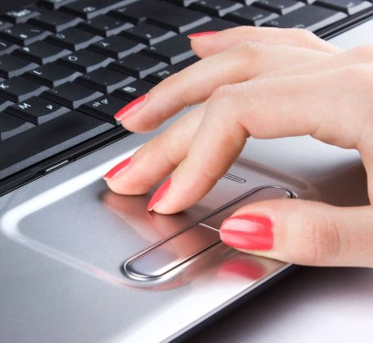
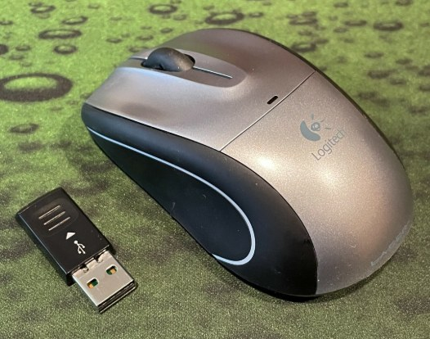
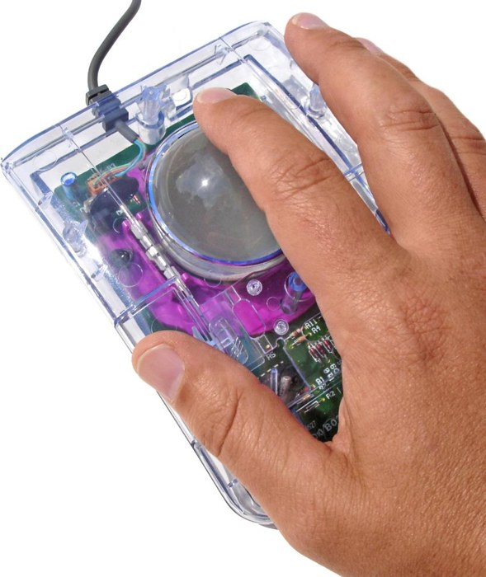
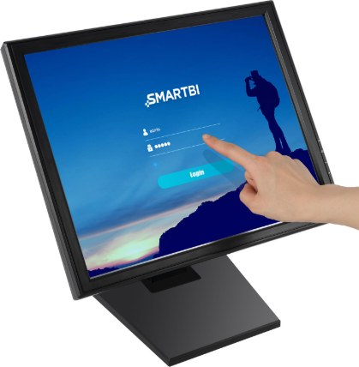

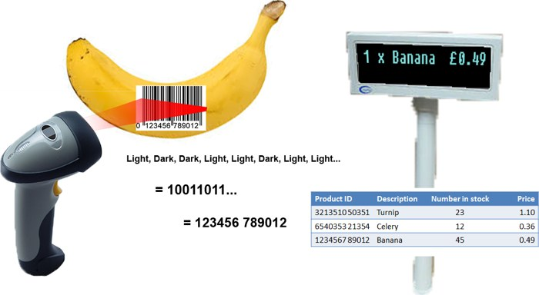
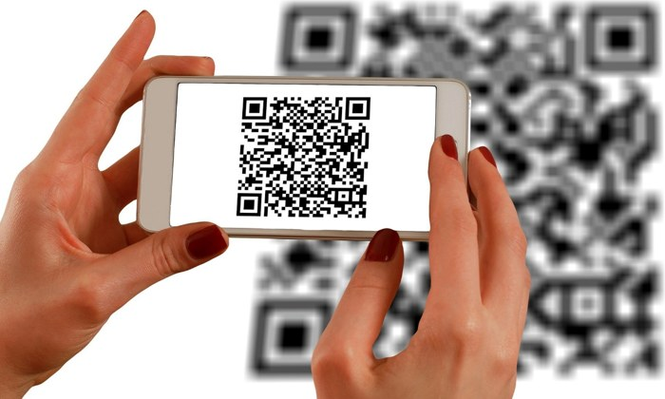
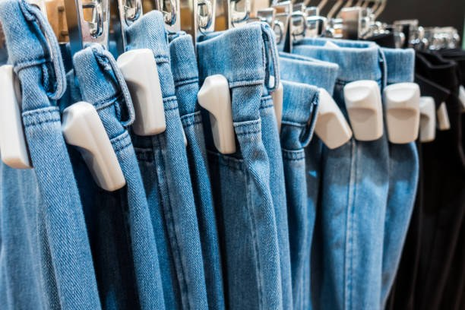


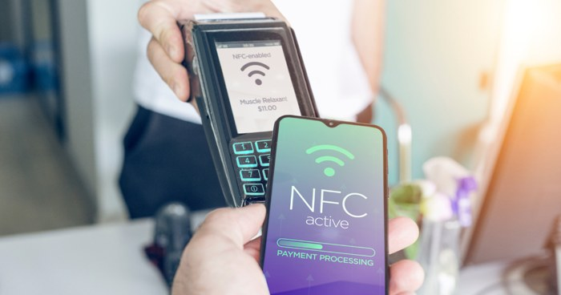
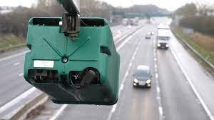
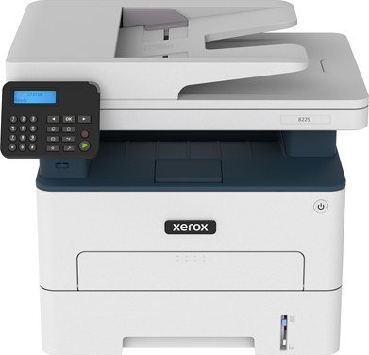


Input devices: what they look like
ESSENTIAL
KEY IDEA
Keyboard
Mouse
Trackball
Touchscreen
Microphone
Controller
Webcam
Barcode reader
QR code
RFID tags
NFC reader
ANPR camera
OMR scanner
2D scanner
Fingerprint
Notes:
11 to 12 minutes. Quick visual recap of the three families. Ask students to point out which family each device belongs to: row 1 and the first two of row 2 are manual, the rest are automatic capture. Photos are from the original 1.1.3 slides; teal icons are used where the original deck had no photo. Replace any icon with your own photo if you prefer.

Slide 9
How to choose an input device
ESSENTIAL
KEY IDEA
Who?
The user: age, training, disability, how many users
Where?
The environment: dirty, wet, noisy, outdoors, needs to stay clean
What data?
Text, sound, image, an ID code or a measurement
How much?
Volume and speed, accuracy needed, cost
Example: a keyboard is fine in an office, but in a dusty factory a sealed keypad or barcode scanner is better.
Take every reason from the scenario: who, where, what, how much.
Notes:
11 to 13 minutes. These four questions turn into reasons in exam answers. Ask for one more example for each box: who (a young child: touchscreen not keyboard), where (operating theatre: voice control keeps hands sterile), what (identity: fingerprint reader), how much (thousands of exam scripts: OMR scanner).

Slide 10
Worked example: N-U-J
ESSENTIAL
WORKED EXAMPLE
A hospital wants to make sure each patient gets the right medicine. Recommend an input device and justify your choice.
Name
A handheld barcode scanner
N
Use
The nurse scans the patient's wristband and the barcode on the medicine
U
Justify
Faster than typing an ID and avoids typing errors, so the wrong medicine is less likely. It can be wiped clean between patients
J
Justify = why THIS device suits THIS scenario better than another.
Notes:
13 to 16 minutes. I do. Think aloud. Name the hardware, not the software: 'barcode scanner' not 'scanning app'. Use: what data it captures here. Justify: link to who, where, what and how much from the last slide. Alternative accepted answer: an RFID reader and RFID wristband. Ask: what would make RFID a better choice? (No line of sight needed, so a sleeping patient need not be moved.)

Slide 11
Device showdown
ESSENTIAL
CHECK-IN
On your whiteboard: write A, B or C for the best device. 3, 2, 1, show. Be ready to justify.
1 Marking 300 multiple-choice answer sheets
A keyboard • B OMR scanner • C camera
B: fast and accurate
2 A car park that charges by time
A ANPR camera • B keypad • C GPS
A: reads plates, no stopping
3 A surgeon checking scans mid-operation
A mouse • B touchscreen • C microphone
C: hands stay sterile
4 Keeping a greenhouse warm
A thermometer app • B temperature sensor • C camera
B: measures all the time
5 Paying for a bus fare
A NFC reader • B barcode scanner • C keypad
A: tap the card, quick
6 A young child choosing a game
A keyboard • B touchscreen • C trackball
B: simple, no typing
Notes:
16 to 22 minutes. Hinge check-in. Students commit before the reveal, then justify using who, where, what, how much. Click to reveal each answer. Round 4: 'thermometer app' is software, a common exam slip: the mark scheme for June 2018 5(a) says the first mark must be hardware, not software. If more than a third get a round wrong, re-teach that family from slide 7.

Slide 12
Barcode, QR, RFID or NFC?
OPTIONAL
KEY IDEA
 | Holds | Range | Good for
Barcode | A short number | Line of sight, close | Shop products
QR code | Text or a web link | Line of sight, phone camera | Menus, tickets, posters
RFID tag | An ID, can be updated | Up to metres, no line of sight | Stock, pets, library books
NFC | An ID or payment data | A few centimetres | Contactless payment
Trade-off: barcodes are almost free to print. RFID tags cost more but many can be read at once without lining them up.
Range and line of sight are the deciding factors. Use them in your justification.
Notes:
Optional, 3 minutes. These four are easy to mix up in exam answers. NFC is a short-range form of RFID: the short range is a security feature for payments. Some RFID tags can be read from many metres away if they have their own battery (active tags), for example toll road tags. Not needed for the exam.

Slide 13
Talk to it
ESSENTIAL
TASK 1
A microphone with speech recognition software lets a user give commands and dictate text by talking.
Core
Two situations where it is useful, with a reason
Two situations where it is impractical, with a reason
Stretch
Speech recognition is ideal for a surgeon but poor in an open-plan call centre. Explain why.
Pairs, on one whiteboard. 4 minutes. Use who, where, what, how much.
Notes:
22 to 28 minutes. From the original worksheet task 1, now done on whiteboards. Circulate and push for the reason, not just the situation.

Slide 14
Talk to it: answers
ANSWERS
Useful
Driving: hands stay on the wheel, eyes on the road
A user who cannot use a keyboard because of a disability
Kitchen smart speaker: hands are busy or messy
Impractical
Noisy factory: background noise causes errors
Open office or library: disturbs others
Passwords or private data: others overhear
Stretch: an operating theatre is quiet and the surgeon must not touch anything. A call centre is noisy with many voices.
Notes:
28 minutes. Every answer links the environment or user to the outcome. That is exactly the skill exam questions reward.

Slide 15
Sensors
ESSENTIAL
KEY IDEA
A sensor measures a physical quantity
Such as temperature, light, pressure or movement
Readings are taken automatically, again and again, day and night
Most give an analogue signal, so an ADC turns it into digital data
Sensor
ADC
CPU
analogue to digital converter
Why not a person?
Never tired, work in danger, read more often.
Monitoring
Records or warns. Changes nothing.
Control
Acts on the reading, such as opening a window.
Notes:
28 to 31 minutes. Keep it brief: OCR does not ask how a sensor works. The ADC is useful background and links to data representation (sound sampling in 1.4.1). Monitoring and control are not named in the specification, but the idea helps students describe how a sensor solves a problem. Control systems come back in lesson B with actuators.

Slide 16
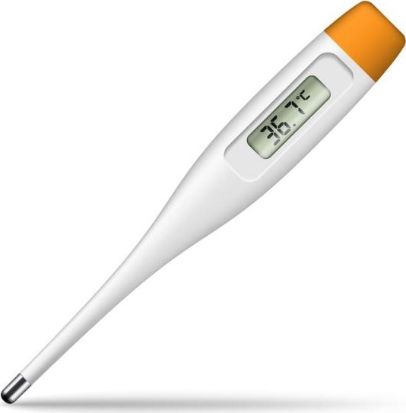
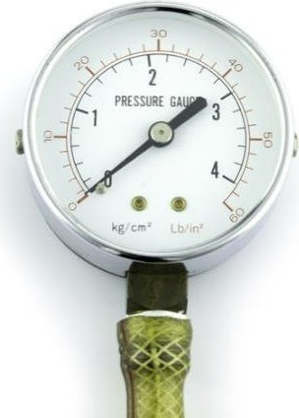
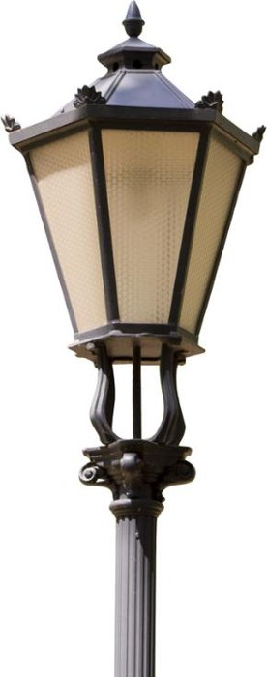
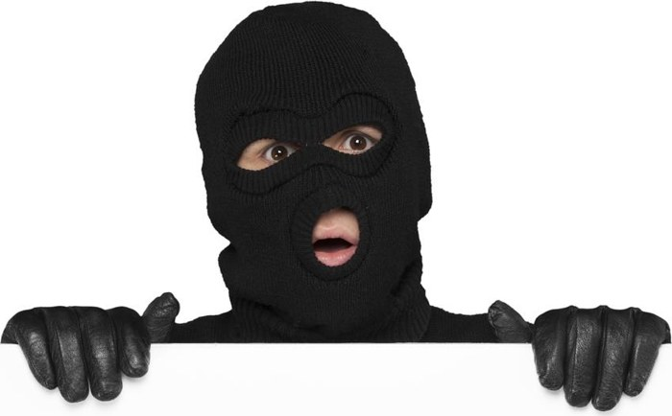
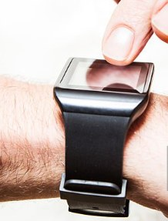

Sensors in use
OPTIONAL
KEY IDEA
Temperature
Pressure
Light: street lamp
Infra-red: intruder
Moisture, humidity
Heart rate, motion
Notes:
Optional, 1 minute. Each picture shows a sensor or the problem it solves. Ask: what does each sensor measure, and is it used to monitor or to control? Photos are from the original 1.1.3 slides; teal icons are used where the original deck had no photo. Replace any icon with your own photo if you prefer.

Slide 17
Sensor match
ESSENTIAL
TASK 2
Pairs: match each set of uses to one sensor below. Each is used once.
1
Central heating; greenhouse heat
2
Damp soil; chip factory air
3
Street lights at dusk; car headlights
4
Burglar alarm movement; counting shoppers
5
Weighbridge; alarm floor mat
6
Breaking glass; dripping pipe
7
Carbon monoxide in a car exhaust
8
Acidity of a river or of soil
Acoustic • Gas • Humidity • Infra-red • Light • pH • Pressure • Temperature
Notes:
31 to 36 minutes. From the original worksheet task 4, shortened. Humidity covers moisture. Answers on the next slide.

Slide 18
Sensor match: answers
ANSWERS
1
Temperature
2
Moisture / humidity
3
Light
4
Infra-red (motion)
5
Pressure
6
Acoustic (sound)
7
Gas
8
pH
In an exam, name the sensor AND say what it measures in that scenario.
Notes:
36 minutes. Click to reveal one at a time. Ask: which of these would you use for a smart greenhouse? (Temperature, humidity, light, gas for CO2, pH for soil.)

Slide 19
Monitoring or control?
OPTIONAL
TASK 3
On your whiteboard: M for monitoring (only records or warns) or C for control (acts on it).
1 Street lights switch on at dusk
C: turns lights on
2 Pollution readings from a river
M: records and warns
3 A patient's heart rate on a ward
M: alarms the nurse
4 Air conditioning keeps a room at 21 °C
C: changes the cooling
5 A burglar alarm detects an intruder
M: sounds an alarm
6 Anti-lock brakes on a car
C: changes the braking
Notes:
Optional, 4 minutes. From the original worksheet task 5. A burglar alarm is usually classed as monitoring: it warns but does not change the thing it measures. Accept a reasoned argument either way: that reasoning is the skill.

Slide 20

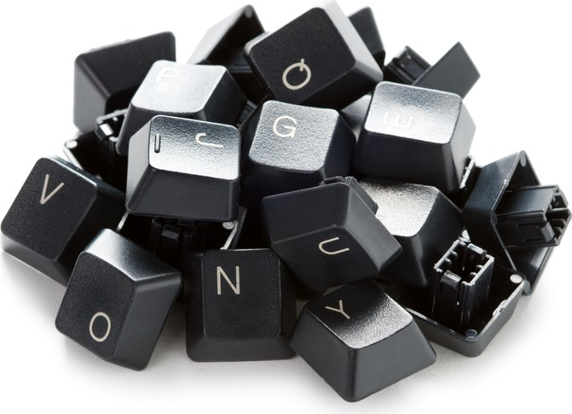
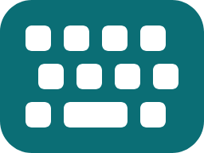
Input for users with disabilities
ESSENTIAL
KEY IDEA
Eye tracker
A camera follows where the user looks to move the pointer
Sip and puff switch
The user blows or sucks on a tube to send a signal
Foot mouse or switch
Pressed with the foot instead of the hand
Microphone
Speech recognition replaces typing
Braille keyboard
Lets a blind user type using braille keys
Large key keyboard
Bigger keys for users with limited fine movement
June 2018 Paper 1 asked for exactly this. Learn two of these.
Notes:
38 to 40 minutes. June 2018 H446/01 Q5(a): name an input device and describe how a user with very limited mobility in their hands and arms could use it to send a signal. The mark scheme accepted foot mouse, camera or eye tracker, and puff or suck switch. Model answer on slide 22.

Slide 21
Where input is heading
OPTIONAL
BEYOND THE SPEC
LiDAR
Some phones fire invisible laser pulses to measure depth, for better photos and AR room scanning.
Hand tracking
Mixed reality headsets use cameras to follow your hands, so you point and pinch instead of using a controller.
Brain-computer interfaces
Research devices read signals from the brain to move a cursor. Early trials help people who are paralysed.
Wearable sensors
Watches measure heart rate and blood oxygen, and can detect a fall and call for help.
Notes:
Optional, 3 minutes. Beyond the specification: not examined, but a newer device is fine in an exam answer if it suits the scenario and is justified. Ask: which family is each one in? (All automatic capture or sensors.) Which raise privacy issues? (Links to 1.5.2 moral and ethical issues.)

Slide 22
How input devices are examined
EXAM ADVICE
Paper 1 | Scenario | What it asked | Marks
June 2019 1(a) | Smart assistant | Name one input and one output device, with a reason for each | 4
June 2018 5(a) | Limited mobility | Name an input device and how the user would use it | 2
June 2023 1(d) | Video editing PC | Explain the role of device drivers for input and output devices | 2
Device drivers are taught in 1.2.1: software that lets the operating system communicate with a device.
Short questions, always in a scenario. The reason must fit the scenario.
Notes:
40 to 41 minutes. These are real OCR H446/01 questions from the project folder. The June 2023 mark scheme for 1(d): a piece of software which allows the hardware device to communicate with the operating system.

Slide 23
What the mark schemes say
ESSENTIAL
EXAM ADVICE
Earns marks
A named hardware device, such as "barcode scanner"
What it is used for in this scenario
A reason linked to the user or environment
One device per answer line
Loses marks
Software instead of hardware: "a scanning app"
Brand names: "an iPad"
Two devices in one answer: only the first is marked
How it works, when the question asks why
Mark scheme: "First mark must be hardware not software."
Notes:
41 to 43 minutes. The project folder has mark schemes but no examiner reports, so these points come from the guidance column of the OCR mark schemes: June 2018 5(a) 'First mark must be hardware not software'; June 2019 1(a) 'max 1 device name, max 1 reason'; June 2023 1(e)(i) 'Must be output devices' and 'Must be suitable for video editing'.

Slide 24
Model answer: June 2018 5(a)
EXAM ADVICE
Software flashes letters on screen. State an input device and describe how a user with very limited mobility in their hands and arms could use it to send a signal. [2]
Weak: 0 marks
"A mouse or a keyboard, so they can click when the letter appears."
Both need hands. Two devices named. The use is not possible for this user.
Strong: 2 marks
"A sip and puff switch (1). The user blows into the tube when the letter they want is on the screen, which sends the signal (1)."
Name it, then describe how THIS user would use it.
Notes:
43 to 45 minutes. The strong answer matches the mark scheme: 1 mark for naming a suitable input device, 1 for its use. Also credited: foot mouse (press with the foot), eye tracker (look at the letter or blink). Ask: rewrite the weak answer with a foot switch.

Slide 25
Input devices in your NEA
NEA LINK
Where it earns marks
3.1.2 Stakeholders: what can your users use?
3.1.4(a) Hardware requirements, justified
3.2.2(c) Usability: keyboard shortcuts, touch-sized buttons
Requirement | Justification
Keyboard | Students type answers to quiz questions
Mouse or touch | To select menu options quickly
Microphone | Not needed: classrooms are noisy
List each input device your solution needs, and justify it from your stakeholders.
Notes:
45 to 46 minutes. Section references from the H446 specification, NEA component 03/04. Saying why a device is NOT needed also shows justification. Students should keep this table for their Analysis section.

Slide 26
Exam practice
ESSENTIAL
TASK 4
Core
(a) Explain what is meant by an input device. [1]
(b) A supermarket is installing self-service tills. Identify two input devices the tills need and explain why each is needed. [4]
Stretch
(c) A farmer wants to water crops only when the soil is dry. Recommend a suitable input device and justify your choice. [3]
(d) Explain one drawback of using a microphone and speech recognition at the self-service tills. [2]
In your book, silently. 8 minutes. Questions written in the style of Paper 1.
Notes:
46 to 54 minutes. Everyone does the core. Fast finishers do the stretch.

Slide 27
Exam practice: answers
ANSWERS
(a) [1]
Hardware that captures data and sends it into the computer
(b) [4] device (1) + reason (1), twice
Barcode scanner (1): fast, no typing errors (1)
Scales (1): weigh loose fruit, check the bagging area (1)
Also: touchscreen, card reader (NFC)
(c) [3]
Moisture sensor in the soil (1)
Takes readings automatically, day and night (1)
Water turns on only below a set level, so none is wasted (1)
(d) [2]
Supermarkets are noisy (1), so words are misheard and the wrong item is added (1)
Notes:
54 minutes. Mark in a different colour pen. Check every reason is linked to the supermarket or the farm. For (d) also accept: customers may not want others to hear what they buy; slower than scanning; accents may not be recognised.

Slide 28
Exit ticket
ESSENTIAL
RECAP
Name one input device from each family: manual, automatic, sensor.
For example: keyboard, barcode scanner, temperature sensor
1
Why is a sensor better than a person taking readings?
Readings are automatic, frequent and accurate, even at night or in dangerous places
2
A library lends books. Name and justify an input device.
RFID reader: reads many book tags at once with no line of sight, so check-out is quick
3
Notes:
55 to 58 minutes. Whiteboards. Click to reveal each answer.

Slide 29
Key terms to remember
RECAP
Input device | hardware that captures data and sends it into the computer
Sensor | measures a physical quantity such as temperature or light
ADC | converts an analogue signal into digital data
Barcode scanner | reads a printed code by line of sight
RFID | reads a tag by radio waves, no line of sight needed
NFC | very short range RFID, used for contactless payment
OMR | reads marks made in set places on a form
OCR | turns printed or handwritten text into editable text
Notes:
Reference slide. The same definitions are in the revision booklet.

Slide 30
Wider study
OPTIONAL
RESEARCH
Choose one task to complete before next week. Write it up in your book.
Task | Focus | Level | Spec
1 | List every input device in your home. Which family is each in? | Accessible | On spec
2 | Find out how a supermarket self-checkout spots a missing item | Accessible | On spec
3 | Accessibility: research three inputs for users with disabilities | Medium | On spec
4 | Analogue to digital conversion: what does sample rate mean? | Medium | Links to 1.4.1
5 | How does ANPR read a plate? What are the privacy issues? | Medium to high | Beyond
6 | Brain-computer interfaces: what can they do today? | Medium to high | Beyond
Notes:
Beyond tasks go past the specification to build a rounder understanding. They will not be examined directly but help with exam answers and the NEA.

