Slide 1
OCR A LEVEL COMPUTER SCIENCE • 1.1.3B
The outside world
Output
devices
Screen
Printer
CPU
Speaker
Choose the right device to present results or act on the world, and justify why it fits
Actuator
data out: images, hard copy, sound, movement
Notes:
1.1.3B Output devices. Spec 1.1.3(a). As in lesson A, OCR's clarification guide says candidates do not need to know how output devices work: they must recommend suitable devices and justify the choice. So there is no 'how a laser printer works' in this lesson. Essential route: about 50 minutes. With the optional slides: about 60 minutes. You need: mini whiteboards and pens, exercise books. Nothing to print or cut out.

Slide 2
What you will be able to do
OUTCOMES
Describe a range of output devices and what each is used for
Choose a suitable output device for a given problem
Explain how sensors and actuators work together to control something
Answer "name and justify" exam questions for full marks
Today's route: 50 to 60 minutes
4 min
Recall: lesson A
5 min
Starter: who am I?
4 min
Four families of output
6 min
Task 1: which printer?
4 min
Screens
4 min
Check-in
4 min
Actuators
8 min
Task 2: design it
ESSENTIAL
do these even if time is short
5 min
Exam advice
8 min
Exam practice
OPTIONAL
skip if time is short
3 min
Exit ticket
Notes:
1 minute. Share the route. Optional slides: beyond the specification and the NEA link. They add about 5 minutes. If time is short, skip every OPTIONAL slide and the lesson still covers all the output content of 1.1.3(a).

Slide 3
Recall: input devices
ESSENTIAL
CHECK-IN
From last lesson. On your whiteboard: answer, then 3, 2, 1, show.
What do N, U and J stand for?
Name the device, its Use here, Justify why it suits
1
Barcode or RFID for tracking pallets in a warehouse?
RFID: no line of sight, many read at once
2
Name a sensor for a smart greenhouse and what it measures.
For example: temperature sensor, how warm the air is
3
Why is "a scanning app" not credited as an input device?
It is software. The mark is for hardware
4
Notes:
1 to 5 minutes. Spaced retrieval from lesson A. Click to reveal each answer. Q4 checks the mark scheme rule 'first mark must be hardware not software'.

Slide 4
Who am I?
ESSENTIAL
STARTER
Guess early for more points: 3 after clue 1, 2 after clue 2, 1 after clue 3.
Round 1
Round 2
Round 3
I make solid objects, layer by layer
I only use power when my picture changes
I turn a signal into movement
Surgeons use me to make models
You can read me in bright sunlight
I open windows and turn on pumps
I am slow, but each thing I make can be different
You find me in e-readers and shop shelf labels
I am often paired with a sensor
3D printer
E-ink display
Actuator
Notes:
5 to 10 minutes. Whiteboards, pairs. Click once per clue: round 1 clues, answer, then round 2 and so on. Keep score on the board. All three devices come back later in the lesson, so this is a preview, not a test.

Slide 5
Four families of output device
ESSENTIAL
KEY IDEA
Visual
Show it
Monitor, TV
Projector
E-ink display
LED lights
Hard copy
Keep it
Inkjet, laser printer
Thermal printer
3D printer
Braille embosser
Sound
Hear it
Speakers
Headphones
Buzzer, alarm
Movement
Do it
Actuator: motor, valve, pump
Vibration (haptic)
Braille display
Both input and output: touchscreen, VR headset, games controller that vibrates
Notes:
10 to 13 minutes. An output device takes data from the computer and presents it to a person, or uses it to act on the world. Chunk into four families for recall. Ask: which family were the three starter answers in?

Slide 6
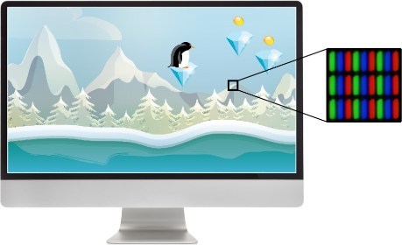
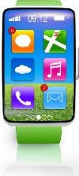
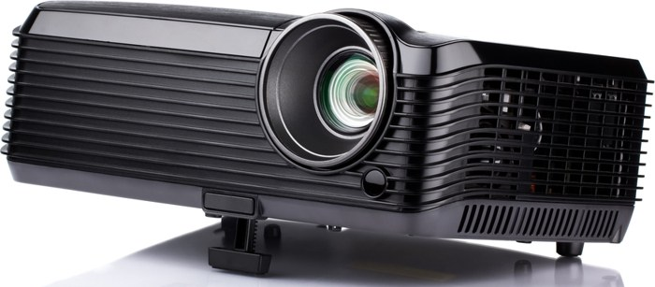
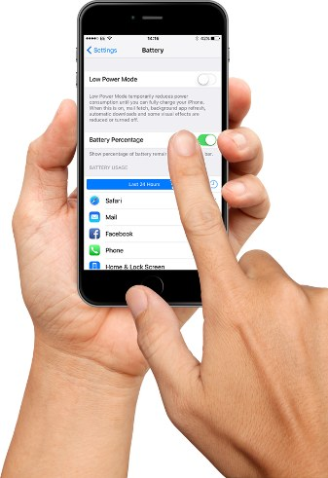

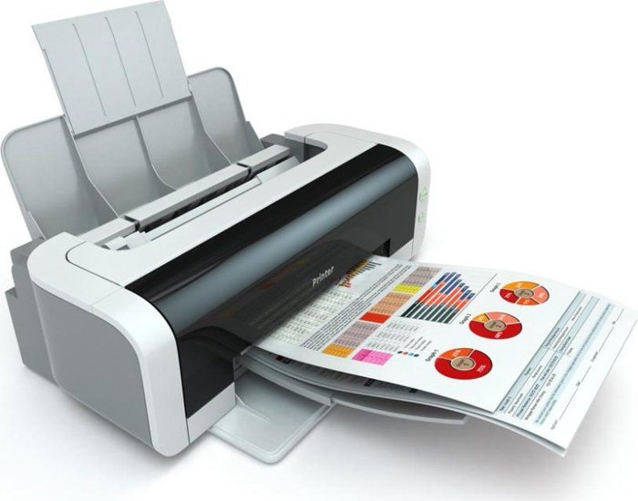
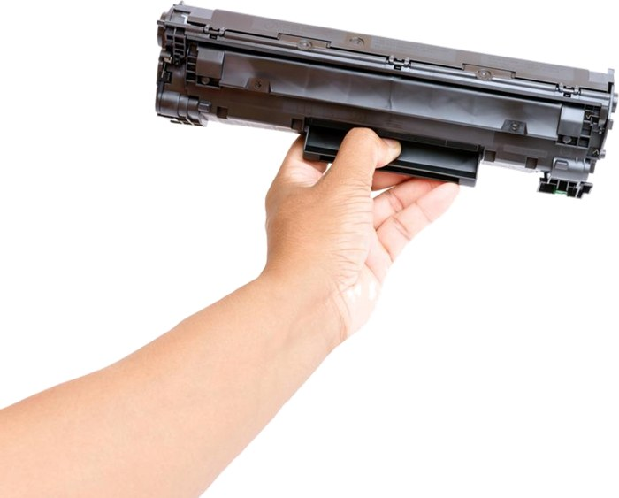
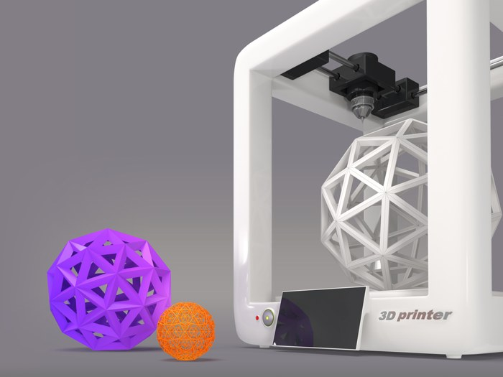

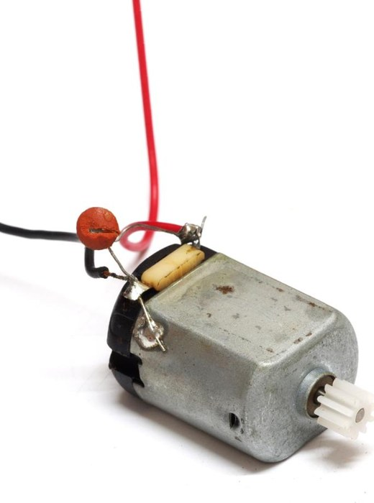
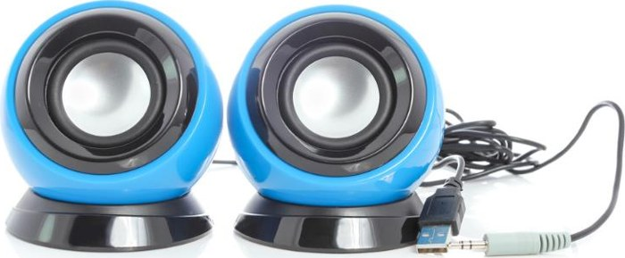



Output devices: what they look like
ESSENTIAL
KEY IDEA
LCD monitor
OLED watch
E-ink display
Projector
Touchscreen
Inkjet printer
Laser (toner)
Thermal printer
Dot matrix
3D printer
Speakers
Headphones
Buzzer, alarm
Motor
Vibration
Notes:
13 minutes. Rows match the families: visual, hard copy, then sound and movement. Ask: which of these could also be an input device? (Touchscreen.) Photos are from the original 1.1.3 slides; teal icons are used where the original deck had no photo. Replace any icon with your own photo if you prefer.

Slide 7
How to choose an output device
ESSENTIAL
KEY IDEA
Who?
How many people see or hear it? Any visual or hearing impairment?
Where?
Bright sunlight, noise, need for privacy or quiet
Keep it?
Hard copy needed, or is it only for now?
How much?
Pages per day, running cost, battery power
Example: a library uses headphones, not speakers: users hear audio without disturbing others.
Same method as input: Name, Use, Justify from the scenario.
Notes:
13 to 15 minutes. These mirror lesson A's who, where, what, how much. Ask for one example per box.

Slide 8
Choosing a printer
ESSENTIAL
KEY IDEA
Printer | Best for | Strength | Drawback
Inkjet | Home, one-off photos | Cheap to buy, good colour | Ink is costly per page
Laser | Offices, high volume | Fast, low cost per page | Dearer to buy
Thermal | Receipts, labels, tickets | No ink, quiet, small | Print fades over time
Dot matrix | Multi-part copies | Works in dusty places | Noisy, low quality
3D | Prototypes, implants | Makes real objects | Slow, one at a time
You do not need to know how a printer works. Know when to use it.
Notes:
15 to 17 minutes. Dot matrix is an impact printer: the pins strike through the top copy onto the carbon copies below, which is why it suits multi-part stationery. Thermal printers use heat-sensitive paper. Neither detail is examined, but the uses are.

Slide 9
Which printer?
ESSENTIAL
TASK 1
On your whiteboard: I inkjet, L laser, T thermal, D dot matrix, 3 for 3D. Then justify.
1 One-off high quality photos at home
I: cheap to buy, good colour
2 Two-part picking lists in a dusty warehouse
D: copies, copes with dust
3 5000 colour flyers for a school open evening
L: fast, cheap per page
4 Receipts at a shop till
T: fast, no ink to replace
5 A model of a patient's heart for a surgeon
3: makes a real 3D object
6 Parcel labels in a delivery depot
T: quick sticky labels
Notes:
17 to 23 minutes. From the original worksheet task 1, now on whiteboards. Click to reveal each answer. Accept laser for the parcel labels if justified by volume. The justification is what earns the mark.

Slide 10
Screens and projectors
ESSENTIAL
KEY IDEA
Display | Best for | Strength | Drawback
LCD (LED lit) | Monitors, TVs | Cheap, bright, sharp | Thicker, uses more power
OLED | Phones, watches | Thin, can bend, low power | Costly, can burn in
E-ink | E-readers, shelf labels | Tiny power, sunlight | Slow refresh, few colours
Projector | Classrooms, cinemas | Huge image, one device | Needs a dim room
Touchscreen | Kiosks, phones | Input and output | Fingerprints, small text
Link the screen to the scenario: size, power, light and cost.
Notes:
23 to 26 minutes. These are characteristics, not how the technology works, which is what OCR wants. OLED pixels make their own light, so a black pixel is off: that is why OLED saves battery on dark screens. Not examined.

Slide 11
Check-in: outputs
ESSENTIAL
CHECK-IN
1 A solar-powered bus stop sign:
A OLED
B projector
C e-ink
D LCD monitor
2 A blind user reading a web page:
A a projector
B a refreshable braille display
C a laser printer
D an OLED screen
3 Which is output only?
A touchscreen
B microphone
C speaker
D VR headset
4 An office printing 2000 pages a day:
A inkjet
B laser
C thermal
D 3D
Write the letter only. 3, 2, 1, show.
Notes:
26 to 29 minutes. Answers on the next slide. Q1 checks power, Q2 accessibility, Q3 the input/output line, Q4 volume and running cost.

Slide 12
Check-in: answers
ANSWERS
C
E-ink only uses power when the sign changes, so a small solar panel is enough
1
B
Raises pins to show braille, so the user reads the page by touch
2
C
A touchscreen and VR headset are both. A microphone is input
3
B
Fast with a low cost per page for high volumes
4
Notes:
29 minutes. Click to reveal each reason. A speaker reader (screen reader software plus headphones) is also a good answer for Q2.

Slide 13
Actuators: outputs that act
ESSENTIAL
KEY IDEA
An actuator turns a signal into movement. Add a sensor and it can control things.
Sensor
Processor
Actuator
feedback: the change affects the next reading
Greenhouse
Temperature too high: motor opens the window
Central heating
Room too cold: valve opens, pump turns on
Automatic door
Motion detected: motor slides the door
Notes:
29 to 33 minutes. Links back to monitoring and control in lesson A. The processor compares each reading with a set value and decides whether to switch the actuator. Ask: in the greenhouse, what happens to the temperature reading after the window opens? (It falls, so the window can close again: feedback.)

Slide 14
Design the outputs
ESSENTIAL
TASK 2
Groups of 2 to 4. On one whiteboard: N-U-J for three output devices.
Tables 1, 5, 9
A screen in car headrests to keep young children busy on long trips
Tables 2, 6, 10
A self-service checkout in a busy supermarket
Tables 3, 7, 11
A museum exhibit that blind and partially sighted visitors can enjoy
Tables 4, 8, 12
A smart home security system that alerts the owner
Stretch: add one input device, and one trade-off of your design.
Notes:
33 to 41 minutes. The car screen is the extension task from the original worksheet. Give 6 minutes, then each group reads out one device with its justification. Model answers on the next slide.

Slide 15
Design the outputs: model answers
ANSWERS
Car headrest screen
Small LCD touchscreen: cheap, children tap. Headphones: driver not distracted
Self-checkout
Touchscreen: shows items and prices. Speaker: spoken prompts. Thermal printer: receipt
Museum exhibit
Speakers or headphones: audio description. Braille display. Vibration: feel the exhibit
Home security
Siren: scares the intruder. Phone screen alert: owner sees it anywhere. Floodlight
Notes:
41 minutes. Other sensible answers are fine if justified. Trade-offs to listen for: a touchscreen in a car could be a distraction, a siren could cause false alarms for neighbours, braille displays are expensive.

Slide 16
Where output is heading
OPTIONAL
BEYOND THE SPEC
3D printed medicine
Hospitals print models of a patient's organs to plan surgery, and print custom implants and hearing aid shells.
Haptic feedback
Game controllers and phones vibrate in patterns, so you can feel a click or a collision.
Mixed reality
Headsets show digital images over the real world, such as instructions over a machine being repaired.
Bone conduction
Headphones that sit in front of the ear, so runners still hear traffic around them.
Notes:
Optional, 3 minutes. Beyond the specification. A newer device can be credited in an exam if it suits the scenario and is justified. Ask: which family is each one in? Which help users with disabilities?

Slide 17
What the mark schemes say
ESSENTIAL
EXAM ADVICE
Earns marks
A named output device
A device that suits the task: "monitor" for video editing
A reason from the scenario: "to play the responses"
One device per answer line
Loses marks
An input device when an output is asked for
A device that does not fit: "printer" for video editing
"To output data": that is true of every device
Describing how the device works
June 2023: "Must be output devices. Must be suitable for video editing."
Notes:
41 to 43 minutes. From the guidance column of the OCR mark schemes: June 2023 H446/01 1(e)(i) 'Must be output devices' and 'Must be suitable for video editing'; June 2019 1(a) 'max 1 device name, max 1 reason'. The project folder has mark schemes but no examiner reports.

Slide 18
Model answer: June 2019 1(a)
EXAM ADVICE
"Bertie Butler" is a home assistant that listens for "Hey Bertie", then answers the question. Name one input and one output device, with a reason for each. [4]
Weak: 1 mark
"Input: keyboard, to type questions. Output: printer, to output the answer."
Bertie listens, so a keyboard does not fit. "To output the answer" is too vague.
Strong: 4 marks
"Input: microphone (1), so it can hear the spoken question (1). Output: speaker (1), so it can play its spoken answer (1)."
Each reason must fit how THIS device is used.
Notes:
43 to 45 minutes. Matches the June 2019 mark scheme. Also credited: buttons to turn it off or mute it; LEDs to show it is on or listening; a screen to show visual information. The weak answer gets 1 for 'printer' only if the examiner accepts it as suitable, so most would award 0 or 1. Ask: improve the weak answer one line at a time.

Slide 19
Output devices in your NEA
OPTIONAL
NEA LINK
Where it earns marks
3.1.4(a) Minimum screen size and resolution, sound
3.2.2(c) Usability: text size, colour contrast, sound alerts
3.4.3 Comment on how well those features worked
Requirement | Justification
1366 x 768 screen | Fits a school laptop, the smallest users have
Speakers | Sound effects in the game (can be muted)
Printer | Not needed: scores are saved, not printed
Justify outputs from your stakeholders, as you did for inputs.
Notes:
Optional, 2 minutes. Section references from the H446 specification, NEA component 03/04. Students add these rows to the requirements table started in lesson A.

Slide 20
Exam practice
ESSENTIAL
TASK 3
Core
(a) A user captures and edits video elements before combining them into a final video. State two different output devices that could be used when editing the videos. [2] (June 2023)
(b) Explain what is meant by an actuator. Give an example of its use. [2]
Stretch
(c) A delivery depot prints two-part delivery notes in a dusty loading bay, and colour brochures for customers in the office. Recommend a printer for each and justify your choices. [4]
In your book, silently. 7 minutes. (b) and (c) written in the style of Paper 1.
Notes:
45 to 52 minutes. Everyone does the core. Fast finishers do the stretch.

Slide 21
Exam practice: answers
ANSWERS
(a) [2] mark scheme
Monitor
Speakers or headphones
Must be output devices, suitable for video editing
(b) [2]
Turns a signal from the computer into movement (1)
A motor that opens a greenhouse window (1)
(c) [4] printer (1) + reason (1), twice
Dot matrix (1): prints through to the carbon copy and copes with dust (1)
Colour laser (1): fast and cheap per page for many brochures (1)
Accept inkjet for brochures if few are printed and quality photos are needed.
Notes:
52 minutes. (a) is from the June 2023 H446/01 mark scheme. Mark in a different colour pen.

Slide 22
Exit ticket
ESSENTIAL
RECAP
What is the difference between an input and an output device?
Input captures data into the computer. Output presents data from it, or acts on the world
1
Why might a train station use speakers as well as screens?
Passengers who cannot see the screen, or are not looking, still hear changes
2
Name an output device for a smartwatch and justify it.
OLED screen: thin, low power on dark screens, so the battery lasts longer
3
Notes:
52 to 55 minutes. Whiteboards. Click to reveal each answer.

Slide 23
Key terms to remember
RECAP
Output device | hardware that presents data from the computer or acts on it
Actuator | turns a signal from the computer into movement
Control system | a sensor, a processor and an actuator, with feedback
Laser printer | fast, low cost per page: high volume printing
Inkjet printer | cheap to buy, good colour: low volume and photos
Thermal printer | uses heat-sensitive paper: receipts and labels
3D printer | builds a solid object layer by layer
E-ink display | uses power only when the image changes
Notes:
Reference slide. The same definitions are in the revision booklet.

Slide 24
Wider study
OPTIONAL
RESEARCH
Choose one task to complete before next week. Write it up in your book.
Task | Focus | Level | Spec
1 | List every output device in a car. Which family is each in? | Accessible | On spec
2 | Compare the running cost per page of an inkjet and a laser printer | Accessible | On spec
3 | Accessible outputs: screen readers and braille displays | Medium | On spec
4 | Design a control system for a smart greenhouse | Medium | On spec
5 | 3D printing in medicine: what is printed today? | Medium to high | Beyond
6 | How does an OLED screen save power on a dark image? | Medium to high | Beyond
Notes:
Beyond tasks go past the specification to build a rounder understanding. They will not be examined directly but help with exam answers and the NEA.

