Slide 1
A-Level Computer Science
Starter
What do the following acronyms stand for in terms of the CPU?
PC
CIR
MAR
ALU
Wednesday lesson – Unit 1
  First topic – 1.1.1 Processor components and the fetch-decode-execute cycle
Friday lesson – Unit 2
  First topic – programming basics & algorithms
Wider study
  Set on Friday but may be from either unit

Slide 2
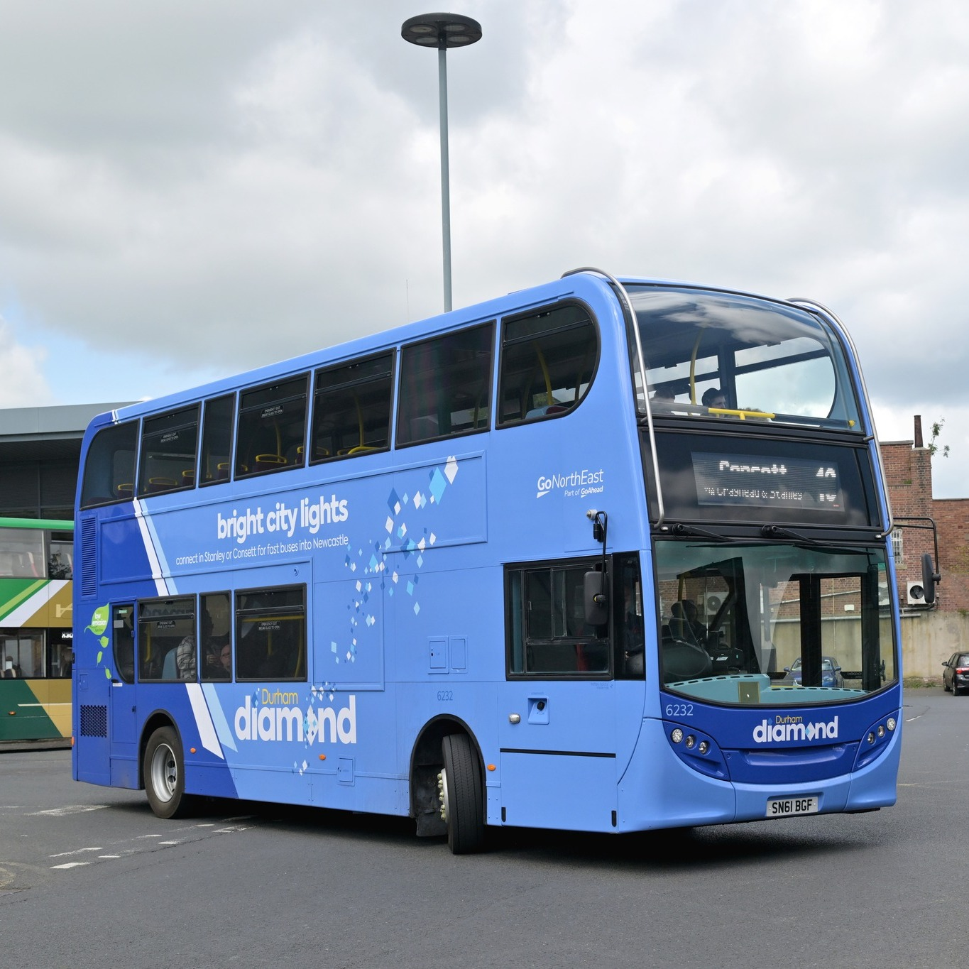
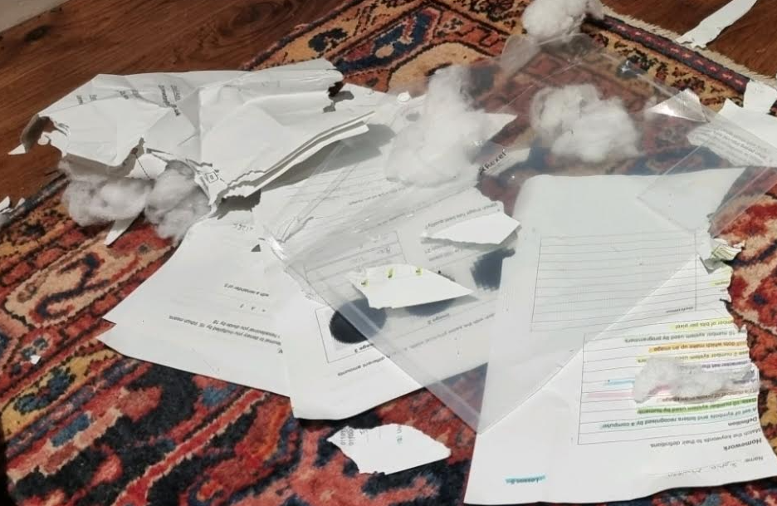
Folders will stay in M9, except when you need to take them home to revise for an assessment.

Slide 3
1.1.1A Processor Components
Objectives
Describe the function of the ALU and Control Unit
Describe the Fetch-Execute cycle and the role of the following registers:
Program counter
Accumulator
Memory Address Register
Memory data register
Current instruction register

Slide 4
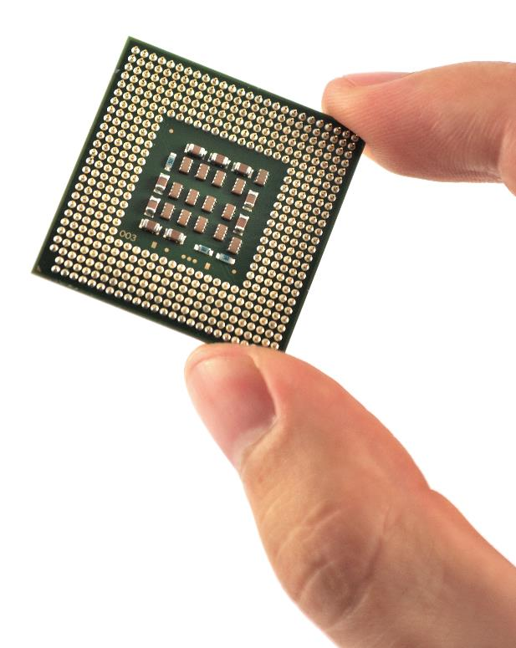
Central Processing Unit (CPU)
The processor (also called the Central Processing Unit or CPU) has a number of different components, each with their own role to perform:
  Control Unit
  Buses
  Arithmetic-Logic Unit (ALU)
  Registers

Slide 5

Control unit
The part of the processor that coordinates the activity of all other components
  Control signals are sent along the control bus between the control unit and the other components of the computer

Slide 6
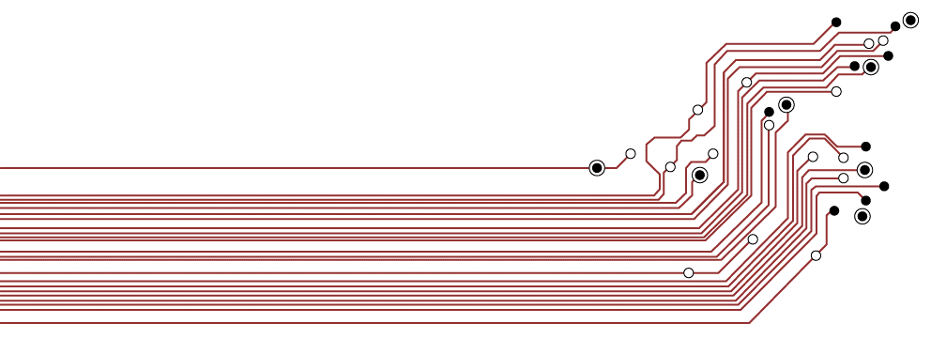
What is a bus?
Buses in a computer consist of a series of connectors that transfer signals between internal components
  They typically consist of 8, 16, 32 or 64 lines

Slide 7
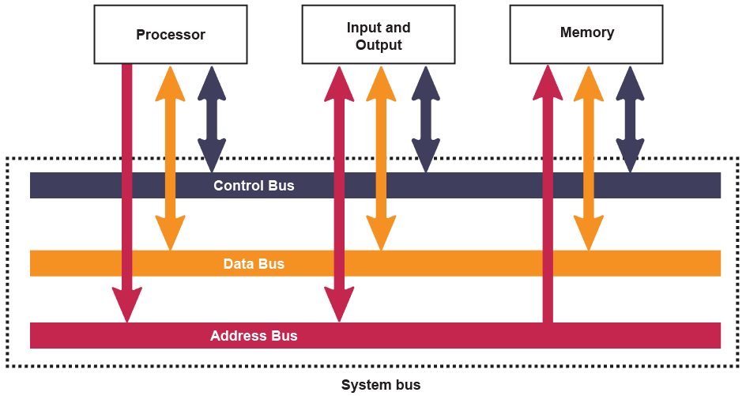
System bus
The system bus consists of three separate buses carrying control signals, addresses and data

Slide 8
Control signals include…
Memory read: causes data from the addressed location in RAM to be placed on the data bus
Memory write: causes data on the data bus to be written into the addressed location in RAM
Bus request: indicates that a device is requesting use of the data bus
Bus grant: indicates that the CPU has granted access to the data bus
Clock: used to synchronise operations

Slide 9
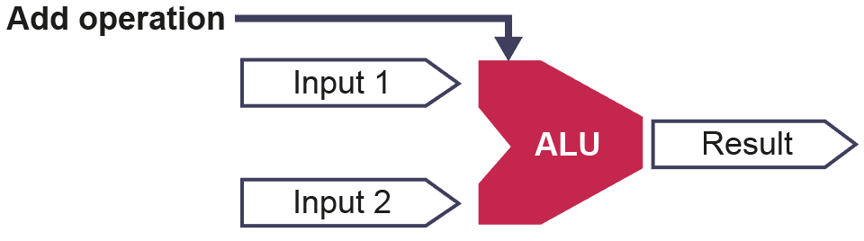
Arithmetic-Logic Unit (ALU)
The problem-solving part of the processor
  This component performs arithmetic, logical and shift operations on data
  Arithmetic operations: Add, Subtract, Multiply and Divide
  Logical operations include AND, OR, NOT and XOR
  Shift operations: Move bits to the left or right within a register

Slide 10
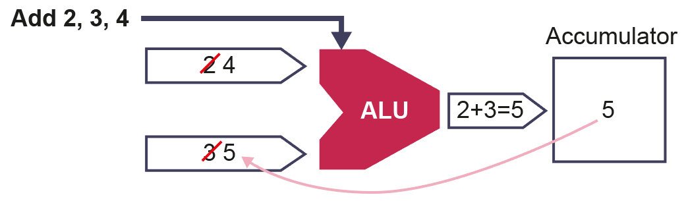
The accumulator
Results from the ALU need to be stored somewhere
  Rather than writing working data back to ‘slow’ memory, processors have several locations of super-fast memory called registers that are used to temporarily store results
  The processor is then able to immediately access and re-use these results in subsequent calculations, e.g. Add 2 + 3 + 4
  For simplicity we will assume the processor has a single general-purpose register called an accumulator

Slide 11
Executing instructions
Carrying out a sequence of programming instructions requires many different pieces of information to be held
The processor has to temporarily hold the current instruction being executed
It has to hold the address of the data that it needs, and also the data itself
It has to keep track of the address of the next instruction to be executed

Slide 12
Dedicated registers
Dedicated registers used by the processor include:
  Program counter (PC) – holds the memory address of the next instruction to be executed
  Current Instruction Register (CIR) – holds the current instruction, which is split into opcode and operand
  Memory Address Register (MAR) - holds the address in memory where the processor is required to fetch or store data from or to
  Memory Data Register (MDR) – temporarily holds data moving between the processor and main memory
  Accumulator – to hold intermediate results of an instruction

Slide 13
The processor
Complete Task 1 of Worksheet A

Slide 14

Executing instructions
The role of the processor is to carry out instructions from programs stored in memory
  The Control Unit coordinates components to work together to achieve this in the same way that a conductor controls all the components of an orchestra

Slide 15
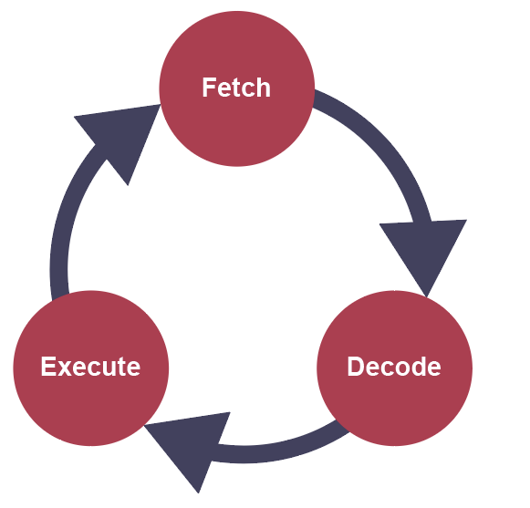
Fetch-execute cycle
Processors operate in defined stages that are used to carry out program instructions
  The process is repeated over and over again for each instruction in a program

Slide 16
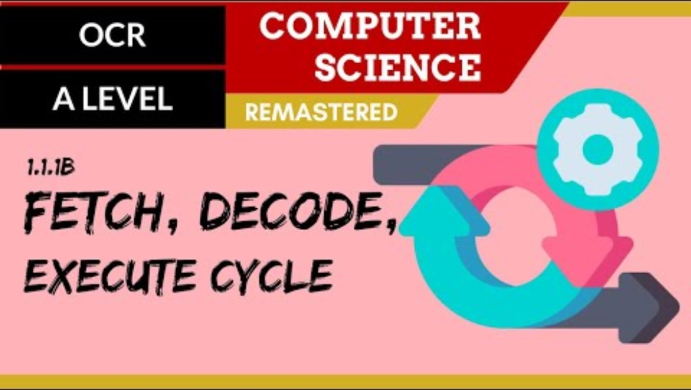

Slide 17
Fetch: Steps 1 - 4
The address of the next instruction is copied from the PC to the Memory Address Register (MAR)
The instruction held at that address is copied to the Memory Data Register (MDR)
Simultaneously, the contents of the Program Counter (PC) are incremented
The contents of the MDR are copied to the current Instruction Register (CIR)

Slide 18
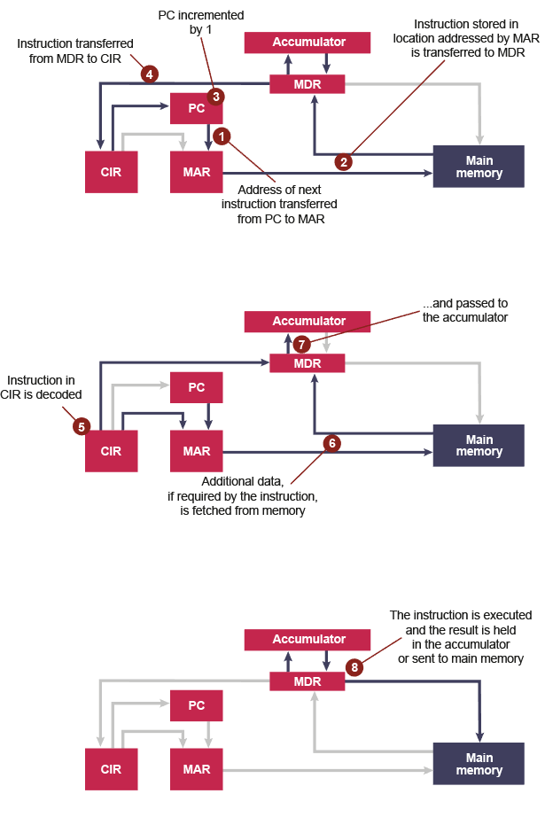
Fetch: (Steps 1 – 4)
Note: Blue lines show connections along which data is travelling in this stage

Slide 19
Decode: Steps 5 – 7
5. The instruction held in the CIR is decoded
6. It is split into operand and opcode to determine the type of instruction it is. Additional data, if required, is fetched from memory…
7. and passed to the accumulator
  The opcode specifies the operation that is to be carried out
  The operand holds either:
  The address of the data to be used, which is then copied to the MAR, or
  The actual data to be operated on, which is passed to the MDR

Slide 20
Decode: (Steps 5 – 7)
With the instruction now in the CIR, the Control Unit can work out what needs to be done to carry it out

Slide 21
Execute: (Step 8)
The instruction is executed and the result held in accumulator or stored in memory

Slide 22
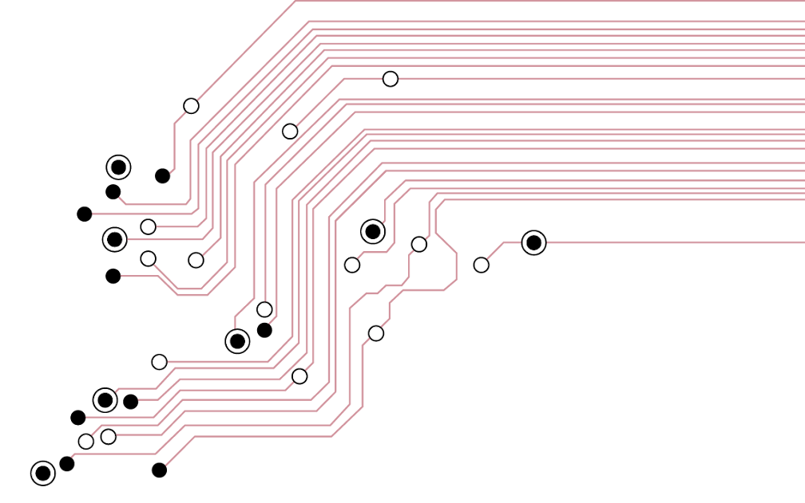
Worksheet A
Complete Task 2
Extension task: For a challenge, try Worksheet B

Slide 23
Plenary
The main components of the processor are:
  ALU
  Control Unit
  registers
  System bus
Can you name the three buses making up the system bus?
Can you name five special registers involved in the fetch-execute cycle?

