Slide 1
1.1.1B Processor Performance
Recall Task
State the five types of control signal that we discussed in the last lesson.
Can you remember what they do?

Slide 2
Control signals
Memory read: causes data from the addressed location in RAM to be placed on the data bus
Memory write: causes data on the data bus to be written into the addressed location in RAM
Bus request: indicates that a device is requesting use of the data bus
Bus grant: indicates that the CPU has granted access to the data bus
Clock: used to synchronise operations

Slide 3
1.1.1B Processor Performance
Objectives
Describe the factors affecting the performance of the CPU: clock speed, number of cores, cache
Understand the use of pipelining in a processor to improve efficiency

Slide 4
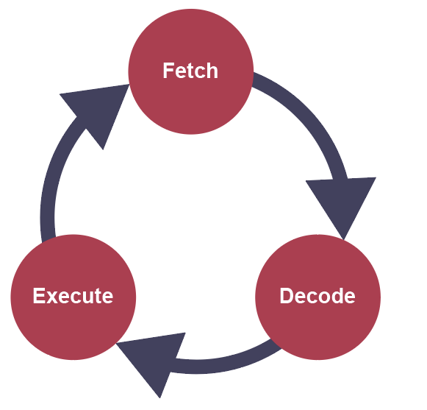
Fetch-execute cycle
In the last lesson we looked at the fetch-execute cycle

Slide 5
Words
Memory is divided up in equal units called words
  Word length is usually 8, 16, 32 or 64 bits
Each word has a separate memory address
  A computer with an 8-line address bus can transmit 8 bits of data (0 or 1) together.
  So an 8-line address bus can transmit 2⁸ = 256 different binary combinations (00000000 to 11111111)
Address | Data or instruction
00000000 | 01101001
00000001 | 01101100
00000010
00000011 | 10011111

Slide 6
Address bus
  What would be the memory capacity in bytes of a machine with an 8-line address bus and a word length of 16 bits?
  The width of the address bus determines the maximum possible memory addresses of the system
With an 8-bit address bus, the maximum number of memory addresses is 2⁸ = 256
Word length = 16 bits = 2 bytes
Memory size = maximum number of memory addresses x word length in bytes
In this case, 256 x 2 = 512 bytes

Slide 7
Address bus
  What would be the memory capacity in bytes of a machine with a 24-line address bus and a word length of 32 bits?
With an 24-line address bus, the maximum number of memory addresses is 2²⁴ = 16,777,216
Word length = 32 bits = 4 bytes
Memory size = maximum number of memory addresses x word length in bytes
In this case, 16,777,216 x 4 = 67,108,864 bytes
67.1Mb or 64MiB

Slide 8
A quick note on units
1 kilobyte (KB) = 10³ = 1,000 bytes
1 megabytes (MB) = 10⁶ = 1,000,000 bytes
1 gigabyte (GB) = 10⁹ = 1,000,000,000 bytes
1 kibibyte (KiB) = 2¹⁰ = 1,024 bytes
1 mebibyte (MiB) = 2²⁰ = 1,048,576 bytes
1 gibibyte (GiB) = 2³⁰ = 1,073,741,824 bytes
Also be careful to distinguish between KB (1,000 bytes) and Kb (1,000 bits = 125 bytes)

Slide 9
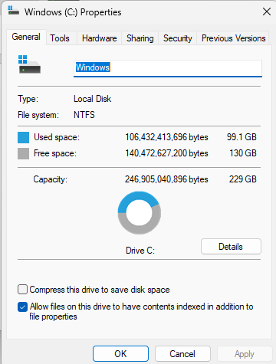
A quick note on units
1 kilobyte (KB) = 10³ = 1,000 bytes
1 megabytes (MB) = 10⁶ = 1,000,000 bytes
1 gigabyte (GB) = 10⁹ = 1,000,000,000 bytes
1 kibibyte (KiB) = 2¹⁰ = 1,024 bytes
1 mebibyte (MiB) = 2²⁰ = 1,048,576 bytes
1 gibibyte (GiB) = 2³⁰ = 1,073,741,824 bytes

Slide 10
Data bus
The data bus is bi-directional as data can be sent both ways along the bus
  The width of the data bus is defined by the number of wires
  or lines it contains
If the data bus is the same width as a computer word, data can be transferred to and from memory in a single operation

Slide 11
Format of instructions
Assembly language is very closely related to machine code
  Generally, there is a one-to-one correspondence between a machine code instruction and its assembly language equivalent
The architecture of a computer, including
  the word size
  and the width of the address bus
determine the format of a machine code instruction for a particular type of processor

Slide 12
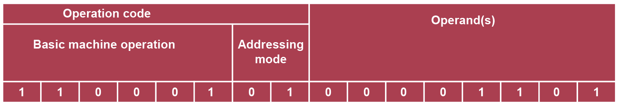
A machine code instruction
The basic structure of a machine code instruction is shown, and given below in hexadecimal:
  C50D ;load contents of accumulator into location 0B
The equivalent assembly code instruction could be:
  LDA #13
The maximum size of the operand will depend on the width of the address bus

Slide 13
Factors affecting performance
The main factors affecting processor performance are:
  Clock speed
  The number of cores in the processor
  The amount and type of cache memory

Slide 14
Factors affecting performance
The Fetch-Execute cycle is triggered by the clock pulses of the system clock
  The faster the clock speed, the faster a computer can fetch, decode and execute instructions
  This clock can change state many billions of times per second
  A 4GHz processor would tick 4 billion times per second

Slide 15
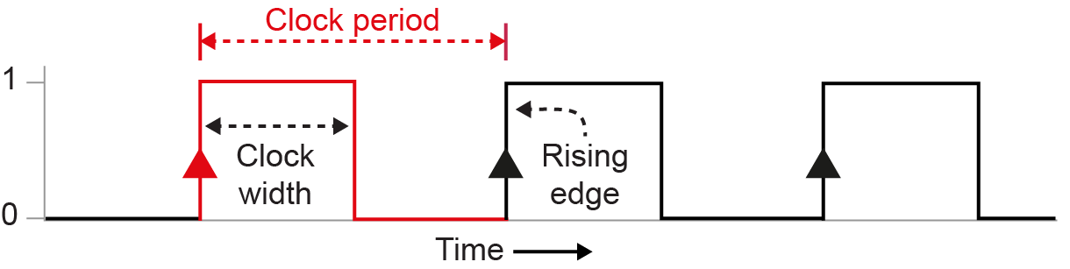
The system clock
A series of regular ON/OFF signals are used to synchronise the operations of the processor components
  Actions are usually carried out on the rising edge of the clock
  Actions each take a fixed number of cycles to complete

Slide 16
Number of cores
Many computers today, including personal computers, have multiple cores
  A dual-core computer has two processors linked together in the same integrated circuit
  A quad-core computer has four linked processors
Each core is theoretically able to process a different instruction at the same time with its own fetch-execute cycle, making a quad-core computer up to four times faster than a single-core computer
  However, the software may not always be able to take full advantage of all of the processors at the same time

Slide 17
Parallel processing
Using several processor cores working at the same time is known as parallel or concurrent processing
  In systems designed for parallel processing, each core can work concurrently on different parts of the same task
  Since instructions are processed sequentially, this is not always possible

Slide 18
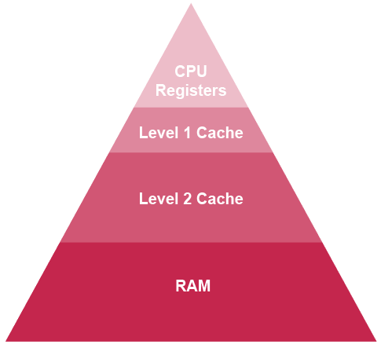
Cache memory
Cache is a small amount of superfast expensive memory that stores data and instructions that have recently been used by the processor
Level 2 cache is larger but not as fast as Level 1 cache
Level 1 cache memory is split into instruction cache and data cache, so that data and instructions can be fetched simultaneously
Both types are held on the processor chip

Slide 19
Cache memory
Level 1 cache memory is split into instruction cache and data cache, so that data and instructions can be fetched simultaneously
The more cache memory a computer has, the more likely it is that it will not have to fetch the next instruction or data from RAM, as it will already have been loaded into the superfast cache memory from which it can be retrieved much more quickly.

Slide 20
Pipelining
This is a technique used to improve performance, for example by overlapping stages in the fetch-execute cycle, or by breaking down the stages in an arithmetic instruction
  An instruction enters the pipeline, and as soon as one stage has been completed, another instruction enters the pipeline
  A third instruction then enters before either of the others is completed

Slide 21
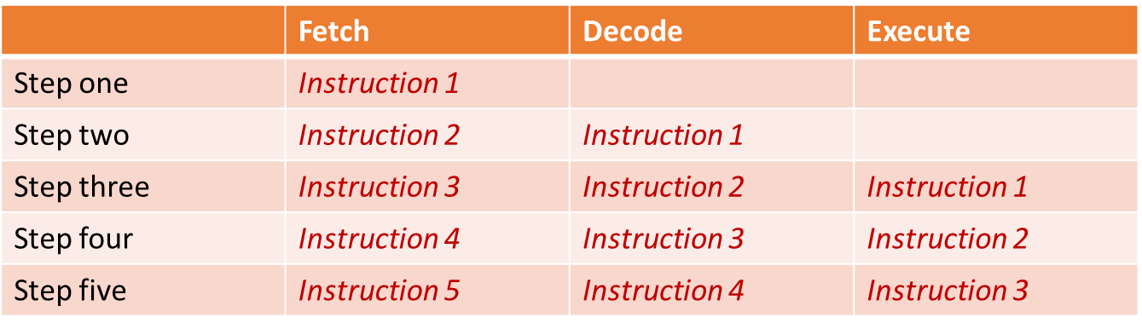
Pipelining
This is a technique used to improve performance, for example by overlapping stages in the fetch-execute cycle, or by breaking down the stages in an arithmetic instruction
Fetch
Decode
Execute

Slide 22
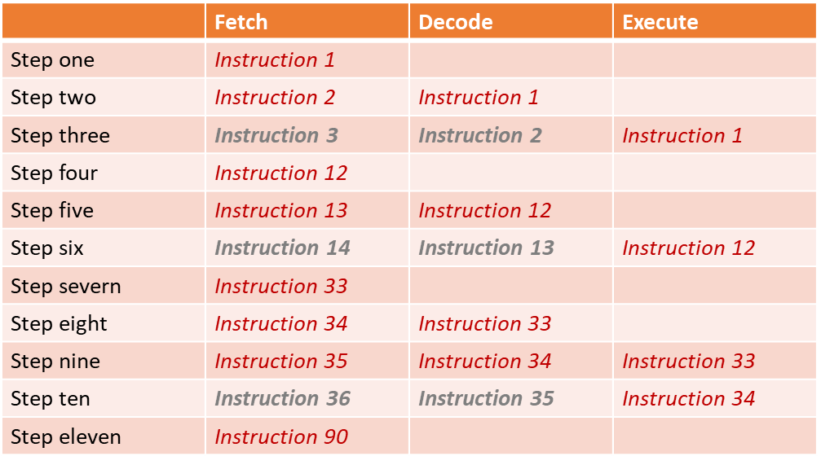
Pipelining
Can you explain what is happening here?
Fetch
Decode
Execute

Slide 23
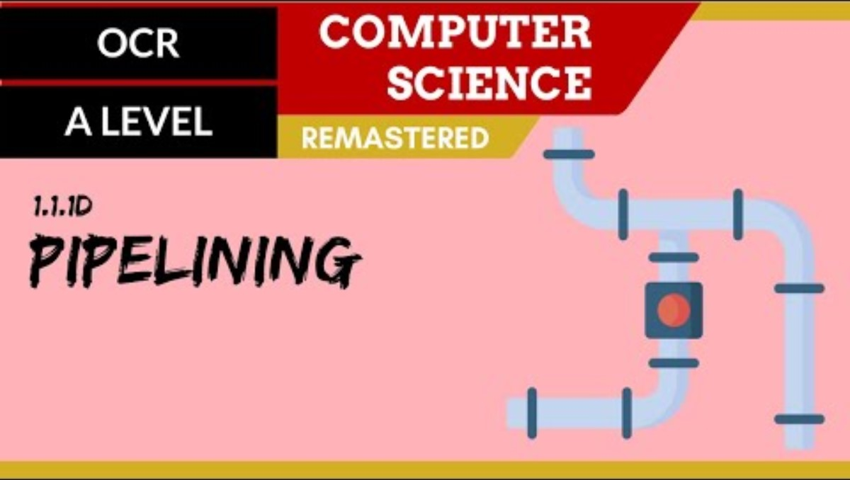
Pipelining

Slide 24
Plenary
The three main factors affecting the performance of the CPU are:
  Clock speed
  Number of cores
  Size and type of cache memory
The size of the address bus determines the maximum size of RAM
The size of the data bus determines the maximum size of an operand in an instruction
Pipelining is used to improve efficiency

