Slide 1
OCR A LEVEL COMPUTER SCIENCE • 1.1.3C
CPU
Storage
and memory
RAM and ROM
primary
Magnetic
Flash
Optical
secondary storage
Magnetic, flash and optical storage, RAM and ROM, and virtual storage: choose the right one and justify it
Virtual storage
looks local, is somewhere else
Notes:
1.1.3C Storage. Spec 1.1.3(a) storage devices for different problems, (b) magnetic, flash and optical, (c) RAM and ROM, (d) virtual storage. Planned as two lessons of about 60 minutes. Lesson 1: slides 1 to 19 (secondary storage and the 9 mark answer). Lesson 2: slides 20 to the end (RAM, ROM, virtual storage, exam practice). Essential route: about 95 minutes over the two lessons. With the optional slides: about 120 minutes. You need: mini whiteboards and pens, exercise books, the completed pre-learning sheet (part 2). Nothing to print or cut out.

Slide 2
What you will be able to do
OUTCOMES
Compare magnetic, flash and optical storage and recommend one for a scenario
Write a structured 9 mark "discuss" answer on storage
Explain the purpose of RAM and ROM, and how virtual memory works
Explain virtual storage and how it differs from virtual memory
Notes:
1 minute. Share the route for both lessons. Optional slides: boot sequence, virtual memory task, beyond the specification. The 9 mark task in lesson 1 is planned in class and written up for homework. Every task, with its answers, is on the slides. '1.1.3C Storage paper backup' holds the same tasks in the same order, only for when the computers or projector are down. Lesson 2 is about 65 minutes with essential slides; drop the XPX stretch or the exam advice extract if time is short.

Slide 3
1.1.3 Input, output and storage: the big picture
CONTEXT
The specification has four parts. All are examined on Paper 1 (Computer systems).
(a)
Devices for a problem
(b)
Magnetic, flash, optical
(c)
RAM and ROM
(d)
Virtual storage
Choose devices for a scenario and justify them
Uses, benefits and drawbacks of each type of storage
What each stores and why we need both
Storage that looks local but is somewhere else
Storage questions include 9 mark "discuss" questions. We will practise one.
Notes:
1 minute. This lesson covers the rest of 1.1.3: storage for (a), and all of (b), (c) and (d). OCR's clarification guide: candidates need the characteristics, benefits and drawbacks of each storage type and must recommend one for a situation and justify it. For RAM and ROM: their purpose, characteristics and role in a range of computers, such as mobile devices and embedded systems.

Slide 4
Pre-learning check-in
ESSENTIAL
CHECK-IN
From the three videos. On your whiteboard: answer, then 3, 2, 1, show.
Name the three types of secondary storage.
Magnetic, flash (solid state) and optical
1
Which type has no moving parts?
Flash (solid state)
2
What does volatile mean? Is RAM or ROM volatile?
Contents are lost when the power is off. RAM is volatile
3
What is virtual storage?
Storage that appears to be local but is physically somewhere else
4
Notes:
1 to 4 minutes. Matches part 2 of the pre-learning sheet (Craig 'n' Dave videos 10, 11 and 12). Click to reveal each answer.

Slide 5
Your phone is full
ESSENTIAL
STARTER
Your phone says "Storage full". You have 4000 photos and 50 videos you want to keep, but you need the space.
On your whiteboard: list three places you could move them to. Give one good and one bad point for each.
Stuck? Use this sentence starter
"I could move them to ______. This is good because ______, but ______."
Stretch: which option keeps them safe if your house floods?
Notes:
4 to 9 minutes. Pairs. Students already know the answers from everyday life. The next slide maps their ideas onto the four storage types in this lesson.

Slide 6
Starter answers
ANSWERS
Where | Type | Good | Bad
Laptop hard drive | Magnetic | Huge capacity, cheap | Can fail if dropped
USB stick, SD card | Flash | Small, tough, portable | Easy to lose
Blu-ray disc | Optical | Cheap to post or keep | Low capacity, slow
Cloud storage | Virtual | Any device, anywhere | Needs internet, monthly fee
Stretch: the cloud. Copies are kept in data centres far from your house.
Notes:
9 minutes. Every answer is a trade-off: that is exactly what exam questions on storage test. Point out the cloud is listed as virtual storage: it appears on the phone like a folder, but the data is physically in a data centre.

Slide 7
Why we need secondary storage
ESSENTIAL
KEY IDEA
Primary memory (RAM)
Holds programs and data in use now
Very fast, so the CPU is not kept waiting
Volatile: lost when the power goes off
Small and expensive per GB
Secondary storage
Keeps files and programs long term
Non-volatile: kept with no power
Much larger capacity, cheaper per GB
Slower: programs are loaded into RAM to run
Secondary storage: non-volatile, large, long term. RAM: volatile, fast, now.
Notes:
9 to 11 minutes. Keep brief: the detail on RAM comes in lesson 2. The point is why every computer needs both.

Slide 8
Six ways to compare storage
ESSENTIAL
KEY IDEA
Capacity
How much it holds
Cost
Price per GB, not just price
Speed
How fast it reads and writes
Portability
Size and weight to carry
Durability
Survives knocks, heat, water
Reliability
Keeps working over time
Memory hook: Can Cats Swim Past Dogs Running?
Notes:
11 to 12 minutes. These six headings are the vocabulary of every storage answer. Durability is surviving physical damage. Reliability is working correctly over a long time. Cost per GB matters more than the price of one device.

Slide 9
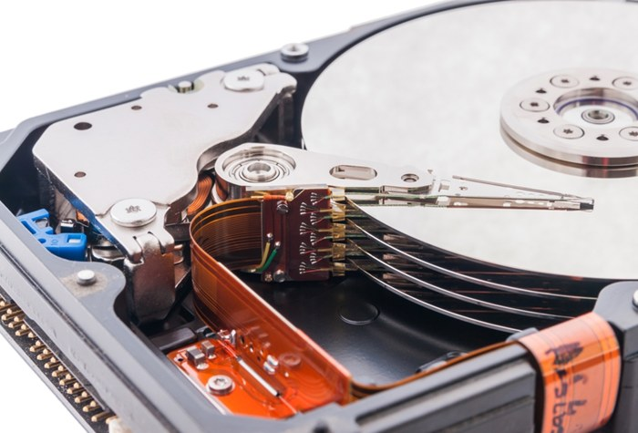
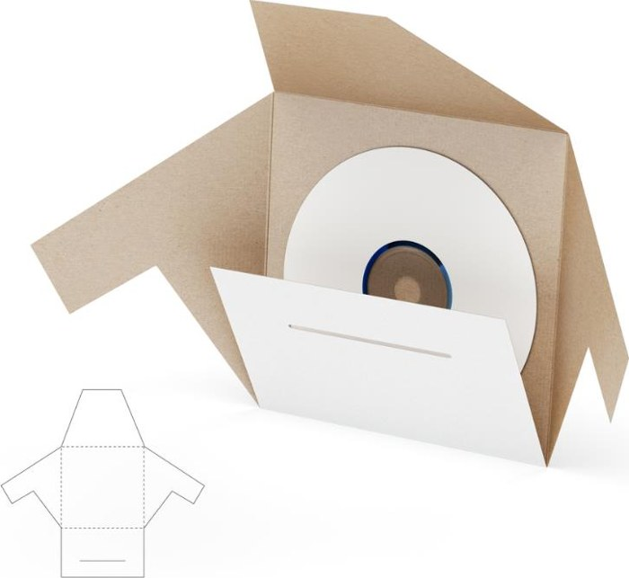


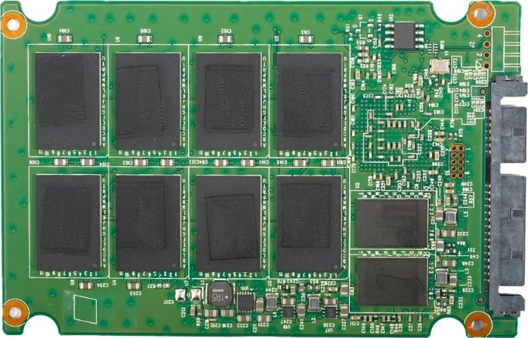
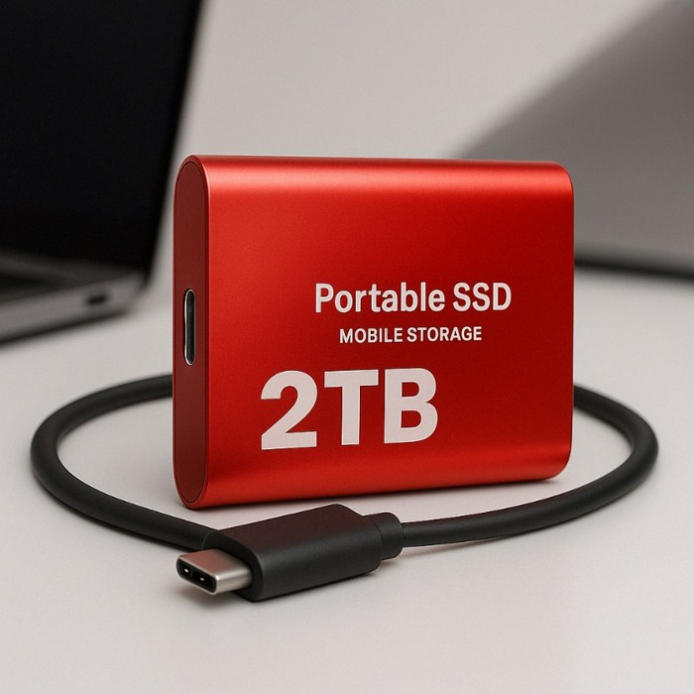
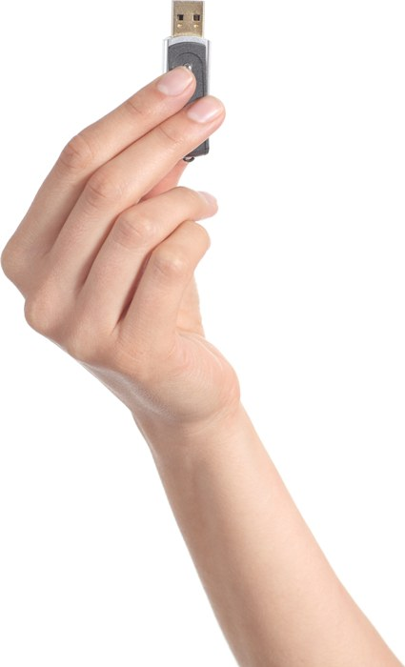
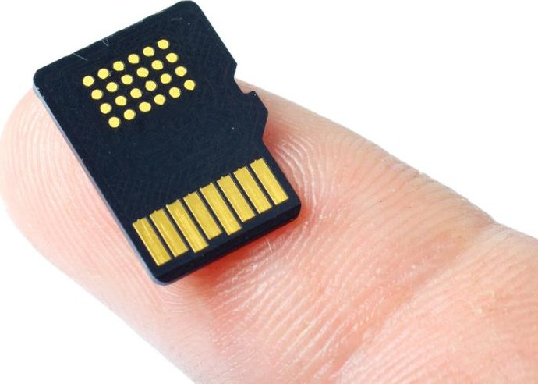
What storage devices look like
ESSENTIAL
KEY IDEA
Magnetic: hard disk, tape. Optical: CD, DVD, Blu-ray. Flash: SSD, USB stick, SD card.
Hard disk (inside)
Magnetic tape
CD or DVD
Blu-ray
SSD (inside)
Portable SSD
USB stick
SD card
Notes:
12 minutes. Top row: magnetic then optical. Bottom row: all flash. Ask: which have moving parts? (Hard disk, tape drive, disc drives.) Photos are from the original 1.1.3 slides; teal icons are used where the original deck had no photo. Replace any icon with your own photo if you prefer.

Slide 10
Teach it: storage jigsaw
OPTIONAL
TASK
Groups of 2 to 4, seated. On one whiteboard: teach your type in 1 minute.
Tables 1 Magnetic
Tables 2
Flash (solid state)
Tables 3
Optical
Tables 4
Cloud (virtual) storage
Your whiteboard must show
Two examples and how it stores data, in one sentence
Capacity, cost per GB, speed, durability, portability
Two typical uses, and one advantage and one disadvantage
6 minutes to prepare. The next slides check what you taught.
Notes:
Optional alternative to teaching slides 11 to 14 directly: about 12 minutes in total. Adapted from the group presentation task in the updated original deck, but done on mini whiteboards at tables so there is no computer time or moving around. Cloud groups: what it is, common uses (not just saving files), advantages and disadvantages. If you prefer the picker wheel from the original deck to allocate topics, use it here. Students complete the comparison table (Task 1) while each group presents.

Slide 11
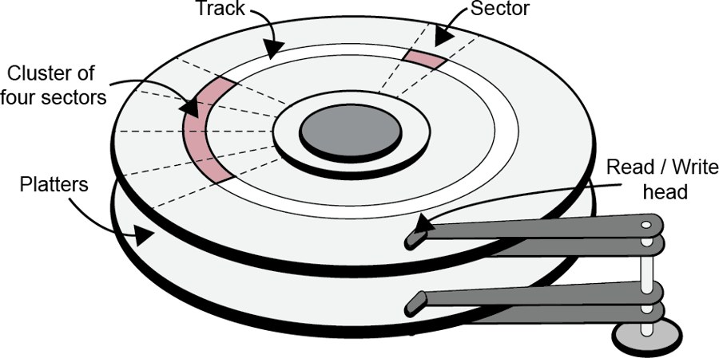
Magnetic storage
ESSENTIAL
KEY IDEA
How it stores data: tiny areas are magnetised one way or the other (1 or 0). A read/write head moves over the spinning disk.
Examples: hard disk drive (HDD), magnetic tape
Strengths
Huge capacity
Lowest cost per GB
Reliable for years
Weaknesses
Moving parts: can break if dropped
Slower than flash
Noisy, uses more power
Typical uses
Desktop PCs, servers
Backups
Tape: archives
Notes:
12 to 15 minutes. The 'how it stores data' line is from the October 2021 mark scheme indicative content, so it is credited in a 9 mark answer, but keep it to one sentence. Tape is sequential access: very slow to find one file, but very cheap for huge backups, so it is still used for archives. The diagram shows platters, tracks, sectors and the read/write head: useful background, but OCR does not ask for it. Typical HDD: 1 to 30 TB, spinning at 5400 or 7200 rpm.

Slide 12
Flash (solid state) storage
ESSENTIAL
KEY IDEA
How it stores data: electric charge is trapped in memory cells. There are no moving parts.
Examples: solid state drive (SSD), USB memory stick, SD card
Strengths
Very fast access
Tough: no moving parts
Small, light, silent
Low power
Weaknesses
Higher cost per GB
Each cell has a limited number of writes
Typical uses
Laptops, phones, tablets
Cameras (SD card)
Moving files (USB)
Notes:
15 to 18 minutes. The June 2023 and October 2021 mark schemes both credit 'limited number of read/write cycles' as a drawback, which matters for servers that write all day. Beyond the spec: modern SSDs spread writes across cells (wear levelling), so most last for many years in normal use. USB sticks and external SSDs can be password protected; an external SSD is tougher and harder to lose than a USB stick, so it suits backing up a whole PC.

Slide 13
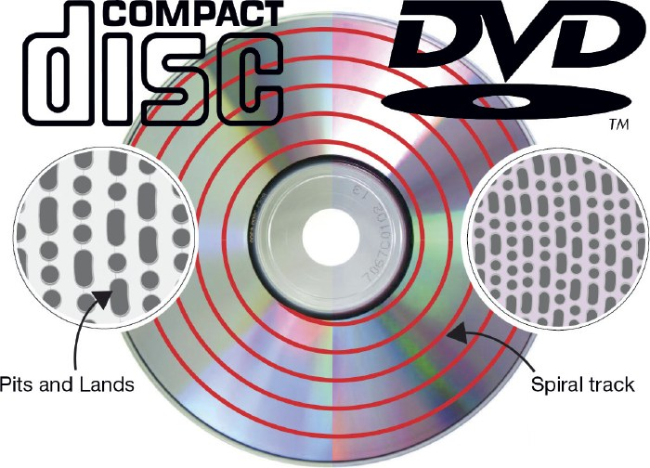
Optical storage
ESSENTIAL
KEY IDEA
How it stores data: a laser reads pits and lands on a reflective surface of the disc.
Examples: CD (700 MB), DVD (4.7 GB), Blu-ray (25 to 100 GB)
Strengths
Very cheap to make and post
Light, robust in transit
ROM discs cannot be changed
Weaknesses
Low capacity
Slowest to read
Scratches cause errors
Needs a drive
Typical uses
Films and games for sale
Archives that must not change
Notes:
18 to 21 minutes. June 2019 4(a) mark scheme: 'read/written to using a laser', 'reflective surface', 'pits and lands', plus an example such as Blu-ray or CD. It did NOT accept DVD variants when the question said 'other than DVDs'. Why do the same size discs hold different amounts? Blu-ray uses a shorter wavelength (blue-violet) laser, so pits are smaller and the spiral track is packed more tightly.

Slide 14
ROM, R or RW?
OPTIONAL
CHECK-IN
On your whiteboard: ROM (read only), R (record once) or RW (rewrite). Then justify.
1 A new game sold in shops
ROM: pressed, cannot change
2 One-off copies of a wedding video for guests
R: write once, then keep
3 A weekly backup, wiped and reused
RW: erase and rewrite
4 An album sold at gigs
ROM: cheap to press in bulk
5 Tax records that must not be altered
R: cannot be changed later
6 Moving files between two old PCs
RW: reuse the same disc
Notes:
Optional, 3 minutes. From the CD formats slides in the updated original deck. CD-ROM is pressed at the factory; CD-R can be written once; CD-RW can be erased and rewritten many times. The same idea applies to DVD and Blu-ray (BD-R, BD-RE).

Slide 15
Compare the three types
ESSENTIAL
TASK 1
In your book: copy and complete the table. Then click to check one column at a time.
Typical size
Capacity
Cost per GB
Speed
Durability
Portability
Typical use
Magnetic (HDD)
Flash (SSD)
Optical (Blu-ray)
1 to 30 TB
0.25 to 8 TB
25 to 100 GB
Highest
High
Low
Lowest
Highest
Low
Medium
Fastest
Slowest
Low: moving parts
High
Medium: scratches
Medium
High
High (disc only)
PCs, servers, backup
Laptops, phones
Films, games for sale
Ratings are relative. In an exam, say what each one means for the scenario.
Notes:
21 to 26 minutes. Students build the comparison themselves (in books, or on whiteboards in pairs), then click to reveal each column. This replaces the old worksheet table and the HDD and SSD research question. If you used the jigsaw, students fill it in while groups present. Typical sizes in 2026: HDD 1 to 30 TB, SSD 0.25 to 8 TB, CD 700 MB, DVD 4.7 GB, Blu-ray 25 to 100 GB, LTO-9 tape 18 TB. Avoid quoting prices in exams: they change. Say 'lower cost per GB'.

Slide 16
Which storage?
ESSENTIAL
CHECK-IN
On your whiteboard: M magnetic, F flash or O optical. 3, 2, 1, show, then justify.
1 A helmet camera for mountain biking
F: tough, light, small
2 A travel agent backing up 800 GB each night
M: cheapest per GB
3 A new games console title sold in shops
O: cheap to make, post
4 A laptop that must start up quickly
F: fastest access
5 Moving coursework between home and school
F: USB, small, portable
6 Keeping training videos for 10 years
M: tape or HDD, cheap
Notes:
22 to 28 minutes. These scenarios are from the Craig 'n' Dave video the students watched. Click to reveal each answer. Accept cloud storage for 5 and 6 with a reason, and optical for 6 (a write-once disc cannot be changed). The justification earns the mark.

Slide 17
Why not the others?
ESSENTIAL
TASK 2
The choice is given. On your whiteboard: why it suits, and why the others do not.
A
A drone that films crops from the air
SD card (flash)
B
A hospital storing 20 years of X-ray scans
Hard disks (magnetic)
C
A band selling an album at gigs
CD (optical)
D
A teacher's laptop used in every lesson
SSD (flash)
Pairs. A and B for everyone. C and D for stretch. 6 minutes.
Notes:
28 to 34 minutes. Comparing with the alternatives is what moves an answer from describing to evaluating (AO3). Model it for A first if needed: flash suits a drone because it is light and survives vibration. A hard disk is heavier and its moving parts could fail. A disc drive is far too heavy and slow.

Slide 18
Why not the others? Answers
ANSWERS
A Drone: SD card
Light, survives vibration and knocks. HDD: heavier, moving parts. Optical: too heavy and slow to write.
B X-rays: hard disks
Huge capacity at the lowest cost per GB. SSD: far dearer for that much. Optical: too small, too many discs.
C Album: CD
Very cheap to press and sell. Flash: costs more per copy. HDD: far too big and costly.
D Laptop: SSD
Fast start-up, survives being carried. HDD: slower and can be damaged. Optical: too slow.
Notes:
34 minutes. For B, the October 2021 mark scheme also credits tape for long-term backups that are rarely accessed.

Slide 19
Structuring a 9 mark answer
ESSENTIAL
EXAM ADVICE
1 Know
AO1: 4
How each type stores data. Benefits and drawbacks
2 Apply
AO2: 2
Link each point to THIS scenario
3 Weigh up
AO3: 3
Which suits each part of the scenario, and why
4 Conclude
AO3
A clear recommendation with a reason
Mark band | What it needs
7 to 9 | Both sides, applied throughout, a justified conclusion
4 to 6 | Both types covered, some context, conclusion not fully justified
Notes:
34 to 37 minutes. The AO split (AO1.1 2, AO1.2 2, AO2.1 2, AO3.3 3) is printed on the October 2021 and June 2023 H446/01 mark schemes. June 2023 guidance: 'Candidates can conclude either method, but to score in the top mark band must have a clear line of reasoning to justify their choice.' Marks are given by level, not by counting points.

Slide 20
Worked example: plan first
ESSENTIAL
WORKED EXAMPLE
October 2021 1(c). An insurance company uses storage in servers, client machines and for backup. For each, discuss whether magnetic or solid state storage is most suitable. [9]
Part | Choose | Because (scenario) | But
Servers | SSD + HDD | Fast access to customer records for many users | SSD write limit: plan to replace
Client PCs | SSD | Quick start-up and program loading | Smaller capacity: data is on the server
Backup | HDD or tape | Huge, cheap per GB. Speed matters less | Tape is slow to restore
Conclusion: both are suitable, but for different jobs in this company.
Notes:
37 to 41 minutes. I do. Build the plan from the mark scheme's indicative content: SSDs for operating system and program files on clients and servers for quicker boot and loading; magnetic hard drives for large quantities of data at low cost; tape for backups as it is too slow for day-to-day use; SSD write limits for data-heavy servers; SSD in mobile devices for mobile workers. A 2 minute plan like this stops students writing two separate lists.

Slide 21
Worked example: one paragraph
OPTIONAL
WORKED EXAMPLE
AO1
"Magnetic hard drives store data by magnetising areas of a spinning disk, read by a moving head. They have a large capacity and a low cost per GB."
AO2
"The company will back up every customer record each night, which is a very large amount of data."
AO3
"So magnetic storage suits the backup: it can hold all of it cheaply, and backups run overnight, so its slower speed does not matter. An SSD of that size would cost far more for no real benefit."
Know it, apply it, judge it. Then do the same for servers and clients.
Notes:
Optional, 2 minutes. One paragraph of a top band answer for the backup part. Point out the comparison with the alternative in the AO3 part.

Slide 22
Your turn: 9 marks
ESSENTIAL
TASK 3
June 2023 1(e)(ii)
Video elements are captured in different locations and then edited. Discuss the suitability of a flash storage device and a magnetic storage device for storing the video elements while they are collected and edited. [9]
In class: groups of 2 to 4
Plan on one whiteboard with the grid: part, choose, because, but
Parts: collecting on location, editing
Then on your own
Write one paragraph in your book
Homework: the full answer with a conclusion
Notes:
41 to 55 minutes. A real question from June 2023 H446/01. Allow 6 minutes to plan and 6 to write one paragraph. Answers on the next slide.

Slide 23
Your turn: mark scheme points
ANSWERS
Flash
Fast read/write: less loading time, smoother playback when editing
No moving parts: safer when carried between locations
Higher cost per GB, rising sharply at high capacity
Magnetic
Low cost per GB: video files are very large
Good for archiving the elements after rendering
Moving parts: could be damaged in transport. Slower to load
Conclusion: either is fine if justified. For example, flash on location and when editing, magnetic to archive.
Notes:
55 to 58 minutes. All points are from the June 2023 mark scheme. End of lesson 1. Homework: write the full answer.

Slide 24
Lesson 2: recall
ESSENTIAL
CHECK-IN
From lesson 1. On your whiteboard: answer, then 3, 2, 1, show.
Why are hard disks used for large backups?
Huge capacity at the lowest cost per GB
1
Give two reasons an SSD suits a laptop.
Fast access, and no moving parts so it survives knocks
2
How is data read from an optical disc?
A laser reads pits and lands on a reflective surface
3
What must a top band 9 mark answer end with?
A conclusion justified by the points made
4
Notes:
Lesson 2, 0 to 4 minutes. Spaced retrieval from lesson 1. Collect the homework 9 mark answers.

Slide 25
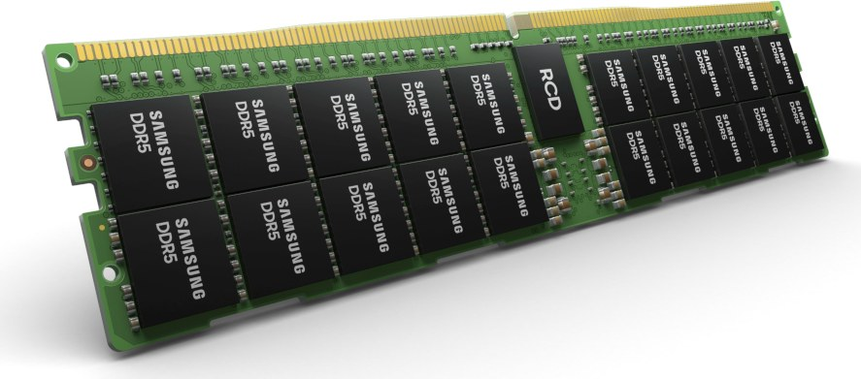
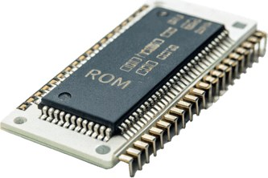
RAM and ROM
ESSENTIAL
KEY IDEA
 | RAM | ROM
Stands for | Random access memory | Read only memory
Power off | Volatile: contents lost | Non-volatile: contents kept
Read or write | Read and write | Read only
Stores | OS, programs and data in use now, temporary files | Firmware (BIOS or UEFI): POST and bootstrap loader
Size | Large: 8 to 32 GB in a PC | Small: a few MB
RAM
ROM chip
RAM: working memory for now. ROM: fixed instructions that never change.
Notes:
4 to 8 minutes. Wording matches the October 2021 mark scheme for 1(a)(ii): RAM is volatile, used for storing programs, data and parts of the OS currently in use; ROM is non-volatile, used for storing the BIOS or bootstrap. June 2023 5(a): RAM stores instructions and programs currently running and data currently in use. Temporary files and POST come from the updated original deck.

Slide 26
Switching on: ROM at work
ESSENTIAL
WORKED EXAMPLE
1
Power on
The CPU runs the firmware stored in ROM: the BIOS, or UEFI on newer PCs
2
POST
The power-on self-test checks the hardware: RAM, keyboard, drives
3
Bootstrap
The bootstrap loader finds the OS on secondary storage and loads it into RAM
4
Run
The OS takes over and loads each program into RAM when it is opened
Beyond the spec: UEFI, the newer BIOS, starts faster, supports drives over 2 TB and adds Secure Boot.
Why both? RAM is empty at power on, so ROM must start things off.
Notes:
8 to 11 minutes. From the 'contents of ROM' slide in the updated original deck. For the exam, 'ROM stores the bootstrap / BIOS' is what the October 2021 mark scheme credits; POST and UEFI are useful detail. Ask: what would happen if the bootstrap were stored in RAM? (It would be lost at power off, so the computer could not start.)

Slide 27
RAM and ROM in three computers
ESSENTIAL
KEY IDEA
Desktop PC
ROM: the bootstrap that loads the OS from the SSD
RAM: the OS, open programs and files
Smartphone
ROM: start-up code. The OS sits in flash storage
RAM: running apps, so switching is quick
Washing machine
ROM: the wash programs, which never change
RAM: the settings chosen and sensor readings
An embedded system runs one fixed program, so it lives in ROM.
Notes:
8 to 11 minutes. OCR's clarification guide asks for the role of RAM and ROM 'in a range of different computers e.g. mobile devices, embedded systems'. June 2019 1(b) mark scheme: an embedded operating system is stored in the device's ROM and cannot be changed. Beyond the spec: in modern PCs the BIOS (now usually UEFI) is stored in flash memory so it can be updated, but it is still called ROM in exam answers.

Slide 28
RAM or ROM?
ESSENTIAL
CHECK-IN
On your whiteboard: write RAM or ROM. 3, 2, 1, show. Be ready to say why.
1 The instructions that run when you switch on
ROM: must survive power off
2 The essay you are typing right now
RAM: data in use, changes
3 The wash programs in a washing machine
ROM: fixed, never change
4 The 40 °C wash you just chose
RAM: changes each wash
5 The parts of the OS in use now
RAM: loaded from storage
6 The program inside a TV remote
ROM: embedded, fixed
Notes:
11 to 14 minutes. Click to reveal each answer. If many get 4 wrong, stress that ROM holds what never changes; anything chosen or calculated while running is in RAM.

Slide 29
Types of RAM
OPTIONAL
BEYOND THE SPEC
SRAM: Static RAM
Very fast but expensive and takes more space. Used for cache memory (1.1.1).
DRAM: Dynamic RAM
Cheaper and denser, so more fits on a chip. Used for main memory.
DDR SDRAM: The DRAM in PCs today
Transfers data twice per clock tick. DDR1 (2000) to DDR5 (on sale from 2021).
A DDR RAM module
Not examined. In the exam, "RAM" is enough.
Notes:
Optional, 2 minutes. From the 'types of RAM' slide in the updated original deck, with one correction: DDR is a type of synchronous DRAM (DDR SDRAM), not another name for all SDRAM. Each DDR generation is faster than the last; DDR5 can be up to about twice as fast as DDR4. Link: SRAM cache is why cache size affects CPU performance (1.1.1(c)).

Slide 30
When RAM fills up
ESSENTIAL
WORKED EXAMPLE
1 Switch on: the OS is loaded into RAM
RAM
Disk
Docs
virtual memory
2 Open Word, PowerPoint and a game: each is copied into RAM
Browser
Game
free
Browser
3 Open a browser: there is no free RAM left
PowerPoint
4 The OS moves pages not in use (the game) to virtual memory on the disk
Word
Game
5 The browser loads into the freed RAM. The game swaps back when needed
OS
Benefit: more programs can run. Drawback: the disk is far slower than RAM.
Notes:
13 to 18 minutes. I do. Click through the five steps; the diagram builds with them. Recreated from the RAM and virtual memory animation in the updated original deck, with one change: it is the program NOT in use (the game) that is moved out to the disk, so the browser that is being used can go into RAM. Mark scheme wording (June 2018 2(a)(iii), November 2020 9(a)(iii), June 2023 5(b)): an area of secondary storage is used as virtual memory; pages not currently needed are moved there; they are moved back when needed. If pages are swapped in and out constantly the computer slows down badly: disk thrashing (1.2.1). Without virtual memory, older computers showed an 'out of memory' error and refused to open the program.

Slide 31
Your turn: virtual memory
ESSENTIAL
TASK 4
June 2023 5. Amaya edits photographs on an old computer: dual core 1.8 GHz processor, 1 GB RAM, 500 GB HDD.
(a) State the role of RAM in a computer system. [1]
(b) Explain what is meant by 'virtual memory' and why this may be needed when Amaya is editing her photographs. [2]
Stretch: June 2018 2(a)(iii)
Programs A and B are in memory. The OS needs to load program C but there is not enough space. Describe how it uses virtual memory. [3]
Notes:
Essential, about 5 minutes: the virtual memory task. Real Paper 1 questions. Useful practice for 1.2.1 because students confuse virtual memory with virtual storage.

Slide 32
Virtual memory: mark scheme
ANSWERS
(a) [1]
Stores instructions or programs currently running, or data currently in use
(b) [2]
If there is not enough RAM, secondary storage is used to store instructions and data
Large image files or programs may exceed her 1 GB of RAM
Stretch [3]
The OS uses an area of secondary storage as virtual memory (1)
Unused pages of program A or B are moved into virtual memory (1)
Program C is loaded into the RAM that has been freed (1)
Notes:
39 minutes. From the June 2023 and June 2018 H446/01 mark schemes.

Slide 33
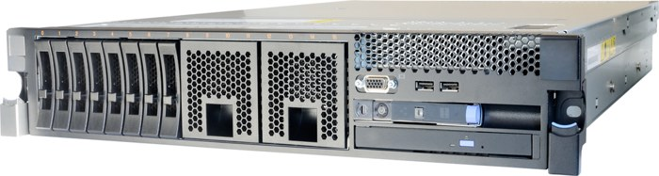
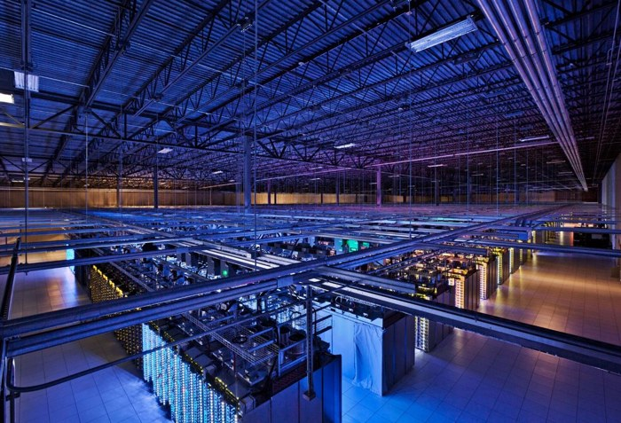
Virtual storage
ESSENTIAL
KEY IDEA
Virtual storage appears to be local, but is physically located elsewhere: on the network, remotely or in the cloud.
What you see | Where it really is | Example
C: drive | Inside this computer | Local SSD (not virtual)
H: drive | School server room | Network drive
OneDrive folder | A data centre | Cloud storage
Logical view: one simple drive. Physical reality: disks somewhere else.
Notes:
18 to 22 minutes. Definition from OCR's clarification guide for 1.1.3(d): 'Virtual storage would be that which may appear to be local but is physically located elsewhere on the network/remotely/in the cloud.' Beyond the spec: in a data centre, one 'drive' you see may be spread over hundreds of physical disks. That is the logical versus physical idea in the Craig 'n' Dave video.

Slide 34
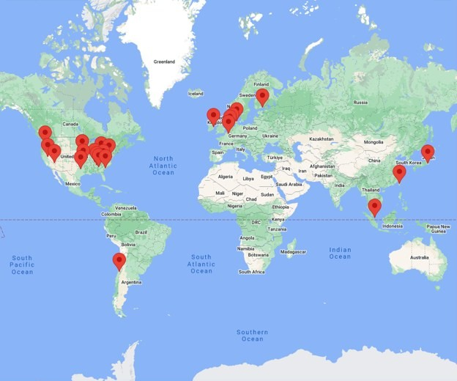

Where is the cloud?
OPTIONAL
KEY IDEA
Not just saving files
Sync photos across all your devices
Edit one document together
Automatic backup
Apps such as Microsoft 365
Google's data centres, 2023
The cloud is someone else's computers, in data centres like these.
Notes:
Optional, 3 minutes. Map and data centre photo from the updated original deck (the map is cropped from a 2023 screenshot of google.com/about/datacenters). Cloud software (Microsoft 365, Google Classroom, Adobe Creative Cloud) is cloud computing, which goes slightly beyond virtual storage, but it shows why the data is held remotely. Ask: if you use Gmail or OneDrive, which country might your data be in? Why might that matter? (Data protection law, 1.5.1.)

Slide 35
Virtual storage: trade-offs
ESSENTIAL
KEY IDEA
Benefits
Access files from any device, anywhere
Easy to share and work on files together
Add more space without buying hardware
Provider backs up and maintains it
Data is safe if a local device is lost
Drawbacks
Needs a network or internet connection
Slower than a local drive
Ongoing cost to rent the space
Data is held by another company: security and privacy
If the provider fails, access is lost
Weigh these up against the scenario: who, where, how much data.
Notes:
22 to 25 minutes. Points from the Craig 'n' Dave video and the June 2019 mark scheme on streaming versus owning a copy (reliant on the provider and the connection). Link to 1.5.1: data held by a cloud provider must still be protected under the Data Protection Act 2018.

Slide 36
Do not confuse: virtual memory
ESSENTIAL
KEY IDEA
Virtual storage (1.1.3)
Storage that looks local but is elsewhere
Network drive, cloud storage
Solves: sharing, access anywhere, space
Virtual memory (1.2.1)
Used when RAM is full
Part of secondary storage acts as extra RAM
Pages not needed now are moved out, and back when needed
Much slower than RAM
Virtual memory is on Paper 1 often. Read which one the question asks for.
Notes:
25 to 27 minutes. Virtual memory belongs to 1.2.1 (operating systems) but is asked often: June 2018 2(a)(iii), November 2020 9(a)(iii), June 2023 5(b). The pre-learning 'GCSE question' in the original deck asked why we need virtual memory, so students often mix the two up. If too many pages are swapped in and out, the computer slows down badly: disk thrashing (also 1.2.1).

Slide 37
Should XPX move to the cloud?
ESSENTIAL
TASK 5
XPX is a delivery company with 700 TB of data on a server at its head office in Birmingham. Every night it backs up to another computer in the same building. Staff work all over the country.
Core: pairs, one whiteboard
Two benefits of moving to cloud storage
Two drawbacks
One risk of the backup they have now
Stretch
Roughly how long would 700 TB take to upload at 1 Gbit per second? What does that tell XPX?
Notes:
27 to 33 minutes. Scenario from the original deck's research task, now a whiteboard task. The stretch links to data units (1.4.1) and to the cost of moving to virtual storage.

Slide 38
XPX: answers
ANSWERS
Benefits
Staff anywhere can reach the data
Copies held off site: safe from a fire at head office
Space grows without buying servers
Provider handles maintenance
Drawbacks
Needs fast, reliable internet
Monthly cost for 700 TB
Data held by another company
An outage stops planning
Risk now
A fire or flood destroys the server and backup together
Stretch: about 65 days
5.6 × 10¹⁵ bits ÷ 10⁹ bits per s = 5.6 million s
Notes:
33 minutes. 5.6 million seconds is about 65 days of continuous upload, so a move this big is often done by posting physical drives to the provider. A reasonable recommendation: keep the main server, and back up to the cloud instead of the same building.

Slide 39
Where storage is heading
OPTIONAL
BEYOND THE SPEC
DNA storage
Data can be written as the letters of DNA. A few grams could in theory hold a huge archive, but writing it is very slow and costly.
Glass storage
Lasers write data inside glass plates that could last thousands of years. Researched for long-term archives.
RAID
Several disks act as one. If one disk fails, the data can be rebuilt from the others.
The 3-2-1 backup rule
3 copies, on 2 types of storage, 1 kept off site. A good rule for your NEA files too.
Notes:
Optional, 3 minutes. Beyond the specification: not examined. RAID and the 3-2-1 rule are useful when discussing backup in a 9 mark answer, as long as they are linked to the scenario.

Slide 40
What the mark schemes say
ESSENTIAL
EXAM ADVICE
Earns marks
"Volatile: lost when the power is off"
ROM stores the bootstrap or BIOS
RAM stores programs, data and parts of the OS in use
"Lower cost per GB", "no moving parts"
Each point linked to the scenario
Loses marks
"Temporary" and "permanent" with no detail
"Cheaper" with no comparison
A DVD when told "other than DVDs"
Virtual memory for virtual storage
No conclusion when asked to discuss
Notes:
40 to 42 minutes. From the mark scheme answers and guidance: October 2021 1(a)(ii) and 1(c), June 2023 1(e)(ii) and 5, June 2019 4(a) 'Do not accept DVD variants (DVD-R, DVD-RW etc)'. The project folder has mark schemes but no examiner reports.

Slide 41
Model answer: October 2021 1(a)(ii)
EXAM ADVICE
The computer system contains RAM and ROM. Explain the difference between RAM and ROM, including how these are used by the computer system. [4]
Weak: 1 mark at most
"RAM is temporary and ROM is permanent. RAM is faster and bigger."
No use given for either. "Faster and bigger" is not on the mark scheme.
Strong: 4 marks
"RAM is volatile, so its contents are lost when the power is off (1). It stores the programs, data and parts of the OS in use (1). ROM is non-volatile (1) and stores the bootstrap that starts the computer (1)."
Two parts each: a property, then what it is used for.
Notes:
42 to 44 minutes. The strong answer uses the four points of the October 2021 mark scheme. Ask: what single word would lift the weak answer's first sentence? (Volatile.)

Slide 42
Storage in your NEA
NEA LINK
Where it earns marks
3.1.4(a) Minimum RAM and storage space, justified
3.1.3(b) Where data is saved: file, database, cloud
3.3.1 Evidence of each version of your work
Protect your own project
Save to the school network drive (virtual storage)
Keep a second copy on a USB stick or cloud
Use version control, such as Git, to keep every iteration
Lost code cannot be marked. Back up after every session.
Notes:
44 to 45 minutes. Section references from the H446 specification, NEA component 03/04. Version control is beyond the specification but gives clear evidence of the iterative development required in 3.3.1.

Slide 43
Exam practice
ESSENTIAL
TASK 6
Core
(a) Giving an example other than DVDs, describe what is meant by the term 'optical media'. [2] (June 2019)
(b) A washing machine stores its wash programs in ROM. Explain why ROM is used. [2]
(c) Explain what is meant by virtual storage. Give one drawback. [3]
Stretch
(d) A school wants to move all student files from its own file server to cloud storage. Discuss the benefits and drawbacks for the school. [6]
In your book, silently. 10 minutes. (b) to (d) in the style of Paper 1.
Notes:
45 to 55 minutes. Everyone does the core. Fast finishers do the stretch, ending with a recommendation.

Slide 44
Exam practice: answers
ANSWERS
(a) [2] mark scheme
A laser reads pits and lands (1)
Blu-ray or CD (1)
(b) [2]
Non-volatile: kept when unplugged (1)
Read only: cannot be changed (1)
(c) [3]
Looks local (1), is elsewhere (1)
Needs a connection to work (1)
(d) [6] levels: look for
Students reach files from home
No server to buy, maintain or back up
Needs reliable internet in every room
Ongoing cost; data on a third party
Data protection for under 18s
A justified recommendation
Notes:
55 minutes. (a) is from the June 2019 H446/01 mark scheme. Mark in a different colour pen.

Slide 45
Exit ticket
ESSENTIAL
RECAP
Why does a computer need both RAM and ROM?
ROM keeps the start-up instructions with no power. RAM holds what is running now, and changes
1
A photographer works outdoors. Which storage for the camera, and why?
Flash (SD card): small, light, no moving parts so it survives knocks
2
Virtual storage or virtual memory: "my H: drive is on the school server"?
Virtual storage: looks local, physically elsewhere
3
Notes:
55 to 58 minutes. Whiteboards. Click to reveal each answer.

Slide 46
Key terms to remember
RECAP
Secondary storage | non-volatile storage for files and programs long term
Magnetic storage | data held as magnetised areas: hard disk, tape
Flash storage | solid state, no moving parts: SSD, USB stick, SD card
Optical storage | a laser reads pits and lands: CD, DVD, Blu-ray
RAM | volatile, read and write: programs and data in use
ROM | non-volatile, read only: the bootstrap
Volatile | contents are lost when the power is off
Virtual storage | appears local, physically elsewhere: network or cloud
Virtual memory | secondary storage used as extra RAM when RAM is full
Notes:
Reference slide. The same definitions are in the revision booklet.

Slide 47
Wider study
OPTIONAL
RESEARCH
Choose one task to complete before next week. Write it up in your book.
Task | Focus | Level | Spec
1 | Check the storage and RAM in your phone and a laptop | Accessible | On spec
2 | Find the cost per GB of an HDD, SSD and Blu-ray today | Accessible | On spec
3 | How does a smart fridge or washing machine use ROM? | Medium | On spec
4 | Paging and disk thrashing in virtual memory | Medium | Links to 1.2.1
5 | RAID: how can a server survive a failed disk? | Medium to high | Beyond
6 | DNA and glass storage: the future of archives | Medium to high | Beyond
Notes:
Beyond tasks go past the specification to build a rounder understanding. They will not be examined directly but help with exam answers and the NEA.

