Slide 1
OCR A LEVEL COMPUTER SCIENCE • 1.4.2c
Lists & Linked Lists
How a chain of nodes stores data and why it can grow and shrink
10
next
20
next
30
next
None
Notes:
2-hour lesson, Year 13, first exposure to linked lists. Session 1 desk-based (this deck + whiteboards). Session 2 computer-based practical (final section). Keep one idea per slide; pause for whiteboard responses on the question slides.

Slide 2
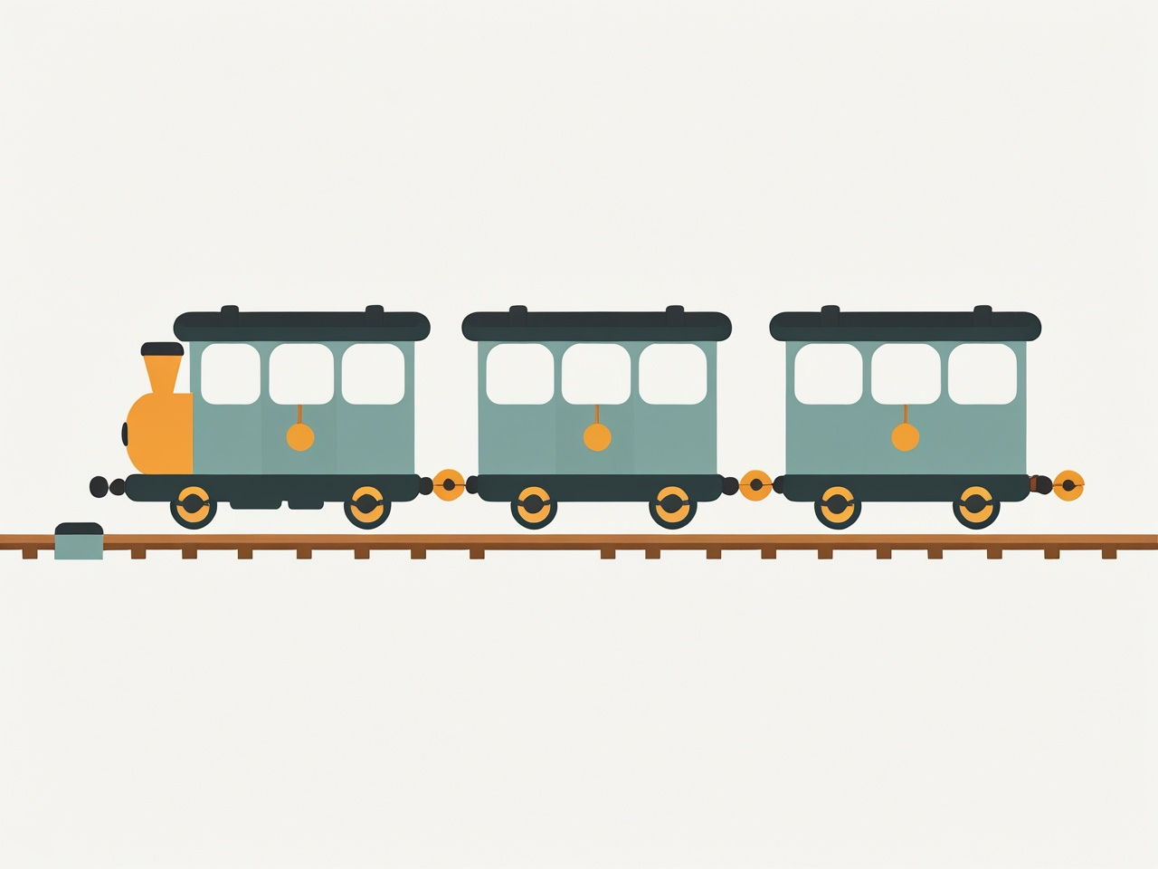
What we need to know and do
OUTCOMES
What a linked list is, in your own words
The key terms:
  node
  pointer
  head
  null
Describe how to add and remove nodes
Build a linked list in Python using OOP
Notes:
Read the four outcomes aloud. Emphasise the practical at the end is a stretch beyond the spec but builds real understanding.

Slide 3
Think first…
DISCUSS
If you have a row of boxes all pushed together and you want to add one in the MIDDLE, what has to happen to all the other boxes?
On your whiteboard: sketch the boxes and show what happens. Decide if it is fast or slow
Let's have a look at how this works
Notes:
Let students struggle for ~2 minutes. Collect answers. The point to draw out: inserting into an array means shuffling everything after it = slow. This sets up WHY linked lists exist.

Slide 4
Your challenge: invent a better way
YOUR TURN
Is there a better way?
What is the problem?
How could you add an item to the MIDDLE of a list so that NONE of the other items have to move?
In pairs (4 minutes)
Draw the items as separate boxes
Invent a rule so each box can 'find' the next one
Show how you would add a box in the middle
Be ready to explain your idea
Sketch your idea…
Notes:
Do NOT reveal the node concept yet. Give pairs 4 minutes. Circulate. Look for any group that lands on 'each box knows where the next one is' — build the whole node idea from THEIR words. If no group gets there, the human-pointer demo on the next activity nudges them. The point is they reach for pointers themselves.

Slide 5
The problem with a fixed list (array)
WHY
WORKSHEET – TASK 1
An array is fixed
All items sit in one solid block
Inserting in the middle shuffles everything item after that along
An array is STATIC, its size is set when you make it
  What problem can this cause?
A linked list is flexible
Items can be anywhere in memory
Each item just points to the memory address of the next one
The list is “DYNAMIC”, it grows and shrinks while running
Let's have a look at how this works
Notes:
Keep it to the contrast: fixed-and-shuffles vs flexible-and-points. Don't introduce Big-O notation; keep language plain.

Slide 6
Key idea: the NODE
KEY TERM
WORKSHEET – TASK 2
A node is one item in the list. It holds two things:
DATA
20
NEXT
(a pointer)
DATA = the value we store (here, 20)
NEXT = a pointer to the next node
(memory address of the next node’s location)
Think of NEXT as an arrow
It says: 'the next item is over there'
Notes:
This is the atom of the whole topic. Say it slowly: a node = data + a pointer to the next node. Point at the two halves of the diagram.

Slide 7
More key terms
KEY TERMS
WORKSHEET – TASK 3
head
10
next
20
next
30
next
None
tail (last node)
head
Points to the FIRST node
Your only way in
tail
The LAST node
Its 'next' is None / null
null / None
Means 'points to nothing’
Marks the end of the list
Notes:
Connect head to the green arrow on the diagram. Stress: the only handle the program keeps is the head; everything else is reached by following next. None at the end is how we know to stop.

Slide 8
Traversing: visiting every node
OPERATION
WORKSHEET – TASK 4
head
10
next
20
next
30
next
None
tail (last node)
The steps
Start a pointer at the head
Look at the current node's data
Move the pointer to current.next
Repeat until the pointer is None
current = head
while current is not None:
print(current.data)
current = current.next
Notes:
Walk a finger along the diagram as you read each line. The key sentence: there is NO index and NO jumping — you must follow the chain. This is the trade-off vs arrays.

Slide 9
Predict the steps: insert at the start
PREDICT
We want to add 5 to the front. BEFORE and AFTER are shown. What steps get us there?
BEFORE
10
next
20
next
Write your steps (1, 2, 3…)
None
AFTER
5
next
10
next
20
next
None
Notes:
Students write the steps on whiteboards BEFORE the reveal. Don't help yet. Expect: create node / point it at old head / move head. The common slip is forgetting to move head, or pointing head first and losing the rest.

Slide 10
Insert at the beginning
OPERATION
WORKSHEET – TASK 5
Three steps
Create the new node
Point it at the old first node
Move head to the new node
new_node = Node(value)
new_node.next = head
head = new_node
Did you spot it? Order matters. If you move head FIRST, you lose the link to the rest of the list. Point the new node forward, THEN move head.
Notes:
This is the cheapest insert: no walking needed. Note the order — point the new node forward BEFORE moving head, or you lose the rest of the list.

Slide 11
Insert at the end
OPERATION
WORKSHEET – TASK 6
The steps
Create the new node (next = None)
If the list is empty, it becomes head
Otherwise traverse to the last node
Point the last node at the new node
current = head
while current.next is not None:
current = current.next
current.next = new_node
Notice: you must walk along the whole list first, so this is slower than inserting at the start.
Notes:
Contrast with the previous slide: end-insert needs a full traversal. Mention that real code often keeps a 'tail' pointer to avoid this — good extension question.

Slide 12
Predict the steps: insert in the middle
PREDICT
Add 15 between 10 and 20. What is the EXACT order of steps? Be careful…
BEFORE
10
next
20
next
30
next
None
Write the order carefully
AFTER
10
next
15
next
20
next
30
next
None
Notes:
THE most valuable prediction. Most students will re-point 10 first and orphan 20 and 30. Let them. They discover the bug when they trace it on the next reveal. Do not warn them in advance.

Slide 13
Insert in the middle
OPERATION
WORKSHEET – TASK 7
The steps
Walk to the node before the gap
New node points to current.next
Current now points to the new node
new_node.next = current.next
current.next = new_node
Trap: what if you swap the two lines?
If 10 points to the new node FIRST, nothing remembers where 20 and 30 are, they are lost. Link the new node IN first, THEN break the old link.
Order Matters:
Link the new node to the next node first THEN break the old link.
If you do it the other way round, you lose the rest of the list.
Notes:
The classic bug. Demonstrate on the board what happens if you re-point current first: the tail is orphaned. 'Attach, then detach.'

Slide 14
Deleting nodes
OPERATION
To delete a node, make the one before it point PAST it.
From the start
Move head to head.next
The old first node is gone
From the end
Traverse to the second-to-last node
Set its next to None or null
Notes:
One sentence captures all three: deleting = making the predecessor point to the successor. Skip over it and it ceases to exist in the list.

Slide 15
Predict the steps: delete from the middle
PREDICT
Remove 20 from the list. How do you make it disappear without breaking the chain?
BEFORE
10
next
20
next
30
next
Write your steps
None
AFTER
10
next
30
next
None
Notes:
Expect them to reason: make 10 point past 20, straight to 30. Draw out that nothing then points to 20, so it is gone. Good moment to ask 'where does the deleted node actually go?' (Python reclaims it.)

Slide 16
Check your steps: delete from the middle
REVEAL
head
10
next
20
next
30
next
None
10 now points PAST 20, straight to 30. Nothing points to 20, so it is gone.
# traverse to the node BEFORE the target (10), then:
current.next = current.next.next # skip over 20
In one sentence:
deleting a node means making the one before it point to the one after it.
Notes:
The greyed node is the deleted one, still drawn so students see it is bypassed not erased. Connect to the single-sentence rule that covers all three deletes.

Slide 17
Deleting nodes
OPERATION
WORKSHEET – TASK 8
To delete a node, make the one before it point PAST it.
From the start
Move head to head.next
The old first node is gone
From the end
Traverse to the second-to-last node
Set its next to None or null
From the middle
Traverse to the node before it
Point it past the target and point to the node the deleted node pointed to
Notes:
One sentence captures all three: deleting = making the predecessor point to the successor. Skip over it and it ceases to exist in the list.

Slide 18
Spot the bug
CHALLENGE
WORKSHEET – TASK 9
This code is meant to add a node to the END of the list. It has a bug. Find it and fix it.
Which line is wrong?
What happens?
What is your recommend fix:
def insert_at_end(self, value):
new_node = Node(value)
current = self.head
while current is not None:
current = current.next
current.next = new_node
Hint:
Trace it on paper.
Where is 'current' pointing when the loop stops?
Notes:
The loop walks one step too far: it stops when current is None, then tries current.next = new_node, which crashes (can't set .next on None). The fix is 'while current.next is not None'. Spotting a broken algorithm needs deeper understanding than writing one. Let students explain the fix to each other.

Slide 19



Where are linked lists used?
IN PRACTICE
WORKSHEET – TASK 10
Music playlists
Each song points to the next track
Browser history
Back/forward = points both ways
(Doubly linked list)
Undo / redo
A chain of previous states
Notes:
Grounding the abstract idea in real uses helps it stick. Ask which of these needs to point BOTH ways (browser history) — sets up the doubly linked list challenge.

Slide 20
Quick check
DISCUSS
WORKSHEET – TASK 11
On your worksheet:
What two things does every node hold?
What does the head pointer point to?
What value marks the end of the list?
Why can't you jump straight to the 5th node?
Give one advantage of a linked list over an array.
Notes:
Cold-call or paired whiteboards. Answers: 1) data + next pointer; 2) the first node; 3) None/null; 4) no index, must traverse; 5) dynamic size / fast insert at front / no shuffling.

Slide 21
Summary so far
RECAP
WORKSHEET – TASK 12
A linked list is a chain of nodes
A node = data + a pointer (next) to the next node
head points to the first node; the last node's next is None
To traverse, follow next until you reach None
To insert or delete, you re-point the arrows — no shuffling
It grows and shrinks while the program runs
Notes:
Recap before the break / transition to computers. Check confidence with a quick thumbs scale before moving to the practical.

Slide 22
PART 2 • AT THE COMPUTERS
Build it in Python
Work at your own pace. Each task builds on the last.
Notes:
Transition point. From here students are at machines for the rest of the session. The remaining slides are self-paced reference they can read on screen.

Slide 23
First: a quick OOP reminder
TAUGHT
Class vs object
A class is a blueprint
An object is a real thing built from it
Objects have attributes (data) and methods (actions)
class Node:
def __init__(self, data):
self.data = data
self.next = None
self.data holds the value.
self.next holds a pointer to another node object.
Notes:
Bridge from the spec OOP knowledge to this use of it. Keep it short; the next slide tackles the hard bit.

Slide 24
The tricky bit: a node holds a node
TAUGHT
self.next does not store a copy. It stores a link to ANOTHER node object.
Say it like this
Node 1's next IS node 2
Node 2's next IS node 3
Following next opens the next node
Same blueprint, linked together
Notes:
THE key conceptual slide. Use the physical analogy: each person holds a card with the NAME of the next person, not a clone of them. Following the name takes you to that real person. Let students draw it themselves before moving on.

Slide 25
See it for real: Python Tutor
TOOL
GRAPHIC PLACEHOLDER
Alt-text: Screenshot placeholder of pythontutor.com showing Node objects on the heap connected by arrows, with the step controls visible.
How to use it
Go to pythontutor.com
Paste your Node and LinkedList code
Click 'Visualize Execution'
Step forward and watch the arrows appear
Other tools: VisuAlgo (visualgo.net/en/list) animates insert and delete on a linked list.
Notes:
Strongly recommend students paste their OWN code here. Seeing the heap objects and arrows is what makes 'a node holds a node' click.

Slide 26
Your tasks — go at your own pace
PRACTICAL
Core
Complete insert_at_start and display
Test it, then trace it in Python Tutor
Stretch
Add insert_after_position
Add delete_by_value (edge cases)
Develop
Add insert_at_end
Add delete_from_start
Challenge
Build a doubly linked list
Where would back/forward use it?
Stuck? Draw the arrows on paper first, then write the code. Test after every method.
Notes:
Open the starter file for students. Everyone starts at Core; nobody is expected to finish Challenge. Circulate and prompt with questions rather than answers.

Slide 27
Test your list as you go
PRACTICAL
ll = LinkedList()
ll.insert_at_end(10)
ll.insert_at_end(20)
ll.insert_at_start(5)
ll.display() # 5 -> 10 -> 20 -> None
ll.delete_by_value(10)
ll.display() # 5 -> 20 -> None
Run your file after each method.
If the output isn't what you expect, draw the arrows on paper and find where they go wrong.
Notes:
Encourage test-as-you-go. The comments show the expected output so students can self-check without asking.

Slide 28
Wider study: Make the case
Report
A leaderboard is READ constantly but rarely CHANGED. Would you store it as an array or a linked list? Defend your answer.
Think about
What is this list used for MOST?
Which structure is faster to read by position?
Which is faster to insert into?
Does the trade-off favour one here?
Our choice, and why:
Notes:
There is no single 'right' answer they can recall — they must weigh the trade-off against the context (array wins here: fast read-by-position, changes are rare so slow insert doesn't matter). This is exactly AO2/AO3. Take 2-3 contrasting answers and have the class judge which justification is strongest.

Slide 29
Key terms to remember
RECAP
GRAPHIC PLACEHOLDER
Alt-text: A clean recap diagram: head -> [data|next] -> [data|next] -> [data|next] -> None, with each part neatly labelled (head, node, data, next pointer, None). This is the single 'cheat sheet' image for the topic.
Node: data + a pointer
Pointer / next: link to the next node
Head: points to the first node
Tail: the last node
Null / None: marks the end
Traverse: follow next to the end
Notes:
Final recap. Point students to the algorithm reference document and the solutions file for revision.

