Slide 1
OCR A LEVEL COMPUTER SCIENCE • 1.4.2
Stacks
5
top
Last in, first out, and why it powers undo, recursion and so much more
8
3
Notes:
2-hour lesson, Year 13, first exposure to stacks. Session 1 desk-based (this deck + whiteboards). Session 2 computer-based practical. Main lesson covers the LIFO stack with one top pointer; the call-stack is the hard concept; expression evaluation is introduced as an application only. Emphasise NEA usefulness throughout.

Slide 2
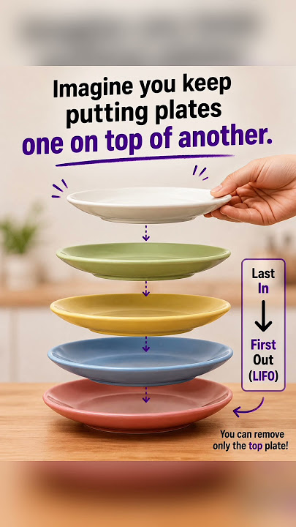
What you will be able to do
OUTCOMES
Explain what a stack is
Explain what LIFO means
Use the key terms:
  top
  push
  pop
  peek
Describe push, pop and peek step by step
Explain stack overflow and underflow
Be able to protect / guard against them
Build a stack in Python for your projects
Notes:
Read the outcomes aloud. Flag that the Python skill is directly useful for NEA projects (undo features, backtracking, expression handling, navigation history).

Slide 3
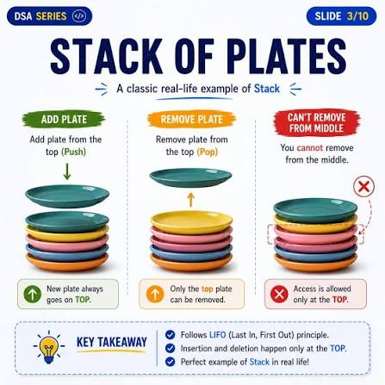
Think first...
DISCUSS
Think about a stack of plates.
To take a plate, which one do you take? Why?
When you add one, where does it go? Why?
On your whiteboard: write the one rule a stack of plates always follows.
Notes:
Let them articulate it themselves. Draw out: you always add to the top and always take from the top. The last plate you put on is the first one you take off. This IS LIFO, in their words.

Slide 4
A stack is LIFO
KEY IDEA
LIFO = Last In, First Out. The last item added is the first one removed.
Everything happens at ONE end: the top
There is no front and rear like a queue
5
top
8
3
push = add an item on top
pop = remove the item from the top
Notes:
Anchor to the plates: top = the plate you can reach. Contrast directly with the queue: a queue is FIFO with two pointers; a stack is LIFO with one pointer (top). This contrast is worth labouring.

Slide 5
Push: adding to the top
OPERATION
Move the top pointer up by one, then put the new item there.
BEFORE
AFTER push(5)
The steps
Check the stack is not full
Move top up by one
Put the new item at top
5
top
8
top
8
3
3
top = top + 1
stack[top] = value
Notes:
Walk it: top goes up first, then the value lands. Stress checking 'is it full?' first; this sets up overflow. Only the top moves; nothing else shifts (unlike a queue insert or array shuffle).

Slide 6
Pop: removing from the top
OPERATION
Take the item at the top, then move the top pointer down by one.
BEFORE
AFTER pop()
The steps
Check the stack is not empty
Read the item at top
Move top down by one
5
top
8
8
top
3
3
value = stack[top]
top = top - 1
Notes:
pop returns 5 and top drops to index 1. Note: we do not erase the old cell; it is simply no longer 'in' the stack because top has moved below it. Check 'is it empty?' first; this sets up underflow.

Slide 7
Predict: what could go wrong?
DISCUSS
Before we name any problems, work out for yourselves what a stack should do and what you think could go wrong.
A stack of plates is already completely full. What should happen if someone tries to push another plate on?
A stack of plates is completely empty. What should happen if someone tries to pop a plate off?
Talk to your partner: what check would a program need to make before each of push and pop?
On your whiteboard: write your two checks. We will compare them with the two named problems on the next slide.

Slide 8
Peek, isEmpty and isFull
OPERATION
peek (or top)
Look at the top item
Do NOT remove it
Useful to 'check' before acting
isEmpty
True when top = -1
No items to pop
Check before every pop
isFull
True when top = size - 1
No room to push
Check before every push
Why peek?
Sometimes you need to see what is on top to decide what to do, without taking it off yet.
Notes:
peek is the cheap 'look but do not touch' operation. isEmpty/isFull are the guards. top = -1 for empty is a useful convention: the first push moves it to 0.

Slide 9
Overflow and underflow
KEY IDEA
A stack lives in a fixed-size array, so two things can go wrong.
Stack OVERFLOW
Trying to push onto a FULL stack
There is no room for the new item
The isFull check prevents it
Stack UNDERFLOW
Trying to pop from an EMPTY stack
There is no item to remove
The isEmpty check prevents it
These are exam terms, so learn them
Overflow = push when full.
Underflow = pop when empty.
Both are stopped by checking isFull or isEmpty first.
Notes:
Overflow and underflow are named, examinable. Tie them back to the guards from the previous slide. A real stack overflow (too much recursion) connects to the next big idea: the call stack.

Slide 10
Worked example: filling and overflowing a stack
WORKED EXAMPLE
A stack of size 3 starts empty (top = -1). Follow it through four push operations.
Operation | Stack contents (bottom to top) | top
push(4) | 4 | 0
push(7) | 4, 7 | 1
push(2) | 4, 7, 2 | 2
push(9) | REJECTED | 2 (unchanged)
top has reached size - 1 (index 2), so isFull is TRUE. push(9) is correctly rejected instead of overflowing. Without this check, the program would try to write beyond the end of the array.

Slide 11
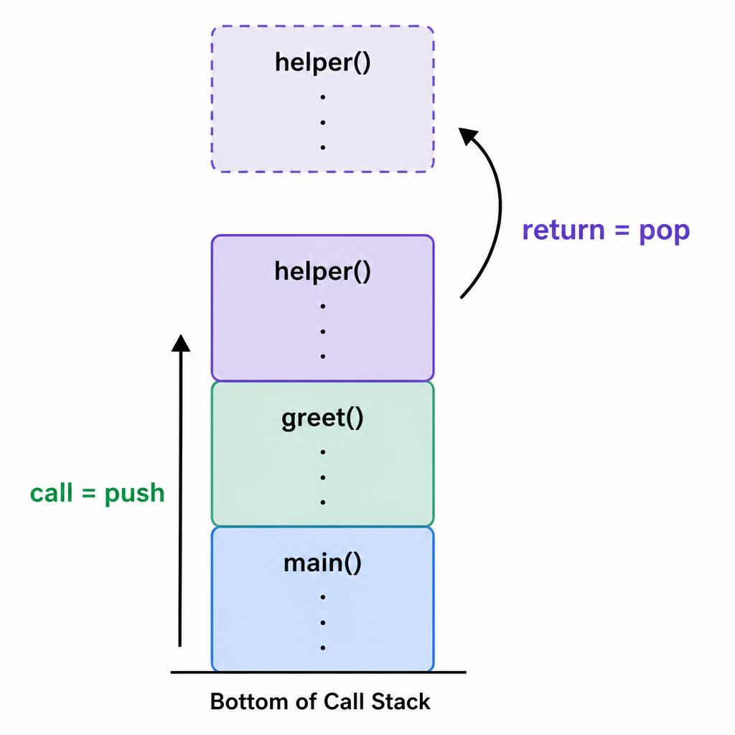
The big idea: the call stack
KEY IDEA
Your computer uses a stack to keep track of function calls.
This is why stacks matter.
How it works
Calling a function PUSHES a frame on
The frame holds that call's variables
When the function returns, its frame is POPPED
The most recent call is always on top
Too many calls with no return = stack overflow
Notes:
The key conceptual slide. Use the analogy: each function call is a plate placed on top; you cannot get back to the one underneath until the top one is finished (returns). This is exactly LIFO. Connect 'too much recursion' to the real 'stack overflow' error. Let students predict what the stack looks like at the deepest point.

Slide 12
What must the computer remember?
DISCUSS
Before we see the official answer: design it yourselves.
When a function is called, the computer must return to exactly the right place afterwards, with the right values.
In pairs, list everything the computer needs to remember about a single function call to make this possible.
Bookmark idea: what does a bookmark need to 'remember' for you when you put it in a book?
Check your list against the four parts of a stack frame on the next slide.
How close did you get?

Slide 13
The stack frame
KEY IDEA
Every time a function is called, the computer creates a block of memory called a stack frame (also called an activation record) that holds everything that call needs.
A stack frame contains:
Frame for greet(name)
greet(name)
Return address: where to go back to when the function finishes
Parameters: the values passed into the function
Local variables: any variables created inside the function
Return value space: space to store the result (if the function returns a value)
return address : line 7
parameter : name = "Jo"
local var : message = ...
return value : None
One frame per call. When the function returns, its frame is popped and all its local data disappears.

Slide 14
Why does a computer need stack frames?
WHY?
With frames, every call is independent:
Without frames, the computer would not know:
Each call gets its own private copy of parameters and local variables
Returning is just popping the frame and jumping to the return address
This is what makes recursion possible
Where to go back to after the function finishes
Which values belong to which call
How to handle the same function called twice with different inputs
Bookmark analogy:
Imagine reading a book.
You put a bookmark in when you pause, then open a second book and put another bookmark in.
You can stack as many bookmarks as you like.
The pile of bookmarks is the call stack.
Each bookmark, together with your notes about what you were thinking at that point, is a stack frame.

Slide 15
Worked example: frames on the call stack
HOW?
Call stack, step by step:
def main():
x = 10
result = double(x) # line 3
print(result)
def double(n):
return n * 2
main()
Step 1: main() is called
main()
return : end of programme
local : x = 10
Step 2: double(x) is pushed on top
top of stack
double(n) [TOP]
return : line 3 of main()
param : n = 10
What happens when double() returns?
1. double() finishes and produces the value 20
2. Its frame is popped. The local variable n no longer exists anywhere in memory
3. The return address sends execution back to line 3 of main(), which stores the result in 'result'

Slide 16
Recursion: the same function, different frames
HOW?
Call stack when countdown(3) calls countdown(2) calls countdown(1):
def countdown(n):
if n == 0:
return
countdown(n - 1) #line 3
countdown(3)
return : end of programme
Param : n = 3
countdown(2)
countdown(3) creates THREE separate frames, each with its own value of n.
return : line 3
Param : n = 2
top of stack
countdown(1) [TOP]
This is why recursion works
return : line 3 of main()
Each call gets its OWN frame with its OWN value of n
n = 1 finishes first (frame popped), then n = 2, then n = 3
Too many calls with no return causes stack overflow
param : n = 1
countdown(1) pops first, then (2), then (3)
Stack overflow: what if countdown() never reached n == 0?

Slide 17
Worked example: tracing countdown(3)
WORKED EXAMPLE
countdown(n) calls itself with n - 1 until n = 0. Trace the call stack from bottom to top.
Event | Call stack (bottom to top)
call countdown(3) | countdown(3) [n=3]
call countdown(2) | countdown(3) [n=3], countdown(2) [n=2]
call countdown(1) | ..., countdown(1) [n=1]
call countdown(0) | ..., countdown(0) [n=0]
countdown(0) hits base case, returns | countdown(3), countdown(2), countdown(1)
countdown(1) returns | countdown(3), countdown(2)
countdown(2) returns | countdown(3)
countdown(3) returns | (empty)

Slide 18
Quick check
DISCUSS
On your whiteboard:
1. Name three things stored inside a stack frame.
2. Why does the return address matter? What would happen without it?
3. If function A calls function B, and B calls function C, which frame is on top? Which is at the bottom?
4. When C finishes, what happens to its frame? Where does the programme go next?
5. In the countdown example, what would happen if the base case (n == 0) was missing?

Slide 19
Trace the call stack
DISCUSS
def main():
greet()
def greet():
helper()
def helper():
print('hi')
On your whiteboard
main() runs and calls greet()
greet() runs and calls helper()
Draw the stack at its TALLEST point
Then show what happens as each returns
Answer:
At the tallest point the stack is (bottom to top) main, greet, helper.
Helper returns first (popped), then greet, then main. Last in, first out.
Notes:
Let students build the stack themselves before revealing. The penny-drop: helper was pushed last and returns first. This is the LIFO rule made concrete, and it explains recursion's behaviour later in the course.

Slide 20
Where are stacks used?
IN PRACTICE
Undo / redo
The last action is the first undone
Back button
The last page visited is the first returned to
Recursion and backtracking
The call stack; solving mazes; depth-first search
Notes:
All share the LIFO property: the most recent thing is dealt with first. Very relevant to NEA: undo features, navigation history, and backtracking algorithms are all natural stack uses.

Slide 21
How could a stack work out 3 + 4 × 2?
DISCUSS
A calculator must work out 4 × 2 before adding the 3, even though the + sign appears first.
In pairs: imagine you have a stack. Which numbers and operators would you push, and in what order, so that popping them in the right sequence gives the correct answer?
What extra problem would a stack need to solve if brackets were added, e.g. (3 + 4) × 2?
This idea is used inside real calculators and compilers.
We will return to the full method (converting to postfix / RPN) in a later lesson.

Slide 22
Application: working out sums
STRETCH
Stacks are perfect for evaluating expressions like 3 + 4 * 2 in the correct order.
You will meet this again
Converting infix to postfix (Reverse Polish Notation or RPN)
Evaluating the postfix with a stack
We explore the algorithm in wider study
Why a stack fits
Numbers and operators are pushed and popped
It handles brackets and priority cleanly
Used inside calculators and compilers
*we will come back to this at a later date
*Postfix and infix are different ways to write mathematical expressions
For now: when a problem needs the most recent thing first, a stack is the right tool.
Notes:
Stretch and awareness only. Do not teach the shunting-yard algorithm here; it is a wider-study task. The takeaway is recognising a stack as the right tool for expression handling.

Slide 23
Stack or queue?
COMPARE
They look similar but behave in opposite ways.
Knowing which to use is an exam and NEA skill.
Stack
LIFO: last in, first out
One pointer: top
push and pop, both at the top
Undo, recursion, backtracking
Queue
FIFO: first in, first out
Two pointers: front and rear
enqueue at rear, dequeue at front
Print jobs, buffers, simulations
Quick test:
“most recent first” means a stack.
“in the order they arrived” means a queue.
Notes:
This contrast is highly examinable. The one-line test at the bottom is the takeaway. If they did queues recently, this consolidates both.

Slide 24
Worked example: stack or queue?
WORKED EXAMPLE
For each scenario, decide which structure fits and why.
Scenario | Structure | Why
Ctrl+Z undo history | Stack | Most recent action must be undone first
Print jobs on a shared printer | Queue | Jobs printed in the order they were sent
Browser back button | Stack | Most recently visited page returned to first
Customers in a bank queue | Queue | Served in the order they arrived
Checking if brackets are balanced | Stack | Most recently opened bracket closed first
Quick test: 'most recent first' points to a stack. 'In the order they arrived' points to a queue.

Slide 25
Quick check
DISCUSS
On your whiteboard:
1. What does LIFO stand for?
2. Which end do you push and pop at?
3. How many pointers does a stack need, and what is it called?
4. What is stack overflow? What is stack underflow?
5. Name one real use of a stack.
Notes:
Cold-call or paired whiteboards. Answers: 1) Last In First Out; 2) the top, for both; 3) one, called top; 4) overflow = push when full, underflow = pop when empty; 5) undo / back button / call stack / backtracking.

Slide 26
Summary so far
RECAP
A stack is LIFO: last in, first out
Everything happens at one end, the top
push adds to the top; pop removes from the top; peek looks
Check isFull before push, isEmpty before pop
Overflow = push when full; underflow = pop when empty
The call stack tracks function calls: call = push, return = pop
Notes:
Recap before the transition to computers. Quick thumbs check on the LIFO idea and the call-stack connection before moving on.

Slide 27
PART 2 • AT THE COMPUTERS
Build it in Python
Work at your own pace. Each task builds on the last.
Notes:
Transition point. From here students are at machines for the rest of the session. Remaining slides are self-paced reference. Emphasise this is directly reusable in their NEA projects.

Slide 28
What does a stack class need to remember?
DISCUSS
Before we see the code: compare a stack with the queue class from the last lesson.
A queue class needed three variables: front, rear and count.
Based on everything you know about a stack, what is the minimum a stack class needs to keep track of?
Why do you think a stack needs fewer variables than a queue?
Check your answer against the class definition on the next slide. How close did you get?

Slide 29
A stack as a class
TAUGHT
The idea
Store the items in a list
Keep one variable: top
push and pop are methods
class Stack:
def __init__(self, size):
self.items = [None]*size
self.top = -1 # empty
self.size = size
Why top = -1?
It means 'the stack is empty’.
The first push moves top to 0, which is the first cell.
It also makes isEmpty easy: the stack is empty when top is -1.
Notes:
Note this stack needs only ONE pointer, unlike the queue's two. Simpler to code. The -1 convention for empty is worth dwelling on; it makes push and isEmpty clean.

Slide 30
Push and pop in Python
TAUGHT
def push(self, value):
if self.top == self.size - 1:
return False # full
self.top += 1
self.items[self.top] = value
return True
def pop(self):
if self.top == -1:
return None # empty
value = self.items[self.top]
self.top -= 1
return value
Notice the guards:
push checks for full (stops overflow)
pop checks for empty (stops underflow).
These two lines are what keep the stack safe.
Notes:
The guards map directly onto overflow/underflow. Point out how short and clean a stack is compared with a circular queue: one pointer, no MOD. Good news for their NEA.

Slide 31
Worked example: tracing the Python stack
WORKED EXAMPLE
Stack(3) is created, then three calls are made. Trace the object's state after each line.
s = Stack(3)
s.push(6)
s.push(1)
s.pop()
Line | self.items | top
s = Stack(3) | [None, None, None] | -1
s.push(6) | [6, None, None] | 0
s.push(1) | [6, 1, None] | 1
s.pop() | [6, 1, None] | 0

Slide 32
Your tasks, go at your own pace
PRACTICAL
Core
Complete push and pop
Test it with a few values
Stretch
Use a stack to reverse a word
Push each letter, then pop them all
Develop
Add peek and isEmpty
Make it print the stack contents
Challenge
Check if brackets are balanced
e.g. ( [ ] ) is valid, ( ] is not
Stuck? Draw the stack and the top pointer on paper first, then write the code. Test after every method.
Notes:
Open the starter file. Everyone starts at Core. The reverse-a-word task (Stretch) is a lovely demonstration of LIFO. Balanced brackets (Challenge) is a real, useful algorithm and great NEA material.

Slide 33
Test your stack as you go
PRACTICAL
s = Stack(5)
s.push(3)
s.push(8)
s.push(5)
print(s.pop()) # 5 (last in, first out)
print(s.peek()) # 8 (look, do not remove)
print(s.pop()) # 8
Run your file after each method. If the output is not what you expect, draw the stack and the top pointer on paper and find where they go wrong.
Notes:
Test-as-you-go. The comments give expected output so students self-check. The pop returning the last-pushed value is the LIFO behaviour in action.

Slide 34
Key terms to remember
RECAP
LIFO: last in, first out
top: the only pointer a stack needs
push: add to the top
pop: remove from the top
peek: look at the top without removing
overflow / underflow: push full / pop empty
Notes:
Final recap. Point students to the algorithm reference and the solutions file for revision and for reuse in their NEA projects.

