Slide 1
1.4.1A Objectives
Represent positive integers in binary and hexadecimal
Convert between binary, hexadecimal and denary

Slide 2
Binary number system
The binary number system uses only two digits,
0 and 1
To understand how this works, it is helpful to look first at the fundamentals of the denary or decimal system, which uses digits 0..9

Slide 3
Number symbols
The denary number system uses a combination of just ten symbols to represent any number
Number systems are referred to by their base; that is, the number of symbols used to construct values
Denary is base 10 and the base may be referred to as a subscript
  In denary the number 11, for example, may be written as 11₁₀
  In binary, it would be written as 11₂ and in hexadecimal as 11₁₆
  11₁₀, 11₂ and 11₁₆ all represent different values

Slide 4
Base 2
Numbers which use base 2 are commonly referred to as binary numbers
Can you see a pattern in the binary values?
Denary | Binary
1 | 1
2 | 10
3 | 11
4 | 100
5 | 101
6 | 110
7 | 111
8 | 1000
9 | 1001
10 | 1010
11 | 1011

Slide 5
Place value
In any counting system, the position of the value determines its contribution to the overall total
Therefore 183₁₀ represents the value of
one hundred, eight tens and three units
Base^{position} | 10² | 10¹ | 10⁰
Place value | 100 | 10 | 1
Number | 1 | 8 | 3
Digit value | 100x1 | 10x8 | 1x3

Slide 6
The binary system
Binary works the same way, except the base used is 2 instead of 10
Therefore 1 0 1 1 0 1 1 1₂ represents
128 + 32 + 16 + 4 + 2 + 1 which is equivalent to 183₁₀
Base^{position} | 2⁷ | 2⁶ | 2⁵ | 2⁴ | 2³ | 2² | 2¹ | 2⁰
Place value | 128 | 64 | 32 | 16 | 8 | 4 | 2 | 1
Number | 1 | 0 | 1 | 1 | 0 | 1 | 1 | 1
Digit value | 128x1 | 0 | 32x1 | 16x1 | 0 | 4x1 | 2x1 | 1x1

Slide 7
Converting from denary
The place value table is useful to aid conversion from denary to binary
  Convert 159₁₀ to binary
Place value | 128 | 64 | 32 | 16 | 8 | 4 | 2 | 1
Number | 1 | 0 | 0 | 1 | 1 | 1 | 1 | 1
1. Can 128 be used to make some of 159?
2. If it can, use it by setting bit value to 1, (0 if not)
3. If value used subtract from starting value,
eg. 159 – 128 = 31
4. Repeat using value from step 3 until nothing left

Slide 8
Hexadecimal – Base 16
Number systems with bases above 10 often still use 0 to 9 but require extra symbols for values past 9
An example of this is base 16 which is referred to as the hexadecimal number system
Hexadecimal uses letters for the values 10 to 15
0 | 1 | 2 | 3 | 4 | 5 | 6 | 7 | 8 | 9 | 10 | 11 | 12 | 13 | 14 | 15
0 | 1 | 2 | 3 | 4 | 5 | 6 | 7 | 8 | 9 | A | B | C | D | E | F

Slide 9
Denary to hex conversion
Converting to two-digit hexadecimal numbers
Divide the number by 16, and add the remainder
What is 47₁₀ in hexadecimal?
What is 57₁₀ in hexadecimal?
What is 237₁₀ in hexadecimal?
43 | ÷ | 16 | = | 2 remainder 11
 |  |  | = | 2 remainder B
 |  |  | = | 2B

Slide 10
Hexadecimal values
The rules of place value work in the same way:
Therefore, the equivalent of 3F5₁₆ in denary is
(256x3) + (16x15) + 5 = 768 + 240 + 5 = 1013₁₀
What is A3₁₆ in denary?
Base^{position} | 16² | 16¹ | 16⁰
Place value | 256 | 16 | 1
Number | 3 | F (or 15) | 5
Digit value | 256 x 3 | 16 x 15 | 1 x 5

Slide 11
Significant powers
Why is the answer to 2⁴ significant?
2⁰ = 1
2¹ = 2
2² = 4
2³ = 8
2⁴ = 16

Slide 12
Significance of 16
16 is the fourth power of 2
This means that base 16 numbers can be translated from 4 consecutive bits of a binary value
This makes it simple to translate binary numbers into hexadecimal values and back again
 |  | 8 | 4 | 2 | 1 | 8 | 4 | 2 | 1
216 | = | 1 | 1 | 0 | 1 | 1 | 0 | 0 | 0
 | = | D |  |  |  | 8

Slide 13
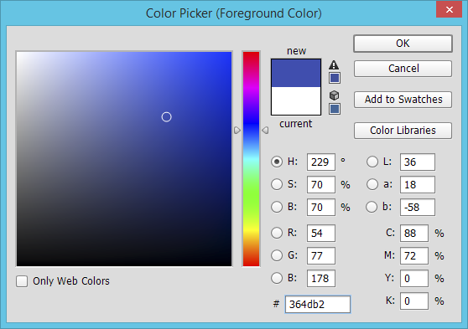
Hex colour codes
The hex code for this colour is 36 4D B2
  What does this mean?
  How can you increase the amount of red,
  using the hex code?

Slide 14
Why use hex?
A hexadecimal value is much easier to read and remember than a string of binary digits
It is quicker to write or type, since a hex digit takes up only one character, not four
There is less chance of making an error when typing hex characters than a string of 1s and 0s
It is used to define colours, in MAC addresses, in assembly languages and machine code
It is very easy to convert to and from binary

Slide 15
Plenary
Denary numbers are easy to understand but they are not easy to use in electronics
Binary is simple to use with circuitry but is difficult to read by humans
Hexadecimal makes binary easier to read and easier to transcribe (copy) accurately

