Slide 1
1.4.1A Objectives
Represent positive integers in binary and hexadecimal
Convert between binary, hexadecimal and denary

Slide 2
Binary number system
The binary number system uses only two digits,
0 and 1
To understand how this works, it is helpful to look first at the fundamentals of the denary or decimal system, which uses digits 0..9

Slide 3
Number symbols
The denary number system uses a combination of just ten symbols to represent any number
Number systems are referred to by their base; that is, the number of symbols used to construct values
Denary is base 10 and the base may be referred to as a subscript
  In denary the number 11, for example, may be written as 11₁₀
  In binary, it would be written as 11₂ and in hexadecimal as 11₁₆
  11₁₀, 11₂ and 11₁₆ all represent different values

Slide 4
Base 2
Numbers which use base 2 are commonly referred to as binary numbers
Can you see a pattern in the binary values?
Denary | Binary
1 | 1
2 | 10
3 | 11
4 | 100
5 | 101
6 | 110
7 | 111
8 | 1000
9 | 1001
10 | 1010
11 | 1011

Slide 5
Place value
In any counting system, the position of the value determines its contribution to the overall total
Therefore 183₁₀ represents the value of
one hundred, eight tens and three units
Base^{position} | 10² | 10¹ | 10⁰
Place value | 100 | 10 | 1
Number | 1 | 8 | 3
Digit value | 100x1 | 10x8 | 1x3

Slide 6
The binary system
Binary works the same way, except the base used is 2 instead of 10
Therefore 1 0 1 1 0 1 1 1₂ represents
128 + 32 + 16 + 4 + 2 + 1 which is equivalent to 183₁₀
Base^{position} | 2⁷ | 2⁶ | 2⁵ | 2⁴ | 2³ | 2² | 2¹ | 2⁰
Place value | 128 | 64 | 32 | 16 | 8 | 4 | 2 | 1
Number | 1 | 0 | 1 | 1 | 0 | 1 | 1 | 1
Digit value | 128x1 | 0 | 32x1 | 16x1 | 0 | 4x1 | 2x1 | 1x1

Slide 7
Converting from denary
The place value table is useful to aid conversion from denary to binary
  Convert 159₁₀ to binary
Place value | 128 | 64 | 32 | 16 | 8 | 4 | 2 | 1
Number | 1 | 0 | 0 | 1 | 1 | 1 | 1 | 1
1. Can 128 be used to make some of 159?
2. If it can, use it by setting bit value to 1, (0 if not)
3. If value used subtract from starting value,
eg. 159 – 128 = 31
4. Repeat using value from step 3 until nothing left

Slide 8
Hexadecimal – Base 16
Number systems with bases above 10 often still use 0 to 9 but require extra symbols for values past 9
An example of this is base 16 which is referred to as the hexadecimal number system
Hexadecimal uses letters for the values 10 to 15
0 | 1 | 2 | 3 | 4 | 5 | 6 | 7 | 8 | 9 | 10 | 11 | 12 | 13 | 14 | 15
0 | 1 | 2 | 3 | 4 | 5 | 6 | 7 | 8 | 9 | A | B | C | D | E | F

Slide 9
Denary to hex conversion
Converting to two-digit hexadecimal numbers
Divide the number by 16, and add the remainder
What is 47₁₀ in hexadecimal?
What is 57₁₀ in hexadecimal?
What is 237₁₀ in hexadecimal?
43 | ÷ | 16 | = | 2 remainder 11
 |  |  | = | 2 remainder B
 |  |  | = | 2B

Slide 10
Hexadecimal values
The rules of place value work in the same way:
Therefore, the equivalent of 3F5₁₆ in denary is
(256x3) + (16x15) + 5 = 768 + 240 + 5 = 1013₁₀
What is A3₁₆ in denary?
Base^{position} | 16² | 16¹ | 16⁰
Place value | 256 | 16 | 1
Number | 3 | F (or 15) | 5
Digit value | 256 x 3 | 16 x 15 | 1 x 5

Slide 11
Significant powers
Why is the answer to 2⁴ significant?
2⁰ = 1
2¹ = 2
2² = 4
2³ = 8
2⁴ = 16

Slide 12
Significance of 16
16 is the fourth power of 2
This means that base 16 numbers can be translated from 4 consecutive bits of a binary value
This makes it simple to translate binary numbers into hexadecimal values and back again
 |  | 8 | 4 | 2 | 1 | 8 | 4 | 2 | 1
216 | = | 1 | 1 | 0 | 1 | 1 | 0 | 0 | 0
 | = | D |  |  |  | 8

Slide 13
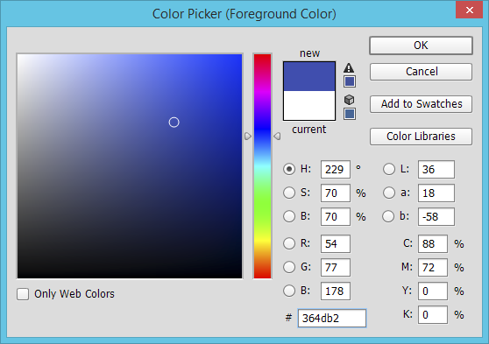
Hex colour codes
The hex code for this colour is 36 4D B2
  What does this mean?
  How can you increase the amount of red,
  using the hex code?

Slide 14
Why use hex?
A hexadecimal value is much easier to read and remember than a string of binary digits
It is quicker to write or type, since a hex digit takes up only one character, not four
There is less chance of making an error when typing hex characters than a string of 1s and 0s
It is used to define colours, in MAC addresses, in assembly languages and machine code
It is very easy to convert to and from binary

Slide 15
Plenary
Denary numbers are easy to understand but they are not easy to use in electronics
Binary is simple to use with circuitry but is difficult to read by humans
Hexadecimal makes binary easier to read and easier to transcribe (copy) accurately

Slide 16
1.4.1A2 Objectives
Use sign and magnitude to represent negative numbers in binary
Use two’s complement to represent negative numbers in binary

Slide 17
Calculating range
Remember that the number of bits determines how many values can be represented in binary
  How many binary values can be represented in 4 bits?
  What is the highest and lowest values that can be represented?
  0 … 2^{n} - 1

Slide 18
Representing negative numbers
How can negative numbers be represented?
One method is called sign and magnitude
The first bit acts as the sign, 0 for + and 1 for –
The other 7 bits act as normal
How would the number -3 be represented in an 8-bit byte using sign and magnitude?
1 0 0 0 0 0 1 1

Slide 19
Sign and magnitude
The binary representation of 3 is 00000011
The binary representation of -3 is 10000011
Add these two numbers:
  This is -6!
Clearly arithmetic does not work in the normal way using sign and magnitude
 |  | 0 | 0 | 0 | 0 | 0 | 0 | 1 | 1
 | + | 1 | 0 | 0 | 0 | 0 | 0 | 1 | 1
 | = | 1 | 0 | 0 | 0 | 0 | 1 | 1 | 0

Slide 20
Two’s complement
Negative values are most commonly represented using a method called two’s complement

Slide 21
Two’s complement
The two’s complement of a signed binary value is found by flipping all of the bits and adding one
00000011 = 3
00000010 = 2
00000001 = 1
00000000 = 0
11111111 = -1
11111110 = -2
11111101 = -3

Slide 22
Signed binary representation
Find -77₁₀ in two’s complement:
  Find the positive value first:
  Flip the bits:
  And add 1:
128 | 64 | 32 | 16 | 8 | 4 | 2 | 1
0 | 1 | 0 | 0 | 1 | 1 | 0 | 1 | = | 77
1 | 0 | 1 | 1 | 0 | 0 | 1 | 0
1 | 0 | 1 | 1 | 0 | 0 | 1 | 1 | = | -77

Slide 23
Two’s complement range
Note that the number of values that can be represented is the same as for positive binary numbers
However, half the range of values now represents negative numbers
  Maximum for 8 bits is 127₁₀ which is 01111111 in binary
  Minimum is -128₁₀ which is 10000000 in binary
  -(2^{(n-1)}) … 2^{(n-1)} - 1
  What range of values can be represented in16 bits?

Slide 24
Subtraction with two’s complement
Two’s complement can be used to ensure subtraction will occur when adding negative values
The calculation 65₁₀ - 43₁₀ should produce the same result as 65₁₀ + -43₁₀
This way we can always use addition when we want to subtract

Slide 25
Binary subtraction
Using two’s complement, we can find 65₁₀ + -43₁₀
 | 1 | 1 |  |  |  |  |  | 1
 |  | 0 | 1 | 0 | 0 | 0 | 0 | 0 | 1
+ |  | 1 | 1 | 0 | 1 | 0 | 1 | 0 | 1
 | 1 | 0 | 0 | 0 | 1 | 0 | 1 | 1 | 0
Ignore the carry bit
Answer is 22₁₀

Slide 26
Two’s complement overflow
Where the result of the addition is too large to fit in the allocated number of bits, overflow will occur
  This is the same as standard binary addition
  If the result requires more bits than are available, the number will not be represented correctly
  A ‘1’ in the left most bit indicates a negative number, therefore overflow occurs above 127 with 8 bits
1 | 1 | 0 | 1 | 0 | 1 | 0 | 1

Slide 27
Summary
Negative values use two’s complement in order to be processed correctly without the need for additional processor logic circuits

Slide 28
Recall: think about this …
Binary
Key Stage 3 question: What is the denary number represented by binary 10101?
GCSE question What is 95₁₀ when written in hexadecimal?
A-Level questions What is -3 in two’s complement binary?
Recall

Slide 29
Recall: think about this …
Binary
Key Stage 3 question: What is the denary number represented by binary 10101? 21
GCSE question What is 95₁₀ when written in hexadecimal? 5F
A-Level questions What is -3 in two’s complement binary? 11111101
Recall

Slide 30
Binary addition
The rules of binary addition are the same:
  Three 1s occur during a carry operation
 |  |  |  |  |  |  |  |  |  |  |  |  | 1
 | 0 |  |  | 0 |  |  | 1 |  |  | 1 |  |  | 1
+ | 0 |  | + | 1 | OR | + | 0 |  | + | 1 |  | + | 1
 | 0 |  |  | 1 |  |  | 1 |  | 1 | 0 |  | 1 | 1

Slide 31
Adding binary values
This concept can be extended to binary values of more than one bit
1
1
1
Carry
1
0
1
0
1
+
1
1
1
=
1
1
1
0
0

Slide 32
Significant powers
2⁴ = 16
2³ = 8
2² = 4
2¹ = 2
2⁰ = 1
2⁻¹ = ?
2⁻² = ?

Slide 33
Significant powers
2⁴ = 16
2³ = 8
2² = 4
2¹ = 2
2⁰ = 1
2⁻¹ = 0.5
2⁻² = 0.25

Slide 34
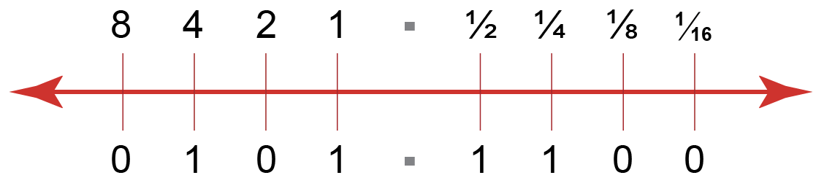
Binary fractions
Using bits to the right of the units column introduces fractional values
We also introduce a (virtual) “binary point”.

Slide 35
Fractional values
Fractional values are negative powers of 2
For example:
  2⁻² is the same as ½² or 0.25₁₀
Place value | 2² | 2¹ | 2⁰ | 2⁻¹ | 2⁻² | 2⁻³
Decimal equivalent | 4 | 2 | 1 | 0.5 | 0.25 | 0.125

Slide 36
Fixed-point binary
A fixed-point binary value uses a specified number of bits where the placement of the binary point is fixed
  For example, in an 8 bit fixed-point binary value, the binary point could be set between the fourth and fifth bits
  Therefore 6.625₁₀ as a fixed-point byte would be:
  What effect does this have on accuracy and range?
2³ | 2² | 2¹ | 2⁰ | 2⁻¹ | 2⁻² | 2⁻³ | 2⁻⁴
8 | 4 | 2 | 1 | 0.5 | 0.25 | 0.125 | 0.0625
0 | 1 | 1 | 0 | 1 | 0 | 1 | 0

Slide 37
Fixed-point binary
  What effect does this have on accuracy and range?
  In this example, 8 bits would be able to store values between 0 and 15.9375
  Clearly the range is much reduced.
  Accuracy for fractional numbers is increased from previously, but it still may not be very accurate.
  Using these 8 bits, how close could we get to 10.54?
  How close could we get to ⅔?
2³ | 2² | 2¹ | 2⁰ | 2⁻¹ | 2⁻² | 2⁻³ | 2⁻⁴
8 | 4 | 2 | 1 | 0.5 | 0.25 | 0.125 | 0.0625
0 | 1 | 1 | 0 | 1 | 0 | 1 | 0

Slide 38
Fixed-point binary
  With fixed point binary, we are sacrificing range for accuracy.
  However, the accuracy may not be useful to us.
  Some values cannot be represented at all (irrational numbers mean irrational binary numbers as well – for example ⅔ is actually equal to 0.1010101010101010101010101… in binary)
  Others would need huge amounts of digits after the binary point to be even close to accurate.
  Clearly, for the majority of rational numbers, we need another method of writing these in a binary format.
2³ | 2² | 2¹ | 2⁰ | 2⁻¹ | 2⁻² | 2⁻³ | 2⁻⁴
8 | 4 | 2 | 1 | 0.5 | 0.25 | 0.125 | 0.0625
0 | 1 | 1 | 0 | 1 | 0 | 1 | 0

Slide 39
Summary
The fundamental building block of processor operation is addition
Fixed point binary is one way of representing binary fractions

