Slide 1

1.4.1D Binary values and character Sets
Use names, symbols and corresponding powers of 2 for binary prefixes e.g. Ki, Mi
Differentiate between the character code of a decimal digit and its pure binary representation
Describe how character sets (ASCII and Unicode) are used to represent text
What does this symbol mean?

Slide 2

Electricity
A computer is an electrical device that works in the same way as a light bulb connected to a battery
Data is stored and processed using combinations of ON and OFF voltages, equivalent to a lamp turning on and off where ON = 1 and OFF = 0
These voltages are ‘transferred’ around the parts of the computer using wires

Slide 3
Binary digits
Each individual digit in a binary value is referred to as a bit, (from the term binary digit)
In a computer we can represent binary values by using ON and OFF voltage signals for each individual bit
  For n bits a computer can produce 2^{n} different combinations of values
  For example, using 4 bits there are 2⁴ =16 combinations, from 0000 to 1111.

Slide 4
Bytes
As a binary value gets larger, more bits are needed to store the number
A byte is a collection of 8 bits, for example 10100101
More than 8 bits can be grouped together to hold larger values

Slide 5
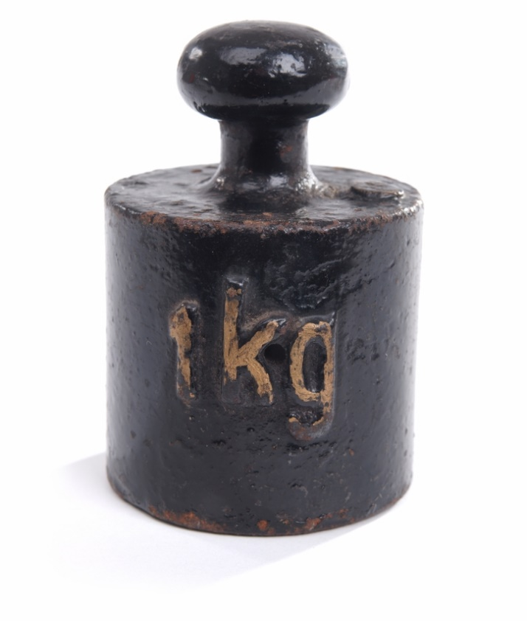
Large values
Computers process and store large amounts of bytes, often in the order millions or billions
  When dealing with large quantities
  it is more convenient to summarise
  this using number prefixes
  A common example of this is
  the kilogram (kg) which is equivalent
  to 1000 grams:

Slide 6
Prefixes for bytes
The same number prefixes for decimal values can be used to summarise large quantities of bytes
Common prefixes include:
Prefix | Symbol applied to Bytes | Multiple
kilo | KB | 10³ = 1,000
mega | MB | 10⁶ = 1,000,000
giga | GB | 10⁹ = 1,000,000,000
tera | TB | 10¹² = 1,000,000,000,000

Slide 7
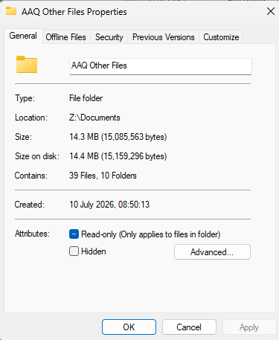
However…
If you right click on a Windows folder and choose “Properties”, you get something like this. What’s strange about it?

Slide 8
However…
Yes, clearly 15,085,563 bytes should not be 14.3MB (Windows rounds down so it should be 15.0).
What’s going on here?

Slide 9
Other prefixes
Traditionally computer scientists used these same number prefixes to refer to groups of bytes
These are not the same as their decimal equivalents
  Base 2 was used as the multiplier instead of base 10
  For example, a kilobyte was used as a representation of 2¹⁰ bytes, megabyte 2²⁰ and so on
  So, 1 kB was equivalent to 1024 Bytes
  1MB to 1,048,576 Bytes (or 1024 kB)

Slide 10
However…
If we divide 15,085,563 by 1,048,576 we get …
Yes,14.3
So Windows still uses the “old” prefixes.

Slide 11
New prefixes
To eliminate this confusion, in 1998 the International Electrotechnical Commission (IEC) established different prefixes to represent multiples of base 2:
Prefix | Symbol applied to Bytes | Multiple
kibi | KiB (kibibyte) | 2¹⁰ = 1,024
mebi | MiB (mebibyte) | 2²⁰ = 1,048,576
gibi | GiB (gibibyte) | 2³⁰ = 1,073,741,824
tebi | TiB (tebibyte) | 2⁴⁰ = 1,099,511,627,776

Slide 12
Complete the prefix table
Notes
Symbol | Name | Power | Number of bytes |  | Symbol | Name | Power | Number of bytes
kB | kilobyte | 10³ | 1,000 |  | KiB
MB |  |  |  |  | MiB
GB |  |  |  |  | GiB
TB |  |  |  |  | TiB
Decimal prefixes (left) go up in steps of 1,000. Binary prefixes (right) go up in steps of 1,024.
The “i” in KiB, MiB, GiB and TiB tells you it is a binary prefix.
Hint: each binary prefix is 1,024 times the one before.
Notes:
Students copy the completed table into their notes. The first row of each side is given as a model.

Slide 13
Complete the prefix table
Answers
Symbol | Name | Power | Number of bytes |  | Symbol | Name | Power | Number of bytes
kB | kilobyte | 10³ | 1,000 |  | KiB | kibibyte | 2¹⁰ | 1,024
MB | megabyte | 10⁶ | 1,000,000 |  | MiB | mebibyte | 2²⁰ | 1,048,576
GB | gigabyte | 10⁹ | 1,000,000,000 |  | GiB | gibibyte | 2³⁰ | 1,073,741,824
TB | terabyte | 10¹² | 10¹² |  | TiB | tebibyte | 2⁴⁰ | ≈1.1 × 10¹²
Decimal prefixes (left) go up in steps of 1,000. Binary prefixes (right) go up in steps of 1,024.
The “i” in KiB, MiB, GiB and TiB tells you it is a binary prefix.
Check: 1 MiB = 1,024 KiB = 1,024 × 1,024 bytes.
Notes:
Students copy the completed table into their notes. The first row of each side is given as a model.

Slide 14
Where did my storage go?
Your turn
Manufacturers use decimal prefixes. Windows divides by binary prefixes but still shows “GB”.
1 A new 1 TB drive shows as 931 GB in Windows. Show the calculation that explains this.
2 What will Windows show for a 64 GB memory stick?
3 How many bytes are in 4 KiB?
4 How many KiB are in 2 MiB?
5 1 GiB is about 7% bigger than 1 GB, but 1 TiB is about 10% bigger than 1 TB. Why does the gap grow?
Notes:
Calculators allowed. Q5 is the stretch. A nice follow-up: ask students to check the Properties box of a file on their own computer.

Slide 15
Where did my storage go?
Answers
Manufacturers use decimal prefixes. Windows divides by binary prefixes but still shows “GB”.
1 A new 1 TB drive shows as 931 GB in Windows. Show the calculation that explains this. 10¹² ÷ 2³⁰ = 931.3 GiB
2 What will Windows show for a 64 GB memory stick? 64 × 10⁹ ÷ 2³⁰ = 59.6 GiB
3 How many bytes are in 4 KiB? 4 × 1,024 = 4,096 bytes
4 How many KiB are in 2 MiB? 2 × 1,024 = 2,048 KiB
5 1 GiB is about 7% bigger than 1 GB, but 1 TiB is about 10% bigger than 1 TB. Why does the gap grow? Each step multiplies by 1,024 not 1,000, so the 2.4% difference compounds: 1.024³ ≈ 1.074, 1.024⁴ ≈ 1.100.
Notes:
Calculators allowed. Q5 is the stretch. A nice follow-up: ask students to check the Properties box of a file on their own computer.

Slide 16
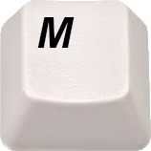
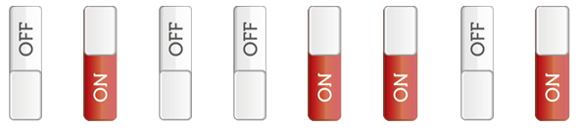
Part 2: Representing text characters
If a computer understands only 1s and 0s, what happens when the ‘M’ key is pressed on the keyboard?
0 1 0 0 1 1 0 1

Slide 17
Decode race
Starter
Key: A = 65 a = 97 space = 32.
Count on through the alphabet from there.
Message 1 (denary)
65 83 67 73 73 32 73 83 32 79 76 68
Message 2 (7-bit binary, harder)
1110101 1101110 1101001 1100011 1101111 1100100 1100101
Think: what did you and the sender need to agree on before this could work?
Notes:
Race in pairs. Message 2 needs binary to denary conversion first: 1110101 = 117 = u. The discussion question leads directly into why a standard such as ASCII was needed.

Slide 18
Decode race
Answers
Key: A = 65 a = 97 space = 32. Count on through the alphabet from there.
Message 1 (denary)
65 83 67 73 73 32 73 83 32 79 76 68
ASCII IS OLD
Message 2 (7-bit binary, harder)
1110101 1101110 1101001 1100011 1101111 1100100 1100101
unicode
You both had to agree that 65 means A.
An agreed table of codes like this is a character set.
Without one, the same number could mean different characters on different computers.
Notes:
Race in pairs. Message 2 needs binary to denary conversion first: 1110101 = 117 = u. The discussion question leads directly into why a standard such as ASCII was needed.

Slide 19
Design your own character set
Your turn
Every character needs its own binary code.
With n bits you get 2ⁿ different codes.
What is the fewest bits you need each time?
Characters you want to include | Running total | Fewest bits
Uppercase A to Z | 26
+ lowercase a to z
+ digits 0 to 9
+ space and 32 punctuation symbols
+ 33 control codes (Enter, Backspace, Esc…)
+ accents and symbols (é, ñ, ü, £, ©…) | up to 256
+ every language, maths symbols and emoji | over 150,000
Think: which row matches ASCII?
Which row explains why we needed something bigger?
Notes:
Students arrive at 7-bit ASCII themselves before slide 13 tells them. 2^17 = 131,072 is not enough for 150,000+, so 18 bits. Unicode currently defines around 155,000 characters.

Slide 20
Design your own character set
Answers
Every character needs its own binary code.
With n bits you get 2ⁿ different codes.
What is the fewest bits you need each time?
Characters you want to include | Running total | Fewest bits
Uppercase A to Z | 26 | 5 (32 codes)
+ lowercase a to z | 52 | 6 (64)
+ digits 0 to 9 | 62 | 6 (64)
+ space and 32 punctuation symbols | 95 | 7 (128)
+ 33 control codes (Enter, Backspace, Esc…) | 128 | 7 (128)
+ accents and symbols (é, ñ, ü, £, ©…) | up to 256 | 8 (256)
+ every language, maths symbols and emoji | over 150,000 | 18 (262,144)
7 bits = ASCII. 8 bits = extended ASCII.
The last row is why Unicode was needed.
Notes:
Students arrive at 7-bit ASCII themselves before slide 13 tells them. 2^17 = 131,072 is not enough for 150,000+, so 18 bits. Unicode currently defines around 155,000 characters.

Slide 21
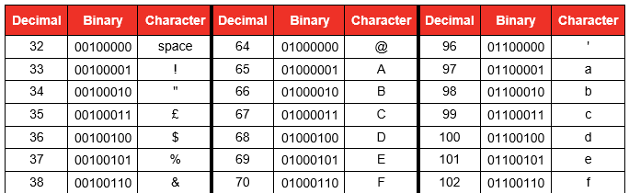
ASCII Code
In 1963 the American Standard Code for Information Interchange, (ASCII,) was established to encode symbols found in the English alphabet
  It was composed of a 7 bit character set.
What are the limitations of using a 7 bit character set? How many combinations of 7 bits are there?

Slide 22
Representing characters
Every character on the keyboard is represented by a binary value
Uppercase letters (capitals) have different values from lowercase characters
Punctuation symbols have their own characters
How many characters are there on a standard keyboard? How many bits would be required to represent this many combinations?
What character is represented by 0100000 (32)?

Slide 23
ASCII Table
Why does a space need a character? (Code 32)
The first 32 codes are control characters, for example:
  Backspace (Code 8)
  Carriage Return or Enter (Code 13)
  Escape (Code 27)
An eighth bit was later introduced for extra characters such as ©, ® etc.

Slide 24
ASCII reference: codes 32 to 127
Reference
sp 32 | ! 33 | " 34 | # 35 | $ 36 | % 37 | & 38 | ' 39 | ( 40 | ) 41 | * 42 | + 43 | , 44 | - 45 | . 46 | / 47
0 48 | 1 49 | 2 50 | 3 51 | 4 52 | 5 53 | 6 54 | 7 55 | 8 56 | 9 57 | : 58 | ; 59 | < 60 | = 61 | > 62 | ? 63
@ 64 | A 65 | B 66 | C 67 | D 68 | E 69 | F 70 | G 71 | H 72 | I 73 | J 74 | K 75 | L 76 | M 77 | N 78 | O 79
P 80 | Q 81 | R 82 | S 83 | T 84 | U 85 | V 86 | W 87 | X 88 | Y 89 | Z 90 | [ 91 | \ 92 | ] 93 | ^ 94 | _ 95
` 96 | a 97 | b 98 | c 99 | d 100 | e 101 | f 102 | g 103 | h 104 | i 105 | j 106 | k 107 | l 108 | m 109 | n 110 | o 111
p 112 | q 113 | r 114 | s 115 | t 116 | u 117 | v 118 | w 119 | x 120 | y 121 | z 122 | { 123 | | 124 | } 125 | ~ 126 | DEL 127
Each row is 16 codes. Uppercase and lowercase letters are exactly two rows (32) apart. Codes 0 to 31 are control characters.
Notes:
Reference slide for the pattern and mask tasks. sp = space (32), DEL = delete (127). Laying the table out in rows of 16 makes the gap of 32 between cases visible.

Slide 25
Spot the pattern
Your turn
You know: 'A' = 65 'a' = 97 '0' = 48 space = 32
Predict | 'Z' | 'z' | '7' | 'M' | 'a' − 'A'
Code
1 In Python, "Zebra" < "apple" is True. Why?
2 "10" < "9" is also True. Why?
3 Why might the designers have chosen a gap of exactly 32 between cases?
Notes:
No lookup allowed: students count on from the codes given. Q1 and Q2 explain real sorting bugs students will meet in their NEA. Q3 sets up the next task.

Slide 26
Spot the pattern
Answers
You know: 'A' = 65 'a' = 97 '0' = 48 space = 32
Predict | 'Z' | 'z' | '7' | 'M' | 'a' − 'A'
Code | 90 | 122 | 55 | 77 | 32
1 In Python, "Zebra" < "apple" is True. Why? Strings are compared by character code. 'Z' is 90 and 'a' is 97, so every uppercase letter comes before every lowercase letter.
2 "10" < "9" is also True. Why? It compares '1' (49) with '9' (57) first. Digits in a string are characters, not numbers.
3 Why might the designers have chosen a gap of exactly 32 between cases? 32 is one bit (bit value 32), so changing case only means changing one bit.
Notes:
No lookup allowed: students count on from the codes given. Q1 and Q2 explain real sorting bugs students will meet in their NEA. Q3 sets up the next task.

Slide 27
One bit, whole alphabet
Your turn
Character | Code | 8-bit binary
'A' | 65 | 0100 0001
'a' | 97 | 0110 0001
'm' | 109 | 0110 1101
'7' | 55 | 0011 0111
Reminder: AND with 0 clears,
OR with 1 sets, XOR with 1 toggles.
1 Which bit is different between 'A' and 'a'?
2 Give the operator and mask to turn any letter into uppercase.
3 Give the operator and mask to turn any letter into lowercase.
4 Give the operator and mask to swap the case of any letter.
5 Apply your uppercase mask to 'm'. Check the result is 'M' (77).
6 Which mask turns the character '7' into the number 7?
Notes:
Links 1.4.1D back to masks in 1.4.1C. Q6 shows the difference between a digit's character code and its pure binary value. Stretch: why does the uppercase mask not damage a letter that is already uppercase? (AND 0 on a bit that is already 0 leaves it as 0.)

Slide 28
One bit, whole alphabet
Answers
Character | Code | 8-bit binary
'A' | 65 | 0100 0001
'a' | 97 | 0110 0001
'm' | 109 | 0110 1101
'7' | 55 | 0011 0111
Reminder: AND with 0 clears,
OR with 1 sets, XOR with 1 toggles.
1 Which bit is different between 'A' and 'a'? Bit 3 from the left (value 32)
2 Give the operator and mask to turn any letter into uppercase. AND 1101 1111
3 Give the operator and mask to turn any letter into lowercase. OR 0010 0000
4 Give the operator and mask to swap the case of any letter. XOR 0010 0000
5 Apply your uppercase mask to 'm'. Check the result is 'M' (77). 0100 1101 = 77 ✓
6 Which mask turns the character '7' into the number 7? AND 0000 1111 gives 0000 0111
Notes:
Links 1.4.1D back to masks in 1.4.1C. Q6 shows the difference between a digit's character code and its pure binary value. Stretch: why does the uppercase mask not damage a letter that is already uppercase? (AND 0 on a bit that is already 0 leaves it as 0.)

Slide 29
Character form of decimal digits
Numeric characters are also encoded
  The code 0111001 represents the character ‘9’ in ASCII
  The binary byte representing ‘9’ would be 00001001₂
What are the implications of this difference?
What will this code output?
print ('9 + 3 =',9 + 3)
print ('"9" + "3" = ',"9" + "3")
print ('ord("9") + ord("3") = ',ord("9") + ord("3"))

Slide 30
Unicode
The Unicode system was introduced to standardise the encoding of characters from all languages
  Unicode can apply a variable length encoding of either 16 bits (65,536 combinations) or 32 bits (4.3 billion combinations)
  To improve adoption of this new standard, the first 128 Unicode characters were set to be the same as the ASCII character set
What is the obvious disadvantage of using up to 32 bits per character?

Slide 31
Advantage of Unicode
In Unicode, every character in every language in the world can be represented
  Español
  한국어
  русский язык
  ਪੰਜਾਬੀ ਦੇ
  Ελληνικά
  And of course, every mathematical and scientific symbol.
Notes:
Spanish
Korean
Macedonian
Pujabi
Greek

Slide 32
Worksheet 1.4.1D
Complete Tasks 1 & 2

Slide 33
Exam-style question
Exam practice
(a) State how many different characters can be represented using 7-bit ASCII. [1]
(b) The character '5' has the ASCII code 53. Give the 8-bit binary for the character '5' and for the integer 5. [2]
(c) Explain why Unicode was introduced. [2]
(d) Give one disadvantage of Unicode compared with ASCII. [1]
(e) A file is 3 MiB. State its size in bytes. [1]
Notes:
7 marks, about 7 minutes. Written in the style of OCR H446 Paper 1; not taken from a past paper.

Slide 34
Exam-style question
Mark scheme
(a) State how many different characters can be represented using 7-bit ASCII. [1]
128
(b) The character '5' has the ASCII code 53. Give the 8-bit binary for the character '5' and for the integer 5. [2]
0011 0101 (1) 0000 0101 (1)
(c) Explain why Unicode was introduced. [2]
ASCII can only represent 128 / 256 characters, mainly English (1). Unicode can represent characters from all languages / symbols / emoji, with one standard code for each (1).
(d) Give one disadvantage of Unicode compared with ASCII. [1]
Uses more bits per character, so files take more storage / take longer to transmit.
(e) A file is 3 MiB. State its size in bytes. [1]
3 × 1,048,576 = 3,145,728 bytes
Notes:
7 marks, about 7 minutes. Written in the style of OCR H446 Paper 1; not taken from a past paper.

Slide 35
True or false?
Quick fire
Thumbs up for true, thumbs down for false.
Be ready to correct the false ones.
Statement | True or false?
1 1 KiB = 1,000 bytes
2 7-bit ASCII can represent Arabic letters
3 'B' is 66, so 'b' is 98
4 The character '9' is stored as 1001
5 The first 128 Unicode characters match ASCII
6 1 GB is bigger than 1 GiB
7 "Zebra" comes before "apple" when sorted by character code
Notes:
Quick plenary. Ask a different student to correct each false statement.

Slide 36
True or false?
Answers
Thumbs up for true, thumbs down for false. Be ready to correct the false ones.
Statement | True or false?
1 1 KiB = 1,000 bytes | False: 1,024 bytes
2 7-bit ASCII can represent Arabic letters | False: English only (128 codes)
3 'B' is 66, so 'b' is 98 | True: cases are 32 apart
4 The character '9' is stored as 1001 | False: 0011 1001 (57)
5 The first 128 Unicode characters match ASCII | True
6 1 GB is bigger than 1 GiB | False: 1 GiB is bigger
7 "Zebra" comes before "apple" when sorted by character code | True: 'Z' (90) < 'a' (97)
Notes:
Quick plenary. Ask a different student to correct each false statement.

Slide 37
Plenary
Electrical signals operated by switches ‘create’ a binary pattern
New prefixes e.g. Kibi and Mebi describe 2^{n} bytes
ASCII and Unicode are used to represent characters
An ASCII digit is not the same as its direct binary translation
Unicode provides a unique way of encoding the alphabet and characters of every nation in the world

