Slide 1
Recall: think about this …
Binary
Key Stage 3 question: What is the denary number represented by binary 10101?
GCSE question What is 95₁₀ when written in hexadecimal?
A-Level questions What is -3 in two’s complement binary?
Recall

Slide 2
Recall: think about this …
Binary
Key Stage 3 question: What is the denary number represented by binary 10101? 21
GCSE question What is 95₁₀ when written in hexadecimal? 5F
A-Level questions What is -3 in two’s complement binary? 11111101
Recall

Slide 3
Objectives
Represent fractions in fixed point binary
Add and subtract binary integers

Slide 4
Binary addition
The rules of binary addition are the same:
  Three 1s occur during a carry operation
 |  |  |  |  |  |  |  |  |  |  |  |  | 1
 | 0 |  |  | 0 |  |  | 1 |  |  | 1 |  |  | 1
+ | 0 |  | + | 1 | OR | + | 0 |  | + | 1 |  | + | 1
 | 0 |  |  | 1 |  |  | 1 |  | 1 | 0 |  | 1 | 1

Slide 5
Adding binary values
This concept can be extended to binary values of more than one bit
1
1
1
Carry
1
0
1
0
1
+
1
1
1
=
1
1
1
0
0

Slide 6
Significant powers
2⁴ = 16
2³ = 8
2² = 4
2¹ = 2
2⁰ = 1
2⁻¹ = ?
2⁻² = ?

Slide 7
Significant powers
2⁴ = 16
2³ = 8
2² = 4
2¹ = 2
2⁰ = 1
2⁻¹ = 0.5
2⁻² = 0.25

Slide 8
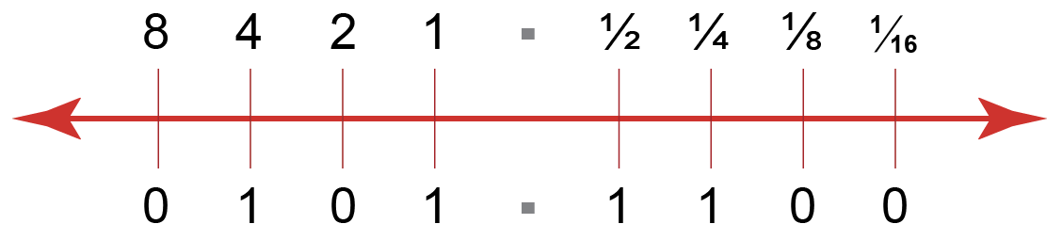
Binary fractions
Using bits to the right of the units column introduces fractional values
We also introduce a (virtual) “binary point”.

Slide 9
Fractional values
Fractional values are negative powers of 2
For example:
  2⁻² is the same as ½² or 0.25₁₀
Place value | 2² | 2¹ | 2⁰ | 2⁻¹ | 2⁻² | 2⁻³
Decimal equivalent | 4 | 2 | 1 | 0.5 | 0.25 | 0.125

Slide 10
Fixed-point binary
A fixed-point binary value uses a specified number of bits where the placement of the binary point is fixed
  For example, in an 8 bit fixed-point binary value, the binary point could be set between the fourth and fifth bits
  Therefore 6.625₁₀ as a fixed-point byte would be:
  What effect does this have on accuracy and range?
2³ | 2² | 2¹ | 2⁰ | 2⁻¹ | 2⁻² | 2⁻³ | 2⁻⁴
8 | 4 | 2 | 1 | 0.5 | 0.25 | 0.125 | 0.0625
0 | 1 | 1 | 0 | 1 | 0 | 1 | 0

Slide 11
Fixed-point binary
  What effect does this have on accuracy and range?
  In this example, 8 bits would be able to store values between 0 and 15.9375
  Clearly the range is much reduced.
  Accuracy for fractional numbers is increased from previously, but it still may not be very accurate.
  Using these 8 bits, how close could we get to 10.54?
  How close could we get to ⅔?
2³ | 2² | 2¹ | 2⁰ | 2⁻¹ | 2⁻² | 2⁻³ | 2⁻⁴
8 | 4 | 2 | 1 | 0.5 | 0.25 | 0.125 | 0.0625
0 | 1 | 1 | 0 | 1 | 0 | 1 | 0

Slide 12
Fixed-point binary
  With fixed point binary, we are sacrificing range for accuracy.
  However, the accuracy may not be useful to us.
  Some values cannot be represented at all (irrational numbers mean irrational binary numbers as well – for example ⅔ is actually equal to 0.1010101010101010101010101… in binary)
  Others would need huge amounts of digits after the binary point to be even close to accurate.
  Clearly, for the majority of rational numbers, we need another method of writing these in a binary format.
2³ | 2² | 2¹ | 2⁰ | 2⁻¹ | 2⁻² | 2⁻³ | 2⁻⁴
8 | 4 | 2 | 1 | 0.5 | 0.25 | 0.125 | 0.0625
0 | 1 | 1 | 0 | 1 | 0 | 1 | 0

Slide 13
Summary
The fundamental building block of processor operation is addition
Fixed point binary is one way of representing binary fractions

