Slide 1
LOS Deformation
Lauren Kendall
January 27, 2026

Slide 2
Overview
Have average velocities over growing time windows (so there is overlap)
V₁ spans A-B, V₂ spans A-C, V₃ spans A-D…
Post-seismic behavior follows exponential/logarithmic decay so velocity and deformation is largest at earlier times
Issues include irregular sampling and noise in values

Slide 3
Outline of Data:
Scaled SAR acquisition times (time of window divided by 46 days)
t = [3, 4, 6, 7, 8, 11, 14, 22]
KEY NOTE:
The velocity is an average over its window
V near the start of the window is likely larger
V near the end of the window is likely smaller
The middle of the window is a good spot to assign the average velocity to a specific day
t_{middle} = [1.5, 2, 3, 3.5, 4, 5.5, 7, 11]

Slide 4
Outline of Data
Main Vectors:
V = [v₁, v₂, v₃, v₄, v₅, v₆, v₇, v₈]
t = [3, 4, 6, 7, 8, 11, 14, 22]
t_{middle} = [1.5, 2, 3, 3.5, 4, 5.5, 7, 11]
We can pair the velocity vector V with the middle time dates t_{middle}, but we need the actual cumulative deformation values at the SAR acquisition dates outlines in vector t

Slide 5
Old Incremental Framework
d₀ = 0
Zero deformation assumed at first postseismic SAR acquisition
d₁ = v₁t₁
t₁ spans first to second SAR acq, denoted as A-B
d₂ = d₁ + v₂ (t₂ – t₁)
first term spans A-B and second term spans B-C
ISSUE: v₂ likely overestimates span B-C since it better represents the middle of its window A-C, not the end portion of it
The overestimation problem continues, leaving us with nearly 30 cm of cumulative deformation

Slide 6
New Incremental Framework
Key: use middle dates but solve for SAR acquisition dates!
t_{middle} = [1.5, 2, 3, 3.5, 4, 5.5, 7, 11]
t = [3, 4, 6, 7, 8, 11, 14, 22]
V = [v₁, v₂, v₃, v₄, v₅, v₆, v₇, v₈]
d₀ = 0
Solve for d₁ at t₁ = 3
d₁= v₁ (t_{mid1}) + v₂ (t_{mid2}-t_{mid1}) + v₃ (t_{mid3}-t_{mid2})
d₁= v₁ (1.5) + v₂ (2-1.5) + v₃ (3-2)
Solve for d₂ at t₂ = 4
d₂= d₁ + v₄ (t_{mid4}-t_{mid3}) + v₄ (t_{mid5}-t_{mid4})
d₂= d₁ + v₄ (3.5-3) + v₅ (4-3.5)

Slide 7
Solve for d₃ at t₃ = 6
d₃= d₂ + v₆ (t_{mid6}-t_{mid5}) + v_{interpolated_for_t=6} ((t_{mid_interpolated}=6 )–t_{mid6})
d₃= d₂ + v₆ (5.5-4) + v_{interpolated_for_t=6} (6-5.5)
Solve for d₄ at t₄ = 7
d₄= d₃ + v₇ (t_{mid7}- (t_{mid_interpolated}=6 ))
d₄= d₃ + v₇ (7-6)
Solve for d₅ at t₅ = 8
d₅= d₄ + + v_{interpolated_for_t=8} ((t_{mid_interpolated}=8 ) - t_{mid7})
d₅= d₄ + v_{interpolated_for_t=8} (8-7)
Solve for d₆ at t₆ = 11
d₆= d₅ + v₈(t_{mid8} - (t_{mid_interpolated}=8 ))
d₆= d₅ + v₈(11-8)
What do we do about t₇ = 14 and t₈=22 if we assigned velocities to the middle window dates, and the last middle window date is 11?
Notes:
Instead of interpolation, can also use the values from the fit

Slide 8
What do we do about t₇ = 14 and t₈=22 if we assigned velocities to the middle window dates, and the last middle window date is 11?
Solution: Fit a nonlinear curve, either exponential or logarithmic, to the velocity values vs. the middle dates
Using this fit, we can extend to get a better velocity estimate at t₇ = 14 and t₈=22
See the following pages of handwritten notes to see how I created the fits
Solve for d₇ at t₇ = 14
d₇= d₆ + + v_{fitted_t=14} (t₇– t_{mid8})
d₇= d₆ + + v_{fitted_t=14} (14– 11)
Solve for d₈ at t₈ = 22
d₈= d₇ + + v_{fitted_t=22} (t₈– t₇)
d₈= d₇ + + v_{fitted_t=22} (22 – 14)

Slide 9
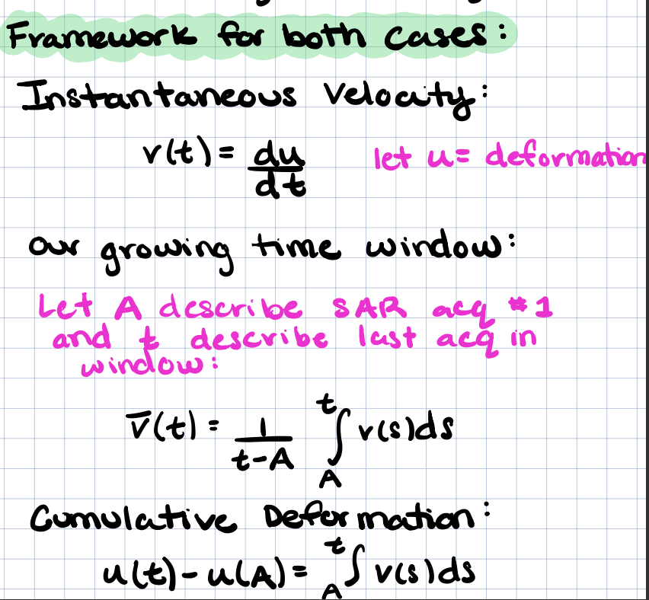
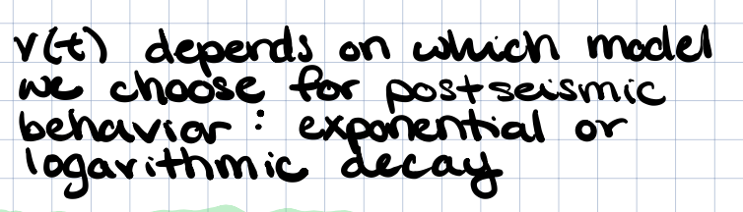

Slide 10
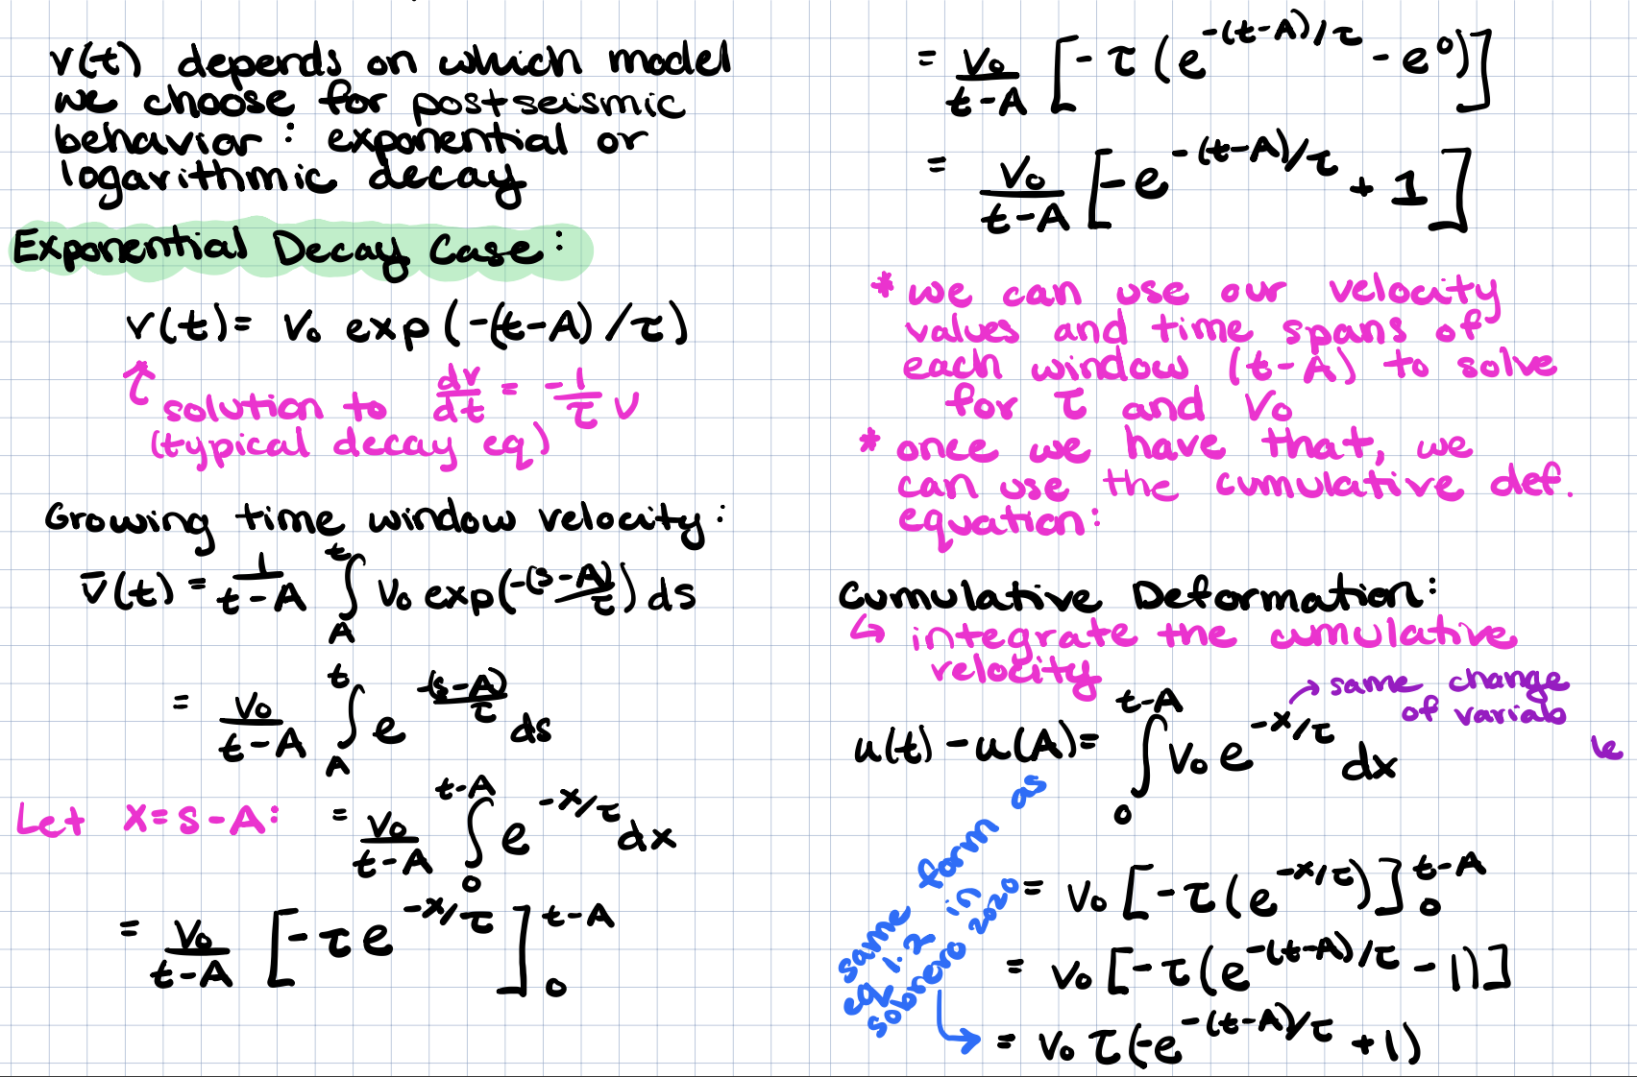

Slide 11
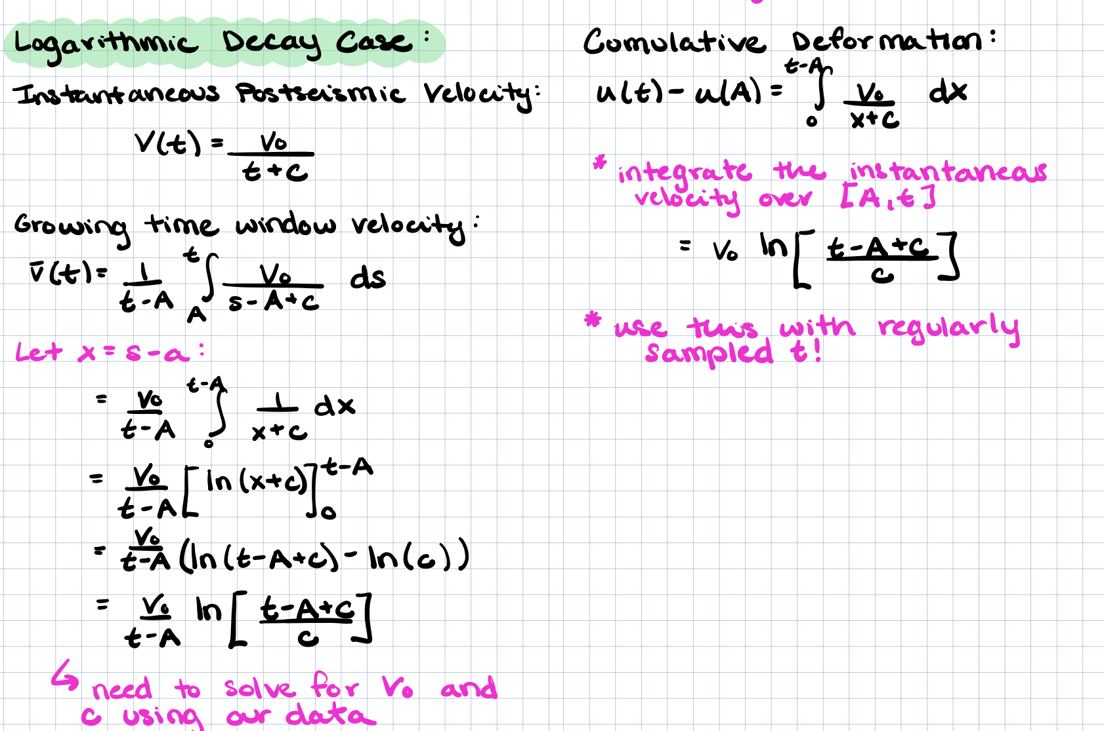

Slide 12
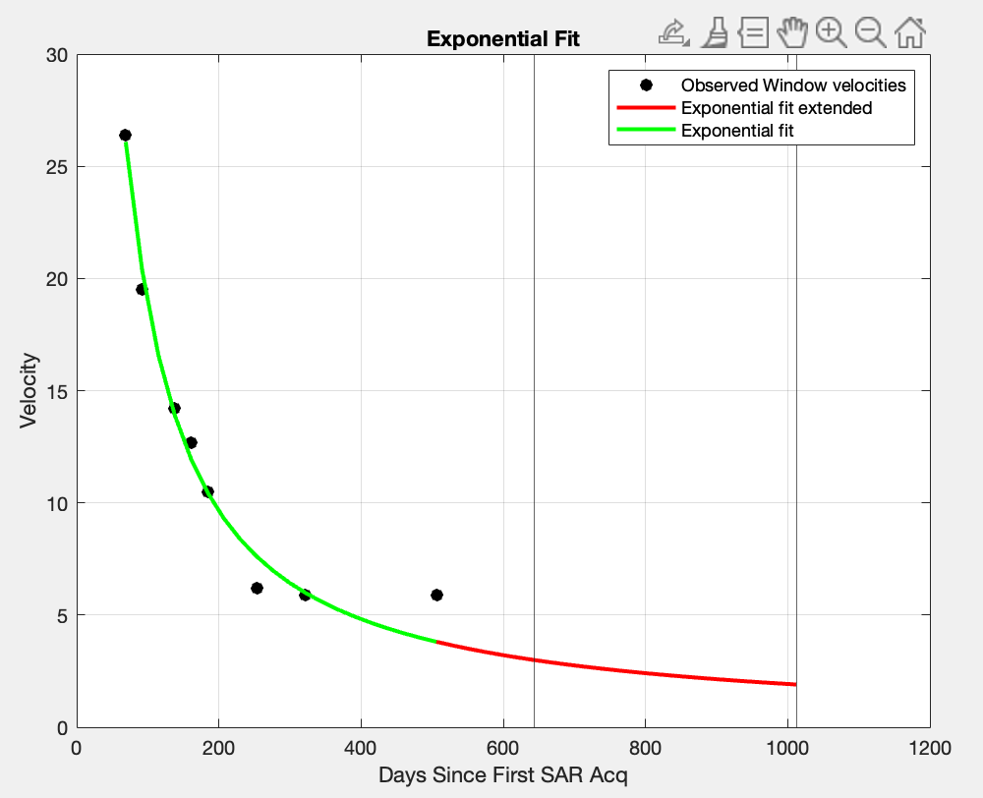
Exponential Fit
V_{t=14} = 2.99
V_{t=22} = 1.90

Slide 13
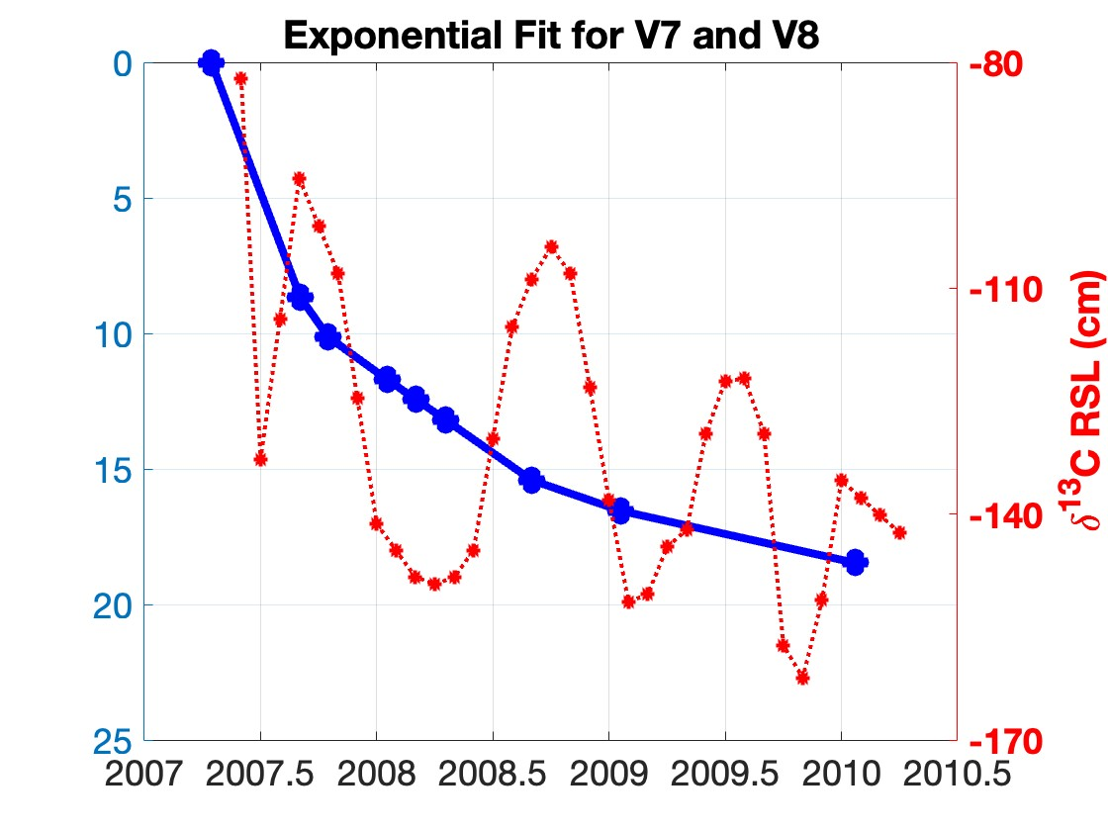
Cumulative Deformation with Exponential Fit

Slide 14
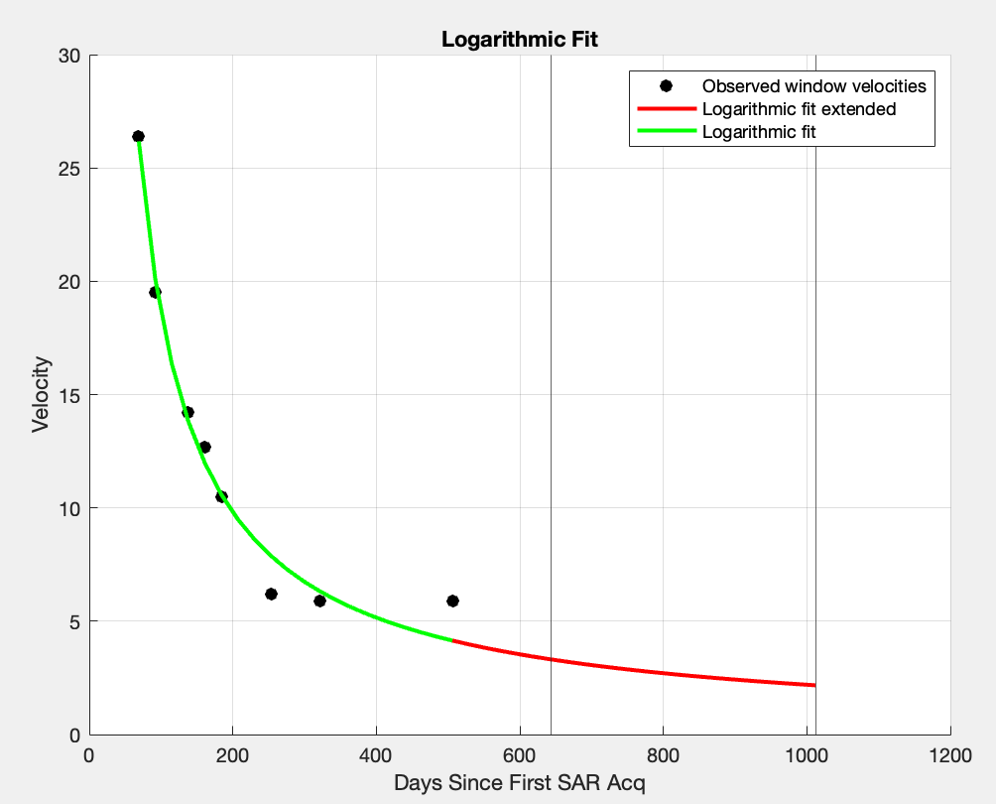
Logarithmic Fit
V_{t=14} = 3.17
V_{t=22} = 2.17

Slide 15

Cumulative Deformation with Logarithmic Fit

Slide 16
Potential Updates/Improvements
For the values that I interpolated, can swap to use the value from the fitted curve, either exponential or logarithmic

