Slide 1


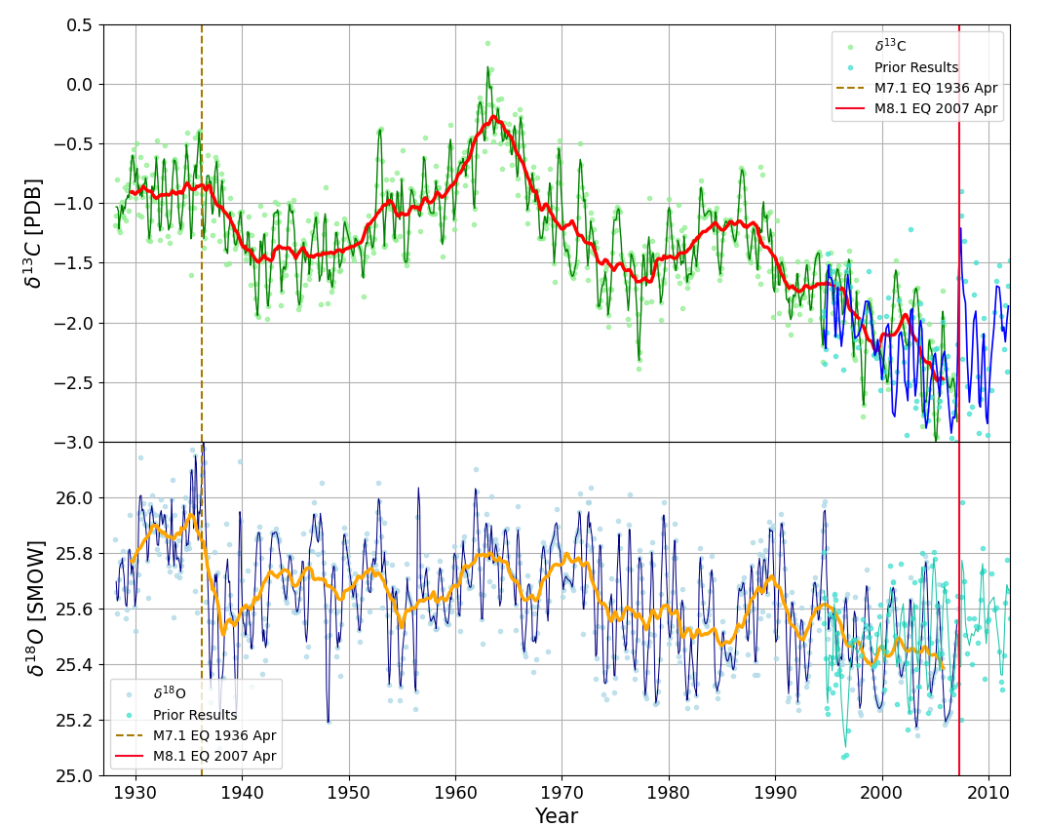
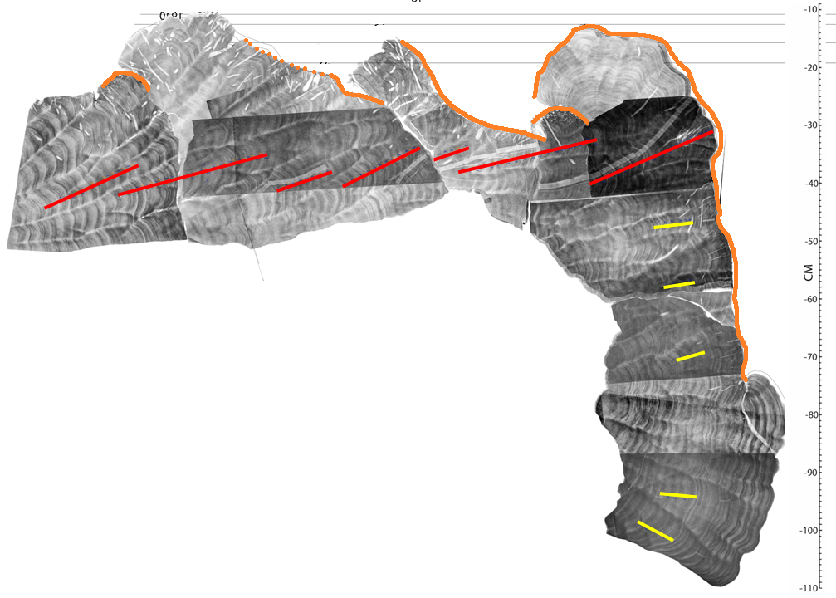
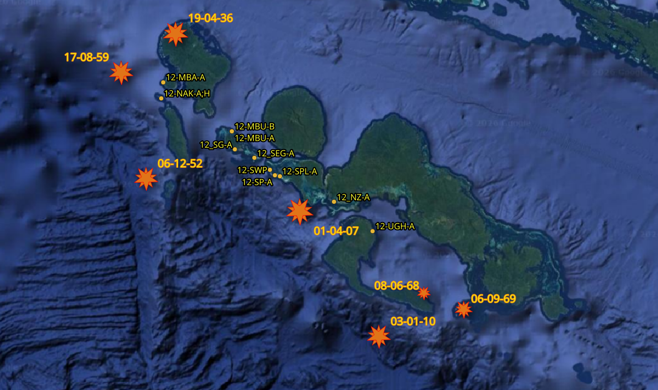
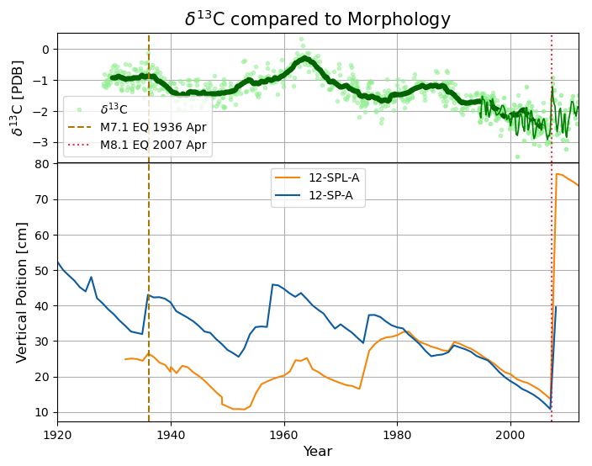
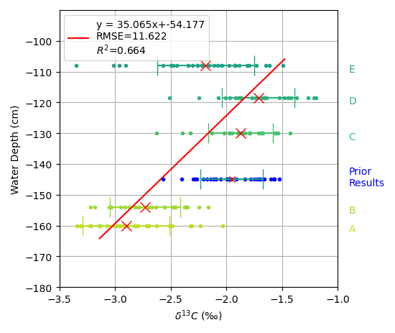
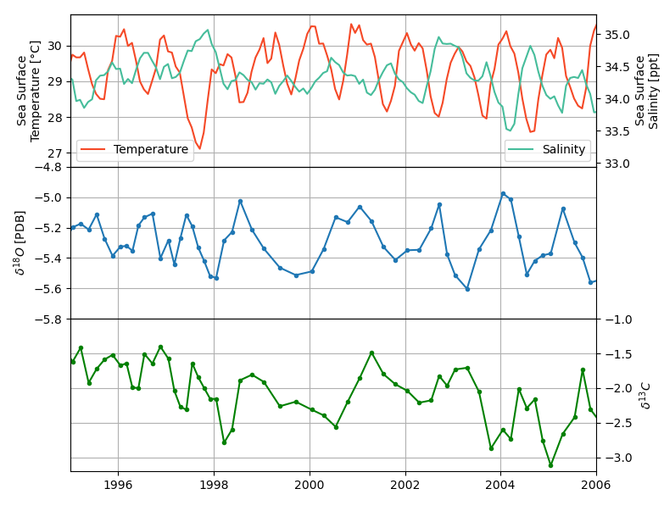
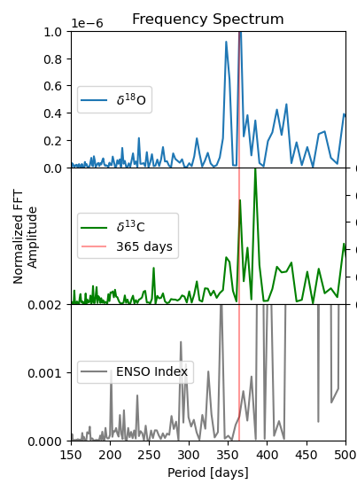
High-resolution Coral Geodesy in the Solomon Islands M. Ege Karaesmen¹, Luc Lavier¹, Frederick Taylor¹ ¹University of Texas at Austin, UTIG
Introduction & Objectives
The Problem: Modern geodetic data (GPS) is crucial for monitoring megathrust earthquakes but is temporally limited, with most records only beginning in the 1990s.
The Solution: We utilize coral skeletons as temporally high-resolved and purely vertical historical geodetic recorders in subduction settings.
Goal: To establish an annual-scale geodetic record that extends centuries back, providing a deeper understanding of the long-term earthquake cycle.
Die Down Surface
Geological Setting & Methodology
Solomon Islands
Study focused on the New Georgia Group, where the active trench is exceptionally close to the coastline (<30 km). This proximity makes the region highly sensitive to vertical deformation from subduction zone processes.
Horizontal Paths
Vertical Paths
Summary & Conclusions
δ13C correlates strongly with RSL and aligns with external environmental datasets (SST, SSS, and Tide Gauges).
Coral morphology provides a structural "sanity check" that validates the isotopic trends.
Major Finding: We demonstrate that δ13C is a robust indicator of vertical tectonics and serves as a powerful proxy for paleogeodesy in subduction environments.
Prior Results
Results
Stable isotopes clearly record major regional seismic events:
1936 Event 7.0 M_{W}: Captured primarily in the δ18O
2007 Event 8.1 M_{W}: Strongly reflected in δ13C
Decoupling Tectonic vs. Climatic Signals
Isotopic signals are influenced by any local and global sea level change, Sea Surface Temperature (SST), Sea Surface Salinity (SSS), ENSO variability or Pacific Decadal Oscillation (PDO).
By comparing coral data with external instrumental datasets, we successfully isolated the tectonic signal from climatic noise. Also spectral tools help to filter high frequency parameters compared to tectonics.
Morphology vs. Geochemistry
While coral morphology indicates RSL change, it is often "binary". It only records events that reach the low-tide level. Isotope analysis provides a continuous vertical record, even when the coral remains submerged.
Ongoing & Future Work
Implementing a bayesian age model to refine the temporal resolution of the proxy.
Scaling: Expanding the analysis to a broader suite of coral samples for a comprehensive regional reconstruction of the Solomon Islands' seismic history.
Methods
Sampling: Collected 575 horizontal and 141 vertical coral samples. We measured stable isotopes δ¹³C and δ¹⁸O to estimate relative sea level (RSL).
Calibration: Established a nearly linear relationship between water depth and δ¹³C by analyzing vertical samples from synchronized ages.

