Slide 1
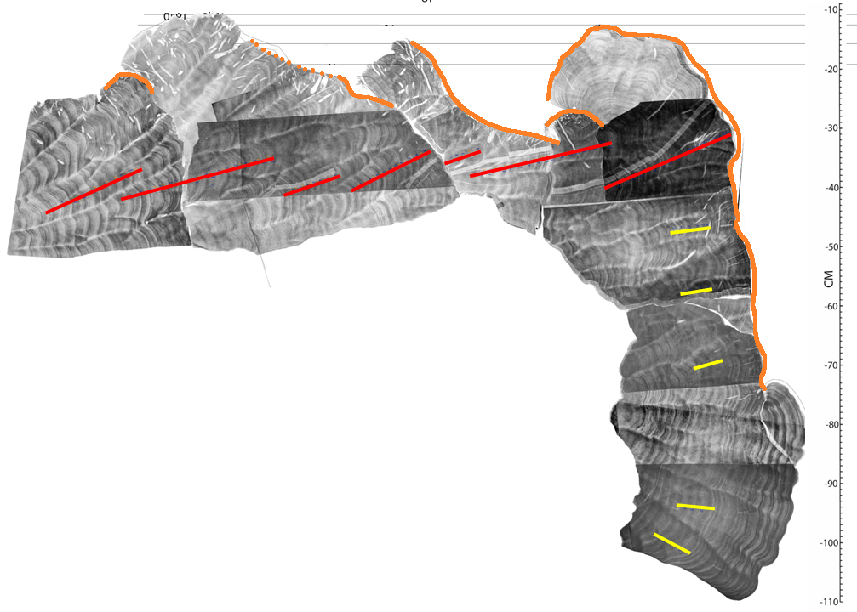
Die Down Surface
G
L
H*
M
L
K
O & N
I
F
Horizontal Paths
E
E
Vertical Paths
D
D
C
C
Prior Results F*
B
A
B
A

