Slide 1
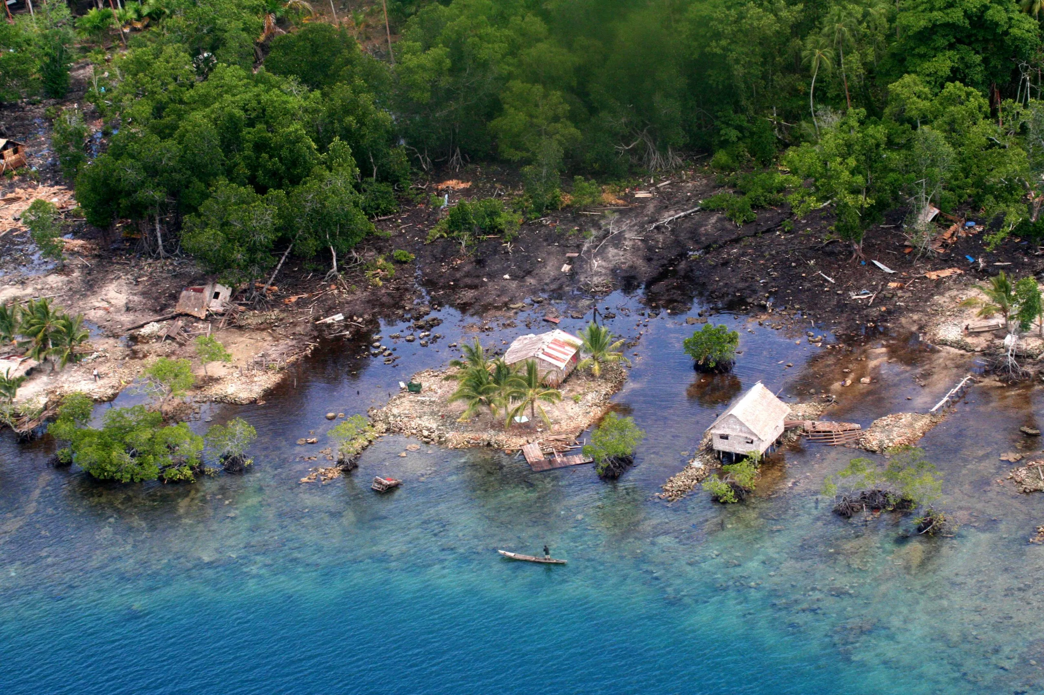


Decadal to Centennial Vertical Paleogeodetic Record of the Seismic Cycle in the Western Solomons from Coral Paleogeodesy and Stable Isotopes
M. Ege Karaesmen, Luc Lavier, Frederic Taylor,
Lauren Kendall, Ann Chen, Laura Wallace
University of Texas at Austin
Notes:
Today I'd like to present our preliminary results on δ¹³C analysis from corals collected in the Western Solomon Islands. You might wonder how this relates to natural hazards — we're attempting to reconstruct multiple past earthquake cycles using the coral record.

Slide 2
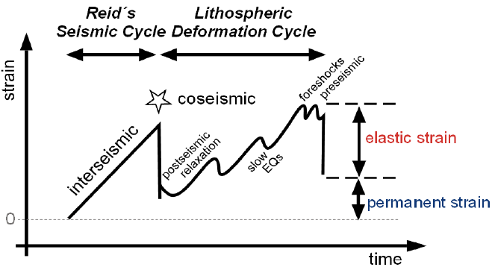
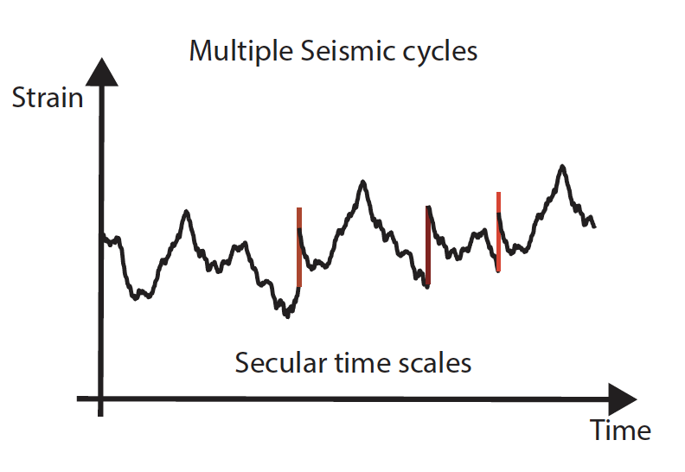
Earthquake Cycles Reconstruction
Reconstruct vertical tectonics over 100s to 1000s years using coral paleogeodesy
Including tectonic motion over multiple seismic cycles
Infer viscoelastic properties
Slow slip events + Precursory
Ono Oncken, (2018)
Notes:
As you know, the physics of earthquakes remains controversial and poorly constrained. Long-term observations, like those from a growing GNSS network on active faults, are essential for improving our understanding. These networks help track vertical motions, postseismic deformation, slow slip events, and potential precursors.

Slide 3
Earthquake Cycles Reconstruction
Reconstruct vertical tectonics over 100s to 1000s years using coral paleogeodesy
Including tectonic motion over multiple seismic cycles
Infer viscoelastic properties
Slow slip events + Precursory
Ono Oncken, (2018)

Slide 4
Earthquake Cycles Reconstruction
Reconstruct vertical tectonics over 100s to 1000s years using coral paleogeodesy
Including tectonic motion over multiple seismic cycles
Infer viscoelastic properties
Slow slip events + Precursory
Ono Oncken, (2018)

Slide 5
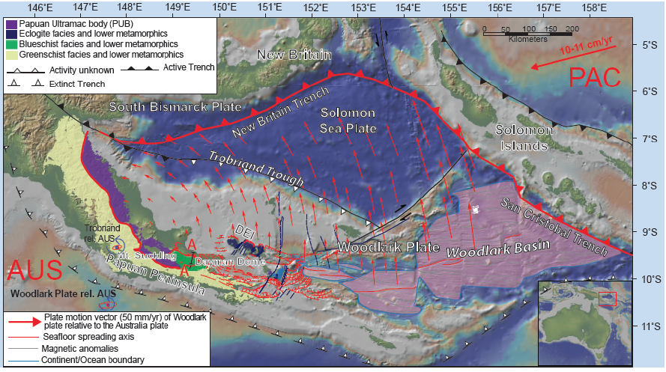
Notes:
The tectonic setting of the Solomon Islands is dominated by the rapid subduction of the Woodlark Basin. Thanks to over 30 years of fieldwork by Fred Taylor (UT Austin), we now have a valuable archive of coral samples from the region.

Slide 6
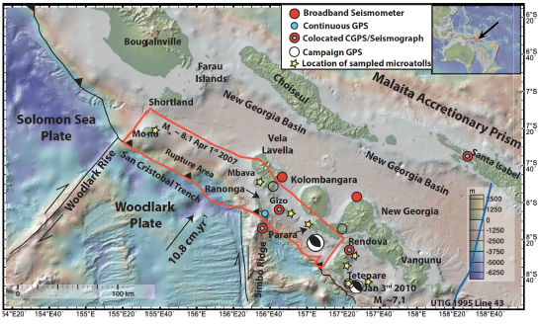
Notes:
The results I'll show today come from Parara Island, south of the Kolombangara volcano. The corals are located near the southwestern edge of Parara (also called Vonavona Island), positioned directly above the Solomon Trench — an area affected by frequent and strong earthquakes.

Slide 7
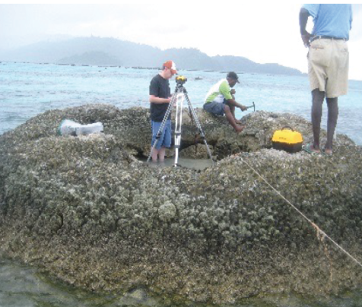
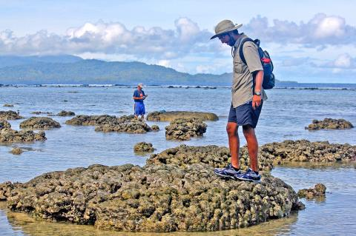
After Mw 8.1 2007
Luc Lavier measuring the vertical position of the sampled coral, near Ranongga Island in 2012.
UT Austin doctoral student Kaustubh Thirumalai inspecting corals near the Solomon Islands’ Ranongga Island in 2015.
Notes:
One of the most significant earthquakes occurred on April 2, 2007, with a moment magnitude of 8.7. Fred Taylor visited the site shortly afterward and observed uplifted corals, which he sampled. The corals, mainly Porites, can exceed one meter in diameter — representing more than 100 years of growth.

Slide 8
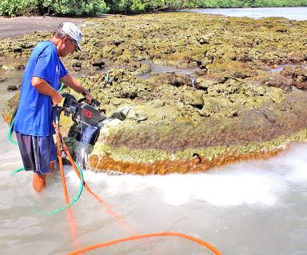
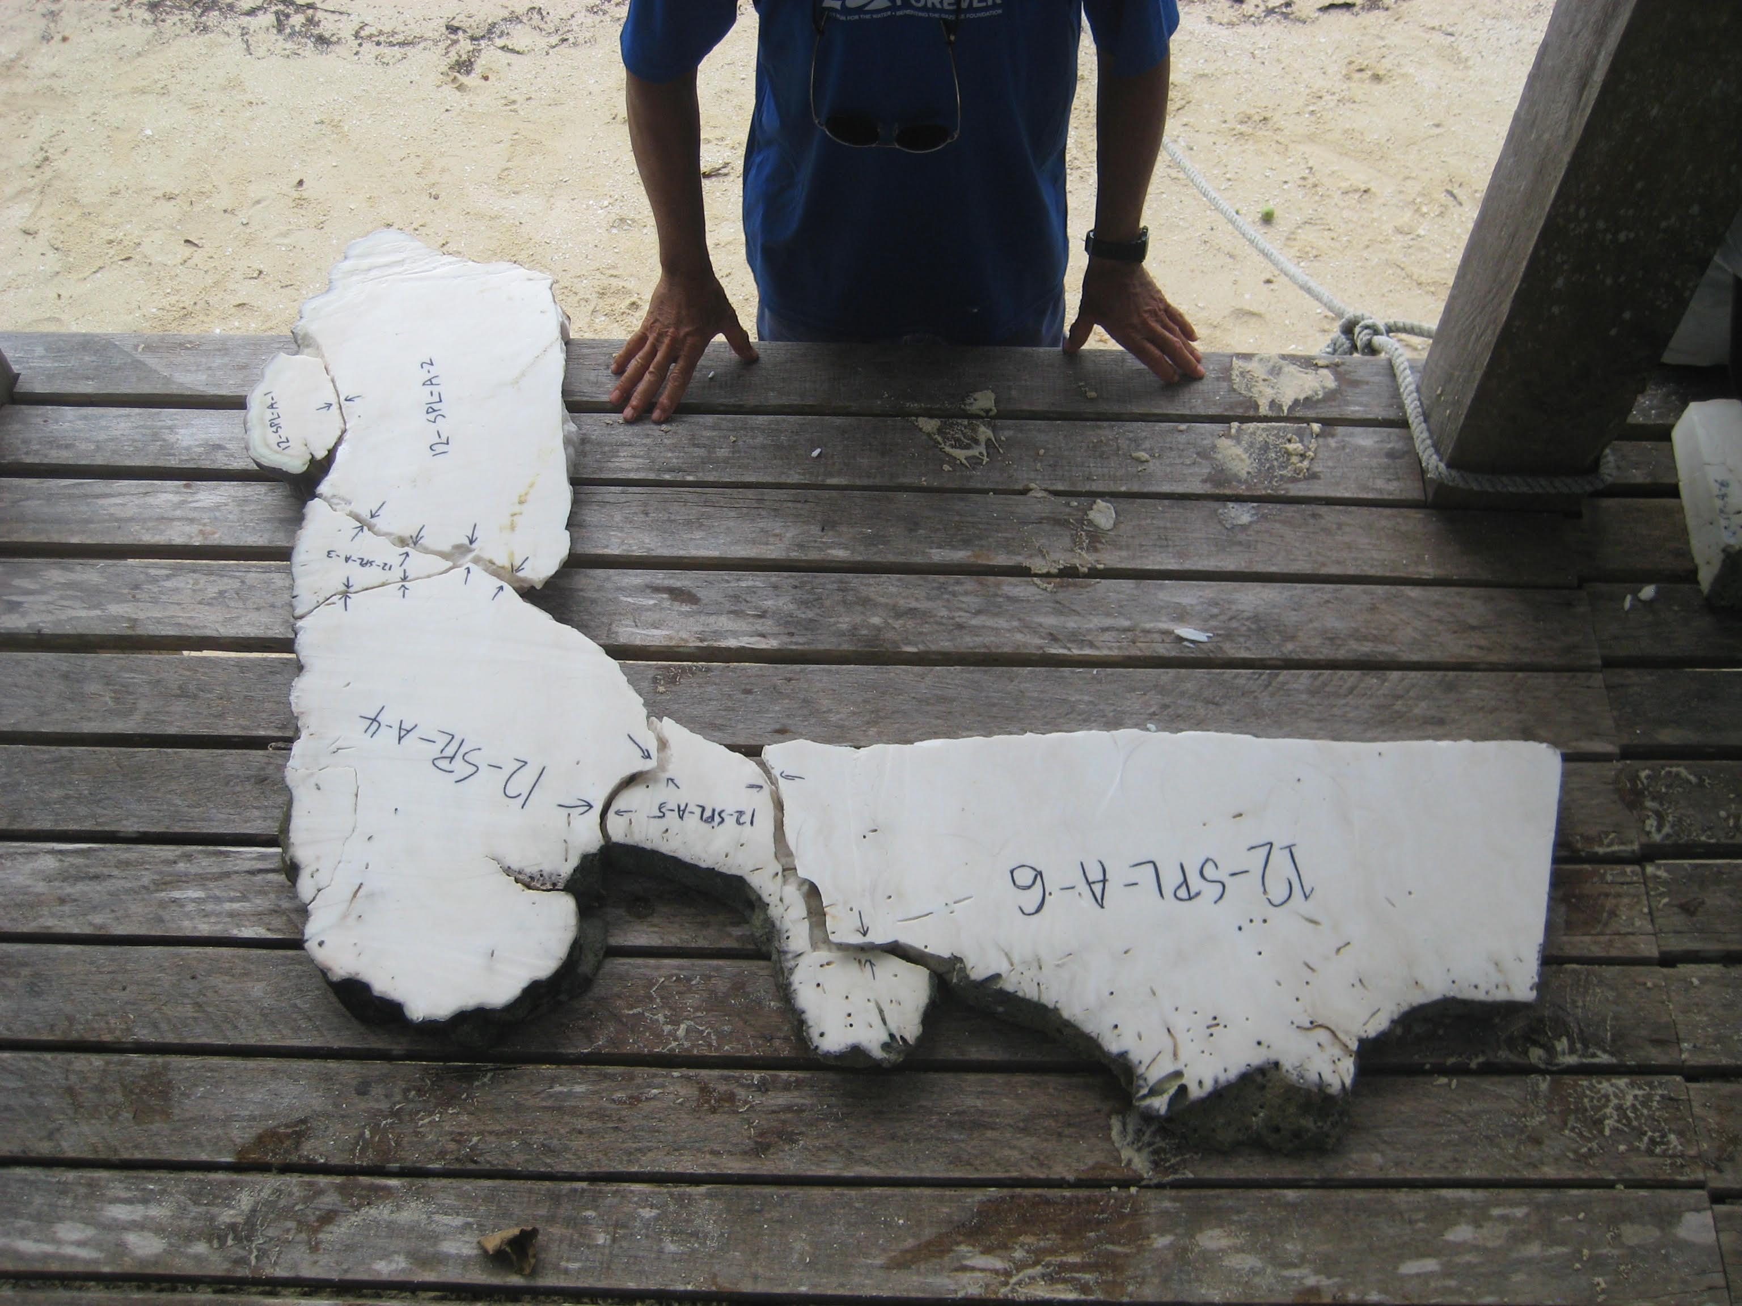
After Mw 8.1 2007
Fred Taylor (UT Austin) collects samples from corals in the Solomon Islands, after 2007 Earthquake uplift. (2015)
The sample taken in 2012 from Parara Island and analyzed in 2024 at Austin.

Slide 9
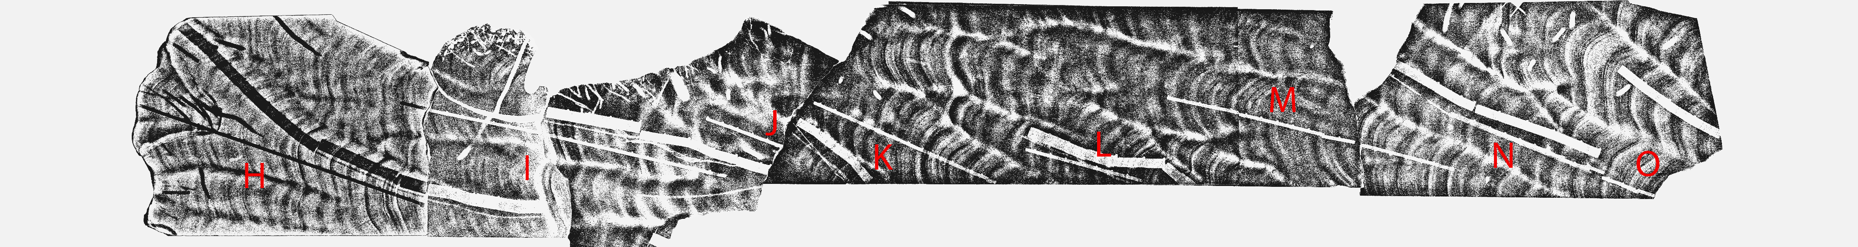
Notes:
This X-ray image shows annual banding within the coral skeleton. We use these bands, much like tree rings, to determine the age. The dark bands indicate sampling paths perpendicular to the banding.

Slide 10
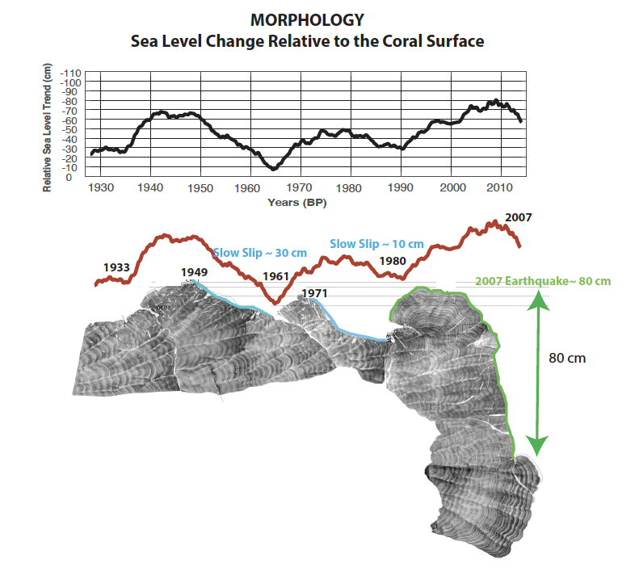
Notes:
From the coral surface morphology alone, we observe signs of tectonic activity. The 2007 earthquake uplifted the coral by more than 80 cm, killing the uppermost parts and allowing new growth lower down. A gently sloping surface likely indicates slow tectonic uplift followed by sudden subsidence.

Slide 11
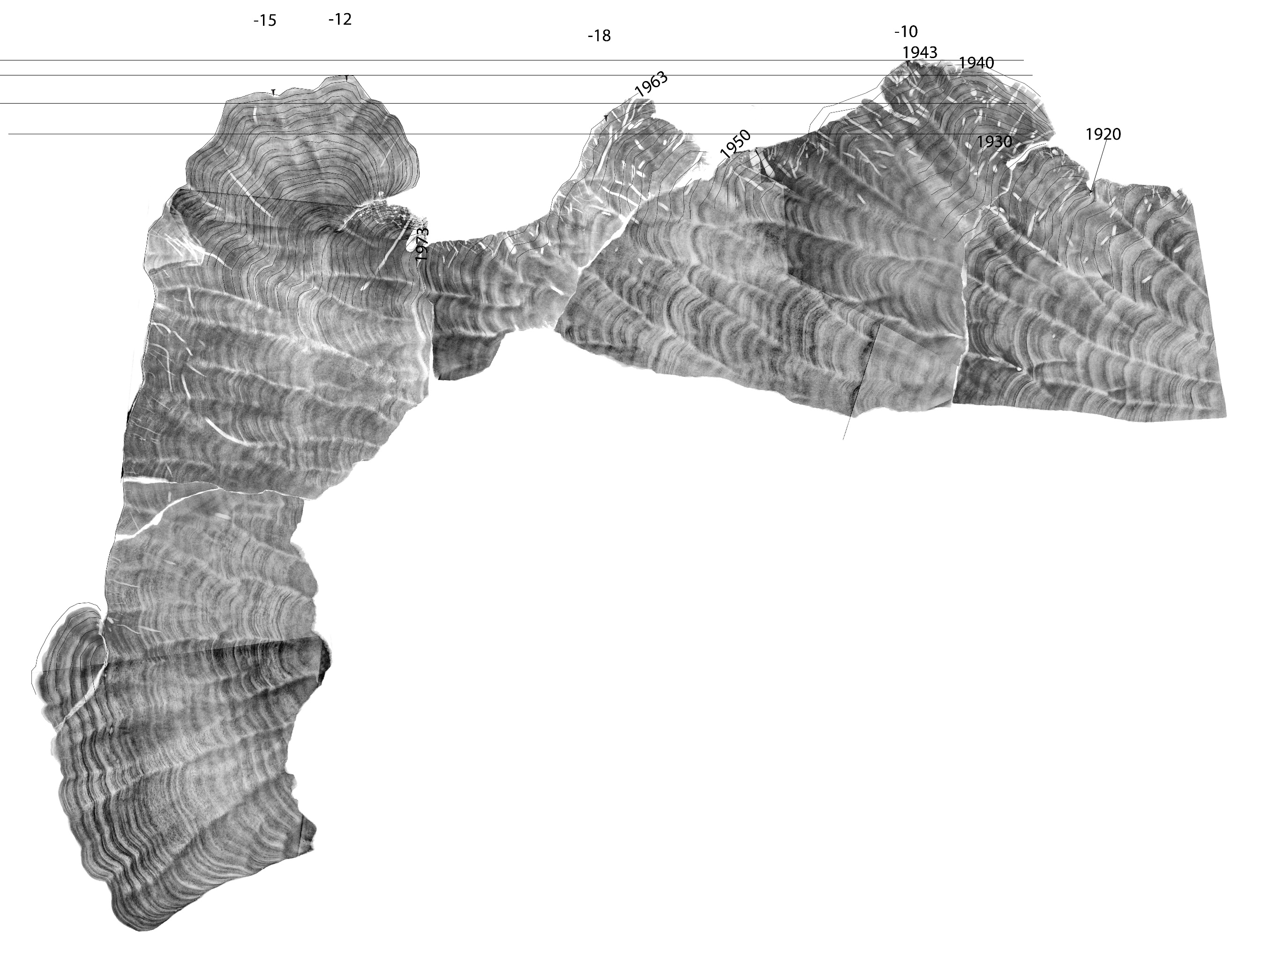
Depth

Slide 12
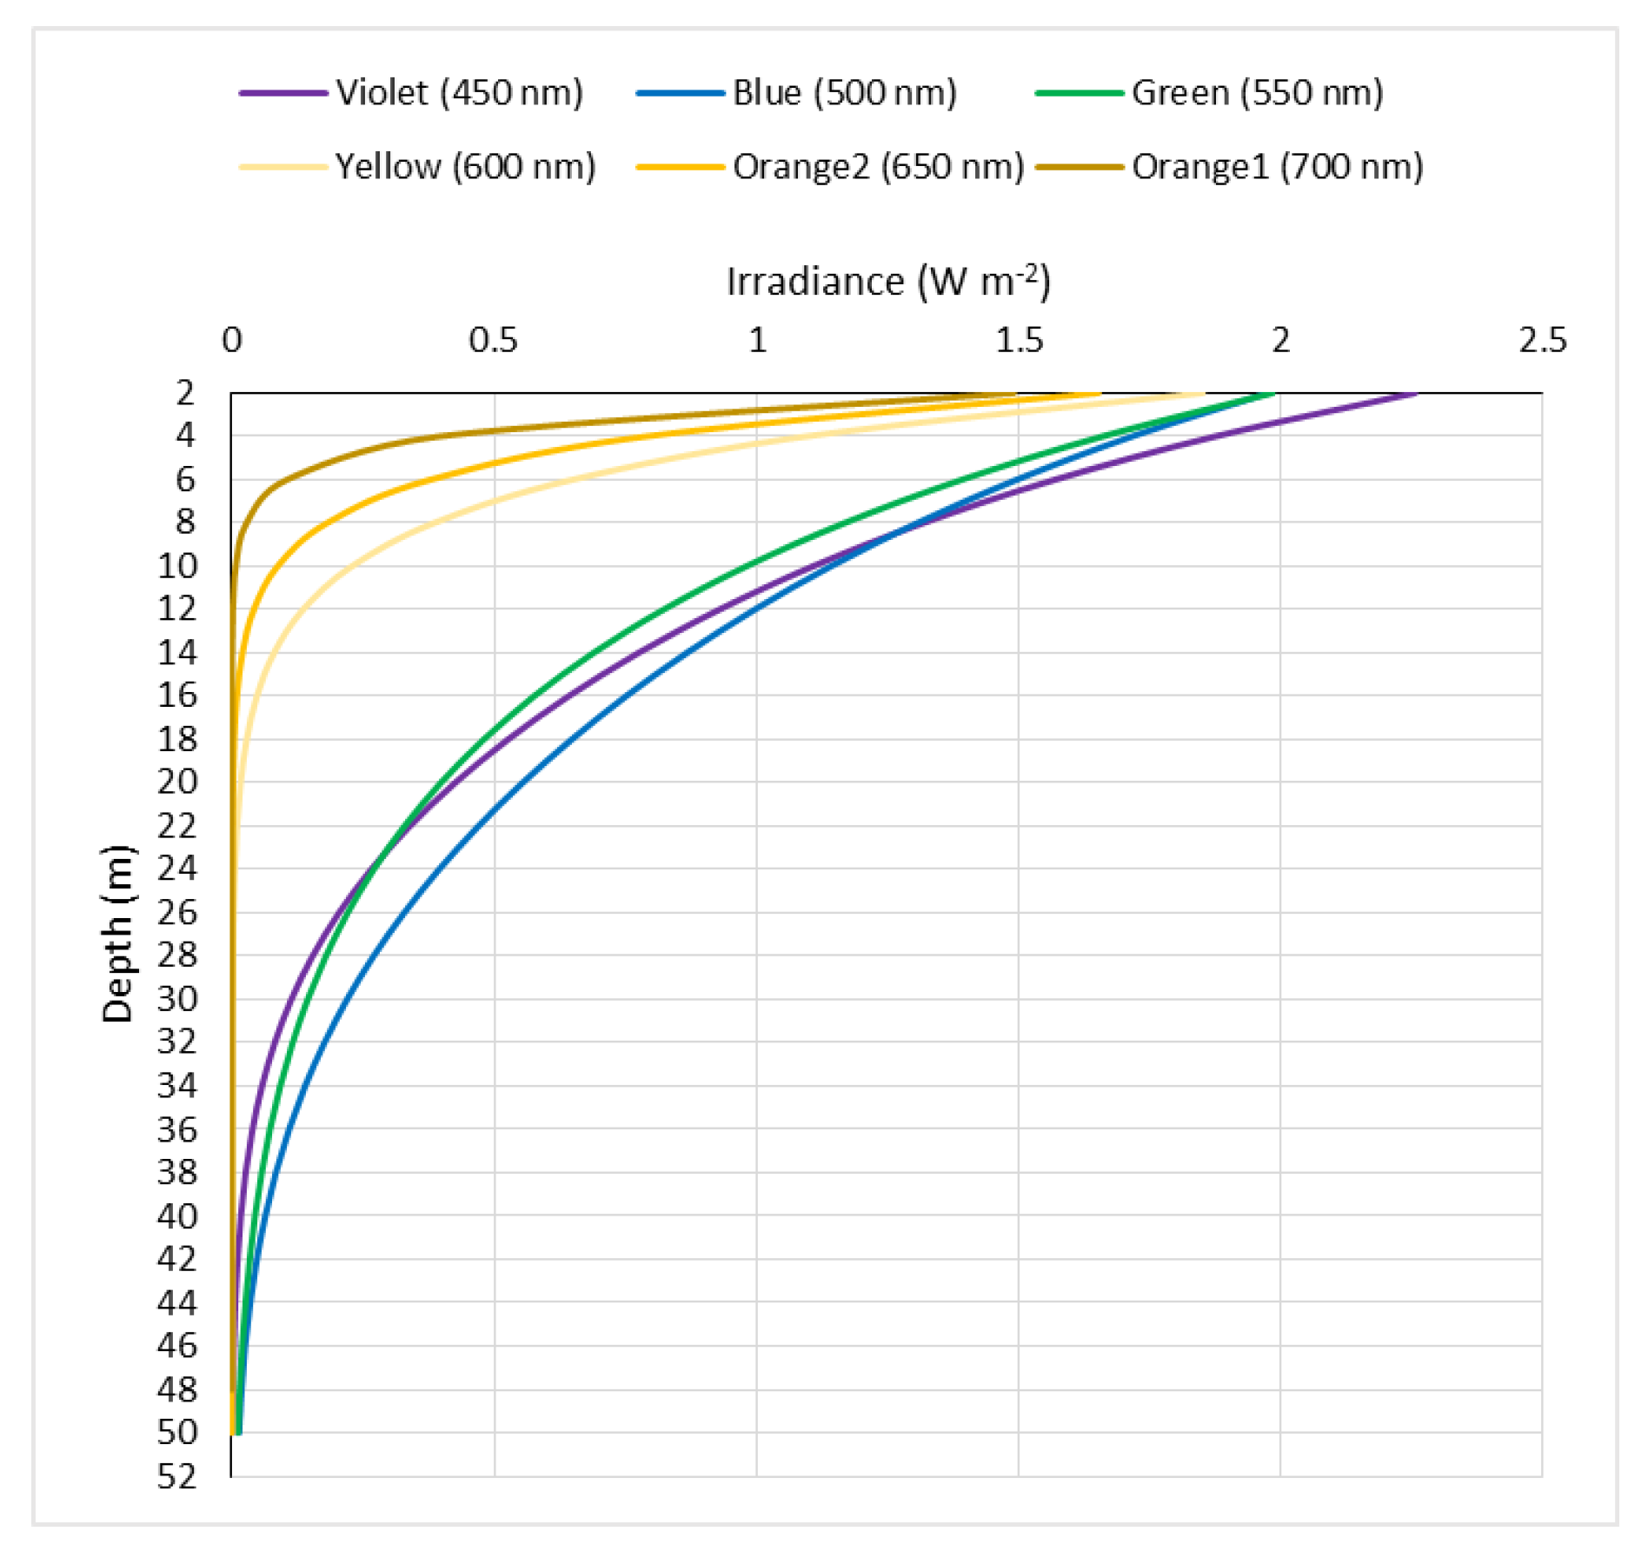
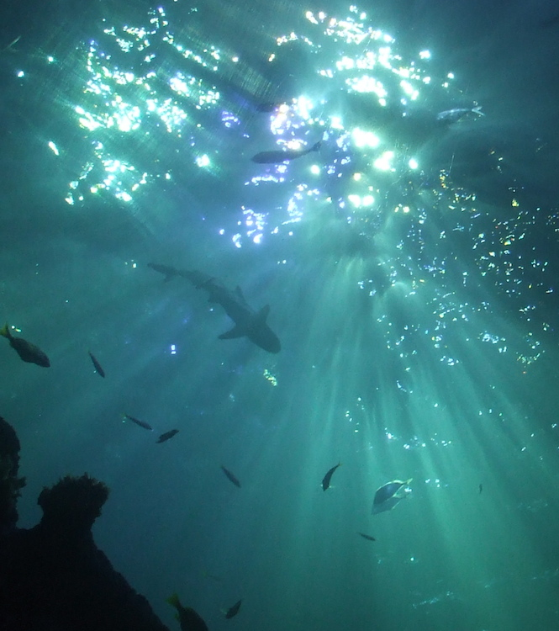
Confirmed with additional data (Blue light/ euphotic zone)
Abdelrahman, Mohamed A. 2016
HYPOTHESIS
-Plankton rejects heavier carbon ¹³C when sunlight is less intense (up to 50 m depth for blue light).
- The excess ¹³C is the used by the coral to build its skeleton.
- The relationship looks linear in shallow water but must be exponential and saturate at some depth.
? Expected behavior
Notes:
Our first step was to assess the relationship between depth and δ¹³C values. As expected, we see a strong linear relationship due to decreasing light intensity with depth. While turbidity and cloud cover can also affect this signal, our broad temporal sampling helps average out these climatic effects.

Slide 13
Age
Notes:
Now I will show our signal with increasing age, sampled horizontal along the coral.

Slide 14
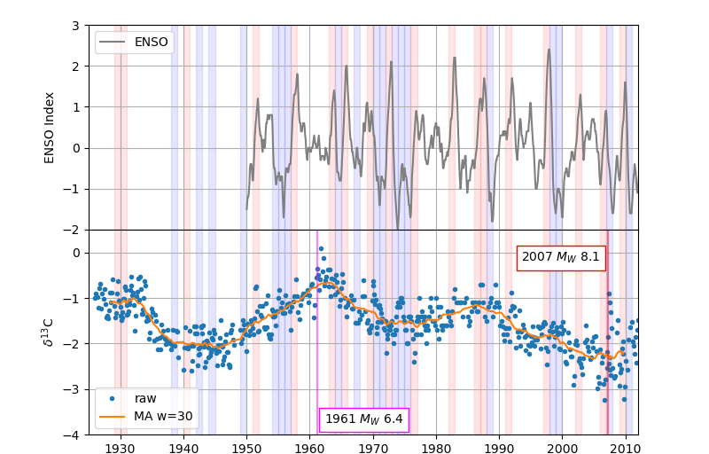
δ13C in Coral
Notes:
This plot shows δ¹³C values over time alongside ENSO events (El Niño Southern Oscillation index), which influence sea level at the centimeter scale. While we see some correlation, our primary focus is identifying major tectonic events like the 2007 earthquake.

Slide 15
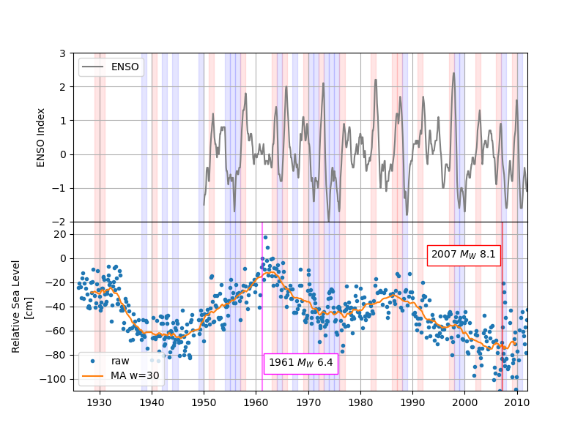
Relative Sea Level Trend

Slide 16
Relative Sea Level Trend
SSE
SSE
Notes:
Using the linear depth–δ¹³C relationship, we reconstructed relative sea level. The data indicate two main tectonic events, one in 2007 and a possible earlier event in 1961. However, data from 1961 are sparse, and we remain uncertain about the exact magnitude and location. Still, the δ¹³C signal reflects two major earthquakes and two slower tectonic deformation events, possibly related to locking or slow slip processes.

Slide 17
Conclusion
Corals provide a high-resolution, natural archive for reconstructing seismic cycles over decades to centuries.
δ¹³C signals in corals show promise for tracking vertical motion and identifying tectonic events, including earthquakes and slow slip events.
Our preliminary results from Parara Island support the potential of stable isotopes to complement traditional paleogeodetic methods.
The coral record reveals both sudden and gradual tectonic processes, improving our understanding of seismic hazards in subduction zones.
Future work will expand sample coverage and refine δ¹³C-sea level calibrations for more robust reconstructions.

