Slide 1
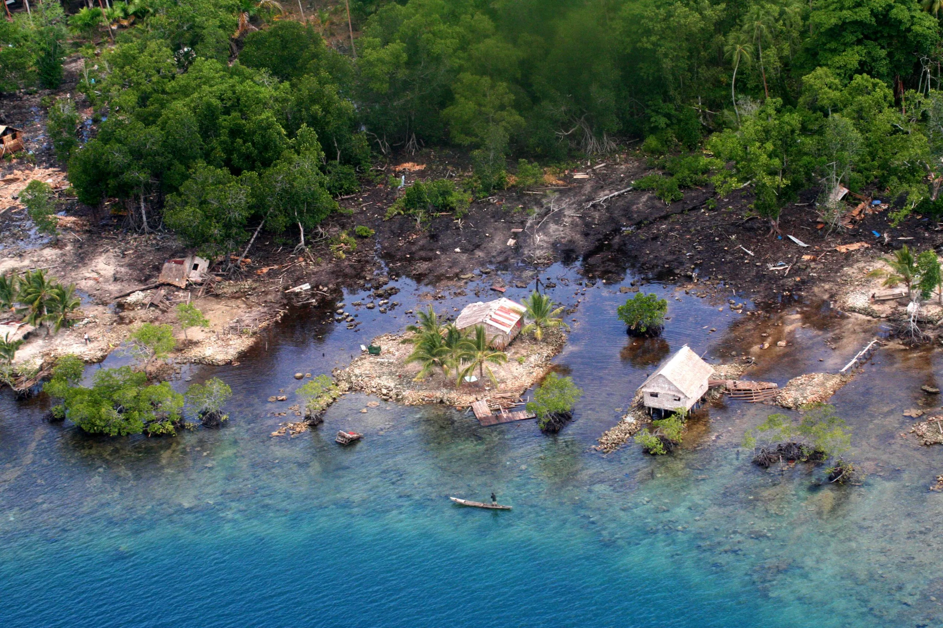


Decadal to Centennial Vertical Paleogeodetic Record of the Seismic Cycle in the Western Solomons from Coral Paleogeodesy and Stable Isotopes
M. Ege Karaesmen, Luc Lavier, Frederic Taylor,
Lauren Kendall, Ann Chen, Laura Wallace
University of Texas at Austin

Slide 2
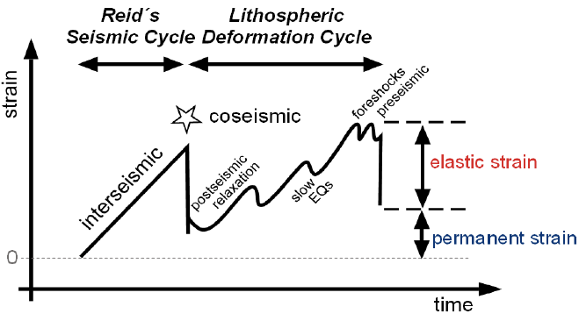
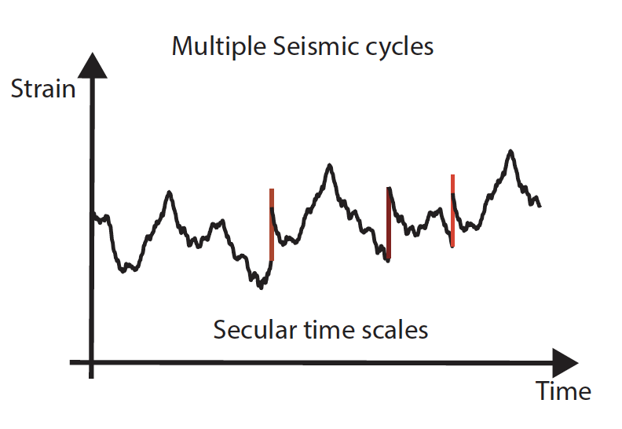
Earthquake Cycles Reconstruction
Reconstruct vertical tectonics over 100s to 1000s years using coral paleogeodesy
Including tectonic motion over multiple seismic cycles
Infer viscoelastic properties
Slow slip events + Precursory
Ono Oncken, (2018)

Slide 3
Earthquake Cycles Reconstruction
Reconstruct vertical tectonics over 100s to 1000s years using coral paleogeodesy
Including tectonic motion over multiple seismic cycles
Infer viscoelastic properties
Slow slip events + Precursory
Ono Oncken, (2018)

Slide 4
Earthquake Cycles Reconstruction
Reconstruct vertical tectonics over 100s to 1000s years using coral paleogeodesy
Including tectonic motion over multiple seismic cycles
Infer viscoelastic properties
Slow slip events + Precursory
Ono Oncken, (2018)

Slide 5
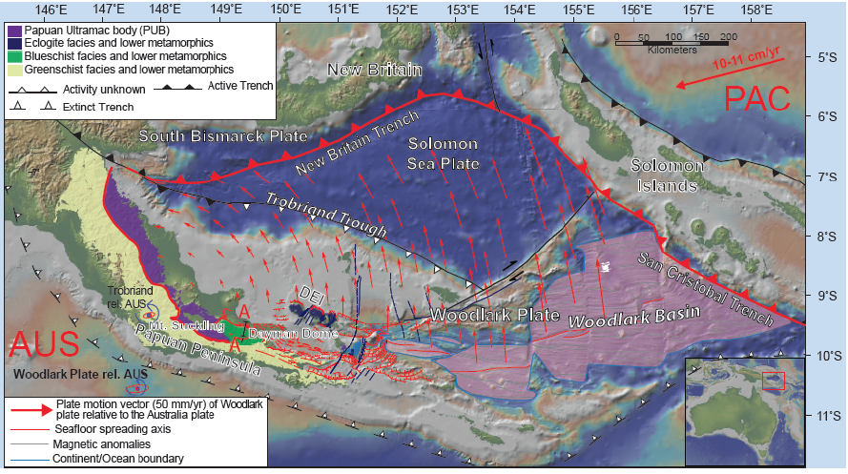

Slide 6
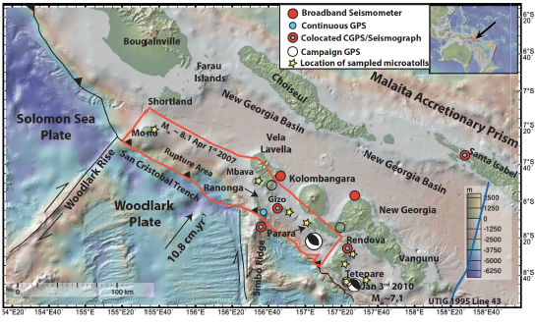

Slide 7
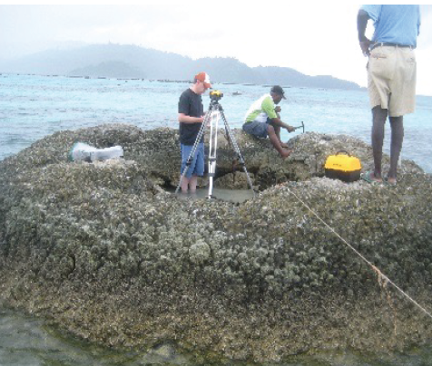
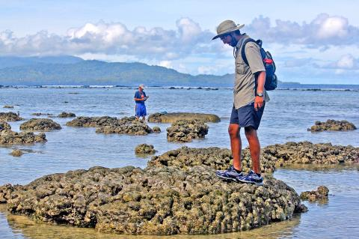
After Mw 8.1 2007
Luc Lavier measuring the vertical position of the sampled coral, near Ranongga Island in 2012.
UT Austin doctoral student Kaustubh Thirumalai inspecting corals near the Solomon Islands’ Ranongga Island in 2015.

Slide 8
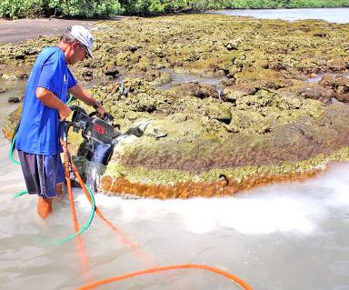
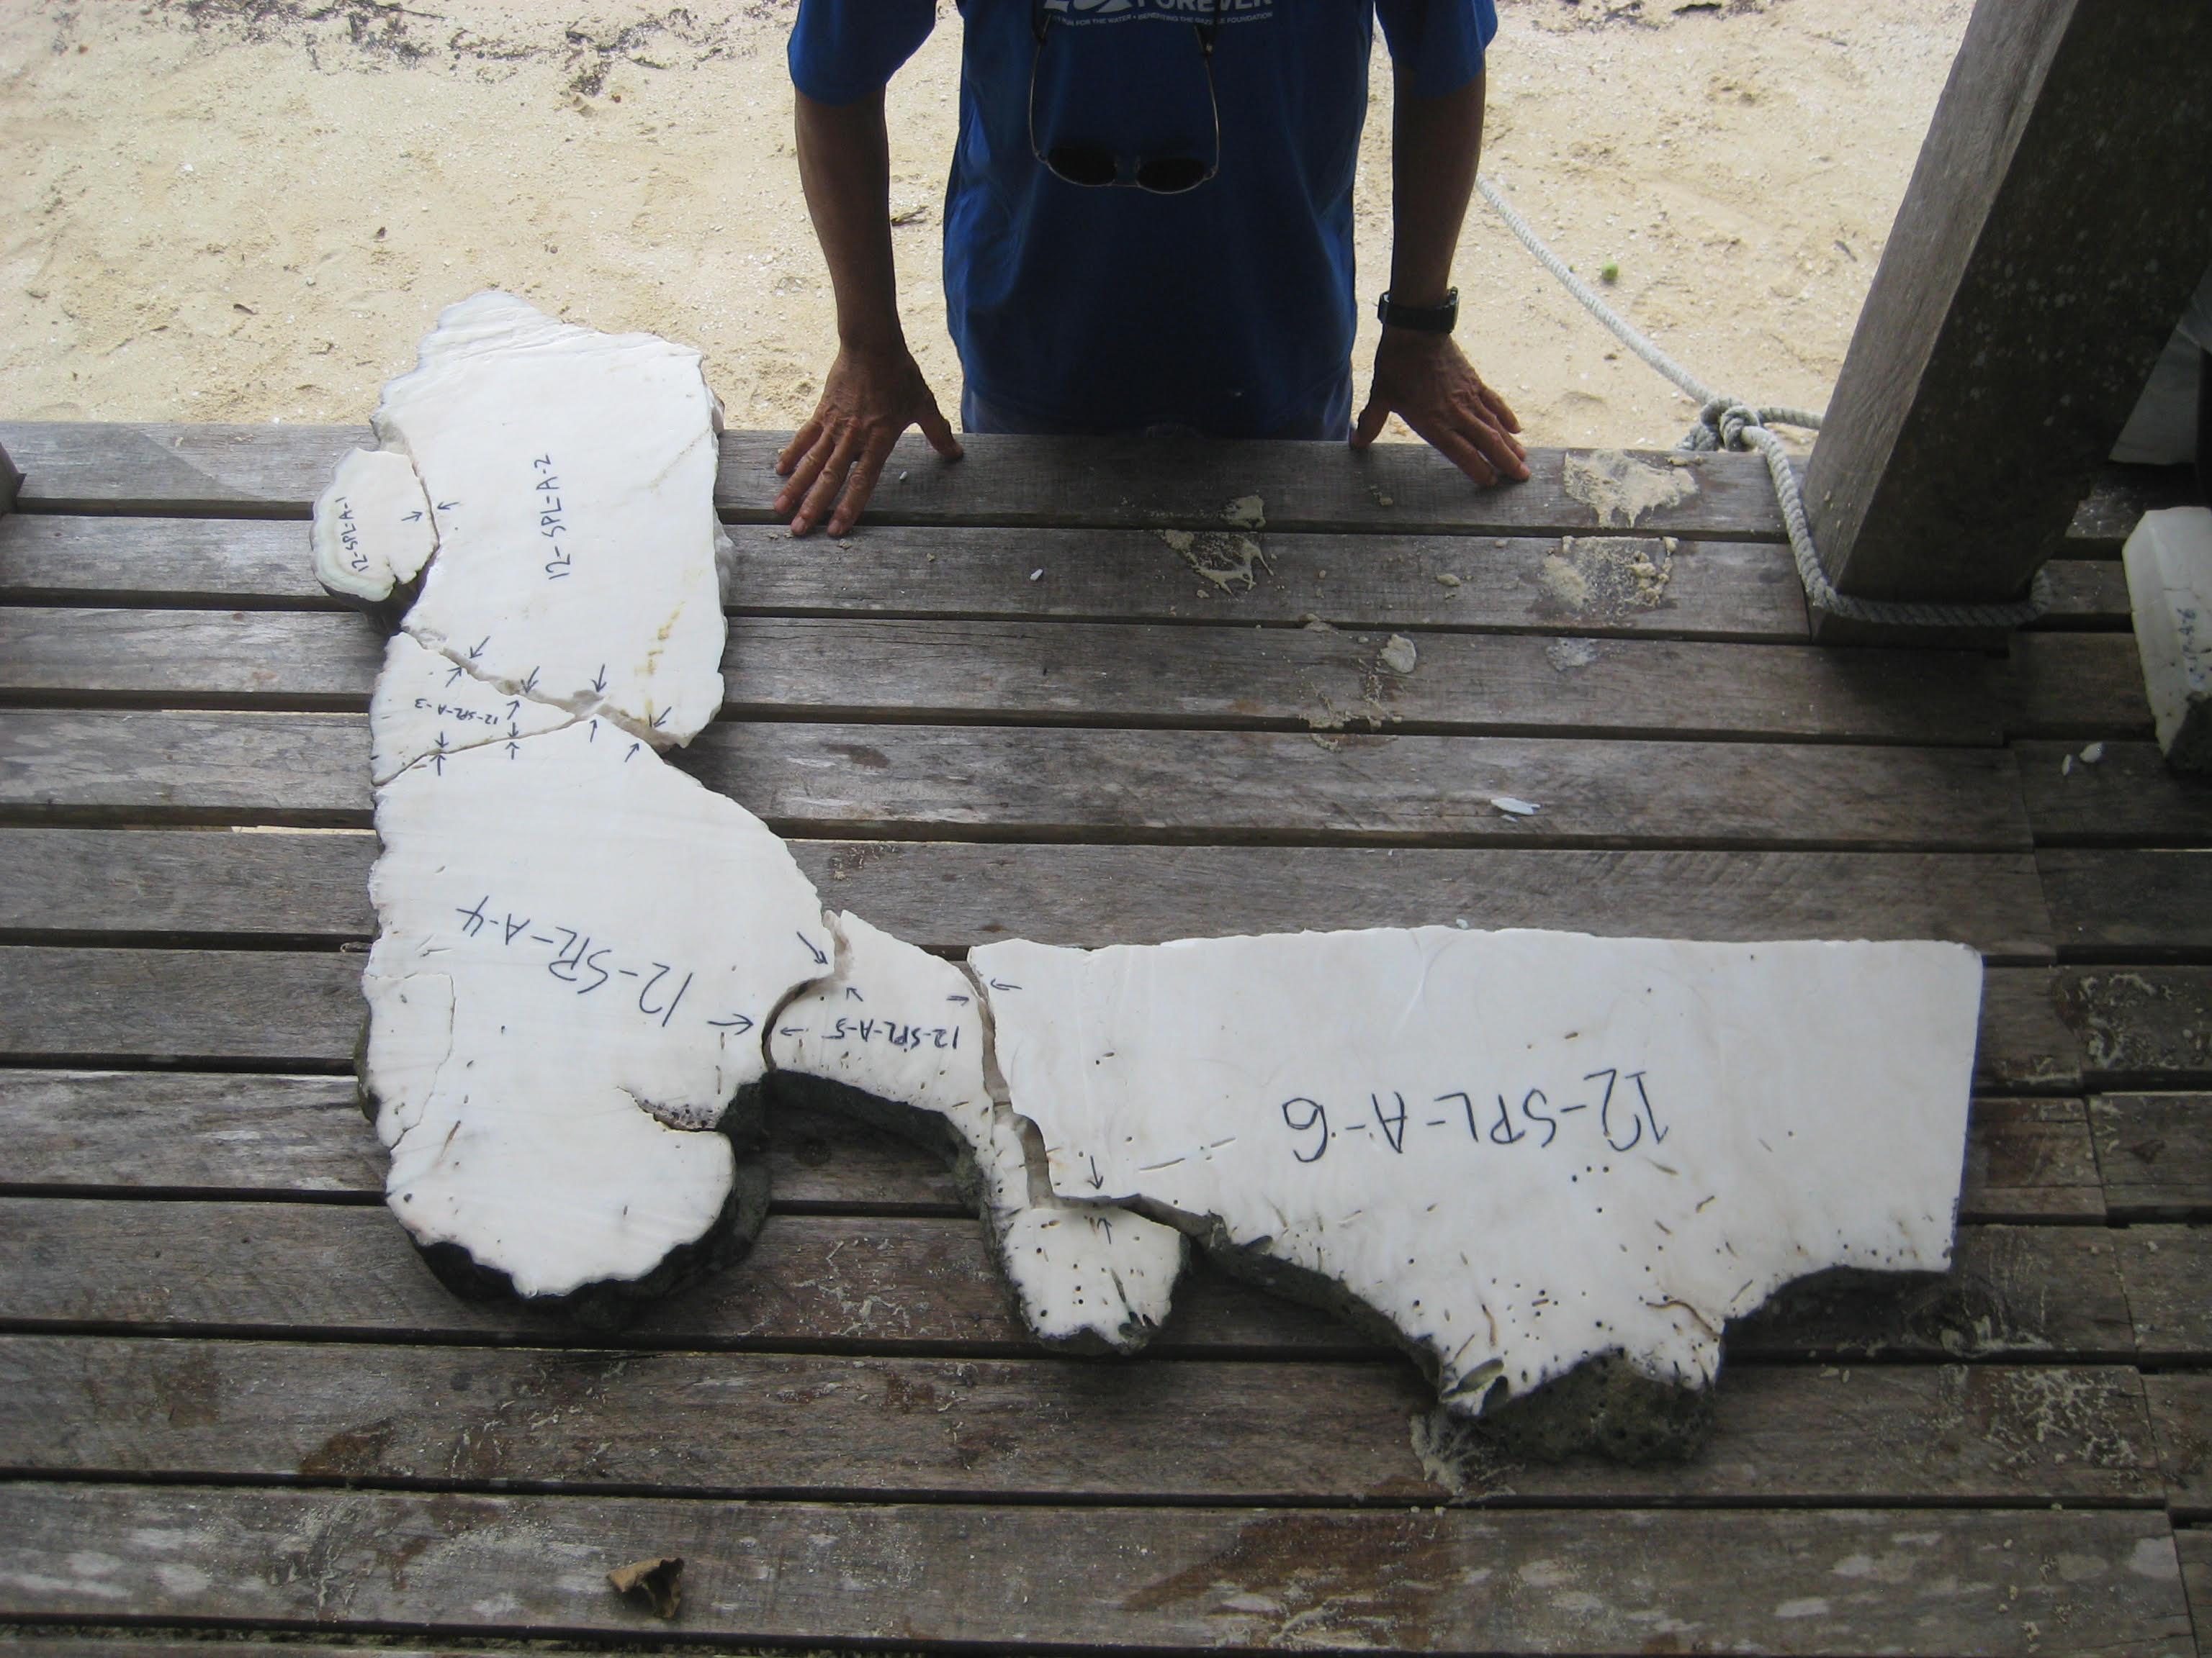
After Mw 8.1 2007
Fred Taylor (UT Austin) collects samples from corals in the Solomon Islands, after 2007 Earthquake uplift. (2015)
The sample taken in 2012 from Parara Island and analayzed in 2024 at Austin.

Slide 9
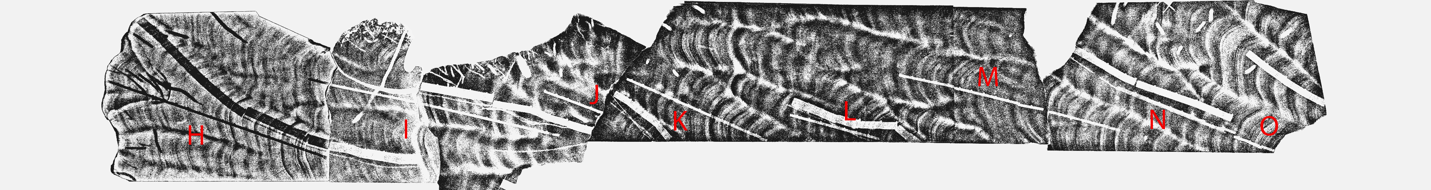

Slide 10
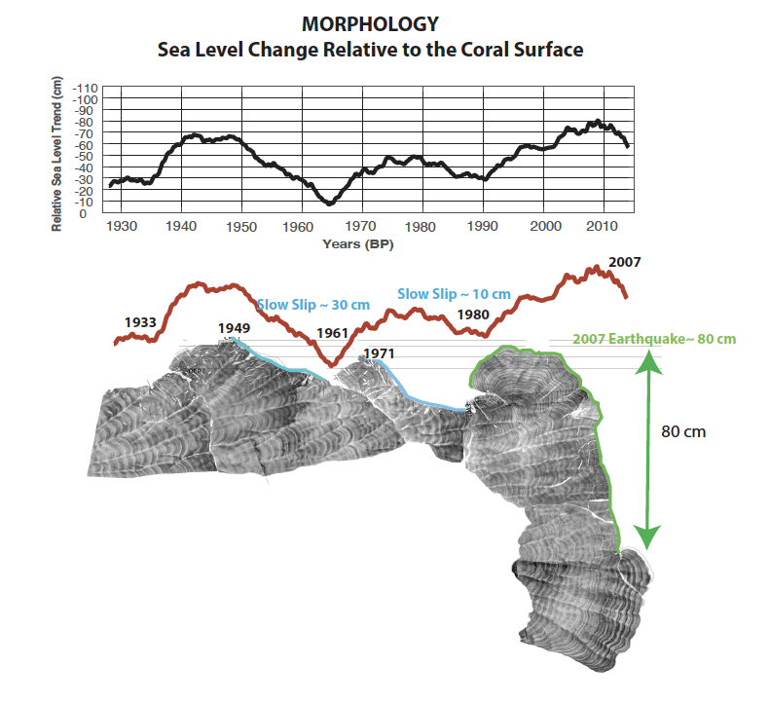

Slide 11
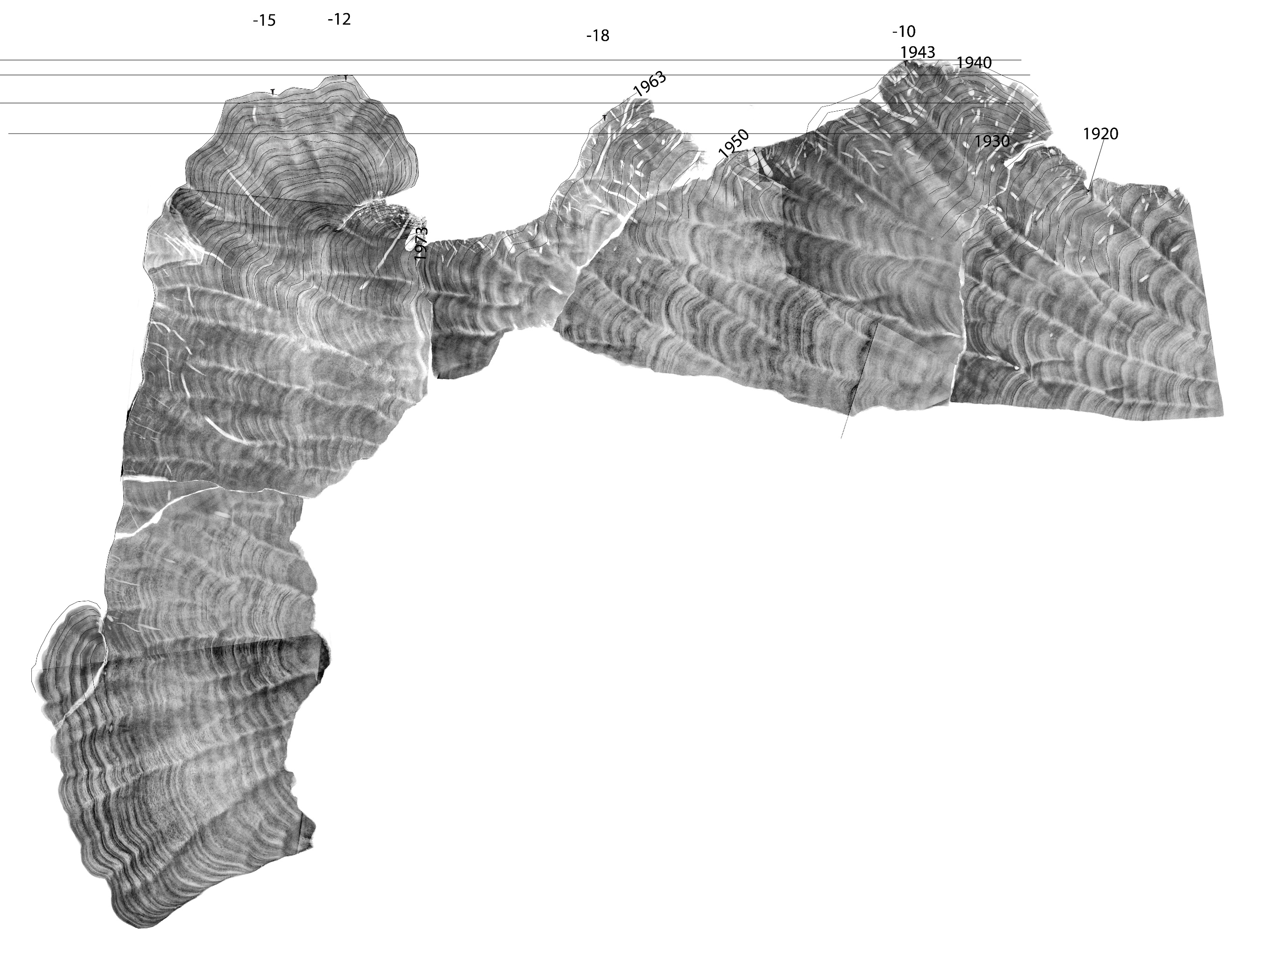
Depth

Slide 12
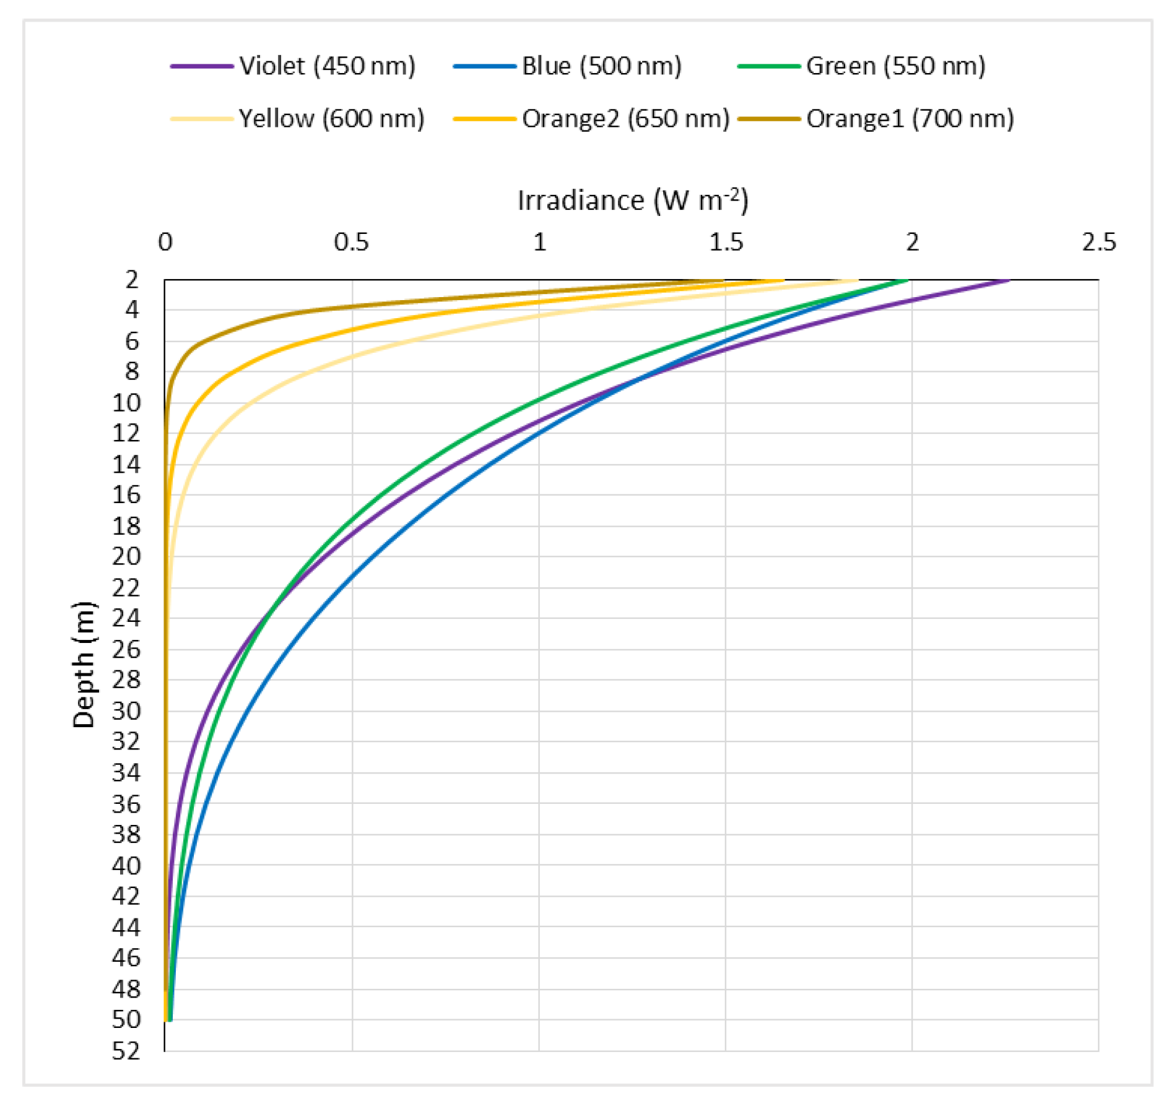
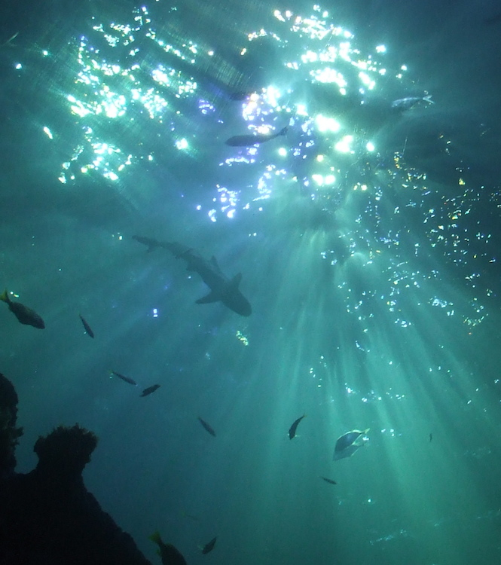
Confirmed with additional data (Blue light/ euphotic zone)
Abdelrahman, Mohamed A. 2016
HYPOTHESIS
-Plankton rejects heavier carbon ¹³C when sunlight is less intense (up to 50 m depth for blue light).
- The excess ¹³C is the used by the coral to build its skeleton.
- The relationship looks linear in shallow water but must be exponential and saturate at some depth.
? Expected behavior

Slide 13
Age

Slide 14
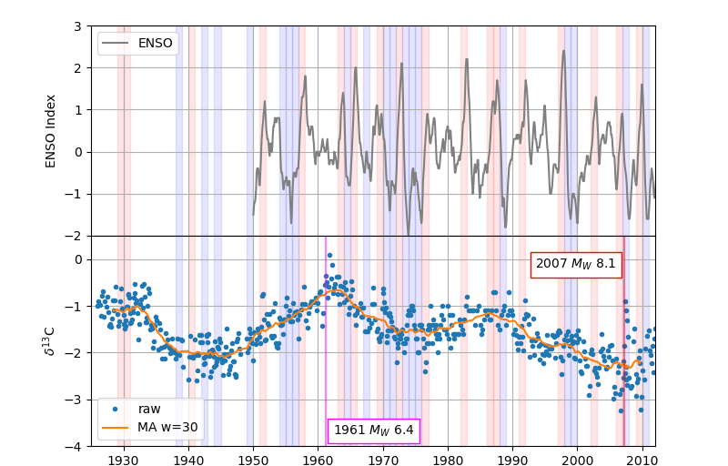
δ13C in Coral

Slide 15
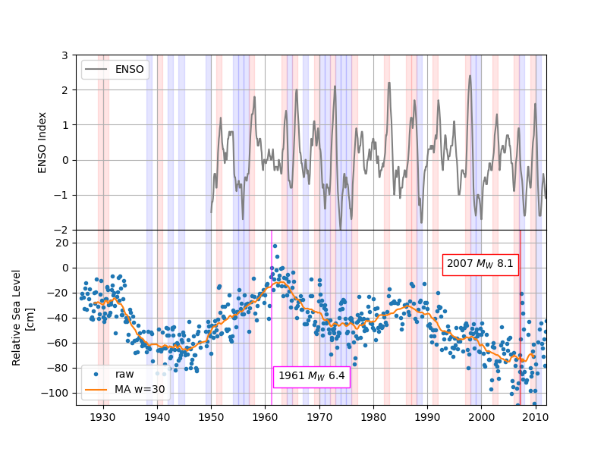
Relative Sea Level Trend

Slide 16
Relative Sea Level Trend
SSE
SSE

