Slide 1
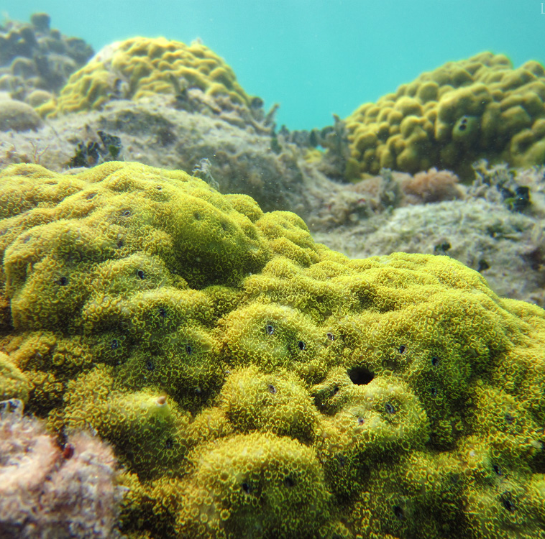


A new method for paleogeodesy with stable isotopes in corals from Solomon Islands
M. Ege Karaesmen
November 6th, 2025
wikipedia.en

Slide 2
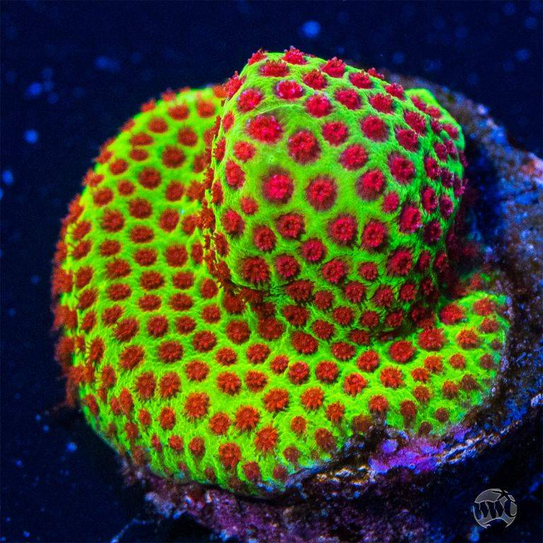
Coral Paleogeodesy
What & how?
Surface deformation in the past is captured by the corals
It is known that the coral morphology is an indicator (Philibosian 2025)
We propose using the δ¹³C time series
bulkreefsupply.com

Slide 3
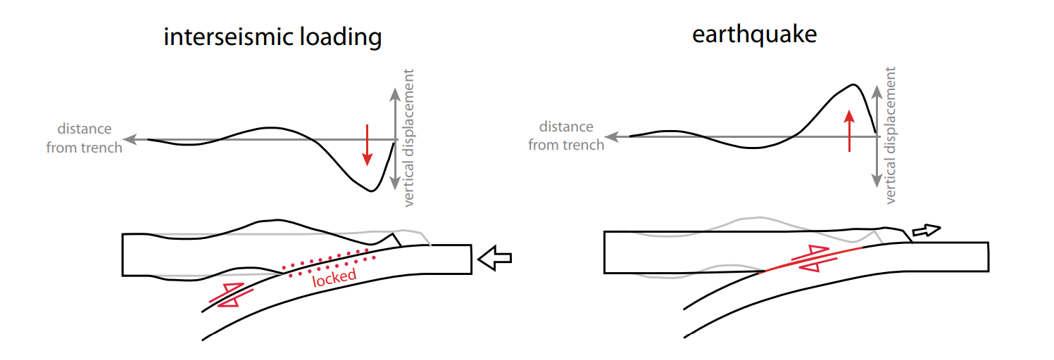

Coral Paleogeodesy
Why?
Establish the detailed parameters in addition to timing of past earthquakes
Slow Slip Events (SSEs)
Slip distribution
Rupture length ?
Width ?
Multiple EQ cycles
Philibosian 2025

Slide 4
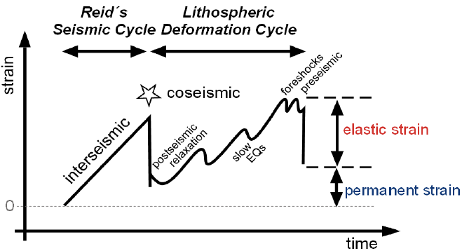
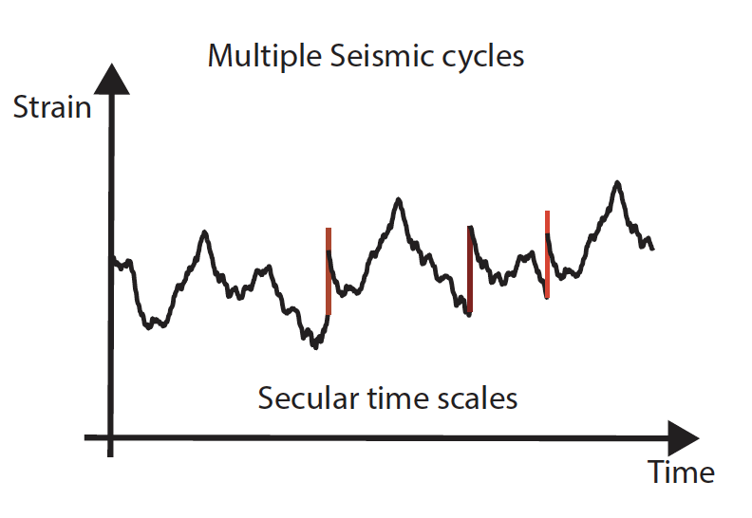
Earthquake Cycles Reconstruction
Reconstruct vertical tectonics over 100s to 1000s years using coral paleogeodesy
Including tectonic motion over multiple seismic cycles
Infer viscoelastic properties
Slow slip events + Precursory
Ono Oncken, (2018)

Slide 5
Earthquake Cycles Reconstruction
Reconstruct vertical tectonics over 100s to 1000s years using coral paleogeodesy
Including tectonic motion over multiple seismic cycles
Infer viscoelastic properties
Slow slip events + Precursory
Ono Oncken, (2018)

Slide 6
Earthquake Cycles Reconstruction
Reconstruct vertical tectonics over 100s to 1000s years using coral paleogeodesy
Including tectonic motion over multiple seismic cycles
Infer viscoelastic properties
Slow slip events + Precursory
Ono Oncken, (2018)

Slide 7
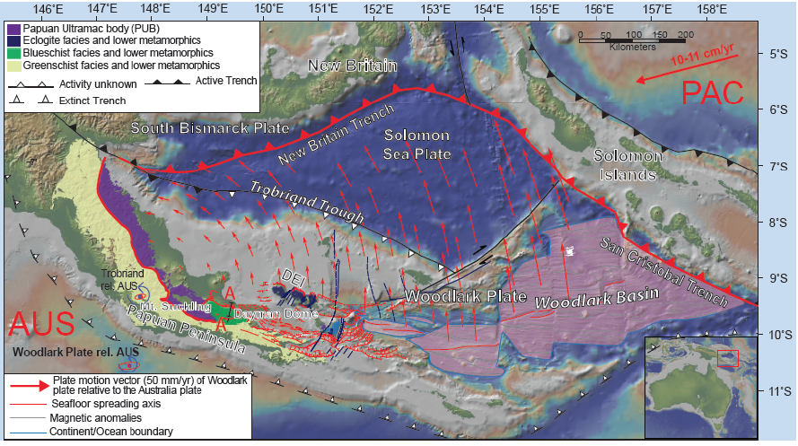

Slide 8
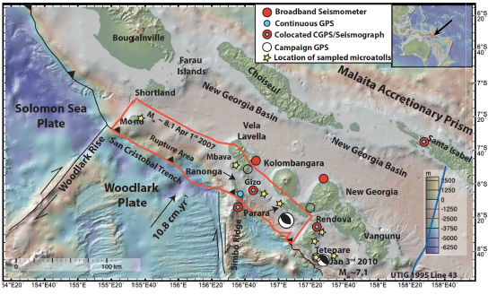

Slide 9
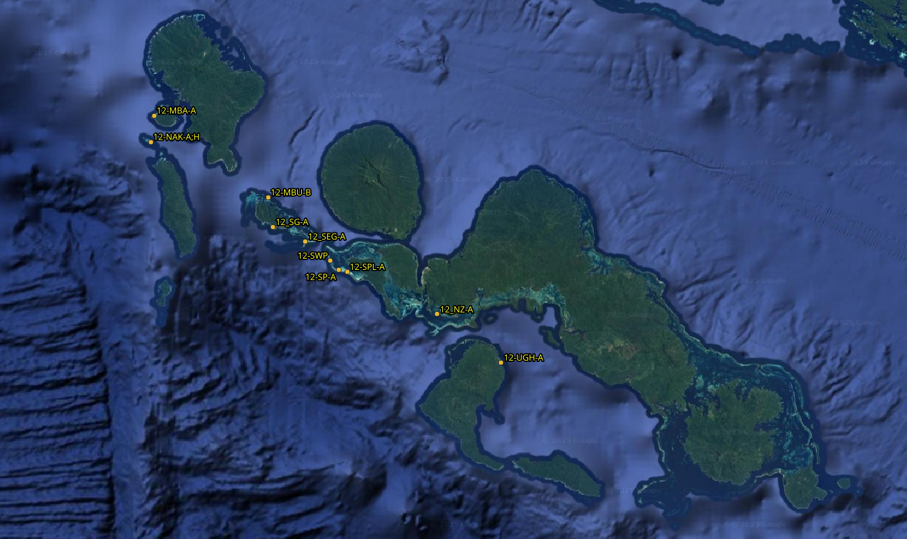

Slide 10
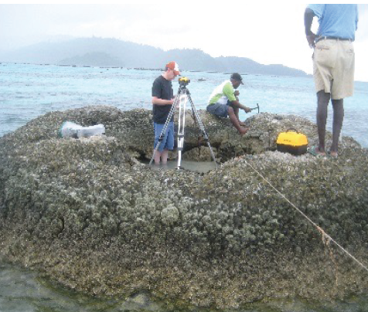
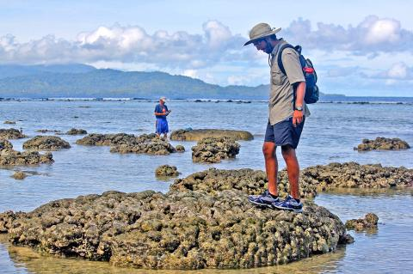
After Mw 8.1 2007
Luc Lavier measuring the vertical position of the sampled coral, near Ranongga Island in 2012.
UT Austin doctoral student Kaustubh Thirumalai inspecting corals near the Solomon Islands’ Ranongga Island in 2015.

Slide 11
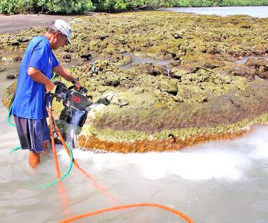
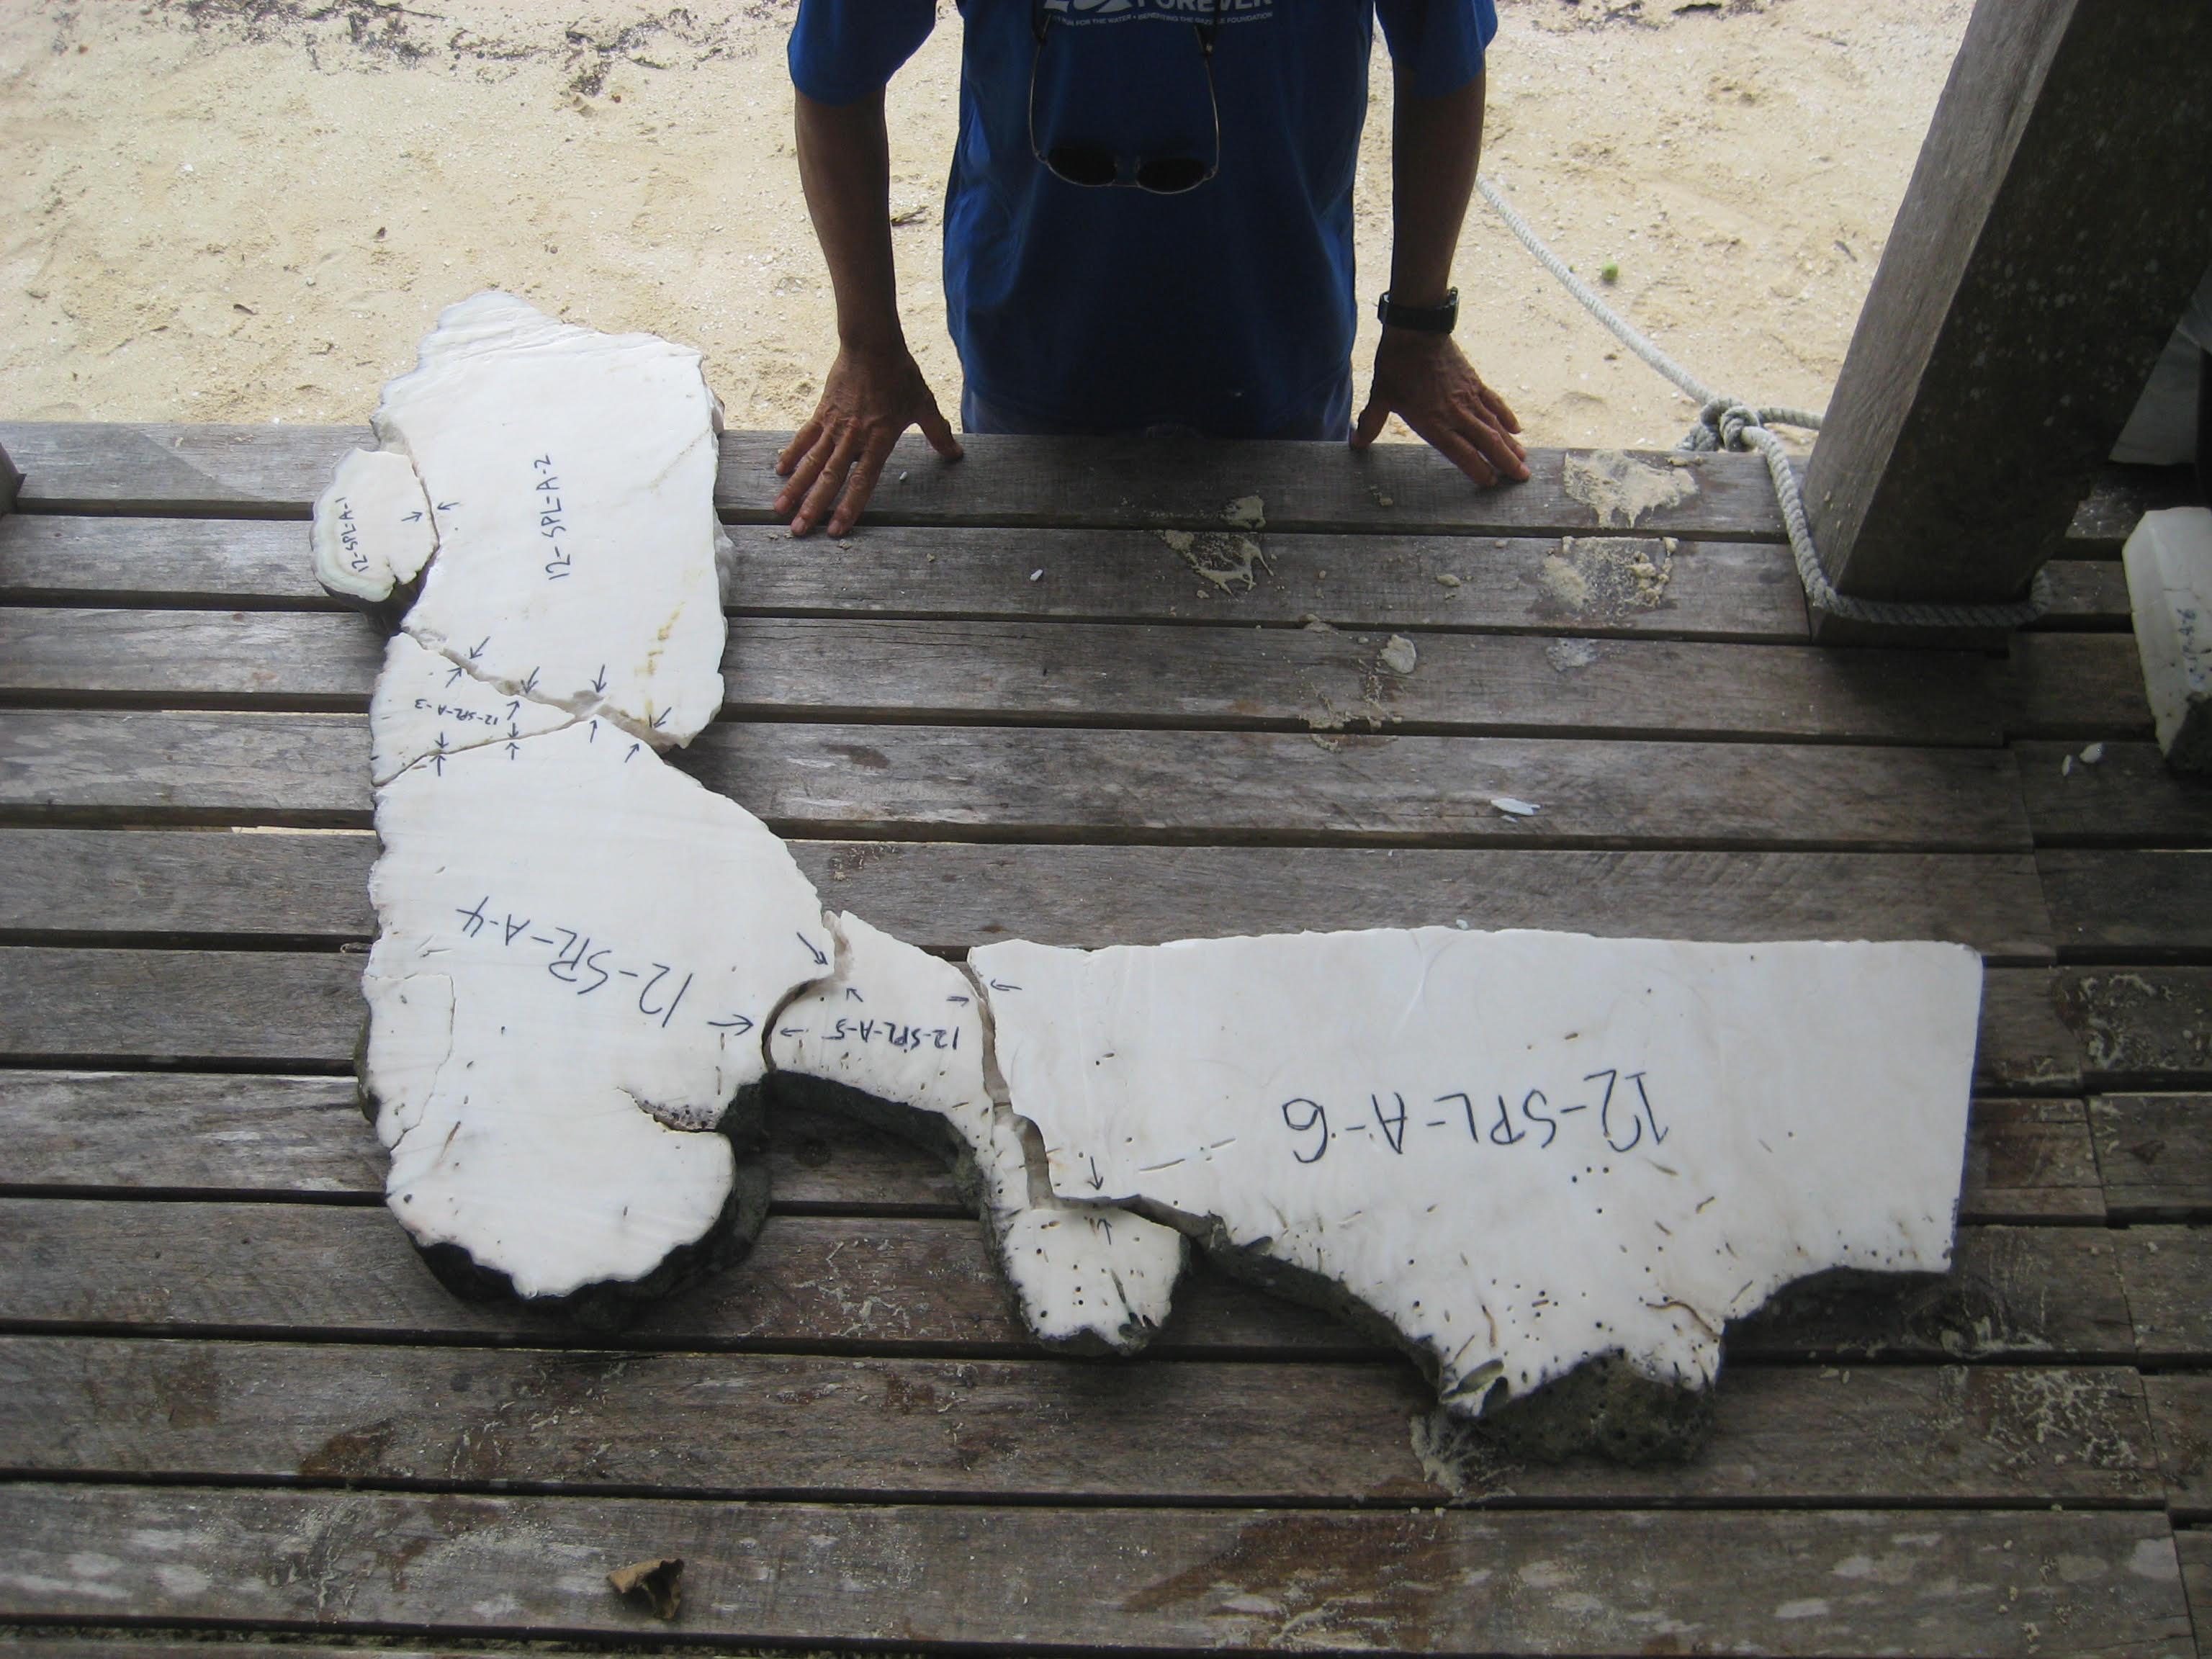
After Mw 8.1 2007
Fred Taylor (UT Austin) collects samples from corals in the Solomon Islands, after 2007 Earthquake uplift. (2015)
The sample taken in 2012 from Parara Island and analayzed in 2024 at Austin.

Slide 12
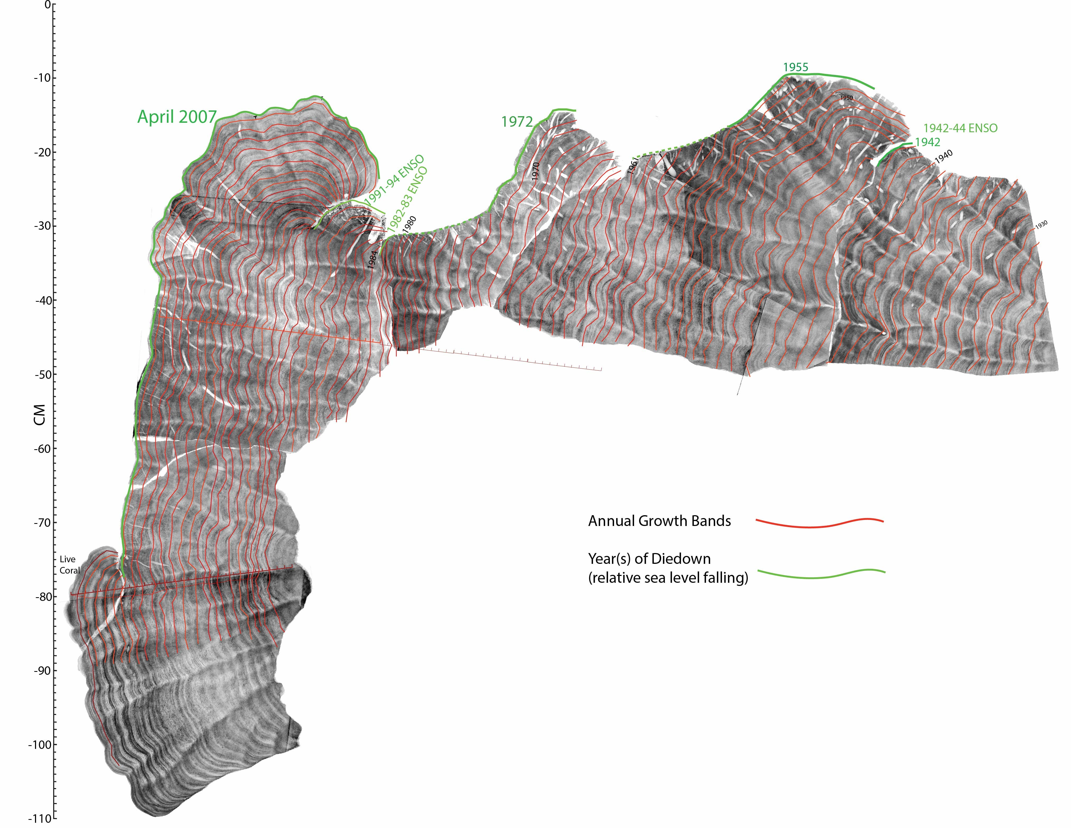

Slide 13
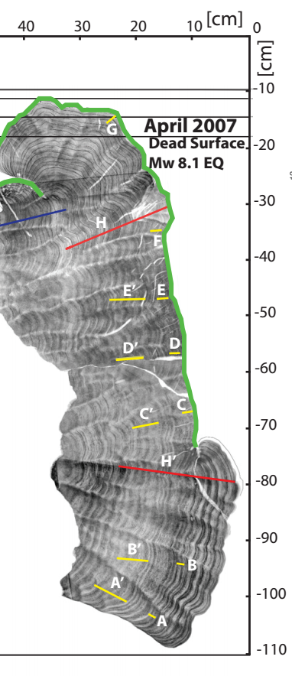
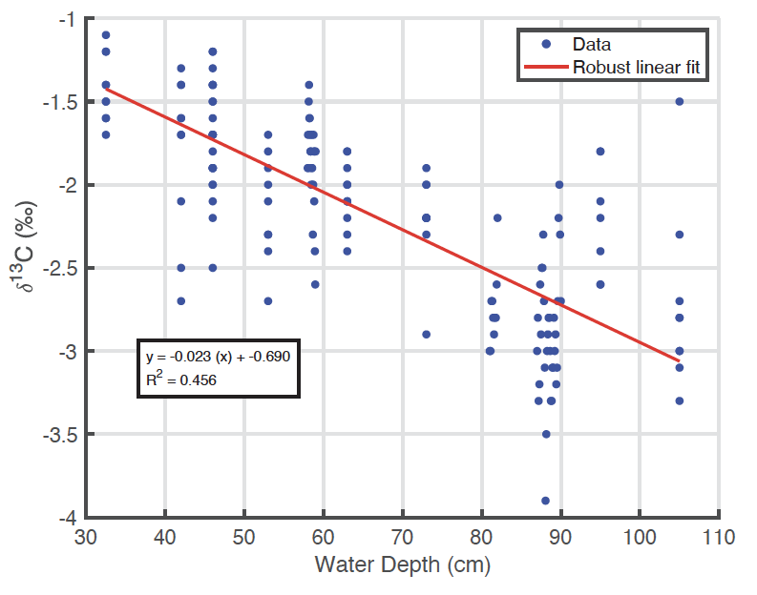

Slide 14
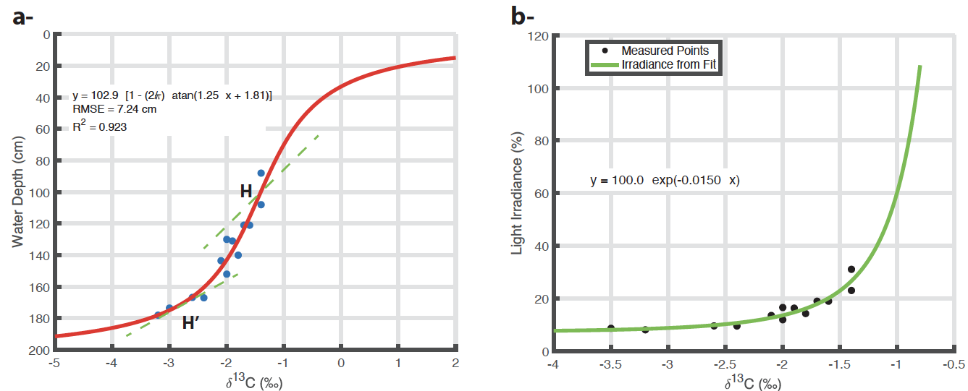

Slide 15


What has been done so far
Sampling
Lab Analysis
Growth Lines
Age Model
Time Series Analysis
Writing!

Slide 16
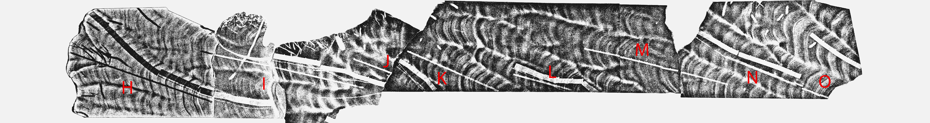

Slide 17
DATA

Slide 18
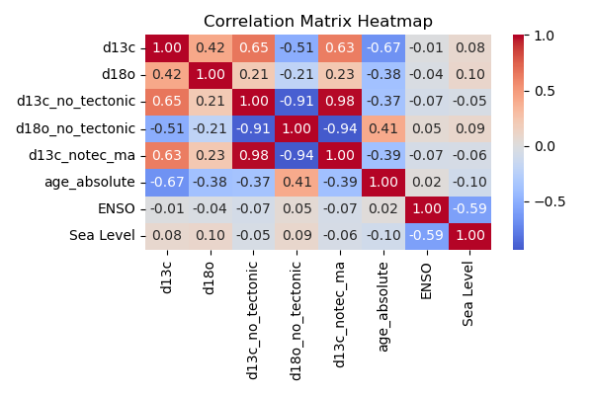

Slide 19
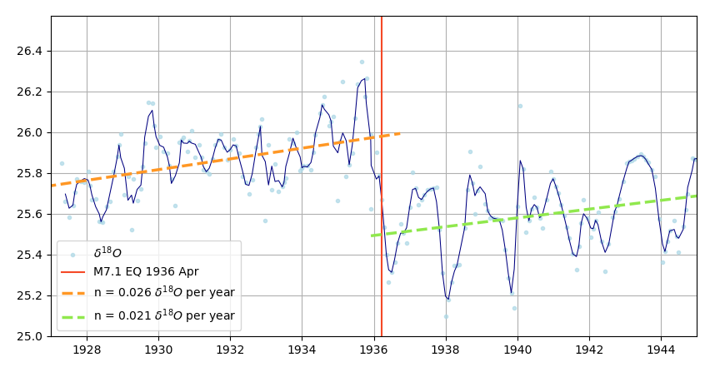

Slide 20
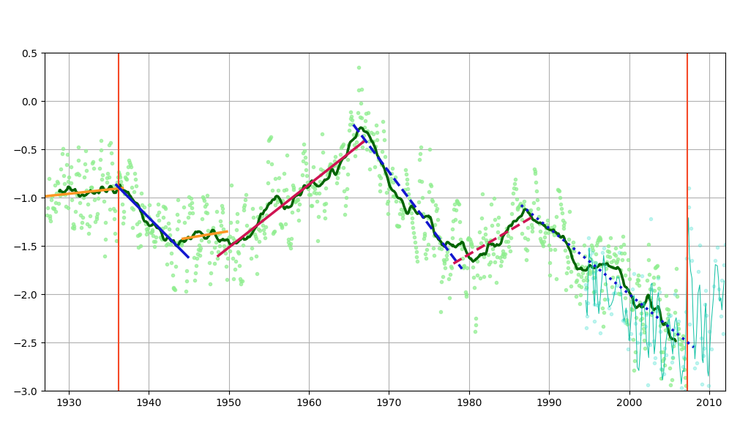
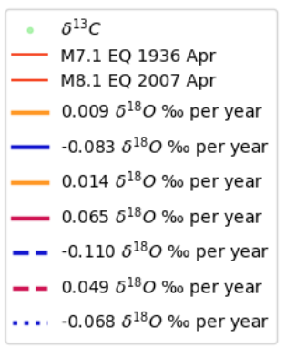

Slide 21
SSE ?
Interseismic
Interseismic
SSE ?
Interseismic

