Slide 1
Slides for Memo

Slide 2
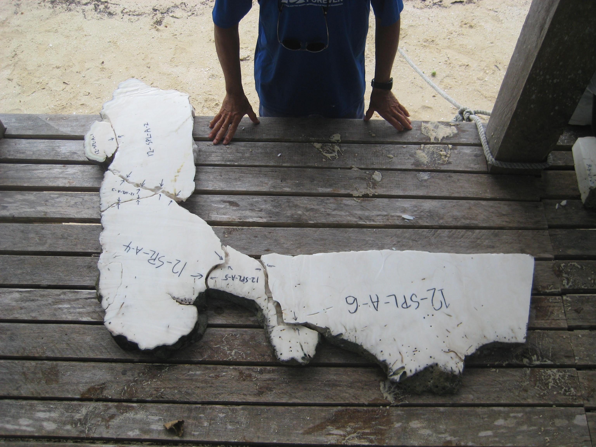

Slide 3
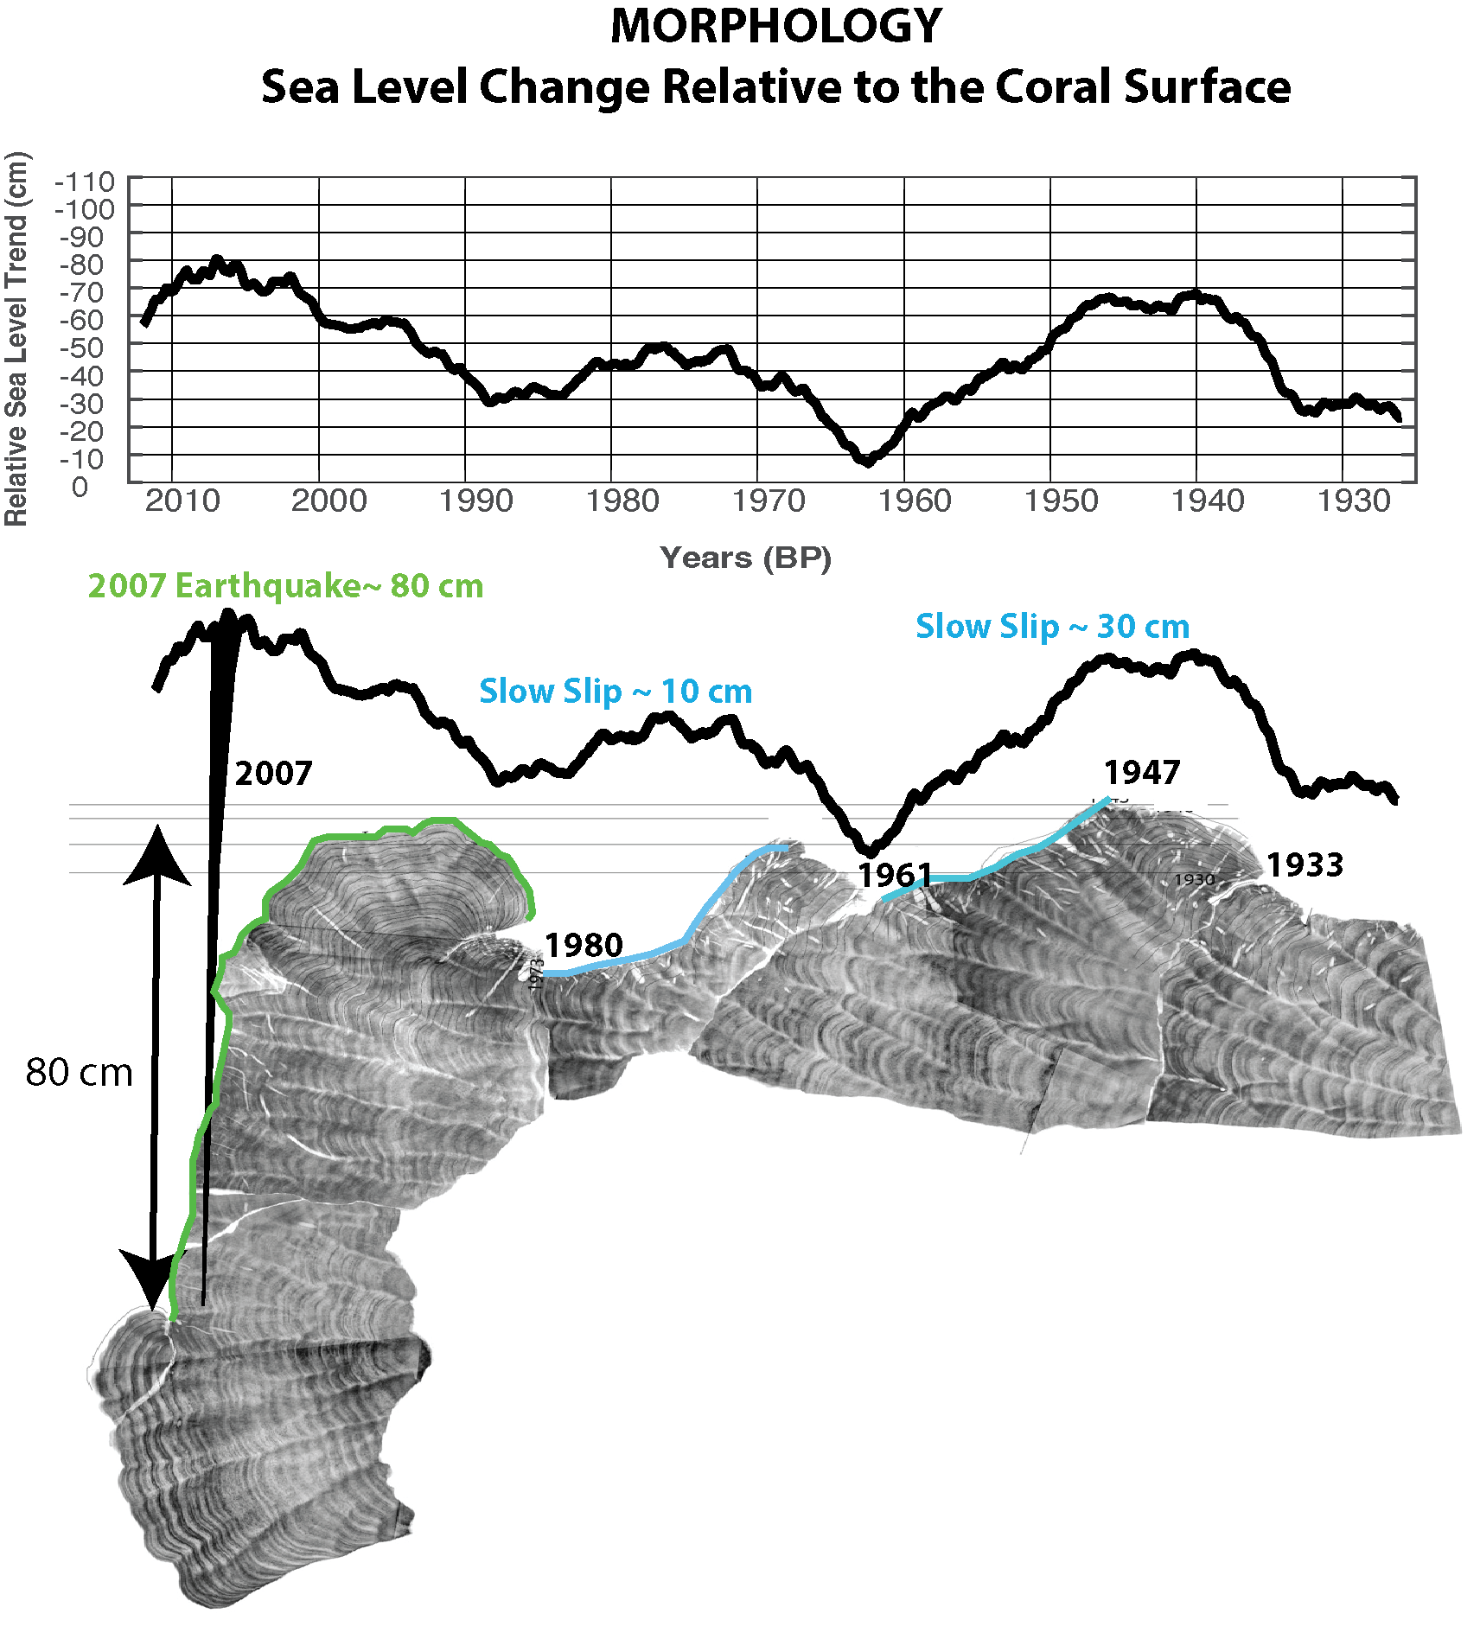

Slide 4
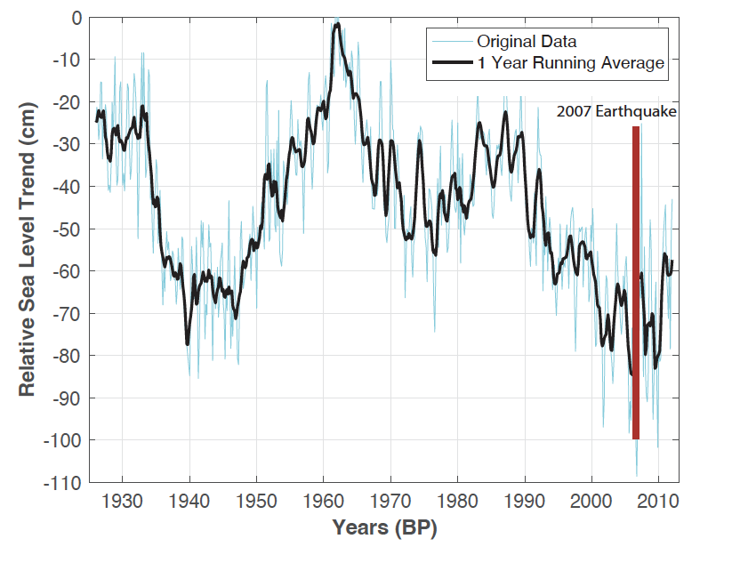
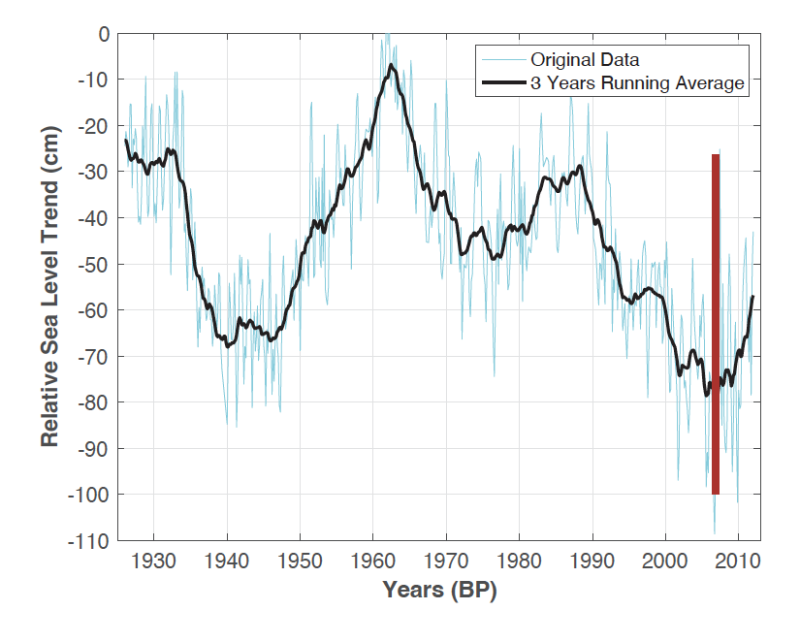
1 year running average
Tectonic plus ENSO Trends ?
3 year running average
Tectonic Trends ?

Slide 5
