Slide 1
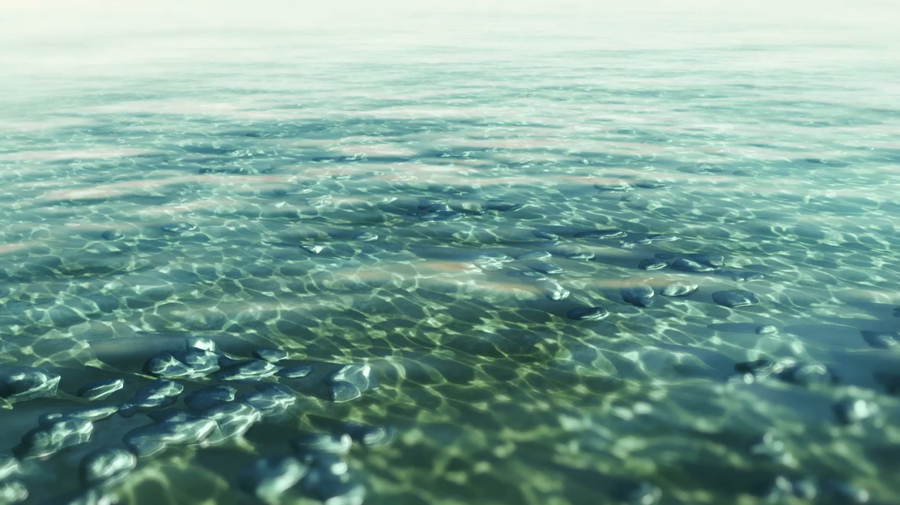
Tracking Sea-Level and Seismic Cycle Variability in the Solomon Islands Using Stable Isotopes in Shallow-Water Corals
Luc Lavier, Fred Taylor,, Lauren Kendall, Mehmet Karaesmen, Ann Chen, Laura Wallace.

Slide 2
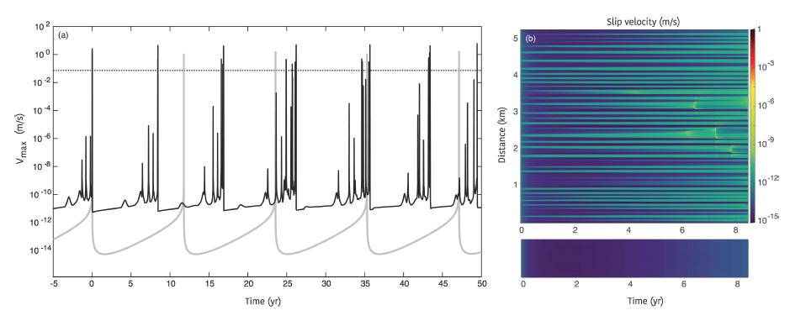
Potential of coral paleogeodesy
Reconstruct vertical tectonics over 100s to 1000s years using coral paleogeodesy.
Have a record of tectonic motion over multiple seismic cycles.
Infer viscoelastic properties over multiple seismic cycles.
Maybe have a longer record of larger slow slip events.
Precursory Slow Slip ?
Catania and Segall, (2021)

Slide 3
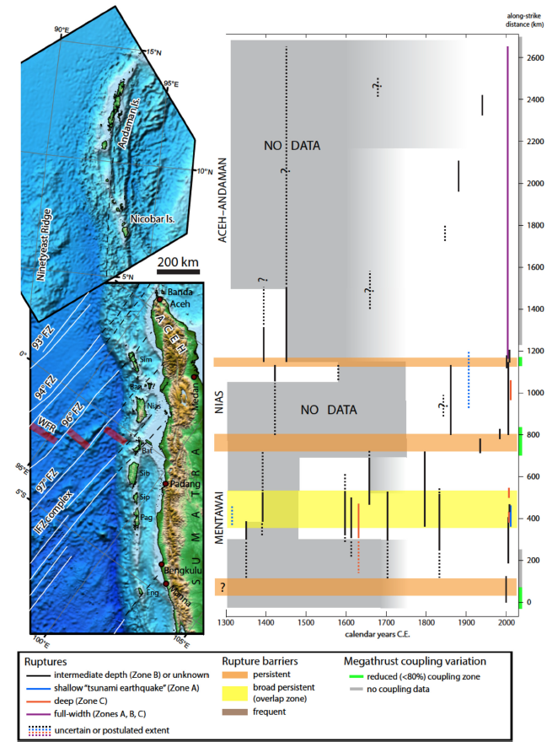
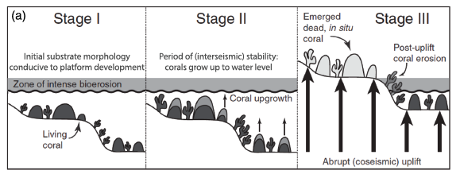
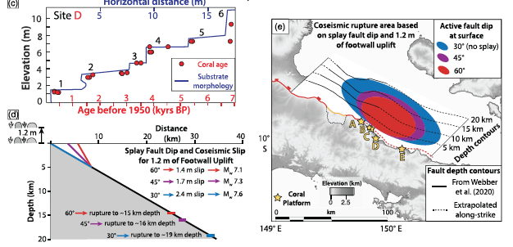
Current state of coral paleogeodesy
Sumatra, Philibosian and Meltzner, 2020
Papua New Guinea, Biemiller at al., 2020

Slide 4
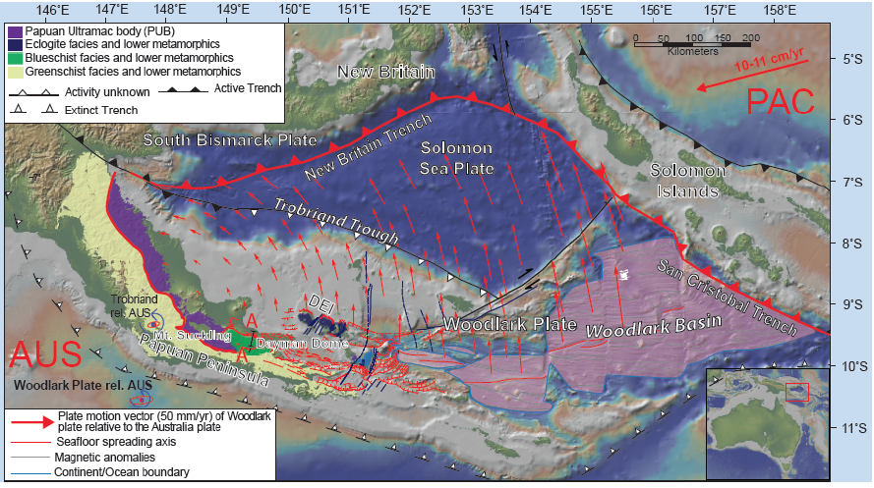
Solomon Islands Example

Slide 5
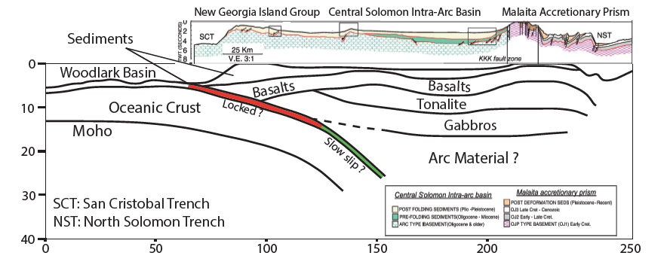
The subduction zone

Slide 6
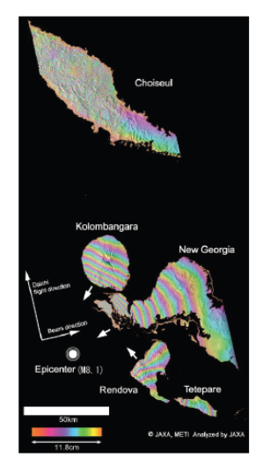
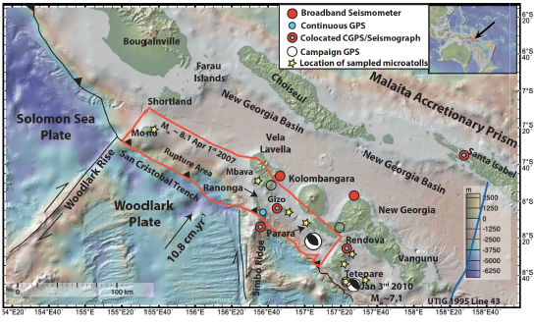
The available data
Miyagi et al. (2009)

Slide 7

The Mw 8.1 2007 earthquake
Vertical motion from corals
Horizontal motion from GPS
InSAR Co-Seismic Map
Each color cycle is 40 radians
Lauren Kendall at UT

Slide 8
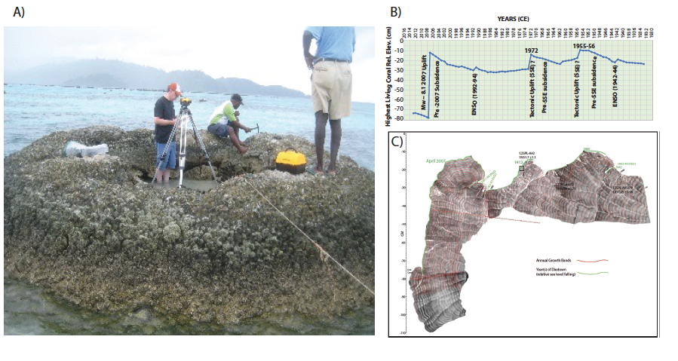
What about the paleorecord?

Slide 9
Record of sea level change and vertical tectonics?
The surface morphology results from times of growth associated with subsidence and dead surfaces associated with emergence (during an earthquake or El Niño events).
If we can remove the long-term absolute sea level change including the Southern oscillation we can access the tectonic vertical motion.
The coral surface shows”
The Mw 8.1 event
The subsidence pre-earthquakes
Some El-Nino events
Two slow tectonic uplifts lasting multiple years after a period of subsidence.

Slide 10
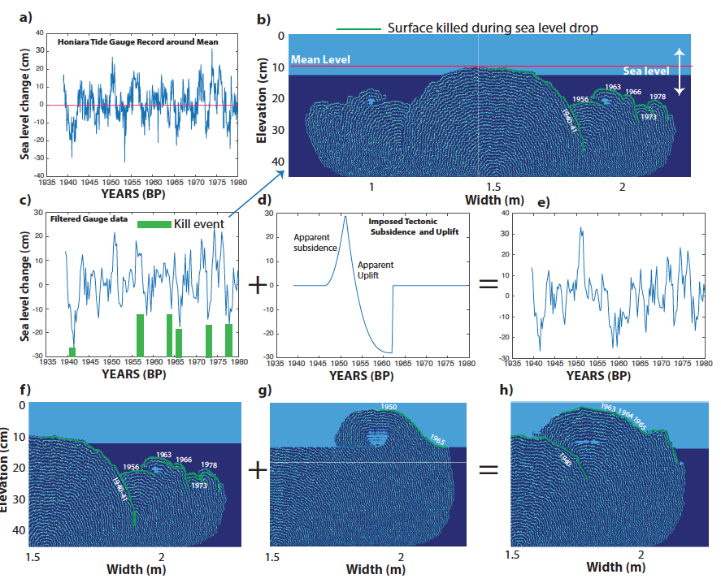
What happened? Forward modeling of coral morphology
The surface does not account for changes in relative sealevel that happen above the coral surface.
We need to infer the relative sea level with more frequency.

Slide 11
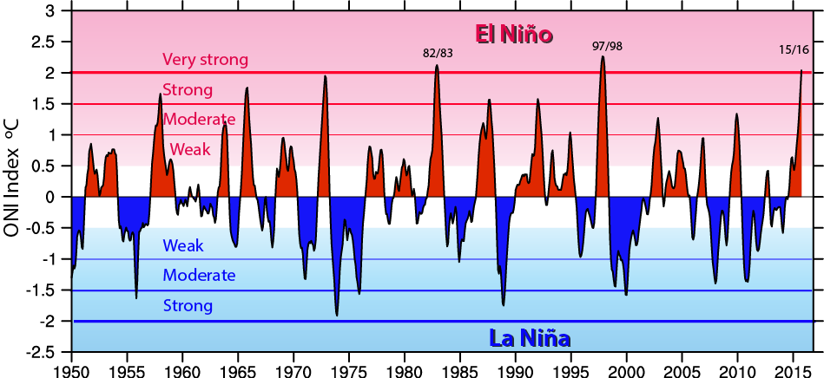
ENSO Index

Slide 12
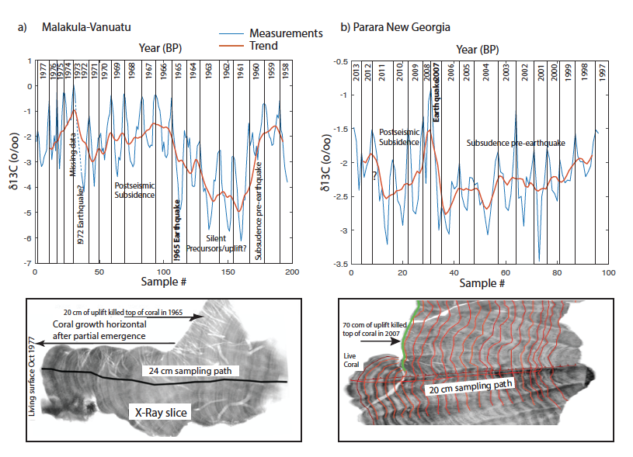
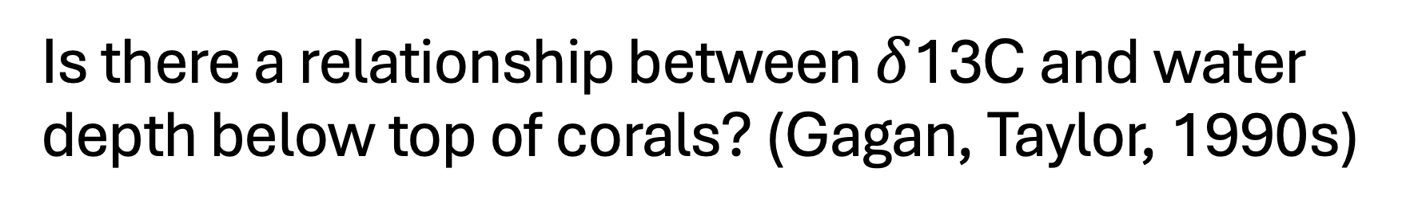
Is there a relationship between $δ$13C and water depth below top of corals? (Gagan, Taylor, 1990s)

Slide 13
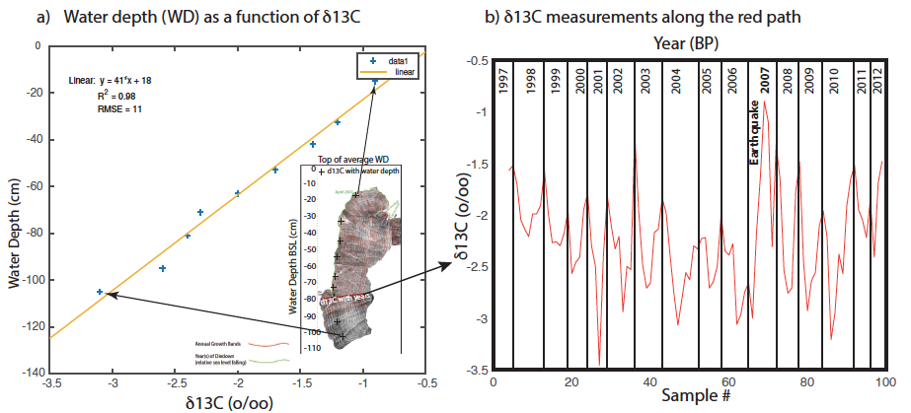
There is actually – too good to be true relationship

Slide 14
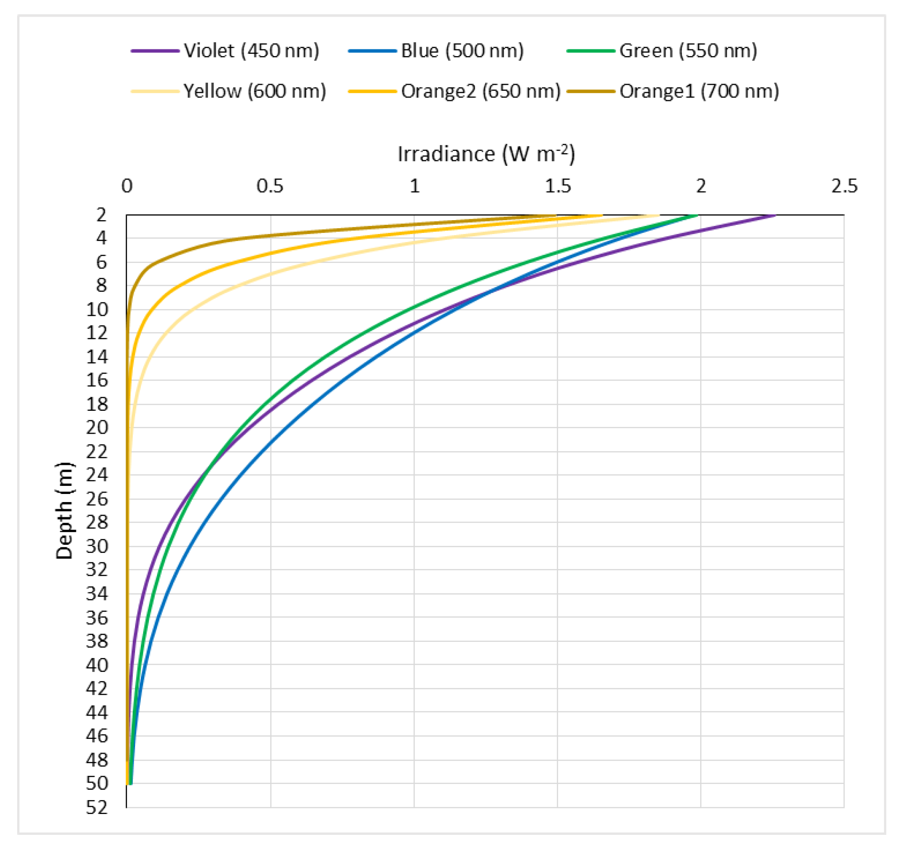
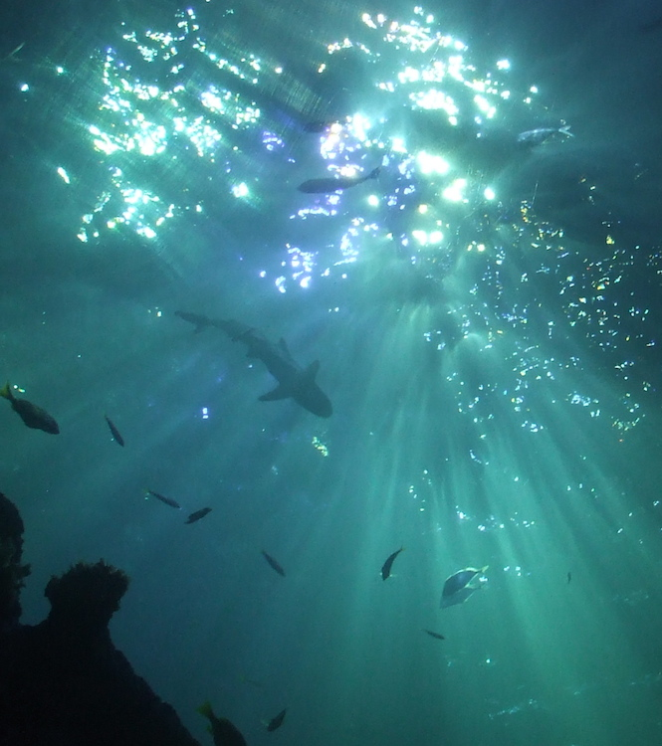
Confirmed with additional data (Blue light/ euphotic zone)
Abdelrhman, Mohamed A. 2016
HYPOTHESIS
-Plankton rejects heavier carbon ¹³C when sunlight is less intense (up to 80 m depth for blue light).
- The excess ¹³C is the used by the coral to build its skeleton.
- The relationship looks linear in shallow water but must be exponential and saturate at some depth.

Slide 15
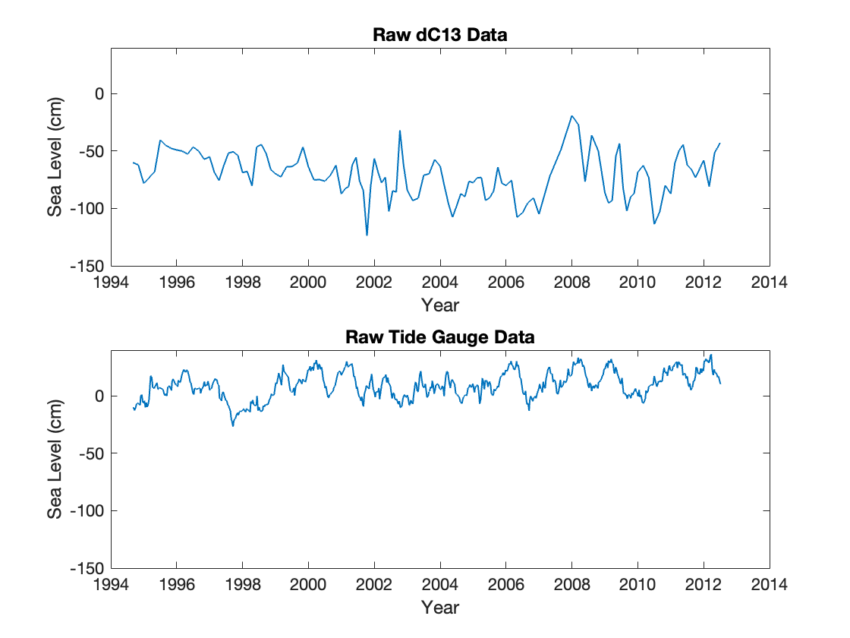
Raw 𝝳C13 and Tide Gauge Data
Honiara B
Lauren Kendall, UT

Slide 16
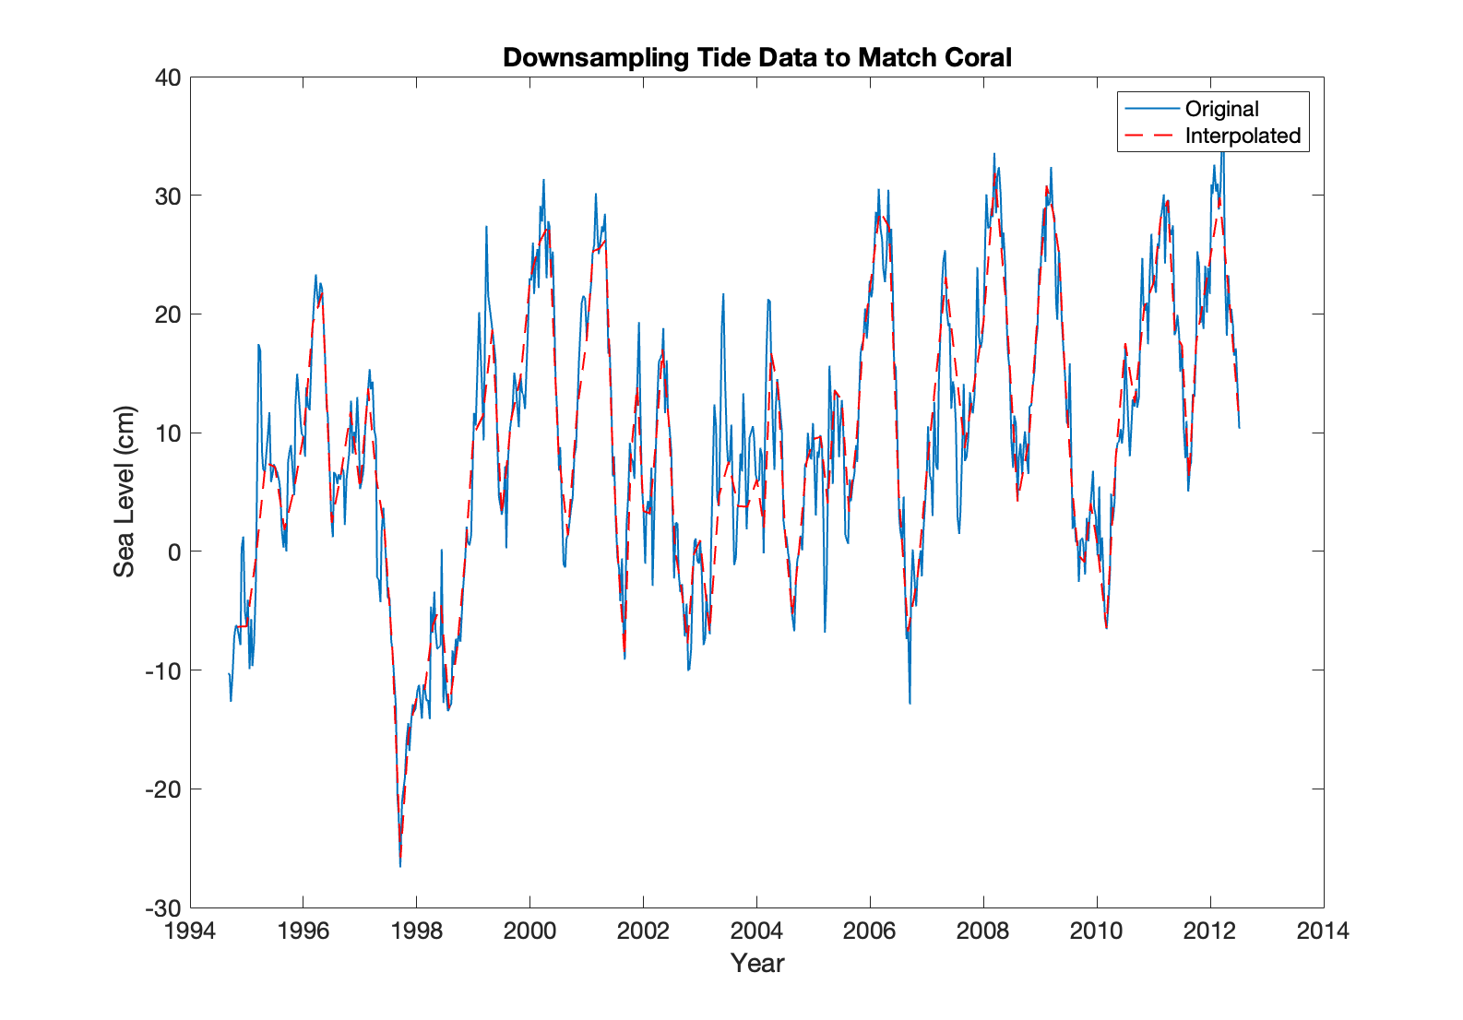
Down-sampled Tide Gauge Data to Match Sampling Rate of 𝝳C13 Data
Lauren Kendall, UT

Slide 17
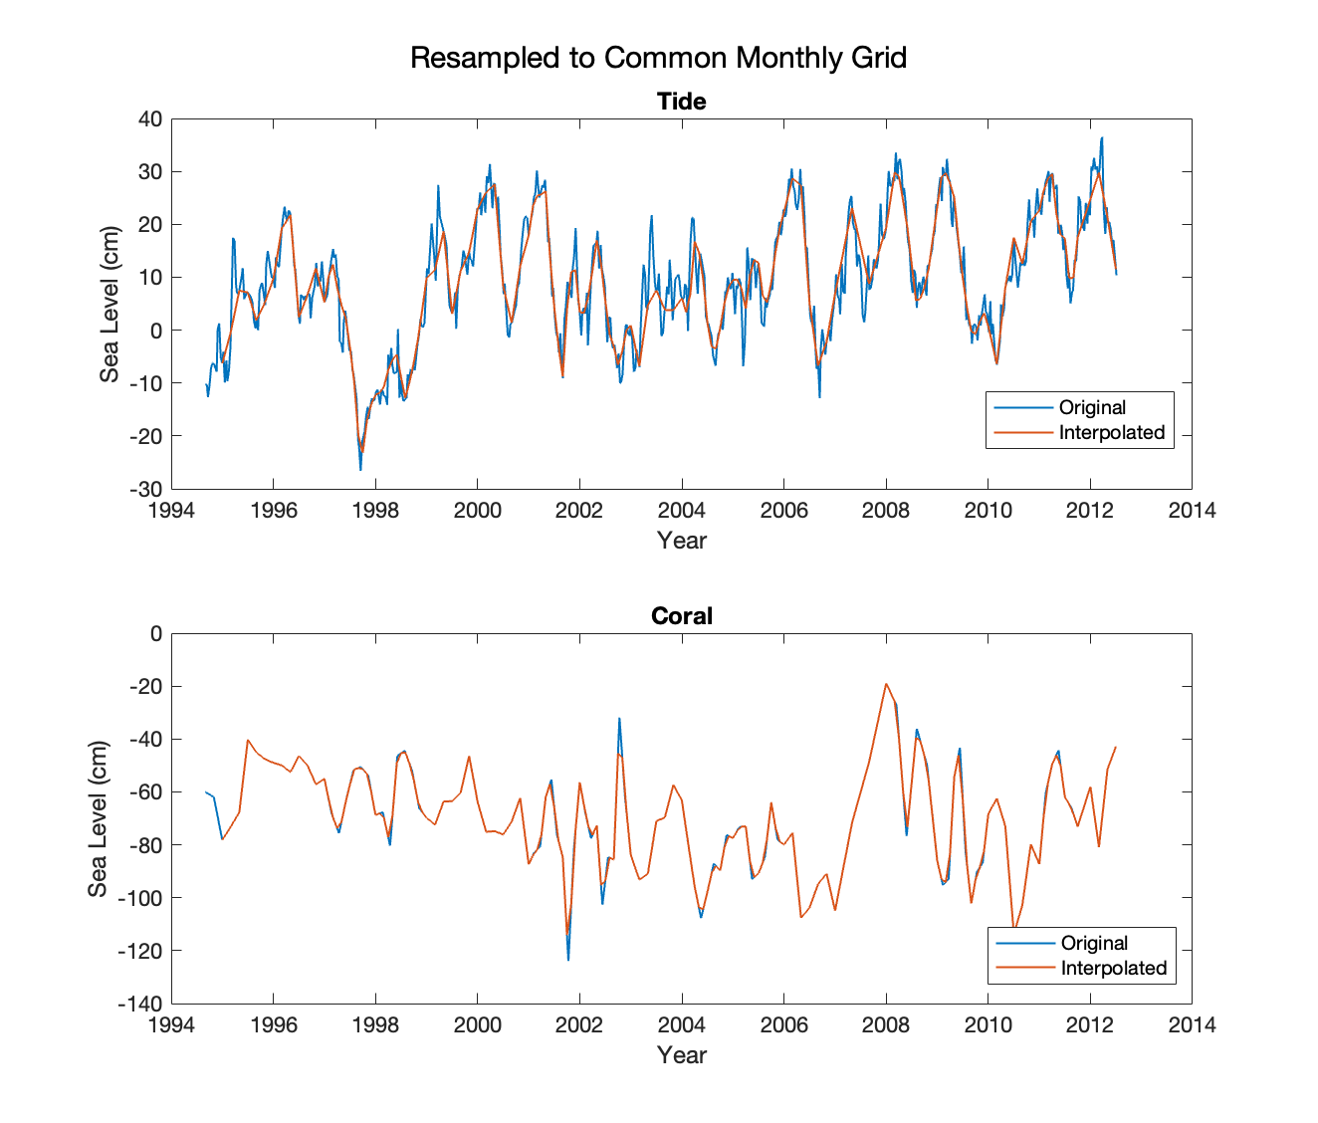
Interpolated both Data Sets to Common Monthly Grid
Lauren Kendall, UT

Slide 18
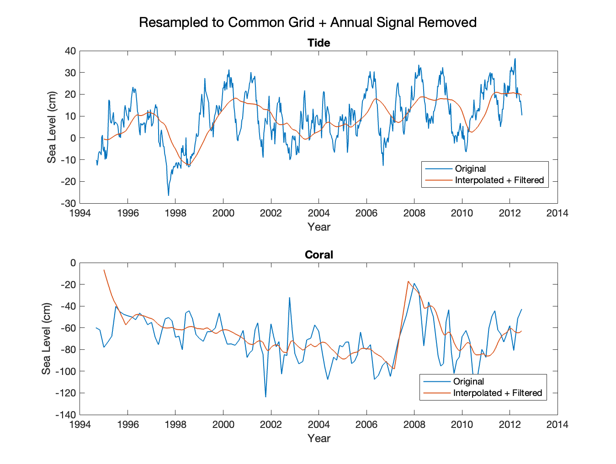
Removed Annual Signal with a Moving Average Box of 12 Samples (Excluding Jump)
Lauren Kendall, UT

Slide 19
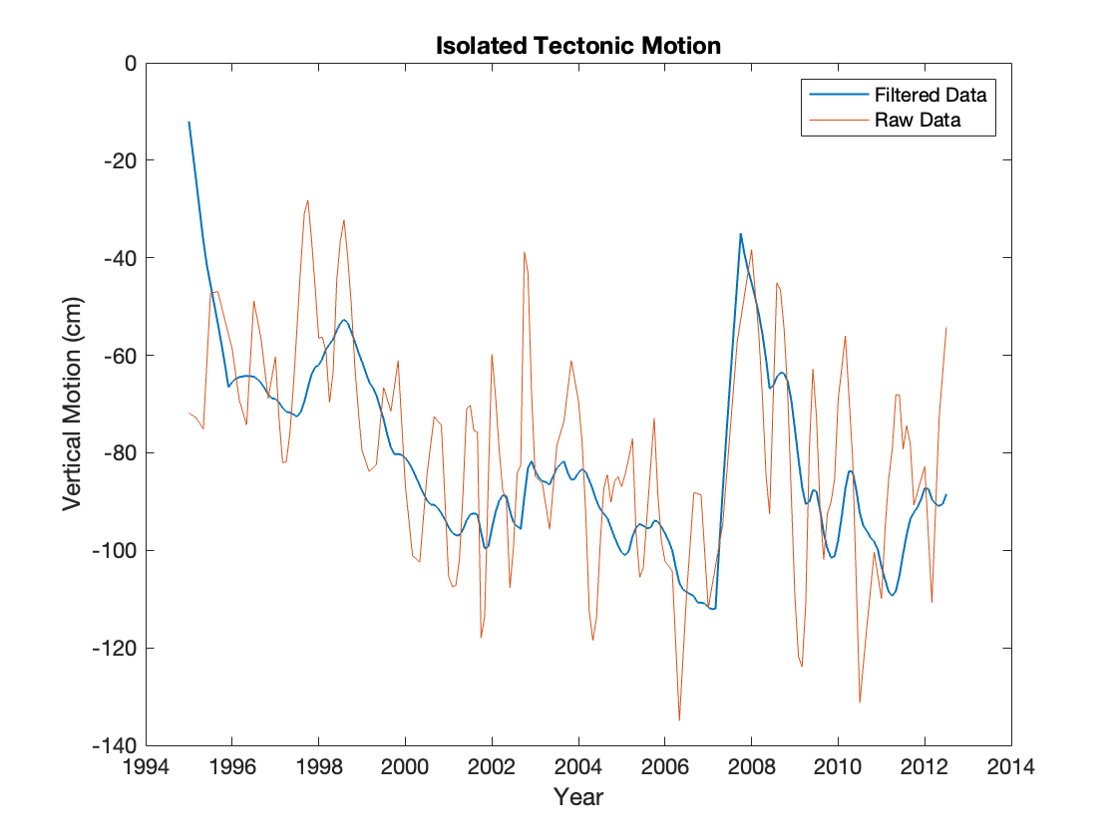
Isolate Tectonic Motion
Lauren Kendall, UT

Slide 20
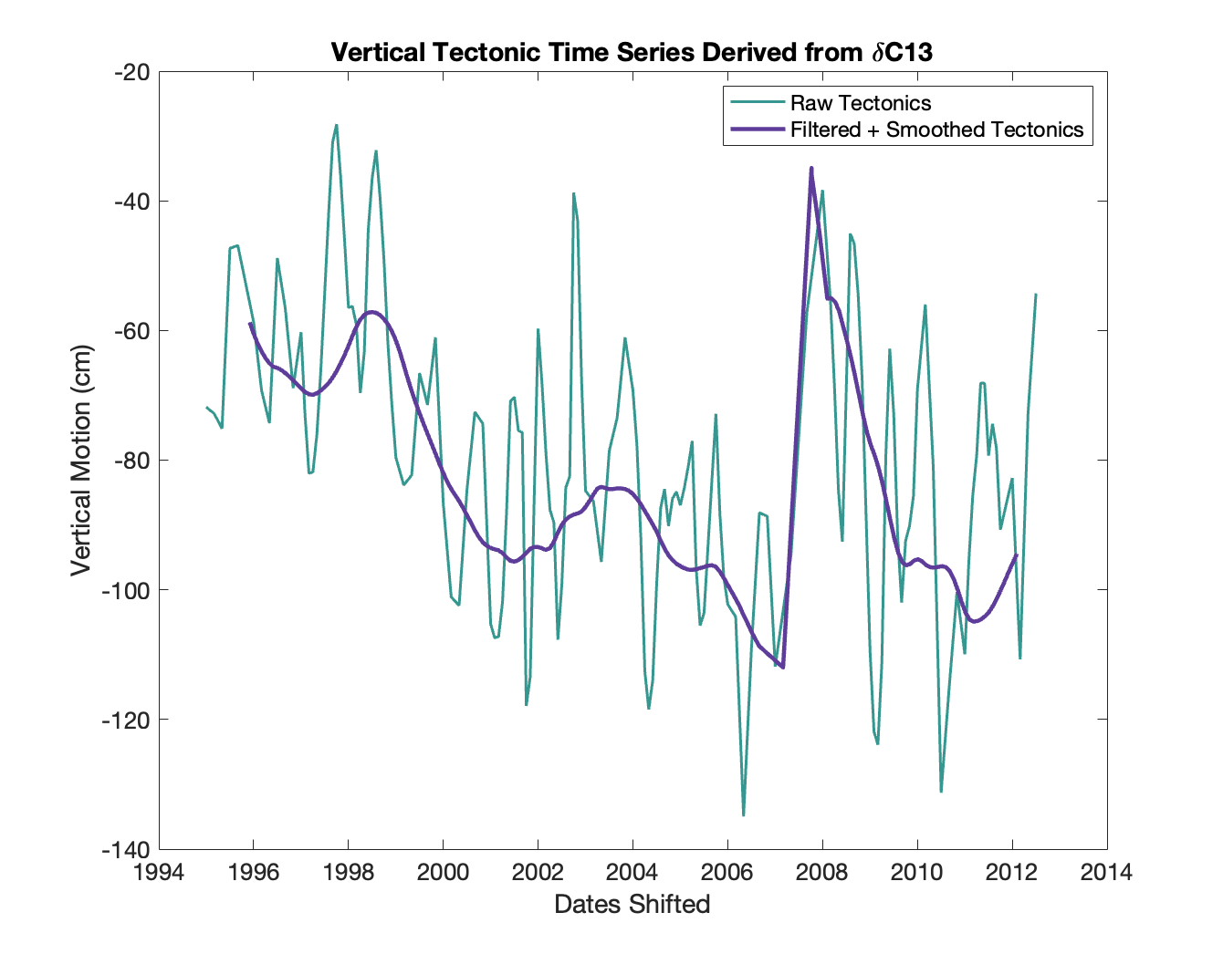
Smoothed Tectonic Motion
Lauren Kendall, UT

Slide 21
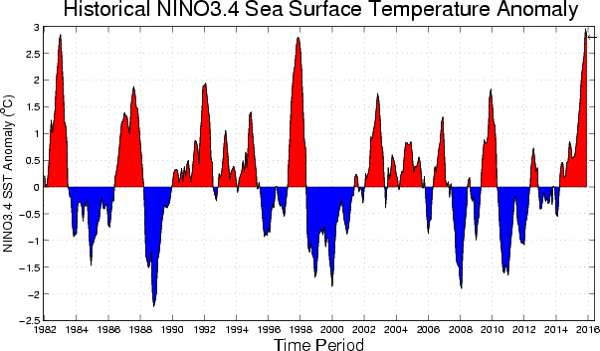
The time series contains greater than yearly sea level change (El Nino for the Solomons) and Tectonics.

Slide 22
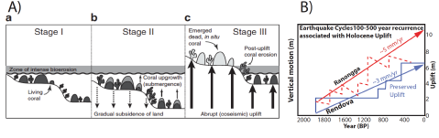
How far back could we go?
500 years old coral near sea level
Thousand years old coral on terraces
How to remove absolute sea level change?
Tide gauge data for most recent corals.
Cross-correlation between the different coral to extract absolute seal level change.
Obtain a dC13 record in an area not much affected by tectonics.
Use Machine Learning to fill gaps in the record.

