Slide 1

Microcontroller Diagnostics Service
Real-time Hardware Monitoring, Non-Volatile DTC Logging & Serial Interface on ATmega32
• Embedded Sensors: LM35 (Heat) & Potentiometer (Voltage)
• Alarm System: Red LED Fault Indicator
• Memory & Serial: Internal EEPROM & UART Terminal ('123' Trigger)
Engineering Team: Group 3

Slide 2
GROUP 3 DIAGNOSTICS SERVICE
Engineering Team & Work Breakdown Structure (WBS)
Filopatir Samir Sobhy فيلوباتير سمير صبحي
• Hardware Schematic Design (Proteus)
• LM35 Sensor Driver & Red LED Logic
• Presentaion Slides
Mina Saber مينا صابر
• Hardware Schematic Design (Proteus)
• Potentiometer Driver & ADC Calibration
Mohamed Kaoud محمد قاعود
• Internal EEPROM Driver Development
• Non-Redundant DTC Storage Logic
Ziad Ayman زياد ايمن
'• Hardware UART Driver & Baud Rate
• Terminal Command Interpreter ('123)

Slide 3

GROUP 3 DIAGNOSTICS SERVICE
System Architecture & High-Level Block Flow
System Key Objectives
• Real-time Hardware Sensing: ADC driver continually samples LM35 temperature and Potentiometer voltage levels.
• Diagnostic Trouble Codes (DTC): Standardized hex codes assigned for safety boundary breaches (0x50, 0x51, 0x52).
• Non-Redundant Logging: Internal EEPROM driver stores unique fault codes without duplicate write cycles.
• Interactive Serial Query: UART terminal listens for command '123' to output logged EEPROM fault reports.

Slide 4
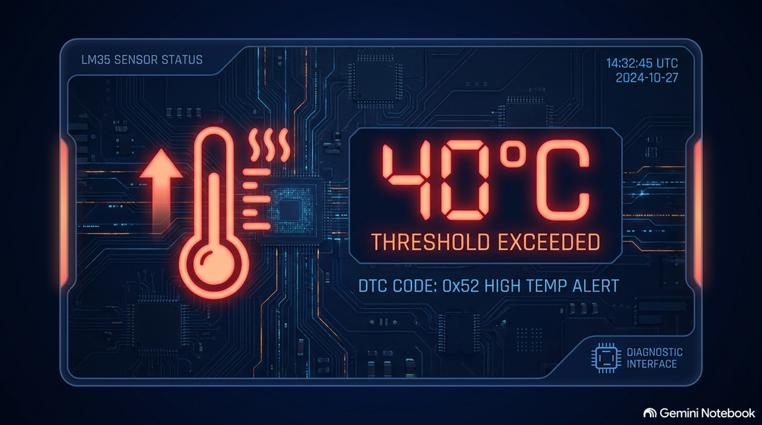
GROUP 3 DIAGNOSTICS SERVICE
Subsystem 1: LM35 Thermal Monitoring
🌡️ Thermal Sensing Specifications
• Hardware Setup: LM35 Sensor connected to ATmega32 ADC.
• Safe Threshold Limit: 40°C
• Diagnostic Logic:
- ADC converts analog thermal voltage to degrees Celsius.
- If Temperature > 40°C:
1. Red LED activates (Fault Alarm ON).
2. DTC Code 0x50 is logged in internal EEPROM.
• Safe State: Temp ≤ 40°C -> Red LED OFF.

Slide 5
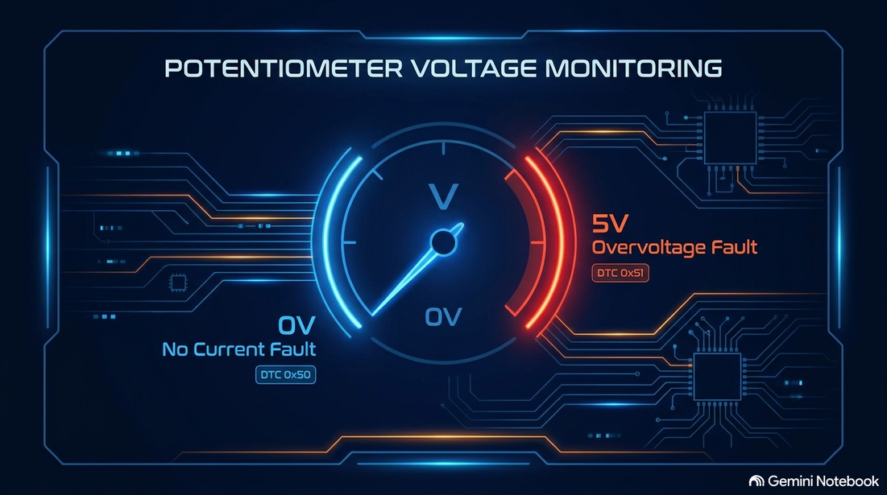
GROUP 3 DIAGNOSTICS SERVICE
Subsystem 2: Potentiometer Monitoring
⚡ Voltage Fault Detection Logic
• Hardware Setup: Precision Potentiometer via ADC channel.
• Boundary Conditions:
1. Minimum Voltage (0V / Pot = 0):
- Fault: 'No Current Detected'
- DTC Code: 0x52 | Red LED ON
2. Maximum Voltage (5V / Pot = Max):
- Fault: 'High Voltage / Overvoltage'
- DTC Code: 0x51 | Red LED ON
• Normal Range (0V < V < 5V):
- System Safe -> Red LED OFF.

Slide 6
GROUP 3 DIAGNOSTICS SERVICE
Diagnostic Trouble Code (DTC) Reference Table
DTC Code | Trigger Condition | Fault Description | Hardware Alarm
0x52 | Potentiometer at 0V (Minimum) | No Current Fault Detected | Red LED ON
0x51 | Potentiometer at 5V (Maximum) | High Voltage / Overvoltage | Red LED ON
0x50 | LM35 Temperature > 40°C | High Temperature Warning | Red LED ON

Slide 7
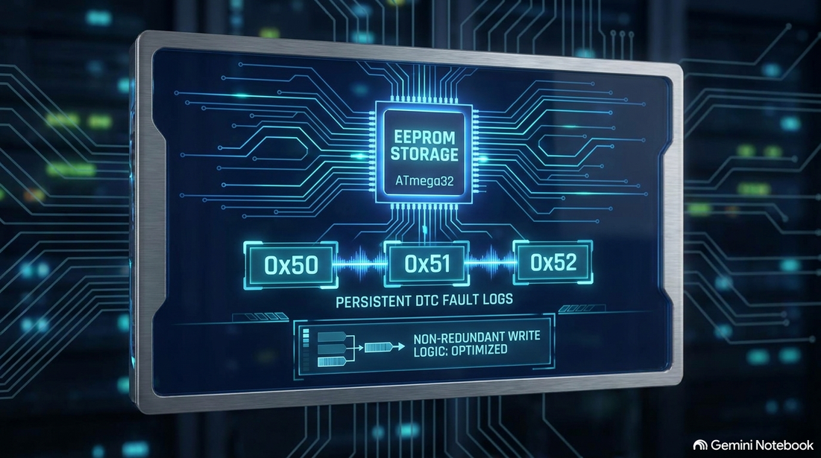
GROUP 3 DIAGNOSTICS SERVICE
Subsystem 3: EEPROM Non-Volatile Memory
💾 Non-Volatile DTC Storage Architecture
Persistent Error Logging — DTCs remain stored across system resets and power loss.
Anti-Duplication Filter — Status flags ensure each fault is written only once, protecting EEPROM write-cycle lifespan.
Modular Address Mapping — Each fault source (temp, high current, low current) has a dedicated EEPROM address and unique DTC code, enabling independent, concurrent fault logging.
Write-Cycle Safety — Driver polls the EEWE hardware flag before completing a write, ensuring data integrity at the register level.
UART-Integrated Retrieval — Stored DTCs are retrievable on-demand via a terminal command, enabling real-time diagnostics without reflashing.

Slide 8
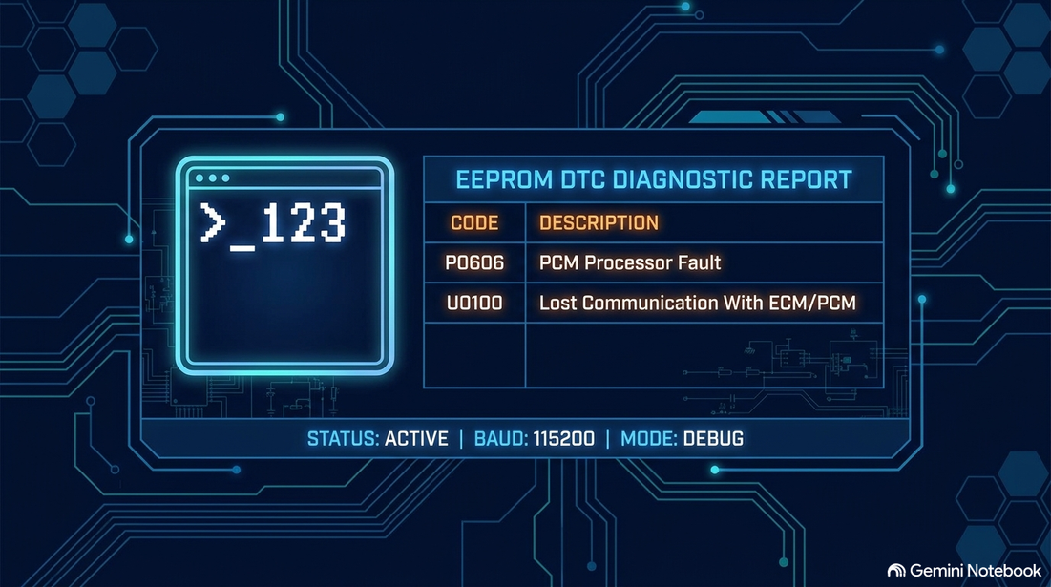
GROUP 3 DIAGNOSTICS SERVICE
Subsystem 4: UART Serial Terminal
💻 Serial Diagnostics & Interpreter
* Module: Hardware UART Driver & Hall command Interpreter.
* Communication Protocol:
- idle: Listens for UART input from terminal
- Command Trigger: Input the password '123' from Virtual Terminal.
- Action: reads stored DTC entries from internal EEPROM.
- Output: Formats and outputs clear human-readable error descriptions on the terminal screen.

Slide 9
GROUP 3 DIAGNOSTICS SERVICE
Project Verification & Summary
Key Project Achievements
Complete Proteus Hardware Simulation (ATmega32, LM35, Potentiometer, Red LED, UART Terminal).
Real-time Diagnostic Sensing with instant visual alarm via Red LED.
Reliable DTC Logging (0x50, 0x51, 0x52) stored in Internal EEPROM.
Optimized Memory Logic: Non-redundant filtering prevents repeated EEPROM wear.
Interactive Command Terminal: Instant diagnostic reports triggered via UART ('123').

