Slide 1

Predictive Modeling of Rehospitalization in Diabetic Patients using Gradient Boosting Techniques
Mirna Elizondo
CS7387 Independent Study
December 7, 2023

Slide 2
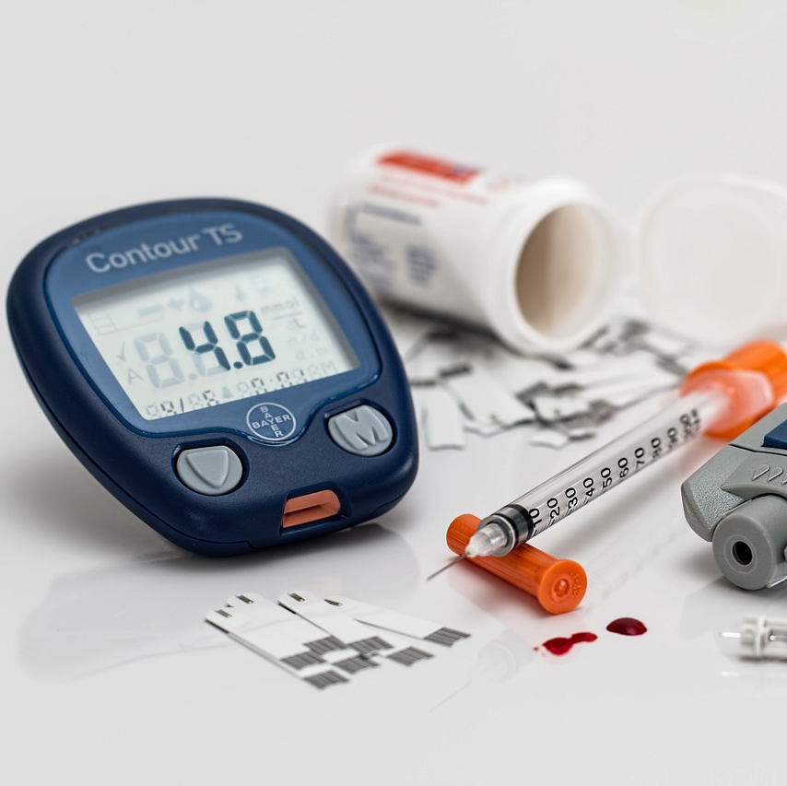
Agenda
Abstract
Problem Statement
Defining Diabetes
Related Work
Datasets
Analysis
Pre-processing
Feature Selection
Models
Results
Conclusion
[4]
Notes:
https://pixabay.com/photos/diabetes-blood-sugar-diabetic-528678/

Slide 3
Abstract
In this study, we propose forecasting the rehospitalization of diabetic patients in the National COVID Cohort Collaborative (N3C). The outcomes of this comprehensive approach have the potential to inform early interventions and personalized care strategies, contributing to improved patient outcomes and optimized resource allocation in the realm of diabetic patient care. The research extends the 2023 IEEE ICHI publication . It focuses on scaling the use of Gradient Boosting Machines (GBM) and DNNs for nearly 20 million patients and tens of thousands of unique observations and conditions in the N3C database. We also address the class imbalance with feature upscaling and downscaling approaches and novel predicate aggregation.

Slide 4
Problem Statement
Predictive Objective: Forecasting rehospitalization among diabetic patients within a 30-day window
Significance:
Proactive Healthcare Management: Enables early intervention and tailored care plans, potentially reducing readmission rates.
Resource Optimization: Efficient allocation of healthcare resources by focusing on high-risk patients.
Improved Patient Outcomes: Reducing rehospitalization positively impacts patient recovery and overall well-being.
Crucial Role of Predictive Models:
Enhancing healthcare delivery through predictive analytics empowers informed decision-making, benefiting both patients and healthcare systems.

Slide 5
What is Diabetes?
Diabetes mellitus (DM) is a chronic metabolic disorder characterized by elevated levels of blood sugar, or glucose. It is caused by:
The body's inability to produce insulin, the hormone that regulates blood sugar levels, or the body's cells becoming resistant to insulin.
Diabetes mellitus (DM) with complications: the risk of developing complications from diabetes increases with time, such as:
Heart disease
Stroke
High blood pressure
Nerve damage (neuropathy)
Eye damage (retinopathy)
Foot problems
Kidney disease
Liver disease
Alzheimer's disease
Depression
Sexual dysfunction
[1]
Notes:
Diabetes mellitus (DM) is a chronic metabolic disorder characterized by elevated levels of blood sugar, or glucose. It is caused by: The body's inability to produce insulin, the hormone that regulates blood sugar levels, or the body's cells becoming resistant to insulin.

Slide 6
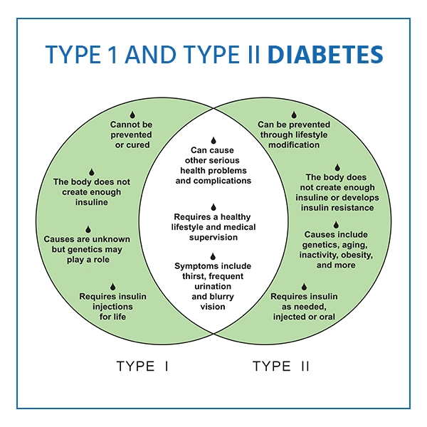
Types of Diabetes
Type 1 diabetes is an autoimmune disease in which the body's immune system attacks the beta cells in the pancreas, the cells that produce insulin.
usually diagnosed in children and adolescents
Type 2 diabetes is the most common type of diabetes. It is caused by a combination of insulin resistance and insufficient insulin production.
Type 2 diabetes is usually diagnosed in adults
[1]
Notes:
elevated levels of blood sugar, or glucose, can be developed at any age tho

Slide 7
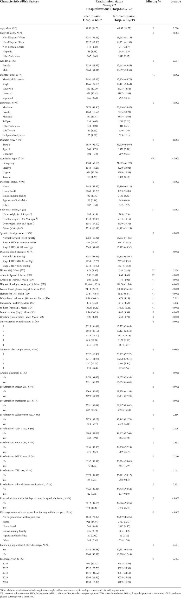
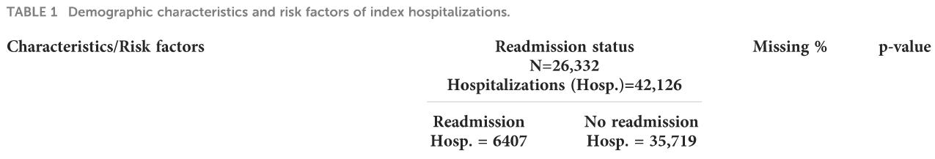
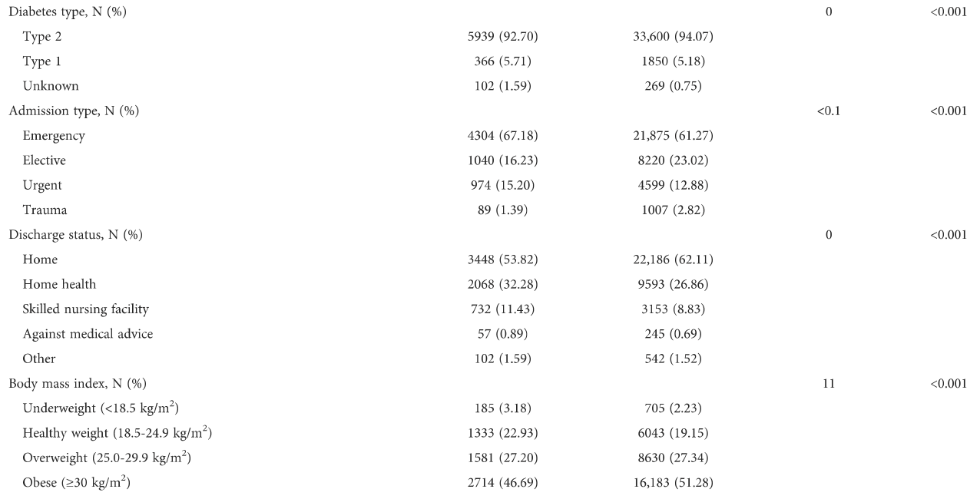
Related Work
Cohort Study Overview:
Utilization of Electronic Health Records (EHRs) from an urban health system in the Southeastern U.S.
Objective: Identification of factors associated with 30-day readmissions among diabetic patients.
Factors Associated with 30-Day Readmissions:
Demographic Factors:
Age, race/ethnicity, insurance status, and cases with unknown diabetes types.
Hospitalization Characteristics:
Admission type, discharge status, length of stay, prior hospitalizations, and discharge status within the last year.

Slide 8
2023 IEEE ICHI:
Model comparison:
Random Forest predicted low positive case probabilities; Gradient Boosting excelled in predicting both classes, particularly 'deceased' labels.
Mitigated class imbalance using under sampling and oversampling.
Evaluated XGBoost, LightGBM, CatBoost, and Gradient Boosting techniques.
Introduced custom loss functions to balance sensitivity-specificity in models

Slide 9
N3C Enclave - Datasets
DataFrame | # Patients | # Concepts
Conditions | 19,457,296 | 59,595
Observations | 20,380,717 | 12,257
Measurements | 20,077,255 | 26,471
Drugs | 18,357,010 | 41,868
Visits | 20,415,631 | 60
Diabetes Label | # Concepts
Complicated | 407
Uncomplicated: | 127
Both | 4
 | Conditions |  |  | Observations |  |  | Procedures
diabetes_1 | 0 | 0 | 1 | 0 | 0 | 1 | 0 | 0 | 1
diabetes_2 | 0 | 1 | 0 | 0 | 1 | 0 | 0 | 1 | 0
diabetes_3 | 1 | 0 | 0 | 1 | 0 | 0 | 1 | 0 | 0
# patients | 2,692,158 | 1,441,288 | 1,046 | 2,664,544 | 1,429,581 | 1,046 | 2,481,107 | 1,352,568 | 1,042
 | Visits |  |  | Measure |  |  | Drugs
diabetes_1 | 0 | 0 | 1 | 0 | 0 | 1 | 0 | 0 | 1
diabetes_2 | 0 | 1 | 0 | 0 | 1 | 1 | 0 | 1 | 0
diabetes_3 | 1 | 0 | 0 | 1 | 0 | 1 | 1 | 0 | 0
# patients | 2,628,827 | 1,407,536 | 1,046 | 2,680,883 | 1,437,147 | 1,046 | 2,616,764 | 1,416,166 | 1,042
Notes:
Diabetes_1 = complicated & uncomplicated
- Malnutrition-related diabetes mellitus with peripheral circulatory complications
- Myopathy and diabetes mellitus
- Posttransplant diabetes mellitus
- Malnutrition-related diabetes mellitus with renal complications
Diabetes_2 = complicated
Diabetes_3 = uncomplicated

Slide 10
Baseline Dataset
Kaggle Data Set: Diabetic records of 130-US hospitals from years 1999-2008 [2]

Slide 11
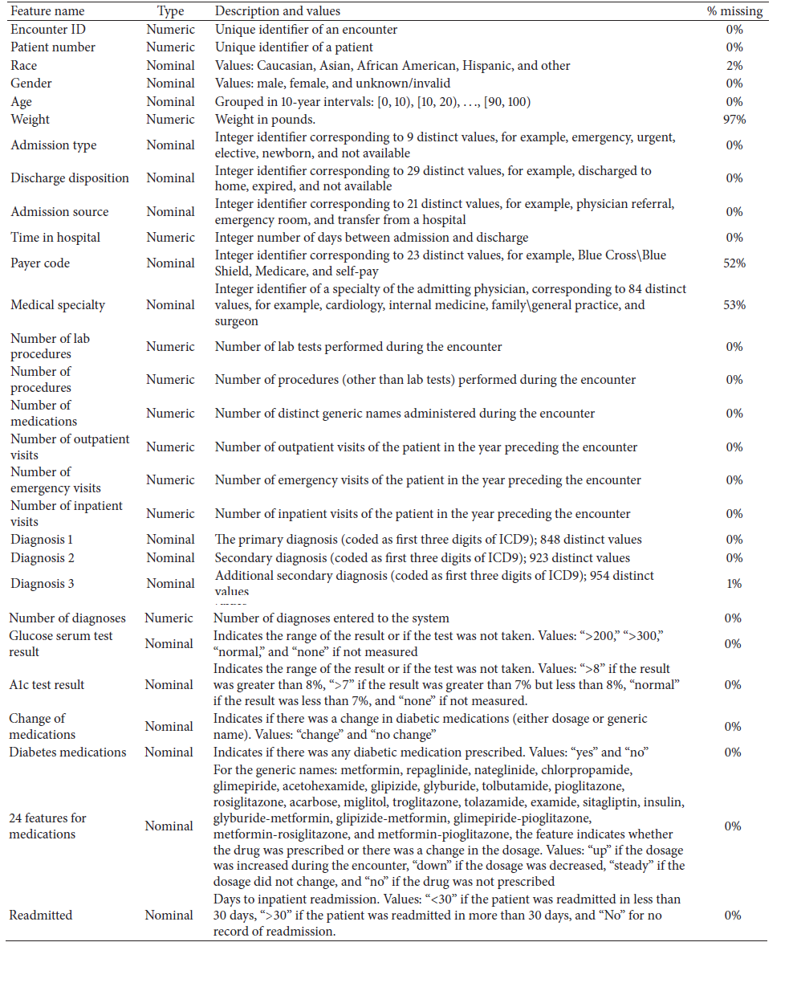
Dataset Analysis

Slide 12
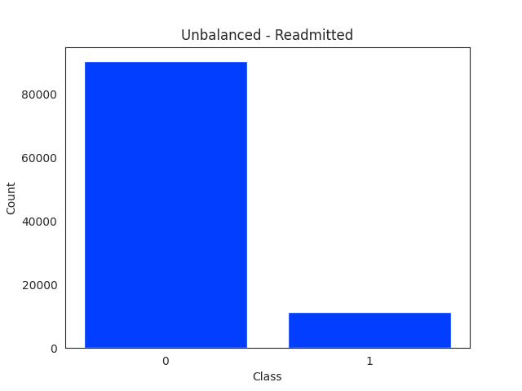
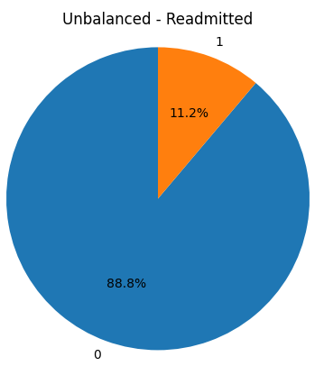
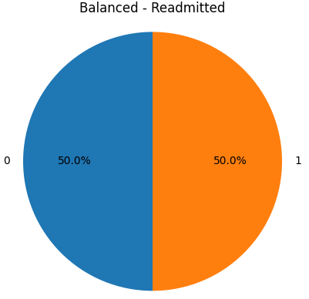
Class Distribution
Majority class: 86950
Minority class: 10966
Shape: (97916, 38)
Majority class: 10966
Minority class: 10966
Shape: (21932 , 1379)

Slide 13
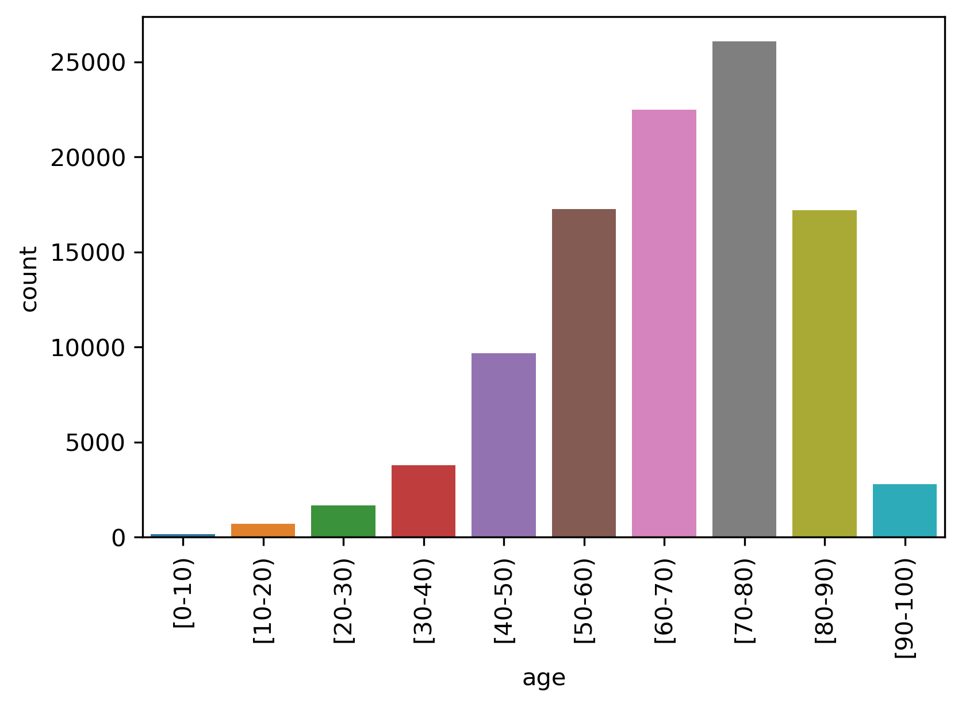
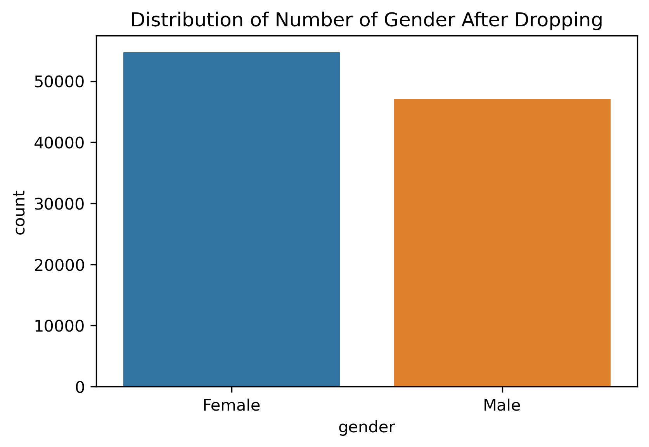
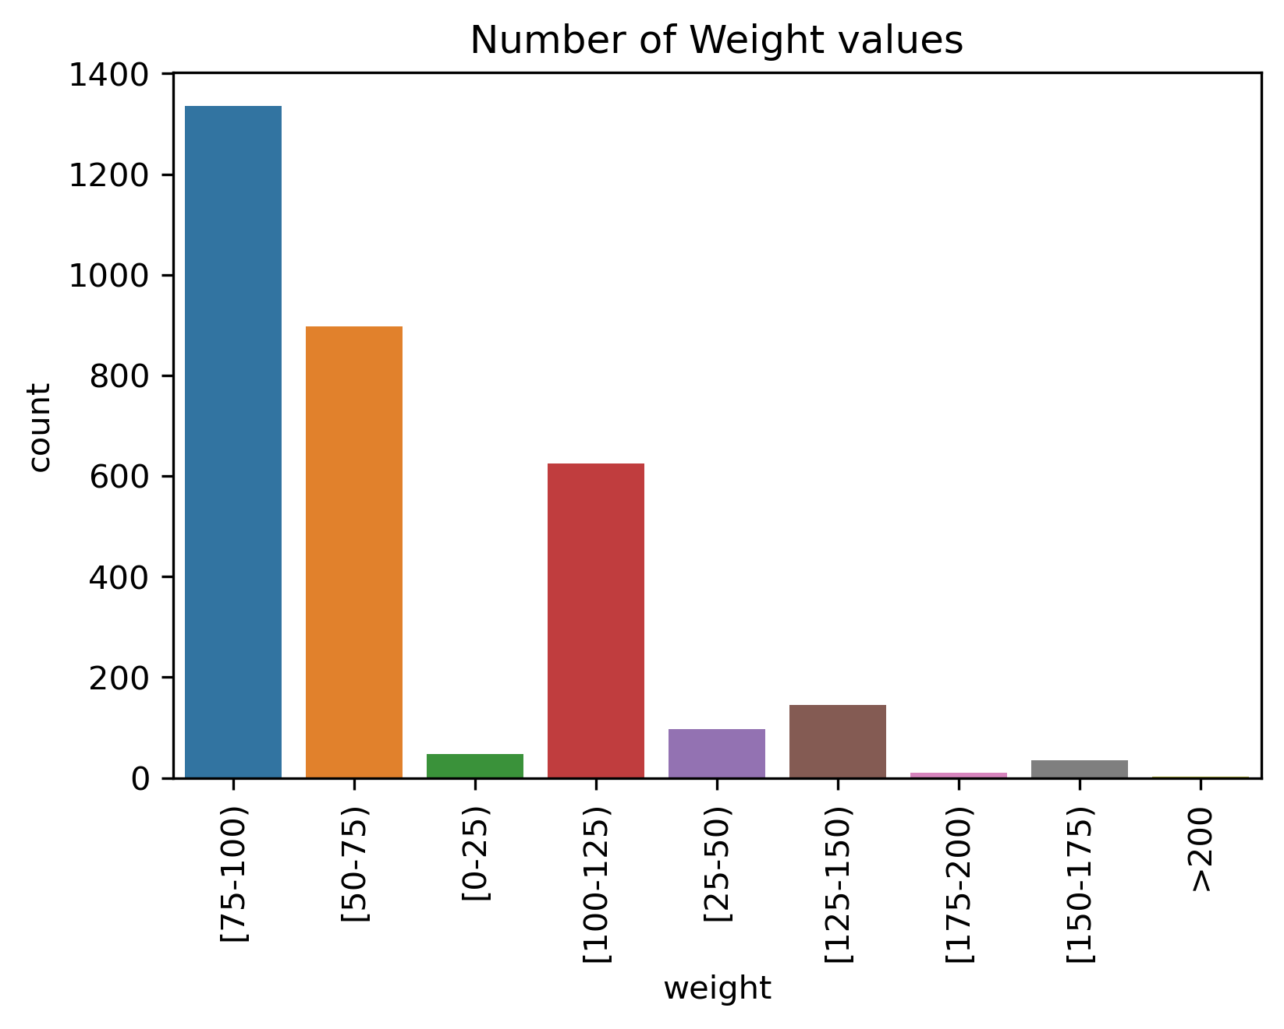
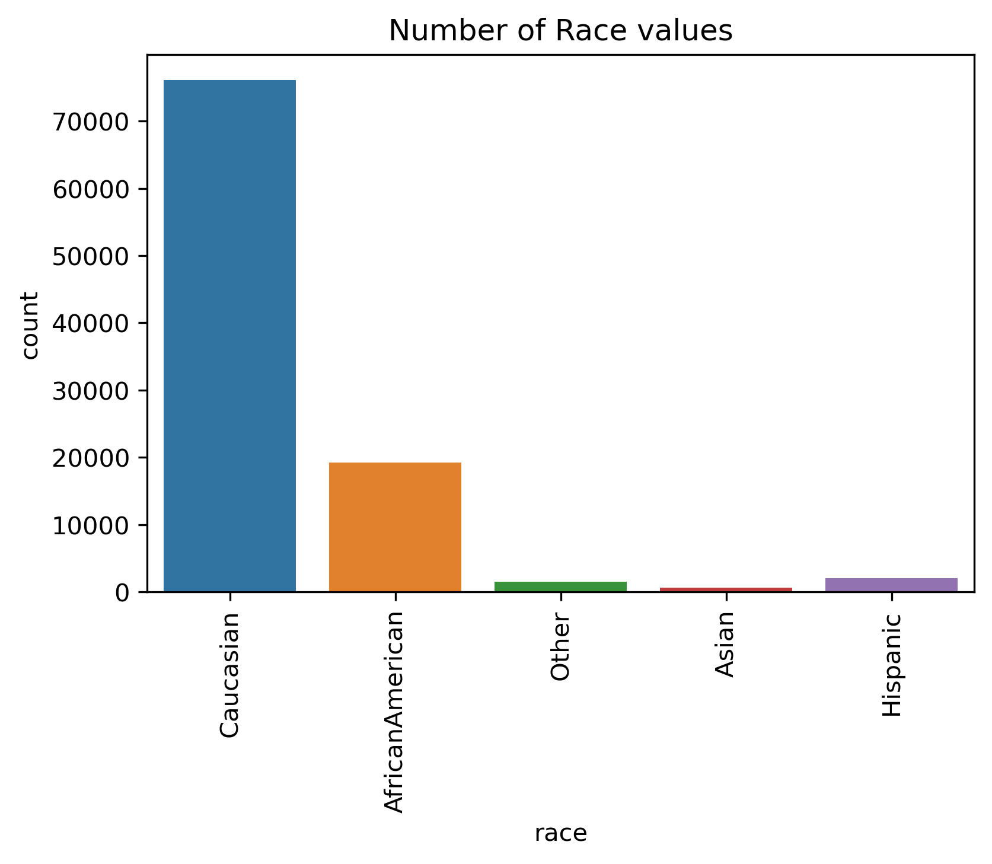

Slide 14
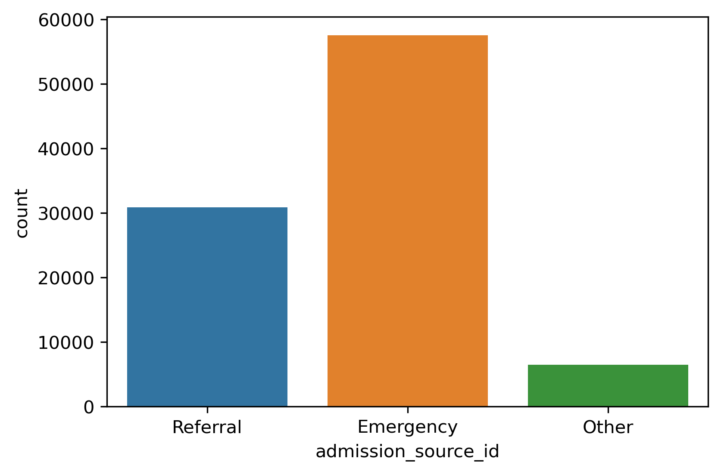
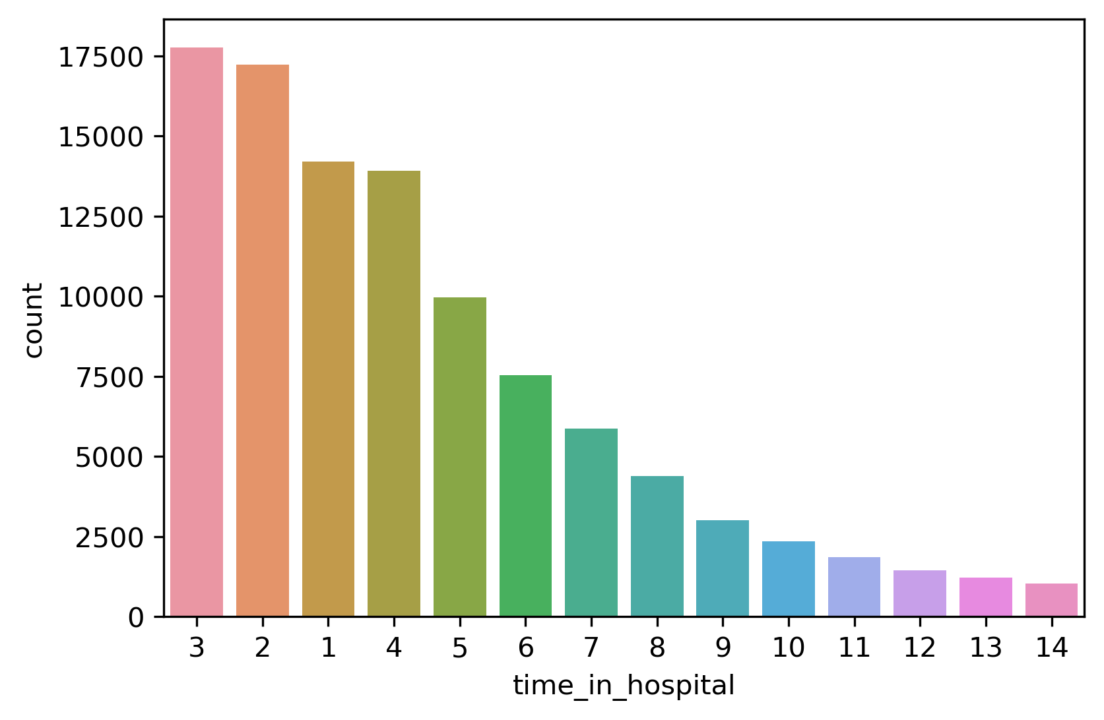
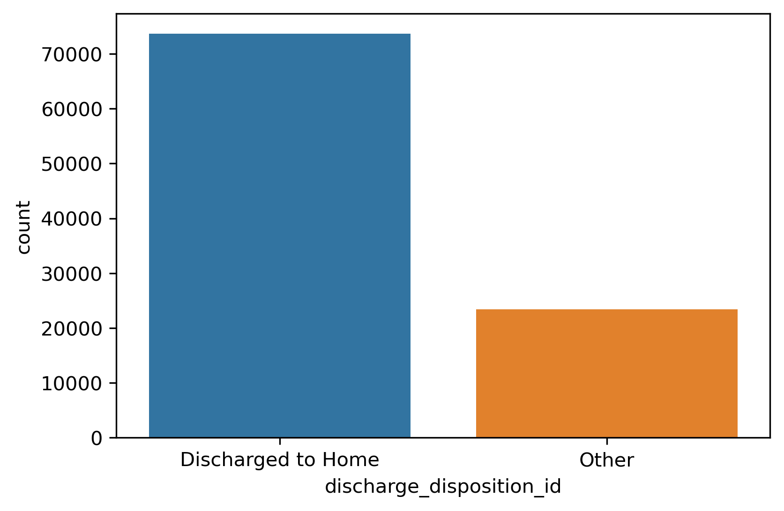

Slide 15
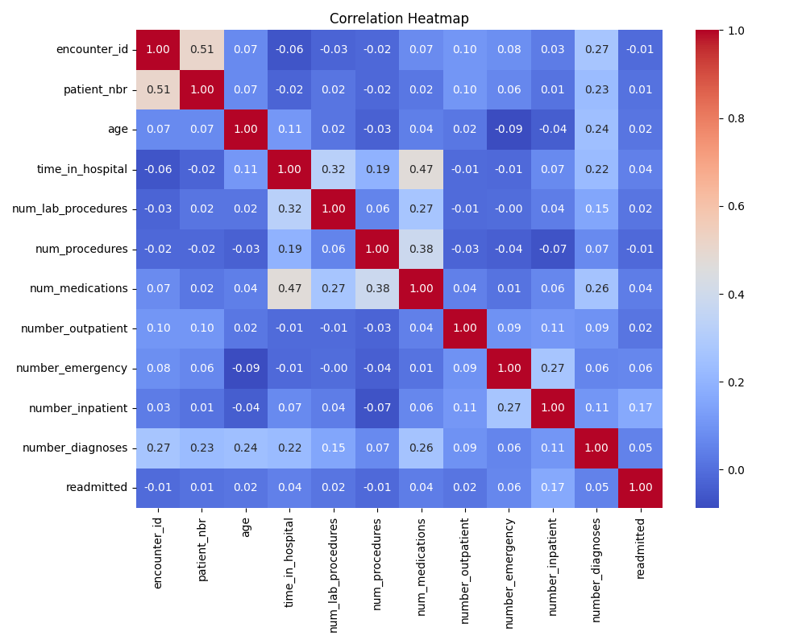
Heatmap

Slide 16
Pre-Processing
Fill missing values
weight: 98,569
diag_1 : 21
diag_2: 358
diag_3: 1423
Drop columns:
Medicines- ['acetohexamide', 'tolbutamide', 'troglitazone', 'tolazamide', 'examide', 'citoglipton', 'glipizide-metformin', 'glimepiride-pioglitazone', 'metformin-rosiglitazone’, 'metformin-pioglitazone’]
Identifiers – [‘encounter_id, patient_nbr’]
Notes:
Difference here vs Enclave (manual mapping/grouping)
Weight filling: grouped_weight = df.groupby(['age', 'race','gender'])['weight'].value_counts(normalize=True).unstack().fillna(0)
Diag_#:
df['diag_1'] = df.groupby(['age', 'gender', 'race'])['diag_1'].fillna(method='ffill')
df['diag_2'] = df.groupby(['age', 'gender', 'race'])['diag_1'].fillna(method='ffill')
df['diag_3'] = df.groupby(['age', 'gender', 'race'])['diag_1'].fillna(method='ffill')

Slide 17
Feature Selection
LassoCV | RandomForestClassifier | LightGBM | XGBoost | CatBoost
number_emergency | age | number_inpatient | number_inpatient | number_inpatient
number_inpatient | time_in_hospital | discharge_Discharged to Home | discharge_Discharged to Home | discharge_Discharged to Home
diag_1_250.41 | num_lab_procedures | number_diagnoses | number_diagnoses | number_diagnoses
diag_1_250.42 | num_procedures | time_in_hospital | time_in_hospital | time_in_hospital
diag_1_250.6 | num_medications | age | age | age
diag_1_250.7 | number_outpatient | num_lab_procedures | num_lab_procedures | num_lab_procedures
diag_1_434 | number_emergency | number_emergency | number_emergency | number_emergency
diag_1_443 | number_inpatient | num_medications | num_medications | num_medications
diag_1_787 | number_diagnoses | diag_1_V58 | diag_1_V58 | diag_1_V58
diag_1_V58 | race_AfricanAmerican | diag_1_434 | diag_1_434 | diag_1_434
 | race_Caucasian | diag_1_V57 | diag_1_V57 | diag_1_V57
 | gender_Female | diabetesMed_No | diabetesMed_No | diabetesMed_No
 | gender_Male | diag_1_428 | diag_1_428 | diag_1_428
 | admission_Elective | num_procedures | num_procedures | num_procedures
 | admission_Emergency | diag_1_250.6 | diag_1_250.6 | diag_1_250.6
 | discharge_Discharged to Home | insulin_Down | insulin_Down | insulin_Down
 | discharge_Other | diag_1_250.7 | diag_1_250.7 | diag_1_250.7
 | admission_Emergency | admission_Elective | admission_Elective | admission_Elective
 | admission_Other | metformin_No | metformin_No | metformin_No
 | admission_Referral | diag_1_440 | diag_1_440 | diag_1_440
Notes:
LassoCV – 10
RFC – 38
GradModels - 20

Slide 18
Models
Random Forest Classifier
Gradient Boosting Classifier
XGBClassifier
LGBM Classifier
Catboost Classifier
Tensor (4 Dense Layers) (y_pred > 0.3, 0.5, 0.7, 0.9)

Slide 19
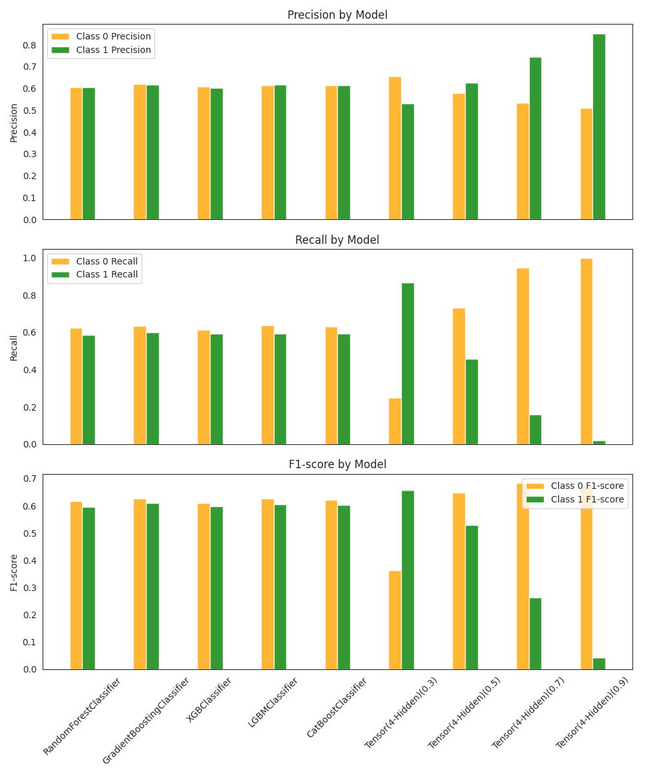
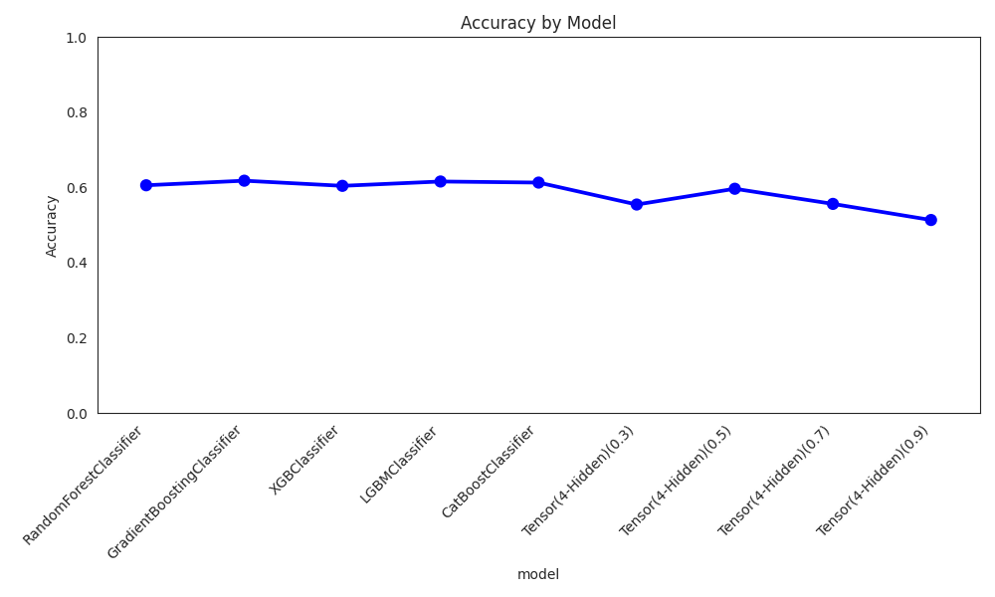
Results

Slide 20
Results
Model | Accuracy | Precision | Recall | F1
RandomForestClassifier | 0.6059 | 0.6053 | 0.5866 | 0.5958
GradientBoostingClassifier | 0.6181 | 0.6176 | 0.6004 | 0.6089
XGBClassifier | 0.6044 | 0.6019 | 0.5939 | 0.5979
LGBMClassifier | 0.6160 | 0.6167 | 0.5927 | 0.6045
CatBoostClassifier | 0.6131 | 0.6127 | 0.5939 | 0.6032
Tensor(4-Hidden)(0.3) | 0.5547 | 0.5309 | 0.8653 | 0.6580
Tensor(4-Hidden)(0.5) | 0.5967 | 0.6266 | 0.4589 | 0.5298
Tensor(4-Hidden)(0.7) | 0.5564 | 0.7432 | 0.1590 | 0.2619
Tensor(4-Hidden)(0.9) | 0.5135 | 0.8519 | 0.0212 | 0.0413

Slide 21
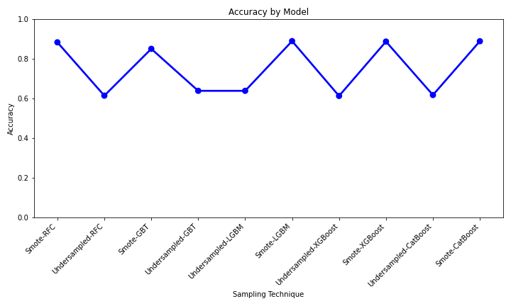
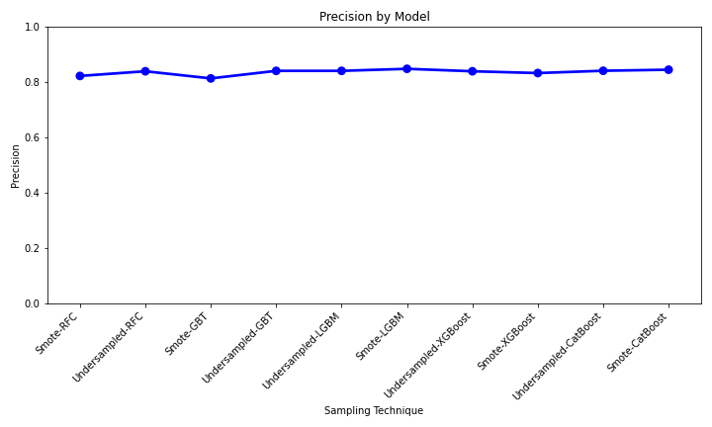
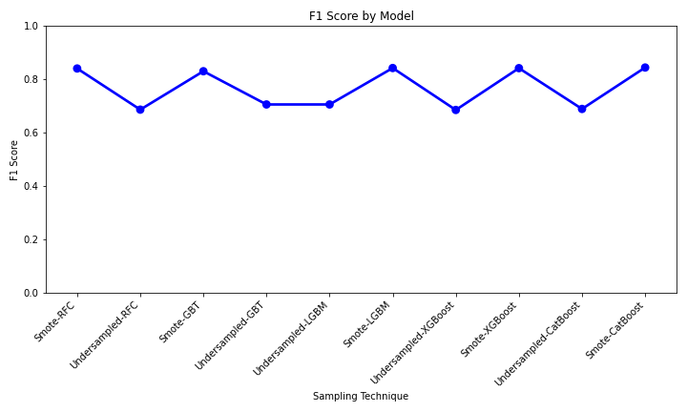
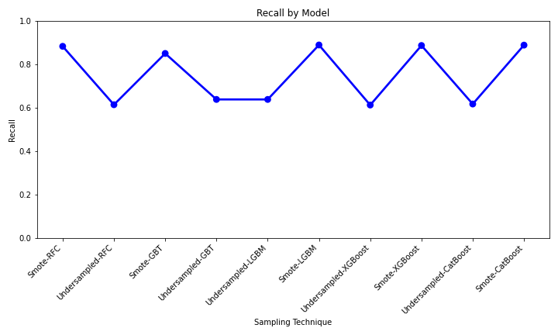
Sampling Results

Slide 22
Conclusion
Sampling Impact:
Undersampling outperformed oversampling across models.
Key Predictive Features:
number_emergency, age, number_inpatient, time_in_hospital, and dischargedToHome.
Model Performance:
Top Performers:
Gradient Boosting Classifier leads with consistent high scores.
LGBMClassifier and CatBoostClassifier closely follow in performance.
Random Forest and XGBClassifier show reasonably good performance but slightly lower than top models.
Tensor-Based Model Insights:
Varying thresholds show trade-offs:
Lower threshold (0.3) maximizes recall but lowers precision and overall scores.
Higher thresholds (0.7 and 0.9) boost precision but drastically reduce recall.

Slide 23
Future Work
FULL ENCLAVE IMPLEMENTATION - currently
Investigated interpretability techniques using SHAP and LIME.
Graph Neural Networks (GNNs):
Capturing Complex Dependencies:
GNNs excel in capturing the intricate web of dependencies and interactions between patients, healthcare providers, and medical events.
By modeling patients as nodes and their interactions as edges in a graph, GNNs can unveil hidden patterns and connections that traditional methods may miss.
Feature Extraction and Representation Learning:
GNNs provide a unique advantage in feature extraction and representation learning.
They can automatically derive meaningful features from the patient interaction graph, potentially revealing critical factors contributing to Long COVID risk.
Notes:
Our dataset consists of hospital admissions of length between one and 14 days that did not result in a patient’s death. Each encounter corresponds to a patient diagnosed with diabetes, although the primary diagnosis may be different. During each of the analyzed encounters, lab tests were ordered and medication was administered.

Slide 24
References
[1] Medicover Hospitals. (n.d.). Diabetes - Types, Symptoms, Causes, Prevention & Treatment. Retrieved [insert access date], from https://www.medicoverhospitals.in/diseases/diabetes/
[2] Tayal, S. (2020). Diabetic Patients Readmission Prediction. Retrieved [insert access date], from https://www.kaggle.com/datasets/saurabhtayal/diabetic-patients-readmission-prediction
[3] Lee, J. Y., Kang, M. J., Kim, H. Y., & Shin, K. (2022). Machine Learning-Based Prediction Models for Diabetes Readmission: Comparative Study. Frontiers in Digital Health, 4, 1050579. https://doi.org/10.3389/fcdhc.2022.1050579
[4] Pixabay. (n.d.). Diabetes Blood Sugar Diabetic [Image]. Pixabay. https://pixabay.com/photos/diabetes-blood-sugar-diabetic-528678/

