Slide 1

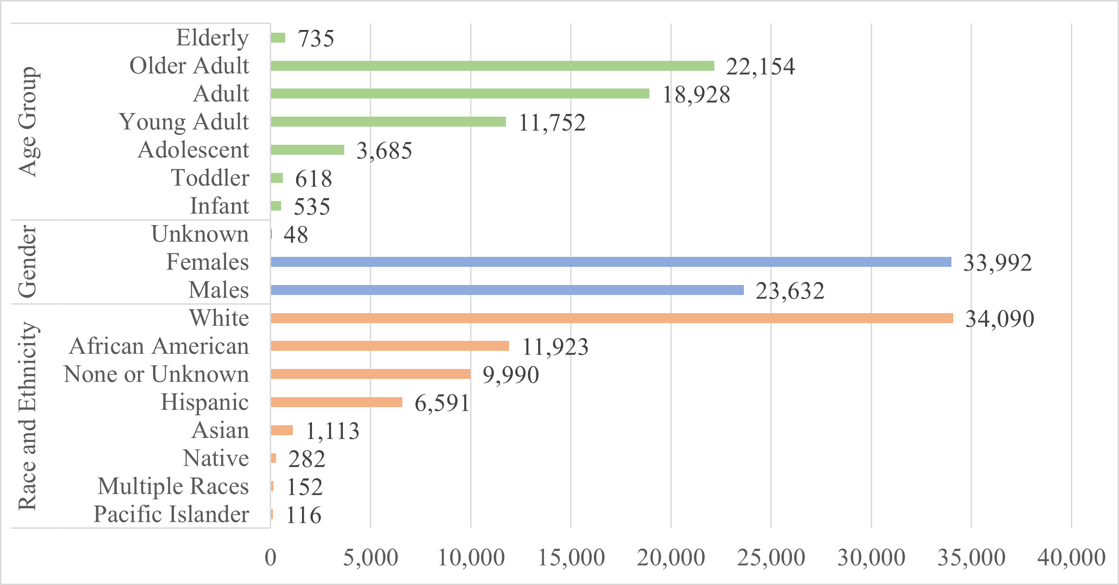
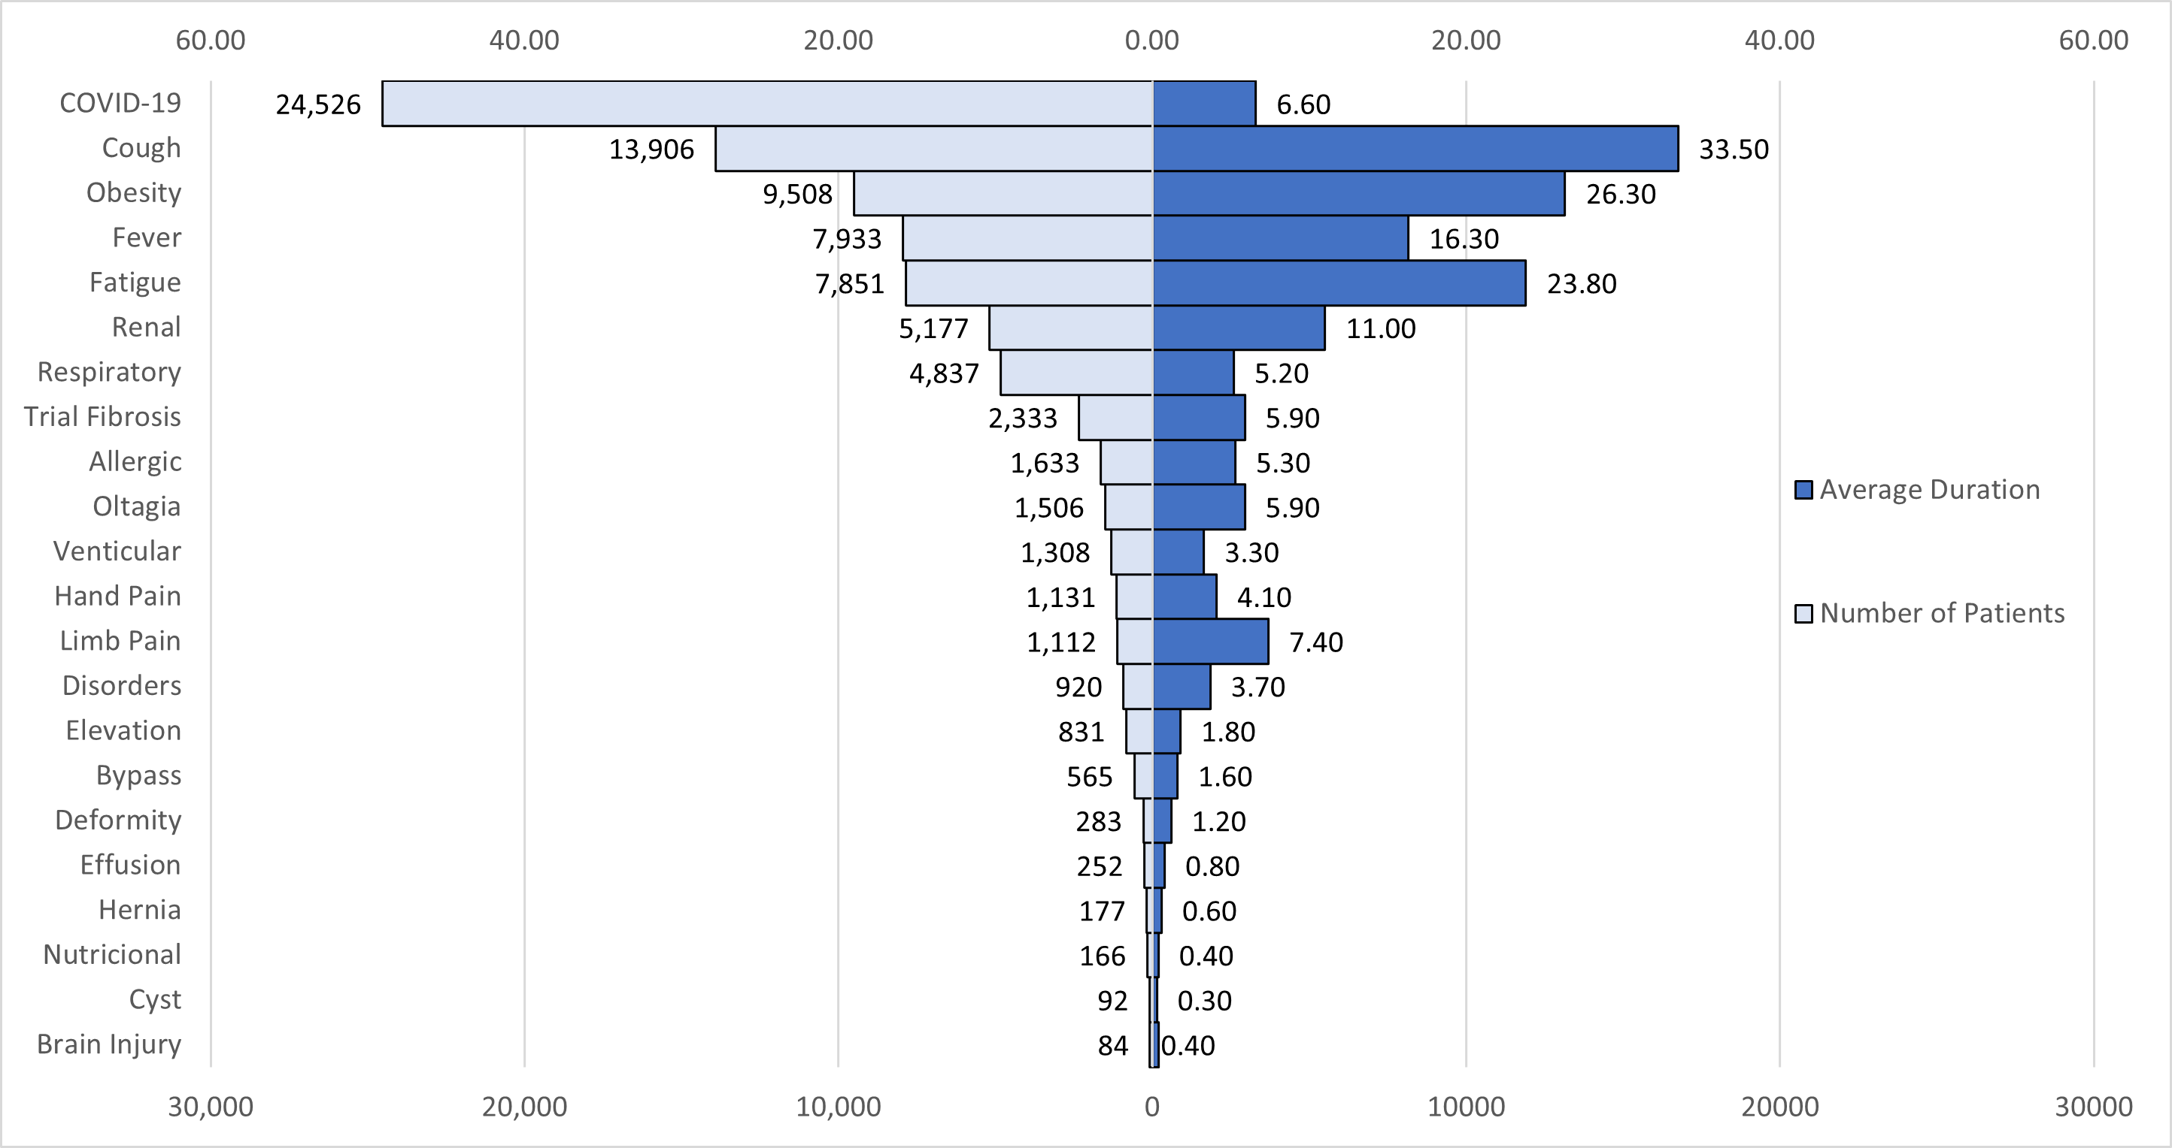
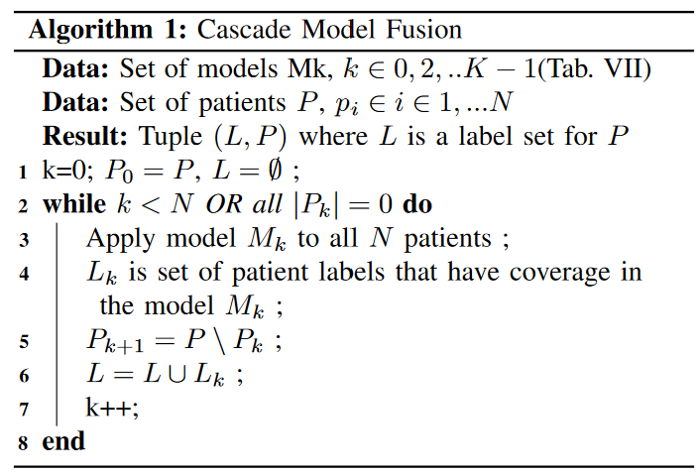
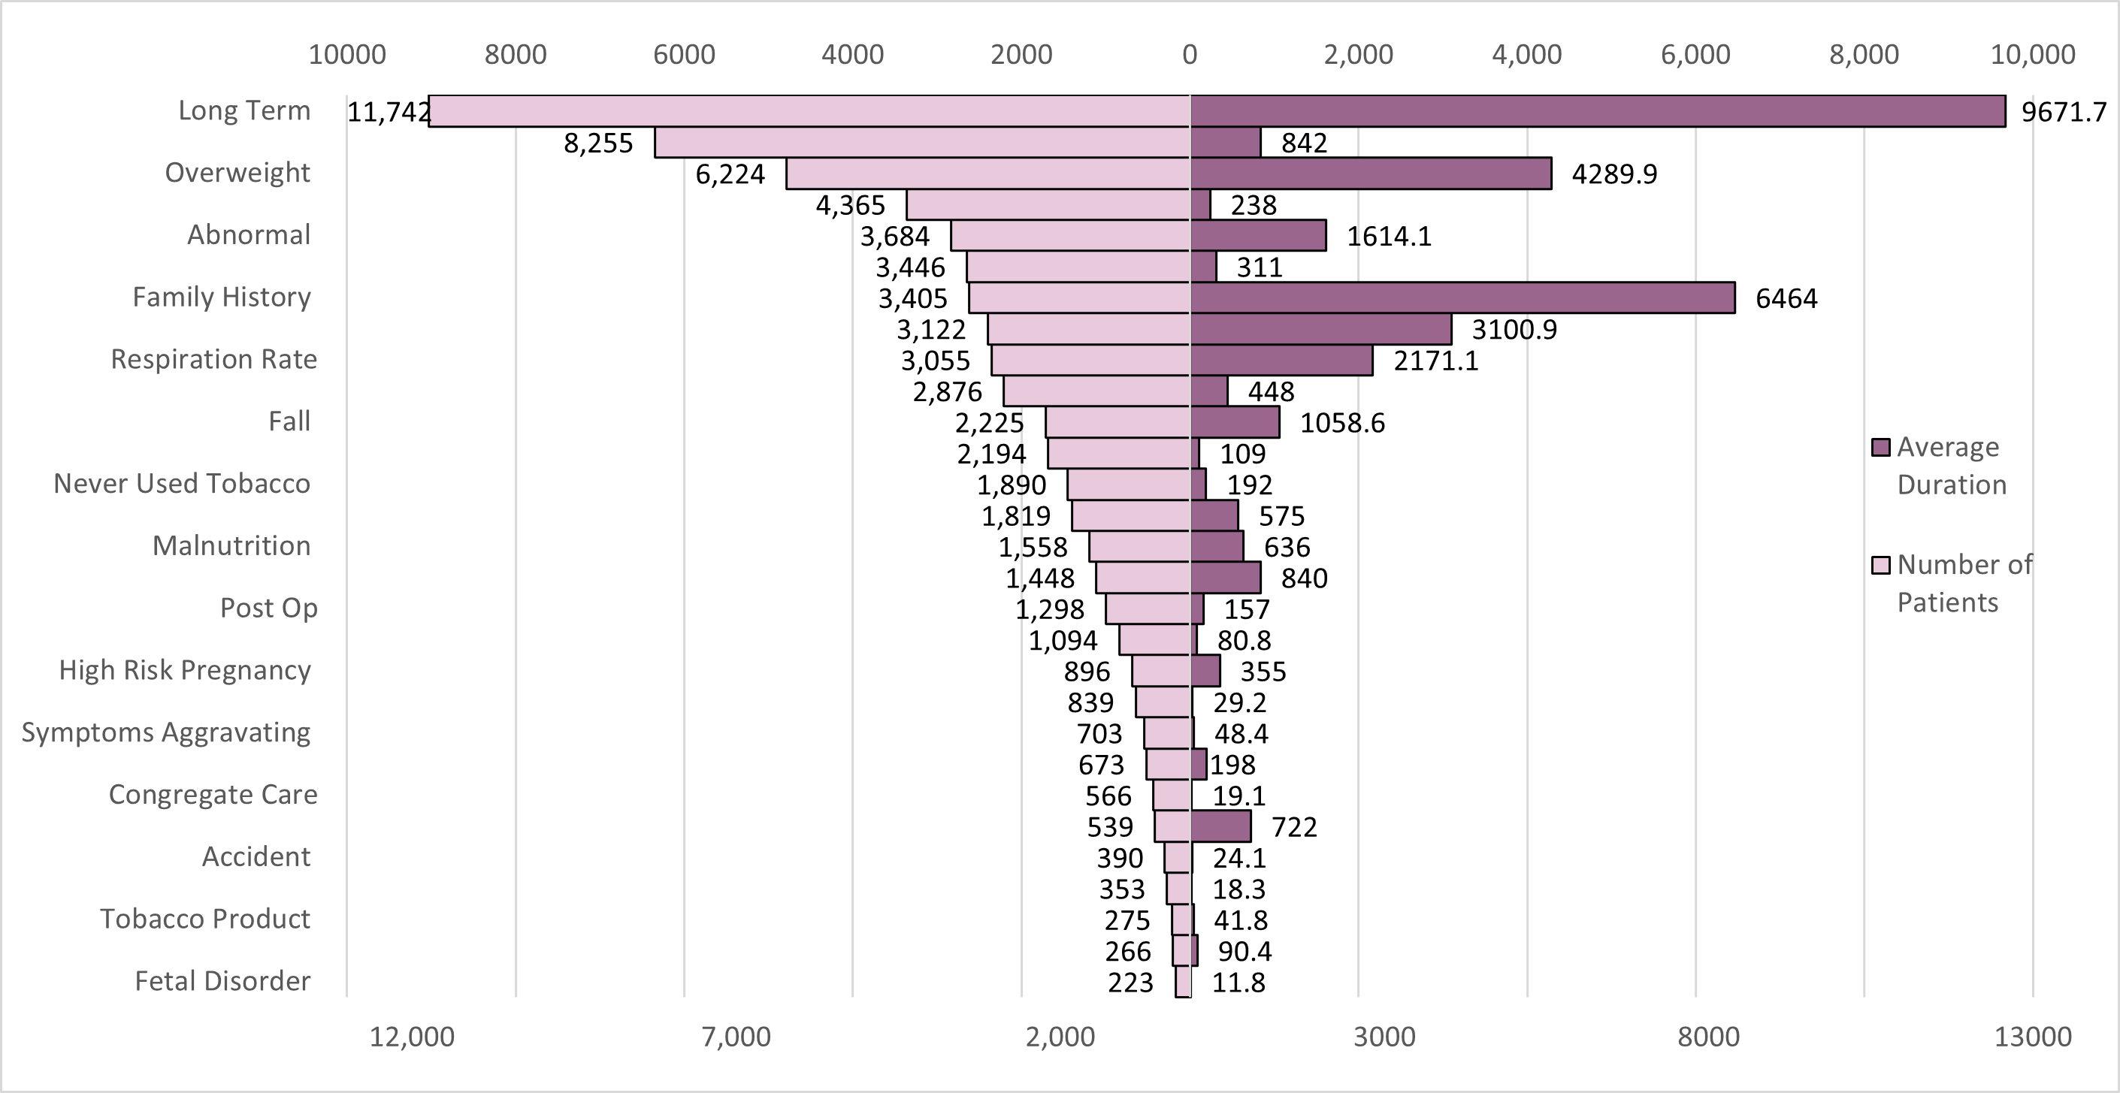
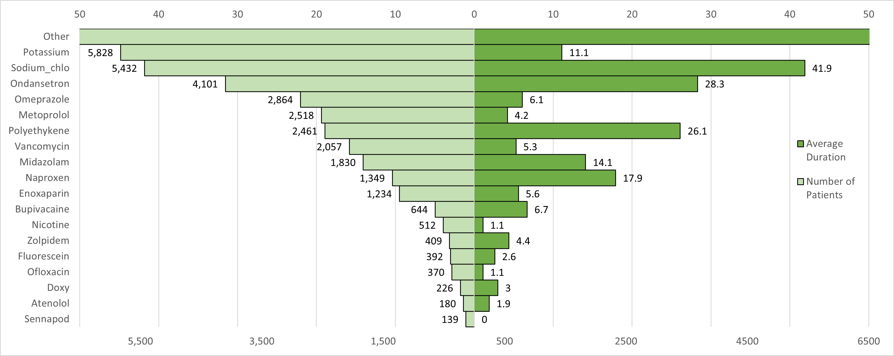
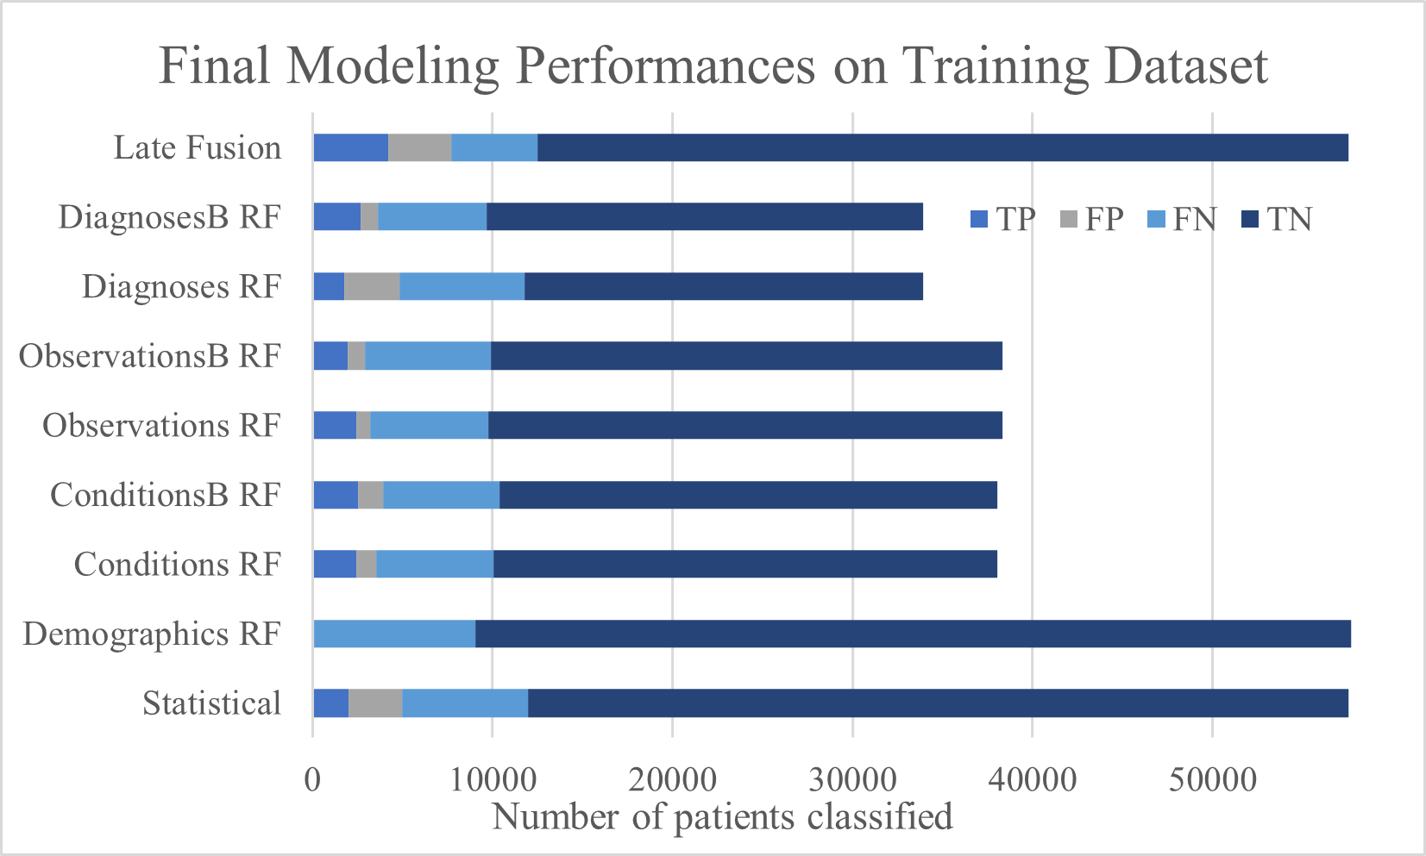
Long COVID Challenge: Predictive Modeling of Noisy Clinical Tabular Data
Mirna Elizondo∗ , Rasim Musal† , June Yu∗ and Jelena Tesic ∗ on behalf of N3C
∗ Computer Science † Information Systems & Analytics
Texas State University, San Marcos TX 786
http://DataLab12.github.io/
Motivation
Exploratory Data Analysis​
Modeling and Results
Real tabular big data science challenge: predict long COVID diagnosis from the NCATS’ National COVID Cohort Collaborative (N3C) Data Enclave Clinical data.
L3C objective: improve the decision-making process public health officials make on Long Covid recovery and prevention.
Provided dataset includes information on 57,672 patients that had COVID, and the information included is: demographics, symptoms, lab test results, procedures, medications, medical conditions, physical measurements and more.
L3C Challenge Dataset
Data Set | Rows X Columns (% missing values)
 | Test | Train
care_site | 8,367 x 8 (66%) | 26 x 8 (1%)
condition_era | 2,484,521 x 8 (0%) | 13,639 x 8 0%
condition_occurrence | 6,316,765 x 21 (37%) | 36,451 x 21 (35%)
condition_to_macro | 1,286,673 x 8 (6%) | 8,388 x 8 (5%)
device exposure | 422,167 x 19 (44%) | 2,836 x 19 (45%)
drug_era | 2,090,455 x 9 (0%) | 12,698 x 9 (0%)
drug_exposure | 13,611,559 x 28 (42%) | 66,050 x 28 (39%)
location | 25,142 x 9 (57%) | 281 x 9 (60%)
long COVID | 57,675 x 2 (13%) | 300 x 2 (0%)
manifest_safe | 69 x 6 (23%) | 300 x 13 (23%)
measure | 32,569,723 x 29 (33%) | 198,151 x 30 (33%)
measure_to_macro | 17,839,906 x 8 (0%) | 112,243 x 8 (2%)
micro_to_macro | 3,524,398 x 28 (54%) | 19,430 x 26 (54%)
note | 321,151 x 19 (59%) | 2,710 x 19 (66%)
note_nlp | 7,580,262 x 21 (38%) | 60,486 x 21 (45%)
observation | 6,869,266 x 25 (49%) | 43,355 x 25 (43%)
observation_period | 45,404 x 7 (0%) | 234 x 7 (0%)
payer_plan_period | 1,370,746 x 26 (69%) | 6,029 x 26 (69%)
person | 57,672 x 26 (29%) | 300 x 26 (28%)
procedure_occurrence | 278,981 x 19 (22%) | 14,645 x 19 (23%)
procedures_to_macro | 991,579 x 8 (5%) | 5,247 x 8 (5%)
provider | 31,664 x 18 (51%) | 477 x 18 (56%)
visit_occurrence | 350,934 x 23 (49%) | 19,411 x 23 (49%)
Figure 1. Distribution over aggregated gender, race, ethnicity, and age group categories in the Demographics
Figure 2. The most frequent conditions per patient in the training data set (left) and their average duration (right).
Figure 5: Late Fusion Cascade Modeling
 | Gradient Boosting |  |  | Random Forest
data frame | P | R | F1 | P | R | F1
Demographics | 0.792 | 0.845 | 0.780 | 0.869 | 0.845 | 0.780
Conditions | 0.750 | 0.785 | 0.760 | 0.780 | 0.799 | 0.760
ConditionsB | 0.750 | 0.785 | 0.750 | 0.770 | 0.793 | 0.760
 | Decision Tree |  |  | Random Forest
data frame | P | R | F1 | P | R | F1
Demographics | 0.871 | 0.848 | 0.780 | 0.870 | 0.845 | 0.780
Conditions | 0.770 | 0.794 | 0.760 | 0.780 | 0.799 | 0.760
ConditionsB | 0.760 | 0.792 | 0.760 | 0.770 | 0.793 | 0.760
Observations | 0.760 | 0.782 | 0.750 | 0.790 | 0.808 | 0.770
ObservationsB | 0.760 | 0.781 | 0.750 | 0.770 | 0.793 | 0.750
Diagnoses | 0.750 | 0.783 | 0.740 | 0.850 | 0.850 | 0.840
DiagnosesB | 0.750 | 0.780 | 0.740 | 0.780 | 0.792 | 0.760
Conditions EDA Summary:
38,044 patient records with at least
one condition in the training set, and 200 of 300 patients in the test set.
Each patient had at least one condition out of
14,764 unique conditions, lasting from 1 to 409 days
96 unique conditions were aggregated into 24 total attribute
Observations EDA Summary:
38,340 patients in the training set and 208 in the test set.
Each observation can last from 1 to a ’long-term stay’ in the hospital, and multiple observations can be observed in a single patients.
We aggregate the observations into 34 groups.
Drugs EDA Summary:
35,872 patients and 14,159 unique drug values
We aggregated the drug values along 23 drug indices
Diagnosis EDA Summary:
22 Demographics, 24 Conditions, and 18 Drug attributes per 38,340 patients in the training set and 200 in the test set.
Figure 3. The most frequent observations per patient in the training data set (left) and their average duration (right).
Table 2. FInal Model Performances For The Entire Training Data Set. The Encoding Of The Total Days For Conditions Observations And Diagnoses Made No Statistical Difference For The Modeling
Table 1. L3c Challenge Training And Testing Data Frame Sources & Percentage Of Missing Data. Data Implemented Bolded
The N3C’s data consists of existing patient records at 94 participating institutions.
The data itself can only be accessed through a secure cloud portal hosted by NCATS known as the Enclave
With collaborative efforts it consists of:
20 billion rows, 1,757.1 million clinical observations, 16.4 million patients, and 6,438,192 SARS-CoV-2 cases
Under the university’s DUR we have access to Level 2 data.
Figure 4. Most frequent drugs per unique patient in the training data set (left) and their average duration (right).
Acknowledgment
The analyses described in this poster were conducted with data or tools accessed through the NCATS N3C Data Enclave https://covid.cd2h.org and N3C Attribution & Publication Policy v 1.2-2020-08-25b supported by NCATS U24 TR002306 and DataLab12. This research was possible because of the patients whose information is included within the data and the organizations and scientists who have contributed to the on-going development of this community resource.
Figure 6: Final Model Performances From Table VII On Entire Training Dataset. Late Fusion Model Only Returns Prediction For 26,923 Patients Out Of 57,562 Patients Total.
Notes:
Poster Instructions posted on Canvas
1. Your poster should be of 40 inches by 30 inches in size -> this is too big, scale it down to 36 by 24! 2. Remember that the text and figures should be legible from 3-5 feet away. This means use 36 pt. minimum 3. Poster should have roughly 20% text, 40% figures and 40% space 4. Use sans serif fonts for readability from a distance 5. Putting information in bullet form is better than in sentences 6. Don’t use a distracting background, and make sure there is sufficient contrast between the background and text. Please also prepare a one-minute speech to explain your poster. Highlight the main contributions.

