Slide 1




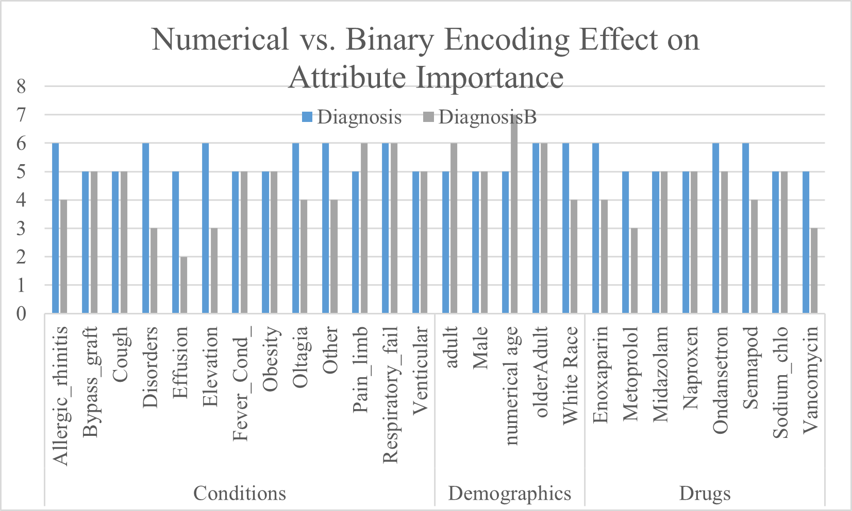
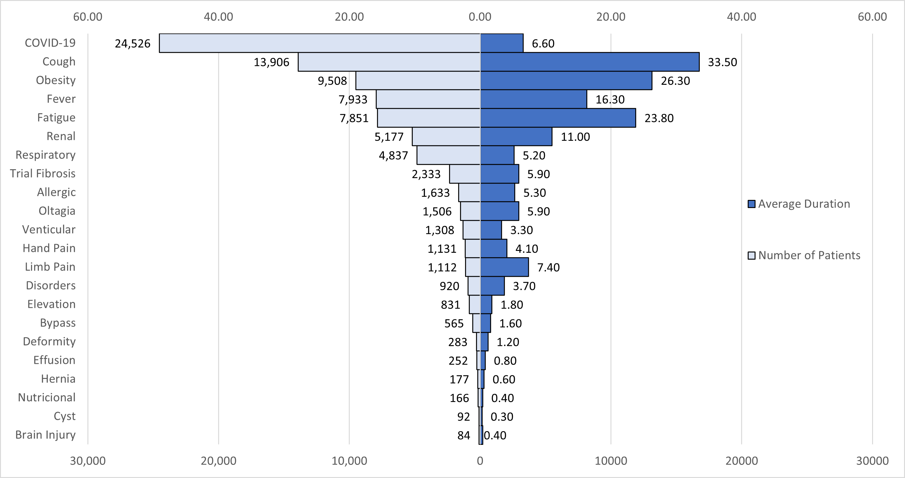
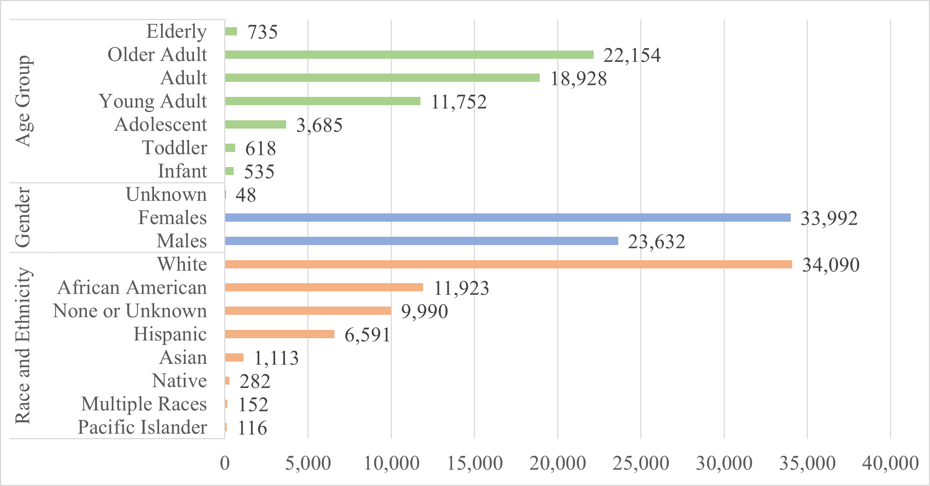
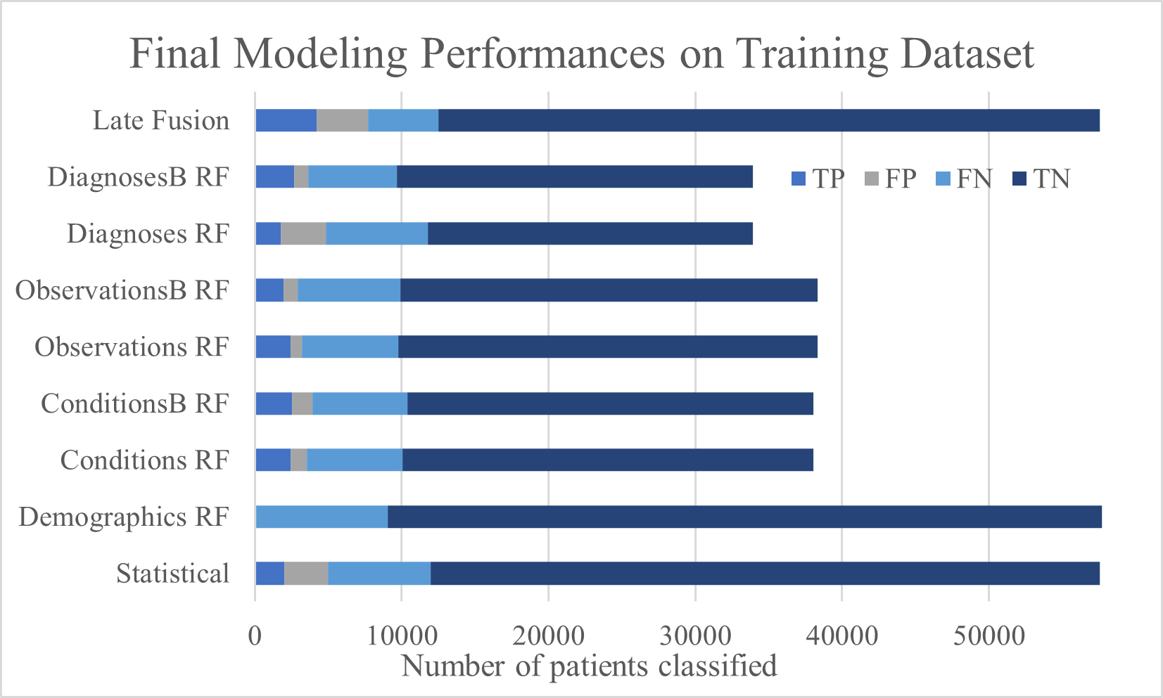
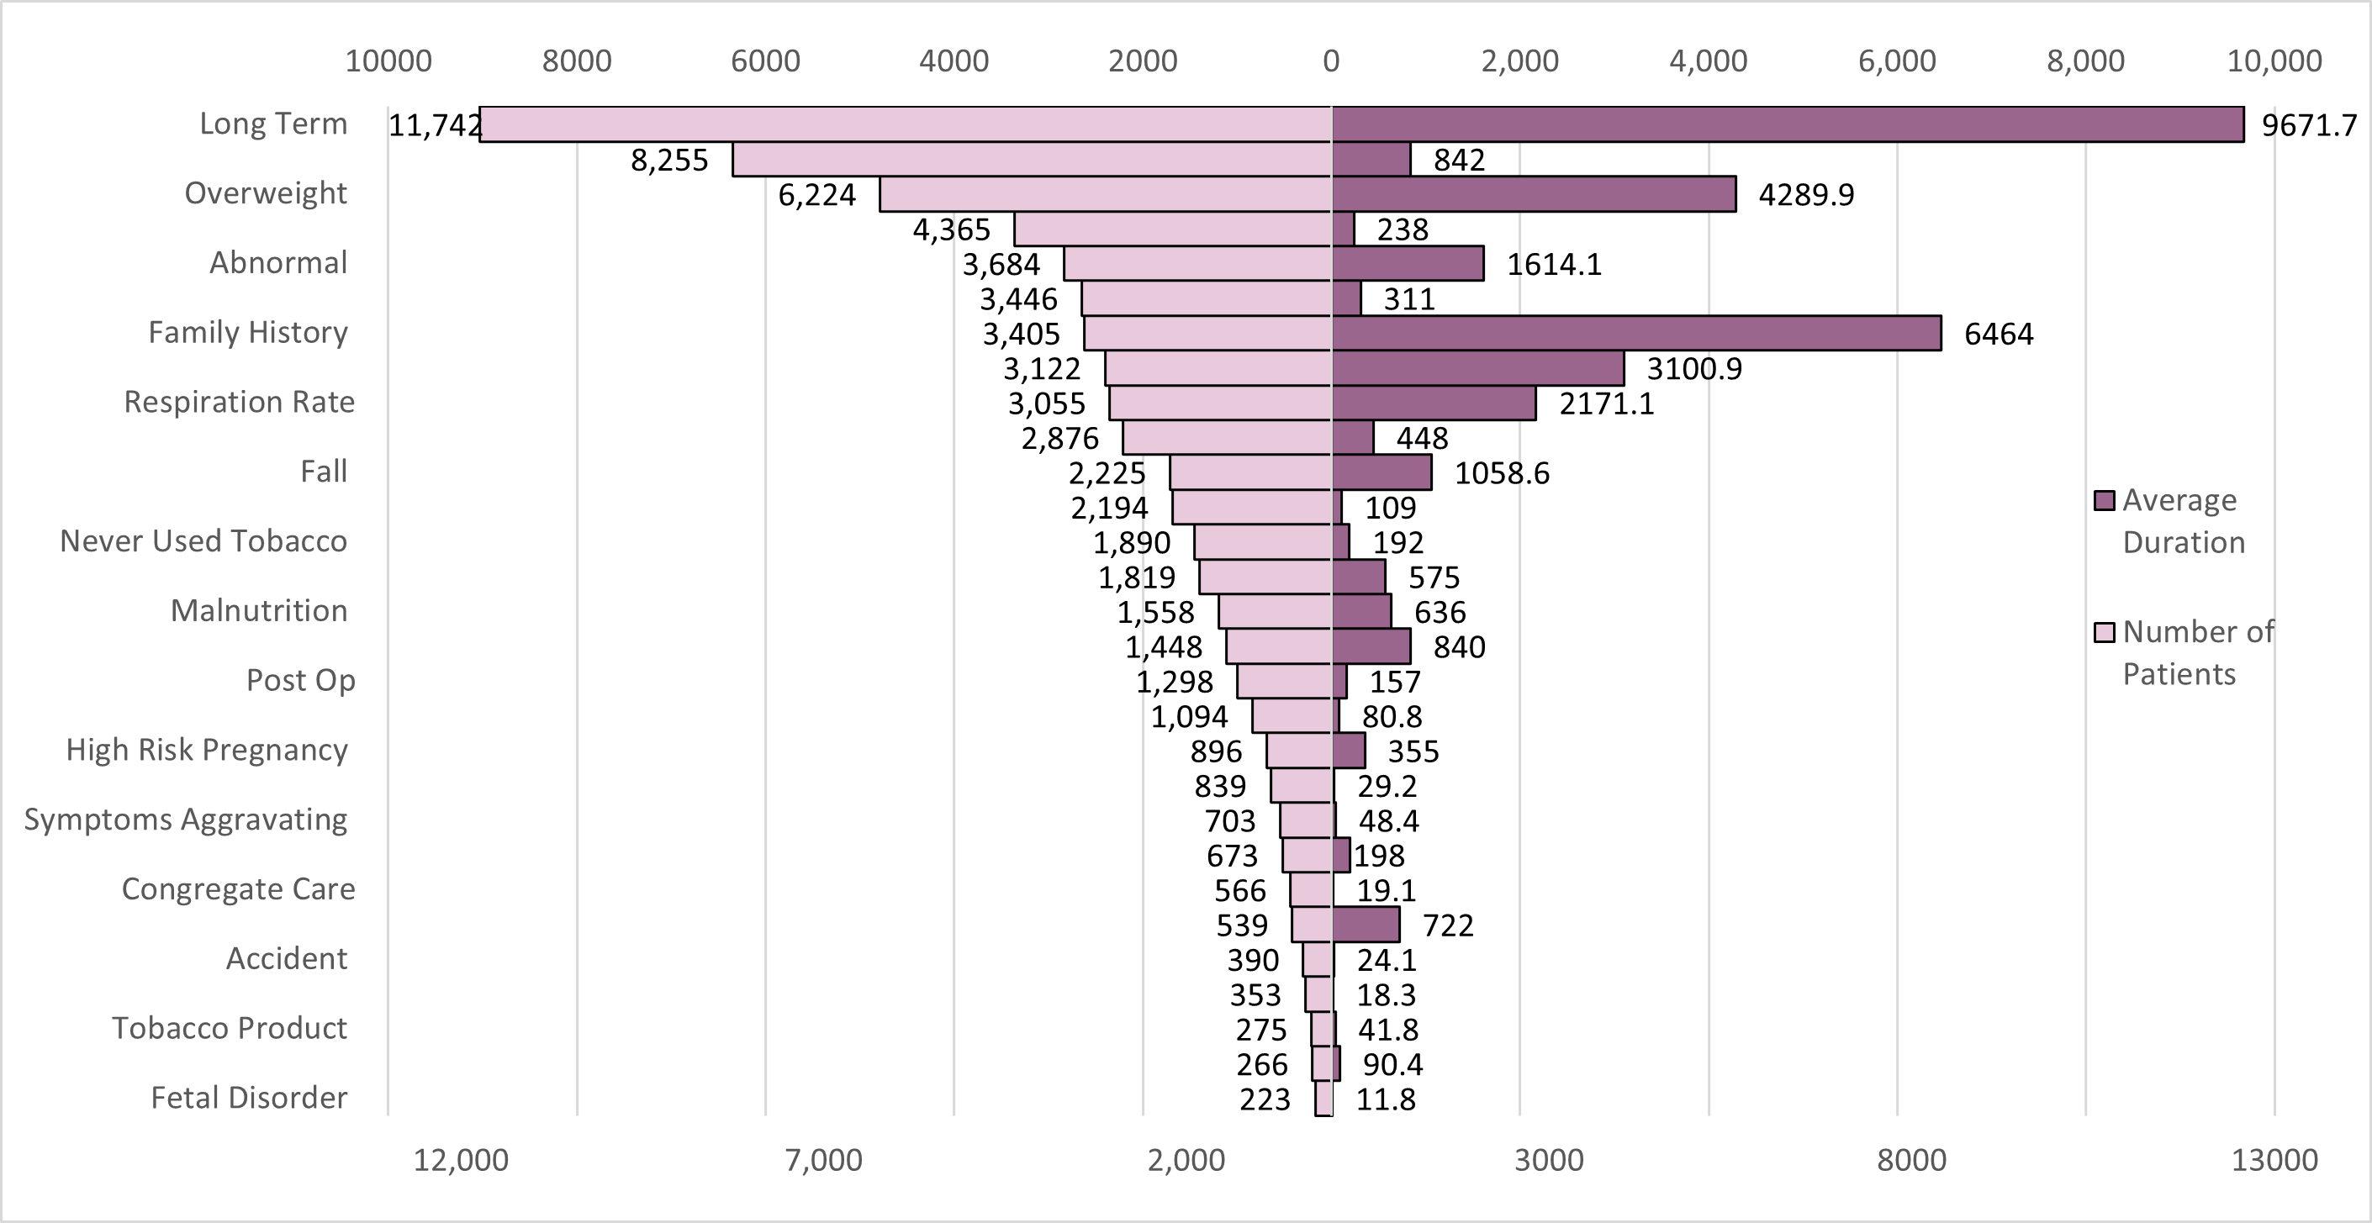
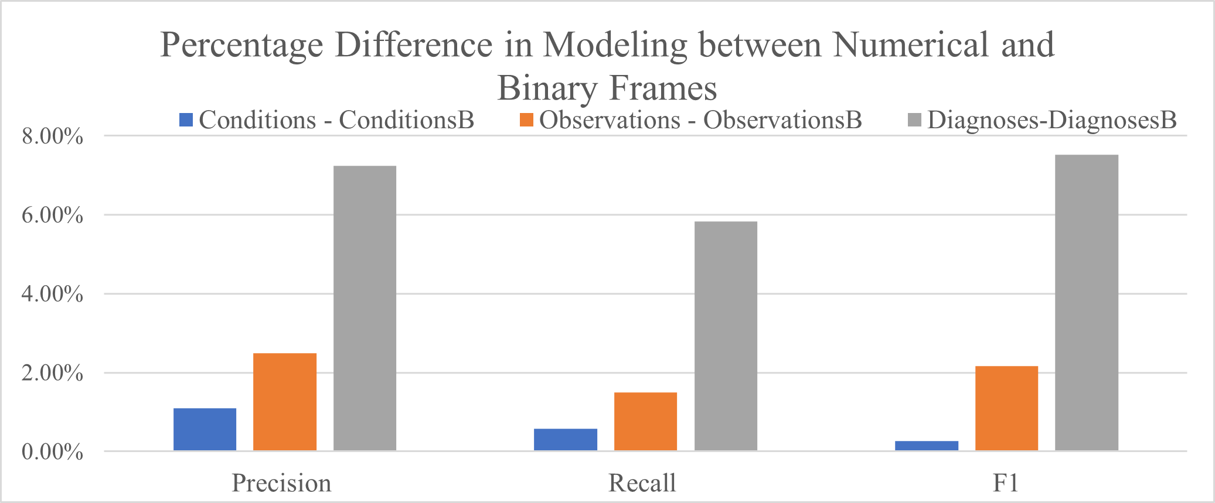
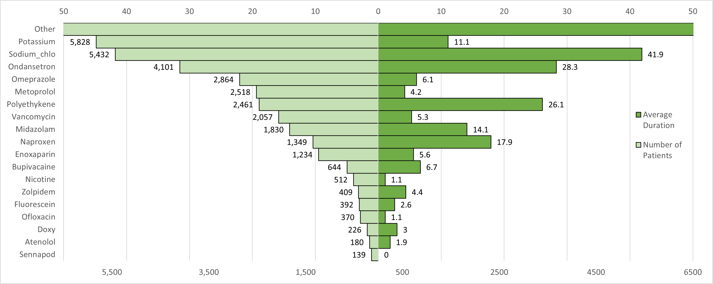
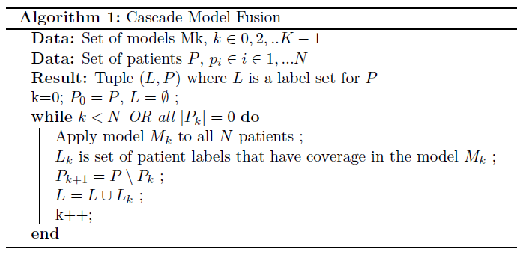
Long COVID Challenge : Predictive Modeling of Noisy Clinical Tabular Data
Mirna Elizondo∗ , Rasim Musal† , June Yu∗ and Jelena Tešić∗ on behalf of N3C
∗Computer Science †Information Systems & Analytics
Texas State University, San Marcos TX 78666
DataLab12.github.io
Motivation
Real tabular big data science challenge: predict long COVID diagnosis from the NCATS’ National COVID Cohort Collaborative (N3C) Data Enclave Clinical data.
L3C objective: improve the decision-making process public health officials make on Long Covid prevention/treatment
Provided dataset includes information on 57,672 patients that had COVID, and the information included is: demographics, symptoms, lab test results, procedures, medications, medical conditions, physical measurements and more.
Methodology
Experiments
Results
The late fusion model described in Algorithm 1 was the most robust model, evident by the high number of TP and low number of FN.
Dataset | # Patient | # Concepts | # Represented
Conditions | 38,044 | 14,764 | 24
Observations | 38,340 | 2,744 | 34
Drugs | 35,872 | 14,159 | 23
Diagnosis | 38,340 | 31,667 | 64
 | Gradient Boosting |  |  | Random Forest
data frame | P | R | F1 | P | R | F1
Demographics | 0.792 | 0.845 | 0.780 | 0.869 | 0.845 | 0.780
Conditions | 0.750 | 0.785 | 0.760 | 0.780 | 0.799 | 0.760
ConditionsB | 0.750 | 0.785 | 0.750 | 0.770 | 0.793 | 0.760
 | Decision Tree |  |  | Random Forest
data frame | P | R | F1 | P | R | F1
Demographics | 0.871 | 0.848 | 0.780 | 0.870 | 0.845 | 0.780
Conditions | 0.770 | 0.794 | 0.760 | 0.780 | 0.799 | 0.760
ConditionsB | 0.760 | 0.792 | 0.760 | 0.770 | 0.793 | 0.760
Observations | 0.760 | 0.782 | 0.750 | 0.790 | 0.808 | 0.770
ObservationsB | 0.760 | 0.781 | 0.750 | 0.770 | 0.793 | 0.750
Diagnoses | 0.750 | 0.783 | 0.740 | 0.850 | 0.850 | 0.840
DiagnosesB | 0.750 | 0.780 | 0.740 | 0.780 | 0.792 | 0.760
Table 2. Final Model Performances For The Entire Training Data Set. The Encoding Of The Total Days For Conditions Observations And Diagnoses Made No Statistical Difference For The Modeling
Figure 8: Numerical vs Binary Effect
Model | data set | TP | FP | FN | TN | P | R | F1
Statistical | Early Fusion | 2,031 | 2,967 | 7,000 | 45,564 | 0.406 | 0.225 | 0.290
Random Forest | Demographics | 98 | 0 | 8,933 | 48,641 | 1.000 | 0.011 | 0.021
Random Forest | Conditions | 2,449 | 1,085 | 6,544 | 27,966 | 0.693 | 0.272 | 0.391
Random Forest | ConditionsB | 2,546 | 1,402 | 6,447 | 27,649 | 0.645 | 0.283 | 0.393
Random Forest | Observations | 2,432 | 799 | 6,555 | 28,554 | 0.753 | 0.271 | 0.398
Random Forest | ObservationsB | 1,980 | 922 | 7,007 | 28,431 | 0.682 | 0.220 | 0.333
Random Forest | Diagnoses | 1,764 | 3,070 | 6,935 | 22,130 | 0.365 | 0.203 | 0.261`
Random Forest | DiagnosesB | 2,659 | 991 | 6,040 | 24,209 | 0.728 | 0.306 | 0.431
Late Fusion | Alg. 1 | 4,216 | 3,482 | 4,816 | 45,048 | 0.548 | 0.467 | 0.504
Figure 2. The most frequent conditions per patient in the training data set (left) and their average duration (right).
Figure 1. Distribution over aggregated gender, race, ethnicity, and age group categories in the Demographics
Table 3: Final Model performances for training set.
Proposal
Figure 5: Final Model Performances From Table VII On Entire Training Dataset. Late Fusion Model Only Returns Prediction For 26,923 Patients Out Of 57,562 Patients Total.
Conclusion and Next Steps
Random Forests was chosen as the fastest modeling algorithm on the Enclave
Next steps are to automate feature aggregation and selection for all unique drugs, conditions, observations, and procedures fields and Enclave processing improvement for scalability.
Data Set | Rows X Columns (% missing values)
 | Test | Train
care_site | 8,367 x 8 (66%) | 26 x 8 (1%)
condition_era | 2,484,521 x 8 (0%) | 13,639 x 8 0%
condition_occurrence | 6,316,765 x 21 (37%) | 36,451 x 21 (35%)
condition_to_macro | 1,286,673 x 8 (6%) | 8,388 x 8 (5%)
device exposure | 422,167 x 19 (44%) | 2,836 x 19 (45%)
drug_era | 2,090,455 x 9 (0%) | 12,698 x 9 (0%)
drug_exposure | 13,611,559 x 28 (42%) | 66,050 x 28 (39%)
location | 25,142 x 9 (57%) | 281 x 9 (60%)
long COVID | 57,675 x 2 (13%) | 300 x 2 (0%)
manifest_safe | 69 x 6 (23%) | 300 x 13 (23%)
measure | 32,569,723 x 29 (33%) | 198,151 x 30 (33%)
measure_to_macro | 17,839,906 x 8 (0%) | 112,243 x 8 (2%)
micro_to_macro | 3,524,398 x 28 (54%) | 19,430 x 26 (54%)
note | 321,151 x 19 (59%) | 2,710 x 19 (66%)
note_nlp | 7,580,262 x 21 (38%) | 60,486 x 21 (45%)
observation | 6,869,266 x 25 (49%) | 43,355 x 25 (43%)
observation_period | 45,404 x 7 (0%) | 234 x 7 (0%)
payer_plan_period | 1,370,746 x 26 (69%) | 6,029 x 26 (69%)
person | 57,672 x 26 (29%) | 300 x 26 (28%)
procedure_occurrence | 278,981 x 19 (22%) | 14,645 x 19 (23%)
procedures_to_macro | 991,579 x 8 (5%) | 5,247 x 8 (5%)
provider | 31,664 x 18 (51%) | 477 x 18 (56%)
visit_occurrence | 350,934 x 23 (49%) | 19,411 x 23 (49%)
Figure 3. The most frequent observations per patient in the training data set (left) and their average duration (right).
Figure 6: Numerical vs. Binary feature encoding shows the significant difference in performance.
Acknowledgments
The analyses described in this poster were conducted with data or tools accessed through the NCATS N3C Data Enclave https://covid.cd2h.org and N3C Attribution & Publication Policy v 1.2-2020-08-25b supported by NCATS U24 TR002306 and DataLab12. This research was possible because of the patients whose information is included within the data and the organizations and scientists who have contributed to the ongoing development of this community resource.​
Table 1. L3c Challenge Training And Testing Data Frame Sources & Percentage Of Missing Data. Data Implemented Bolded
Figure 4. Most frequent drugs per unique patient in the training data set (left) and their average duration (right).
Figure 7: Late Fusion Cascade Modeling

