Slide 1
Update/Demo
Mirna elizondo

Slide 2
Agenda
Purpose of Project
Prior Work
Challenge Overview
Challenge Data
Tools Overview
Code-Workbook Demo
Code-Repo Demo
Contour
Preparation
Pipeline
Submission/Next Steps
Demo
*if you're not sure if you can share it, do not

Slide 3
Purpose of Project
Identify prognostic factors that can support clinical decisions for management/prevention of Long COVID positive patients
Advancement in software tools and computing capacity has allowed AI and Machine Learning to potentially provide insight into patient level data
Create a robust data pipeline to harmonize electronic health record (EHR) data into a common data model
Using four data models commonly used
Observational Health Data Science and Informance (OHDSI)
The National Patient-Centered Clinical Research Network (pcornet)
The ACT Network (ACT)
TriNetX

Slide 4
Prior Work
Advanced age, female sex , multiple conditions, and obesity showed an increased risk of developing Long COVID.
Distributed across 6 clusters of 44 clinical features determined prior or during acute COVID-19.
Semantic Clustering based on HPO-encoded N3C data
Semantic similarity: terms are arranged in a directed acyclic graph with specific terms being related to more general terms. Searches for most common ancestor if match is not found.
To calculate pairwise phenotypic similarity of patients for clustering they adapted the Phenomizer algorithm.
The frequency of each HPO term is defined as the proportion of diseases in a database that are annotated by the term
K-means clustering was applied to the data and the number was determined to be 6 due to ‘elbow curve’ (4/5 also)
[1]

Slide 5
Cont..
Created three machine learning models
All patients
All patients who has been hospitalized for acute COVID
Patients who were not hospitalized
Construction
XGBoost was used, with 924 features in total
Hyperparameters tuned using GridSearchCV (scikit-learn), ten-fold cross validation, set to optimize AUROC
Calculated Shapley values to aid with interpretability
Results:
Non-hospitalized Long COVID clinic patients were disproportionally female
Hospitalized Long COVID clinic patients were disproportionally Black and were more likely to have a pre-COVID-19 comorbidity(multiple illnesses)
[2]
Notes:
AUROC: area under receiver operating characteristic curve
Performance: AUROC, precision, recall, and F-score
Prediction probability: 0.45
Shapley Values: for all features to quantify each features importance made by each model.

Slide 6
Cont..
Like previous, older age, and increasing comorbidities, with higher mortality in patients with cancer and COVID-19
Due to Cancer Cohort male gender was disproportionally represented
Cancer patients that were vaccinated with COVID-19
Limitation:
RWD Challenges (missing data)
Potential misclassification *recurring issue (false positives)
Challenges in primary cancer diagnosis mapping and limited data
Method for construction of COVID-19 negative control
[3]
Notes:
Misclassification- contour/analysis
Missing data – XgBoost
Limited Data: 2021

Slide 7
Challenge Overview
Total of 15 million patients
5.8 million COVID positive patients
17.5 billion rows
Objective:
If infected with SARS-S Covid, what groups are more susceptible to developing PASC/Long COVID
There are currently many definitions for PASC/Long COVID, for the challenge a person is diagnosed with PASC/Long COVID with code ICD-10 code U09.0
Long COVID Silver Standard : represents Patients that are positive with Long COVID

Slide 8
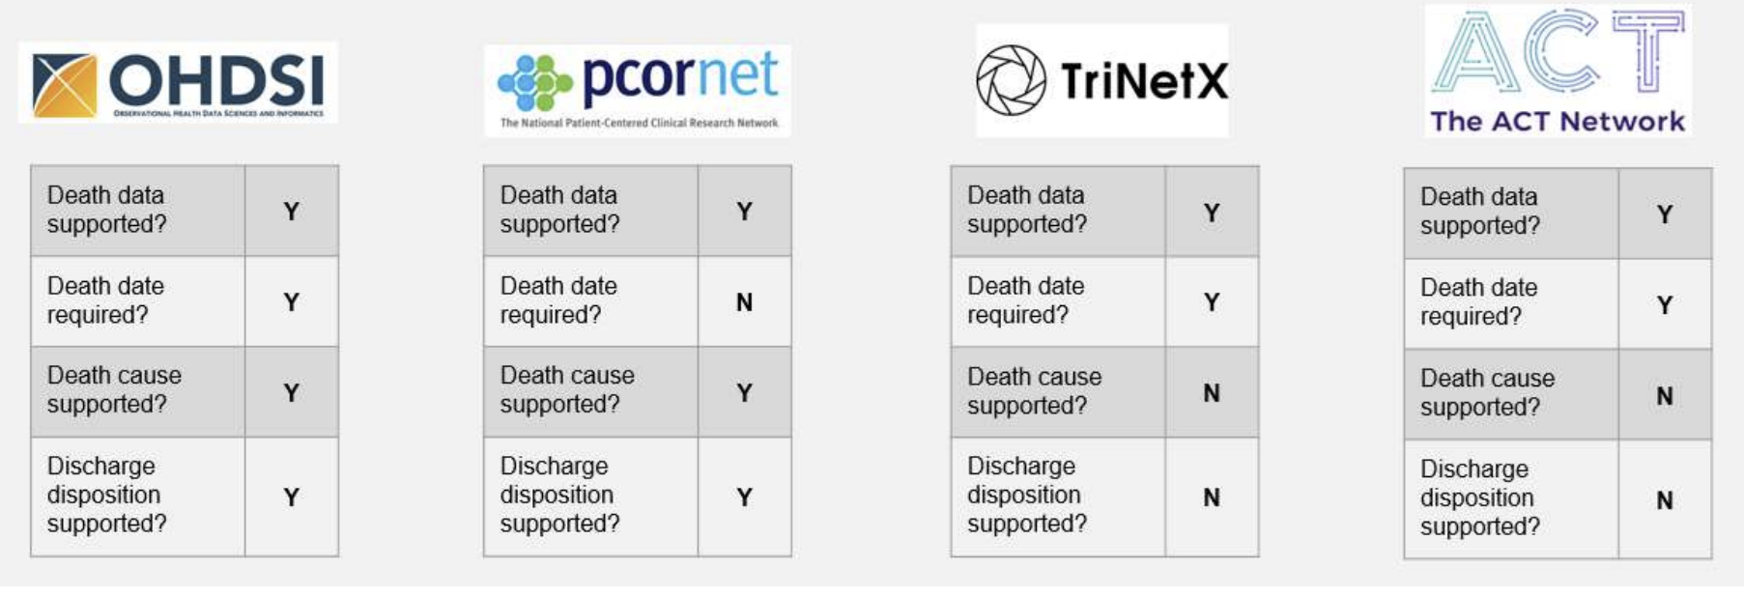
Challenge Data
Data sets include:
Demographics, symptoms, lab test results, procedures, medications, medical conditions, physical measurements
Data has a 1:4 ratio of Long COVID positive : Long COVID negative
287 Human Phenotype Ontology(HPO) Long COVID- associated terms correspond to the OMOP Codes
Mapping OMOP2OBO codes to HPO terms *Prior Work
Notes:
HPO: illness associated with long covid, this includes illness that go by different names or different names for the same type of illness
comorbidity(multiple illnesses)
OMOP: codes used as a standard medical codes in order to group and better define types of illness
HPO & OMOP: can cooperate in order to make data interpretable

Slide 9
Tools Overview
Code Tools:
Code Workbook
Code Repository
Analysis Tools
Contour
Preparation
Project Scope
Data Lineage
Easily find and discover datasets
Search using Project, table, column names
Click through projects to browse data

Slide 10
Code Tools
Code workbook
Code repo
Application that allows users to analyze and transform data in code using intuitive graphical interface
Features:
Interactive console: rapid
Visualization support: (matplotlib, plotly, seaborn)
Template: reuse of code
Multi-language support
Branching
Point-and click user interface
Web-based IDE in Foundry
all common git version control tasks
Have integrated support for code review
Includes integrated features to aid including IntelliSense, code linting and error checking
Repo Types:
Transforms: data transformation logic
Functions: writing business logic, supports TypeScript autocomplete on OMOP types
Model Development here <3
https://unite.nih.gov/docs/foundry/develop-models/models-code-repositories/

Slide 11
Analysis Tools
Contour
Visualize, filter, and transform data without code
Organize analyses into analytical paths
Parameterize analyses to switch between views
Save analysis results as a new dataset
How were using it:
Not all data is mapped
Large datasets (time saver)
Portable throughout Foundry tools
Centralized DQ processes
Preparation
Used for initial cleaning, can do without but simply allows for simplicity

Slide 12
Pipeline Adaptation
Goal: Identify prognostic factors
Feature Sets: potentially (4,5,6)
Gradient Boosting: data fits description of tabular data
*based on literature/resulted in best accuracy (had less data than us)

Slide 13
References
[1]Pfaff, E. R., Girvin, A. T., Bennett, T. D., Bhatia, A., Brooks, I. M., Deer, R. R., Dekermanjian, J. P., Jolley, S. E., Kahn, M. G., Kostka, K., McMurry, J. A., Moffitt, R., Walden, A., Chute, C. G., Haendel, M. A., Bramante, C., Dorr, D., Morris, M., Parker, A. M., … Niehaus, E. (2022). Identifying who has long COVID in the USA: A machine learning approach using N3C data. The Lancet Digital Health, 4(7), e532–e541. https://doi.org/10.1016/S2589-7500(22)00048-6
[2]Reese, J., Blau, H., Bergquist, T., Loomba, J. J., Callahan, T., Laraway, B., Antonescu, C., Casiraghi, E., Coleman, B., Gargano, M., Wilkins, K., Cappelletti, L., Fontana, T., Ammar, N., Antony, B., Murali, T. M., Karlebach, G., McMurry, J. A., Williams, A., … Robinson, P. N. (2022). Generalizable Long COVID Subtypes: Findings from the NIH N3C and RECOVER Programs. MedRxiv, 2022.05.24.22275398. https://doi.org/10.1101/2022.05.24.22275398
[3] Sharafeldin, N., Bates, B., Song, Q., Madhira, V., Yan, Y., Dong, S., Lee, E., Kuhrt, N., Shao, Y. R., Liu, F., Bergquist, T., Guinney, J., Su, J., & Topaloglu, U. (2021). Outcomes of COVID-19 in Patients With Cancer: Report From the National COVID Cohort Collaborative (N3C). Journal of Clinical Oncology, 39(20), 2232–2246. https://doi.org/10.1200/JCO.21.01074

Slide 14
Submission
https://unite.nih.gov/workspace/compass/view/ri.compass.main.folder.7403d6c8-3bab-4282-8904-6bcca88c08b9
L3C Submission Write Up: Created in team directory
Submission Example -> “Person Analysis”*current
Submission Output -> Datafiles consist of datasets refined
December 15, 2022 *due date

Slide 15
Demo:
1.) Contour
Preparation cleaned output set -> Contour
Concept Set Analysis “Non_SARS_Respiratory”
respiratory illness not associated with COVID-19
2.) Code Repository
https://unite.nih.gov/documentation/static/foundry/develop-models/models-code-repositories/
Test Repo
3.) Code Workbook
Tutorial Workbook
“Person Analysis”
4.) Questions
*please note only one user on tool for it to run

