Slide 1
PAIR

Slide 2
Datasets
Census Bureau’s Urban-Rural Classification: Identifies urban areas based on population or housing density, with urban areas having at least 2,000 housing units or 5,000 people.
BRFSS: Health-related telephone surveys collecting data on U.S. residents' health behaviors, chronic conditions, and use of preventive services.
AHRQ SDOH Database: Provides easily linkable data on social, economic, educational, physical, and healthcare contexts at county, ZIP code, and census tract levels.
Medicare Geographic Variation - by National, State & County

Slide 3
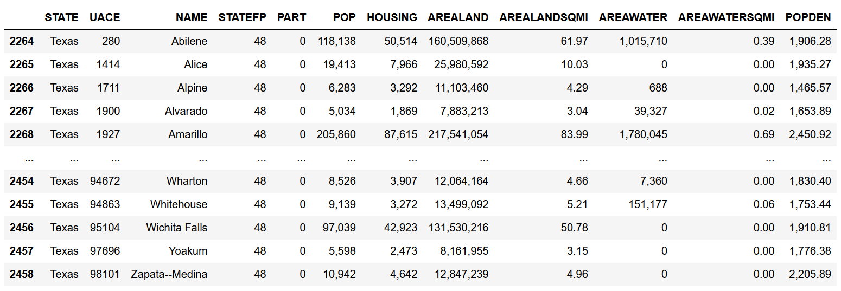
CENSUS – Urban or Rural Classification
Original: 2779 rows x 12 columns
Texas: 195 rows x 12 columns
Urban/Rural:
Urban cities: 195
If not in dataset classified as rural

Slide 4
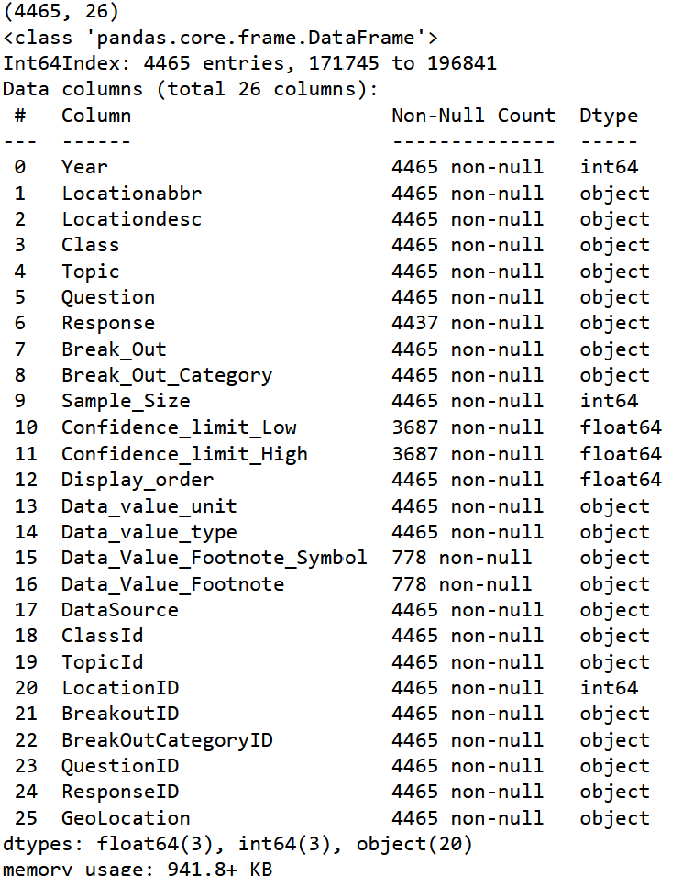
BRFSS
https://www.cdc.gov/brfss/index.html
Original: 232512 rows x 27 columns
Texas: 4465 rows x 26 columns
Years: 2011-2024

Slide 5
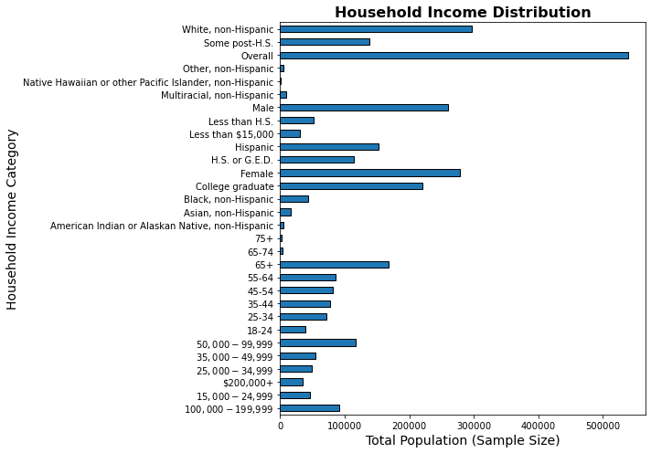
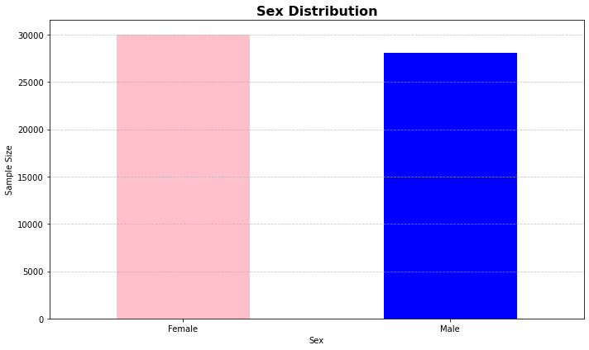
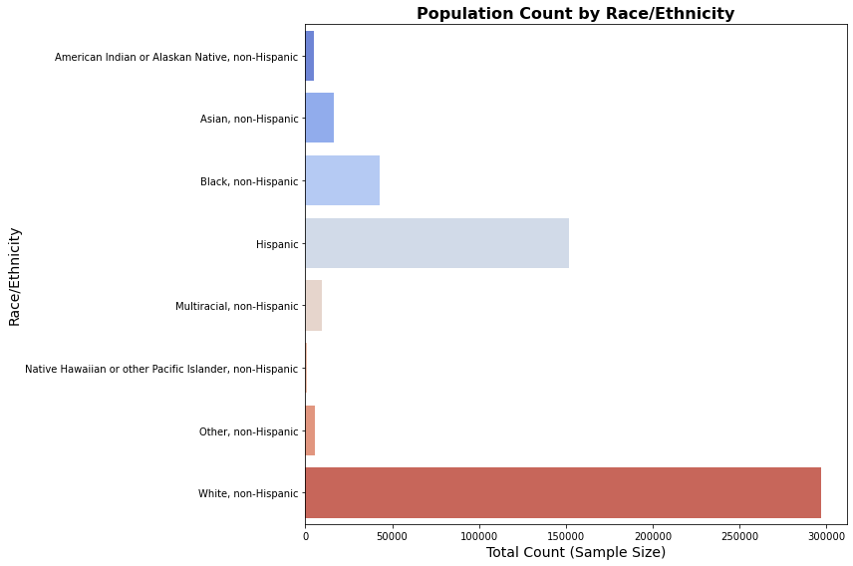
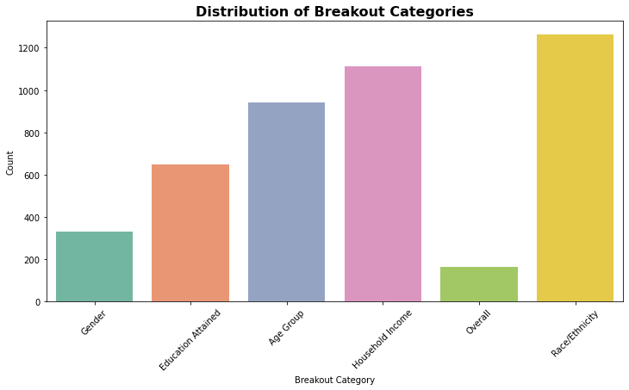

Slide 6
SDOH
https://www.ahrq.gov/sdoh/data-analytics/sdoh-tech-poverty.html
Original: 3229 rows x 682 columns
Texas Dataset: 254 rows x 682 columns
Years: 2010 & 2020

Slide 7
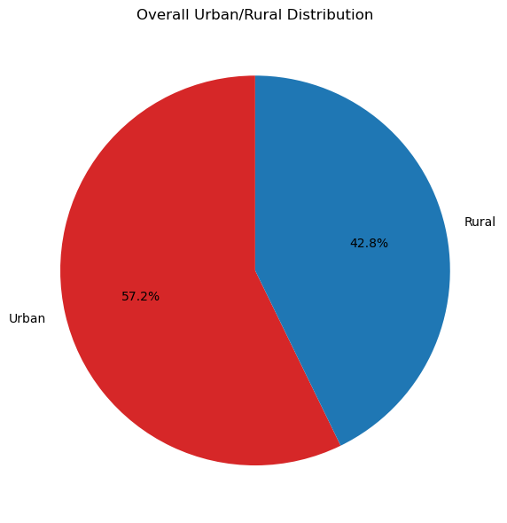
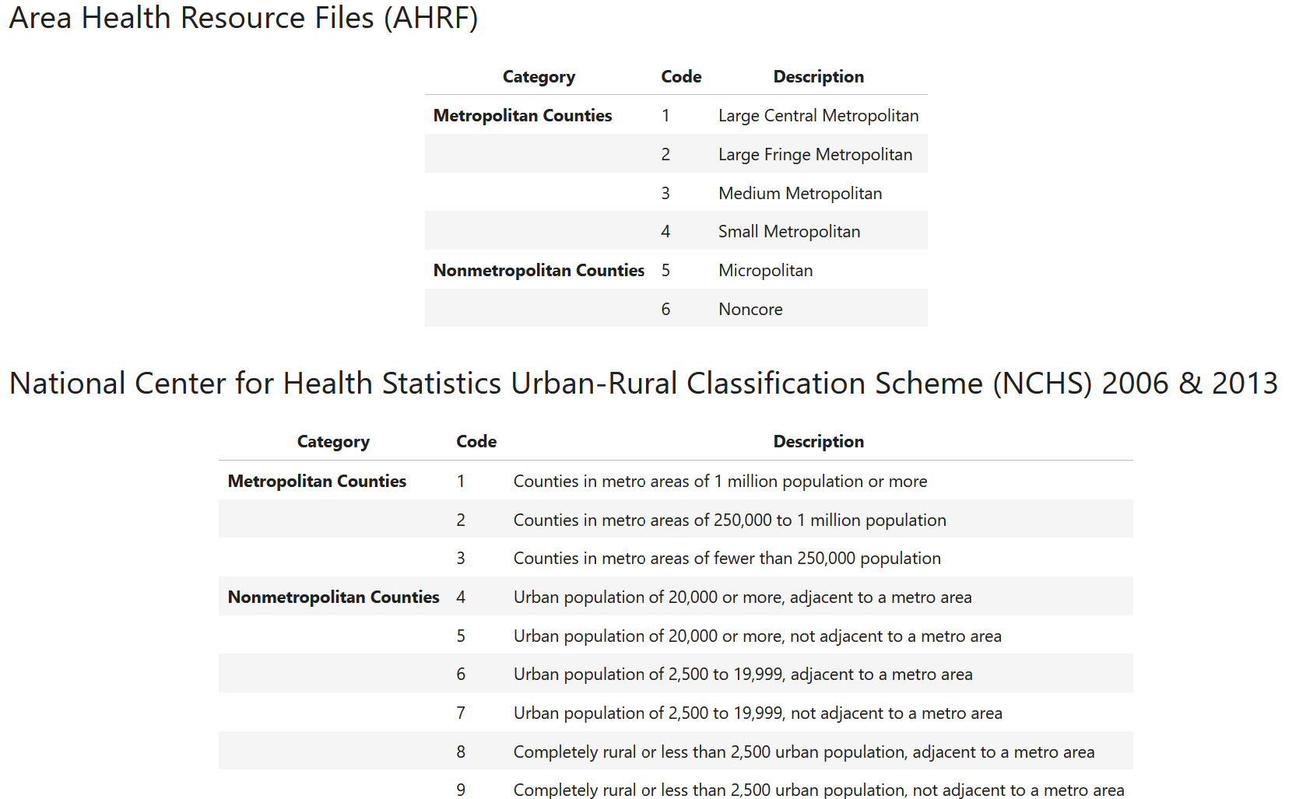
Urban or Rural?
Number of States: 1
Number of Region: 1
Number of Counties: 254
Number of Urban Counties: 95
Number of Rural Counties : 71

Slide 8
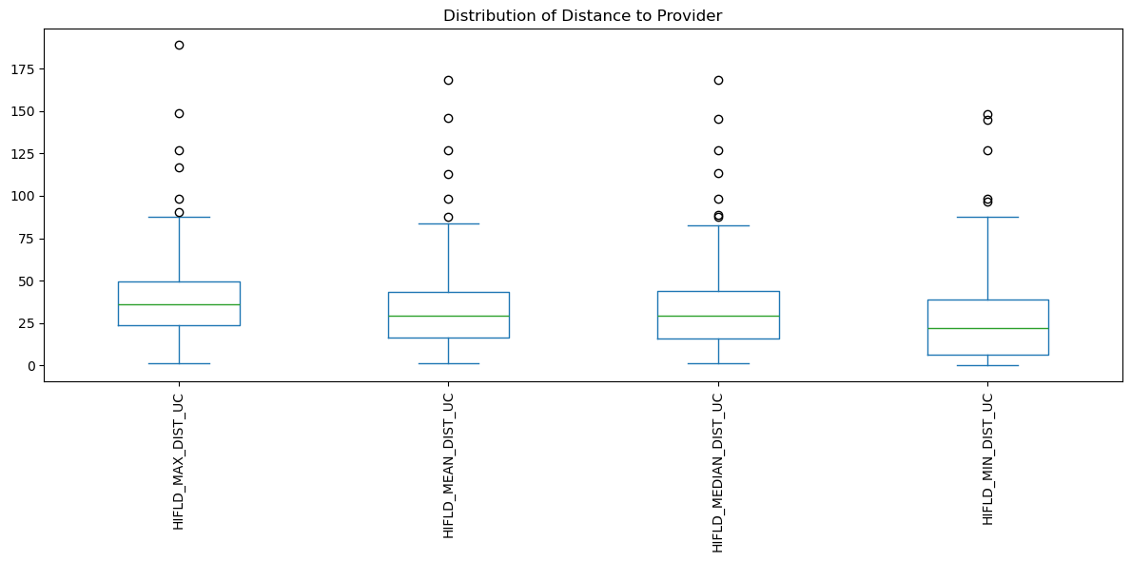
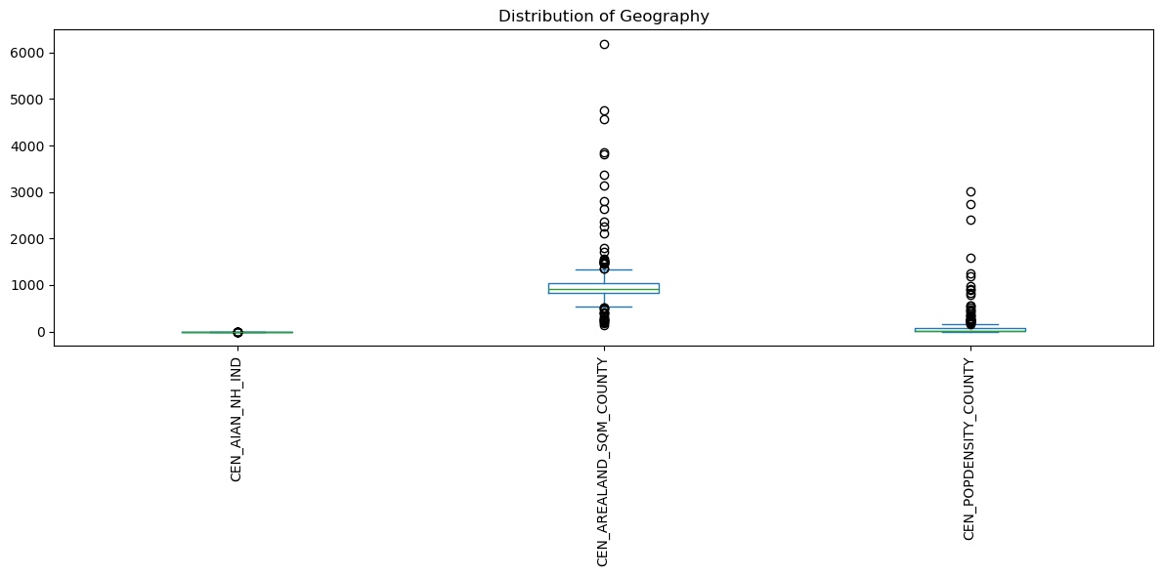
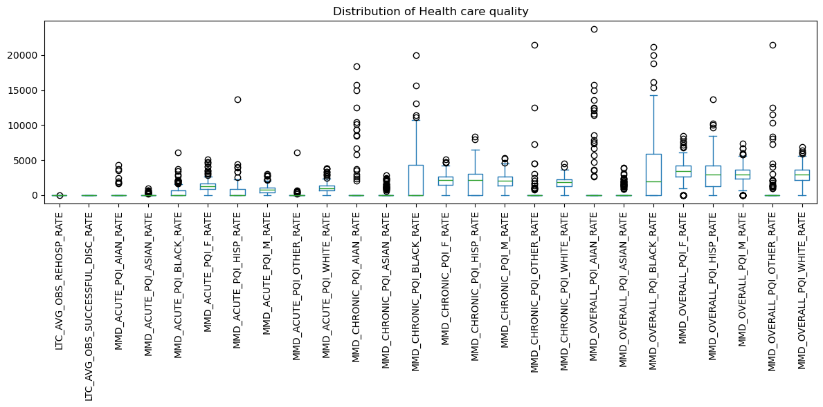

Slide 9
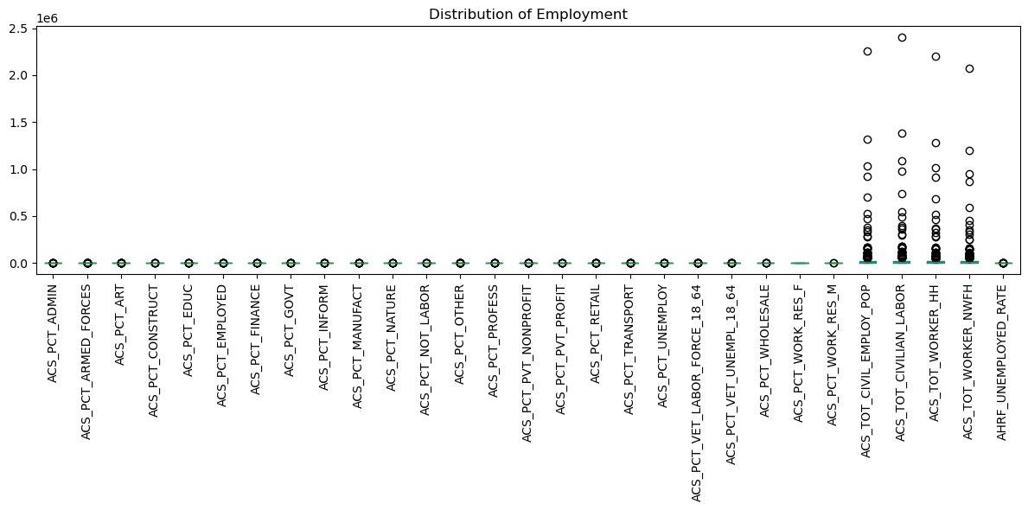
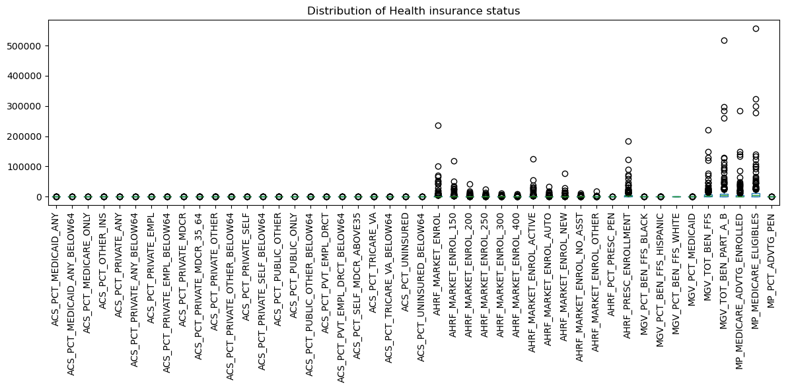

Slide 10
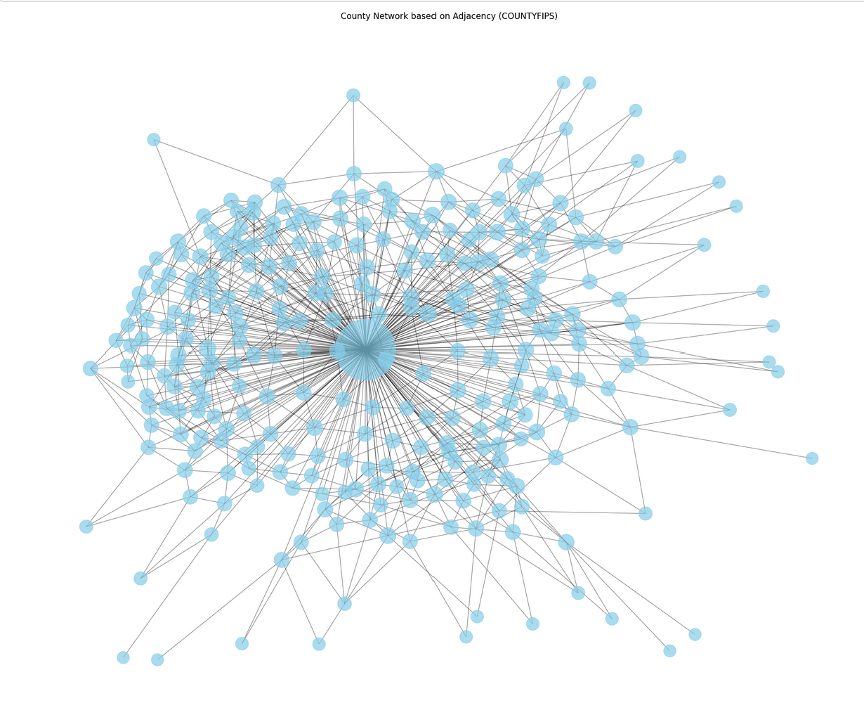

Slide 11
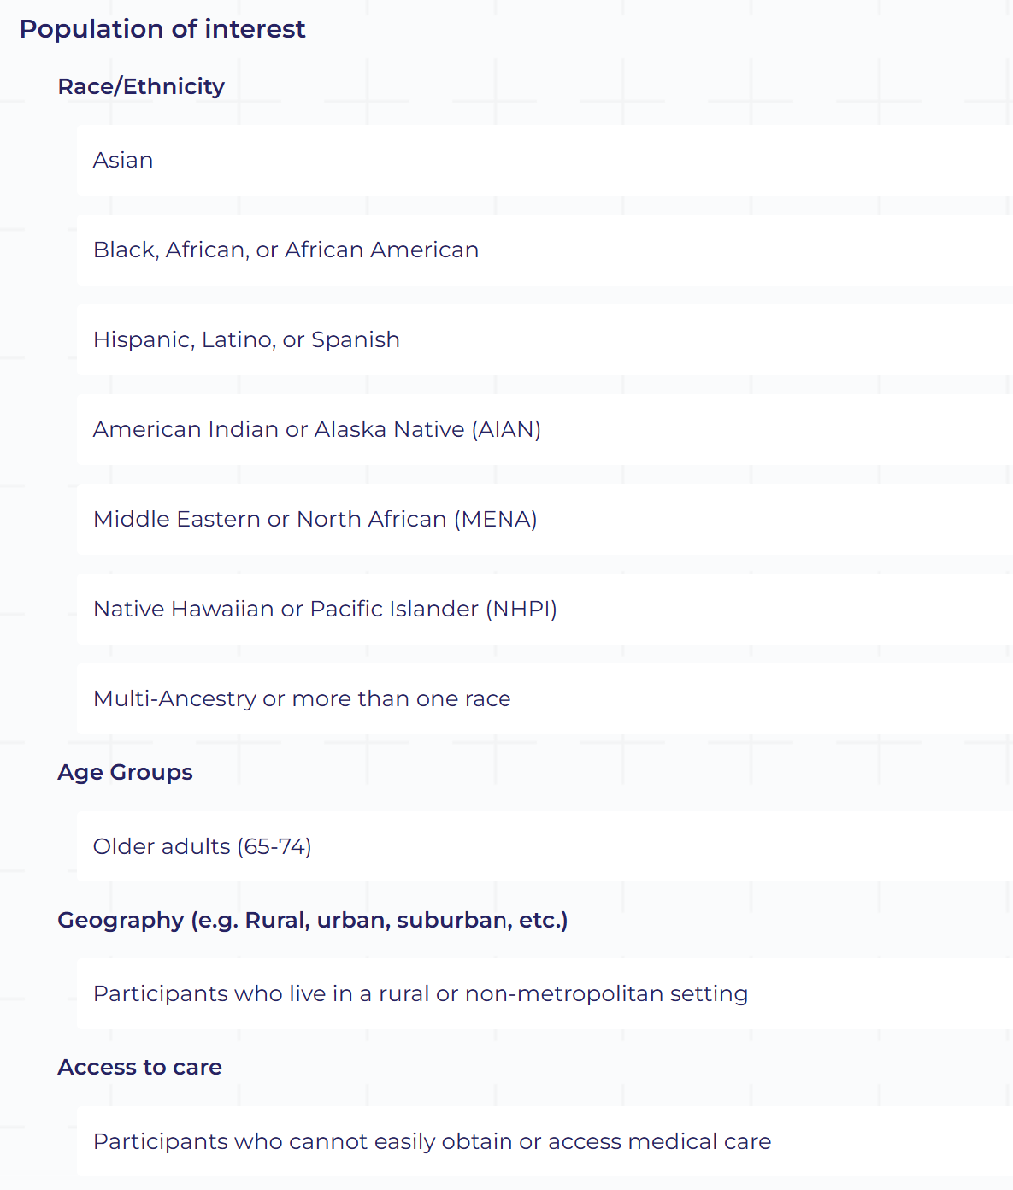
All Of Us
Dataframe | ID | Rows | Columns
Survey | 57011715 | 410361 | 10
Person | 57011715 | 9375280 | 9
Unique Survey Columns | # Unique Values
person_id | 117023
survey_datetime | 116780
survey | 1
question_concept_id | 81
question | 81
anwer_concept_id | 74
answer | 90
survey_version_concept_id | 0
survey_version_name | 0
Unique Person Columns | # Unique Values
person_id | 410361
gender_concept_id | 4
gender | 4
date_of_birth | 25467
race_concept_id | 9
race | 9
ethnicity_concept_id | 6
ethnicity | 6
sex_at_birth_concept_id | 4
sex_at_birth | 4

Slide 12
Medicare Geographic Variation (MGV)
Original: 30273 rows x 247 columns
Texas: 2295 rows x 245 columns
Years: 2014-2022
https://data.cms.gov/summary-statistics-on-use-and-payments/medicare-geographic-comparisons/medicare-geographic-variation-by-national-state-county/data

Slide 13
MGV Data Sources
Primary Data Source: CMS’s Chronic Conditions Data Warehouse (CCW)
Contains 100% Medicare claims for Fee-For-Service (FFS) beneficiaries.
Includes enrollment, eligibility data, and flags for 30 specific chronic conditions
Unique beneficiary identifiers enable longitudinal tracking of spending and utilization.
Settings of Care - Data supports analysis across various care settings:
Inpatient and outpatient hospitals.
Post-acute care (e.g., long-term care hospitals, inpatient rehabilitation, skilled nursing facilities, home health agencies).
Hospice, physician services, laboratories, and durable medical equipment (DME).
Physician Services Classification:
2014-2022: Categorized using the Restructured BETOS Classification System (RBCS), with eight major categories, including E&M, procedures, imaging, and laboratory tests.
2007- 2013: Defined by the historical BETOS scheme, which includes six major categories.
Quality Measures:
Incorporates Prevention Quality Indicators (PQIs) from the Agency for Healthcare Research and Quality (AHRQ).
Measures hospital admission rates for ambulatory care-sensitive conditions.
Historically endorsed by the National Quality Forum through FY 2021.

Slide 14
https://data.cms.gov/tools/geographic-variation-in-standardized-medicare-spending-state

Slide 15
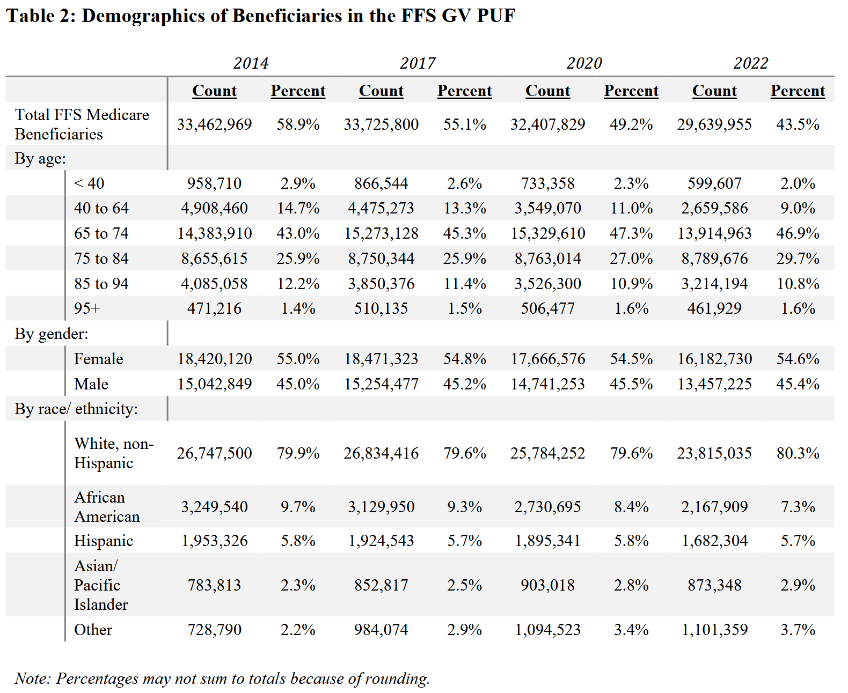
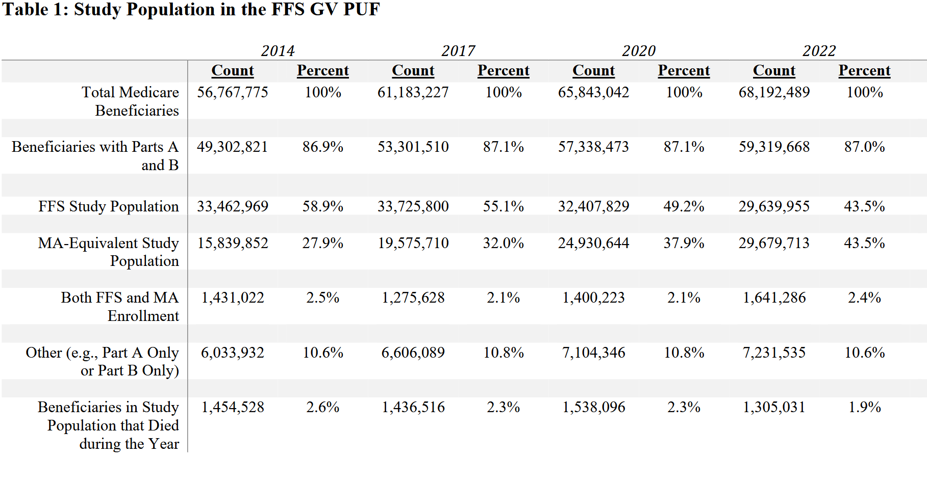
MGV

