Slide 1

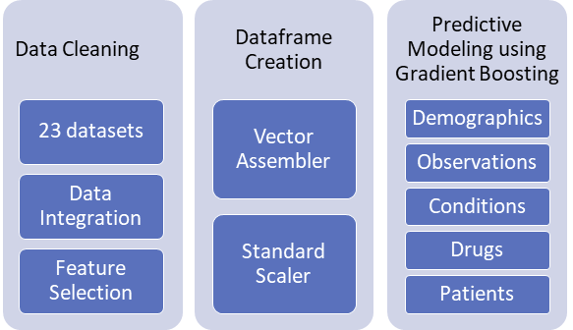
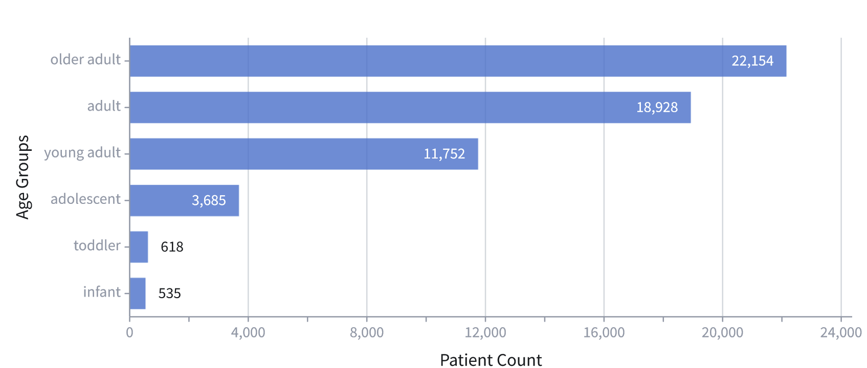
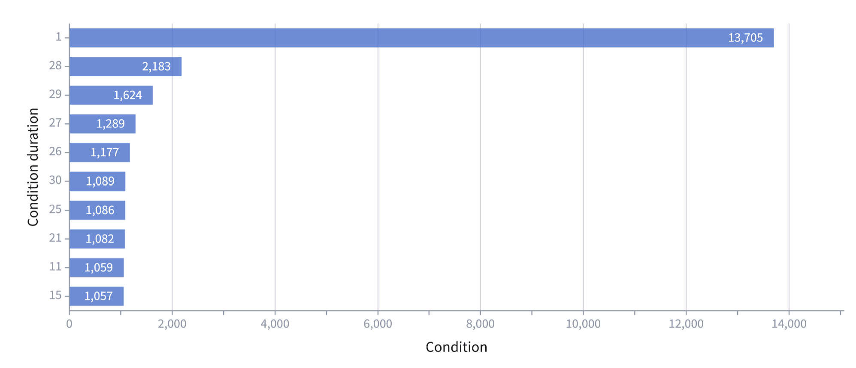
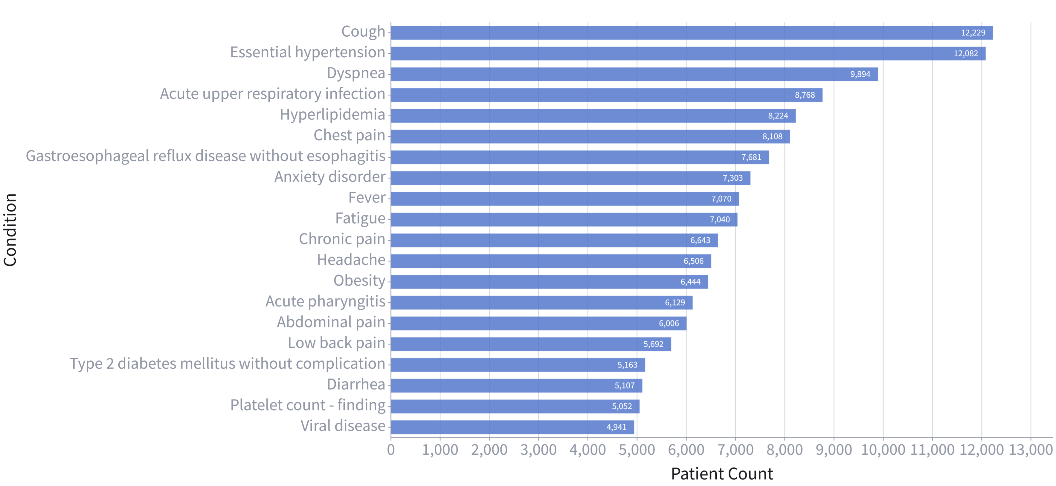
Identifying Prognostic Factors from NIH N3C Clinical Data for Long Covid
Mirna Elizondo
Advisor: Dr. Jelena Tešić
http://DataLab12.github.io/
Motivation
Exploratory Data Analysis​
Predictive Modeling Pipeline
Real tabular big data science challenge: predict long COVID diagnosis from the NCATS’ National COVID Cohort Collaborative (N3C) Data Enclave Clinical data.
L3C objective: improve the decision-making process public health officials make on Long Covid recovery and prevention.
Provided dataset includes information on 57,672 patients that had COVID, and the information included is: demographics, symptoms, lab test results, procedures, medications, medical conditions, physical measurements and more.
EDA Summary
condition information for 38,044 patients and information for 14,476 conditions that lasted from 1-409 days.
observation information for 38,340 patients and have 2,744 total observations including 14,159 prescribed drugs.
Females represent a small percentage of patients
Data Set | Columns | Rows
visit_occurence | 23 | 3.5m
provider | 18 | 31.7k
procedures_to_macrovisits | 8 | 992k
procedure_occurrence | 19 | 2.8m
person | 26 | 57.7k
payer_plan_period | 7 | 1.4m
observation | 25 | 45.4k
observation_period | 7 | 45.4k
microvisits_to_macrovisits | 26 | 6.9m
measurement_to_macrovisits | 8 | 3.5m
note | 19 | 17.8m
note_nlp | 21 | 321k
measurement_to_macrovisits | 30 | 7.6m
manifest_safe_harbor | 13 | 32.6m
location | 9 | 69
Long COVID Silver Standard | 5 | 25.1k
drug_exposure | 28 | 57.7k
drug_era | 9 | 13.6k
device_exposure | 19 | 2.1m
condtion_to_macrovisit | 8 | 422k
condition_occurrence | 21 | 1.3m
condition_era | 8 | 2.5m
care_site | 8 | 8.4k
L3C Challenge Dataset
The N3C’s data consists of existing patient records at 94 participating institutions.
The data itself can only be accessed through a secure cloud portal hosted by NCATS known as the Enclave
With collaborative efforts it consists of:
20 billion rows, 1,757.1 million clinical observations, 16.4 million patients, and 6,438,192 SARS-CoV-2 cases
Under the university’s DUR we have access to Level 2 data.
Figure 4. Modeling Flow
Progress Results
EDA: Females had higher condition counts, condition occurrences, drugs prescribed, and observations as a group as compared to median values
Modeling:
Linear Regression:
AUROC : 0.64562
Area Under Precision Recall curve: 0.47301
Logistic Regression:
AUROC : 0.54117
Area Under Precision Recall curve: 0.46276
Figure 1. Age groups created with conditional formatting:
less than or equal to 2 - infant
greater than 2 and less than 4 - toddler
greater than 4 and less than 14 - adolescent
greater than 14 and less than 30 - young adult
greater than 30 and less than 50 – adult
greater than 50 and less than 91 – older adult
Demographics Data Aggregation
The data provided in Censored Training folder contains 23 data frames that capture the patient information at multiple resolutions
location_id – there is one location for multiple patients.
conditions – there can be multiple observations per patient
Patient file contains demographic information and long covid information for the 57,672 patients:
11,446 had SARS-COV-2 twice
9,031 have long covid diagnosis.
Dataframes aggregated were person, location, and Long COVID Silver Standard
Demographics Dataframe
Preparation tool: we normalize and drop insignificant columns (all null columns)
Contour Analysis Tool: we calculated condition durations (end_date – start_date), condition, visit, and observation counts
Code Workbook: combine on person_id, visit_occurrence_id, and condition_concept_id and analyze dataset
Age was calculated (2021-year_of_birth) using a Logistic Regression model that predicts year_of_birth with simple features: gender, race, ethnicity, and pasc code (1330) plus over_90 information (735)
Table 1. Censored Training Data: Datasets included are in bold
Conditions Data Aggregation
Acknowledgment
The analyses described in this poster were conducted with data or tools accessed through the NCATS N3C Data Enclave https://covid.cd2h.org and N3C Attribution & Publication Policy v 1.2-2020-08-25b supported by NCATS U24 TR002306 and DataLab12. This research was possible because of the patients whose information is included within the data and the organizations and scientists who have contributed to the on-going development of this community resource
Figure 2. Recurring top 20 conditions
Figure 3. Condition durations
Conditions Dataframe
Preparation tool: we normalize and drop insignificant columns (all null columns)
Contour Analysis Tool: we calculated condition durations
Code Workbook: on person_id, visit_occurrence_id, and observation_concept_id and combined:
Observation_period, observation, and visit_occurrence datasets
Demographics and Drugs dataframe
Notes:
Poster Instructions posted on Canvas
1. Your poster should be of 40 inches by 30 inches in size -> this is too big, scale it down to 36 by 24! 2. Remember that the text and figures should be legible from 3-5 feet away. This means use 36 pt. minimum 3. Poster should have roughly 20% text, 40% figures and 40% space 4. Use sans serif fonts for readability from a distance 5. Putting information in bullet form is better than in sentences 6. Don’t use a distracting background, and make sure there is sufficient contrast between the background and text. Please also prepare a one-minute speech to explain your poster. Highlight the main contributions.

