Slide 1

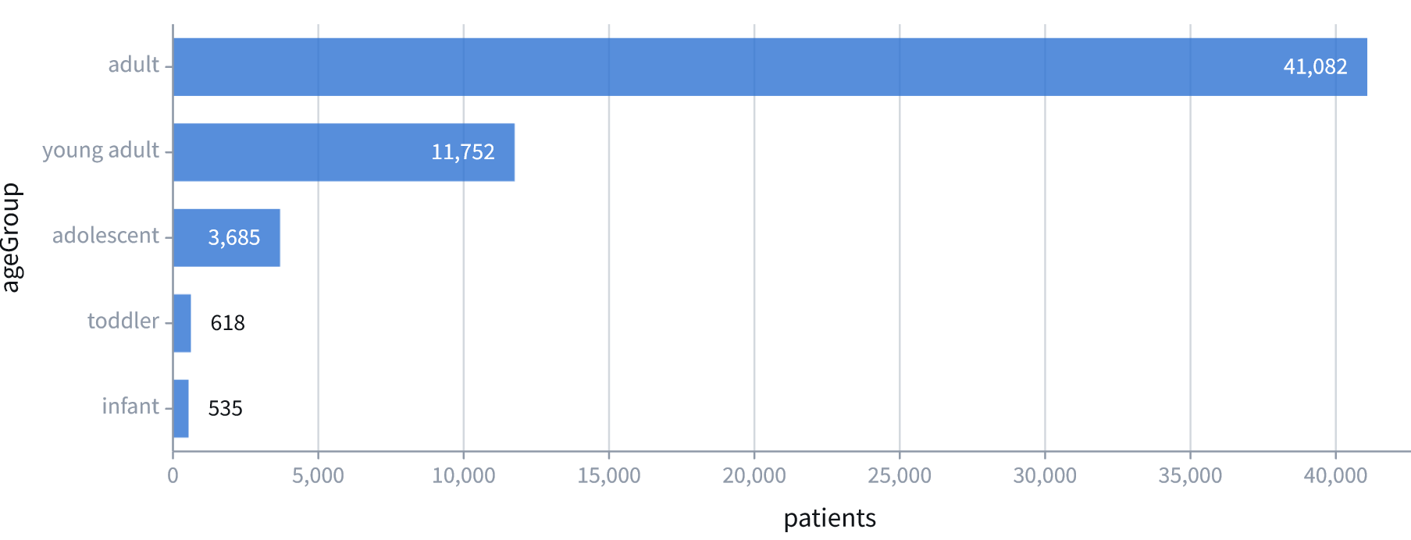
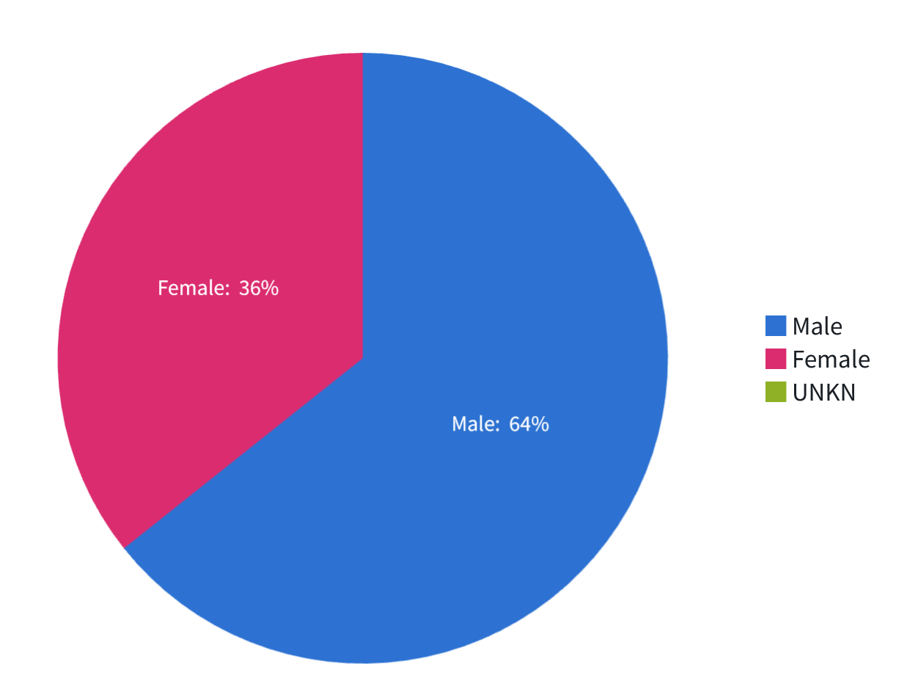
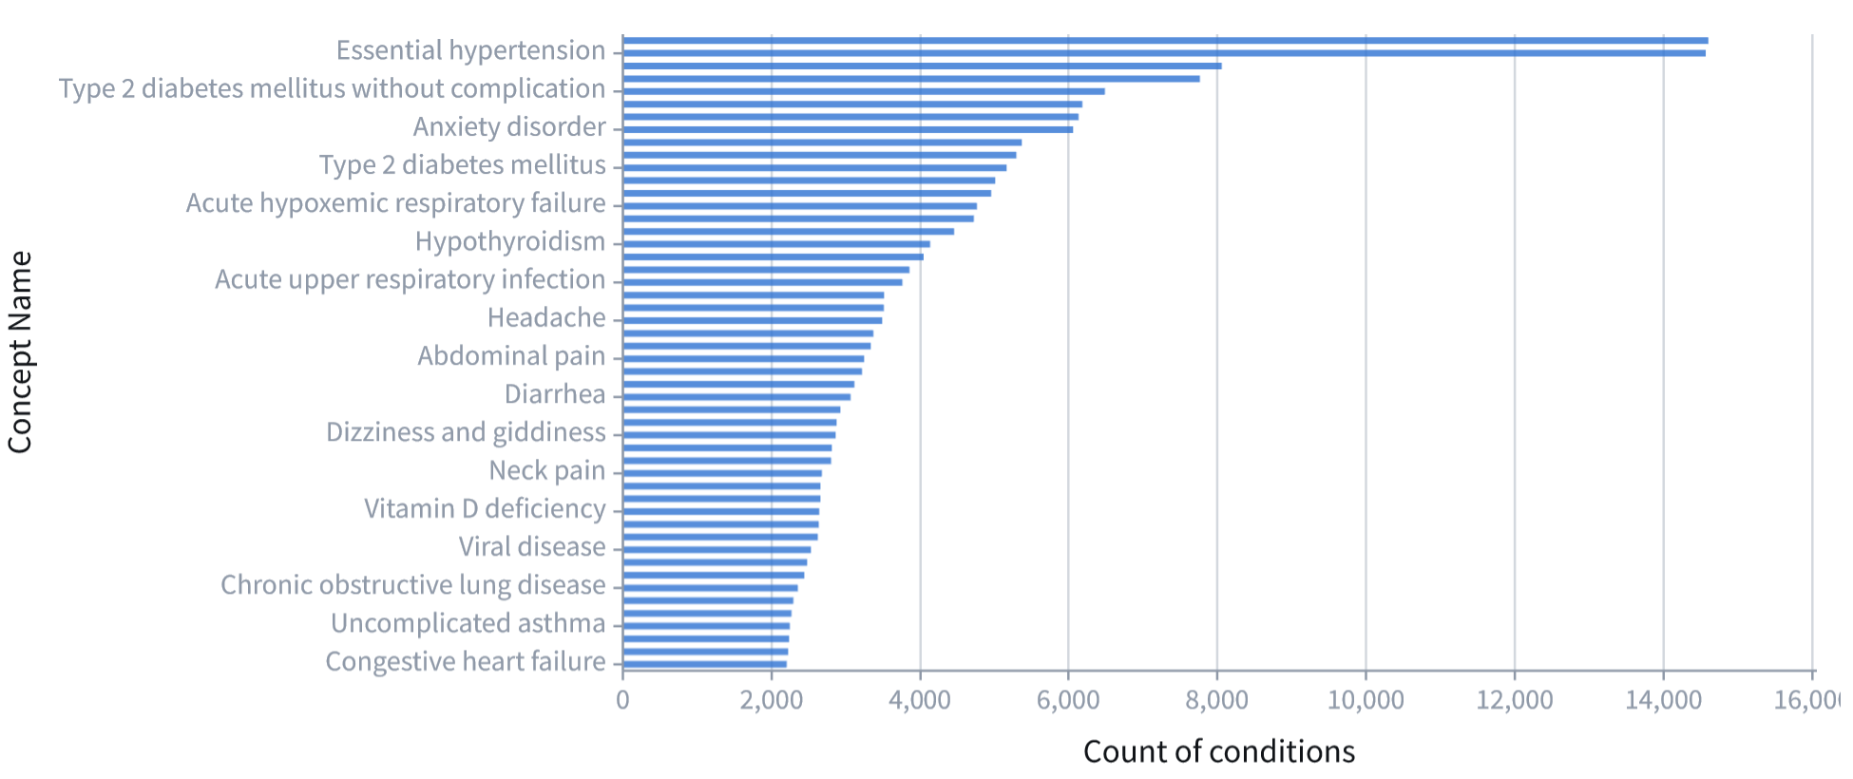
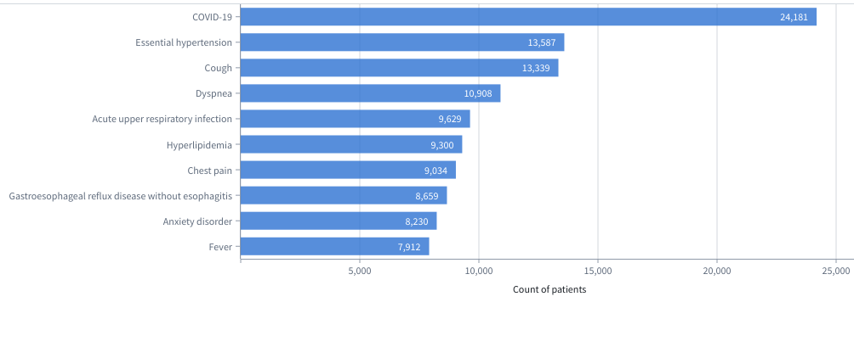
Identifying Prognostic Factors from NIH N3C Clinical Data for Long Covid
Mirna Elizondo, June Yu, Dr. Jelena Tešić Dr. Rasim Musal, Dr. Vangelis Metsis
Department of Computer Science
http://DataLab12.github.io/
Motivation
Data Acquisition and Exploratory Data Analysis​
Baseline Modeling
Since the beginning of the COVID-19 pandemic there has been an increase in research studying the novel SARS-CoV-2 virus, trying to expand the limited knowledge of the signs, symptoms and effective courses of treatment for this virus. As the pandemic evolves we must considering the lasting effects or Long Covid condition.
If we can identify the most significant prognostic factors on patients from the NCATS’ National COVID Cohort Collaborative (N3C) Data Enclave, we can help improve public health officials make more informative decisions on PASC/Long Covid recovery and prevention.
[1]
Data Set | Columns | Rows
visit_occurence | 23 | 3.5m
provider | 18 | 31.7k
procedures_to_macrovisits | 8 | 992k
procedure_occurrence | 19 | 2.8m
person | 26 | 57.7k
payer_plan_period | 7 | 1.4m
observation | 25 | 45.4k
microvisits_to_macrovisits | 26 | 6.9m
measurement_to_macrovisits | 8 | 3.5m
note | 19 | 17.8m
note_nlp | 21 | 321k
measurement_to_macrovisits | 30 | 7.6m
manifest_safe_harbor | 13 | 32.6m
location | 9 | 69
Long COVID Silver Standard | 5 | 25.1k
drug_exposure | 28 | 57.7k
drug_era | 9 | 13.6k
device_exposure | 19 | 2.1m
condtion_to_macrovisit | 8 | 422k
condition_occurrence | 21 | 1.3m
condition_era | 8 | 2.5m
care_site | 8 | 8.4k
[2]
The models will be built on feature sets consisting of patient demographics, conditions, observations, durations, and drugs to predict developing Long Covid.
Feature space is imbalanced causing poor performance and accuracy of the current tested models
[3]
Figures:
[1] Patient Age Groups
[2] Patient Sex
[3] Recurring conditions
[4] Number of patients observed in recurring conditions
Research Questions
Implement an end-to-end L3C data integration, aggregations, modeling, and outcome analysis module as proof-of-concept comparing finding to baseline study
Assess whether the main findings reported in the study are replicated in the more diverse population of the N3C enclave.
Disseminate clinical guidance and educational materials relating Long Covid
Are specific cohorts more likely to develop Long Covid and at what level of severity?
Do patients from different age groups show different factors that could lead to developing Long Covid ?
Conclusion
[4]
Although our data consist of mostly males, female patients shows a statistically significant prognostic factor.
Patients who tested positive for Long Covid prior to four weeks from testing positive for Covid-19, showed a lower time_to_pasc average.
Out of 57,672 patients: 11, 446 had SARS-COV-2 twice, 9,031 have long covid diagnosis.
From this we were able to create datasets consisting of patient Demographics, Observations, Conditions, and Drugs
Long Covid Computational Challenge
Acknowledgment
Additional Research Step
The N3C Data Enclave
The N3C’s data consists of existing patient records at 94 participating institutions.
The data itself can only be accessed through a secure cloud portal hosted by NCATS known as the Enclave
With collaborative efforts it consists of:
20 billion rows, 1,757.1 million clinical observations, 16.4 million patients, and 6,438,192 SARS-CoV-2 cases
Under the university’s DUR we have access to Level 2 data.
Dataset includes:
Demographics, symptoms, lab test results, procedures, medications, medical conditions, physical measurements and more.
Findings:
We have condition information for 38,044 patients and information for 14,476 conditions that lasted from 1-409 days.
We have observation information for 38,340 patients and have 2,744 total observations including 14, 159 prescribed drugs.
The analyses described in this poster were conducted with data or tools accessed through the NCATS N3C Data Enclave https://covid.cd2h.org and N3C Attribution & Publication Policy v 1.2-2020-08-25b supported by NCATS U24 TR002306 and DataLab12. This research was possible because of the patients whose information is included within the data and the organizations and scientists who have contributed to the on-going development of this community resource
Data Cleaning
N3C Enclave provided 23 initial datasets
Datasets were normalized and unsignificant features were dropped
Enclave Tools
Preparation Cleaning
Modeling Datasets
Demographics
Contour Analysis Tool
Code Workbook
Reports
PySpark
Observations
Conditions
Drugs
Patients
Notes:
Poster Instructions posted on Canvas
1. Your poster should be of 40 inches by 30 inches in size 2. Remember that the text and figures should be legible from 3-5 feet away. This means use 36 pt. minimum 3. Poster should have roughly 20% text, 40% figures and 40% space 4. Use sans serif fonts for readability from a distance 5. Putting information in bullet form is better than in sentences 6. Don’t use a distracting background, and make sure there is sufficient contrast between the background and text. Please also prepare a one-minute speech to explain your poster. Highlight the main contributions.

