Slide 1

Predicting PASC/Long COVID in patients from the NIH N3C Clinical Data
Mirna Elizondo
Datalab12

Slide 2
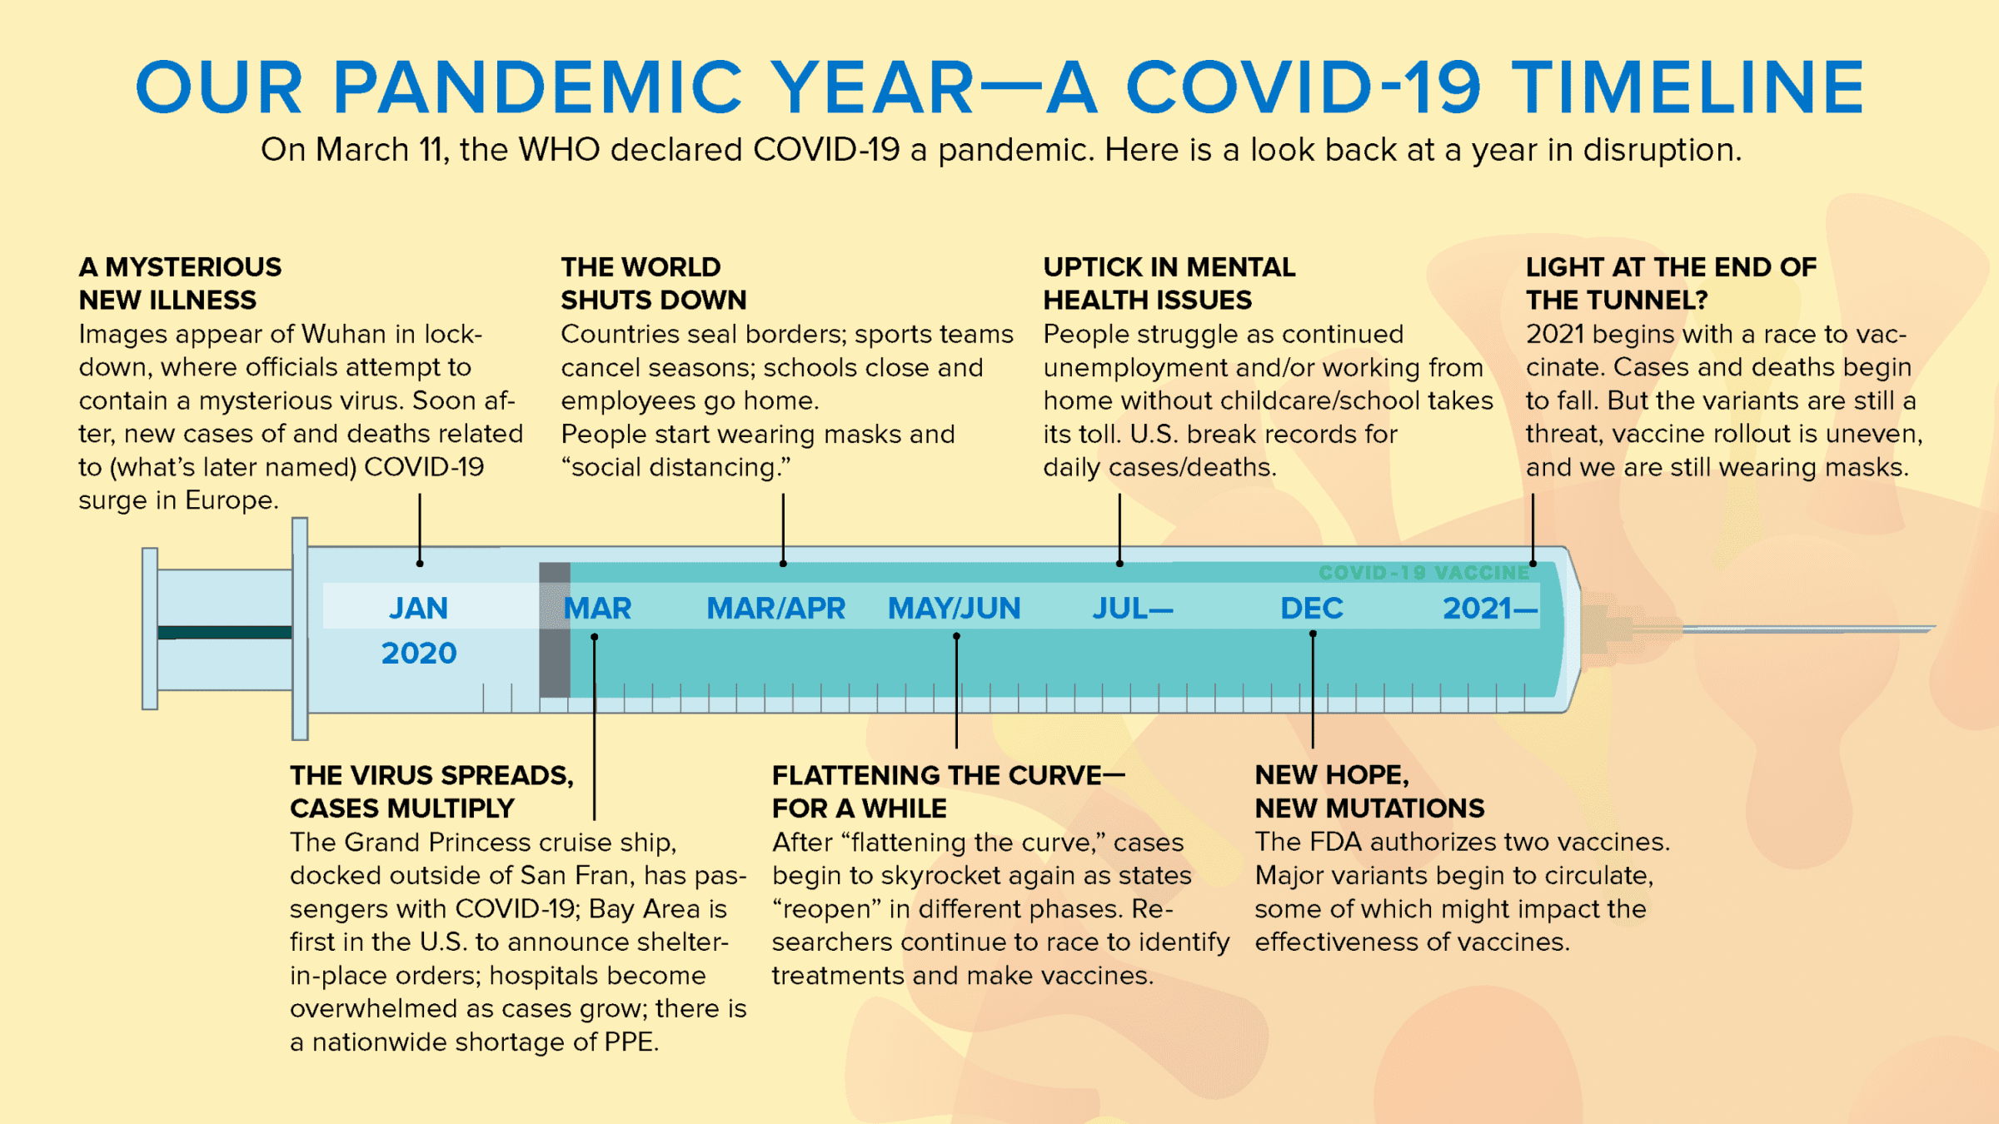
Motivation
Katella, K. (2021). Our Pandemic Year - A Covid -19 Timeline. YaleMedicine. Yale University. etrieved October 29, 2022, from https://www.yalemedicine.org/news/covid-timeline.

Slide 3
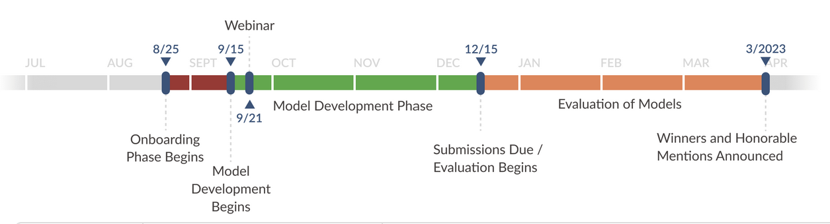
Purpose of Project
Using N3C Enclave we attempt to identify the strongest factors using attribute selection methods:
Predict a label:
1 – Patient shows PASC/Long Covid symptoms
0 – Patient does not show symptoms
“Solutions should provide a percentage likelihood of developing PASC/Long COVID among patients who have tested positive for SARS-CoV-2.”

Slide 4
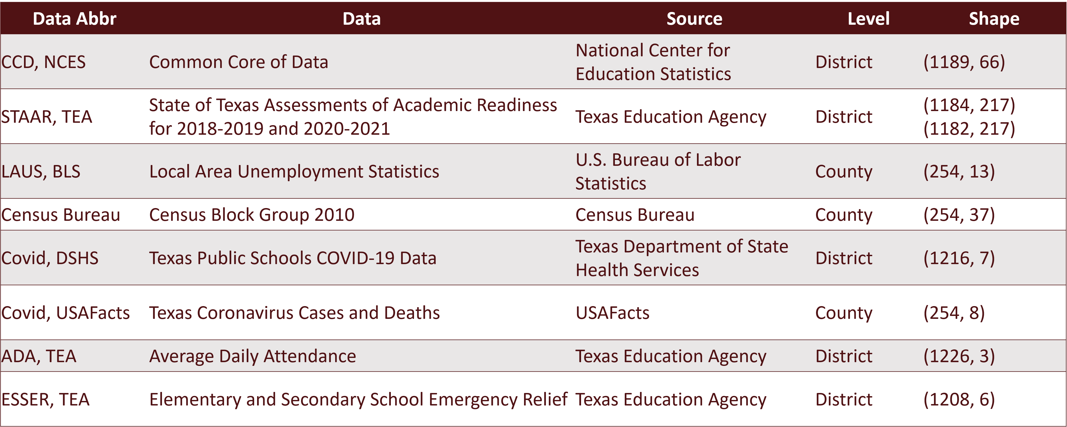
Prior Work:
Resilience Factors
Gradient Boosting Modeling Improvement for Policy Planning and identifying weakest links in Texas Public School System
June Yu, Daniel Payan, Jelena Tešić -Computer Science Department
Li Feng Economics Department
Texas State University
Are students from low-income backgrounds and minority students experiencing more learning loss?
Do students of different grade levels experience learning loss differently?
Is the mode of instruction (hybrid, remote, in person) related to learning loss?
Is school or district attendance negatively correlated with learning loss?
Does the local or regional infection rate lead to more learning loss?
Does the local unemployment rate negatively affect learning losses?

Slide 5
Background
“Anecdotal information about long COVID abounds, but what we need is accurate, comprehensive scientific evidence. Our study will provide critical information for public health, patients and the clinicians who care for people with long COVID.”
- Dr. Grannis also is a professor of family medicine at Indiana University School of Medicine.
Regenstrief and IU developing one of first population-based surveillance systems for long COVID to determine prevalence, trends and outcomes
September 7, 2022
https://www.regenstrief.org/article/developing-first-population-based-surveillance-systems-for-long-covid/
https://healthitanalytics.com/features/how-machine-learning-can-guide-covid-19-decision-making
Notes:
The study: develop an algorithm to effectively predict resource utilization for specific populations (how many resources youll need)
The research team utilized clinical data from the Indiana Network for Patient Care (INPC) to train decision models that predicted healthcare resource utilization. They used data from 96,026 patients in all 957 zip codes in Indiana. containing over 14 billion pieces of patient data.
By examining social determinants of health information and incorporating patient data into algorithms, machine learning can assist in identifying patients who are more likely to need medical resources such as ventilators due to COVID-19 hospitalization, Kasturi said.

Slide 6
Methodology
Data Collection
N3C Enclave
Data Validation
Current
Next two weeks
Feature Selection
Evaluation and Validation of the model
Optimization and retraining
Spring2023

Slide 7
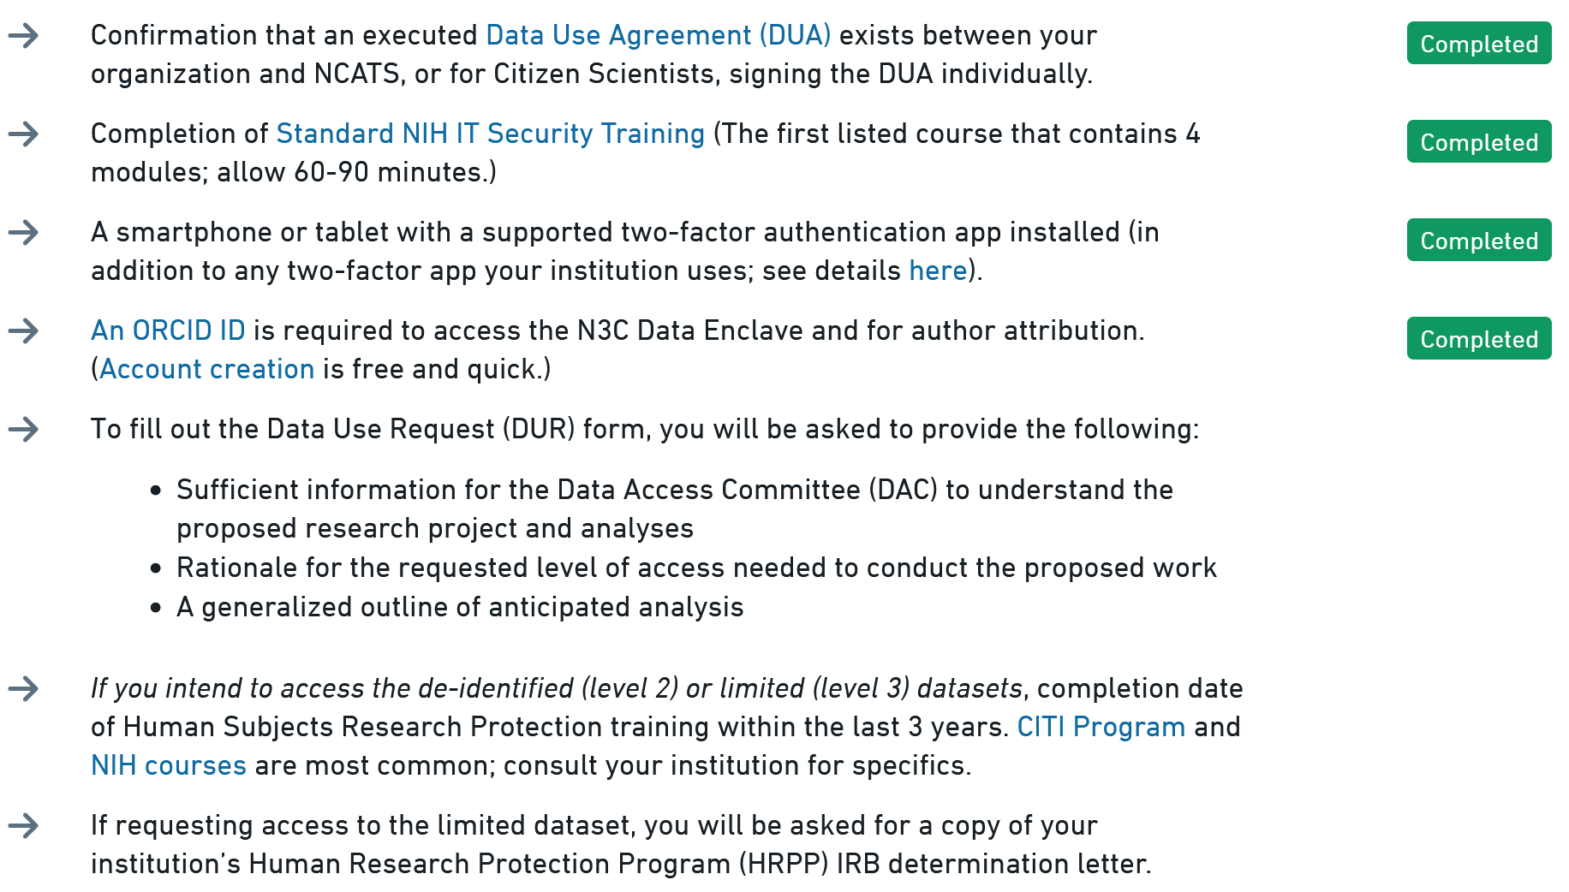
Initial Delay

Slide 8
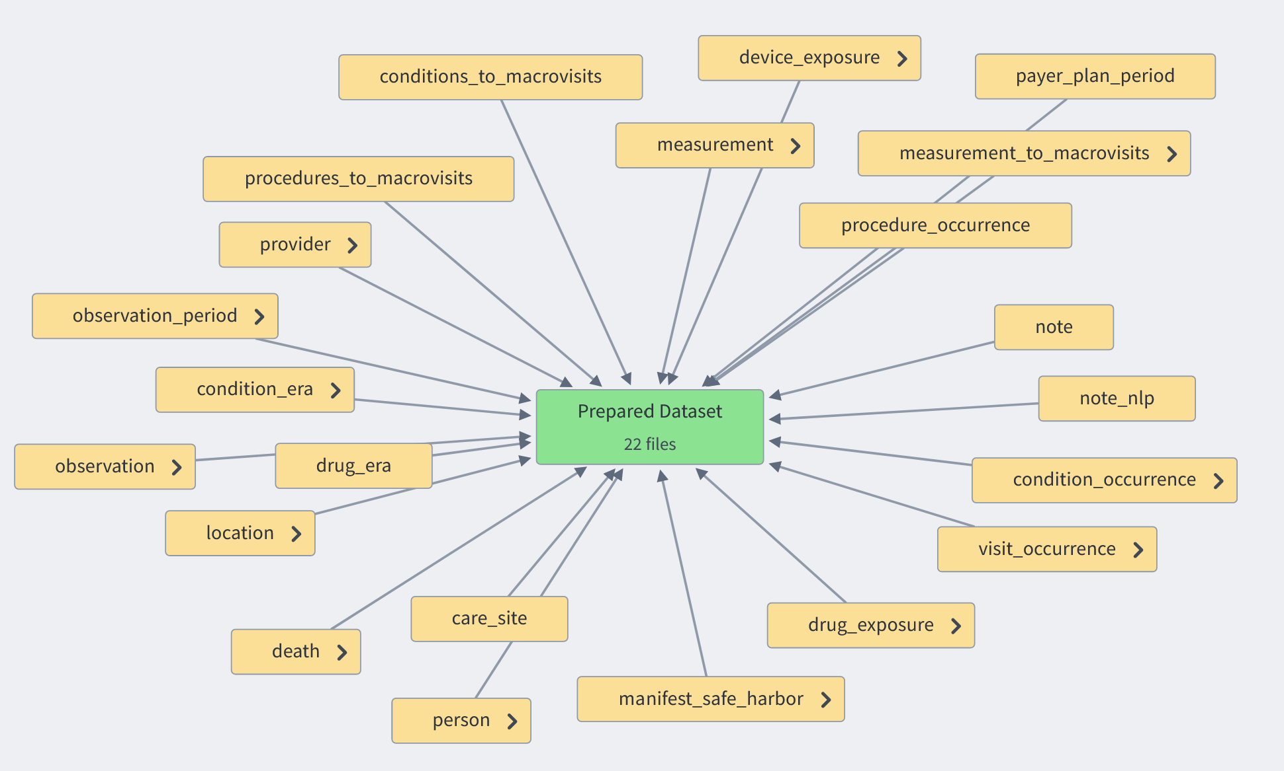
Training Set
Uncensored – 22
“deaths”
Censored – 20
“Long COVID Silver Standard”

Slide 9
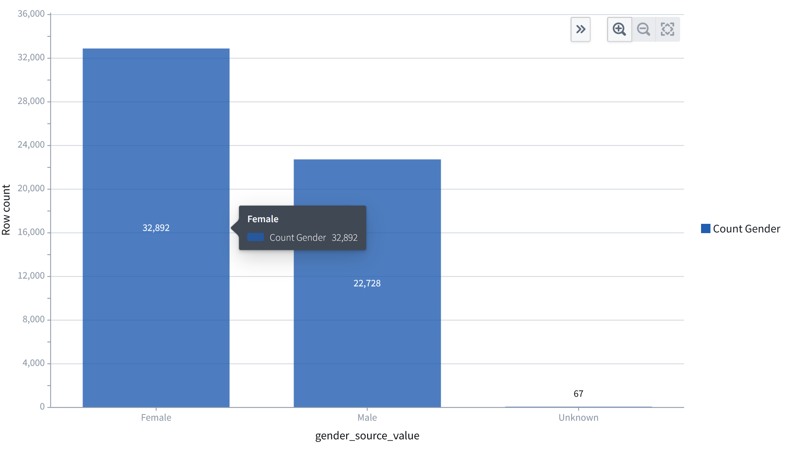
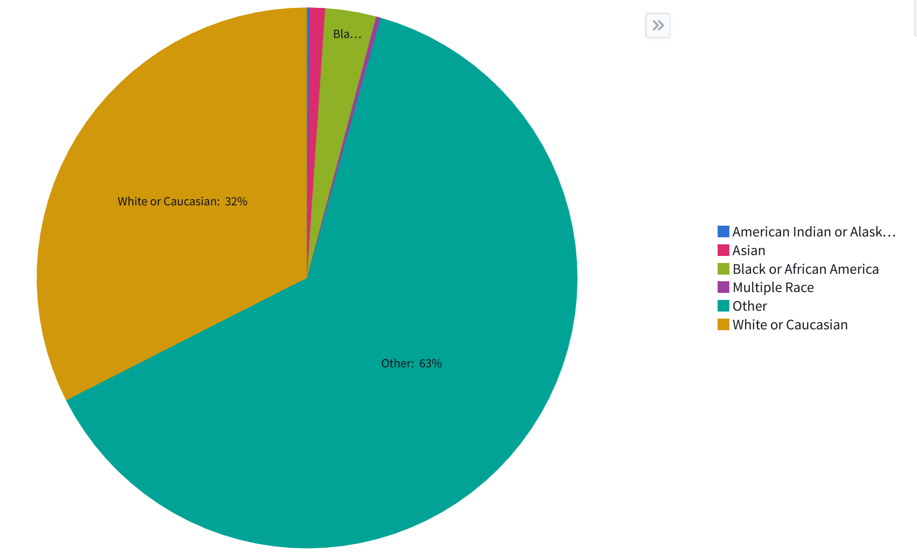
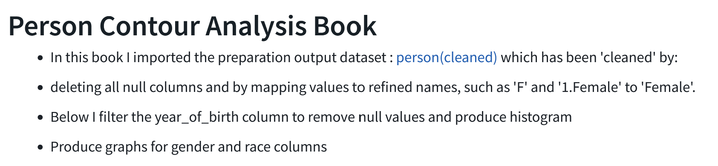
Challenge Data

Slide 10
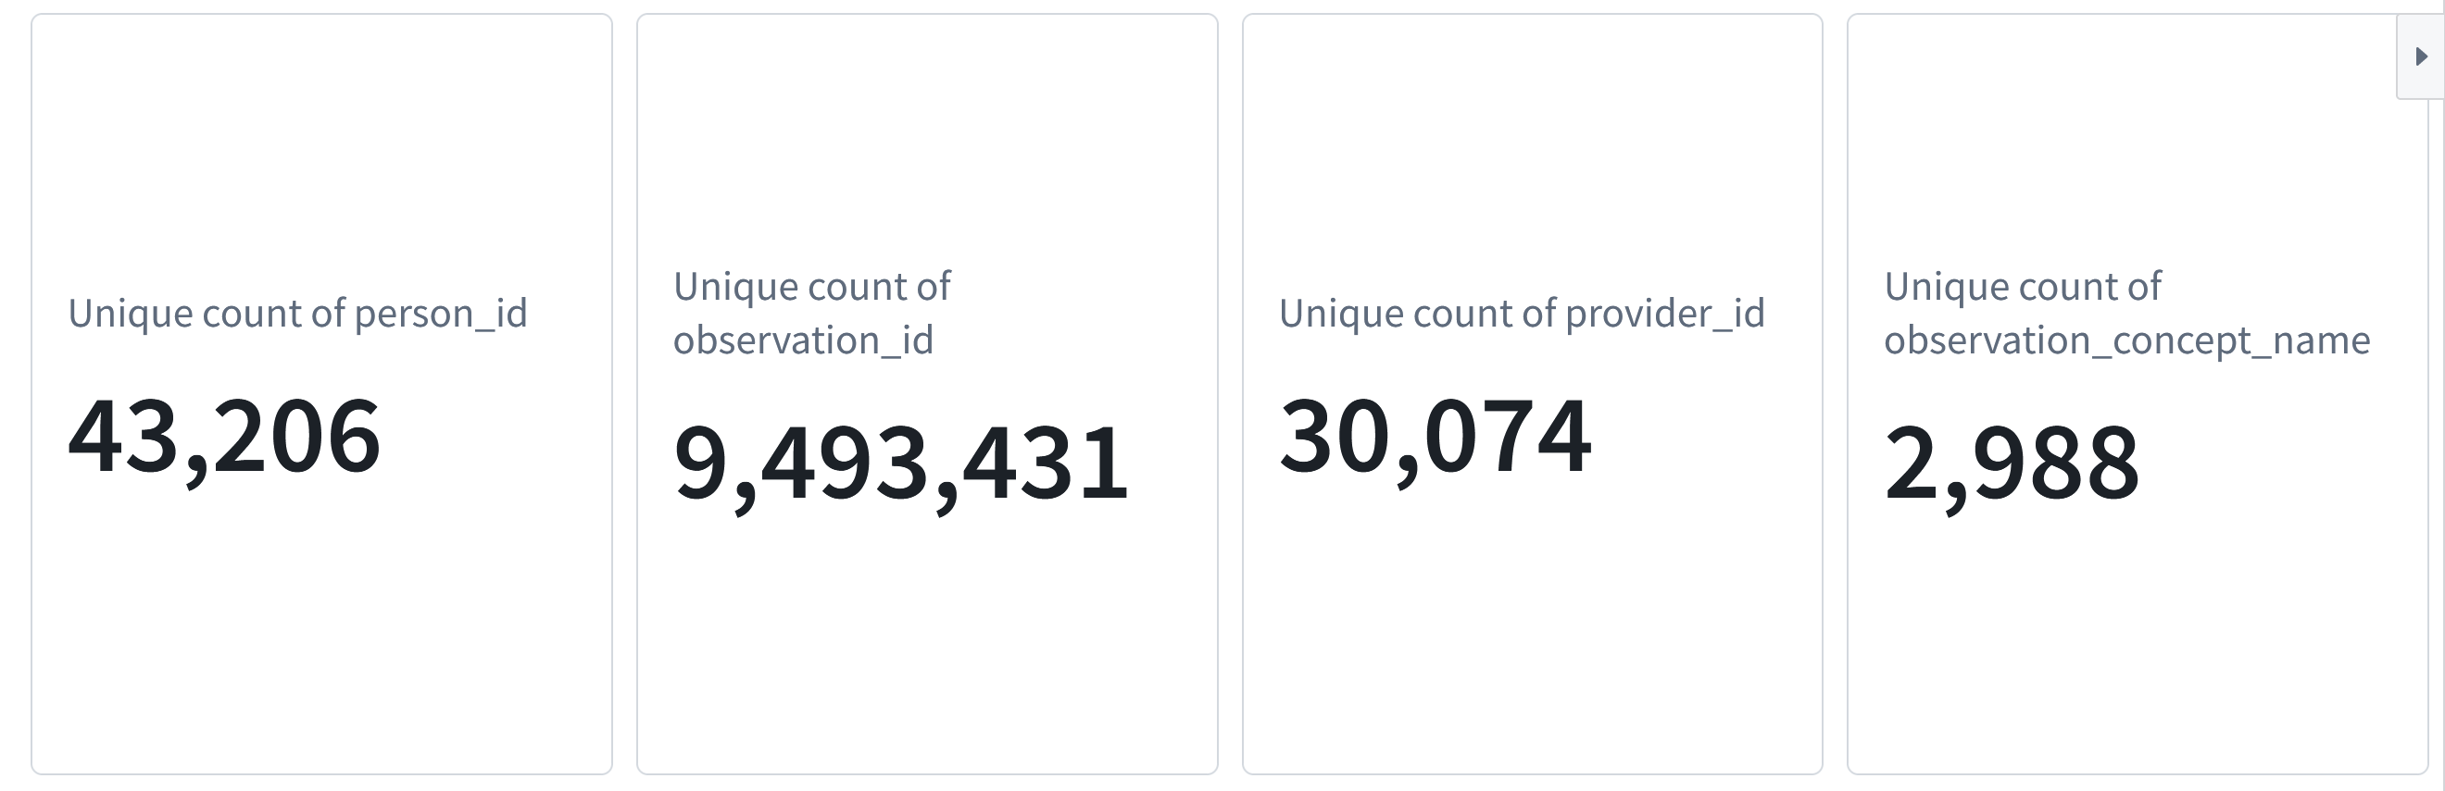
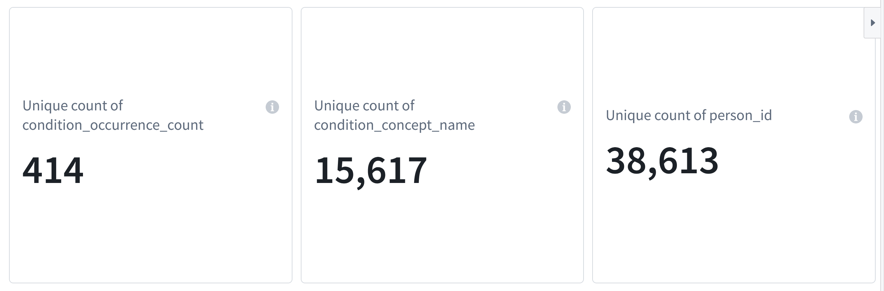

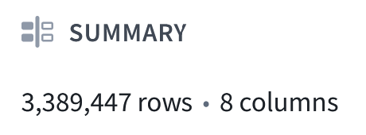
Conditions & Observations

Slide 11
Project Plan
Feature Selection:
- Filter Methods
- Variance Threshold
- Embedded Methods
- L1 Regularized Logistic Regression (Lasso)
- Random Forest Feature Importance
- Wrapper Methods
- Recursive Feature Elimination (RFE) with Random Forest
- Recursive Feature Elimination (RFE) with Ridge Regression
- Permutation Importance with Random Forest
- Permutation Importance with Ridge Regression
- Sequential Feature Selection (SFS) with KNN
- Sequential Feature Selection (SFS) with Ridge Regression
Prediction Aspect:
Gradient Boosting models
- Advanced models:
- XGBoost
- LightGBM
- CatBoost
- HistGradientBoost
- Performance metrics:
- Accuracy
- Matthews Correlation Coefficient (MCC)

Slide 12
Thank You!
The described analysis n this presentation was conducted as part of activities associated with the NIH Long COVID Computational Challenge (L3C). The L3C Challenge was supported by the Rapid Acceleration of Diagnostics (RADx®) Initiative and by the efforts of the National COVID Cohort Collaborative (N3C) and NCATS

