Slide 1
Detecting Hate Speech in Tweets
LING 573 Deliverable 4
Team: PlaceboAffect
(Mohamed Elkamhawy, Karl Haraldsson, Alex Maris, Nora Miao)
Notes:
Mohamed

Slide 2


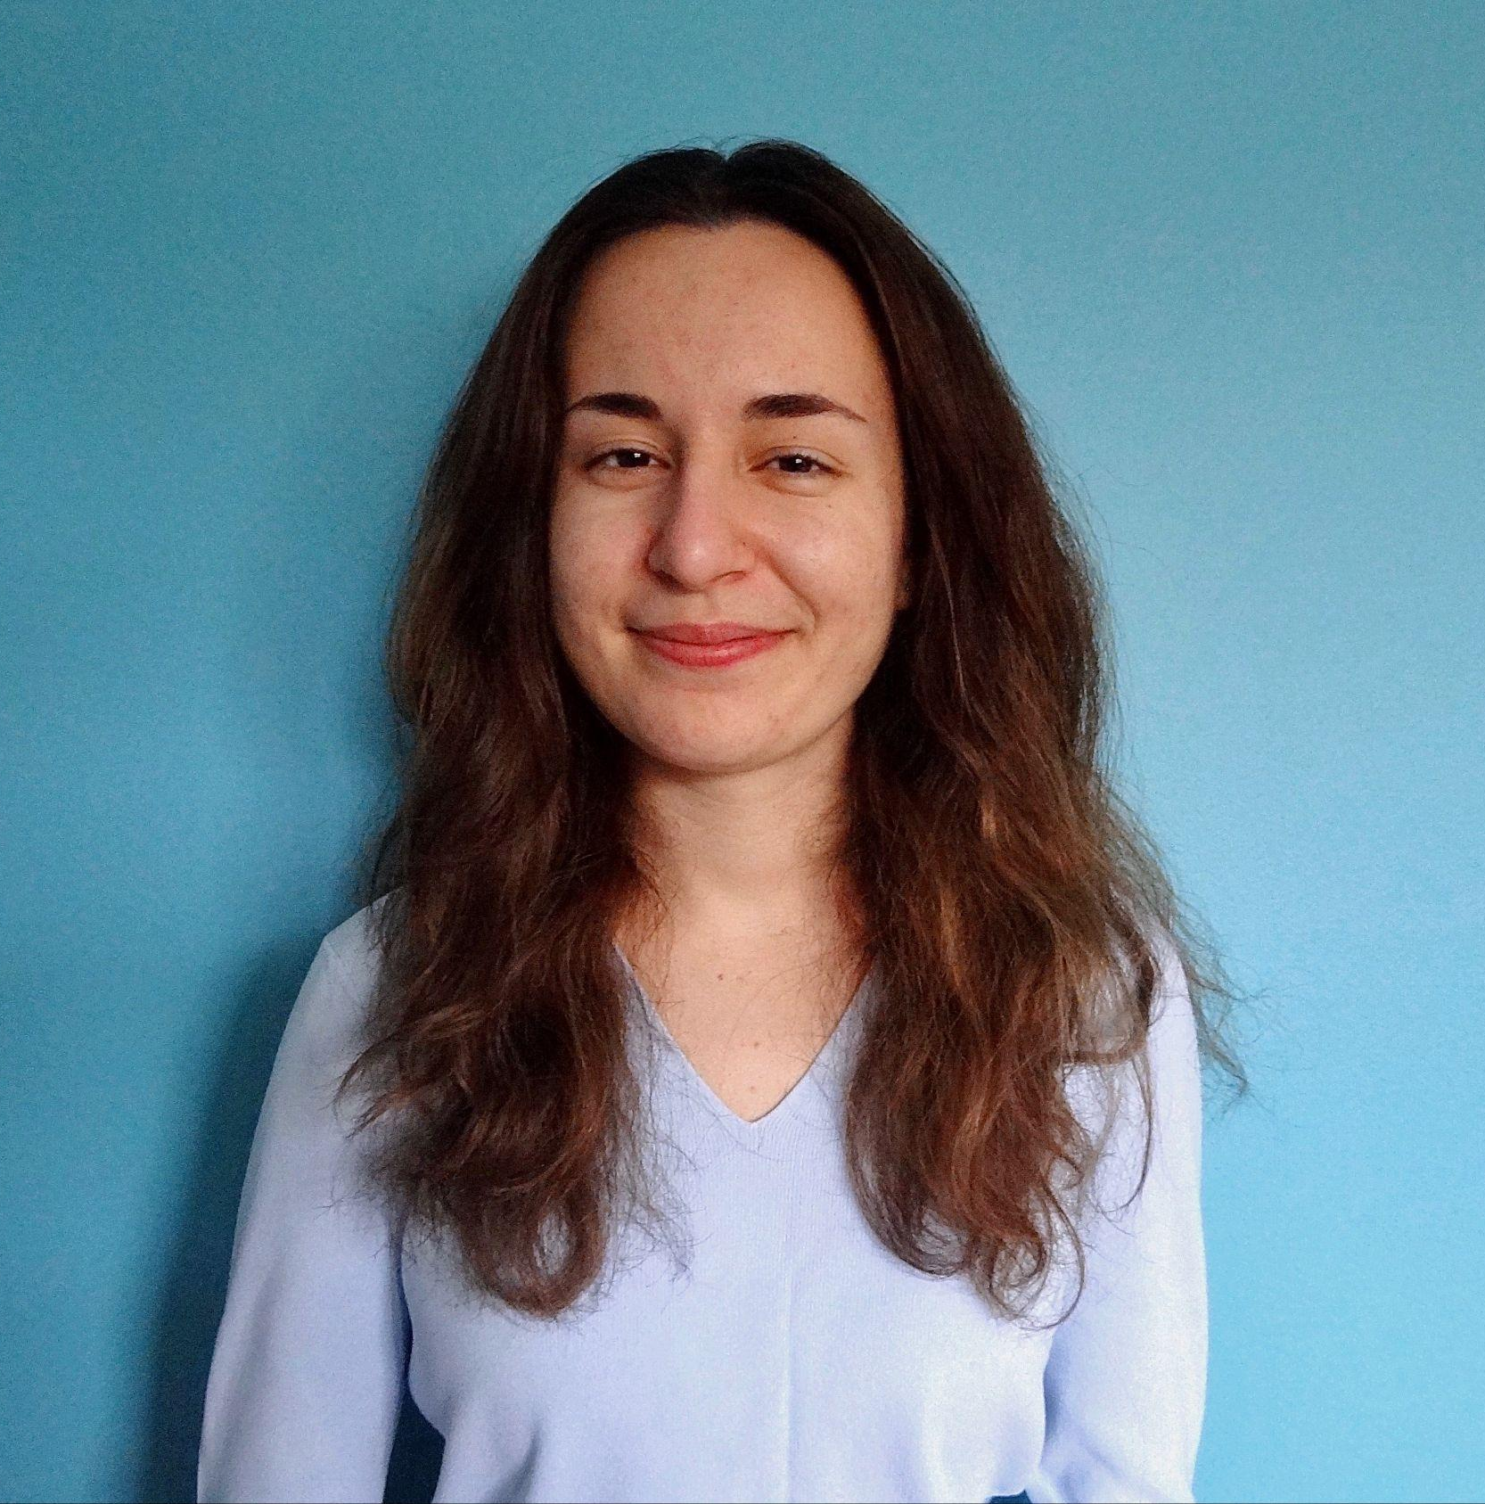

Our Team: PlaceboAffect
Mohamed Elkamhawy
mohame@uw.edu
Karl Haraldsson
kharalds@uw.edu
Alex Maris
alexmar@uw.edu
Nora Miao
norah98@uw.edu
Notes:
Nora

Slide 3
The Shared Task: Detecting Hate Speech
SemEval 2019 Task 5: Multilingual detection of hate speech against immigrants and women in Twitter (HatEval)
Language: English (primary) and Spanish (adaptation)
Recognition type: binary classification (hate speech or non-hate speech)
Affect type: attitude
Target: aspect-specific
Genre: tweets
Modality: text
Notes:
Nora

Slide 4
The Data
Dataset requested via http://hatespeech.di.unito.it/hateval.html
Collected from July to November 2017 for women-targeted tweets and July to September 2018 for immigrant-targeted tweets
English language dataset: 13,000 tweets (9,000 training, 1,000 development, and 3,000 testing)
Spanish language dataset: 6,600 tweets (4,500 training, 500 development, and 1,600 testing)
See Appendix A for more details regarding annotation guidelines for distinguishing hate speech
Notes:
Nora

Slide 5

Examples
@REDACTED Hurray, saving us $$$ in so many ways @potus @realDonaldTrump #LockThemUp #BuildTheWall #EndDACA #BoycottNFL #BoycottNike
@REDACTED Orban in Brussels: European leaders are ignoring the will of the people, they do not want migrants https://t.co/NeYFyqvYlX
[HATEFUL]
[NOT HATEFUL]
Notes:
Nora

Slide 6
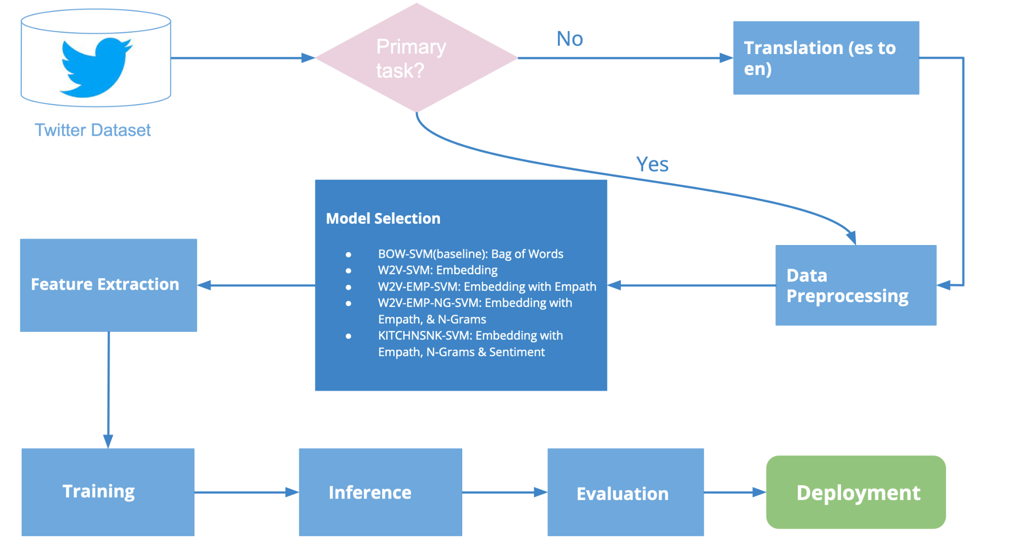
System Architecture
Notes:
Nora
1.5

Slide 7
Approach
 | Preprocessing | Feature Extraction | Training | Inference | Evaluation
Initial System | Tokenize (nltk tweet tokenizer) Lemmatize tokens w/WordNet lemmatizer | Apply CBOW word2vec to produce average tweet embeddings Concatenate lexical information from empath library | SVC from sklearn Grid search for best hyperparameters using dev set Select and save model with best f1_macro score | Use best model from training step (or load model if only performing inference) Feed dev instances into model.predict() Save predictions to output/ | Compare predictions to golden labels, applying sklearn’s accuracy measure as well as macro-averaged versions of precision, recall and f1. Output results to txt file.
Enhanced System | Convert emojis to text (emoji.demojize()) Handle negation | Concatenate sentiment score from vaderSentiment | Tested alternative classification algorithms, e.g., XGBoost, Naive Bayes, Random Forest,etc
Adaptation | deep-translator to translate Spanish tweets into English |  | concatenate english and spanish (translated) training sets
Inputs & Outputs | I: .csv file with tweets O: arrays of tweets & labels | I: array of tweets & labels O: train and dev vectors | I: training vectors O: model object, model file | I: model object, unlabeled instances O: predictions | I: predictions O: results file
Module(s) | features.preprocess | features.extract_features | modeling.classifier | modeling.classifier | main.evaluate
Notes:
Karl
2.0
Drill down into the components of our approach.
Ingest the data and preprocess the text, handled hashtags by removing # and splitting by capitalization (imperfect)
Rm URLs
Tokenize using the nltk tweet tokenizer, which specially handles emoji, @mentions, and URLS (and it splits contractions)
Lemmatize and rm stopwords
Output array of tweets and array of labels
Feature Extraction / FEature engineering Three strategies:
BOW using the CountVectorizer for baseline
Word2vec
Word2vec + lexical scores from the empath library
Output train adn dev vectors
Training
SVC. + 5-fold GridSearchCV model (all on training data)
Note no fine-tuning on dev set.
Best f1-macro (unweighted average of f1 across all classes)
Output model object and file
Inference
System built to either train and test or just test
model.predict() and save preds to output
Calculate macro-averaged precision, recall, and f1 (and acc)

Slide 8
Results (Primary)
Our model substantially outperformed the SemEval 2019 Task 5 Baseline for the Subtask. Also it outperformed our own bag of words baseline model F1-macro (BOW-SVM) by 0.10.
Model | Acc | Prec | Rec | F1-Macro
W2V-SVM (alpha) | 0.52 | 0.54 | 0.54 | 0.52
W2V-EMP-SVM (beta) | 0.50 | 0.54 | 0.55 | 0.49
W2V-EMP-NG-SVM (gamma) | 0.52 | 0.56 | 0.60 | 0.49
KITCHNSNK-SVM (delta) | 0.49 | 0.55 | 0.58 | 0.46
KITCHNSNK-XGBoost (delta) | 0.51 | 0.56 | 0.60 | 0.49
BOW-SVM (D4 baseline) | 0.47 | 0.53 | 0.56 | 0.42
tf-idf SVC (Shared Task Baseline) | - | - | - | 0.45
Notes:
Mohamed
2

Slide 9
Results (Adaptation)
Our model substantially outperformed the SemEval 2019 Task 5 Baseline for the Subtask.
Model | Acc | Prec | Rec | F1-Macro
W2V-SVM (alpha) | 0.66 | 0.64 | 0.65 | 0.64
W2V-EMP-SVM (beta) | 0.70 | 0.65 | 0.77 | 0.64
W2V-EMP-NG-SVM (gamma) | 0.72 | 0.68 | 0.76 | 0.68
KITCHNSNK-SVM (delta) | 0.73 | 0.70 | 0.74 | 0.71
KITCHNSNK-XGBoost (delta) | 0.73 | 0.70 | 0.73 | 0.71
BOW-SVM (D4 baseline) | 0.72 | 0.71 | 0.71 | 0.71
tf-idf SVC (Shared Task Baseline) | - | - | - | 0.70
Notes:
Mohamed
2

Slide 10
Issues and successes
Adaptation task methodology: translating Spanish to English
(+) Reuse English lexical features from primary task
(+) Ability to concatenate primary (English) and adaptation (Spanish) training data
(-) Performance depends on quality of translation
(-) Lose cultural context with translation, and hate speech is often correlated with language-specific slang
Notes:
Karl

Slide 11
Issues and successes
Better performance on dev set compared to test set. Overfit to dev set?
Inefficiencies in training, e.g. speed
Communication norms established early, well-defined task breakdowns
Dataset (Primary task) | Model | F1-Macro
Dev | W2V-SVM (alpha) | 0.65
Test | W2V-SVM (alpha) | 0.52
Dataset (Adaptation task) | Model | F1-Macro
Dev | KITCHNSNK-SVM (delta) | 0.76
Test | KITCHNSNK-SVM (delta) | 0.71
Notes:
Karl

Slide 12
Related Readings
Doris Chinedu Asogwa, Chiamaka Ijeoma Chukwuneke, CC Ngene, and GN Anigbogu. 2022. Hate speech classification using SVM and Naive BAYES. arXiv preprint arXiv:2204.07057.
Valerio Basile, Cristina Bosco, Elisabetta Fersini, Debora Nozza, Viviana Patti, Francisco Manuel Rangel Pardo, Paolo Rosso, and Manuela Sanguinetti. 2019. SemEval-2019 Task 5: Multilingual Detection of Hate Speech Against Immigrants and Women in Twitter. In Proceedings of the 13th International Workshop on Semantic Evaluation, pages 54–63, Minneapolis, Minnesota, USA. Association for Computational Linguistics.
Steven Bird, Ewan Klein, and Edward Loper. 2009. Natural language processing with Python: analyzing text with the natural language toolkit. O’Reilly Media, Inc.
Elisabetta Fersini, Paolo Rosso, and Maria Anzovino. 2018. Overview of the task on automatic misogyny identification at ibereval 2018. In Proceedings of the 3rd Workshop on Evaluation of Human Language Technologies for Iberian Languages (IberEval 2018), volume 2150, pages 214–228.
Ethan Fast, Binbin Chen, and Michael S Bernstein. 2016. Empath: Understanding topic signals in large-scale text. In Proceedings of the 2016 CHI conference on human factors in computing systems, pages 4647–4657.
Notes:
Karl

Slide 13
Thank you.

Slide 14
Appendices

Slide 15
Appendix A: Annotation Guidelines
HS against immigrants may include:
insults, threats, denigrating or hateful expressions
incitement to hatred, violence or violation of rights to individuals or groups perceived as different for somatic traits (e.g. skin color), origin, cultural traits, language, etc.
presumed association of origin/ethnicity with cognitive abilities, propensity to crime, laziness or other vices
references to the alleged inferiority (or superiority) of some ethnic groups with respect to others
delegitimation of social position or credibility based on origin/ethnicity
references to certain backgrounds/ethnicities as a threat to the national security or welfare or as competitors in the distribution of government resources
dehumanization or association with animals or entities considered inferior
Tweets had to meet BOTH of the following criteria:
the tweet content MUST have IMMIGRANTS/REFUGEES as main TARGET, or even a single individual, but considered for his/her membership in that category (and NOT for the individual characteristics)
we must deal with a message that spreads, incites, promotes or justifies HATRED OR VIOLENCE TOWARDS THE TARGET, or a message that aims at dehumanizing, hurting or intimidating the target
See https://github.com/msang/hateval/blob/master/annotation_guidelines.md

Slide 16
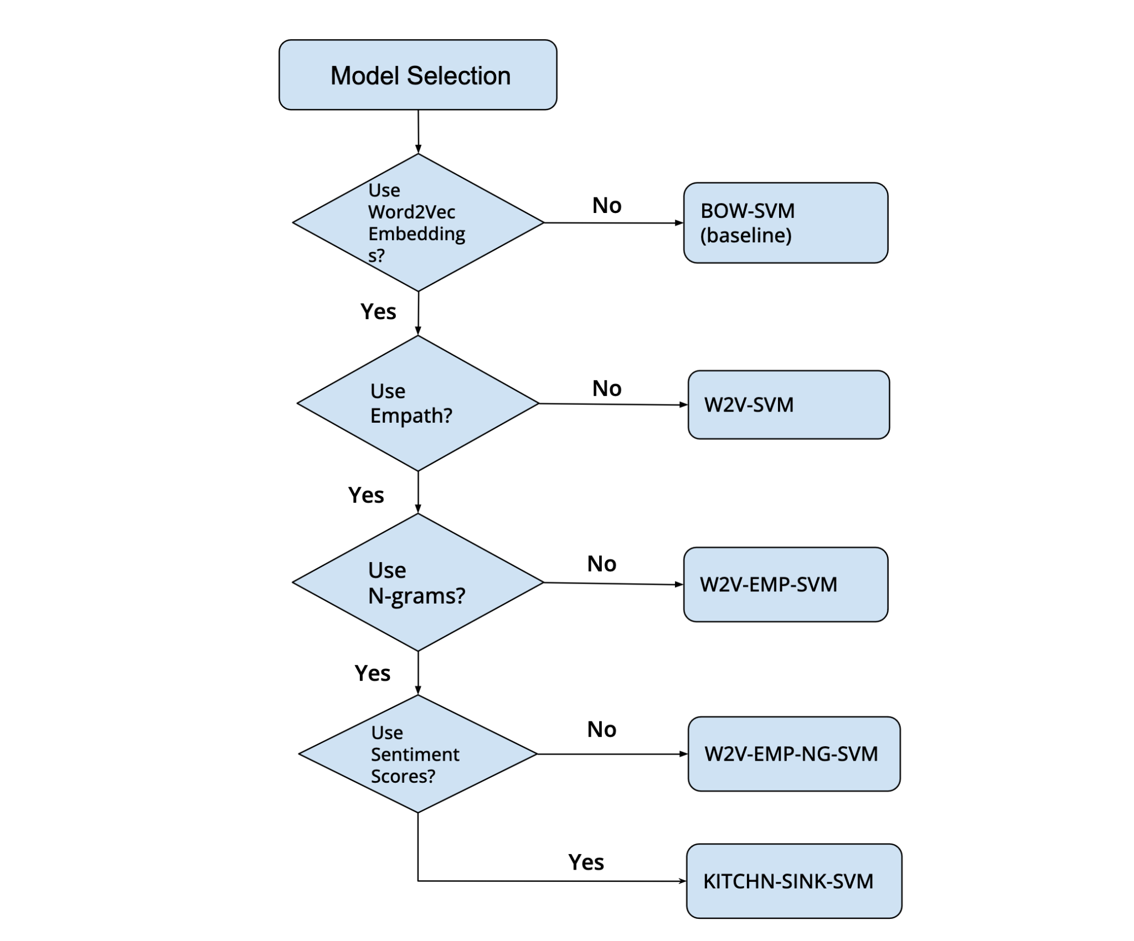
Appendix B: Model Selection

Slide 17
Appendix C: Issues and successes
High amount of false negatives for the W2V approaches
Improvement in recall when using more lexical features (for English evaltest)
English Evaltest Spanish Evaltest
Model | TP | TN | FP | FN
BOW-SVM | 1134 | 277 | 1463 | 126
W2V-SVM | 845 | 713 | 1027 | 415
W2V-EMP-SVM | 979 | 528 | 1212 | 281
W2V-EMP-NG-SVM | 1090 | 460 | 1280 | 170
KITCHNSNK-SVM | 1120 | 361 | 1379 | 140
Model | TP | TN | FP | FN
BOW-SVM | 423 | 727 | 213 | 237
W2V-SVM | 329 | 727 | 213 | 331
W2V-EMP-SVM | 218 | 908 | 32 | 442
W2V-EMP-NG-SVM | 277 | 877 | 63 | 383
KITCHNSNK-SVM | 349 | 821 | 119 | 311
Notes:
Alex
0.5

Slide 18
Appendix C: Issues and successes (evaltest primary)
Scores of words containing ‘stupid’ for the BOW approach
Scores of words containing ‘stupid’ for the W2V-SVM approach
Scores of words containing ‘stupid’ for the W2V-EMP-SVM approach
 | Negative | Positive
Model predictions | 2 | 13
True labels | 13 | 2
 | Negative | Positive
Model predictions | 7 | 8
True labels | 13 | 2
 | Negative | Positive
Model predictions | 7 | 8
True labels | 13 | 2
Notes:
Alex
0.5

Slide 19
Appendix C: Issues and successes (evaltest adaptation)
Tweets containing “deportation”
Spanish evaltest:
 | Negative (non-HS) | Positive (HS)
BOW predictions | 3 | 4
W2V predictions | 6 | 1
EMP predictions | 6 | 1
NG predictions | 5 | 2
KS predictions | 3 | 4
True labels | 0 | 7

Slide 20
Appendix C: Issues and successes
Train vs. dev vs. test set distributions
Dataset (Primary task) | # documents | % hate speech
Train | 9000 | 42.0%
Dev | 1000 | 42.7%
Test | 3000 | 42%
Dataset (Adaptation task) | # documents | % hate speech
Train* | 13500 | 41.8%
Dev | 500 | 44.4%
Test | 1600 | 41.3%
*adaptation training set consisted of the original adaptation training data and the primary training data

Slide 21
Appendix C: Issues and successes (evaltest primary)
TP tweets had the highest average empath ‘hate’ score, then TN and FP, and last FN
‘swearing_terms’ scores had the largest difference between true labeled hate speech (TP, 0.0601) and non hate speech (FP, 0.0187)
However, the model classified high scoring ‘swearing_terms’ tweets as positive for hate speech
 | TP | TN | FP | FN
Average score of ‘hate’ | 0.00462 | 0.00341 | 0.00324 | 0.00318
 | TP | TN | FP | FN
Average score of ‘swearing_terms’ | 0.0601 | 0.0187 | 0.0346 | 0.0152
Notes:
Alex
0,5

Slide 22
Appendix C: Issues and successes (evaltest adaptation)
FP tweets had the highest average empath ‘hate’ score, then FN and TP, and last TN
‘swearing_terms’ scores had the largest difference between true labeled hate speech (TP, 0.1078) and non hate speech (FP, 0.0701)
However, the model classified high scoring ‘swearing_terms’ tweets as positive for hate speech
 | TP | TN | FP | FN
Average score of ‘hate’ | 0.00275 | 0.00253 | 0.00486 | 0.00441
 | TP | TN | FP | FN
Average score of ‘swearing_terms’ | 0.1078 | 0.0090 | 0.0701 | 0.0116
Notes:
Alex
0,5

