Slide 1
EARLY DETECTION OF STUDENT DROPOUT

Slide 2
1. PROBLEM STATEMENT
Student dropout is a serious challenge in education.
Leads to:
Wasted resources for schools & parents.
Fewer opportunities for students.
Lower institutional performance.
Many students show early warning signs → poor grades, absences, lack of support.
Solution: Use machine learning to predict dropout risk early.
Impact: Helps schools intervene, support students, and improve retention.

Slide 3
2. DATASET
The dataset contains information about 1,200 students with 14 variables that capture demographic, academic, and socio-economic factors. These features are used to predict whether a student is at risk of dropping out

Slide 4
Demographic Features:
Gender → Male or Female
Age → Student’s age
Parental_edu → Parent’s highest education level

Slide 5
Academic Features:
Study_time → Weekly study hours
Failures → Number of past class failures
Absences → Number of school absences
G1, G2, G3 → Grades in three evaluation periods

Slide 6
Support & Activities:
Family_support → Extra family support (Yes/No)
Paid_classes → Additional paid classes (Yes/No)
Activities → Participation in extra activities (Yes/No)
Internet → Internet access at home (Yes/No)

Slide 7
Target Variable:
Dropout → Indicates whether the student dropped out (Yes) or continued (No).

Slide 8
3. EDA Findings
Dropout rate: 22% of students.
Grades: Dropouts had lower grades in all periods.
Failures: More failures among dropouts.
Absences: Similar for both groups.
Study Time: Dropouts studied slightly less.

Slide 9
4. MODEL BUILDING & EVALIATION
Built a RandomForest model (150 trees).
Data split: 80% training / 20% testing.
Achieved ~85% accuracy.
Confusion matrix shows good balance between dropout and non-dropout predictions.
Key features: Final grade (G3), absences, and failures.

Slide 10
5. MODEL DEPLOYMENT
I deployed my model using a Streamlit web app.
I can upload student data in CSV format and the model makes predictions.
The trained model file (rf_dropout_model.joblib) is loaded in the app.
After uploading, I can preview the data and then get the dropout risk prediction (0 = continue, 1 = dropout).
The app provides a simple interface: Upload → Preview Data → Predict → Display Results.

Slide 11
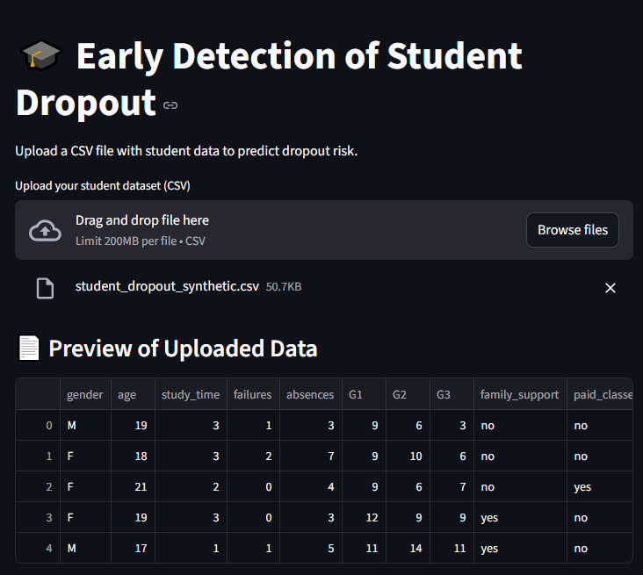

Slide 12
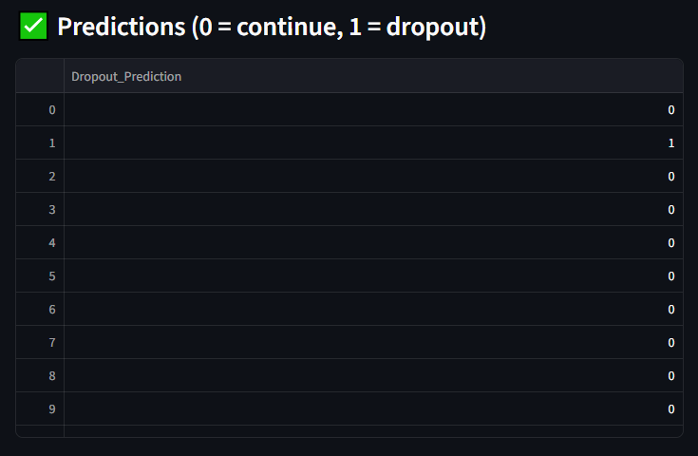

Slide 13
END

