Slide 1
Reversi
Mark Erends
Traineeship Java
Young Capital Professionals

Slide 2

Reversi rules?

Slide 3
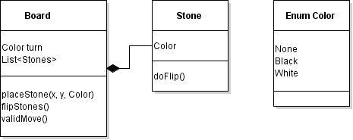
Pojo’s

Slide 4
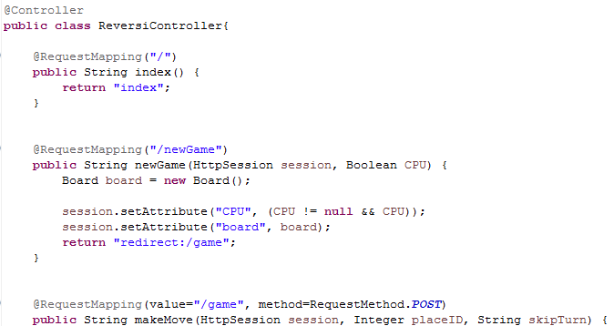
Spring MVC - Controller

Slide 5
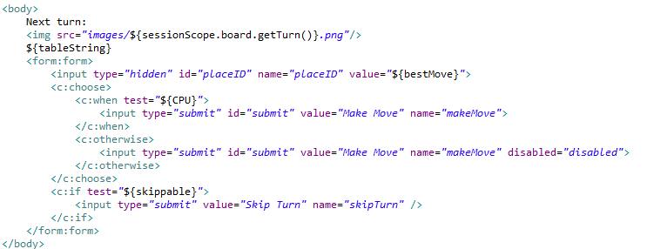

Spring MVC – View & JSTL

Slide 6
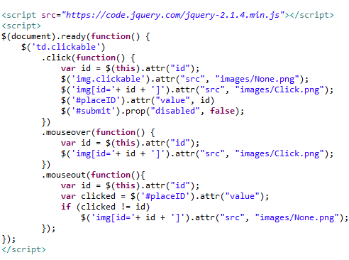


JavaScript & jQuery CSS

Slide 7
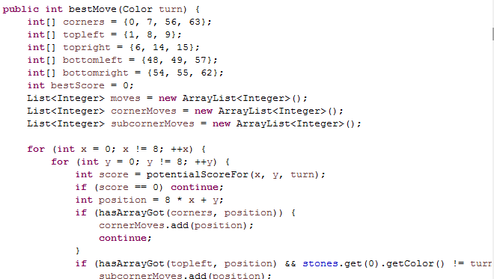

Play versus A.I.

Slide 8
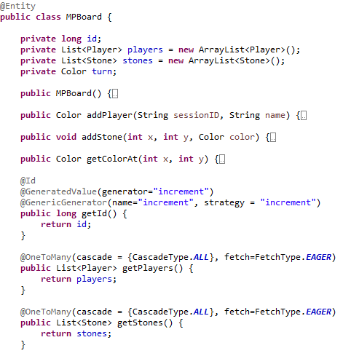
Play online, Store in database!
JPA & Hibernate
@

Slide 9
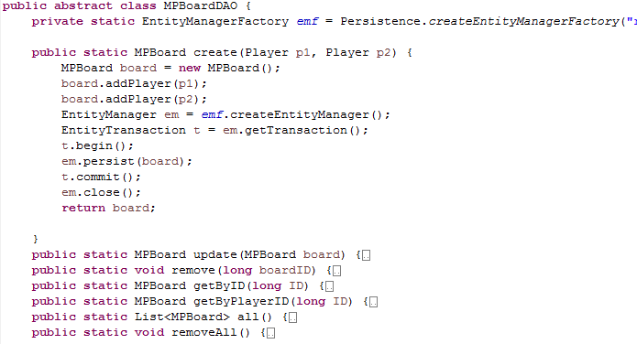
Data Access Object

Slide 10
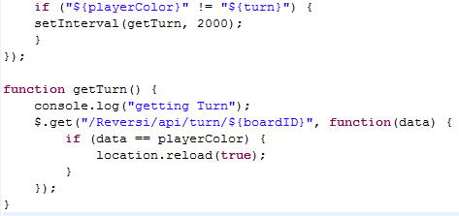

AJAX

Slide 11

DEMO!

Slide 12
Future plans
Chatbox
Error-500-proof
High scores
Graphics?

Slide 13

Thank you for your attention

Slide 14

Drinks!

