Slide 1
Reversi
Mark Erends
Traineeship Java
Young Capital Professionals

Slide 2

Reversi rules?

Slide 3
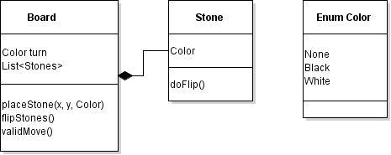
Pojo’s

Slide 4
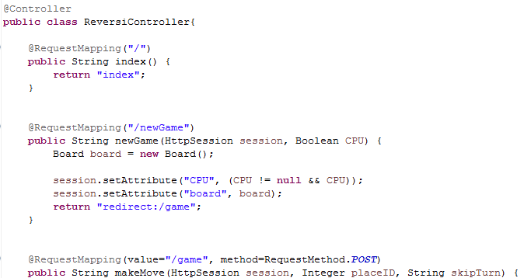
Spring MVC - Controller

Slide 5
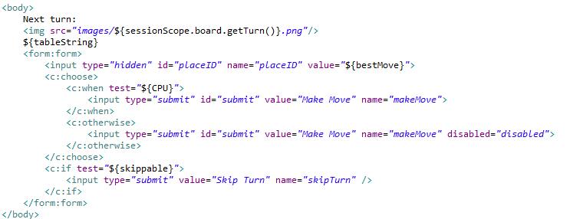

Spring MVC – View & JSTL

Slide 6
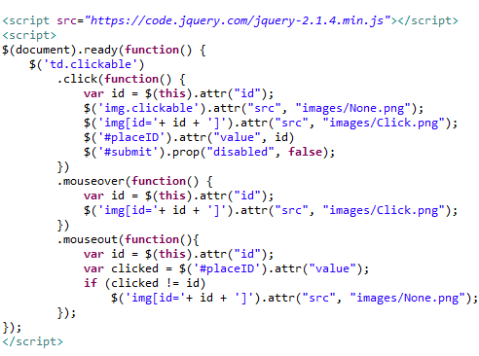


JavaScript & jQuery CSS

Slide 7
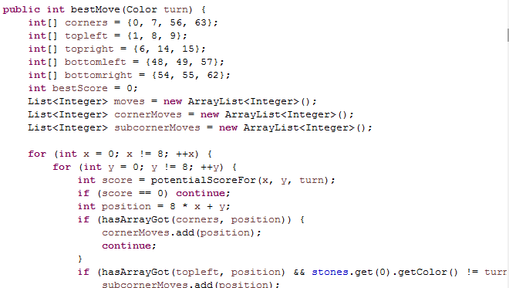

Play versus A.I.

Slide 8
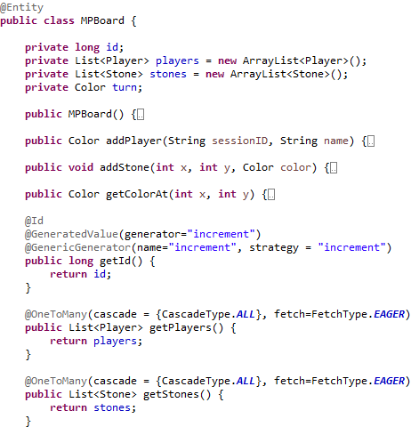
Play online, Store in database!
JPA & Hibernate
@

Slide 9
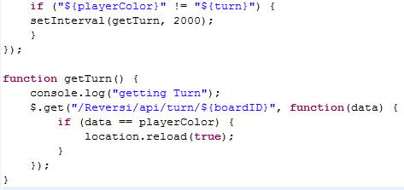

AJAX

Slide 10
DEMO!

Slide 11
Future plans
Cheat-proof
High scores

Slide 12

Thank you for your attention

